Slide 1

Notes:
[BRIEF INTRO]
This is week 5 of our 8-week series on Philippians: Cruciformed Community & Our Civic Witness. We have been discovering that this letter from the Apostle Paul to the church in Philippi is one of the most politically subversive books in the NT, as Paul addresses how these early Christians ought to think and live in city that is committed to the empire.
You’ll recall that I’ve said (in multiple messages) that I’m trying to help us “cross the bridge” over a river of time, culture, language, and situation, so that we can accurately interpret, understand, and apply the book of Philippians to our lives. And that is always our task as Christians who are reading and seeking to interpret the Bible for growing in our faith and encountering God in the text… as this helpful illustration communicates… [NEXT SLIDE]

Slide 2

Notes:
[BRIEF COMMENTS ON GRAPHIC & QUESTIONS]
What did the original audience hear?
What are the differences between the biblical audience and us?
What is the timeless (not bound to culture) theological principle in this text?
How does the principle fit with Christ and the rest of the biblical story?
How should Christians today apply and live out the theological principles? Or in other words, ”What is God saying to us (and specifically me/you)?”
That is why I’ve been reminding us each week of the socio-political and cultural context of Philippi, so that we can hear Paul’s words the way the Philippians would have heard him, and then allow the Holy Spirit to help us cross the bridge and apply it to our own situation.
Remember, the Apostle Paul, a former Pharisee and persecutor of the church before he met the risen Jesus on the road to Damascus, planted the church in Philippi in 52 AD (that’s about 25 years after Jesus’ earthly ministry) which you can read about in Acts chapter 16... [NEXT SLIDE]

Slide 3
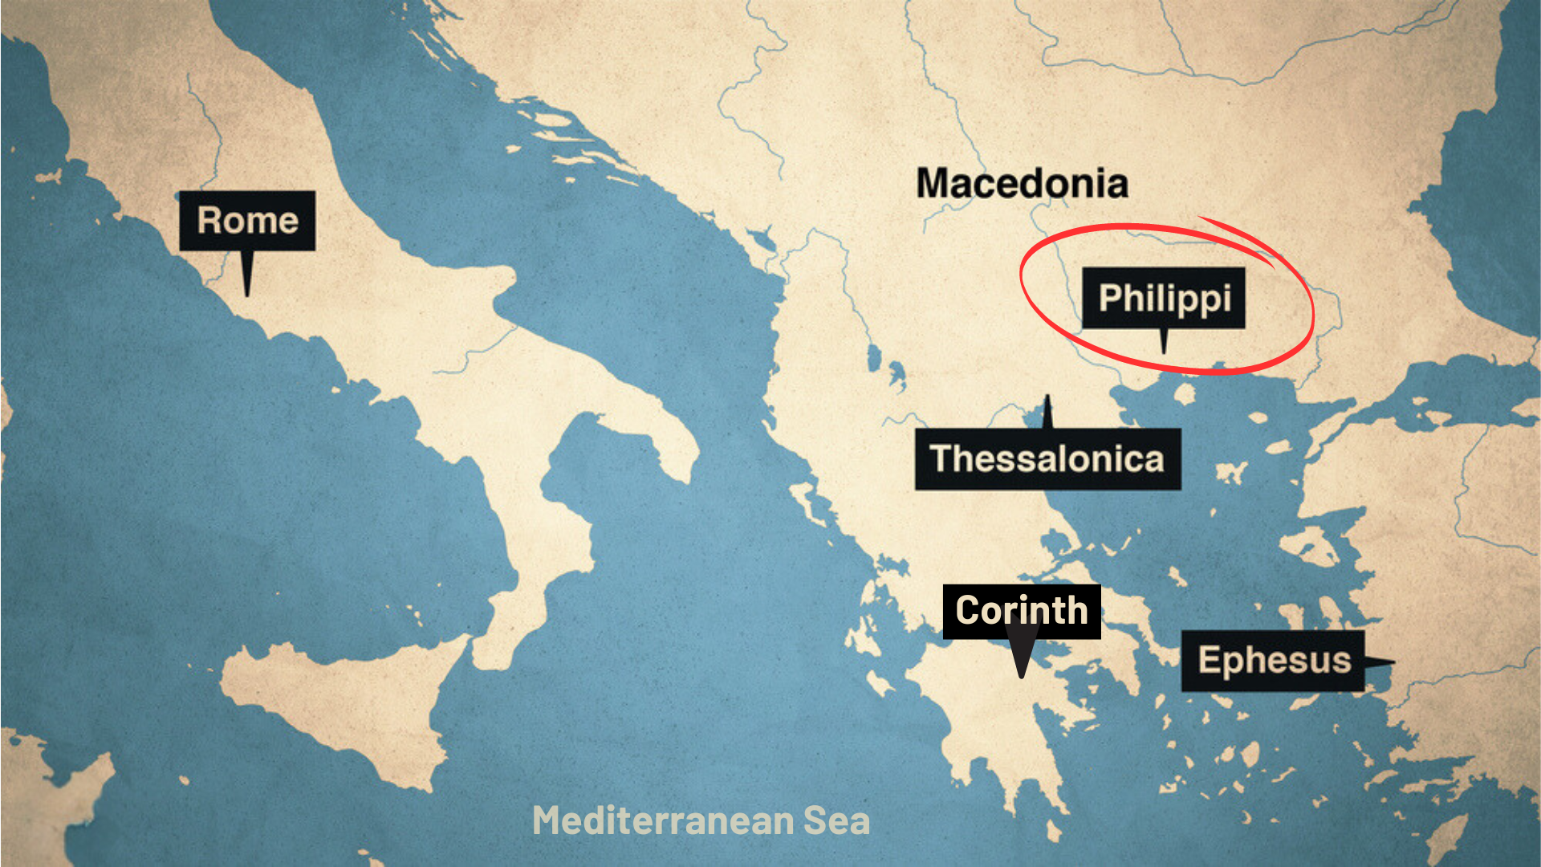
Notes:
About 10 years later (62 AD), Paul writes to the Philippian church from Rome, where he is being kept under house arrest, awaiting his trial before the emperor Nero. The Philippians are concerned for Paul. So, they sent Epaphroditus (who we will read about today) from Philippi to Paul to help him and then bring back word about how he is doing.
Therefore, the letter to the Philippians is Paul’s response to those concerns, as well as his reminders of what the gospel means for how they are to follow Jesus in an idolatrous city. [NEXT SLIDE]

Slide 4
Notes:
[BRIEF COMMENTS]
Philippi was an affluent Roman colony of 10,000 people; it’s full of retired Roman military veterans and patriotic nationalists who are fiercely loyal to empire. They have a special status with Caesar, and they will not tolerate any competing “good news” or rival “Lord”
So, it comes as no surprise that there were strong cultural forces that pressured the city’s inhabitants to express their patriotism publicly and an expectation that all Philippians would uphold their values and virtues, which reinforced the Roman way of life
And just as it is (or at least should be) today, following Christ’s teachings and holding to the values and virtues of his Kingdom, while living in cruciformed community with others who have a counter-cultural faith, brings hardship and challenges to the church in Philippi
Nevertheless, they are doing well, despite their circumstances; Paul is proud of them and wants to inspire them to remain faithful to Jesus, no matter what happens
If you’re just joining us, here is what we’ve covered so far in the letter to the Philippians… [NEXT SLIDE]

Slide 5

Notes:
[BRIEF COMMENTS]
We began our series by giving attention to the opening of Paul’s letter (1:1-11); we read about Paul’s deep love for Christ and for the believers at Philippi
In the second message (1:12-26), we heard Paul encourage the Philippian Christians to see their own sufferings in light of the gospel and the Kingdom that is coming in Christ, in the same way Paul sees his own sufferings and the possibility that he might be executed
In the third message (1:27-2:4), we heard Paul tell the Philippian believers that their civic conduct and political life should reflect the gospel and their confession that “Jesus is Lord” (not Caesar), as they seek to navigate a world full of competing allegiances and remain unified as a church; and we unpacked chapter 1, verse 27—a key verse in the letter
And last week in the fourth message, we looked at chapter 2, verses 5-18… [NEXT SLIDE]

Slide 6

Notes:
[BRIEF COMMENTS]
Paul commands the Philippian believers to adopt the Lord’s way of thinking and living in this world, and he includes a “hymn” in verses 6-11 that emphasizes the humility of Jesus
Paul uses the Christ Hymn to invite us to follow the example of our crucified Lord by cultivating a cross-centered (or cruciformed) attitude that is humble, long-suffering, and willing to trust the way of the Kingdom, because, as we saw with Jesus himself, God exalts those who think and live this way; as Jesus said, “The humble will inherit the earth.”
Therefore, Paul’s encouragement is to obey Christ, work hard, be a bold and courageous witness to a watching world, and keep shining like stars until Christ returns
Which brings us to today’s focus in Philippians 2:19-30. After Paul uses the Christ hymn to call the Philippians to follow the example of our crucified Lord, he then commends two Christians they know: Timothy and Epaphroditus… [NEXT SLIDE]

Slide 7
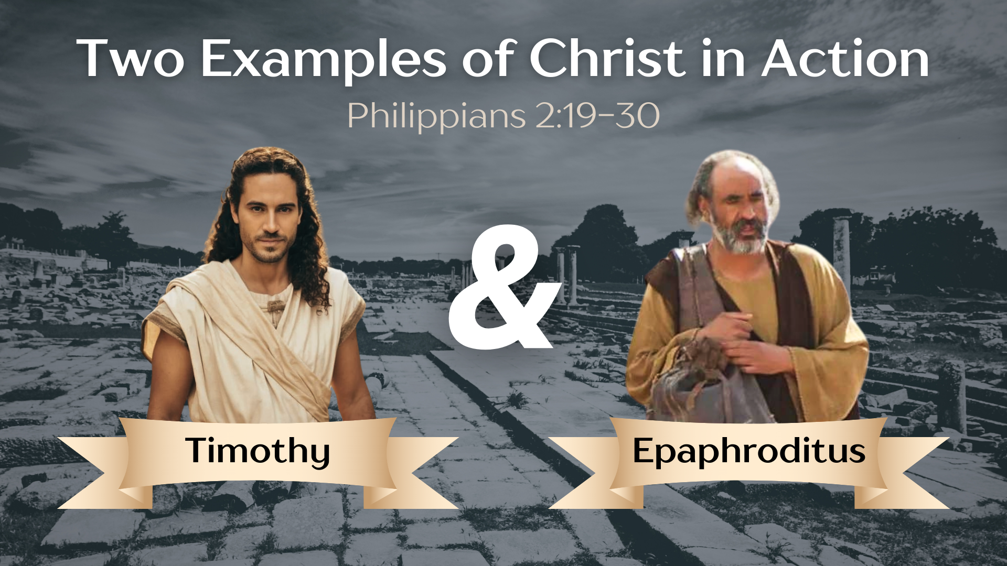
Notes:
He uses both of these men because they have been companions and co-workers with Paul as he labors on under house arrest in Rome. And these two men (as we will hear today from Paul) are examples of what it looks like when we have the mindset of Christ and put our faith into action. So, first Paul uses the example of Jesus, but then he makes sure to point out that there are ordinary people like you and me who are living like Christ.
Let’s now look at these two examples of Christ in action… [NEXT SLIDE]

Slide 8

Notes:
[READ & COMMENT ON PASSAGE VERSE-BY-VERSE]
v. 19 – who is Timothy? – Well, first, remember that he is helping Paul to write this letter (v.1); In Acts 16:1-5, we meet Timothy before Paul arrives in Philippi with Silas. It’s most likely that Timothy was with Paul and Silas’ entourage when they met Lydia. Timothy’s mother and grandmother were Jewish, but his father was a Gentile. He becomes a Christ-follower and like a son to Paul; he is indispensable to Paul’s ministry and church planting efforts. He not only co-authored Philippians, but also 2 Corinthians, 1 Thessalonians, and Philemon. And of course, Paul wrote two letters to Timothy which are in the NT.
So, Paul says that he plans to send Timothy to the Philippians in the near future. Back to verse 19… [READ & COMMENT ON VERSES 19-21]
Who are everyone else or “all the others” that Paul is referring? We’re not sure. But this is something that Paul has encountered on multiple occasions. The ministry gets difficult—people find it hard to remain faithful to their commitments—and they bale on Paul, who is sold out to the cause of Christ. For example, Paul mentions this guy in his second letter to Timothy… [NEXT SLIDE]

Slide 9
“Do your best to come to me quickly, for Demas, because he loved this world, has deserted me and has gone to Thessalonica.” Paul, 2 Timothy 4:9-10 NIV
Notes:
[READ & COMMENT]
“because he loved this world” (NIV) or “the things of this life” (NLT) – what does that mean? What did Demas love so much that he left Paul for Thessalonica? Again, we’re not sure, but the Greek implies that Demas left Paul ”in the lurch” so to speak. When Paul really needed him and trusted him, Demas abandoned his call and commitment for something else he wanted to do, or simply to live a more cush, comfortable life that didn’t demand any cross-bearing. In other words, like many today, Demas chose the temporary benefits of this world over eternal rewards that come through faithfulness to Christ.
But Paul says, Timothy isn’t like that. Like Jesus is described in the Christ Hymn of 2:6-11, Timothy puts others first and is a humble servant. Back to verse 22… [NEXT SLIDE]

Slide 10
Notes:
[READ & COMMENT ON EACH VERSE]
v. 22 – lit. “we have slaved together” in proclaiming the gospel
v. 23 – Paul wants to wait until he sees Nero before he sends Timothy; Timothy is not only a help and trusted companion during Paul’s house arrest, but Timothy can send word to the Philippians of his fate, which they will no doubt be anxious to hear
v. 24 – Notice, Paul’s confidence is in the Lord, not any specific outcome
And now he turns to his second example of someone living like Jesus and putting their faith in action. Look at verse 25… [READ & COMMENT]
v. 25 – Who is Epaphroditus? His name is of pagan origin, meaning: “belonging to Aphrodite” (ancient Greek goddess of sexual love, lust, and passion); But now this man belongs to Christ and his passions are for the Kingdom. And while this is the only time in the NT that he is mentioned, he receives high praise from Paul. Listen to what Paul writes…[NEXT SLIDE]

Slide 11
Notes:
[READ & COMMENT ON VERSES 25-27]
To the Philippians, Epaphroditus was a messenger who delivered a care package on their behalf. To Paul, however, he was much more: a “brother” in Christ’s family, a “co-worker” furthering the gospel mission, and a “fellow soldier” sharing the same trials. Epaphroditus was a man of commitment, devotion, faithfulness, and self-sacrifice. Paul said he put “the interests of others” before himself and so exemplified the mindset and attitude of Christ. And he served Christ and worked on Paul’s behalf until his own health failed him. Then, when he was sick, Epaphroditus didn’t think about himself; rather, he was concerned that the Philippian believers had heard of his illness and were worried about him. So, as we can see, Epaphroditus embodied the example of Christ described in chapter 2, verses 6-11.
Now let’s read the remaining verses… Verse 28.
[READ & COMMENT ON VERSES 28-30]
Finally, as we reflect on these two examples of ordinary people who had the mind and attitude of Christ, and who embodied his call to humble service, we should begin to “cross the bridge” and ask ourselves: “How does this cruciformed way of life stand in contrast to our selfie generation and our celebrity-obsessed culture today? Who are our heroes? Are we celebrating the humble servants among us, or not? And are we taking seriously the NT’s call to live like Christ in the power of the Spirit?
Listen to what John wrote in… [NEXT SLIDE]

Slide 12
1 John 2:3-6 NIV
³ We know that we have come to know him [Christ] if we keep his commands. ⁴ Whoever says, “I know him,” but does not do what he commands is a liar, and the truth is not in that person. ⁵ But if anyone obeys his word, love for God is truly made complete in them. This is how we know we are in him: ⁶ Whoever claims to live in him must live as Jesus did.
Notes:
[READ & COMMENT]
Brothers and sisters, as we continue to study the book of Philippians together, may God help us to “cross the bridge” and connect the dots to our own situation and circumstances. And may the Spirit convict us, guide us, and empower us to live like Jesus in a culture that loves to celebrate and support people and virtues that do not reflect Christ or his Kingdom.
Here are some questions to help us reflect and respond to today’s message… and ultimately… so that we can put our faith in action… [NEXT SLIDE]

Slide 13


Slide 14


Slide 15


Slide 16

Notes:
[READ & BRIEF COMMENT ON EACH QUESTION]
Consider the contrast between Paul’s call to humble service and our celebrity-obsessed, power-hungry culture today. How is God calling me to resist the culture for a life of humble service?
How is God inviting me to put my faith in action at home, on the job, in the church, and in my civic/public life?
Who are living, breathing examples of Christ (humble servants) for me? Who makes Jesus and the gospel attractive to the world? And who is God calling me to commend and thank today?
Let’s pray… [NEXT SLIDE]

Slide 17

Notes:
[CLOSING PRAYER]
Benediction
May the God who looks like Jesus lead you to faithfully follow him in a world that needs to hear and see the Gospel of Jesus Christ. And may the grace and peace of the Lord Jesus comfort and sustain you as a witness of his coming Kingdom. Amen.

