Slide 1

Notes:
[BRIEF INTRO]
In this series we’re focusing on the need to engage with corporate prayer. As I said last week, throughout the Scriptures and church history, every spiritual awakening and renewal was founded on intense, corporate, Kingdom-centered prayer. Therefore, we must see prayer as being about more than going to God for our own spiritual and physical needs, or for the purpose of personal growth. In addition to those things, we must see prayer as our cry for more of the Kingdom! So, what does the Bible say about this? And what might it look like if we begin to pray this way at Grantham?
Last Sunday we looked at 2 Chron 7:14 and how God waits for his people to voice a collective cry for help. The Bible says, “if my people, who are called by my name, will humble themselves and pray and seek my face and turn from their wicked ways, then I will hear from heaven, and I will forgive their sin and will heal their land.”
“my people” is the Church—the Body of Christ
we need humility, confession of sin, repentance, and prayer
In his book on Prayer, Stanley Grenz writes:
“Often God will not act until we realize that we cannot make it on our own. God will not do what God desires to do until we come to see that we desperately need God’s intervention in our lives. As long as we erroneously think that we can handle life’s situations on our own, God simply stands aside. Divine resources do not break into our situation until we admit that life has grown too immense for our own abilities.”
After last week’s message, several of you asked, “How we can engage in corporate prayer here at Grantham Church?” Here is what I shared with you in the most recent Email From the Pastor…. [NEXT SLIDE]

Slide 2

Ways to join our church in corporate prayer:

Slide 3
Ways to join our church in corporate prayer:
Use the opportunities you already have to pray together.

Slide 4
Ways to join our church in corporate prayer:
Use the opportunities you already have to pray together.
Pray before our services in your pew, at the altars, etc.

Slide 5
Ways to join our church in corporate prayer:
Use the opportunities you already have to pray together.
Pray before our services in your pew, at the altars, etc.
Come during the weekday to pray in our building.

Slide 6
Ways to join our church in corporate prayer:
Use the opportunities you already have to pray together.
Pray before our services in your pew, at the altars, etc.
Come during the weekday to pray in our building.
Start/join a prayer meeting in our Prayer Room.

Slide 7
Ways to join our church in corporate prayer:
Use the opportunities you already have to pray together.
Pray before our services in your pew, at the altars, etc.
Come during the weekday to pray in our building.
Start/join a prayer meeting in our Prayer Room.
Stay tuned for the final sermon in our Prayer series!
Notes:
[BRIEF COMMENT ON EACH]
Use the opportunities you already have to pray corporately. Set aside a portion of time to pray in your small groups, learning communities, commission meetings, etc. Pray specifically for renewal and an awakening in the Church. Also, pray for the spiritual needs and a fresh fire in our own congregation.
Come to church a little earlier on Sunday morning and pray in your pew, at the altars, in our Prayer Room, etc. Our worship team already does this at the front of the sanctuary each Sunday morning! Pray for the Spirit to move in our services. Pray for confession, repentance, vulnerability, and a hunger for more of the Kingdom.
Join in prayer with others in the church who you know are burdened and long for renewal and an awakening. We welcome you to come up to the church with a friends during office hours to pray. You can pray in the sanctuary, in the Prayer Room, in our Prayer Garden, or even pray while walking our halls.
Want to join or start a prayer meeting? About a month ago, someone scheduled the Prayer Room on Tuesdays at 4:30 pm. They said, “I’m feeling led to pray there. Others can join me if they want.” If that works for you, why not join them or set up another weekly time (day or night) to pray? Just let our office know what you’d like to do.
Stay tuned for the final sermon in the Prayer series (next week). I will be sharing a short simple prayer that our entire church can pray together as we move into the fall.
[BRIEF PRAYER & NEXT SLIDE]

Slide 8

Scripture Reading
Acts 12:1-17 NIV
Notes:
[INVITATION TO STAND FOR SCRIPTURE READING]
[READ ACTS 12:1-17]
This is the word of the Lord. Thanks be to God
You may be seated. [NEXT SLIDE]

Slide 9
Notes:
[BRIEF COMMENTS ON PASSAGE]
The Apostle Peter is being held in prison, awaiting trial & execution
The church in Jerusalem begins to corporately pray for Peter
Peter thinks he’s dreaming, but an angel actually sets him free
He goes to the house the church was gathered in for prayer
And the church (rather humorously) doesn’t believe he’s at the door
What do we learn from this story?
Corporate prayer makes a difference (and we shouldn’t be surprised…)
The cosmic struggle of good and evil is not just between human beings, but it involves angelic beings as well
We see this in the Old Testament as well. You may recall the story in Daniel chapter 10… [NEXT SLIDE]

Slide 10
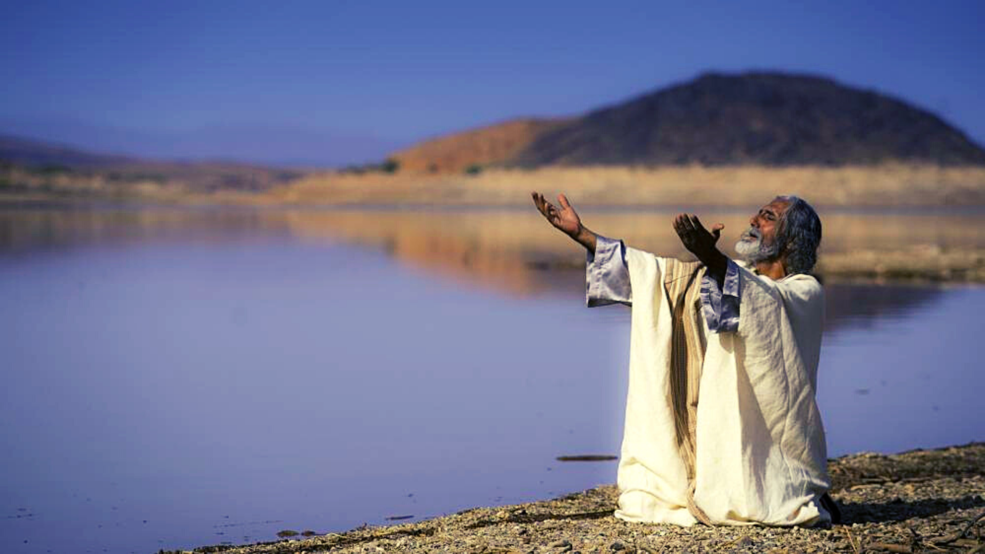
Daniel 10:1-14
Prayer & Spiritual Warfare
Notes:
The prophet Daniel (in his old age) is praying by the Tigris river
He is fasting and praying for insights into the future of God’s people
He does this and mourns for 3 weeks without an answer
And then finally, and angel appears
vs.12-14 -- “Do not be afraid, Daniel. Since the first day that you set your mind to gain understanding and to humble yourself before your God, your words were heard, and I have come in response to them. But the prince of the Persian kingdom resisted me twenty-one days. Then Michael, one of the chief princes, came to help me, because I was detained there with the king of Persia. Now I have come to explain to you what will happen to your people in the future, for the vision concerns a time yet to come.”
So, one of the lessons we learn in Daniel 10 is that while you may not see the struggle going on behind the scenes (in heavenly realms), we can trust that when we pray… we are moving heaven and also getting the attention of spiritual evil in high places.
I experienced this firsthand when I was in college… [BRIEF STORY]
Friends, this battle of the wills (both human and angelic) is real, which is why the Apostle Paul wrote this to the church in Ephesus… [NEXT SLIDE]

Slide 11
For our struggle is not against flesh and blood, but against the rulers, against the authorities, against the powers of this dark world and against the spiritual forces of evil in the heavenly realms.
Paul, Ephesians 6:12 NIV
Notes:
[BRIEF COMMENTS]
The real battle is spiritual. Therefore, our weapons must be spiritual as well.
That’s what Paul meant in 2 Corinthians 10:3-4, “For though we live in the world, we do not wage war as the world does. The weapons we fight with are not the weapons of the world. On the contrary, they have divine power to demolish strongholds.”
Yes, I know how this sounds to some people. It sounds crazy. That’s because an increasing number of Westerners embrace scientism—the idea that the hard sciences alone can answer our questions, solve our mysteries, and provide the only real knowledge of reality. If you think about it, it’s just another version of fundamentalism. It’s arrogant, narrow-minded, and as Greg Boyd reminds us, it totally disregards the worldview and perspectives of all those not living in the West. In his book, God at War, Boyd writes… [NEXT SLIDE]

Slide 12

“One is hard-pressed to find any culture, prior to or contemporary with our own, that does not assume something like this [spiritual warfare] perspective. From a cross-cultural perspective, the insight that the cosmos is teeming with spiritual beings whose behavior can and does benefit or harm us is simply common sense. It is Westerners who are the oddballs for thinking that the only free agents who influence other people and things are humans.”
Notes:
[BRIEF COMMENTS]
Folks, we can’t afford to deny this aspect of reality if we’re going to join God in the cosmic struggle. If we’re going to see prayer as our cry for the Kingdom and as the way we fight as Christians, then we need to accept the NT worldview (that there is a battle of human and angelic wills) and live into more of an awareness of this truth in our prayer life.
And it may be that by accepting this truth that you discover what has been missing in your prayer life… and has too often kept you from praying like it matters. Of course, there may be other things that aren’t helping your prayer life. So, let’s think about that for a few minutes… [NEXT SLIDE]

Slide 13

Views That Help (or Hurt) Our Prayer Life
Notes:
[BRIEF COMMENTS ON EACH]

Slide 14
Views That Help (or Hurt) Our Prayer Life
Nature of time & the universe
(e.g. determinism or free will / “blueprint” theology or warfare worldview—a real battle of wills!)
Notes:
[BRIEF COMMENTS ON EACH]

Slide 15
Views That Help (or Hurt) Our Prayer Life
Nature of time & the universe
(e.g. determinism or free will / “blueprint” theology or warfare worldview—a real battle of wills!)
God’s sovereignty, character & image
(e.g. Zeus / Cosmic Santa Claus or “Abba” Father / the God who looks like Jesus— the “image of the invisible God”)
Notes:
[BRIEF COMMENTS ON EACH]

Slide 16
Views That Help (or Hurt) Our Prayer Life
Nature of time & the universe
(e.g. determinism or free will / “blueprint” theology or warfare worldview—a real battle of wills!)
God’s sovereignty, character & image
(e.g. Zeus / Cosmic Santa Claus or “Abba” Father / the God who looks like Jesus— the “image of the invisible God”)
God’s foreknowledge & partnership with us
(e.g. all is settled & final, or future is to some degree open—possibilities are real, we actualize reality/future)
Notes:
[BRIEF COMMENTS ON EACH]
My friends, I submit to you that we live in a world where God has given us a certain amount of freedom and “say-so” to actualize his good future through our decisions, and particularly through our prayers, where we say “yes” to the Kingdom and become conduits of his grace—where we partner with God in bringing heaven to earth.
That’s what the Methodist missionary E. Stanley Jones had in mind when he wrote… [NEXT SLIDE]

Slide 17

“For in prayer you align yourself to the purposes and power of God, and he is able to do through you that he couldn’t otherwise do. For this is an open universe, where some things are left open, contingent upon our doing them. If we do not do them, they will never be done. So, God has left certain things open to prayer – things which will never be done except we pray.”
E. Stanley Jones, The Way to Power and Poise
Notes:
[BRIEF COMMENTS]
Let that sink in, church.
Finally, I’d like to give us a few takeaways that I think can help us in our spiritual fight. [NEXT SLIDE]

Slide 18

How can we use prayer in our spiritual fight against evil and partner with God in bringing the Kingdom to earth?

Slide 19
How can we use prayer in our spiritual fight against evil and partner with God in bringing the Kingdom to earth?
See prayer as your “say-so” power—pray in the name of Jesus.

Slide 20
How can we use prayer in our spiritual fight against evil and partner with God in bringing the Kingdom to earth?
See prayer as your “say-so” power—pray in the name of Jesus.
Pray with authenticity and passion—put your heart into it!

Slide 21
How can we use prayer in our spiritual fight against evil and partner with God in bringing the Kingdom to earth?
See prayer as your “say-so” power—pray in the name of Jesus.
Pray with authenticity and passion—put your heart into it!
Weaponize your prayers—resist evil and call down the Kingdom.
Notes:
[BRIEF COMMENT ON EACH]
See prayer as your “say-so” power—pray in the name of Jesus.
- You’ve been given some “say-so” authority; how are you using it?
- Jesus is the highest authority; are you praying in his name, and from a place of personal relationship with him? (e.g., Acts 19:13-16)
Pray with authenticity and passion—put your heart into it!
- Don’t try to impress God (or others) with your prayers, be real and honest
- Pray like you mean it; Jeremiah 29:13 “You will seek me and find me when you seek me with all your heart.”
Weaponize your prayers—resist evil and call down the Kingdom.
- Weaponize? Yes, pray like your prayers are a spiritual weapon. Because they are. And since your prayers are a weapon, then aim them at the real enemy and kick the devil in the face! Use Scripture, use prayer, just as Jesus did in the desert.
[INVITATION & RESPONSE]
As we come now to a time of invitation and response… would you close your eyes for just a moment? Imagine that you’re on the frontlines in God’s spiritual army and you’re taking on heavy spiritual fire (in your life, in your family, in the church, etc.). What is happening in this battle? Who or what are your enemies? What is coming up against you? Against us? You see the evil all around you? All around the church? In our world?
Now… what are you going to say to our loving Father (who is himself a mighty fortress), who also happens to command legions of angels? What are you going to say?
And that, brothers and sisters, is how I’m inviting us to pray as a church.
[CLOSING PRAYER]

