Slide 1

Notes:
[BRIEF INTRO]
Welcome/Greeting
Lent to Easter series – Waging Peace: A Journey with Jesus Through Holy Week – At the beginning of Holy Week, Jesus looked out over Jerusalem and cried aloud, “If only you knew the things that make for peace.” And then Jesus spends each day confronting injustice, calling out oppressors, and contending for peace. How did he do this? What did that look like? That’s what we’re giving attention to each week in this series as we discover anew why Jesus is called the Prince of Peace, and what it looks like when we are waging peace like him.
As I said last Sunday, this series is based on Jason Porterfield’s book… [NEXT SLIDE]

Slide 2

Notes:
Fight Like Jesus: How Jesus Waged Peace Throughout Holy Week, published by Herald Press (2022). I’m following the book fairly closely, so you may want to buy the book and marinate in the focus for each week. Also, you may want to use the small group discussion questions posted along with the sermon at our website and podcast.
Last week we began our series with the first day of Holy Week, Palm Sunday. We reflected on the intentionality and meaning of Jesus riding into Jerusalem in his final week, during Passover, on a donkey, to the waving of palm branches. I tried to paint the scene for us so that we could fully grasp what happened that day. And of course, we saw Jesus weep and heard him cry aloud over his people’s failure to accept him and embrace his way of peacemaking.
And again, for Jesus, peace is about the shalom of God. Shalom is not simply the absence of conflict and violence. Shalom is about the presence of goodness and blessing; it looks like health, harmony, and wholeness in every area of life. Shalom is about us flourishing in our relationship with God, with others, and all of creation. Shalom (God’s peace) is what it looks like when everything is as God wants it to be.
This is the sort of peace that Jesus worked for and calls his followers to actively advance until he comes again to bring the fullness of the Kingdom, as we will continue to see today. It’s now day two of Holy Week… [NEXT SLIDE]

Slide 3
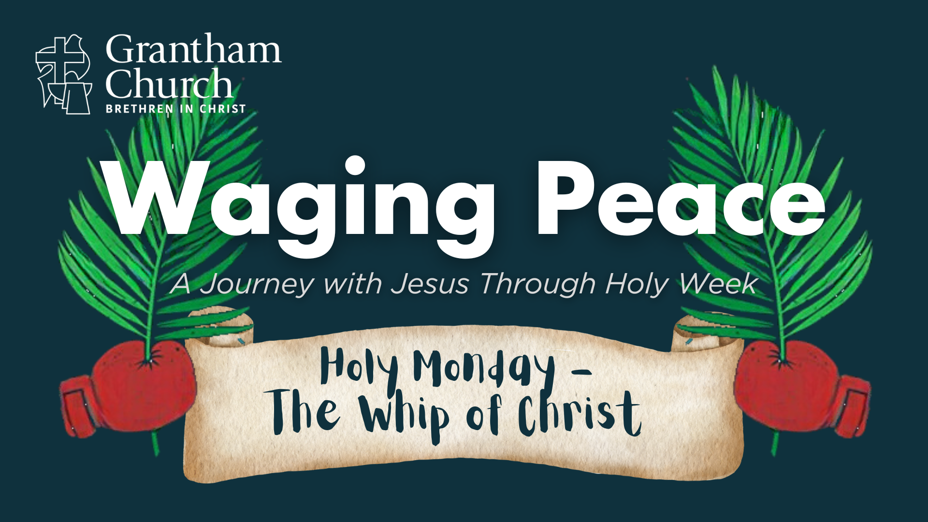
Notes:
Holy Monday. And this morning we’re looking at perhaps the most misunderstood thing that Jesus did in Holy Week—when he went into the temple with a homemade whip, turned over tables, and drove out animals and money changers. This event on Holy Monday has been used by some misguided Christians to justify a self-indulgent anger toward oppressors and violence against evildoers by others. So, in the second message of our series, I’m going to try and help us make sense of Jesus’ actions and then apply our Lord’s example to our own lives.
In a message entitled, The Whip of Christ. Pray with me real quick… [BRIEF PRAYER]
Well, grab your Bible and turn with me to our main Scripture reading… [NEXT SLIDE]

Slide 4

Notes:
[INVITE CONGREGATION TO STAND FOR SCRIPTURE READING]
[READ PASSAGE]
“This is the Word of the Lord…. You may be seated.”
As we saw last week, there are a few things to unpack in this scene so that we can get the full picture of what Jesus was doing in the temple and what he means by what he said.
First, each gospel writer has given us their account of Jesus in the temple that day… [NEXT SLIDE]

Slide 5
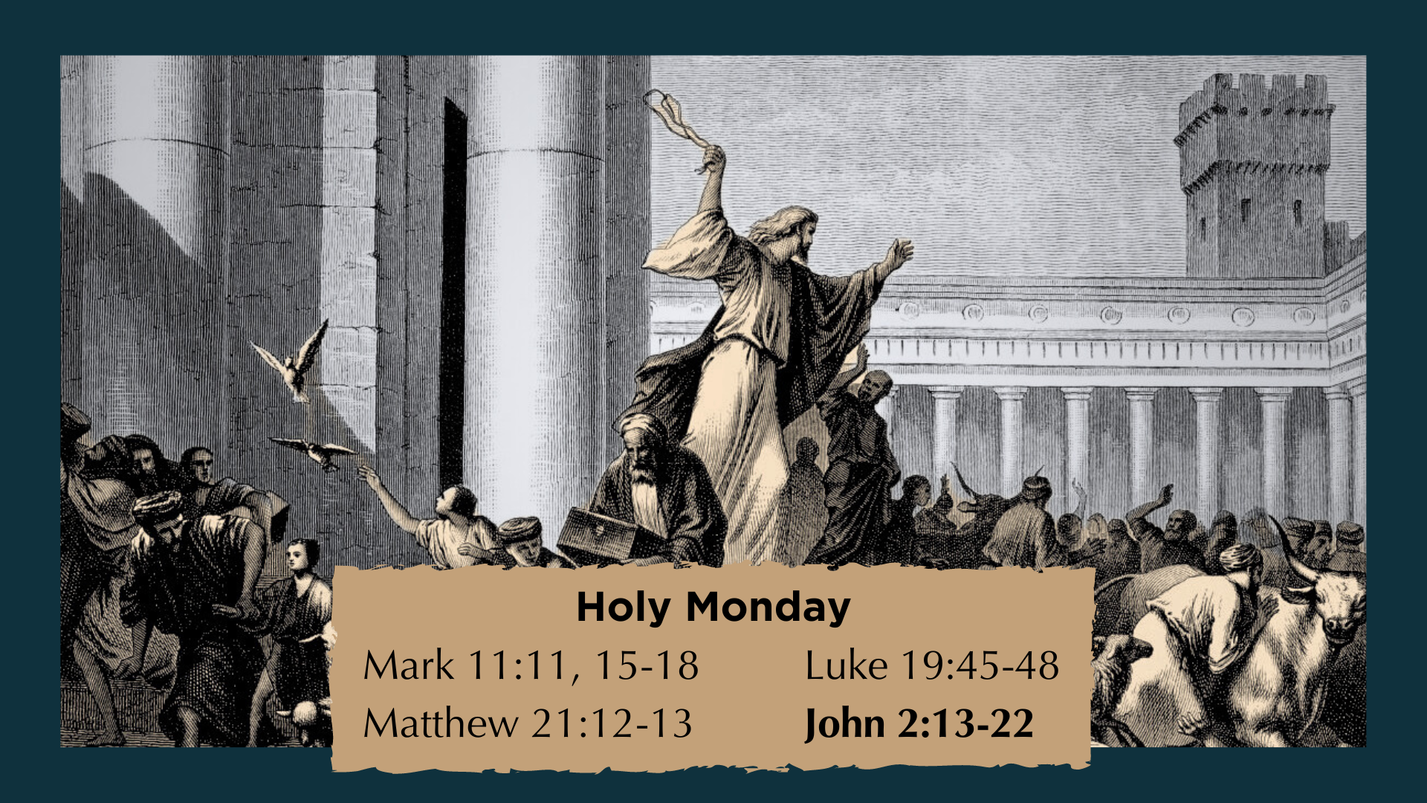
Notes:
[BRIEF COMMENTS]
John puts this event at the beginning of his gospel for theological reasons. But the synoptic gospels each tell us this happened once, following Jesus’ donkey ride into the city
This scene has been described as the “cleansing” of the temple or the “clearing” of the temple; NT scholar Tom Wright believes we should see this as Jesus shutting the place down, or at least signifying God’s judgment on it and its coming collapse
And what occurred there was not a spontaneous outburst of anger; instead, we have good reason to believe that it was all calculated and planned out by Jesus
Listen to what Mark tells us at the end of Palm Sunday… [NEXT SLIDE]

Slide 6
Mark 11:11 NIV – At the End of Palm Sunday
Jesus entered Jerusalem and went into the temple courts. He looked around at everything, but since it was already late, he went out to Bethany with the Twelve.
Notes:
[BRIEF COMMENTS]
Bethany is about two miles on the other side of the Mt. of Olives; Jesus stayed there with his friends Mary, Martha, and Lazarus, who he had raised from the dead on Saturday
And notice, Mark tells us that Jesus scoped out the temple (he assessed the situation) and then retreated for the night, before coming back the next day to begin waging peace
So, I want to submit to you that what Jesus does in the temple (which we’re going to look at more closely in a moment) should first be seen not as an impulsive and spontaneous act of anger, but rather as premeditated prophetic theater in the spirit of the OT prophet Jeremiah.
Jeremiah? What do you mean? Well, listen to what Jesus says after his prophetic act… [NEXT SLIDE]

Slide 7
Mark 11:17 NIV – Jesus Explains His Actions
And as he taught them, he said, “Is it not written:
‘My house will be called a house of prayer for all nations’^{[c]}? But you have made it ‘a den of robbers.’^{[d]}”
c. Isaiah 56:7 – God wants to include Gentiles into salvation
d. Jeremiah 7:11 – The temple is corrupt; God will judge it
Notes:
[READ & BRIEF COMMENTS]
NIV footnotes cite what or who Jesus is quoting from the OT
Isaiah 56 reflects God’s feelings toward non-Jews and his desire for them to be included in temple worship, and ultimately into his Kingdom; challenging a nationalist ideology!
Jeremiah 7:1-11 records God’s word through Jeremiah that their trust in the temple is misplaced if they think they can oppress the poor and the foreigner, cheat people, worship idols, and then pretend that God doesn’t care or notice; Jeremiah said the temple was a “den of thieves” and that God’s wrath would be poured out there due to their unfaithfulness
In other words, Jesus is saying, “You have made my Father’s house a hiding place and home (a religious cover) for people who love their sin and aren’t interested in being freed from it.” And so, as an object lesson, as we saw with Jeremiah, Jesus is embodying God’s feeling toward his people and their tainted worship, and he is pointing to the coming destruction of the temple. And everyone would have understood that Jesus was playing the role of the prophet Jeremiah.
So, when Jesus enters the temple… [NEXT SLIDE]

Slide 8
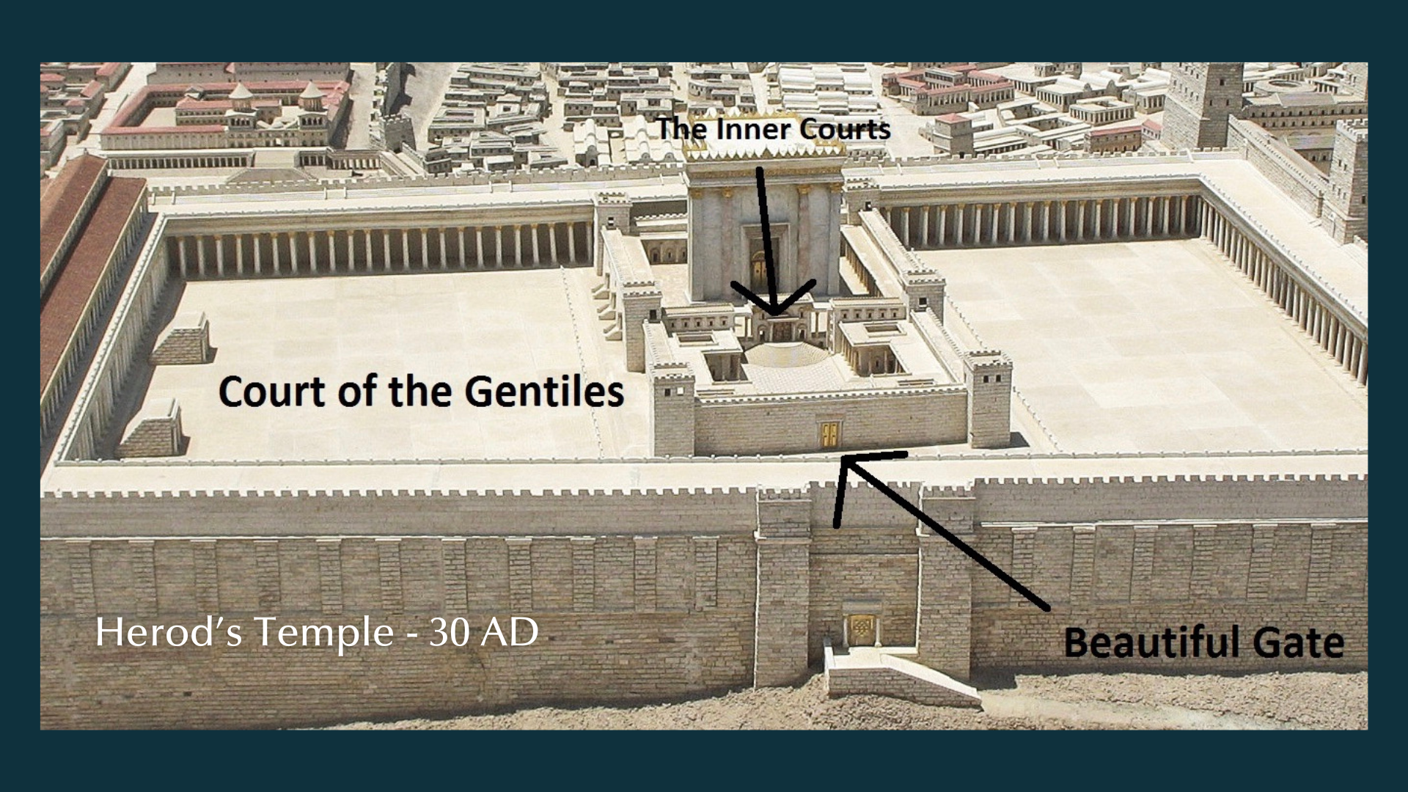
Notes:
And he sees that the outer “court of the Gentiles” had become a marketplace, no doubt he burned with a holy passion and zeal for justice, fairness, and God’s righteousness. From what we can tell the priests and temple leadership were getting rich through their ridiculous exchange rates (when folks came from all over the empire and required to use temple currency) and they were exploiting the poor who had made a Passover pilgrimage and needed animals for sacrifice, sometimes being told that their animals weren’t good enough and needed to buy from them.
We can imagine that it was already infuriating to Jesus that women and children were separated from the Jewish men in worship. And it would have been especially troubling to Jesus that Gentiles were warned by inscriptions on the dividing wall that separated the outer court from the inner courts that crossing that boundary would result in the transgressor’s death. THEN to come into the temple courts and see that the space reserved for Gentiles to worship God was turned into a market with the smells and noises of animals, with the buying and selling of overpriced goods, and an atmosphere that reeked of greed, exclusion, oppression, and injustice. And because it’s the temple, all this activity portrayed God in a corrupt way to outsiders.
So what else would we expect from the God-man who had proclaimed good news to the poor, freedom for the prisoners, and recovery of sight to the blind; who said he came to set the oppressed free and announce that God’s Kingdom was coming through him? So, yeah. Jesus was definitely going to respond. He was going to resist the evil and injustice. Because love is active, not passive. Love doesn’t look away. Love confronts that which is unloving. And that’s what Jesus does when he fashions a homemade whip from some of the animal bedding.
Let’s imagine the scene and understand what is happening here… [NEXT SLIDE]

Slide 9
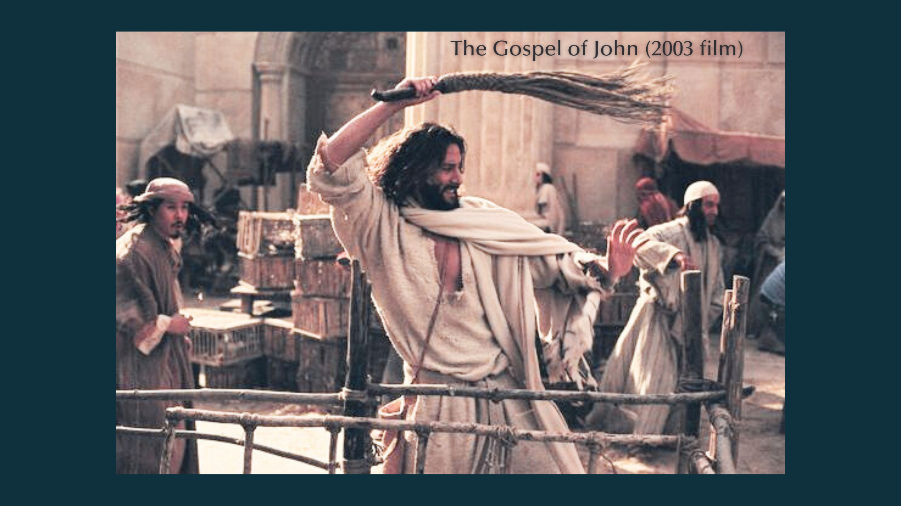
Notes:
[BRIEF COMMENTS]
Remember, Jesus is a well-known rabbi, prophet, & healer, said to be the Messiah by some; many people (especially temple leadership) would have been watching and waiting
So, when Jesus quickly fashions a whip of reeds (not something that can do any real harm to humans), and he begins shooing out the animals and turning over tables, many folks would have quickly seen this popular but controversial rabbi making a public statement; you can easily imagine the temple leaders thinking, “Oh, he thinks he’s like Jeremiah, does he!?”
Notice, they respond to Jesus, not like he is some random Passover pilgrim, but rather as the popular Palm Sunday king who is being watched with great interest: “What sign can you show us to prove your authority to do all this?” By what power and authority do you do this?!
Jesus responds to them with: “Destroy this temple, and I will raise it again in three days.” Jesus knows they’re not going to understand his real meaning, i.e. He is greater than the temple; his Body is the temple; He is replacing the Temple on earth; His resurrection will be proof of his power and authority. His death and resurrection will mark the end of an era and the beginning of a new age and new covenant, as John aims to communicate in his gospel.
So, was Jesus violent in the temple that day? Let’s consider the evidence… [NEXT SLIDE]

Slide 10
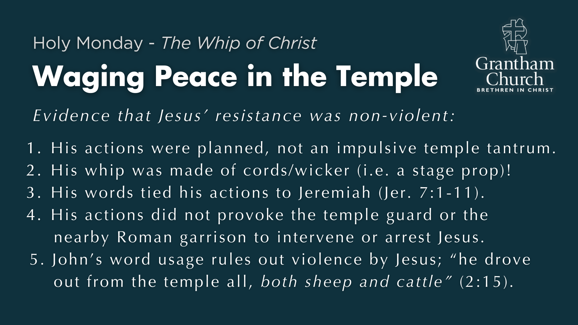
Notes:
[BRIEF COMMENTS ON EACH POINT]
His actions were planned, not an impulsive temple tantrum.
His whip was made of cords/wicker (i.e. a stage prop)!
His words tied his actions to Jeremiah (Jer. 7:1-11).
His actions did not provoke the temple guard or the nearby Roman garrison to intervene or arrest Jesus.
John’s word usage rules out violence by Jesus; “he drove out from the temple all, both sheep and cattle” (2:15).
And yet, while Jesus didn’t employ violence in the temple, or in any of his peacemaking, we mustn’t make the mistake of assuming that non-violence means doing nothing or being passive toward evil and injustice. Listen to this quote from Jason Porterfield's book… [NEXT SLIDE]

Slide 11
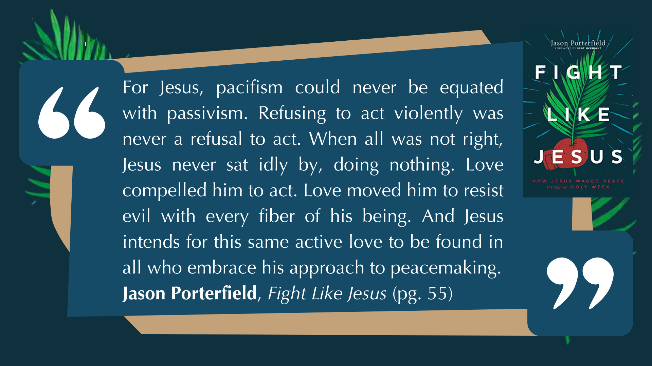
Notes:
[READ & BRIEF COMMENTS]
And that my friends is what “the whip of Christ” looks like. It says, everyone has dignity and worth in God’s eyes, everyone—from the poor peasant pilgrim being exploited at the temple on Passover, to the political and religious elite who are doing the exploiting; from the victims of oppression and violence, to the ones doing the harming and the hurting. Jesus calls us to love them all. And to love them all, we must wage peace as Christ does on Holy Monday.
Let’s sum up now what we’ve seen and heard in Jesus’ example with three lessons in peacemaking… [NEXT SLIDE]

Slide 12
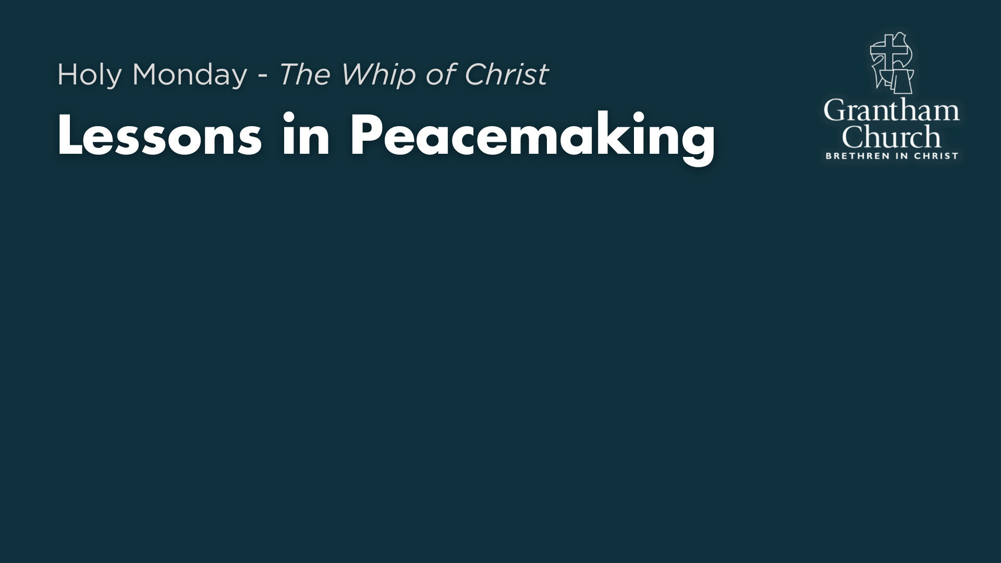

Slide 13
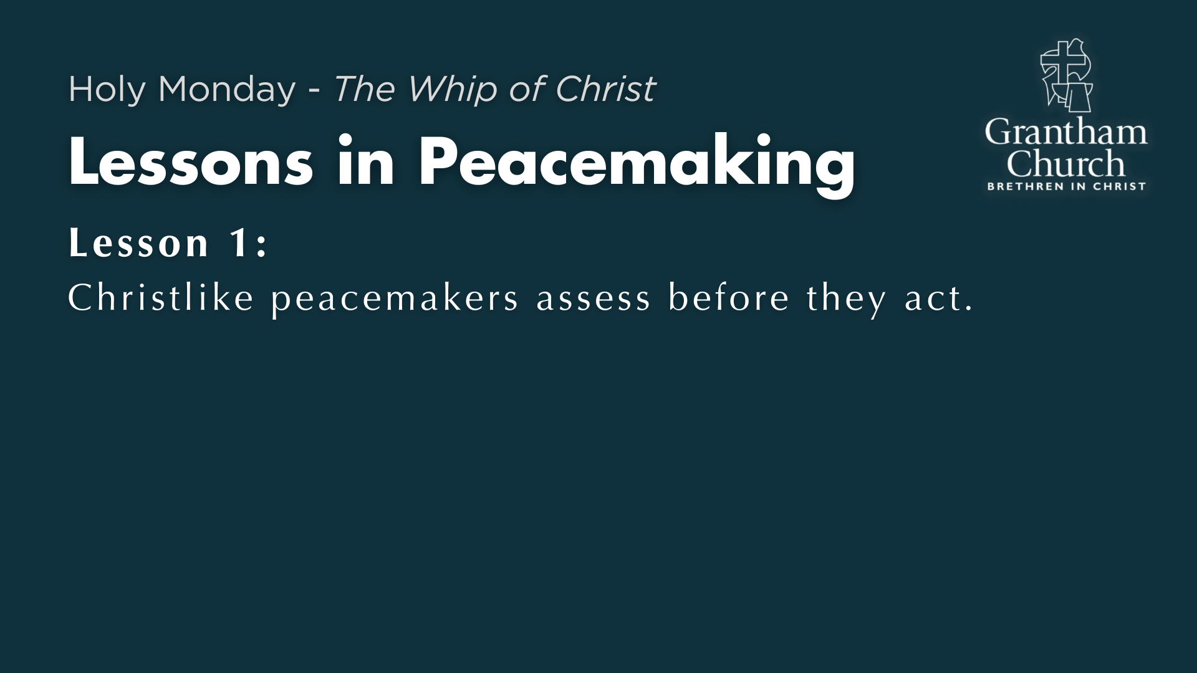

Slide 14
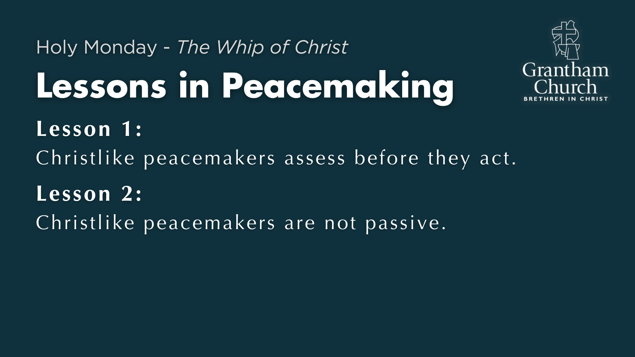

Slide 15
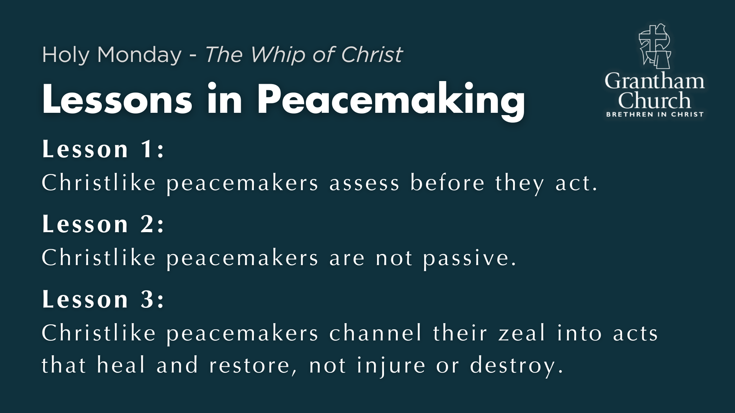
Notes:
[BRIEF COMMENTS ON EACH LESSON]
Lesson 1: Christlike peacemakers assess before they act.
[READ JULIA’S STORY]
Lesson 2: Christlike peacemakers are not passive.
[READ GRETTA’S STORY]
Lesson 3: Christlike peacemakers channel their zeal into acts that heal and restore, not injure or destroy. [READ OTTO’S STORY]
Finally, here are some questions for personal reflection and to help us respond to what the Spirit is saying to us through the message… [NEXT SLIDE]

Slide 16


Slide 17
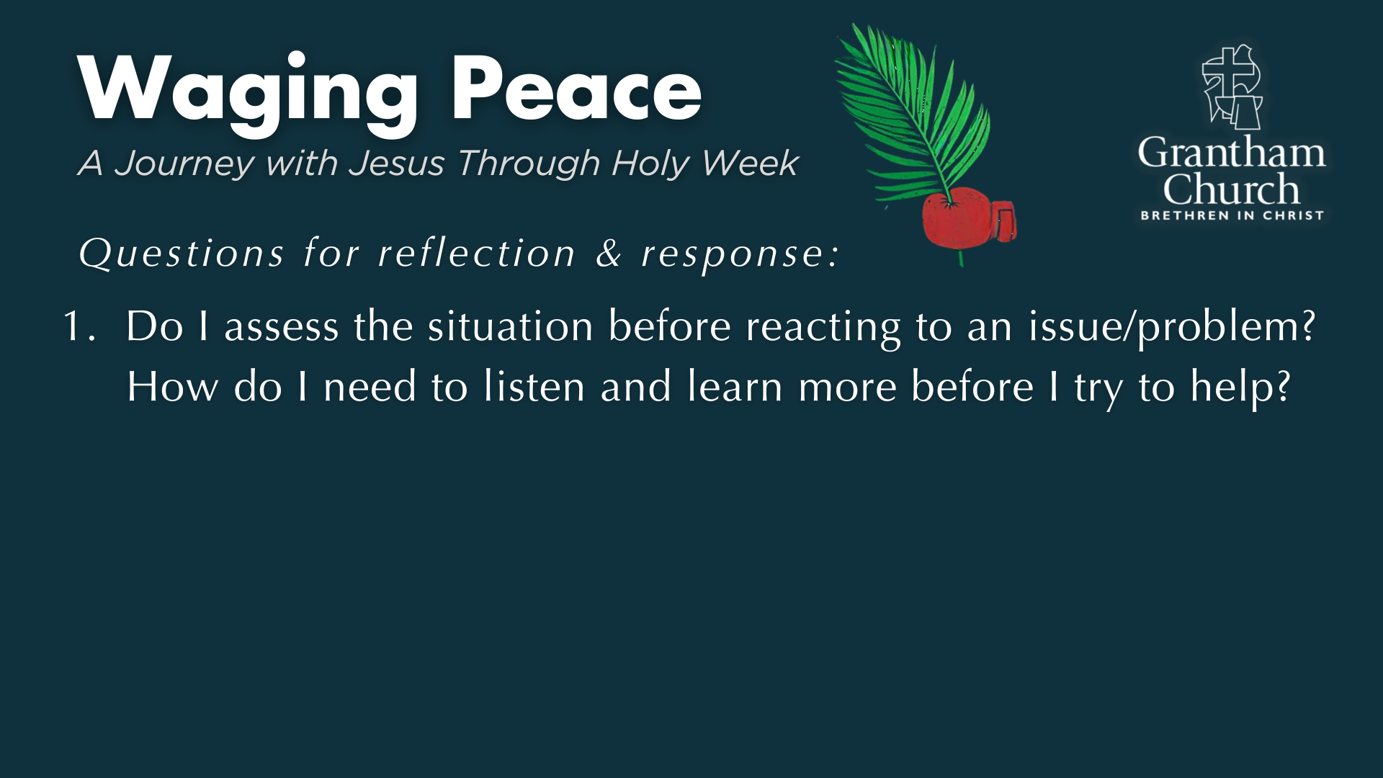

Slide 18
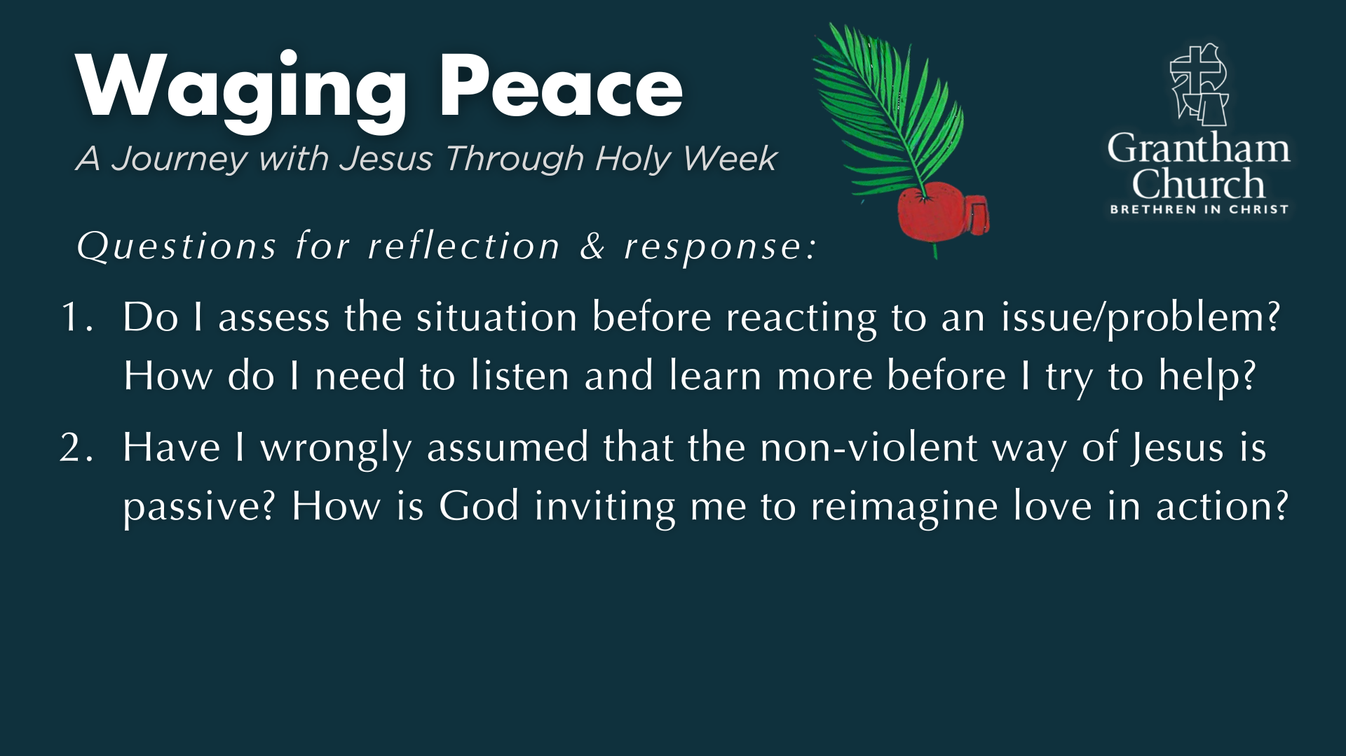

Slide 19
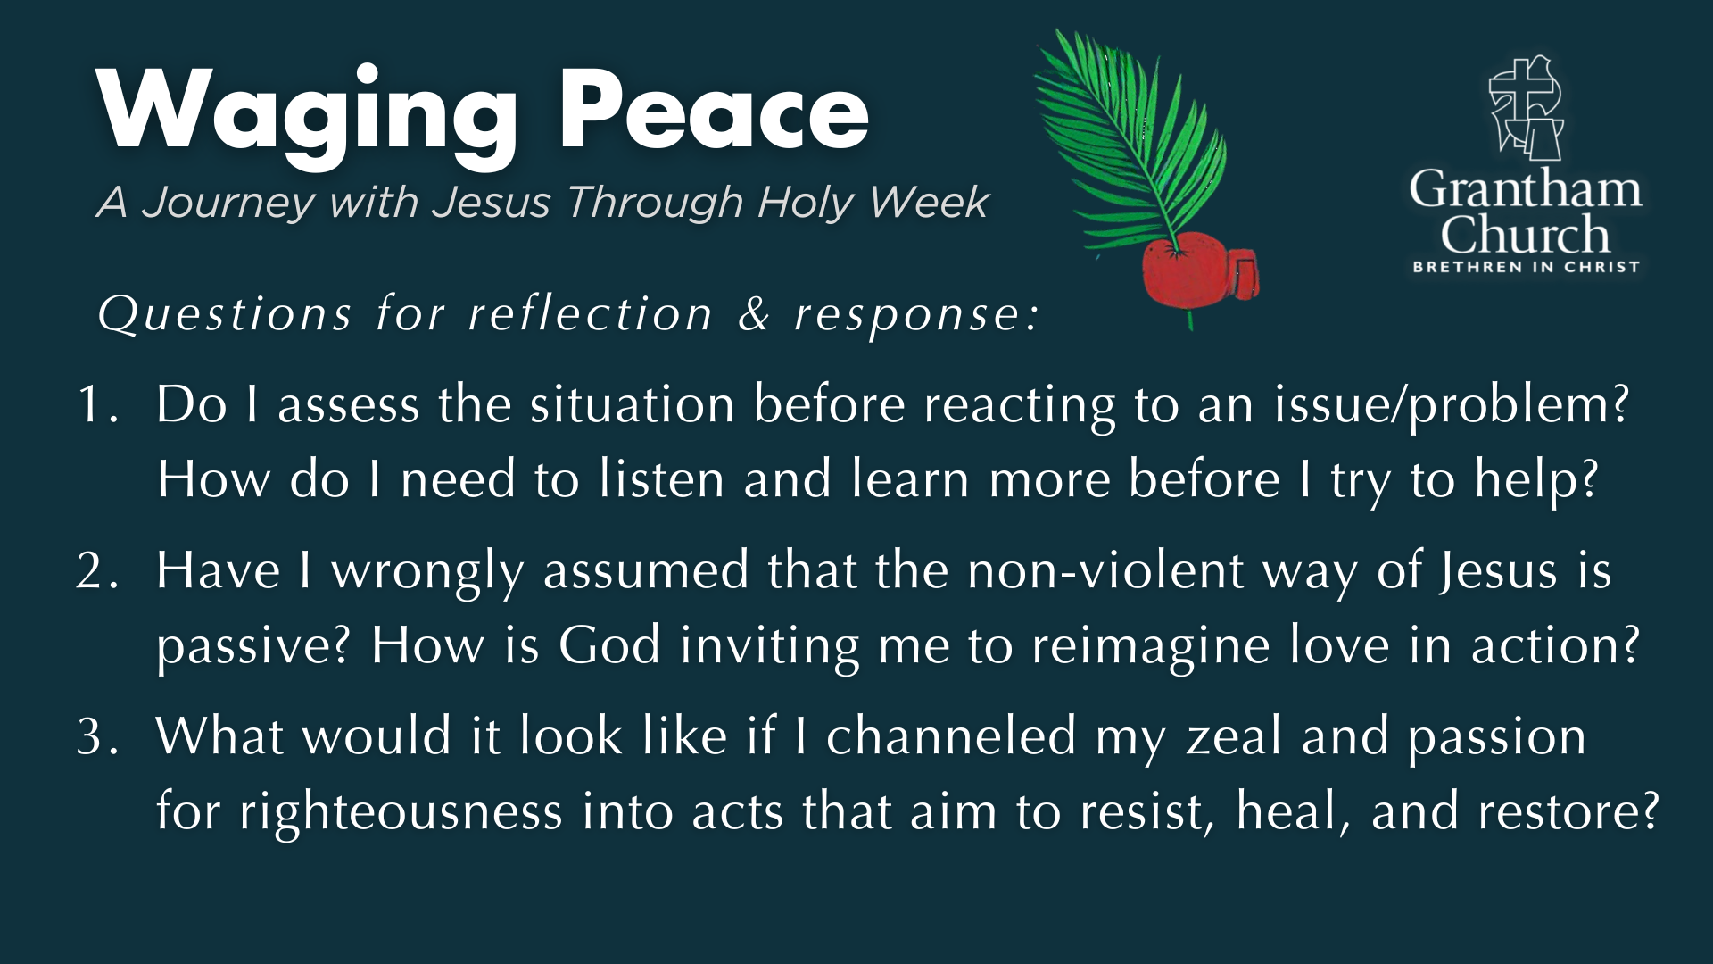
Notes:
[READ & COMMENT ON EACH QUESTION]
Do I assess the situation before reacting to an issue/problem? How do I need to listen and learn more before I try to help?
Have I wrongly assumed that the non-violent way of Jesus is passive? How is God inviting me to reimagine love in action?
What would it look like if I channeled my zeal and passion for righteousness into acts that aim to resist, heal, and restore?
Let’s pray… [NEXT SLIDE FOR CLOSING PRAYER]

Slide 20

Notes:
[CLOSING PRAYER]
Series Benediction – adapted from a “Franciscan Benediction”
May God bless you with discomfort…
Discomfort at easy answers, half-truths and superficial relationships,
Discomfort, so that you will hunger and thirst for righteousness.
May God bless you with anger…
Anger at injustice, oppression, and exploitation of people,
Anger, so that you will work for God’s Kingdom vision of shalom.
May God bless you with tears…
Tears to shed for those who suffer pain, rejection, starvation and war,
Tears, so that you will reach out to comfort them
And turn their pain into joy.
And may God bless you with foolishness…
Foolishness to believe that through the Spirit you can live like Jesus,
Foolishness, so that you will do what others claim cannot be done. Amen.
Grantham Church, go in peace… to love and serve the Lord.

