Slide 1
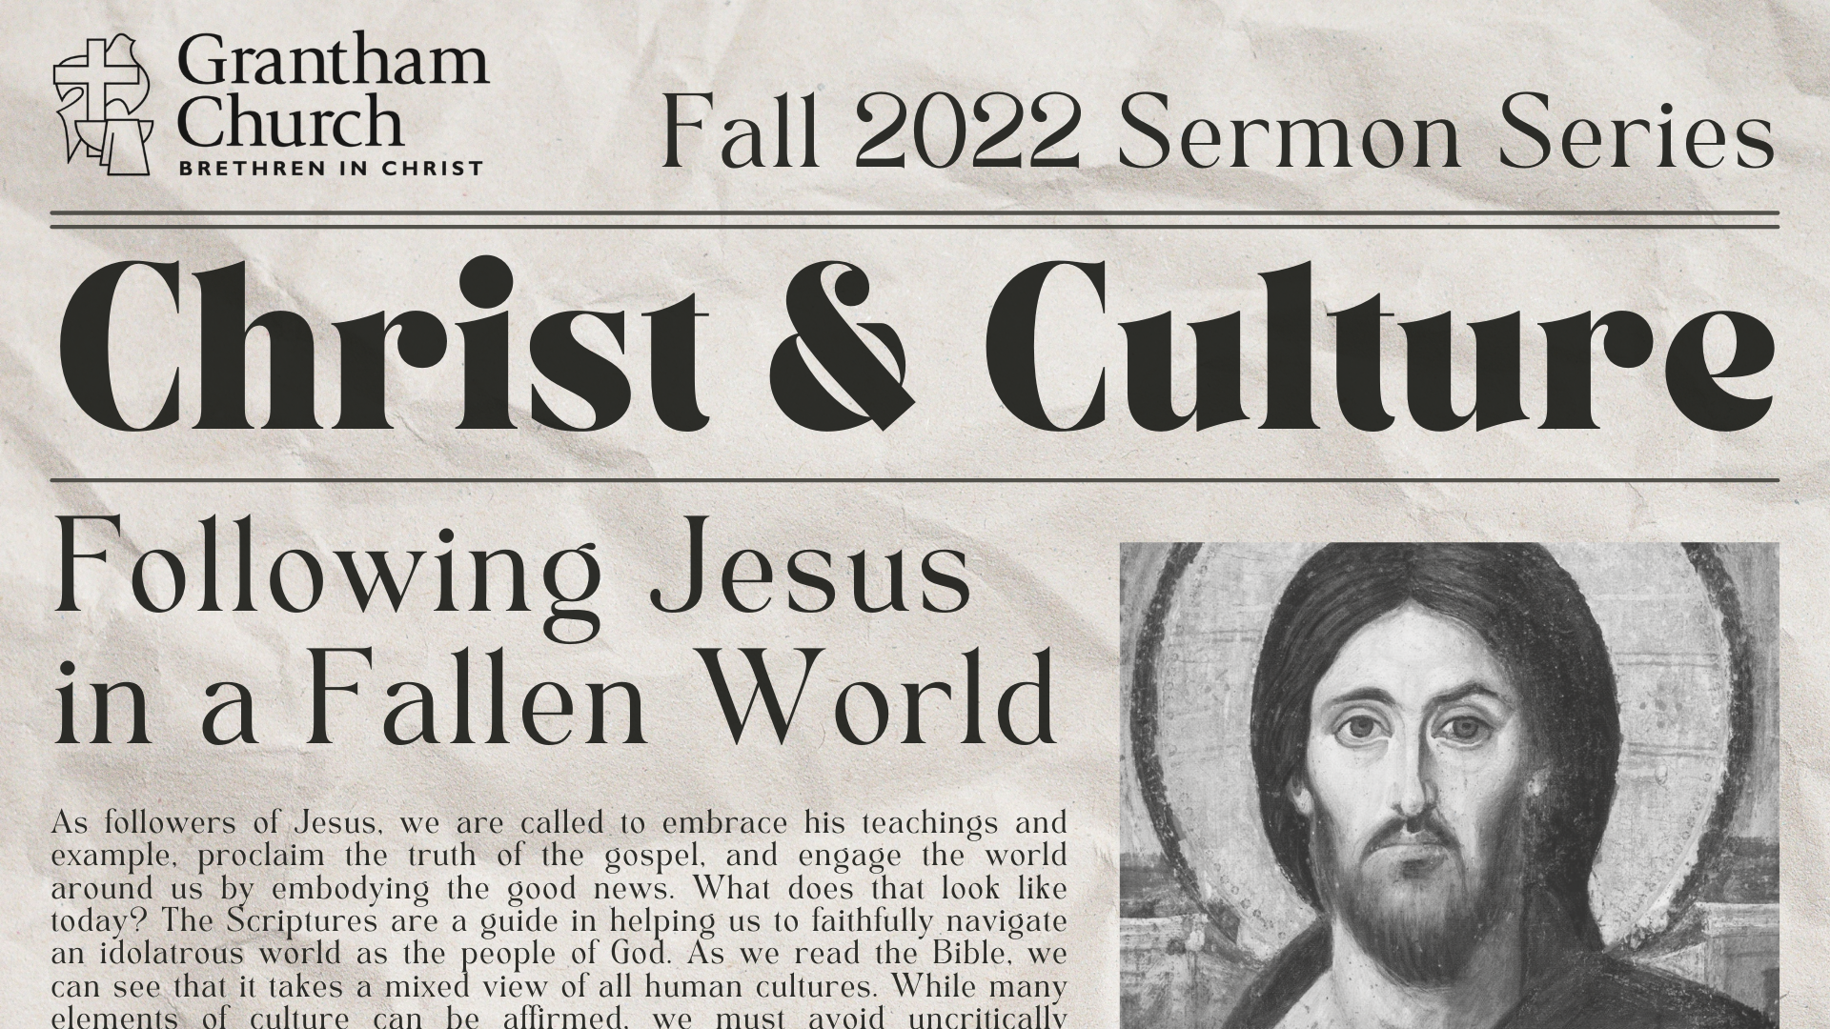
Notes:
[BRIEF INTRO] – Fall Sermon Series – Christ & Culture: Following Jesus in a Fallen World
In this series we have been looking at what it means to be in the world but not of it. We’re called to be holy or set apart for God. And specifically, we are called to live like Jesus in this world. Therefore, we must be wise, discerning children of the light. While there are many elements of culture that can be affirmed, we cannot uncritically accept all aspects of culture without first examining them in light of Christ and the gospel. Or in other words, we want to see culture through the lenses of Christ, the Scriptures, and the gospel.
So, this fall sermon series is about applying the gospel to every area of life and using cultural discernment as we navigate the world as Kingdom people. Once again, here is how we have been defining culture… [NEXT SLIDE]

Slide 2
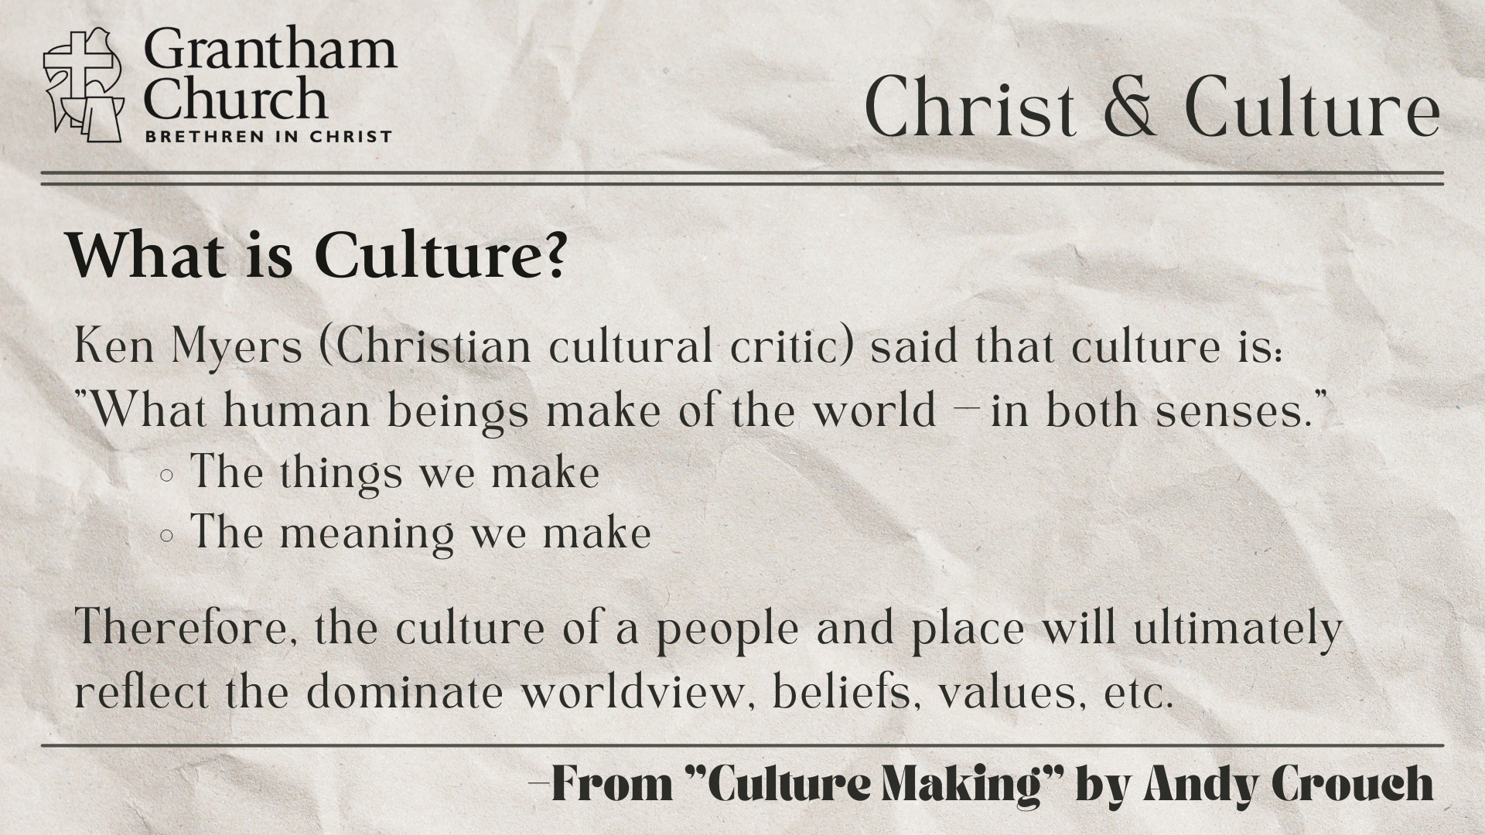
Notes:
[BRIEF COMMENTS ON DEFINITION]
And these two are interlinked:
The things we make: art, music, literature, clothing, food, laws, gardens, architecture, technology, etc.
The meaning we make: we communicate meaning by what we make, because what we make says something about who we believe we are—our identity and purpose, why we’re here, what (or who) we worship, what we value, what is true, what is good, what is right, wrong, so forth and so on.
This morning I want to add to our definition of culture, or simply state it another way. In his book… [NEXT SLIDE]

Slide 3

“Culture is the stories we tell that express meaning about the world… Culture is the way we communicate and “live” our worldview… This “worldview-culture” is primarily expressed through the cultural stories we tell, and the stories we listen to in turn shape our worldview.” (pgs. 23-24)
Notes:
[BRIEF COMMENT]
And how are these stories told? Well, as we will see this morning, they are told in various forms of art, music, tv, movies, advertisements, and much more. In fact, everywhere we turn in our world we are being told stories. And in American culture, if we look closely, we can identify what the dominate stories are that seek to answer the most important questions in life. So, we should expect that some of those stories (certainly aspects of those stories) are not going to align with Christ, the Scriptures, and the gospel. Therefore, we must be alert, wise, and discerning to be able to see what is going on around us.
But remember, we don’t want to adopt these unhealthy postures toward culture as disciples of Jesus... [NEXT SLIDE]

Slide 4
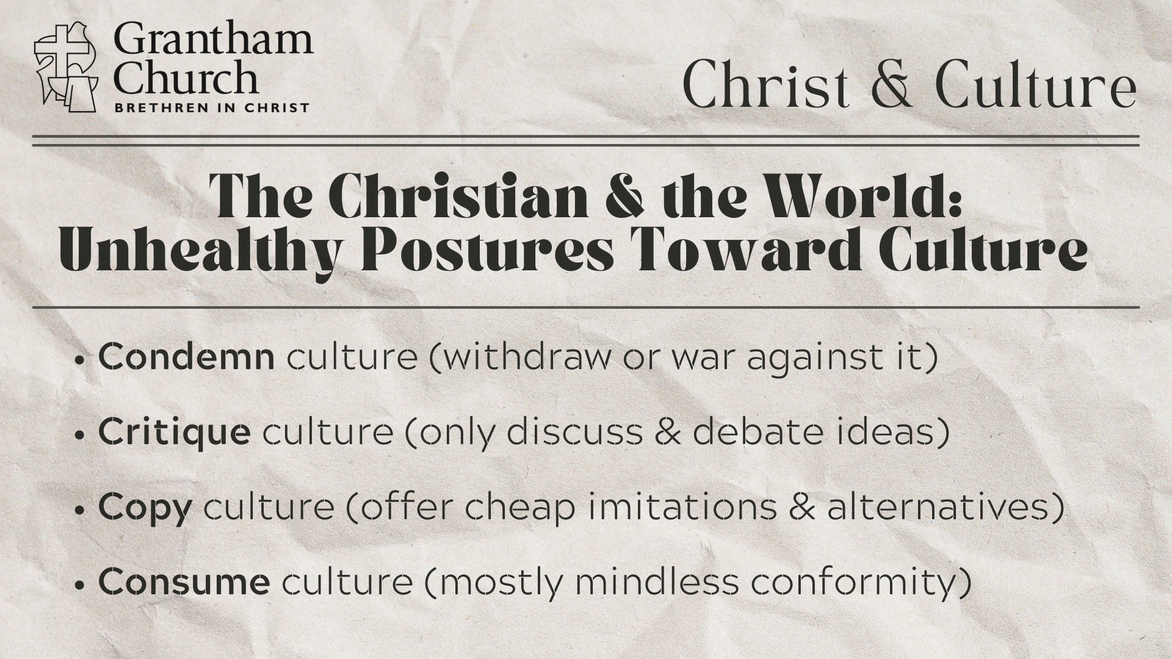
Notes:
[BRIEF COMMENTS ON EACH]
Condemn culture (withdraw or war against it)
Critique culture (only discuss & debate ideas)
Copy culture (offer cheap imitations & alternatives)
Consume culture (mostly mindless conformity)
Instead, we’ve been saying that the Kingdom approach to culture is… [NEXT SLIDE]

Slide 5
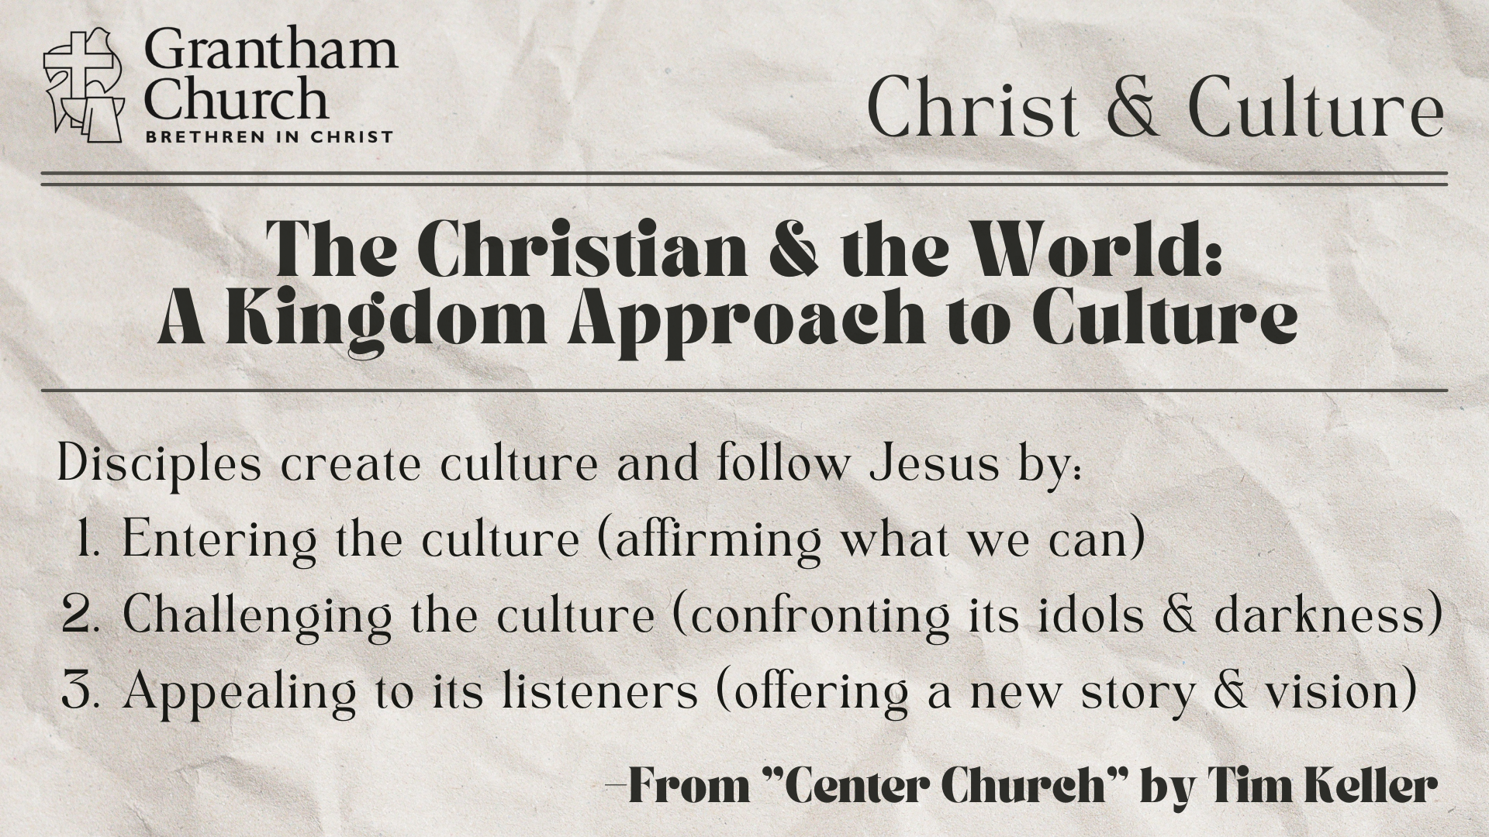
Notes:
[BRIEF COMMENTS ON EACH]
Of course, for this to work, for us to be able to do these three things, we must have a firm foundation in who Christ is, what the Scriptures say (particularly through a Christ-centered reading of Scripture), and how a more robust understanding of the gospel will challenge the zeitgeist—spirit of the age.
And so what I hope to do in this message is help us to wake up to the stories and truth claims of American culture that go against our faith and to see cultural discernment in action. In other words, to help us navigate culture with a gospel saturated mind that can see the world the way Jesus does. Because if we’re going to enter the culture, challenge the culture, and make an appeal to culture with the good news, then we need the mind of Christ.
If you’re taking notes, I’ve entitled this fifth message in our series… [NEXT SLIDE]

Slide 6
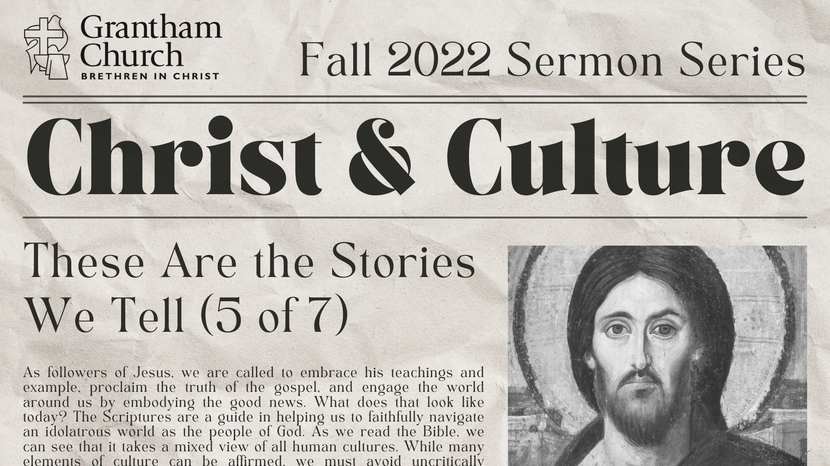
Notes:
Sermon Title: These Are the Stories We Tell
[BRIEF PRAYER & NEXT SLIDE]

Slide 7
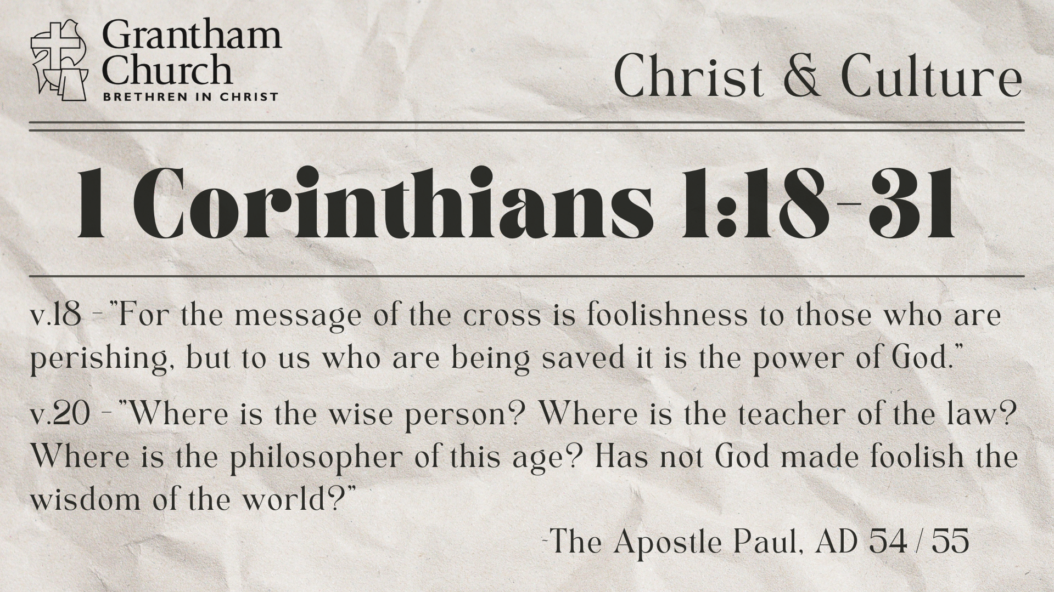
Notes:
Earlier in the service we heard a good bit of the first chapter in Paul’s first letter to the Corinthian church. If you missed that (or your listening through our podcast) you can go back and read 1 Corinthians 1:18-31. I’m just going to focus on verse 18 and 20 from that passage.
But first, to set the context, let me remind you of a few things about this letter:
Paul planted this church and he lived with them for a while (he’s a spiritual father)
This church plant was strategic – port city in Greece, a center of culture & commerce, very pagan!
Several years later he hears reports that the church isn’t doing well and he so he writes them
And what is their problem? Lots of issues, which we will see shortly
But ultimately, they have consumed and modeled the so-called “wisdom” of their surrounding culture
[READ & COMMENT ON VERSES 18 & 20]
v. 18 – the cross turns the world’s wisdom upside down!
v. 20 – what may seem “wise” to the world is actually foolishness to God – You may recall Isaiah 55:8 where the prophet speaking for God says, “For my thoughts are not your thoughts, neither are your ways my ways,” declares the Lord.
Paul wants his audience to undergo a reframe of how they understand wisdom and power. And he begins his letter this way on purpose. Because he is about to address every issue they are dealing with the wisdom of God. He will define the problem and then respond with what the gospel says about it. And here is how the letter breaks down into chapters… [NEXT SLIDE]

Slide 8
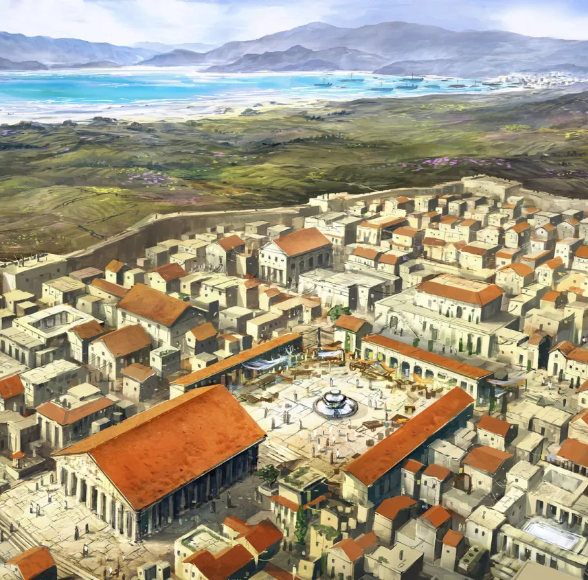
Paul confronts the so-called “wisdom” of the Greco-Roman culture in Corinth with what the gospel says on the matter.
Chapters in 1 Corinthians
1-4 Divisions & Pride
5-7 Sex & Our Bodies
8-10 Food & Local Idols
11-14 The Weekly Worship Gathering (order!)
15 Death & Resurrection
16 Final Greeting
Notes:
[BRIEF COMMENTS ON EACH CHAPTER]
And so we need to see these problems to be reflecting the stories that were being told in the Greco-Roman culture of Corinth. Think about it. Their divisions were largely rooted in the culture’s way of having favorite wisdom teachers; the sexual immorality was allowed and even celebrated because the Greek story was that what you do in your body is inconsequential—the spirit is good and matter is evil; the dispute over what a person could eat was because folks got their meat from local temples where the animal was sacrificed to a pagan deity, it was the water they swam in and the air they breathed; their problems in their house church gatherings come from them mimicking the story of culture that it’s good for you to put yourself before others and be loud, boastful, and boisterous if you want to be heard; and then Paul addresses resurrection because, once again, the church had accepted the culture’s story that the body was merely temporary housing for the soul, and that we should expect to discard of it someday. Which is why goes off on this story of culture that completely undermines the gospel. For in Paul’s words, without the resurrection of Jesus and our own bodies our faith is futile, it’s all for nothing, there is no hope!
And like his letter to the Corinthians, it’s not hard to see all of Paul’s letters (and the rest of the NT epistles for that matter) being the gospel’s response to the stories of culture. And in this way, I see the NT as an invitation for us to apply the gospel to every area of life. For the Scriptures are there, through the power of the Spirit, to help us navigate the world and be wise, discerning children of the light when encountering the stories of culture.
And so now I’d like us to think about the stories our own culture is telling us and how it compares and contrasts with the gospel. I know there are lots of stories out there, but for the sake of time we’re just going to look at five big questions that our world is asking today. Let’s look at the question, what American culture says, and then we will look at what the gospel says with some Scripture references to support it. [NEXT SLIDE]

Slide 9

These are the stories we tell about our…
Identity – “Who are we? Who am I?” American culture says: look inside (not outside) to your feelings, desires, dreams, etc. and freely express yourself The gospel says: you were created in God’s image; you are part of a new community and you are loved as an individual; you are not your own, you were bought at a price Scriptures: Genesis 1:27; 1 Cor. 6:19-20; Col. 3:1-11
Notes:
[READ & COMMENT]
American culture - the problem: this way of discovering identity is incoherent (our feelings contradict each other), this way is unstable (our feelings are always changing; 15, 30, 45 yrs old), and it’s an illusion to say you are your feelings (you’re going to have to choose your feelings). So why do you choose some feelings and not others? I submit to you it’s driven either by the culture (a grid by which you understand yourself) or by your Creator and his will revealed in Christ, the Scriptures, and the gospel (e.g., a 12th century Anglo-Saxon warrior vs. a guy on the streets of America – aggression and same-sex attraction). Clearly, culture has an impact on our identity. And unless we want to be crushed by the weight of this way of doing identity, we must embrace the gospel.
The second big question… [NEXT SLIDE]

Slide 10
These are the stories we tell about our…
Purpose – “Why are we here? Why am I here?” American culture says: you are here to feel good, make money, buy stuff, and be successful; to live your best life now! The gospel says: you were created to love God and love your neighbor; to care for the earth and animal kingdom; to serve others; to make disciples; to embody the Kingdom to come Scriptures: Genesis 1:28; Matt. 20:25-28, 22:37-40, 28:18-20
Notes:
[READ & COMMENT]
The third big question… [NEXT SLIDE]

Slide 11
These are the stories we tell about our…
Evil & Suffering – “Why is the world so messed up?” American culture says: people need more information, better technology, bigger fences and guns; if everyone adopted our political ideologies there would be less evil The gospel says: evil and suffering are a result of fallen humans and angels opposing God’s good will for creation Scriptures: Genesis 3:1-24; Rom. 1:18-25, 5:12, 6:23
Notes:
[READ & COMMENT]
The fourth big question… [NEXT SLIDE]

Slide 12
These are the stories we tell about our…
Redemption – “Who or what is going to save us?” American culture says: we can save our ourselves (country) if we want it bad enough and will vote the right people into office; the problem isn’t sin, it’s just bad ideas and politics The gospel says: we are sinners who live in a broken world; we can’t save ourselves; Jesus changes hearts and saves us Scriptures: John 3:17-17, 14:6; Rom. 10:9; 1 Peter 1:3-9
Notes:
[READ & COMMENT]
And the fifth big question… [NEXT SLIDE]

Slide 13
These are the stories we tell about our…
Future – “Will there be a happy ending?” American culture says: the ending is what we make it; this life is all we’ve got; life is short and the future is uncertain, so “you do you” and “get what you deserve” (e.g., YOLO) The gospel says: Jesus will return to establish his Kingdom on the earth, but those who reject his salvation will perish Scriptures: Daniel 7:13-14; Matt. 24:36-50; Rom. 8:18-25
Notes:
[READ & COMMENT]
So, we can see (just from these stories) that our culture is quite at odds with the gospel story.
That is why the Apostle Paul wrote this familiar verse in Romans 12… [NEXT SLIDE]

Slide 14
“Do not conform to the pattern of this world, but be transformed by the renewing of your mind. Then you will be able to test and approve what God’s will is—his good, pleasing and perfect will.”
Paul, Romans 12:2 NLT
Notes:
[READ & BRIEFLY COMMENT]
And how do we renew our minds? How do we have a gospel saturated mind? How do we know God’s good, pleasing, and perfect will. It comes by whole-heartedly embracing the Christian religion and religious routines, rhythms, and holy habits. It comes through practices of prayer, Scripture reading, through the sacraments, liturgies in worship and at home… all so that we would be properly formed in worship; so that the story of the good news would overpower and overshadow the stories of our culture. Folks, it’s the only way we stand a chance of living as faithful exiles in a modern-day empire.
And now after comparing and contrasting a few stories of culture with the gospel, here are some helpful things to keep in mind (and questions to ask) as we practice cultural discernment on a daily basis. [NEXT SLIDE]

Slide 15

How do we practice cultural discernment?
As disciples, we want our worldview to be shaped by Christ and the Scriptures. We want to see our culture through gospel lenses as faithful exiles.
Therefore, we must be sensitive to our:
Conscience – Are you listening to your conscience?
Context – Are you mindful of others (especially non-believers)?
Community – Are you letting other disciples speak into your life?
Notes:
[READ & BRIEFLY COMMENT ON EACH]
Finally, let’s hear from Paul one last time. Verses that we’ve heard before in this series… [NEXT SLIDE]

Slide 16
Paul, Ephesians 5:15-17 NLT
¹⁵ So be careful how you live. Don’t live like fools, but like those who are wise. ¹⁶ Make the most of every opportunity in these evil days. ¹⁷ Don’t act thoughtlessly, but understand what the Lord wants you to do.
Notes:
[READ & BRIEFLY COMMENT]
As we bring this message to a close, here are some questions for reflection and response… [NEXT SLIDE]

Slide 17
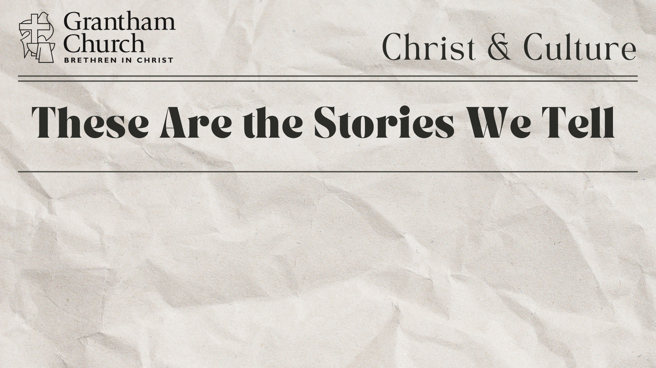
Questions for reflection and response:

Slide 18
Questions for reflection and response:
Are you aware of the stories that American culture is telling you through what you watch, listen to, read, and play?

Slide 19
Questions for reflection and response:
Are you aware of the stories that American culture is telling you through what you watch, listen to, read, and play?
Are your thoughts and feelings being shaped more by Christ and the Scriptures, or by the stories of the world?

Slide 20
Questions for reflection and response:
Are you aware of the stories that American culture is telling you through what you watch, listen to, read, and play?
Are your thoughts and feelings being shaped more by Christ and the Scriptures, or by the stories of the world?
Are you applying the gospel to every area of your life?
Notes:
Questions for reflection and response:
Are you aware of the stories that American culture is telling you through what you watch, listen to, read, and play?
Are your thoughts and feelings being shaped more by Christ and the Scriptures, or by the stories of the world?
Are you applying the gospel to every area of your life?
[CLOSING WORDS & PRAYER]

Slide 21
