Slide 1

Notes:
Today we conclude our 6-week sermon series on, Galatians: Faith Formation in Centered-Set Community.
Each week we’ve gone chapter-by-chapter and verse-by-verse through Galatians, which is the first letter of Paul in the New Testament. And I’ve been inviting us to understand this passionate letter to the churches in Galatia by reading it through the lens of bounded, fuzzy, and centered-set community. [NEXT SLIDE]

Slide 2
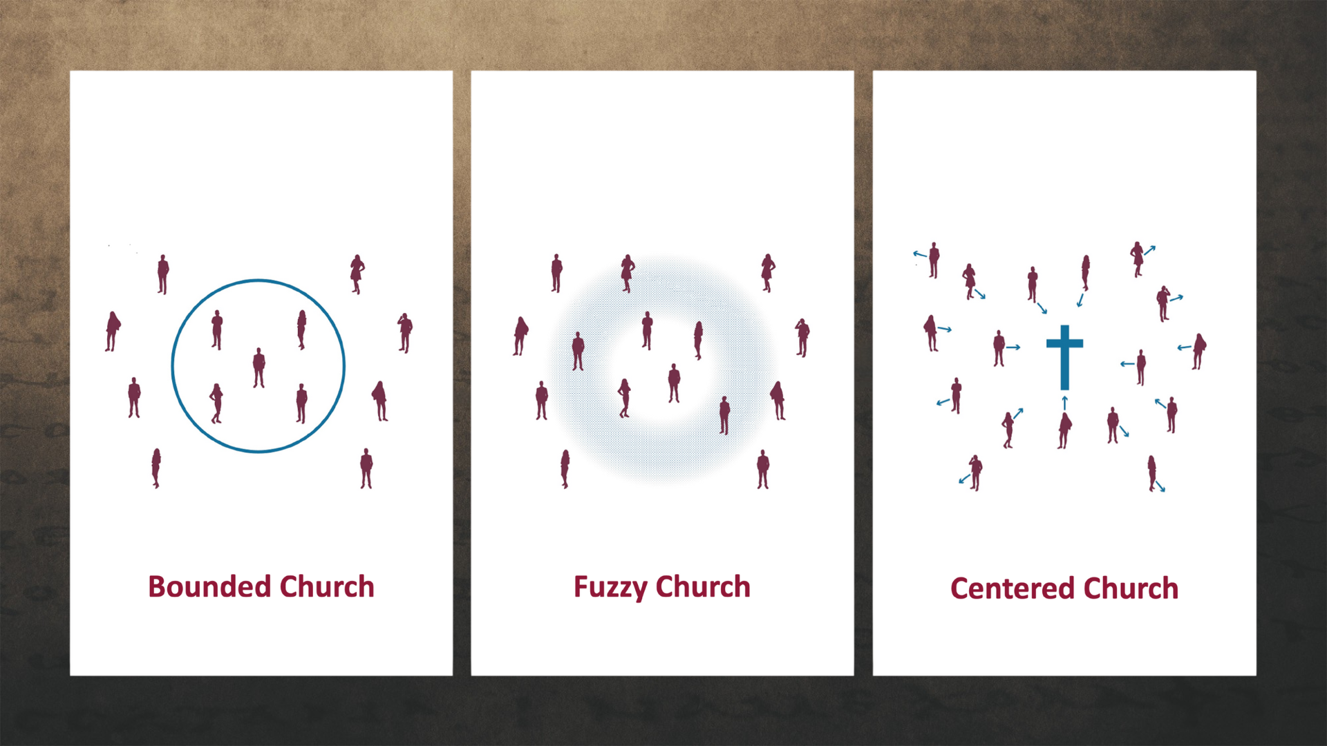
Notes:
And by now you should know and be able to explain what each of these mean and the kind of community we’re seeking to cultivate at Grantham Church…
A Bounded Church has a clear boundary line and separates who is in from who is out. The line generally consists of a list of correct beliefs and certain visible behaviors. And while beliefs, boundaries, and behaviors are important, a bounded church uses these things to create a sense of superiority for its core members and exclude others. And it hinders transparency and utilizes shame to motivate conformity. This is the sort of thinking that was threatening the Galatians and it’s why Paul is so concerned for them and their future.
A Fuzzy Church is the opposite extreme of the bounded church. It erases all lines and boundaries. Fuzzy folks might be more friendly, but the fuzziness about what they believe and who they are erodes the group’s sense of identity and mission. Therefore, it lacks a sense of call to follow Christ, and it disregards discipleship and spiritual formation. It has a tendency toward blandness, low expectations, and it creates a new set of problems in the church. And while liberal or progressive folks can be ”bounded” in their thinking, in our 2025 American context, left-leaning people often gravitate more toward fuzzy thinking.
But a Centered Church, the kind of church that Paul is advocating for and the sort that we want to be at Grantham, discerns who belongs to the group by observing people’s relationship with the center—Jesus Christ. That means in a centered church, we look to see if someone’s heart is oriented toward Jesus and following him. So, rather than focusing on boundaries, we define who Christ is and what he calls us to be and do as disciples as we meet people where they are and encourage each other to move closer to the center. And in that way, we give space for folks to be at different places in their faith journey.
And again, this centered-set community is what Paul wants for the Galatians and what God wants for us. And we can have it if we will embrace the gospel of God’s grace, which makes centered church possible. Remember how we define the gospel… [NEXT SLIDE]

Slide 3
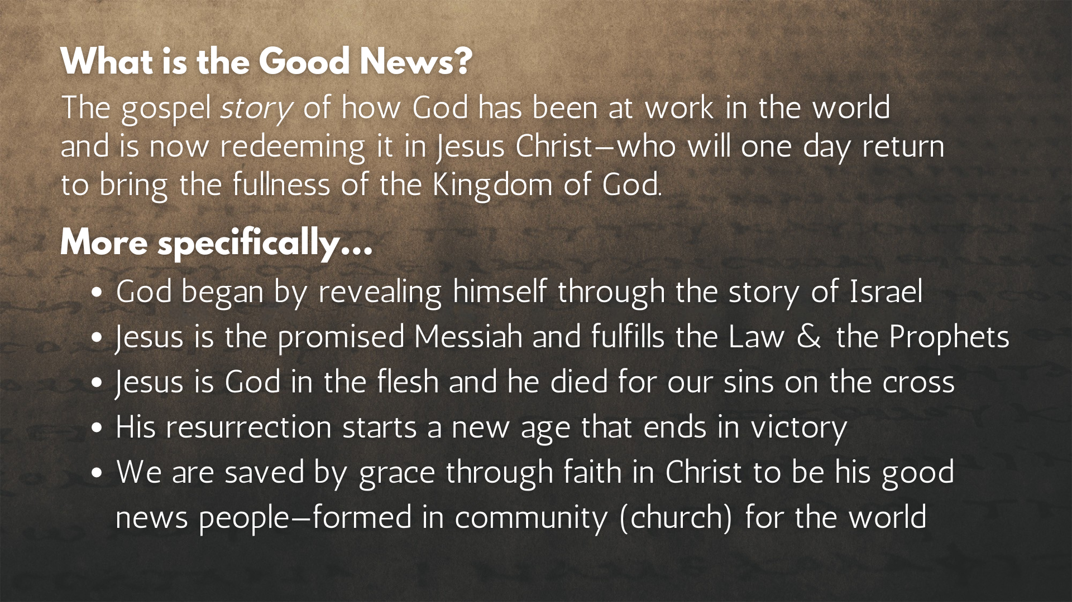
Notes:
[READ SLIDE & COMMENT]
And in the book of Galatians, this gospel of God’s grace is very different than other false gospels, especially the false gospel that religious people may espouse. One last time, here is how they compare... [NEXT SLIDE]

Slide 4
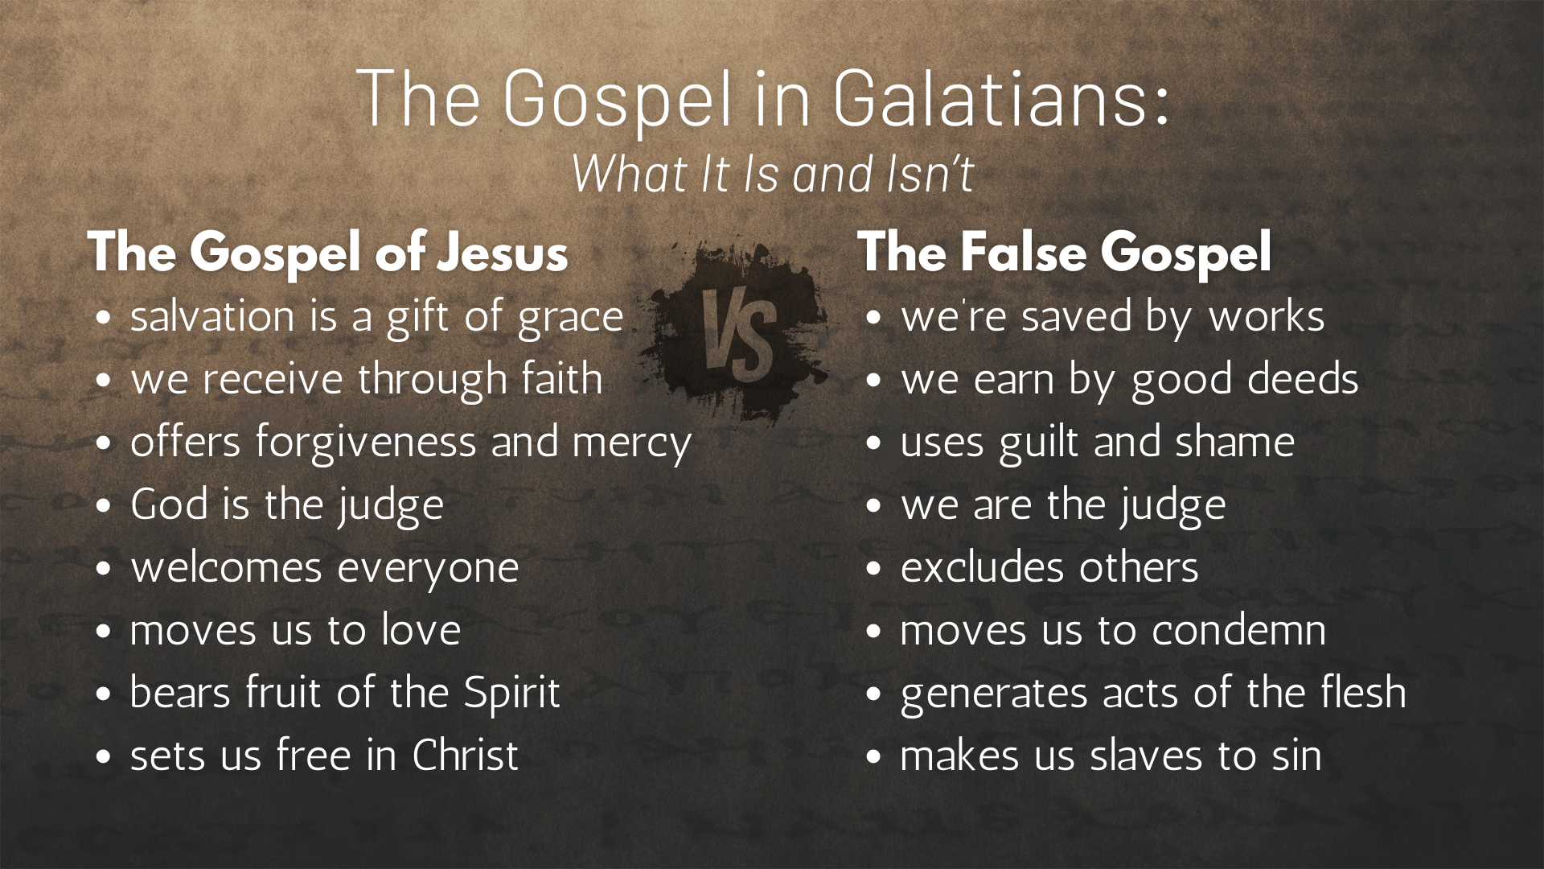
Notes:
[READ SLIDE & COMMENT]
And it’s this false gospel that prompted Paul to write his letter to the churches in Galatia that he helped to plant with his co-worker Barnabas… [NEXT SLIDE]

Slide 5
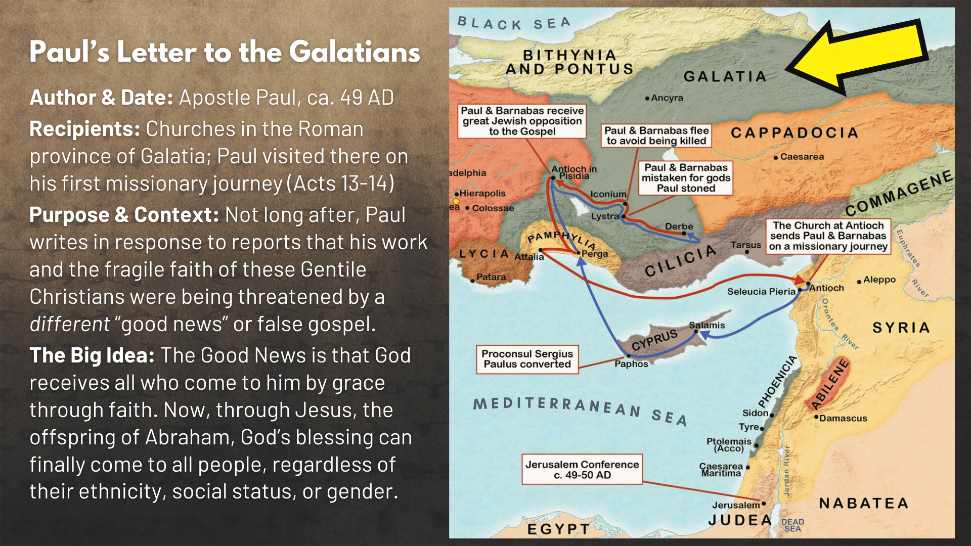
Notes:
Remember, it was the “agitators” or false missionaries from Jerusalem that were leading the Galatians astray with a false gospel that required males to be circumcised and men and women to obey the Torah; essentially making Gentiles become Jewish in order to follow Jesus. But the gospel of Jesus is greater than the Law. And Christianity (as we can still see today) transcends cultural, political, and socio-economic boundaries. That is why Christianity (unlike other religions) is able to maintain its core belief in Jesus and the gospel while taking on different cultural forms and expressions.
And so, Paul writes Galatians to confront the false gospel of the Jewish agitators, explain the purpose of the law and why the gospel of God’s grace and the centered community of Christ (i.e., the church) is far better, and helps us to see what it looks like lived out and embodied by disciples of Jesus… [NEXT SLIDE]

Slide 6
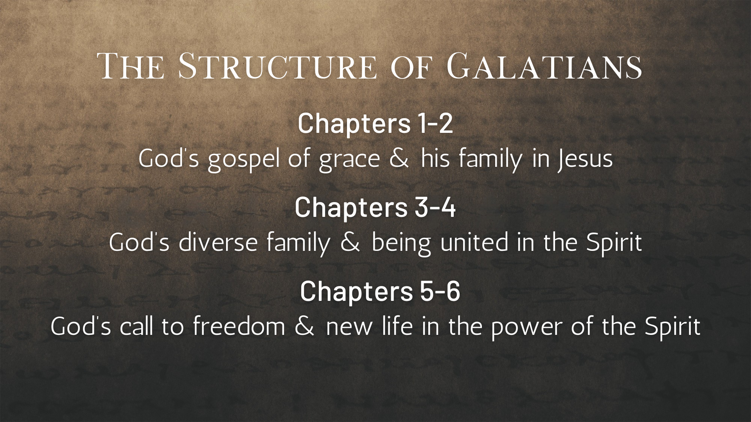
Notes:
In chapters 1-2, Paul unpacks the gospel of God’s grace and the new family he is forming in Jesus. In chapters 3-4, he tells us that God’s family is meant to be diverse (Jew, Gentile, male, female, slave, free, etc.) and that the ground is level at the foot of the cross. We’re all equal and one in Christ. And the Spirit is what makes this unity possible.
Last week, in chapter 5, we heard Paul talk about God’s call to live free of the flesh and sin’s power over us, so that we can embrace our new identity in Christ and walk in the new way of the Spirit. And once again, here is how Paul contrasted the acts of the flesh with the fruit of the Spirit… [NEXT SLIDE]

Slide 7
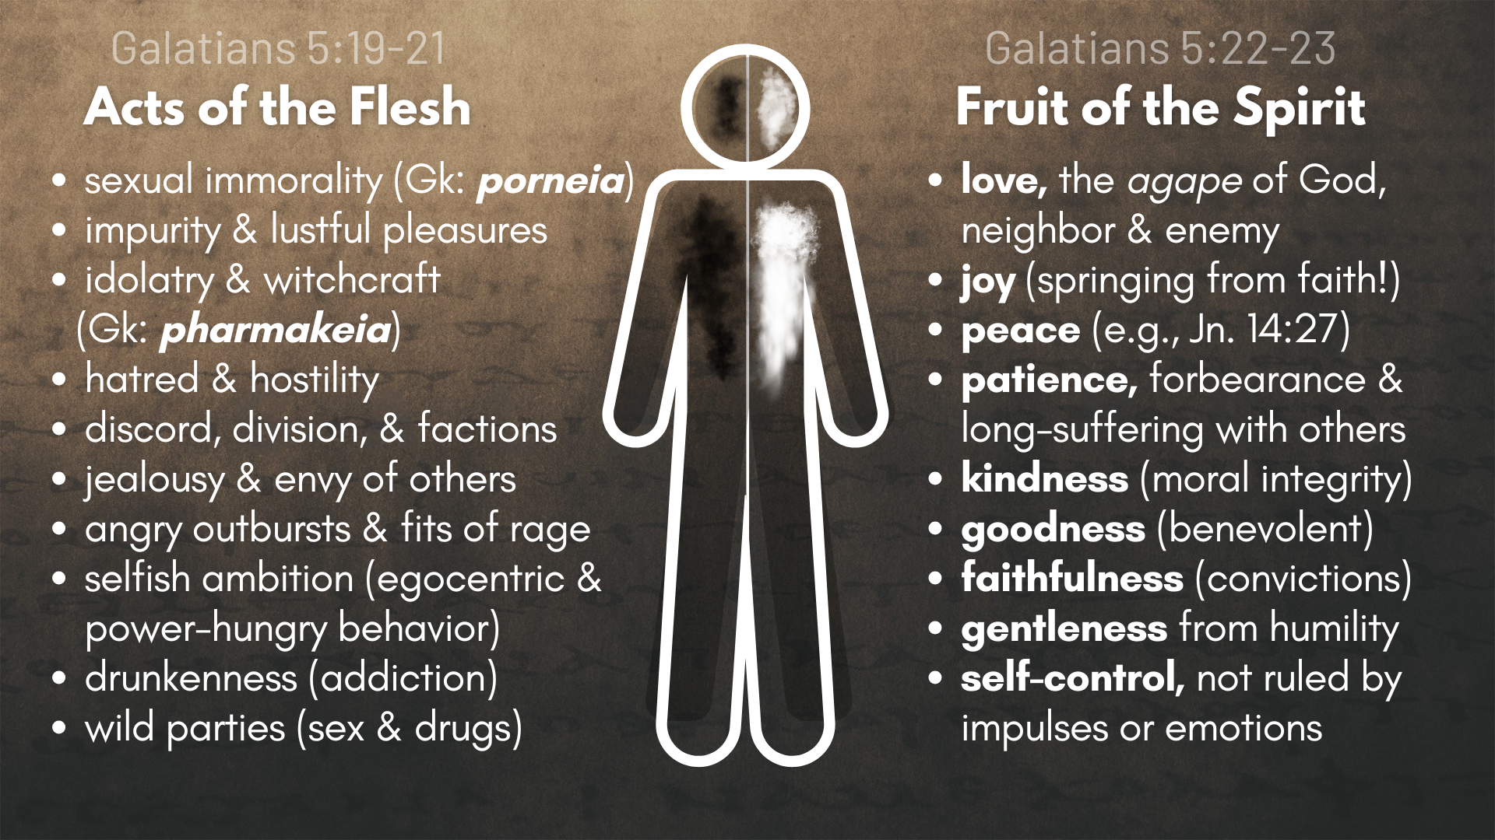
Notes:
[READ SLIDE & COMMENT]
And remember, the “acts of the flesh” that Paul mentions is a vice list that gives us a general idea of what it looks like when a person is “continuing in sin” and not living out of their new identity in Christ. We’re all going to sin as we work out our salvation, but it’s habitual, unrepentant sin that is especially concerning and damaging to the life of the believer.
And what is sin? Literally in the Greek it means to “fall short” or “miss the mark.” It’s a misuse of human energy. It’s thoughts and actions (or a failure to act) that is contrary to the character and will of God revealed in Jesus, who was fully human and fully God. So, sin is what we call those things we do or don’t do that do not reflect God’s best for us.
So, let’s keep all of this in mind as we now move into chapter 6… [NEXT SLIDE]

Slide 8
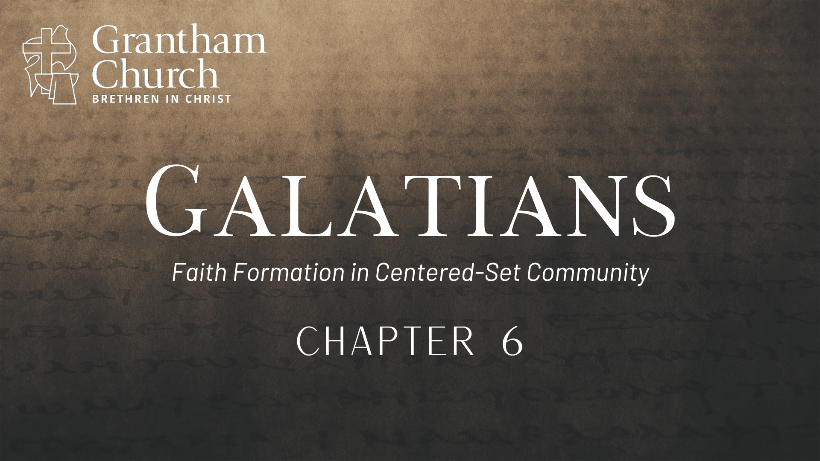
Notes:
In the final chapter of Galatians, we’re going to hear Paul follow up his call to repent of the “acts of the flesh” so that we can bear “fruit of the Spirit” with guidance on how to respond to disciples who are caught up in or being overcome by sin. What do we do that about that? And how do we care-front others rather than confront them?
Yes, carefronting is actually a real word and peace-making practice… [NEXT SLIDE]

Slide 9
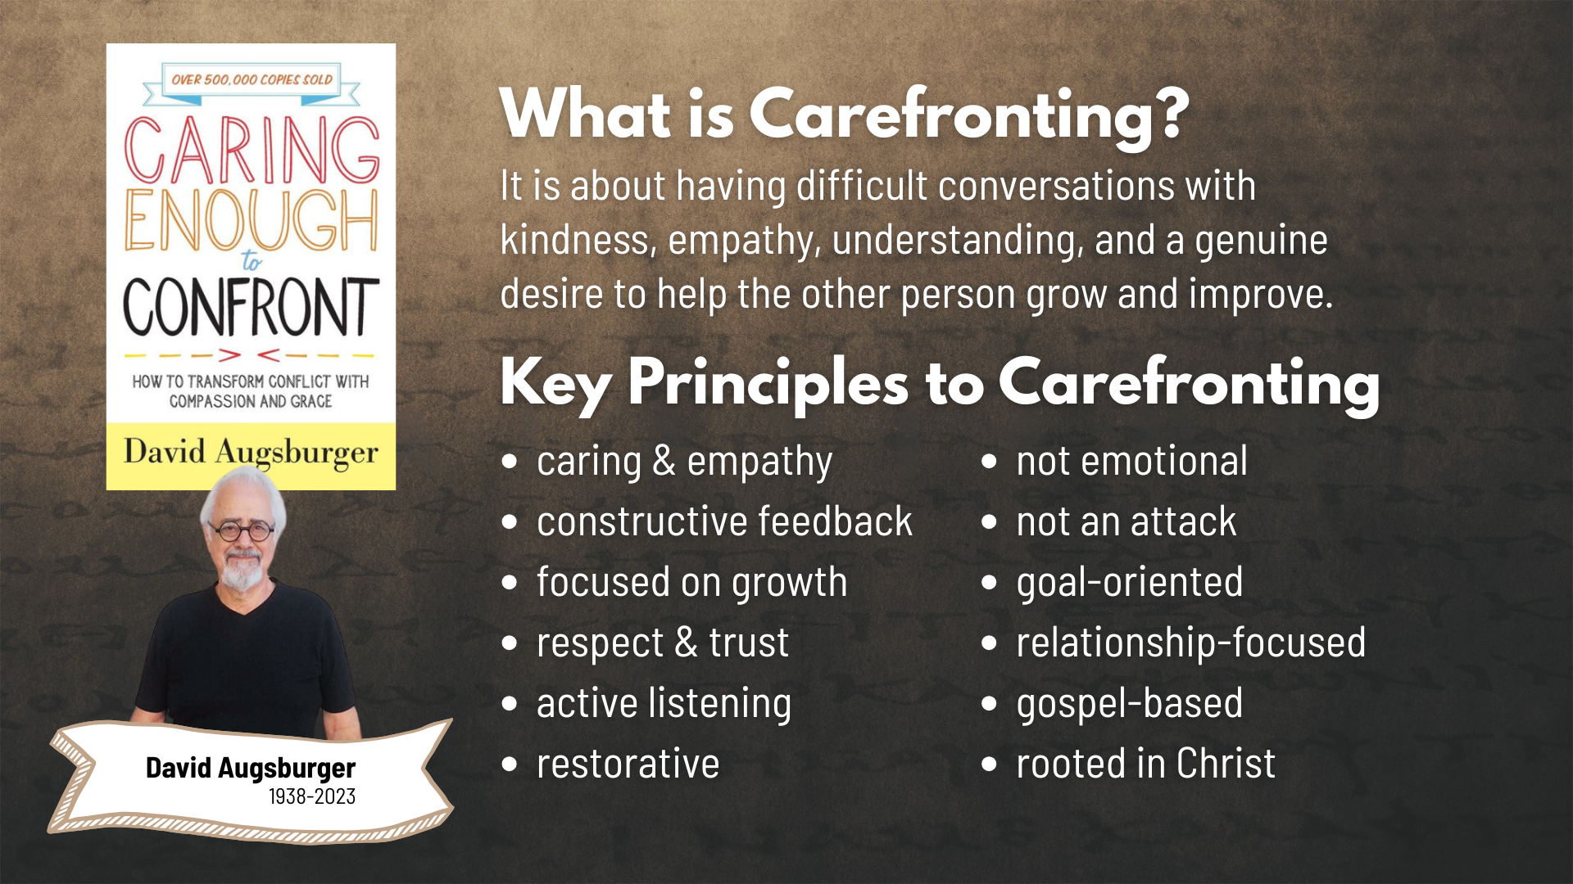
Notes:
The late David Augsburger, an ordained Mennonite minister, pastoral counselor, professor, and author, coined the term around 1980 in his book, Caring Enough to Confront. And his carefronting approach has been used by many churches, organizations, and businesses around the country.
[READ SLIDE & COMMENT]
And so, I want to invite us to hear what Paul is saying in Galatians 6 in keeping with these principles of carefronting someone, particularly a brother or sister in Christ who is “caught” in sin. To put it in the form of a question: “How do we carefront others in a way that isn’t “bounded” but is in keeping with the gospel of God’s grace?” And after we look at that together, I will bring our series to a close with an invitation for us to continue creating and cultivating centered-set community here at Grantham Church.
Let’s begin reading now in Galatians chapter 6… [NEXT SLIDE]

Slide 10
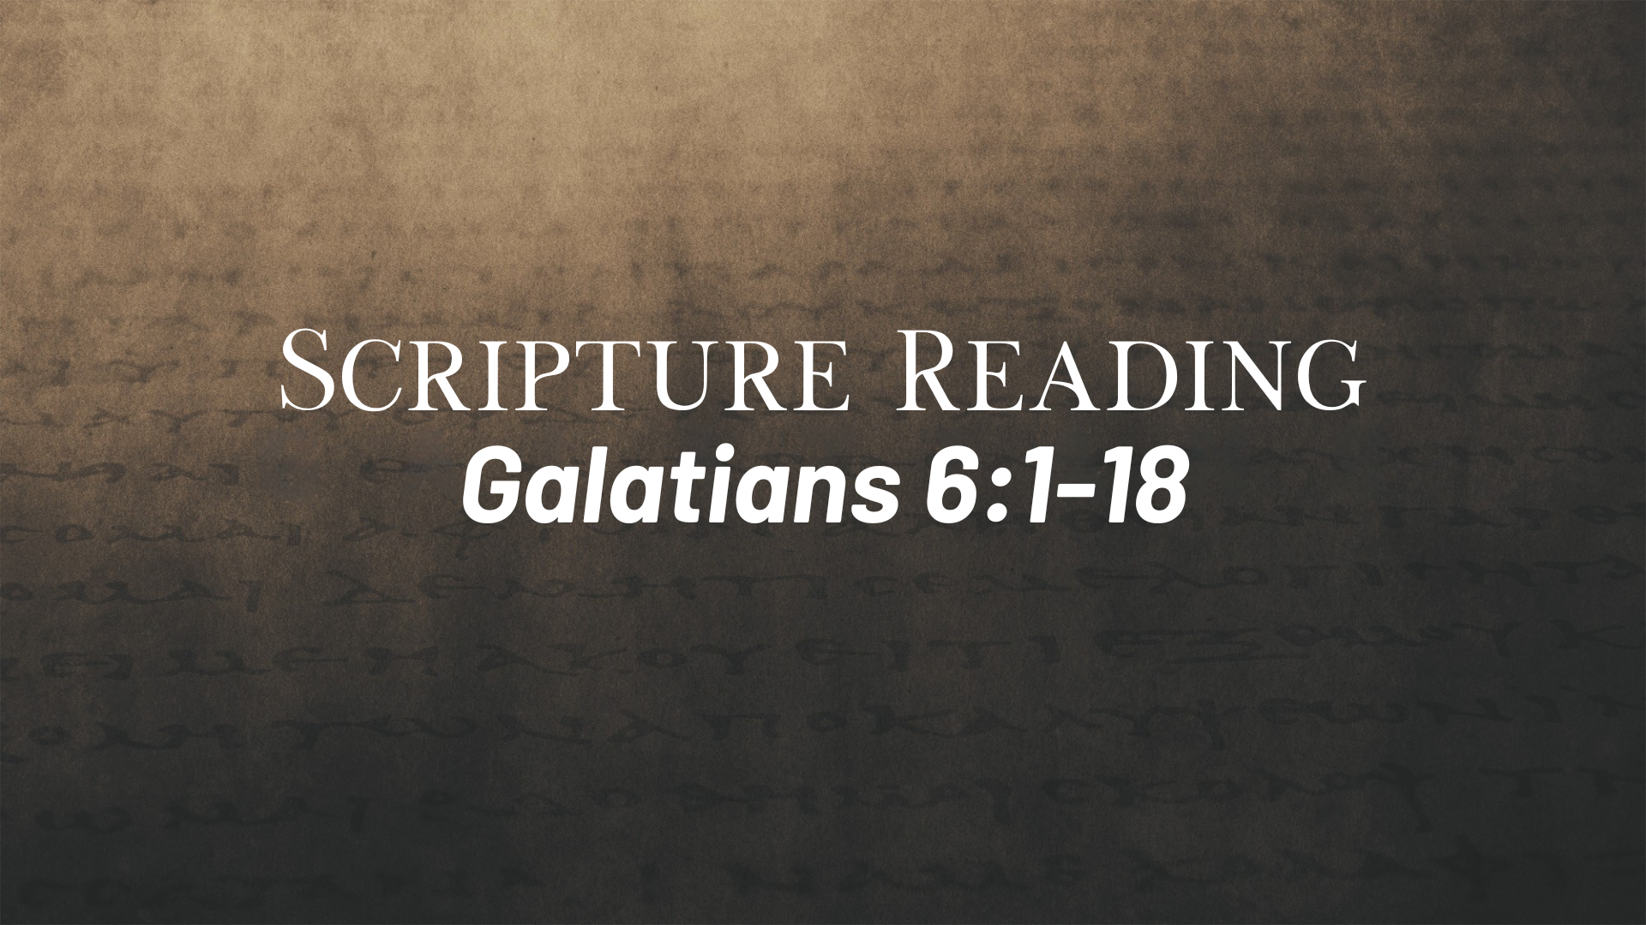
Notes:
[READ GALATIANS 5:1-12 VERSE-BY-VERSE & COMMENT] v. 1 – NLT: “is overcome”; NIV: “is caught in a sin”; GK: trapped, snared, or unable to get out of it; “godly” or “spiritual” (in the Spirit) should “restore” (the goal is restoration) them “gently” with humility; “tempted” (1) don’t fall into the same sin; (2) warning against feeling superior; NOTICE: there are no threats of exclusion in this case.
v. 2 – the sin and the struggle is seen as a “burden” to be shared; “law of Christ” likely refers to his command to love God and your neighbor, as the entire Law hangs on it
v. 3 – Paul is getting at their honor-shame culture and upending their Greco-Roman social hierarchy; remember Gal 3:28 – we are all one in Christ
v. 4-5 – In other words: You may be further along and have gifts to help others, but be careful that you’re not prideful and comparing yourself to others—be humble!
v. 6 – This may seem like a random strangely worded side-comment. Paul is simply saying that mutual love and respect for those who teach you and can help guide you is important.
v. 7 – “misled” or “deceived” in thinking that you or anyone else can go on living in sin and not reap what is sown. Seeds of sin will sprout up weeds that will choke out life. Or if sin is a crop, it will bear bad fruit for the harvest; ”God cannot be mocked” means you can’t go on willfully sinning and think you can defy the divine program of God’s justice.
v. 8 – 10 – think back to chapter 5, if you feed the flesh then you’re going to create a mess of your life, but if you deny your flesh and walk in the Spirit you will enrich your life; let us not become “weary in doing good” refers to the work of spiritual formation and helping (even carefronting) others in an effort to help them back on the road to life.
Let’s stop there and reflect for a moment on what we often call “church discipline”… [NEXT SLIDE]

Slide 11
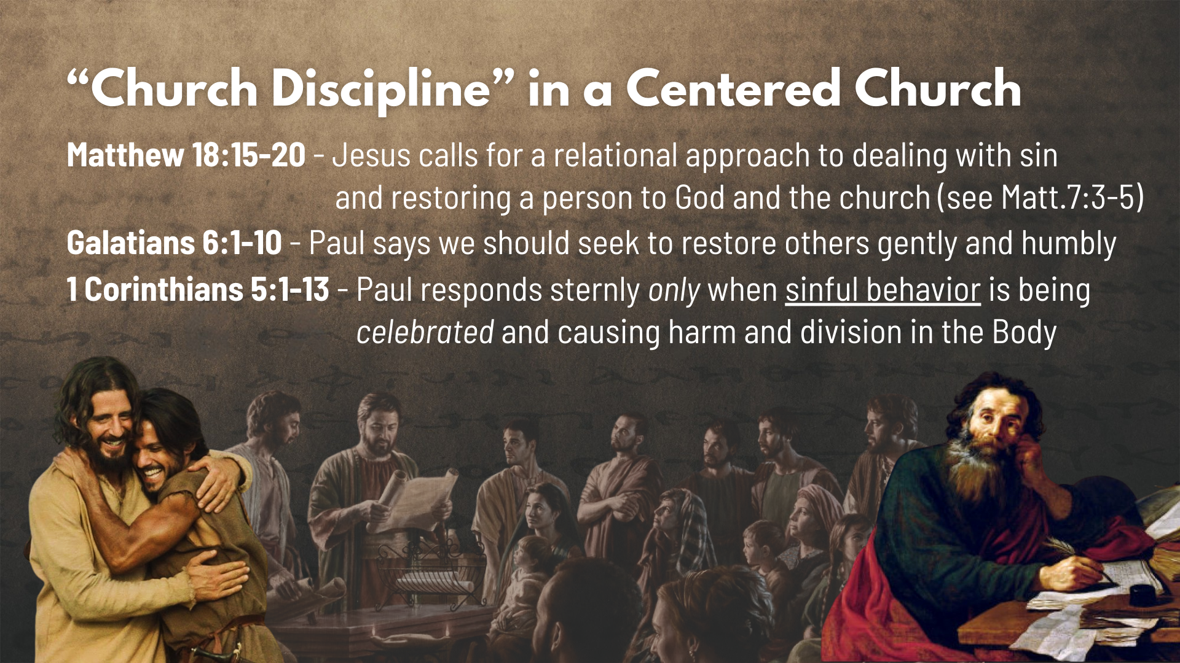
Notes:
My friends, church discipline is in it’s most Christ-like form an act of love. While bounded churches have used power, guilt, and shame to maintain the boundary markers and force compliance from the top-down, the way of Jesus is side-by-side, person-to-person; it’s relational and restorative, as we seek to care for those who have hurt us, or hurt someone else, or to help someone who claims to be a Christian and is living in habitual sin.
Jesus calls for this relational approach to carefronting someone or dealing with sin and restoring them to God in Matthew 18:15-20. He said if someone has done something wrong (particularly something that can’t be ignored), we should go to them in love and speak with them directly. If things aren’t made right, you should then include one or two other trusted believers to help mediate. And if that doesn’t work because someone is seemingly refusing to be reconciled, then it becomes a larger matter with the leadership and church family.
And as we just read in Galatians 6:1-10, Paul says that we should seek to restore others gently and humbly, whether it’s a relational conflict or someone we’re in relationship with is knowingly and willfully living in sin and being overcome by it. Of course, it’s possible that a person doesn’t know or believe they are living in sin, but regardless, notice, these things are to happen within real loving relationships where we have earned the right to speak truth in love to another follower of Jesus. Because that’s what people in authentic relationships do.
Now, what about 1 Corinthians 5:1-13. Paul wrote some strong words and took a stern approach in Corinth, it’s true. He even told them to hand someone “over to Satan” and consider them an unbeliever. While that may seem harsh, and this example has been cited to justify a bounded approach, if you look closely at what happened it is very telling. A so-called brother in the church was having a sexual relationship with his step-mother, all in the name of “freedom in Christ” and the “grace of Christ” and look-how-liberal and fuzzy we are. And it wasn’t just that this guy was sinning, Paul says that the church was proud of it, boasting about it, and celebrating it as a sign of how accepting and tolerate they were. And it’s because of this attitude toward sin that Paul demanded a strong response. Even then, his stern response was in hopes that the person would confess, repent, and be restored.
Back to Galatians 6, verse 11… [NEXT SLIDE]

Slide 12
Notes:
[READ VERSE-BY-VERSE & COMMENT]
v. 11 – Paul has bad eyesight. It’s likely what he was referring to in Galatians 4:15 when he said, “I can testify that, if you could have done so, you would have torn out your eyes and given them to me.” Obviously, the Galatians knew about Paul’s vision problems.
vs. 12-13 – Paul is saying that the false missionaries don’t really care about the Galatians. No, they’re really only interested in “saving face”, avoiding shame, and protecting their own honor. Why? Because they have believed in keeping the Law and in protecting the boundaries for so long. How would it make them look to change their minds now? And if they can get the Galatians to comply and accept their message, well, their beliefs and their line-drawing would be validated. And folks, that is how bounded people think and operate.
v. 14 – boasting was a common practice in the first century to promote one’s honor and to prove yourself worthy of the status you hold. But homie Paul don’t play like that.
v. 15 – “new creation” Have you been changed by the gospel of God’s grace? (2 Cor. 5:17)
v. 16 – Those who accept this message are the real people of God.
v. 17 – Paul is saying, “That’s it. I’m done. I’ve said what needed to be said. And now he is insisting that all attempts to undermine his message and authority should cease. And Paul says, you want to know what qualifies me in saying all of this: my scars tell the story.
Looking back on chapter 6, what practical application can we make from what Paul has said. Here are a few takeaways… [NEXT SLIDE]

Slide 13
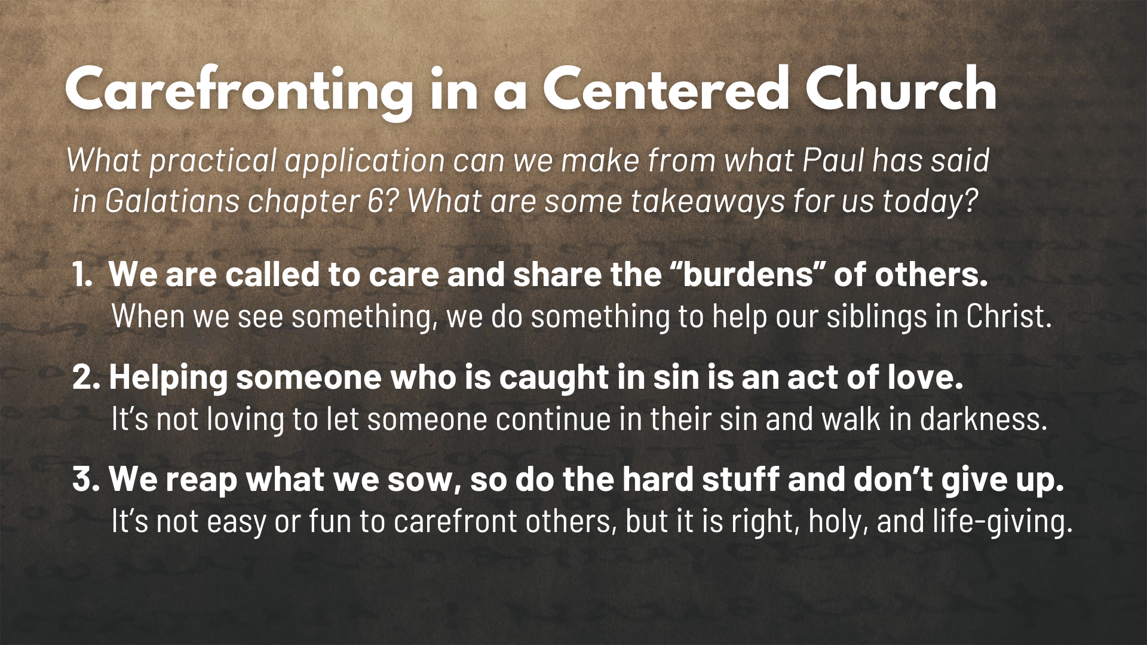
Notes:
[APPLICATION - READ EACH POINT & COMMENT]
1. We are called to care and share the “burdens” of others. When we see something, we do something to help our siblings in Christ.
2. Helping someone who is caught in sin is an act of love. It’s not loving to let someone continue in their sin and walk in darkness.
3. We reap what we sow, so do the hard stuff and don’t give up.
It’s not easy or fun to carefront others, but it is right, holy, and life-giving.
In his commentary on Galatians, N.T. Wright wrote: ”A church formed by Galatians will be a church with Jesus at the center: a church called by love, shaped by love, striving to live by love” (Galatians: pg.384). I trust that you, Grantham Church, will be formed by this vivid, challenging, and passionate letter of Paul as you seek to apply it to your lives.
And now that we’ve reached the end of Galatians, I’d like to wrap up this series by inviting us to continue embracing the gospel of God’s grace and cultivating centered-set community. So, let’s close with some final thoughts about how this sort of community works and what it looks like as we work it out together… [NEXT SLIDE]

Slide 14
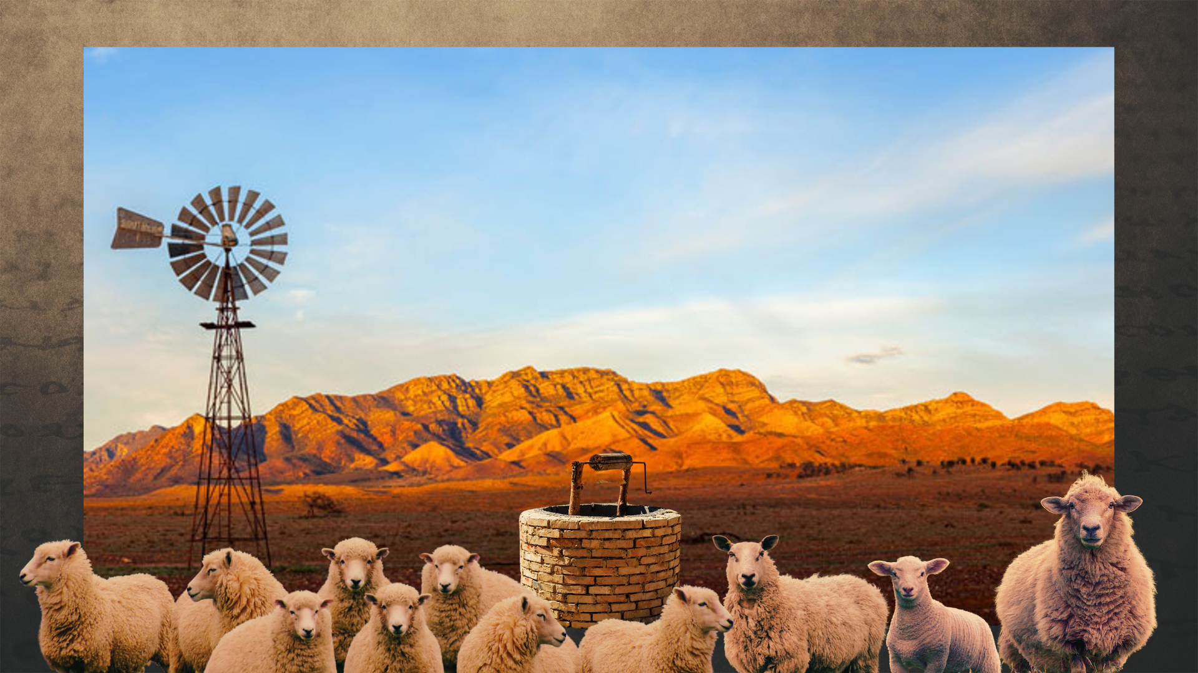
Notes:
[BRIEF COMMENTS]
The Australian Outback covers more than 70% of the continent!
The land is so dry and the landscape so massive, that ranchers and farmers have an interesting way of managing and containing their cattle and sheep
Since it costs famers too much to build fences, they dig wells
The livestock and the sheep will roam, but not too far from the water source because they must keep returning to the well to drink and live
It’s a fitting image and metaphor because this is what it’s like with Christ and the Centered Church. And as you might recall, the well is a metaphor used by Jesus to speak of himself in John chapter 4. Jesus told the woman at the well… [NEXT SLIDE]

Slide 15
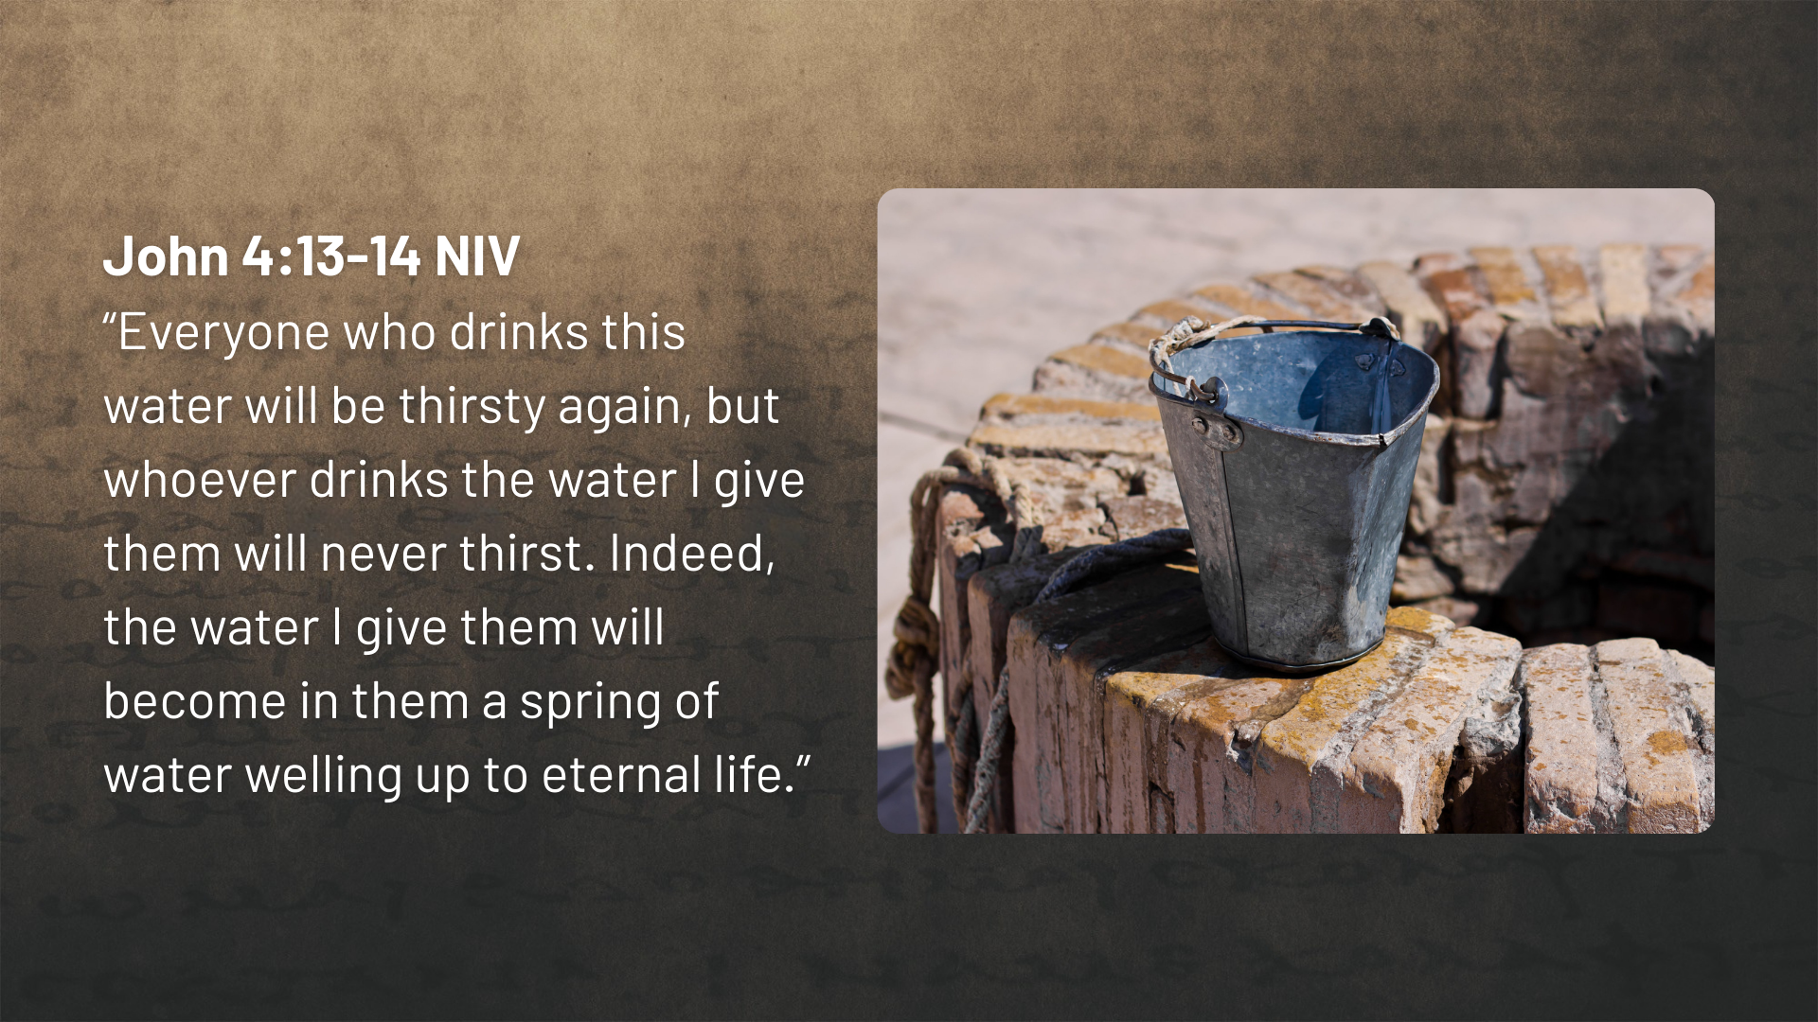
Notes:
[READ & COMMENT]
Being a centered church is about leading people to the well of Christ
So, get this picture… in our own congregation, how do we know who is a Christ-follower and with us on gospel mission? Well, as Jesus said, we only need to look at the “fruit” of their life and the orientation of their heart. Is their life aimed at Christ? [NEXT SLIDE]

Slide 16
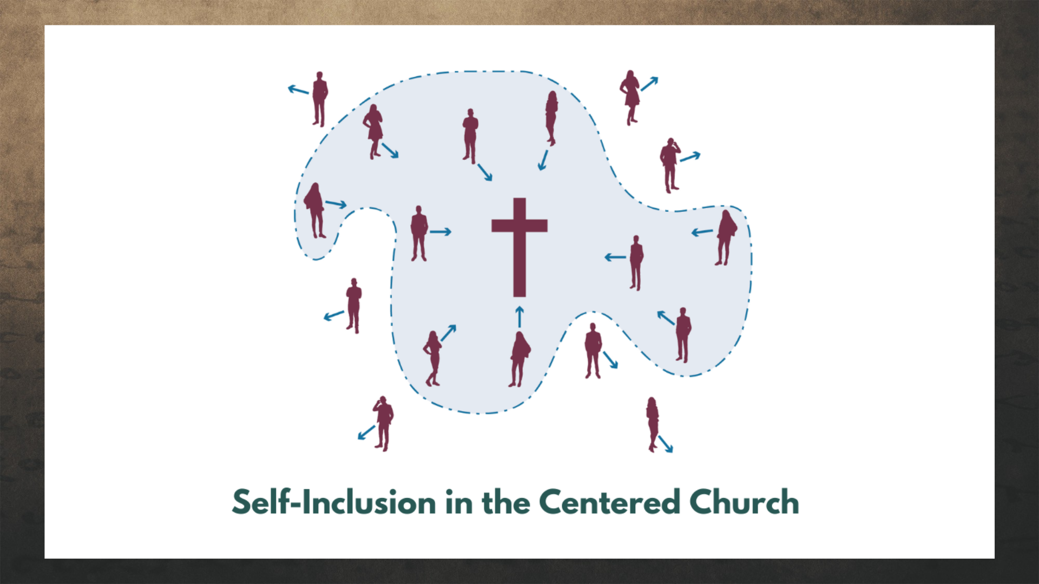
Notes:
[BRIEF COMMENT ON IMAGE]
Is there evidence or ”fruit” that reveals we are pursuing the center? Are present with the church, we are growing in our faith, are we repenting of sins, are we displaying the fruit of the Spirit, are submitting to biblical instruction and correction within the Body, are are including ourselves in on what the Spirit is doing at Grantham?
In his book, Reading Paul (2008), NT scholar Michael J. Gorman writes: “The inclusion that Paul experiences, preaches, and practices is not an inclusion lacking teeth or limits. His gospel does not say, “All are welcome just as they are,” but rather, “All are welcome just as they are to be apprehended by, and fully converted to Jesus Christ the Lord.” And so, as Baker writes, “We quite appropriately must recognize that some people are not centering their lives on Jesus.” Therefore, “We need language to describe those who are not part of our Jesus-centered communities—those we want to invite to come and join us as we drink from the life-giving water of Jesus” (pg.49).
Now, let’s Zoom in further at Christ the Center for a better understanding of what it looks like to be including yourself with us here at Grantham and drinking from the well. [NEXT SLIDE]

Slide 17
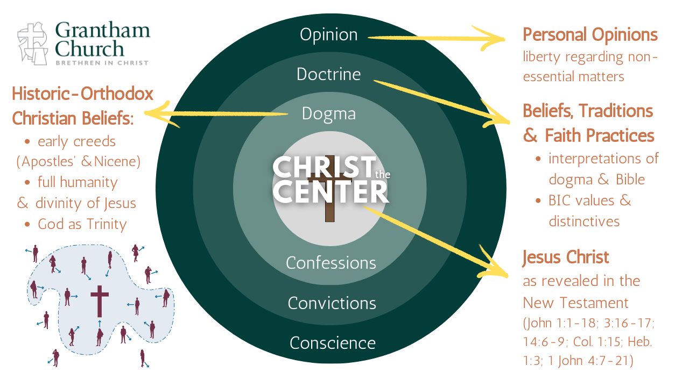
Notes:
[BRIEF COMMENTS ON GRAPHIC]
Baker writes: “Shifting from fence building to digging a well also changes the role of beliefs within a church. When doctrines are treated as a fence, they function as a litmus test. In a bounded church, doctrine can degenerate to mostly a means of defining who is in and who is out. A centered church frees doctrine to be much more than right belief. Doctrine becomes life-giving well water by helping people in the church align with and journey toward the center” (pg.81).
Therefore, when disciples who identify with us are not making decisions in keeping with their aim (their arrow is pointing away from Christ), then we must restore them gently, as Paul tells us in Galatians 6:1. Because that is the most loving thing we can do.
So, to sum up what the deep well of a Centered Church looks like. [NEXT SLIDE]

Slide 18
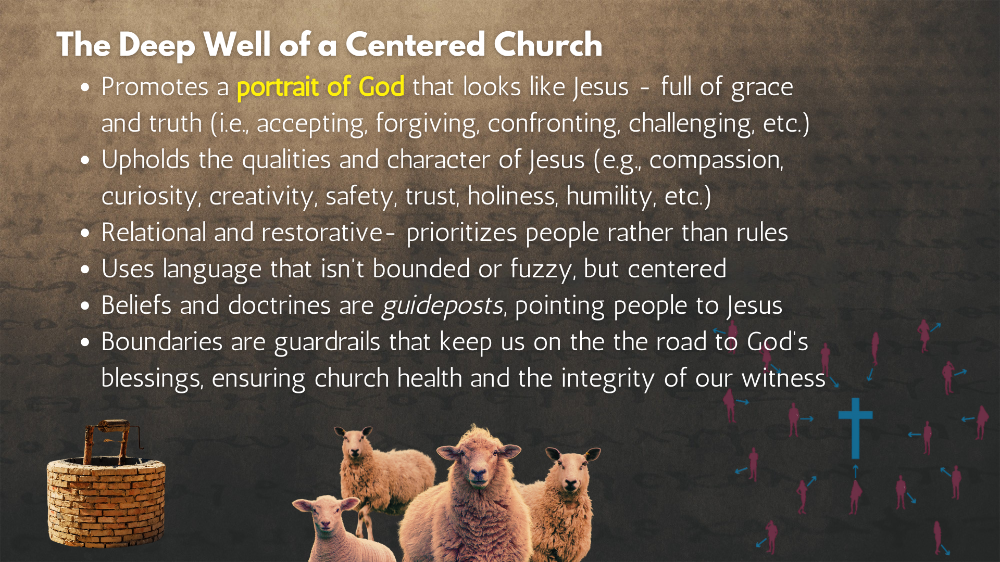
Notes:
[READ SLIDE & COMMENT]
Brothers and sisters, this is what it looks like to be the church of Jesus Christ; to build our lives upon the gospel of God’s grace and to create community that is Christ-centered. May the Lord help us as we learn to embody these truths and lead others to the God who looks like Jesus.
Finally, here are some questions to help us reflect and respond to what the Spirit is saying to us through this message… [NEXT SLIDE]

Slide 19
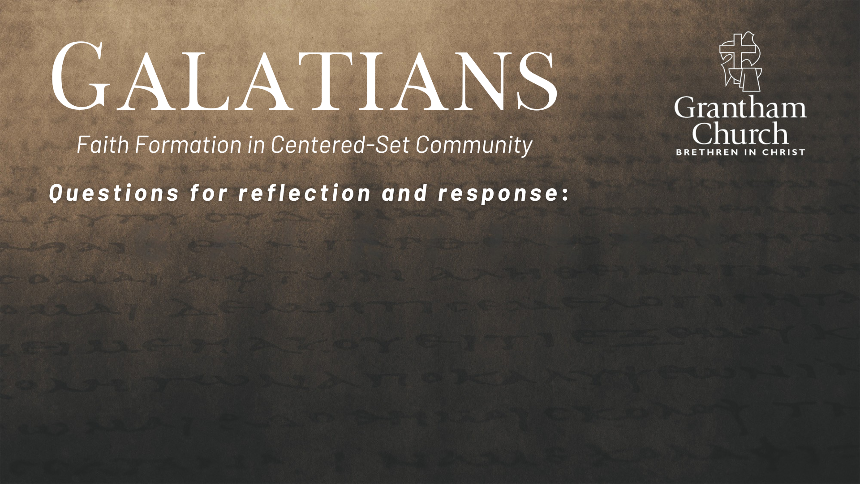
Notes:
Questions

Slide 20
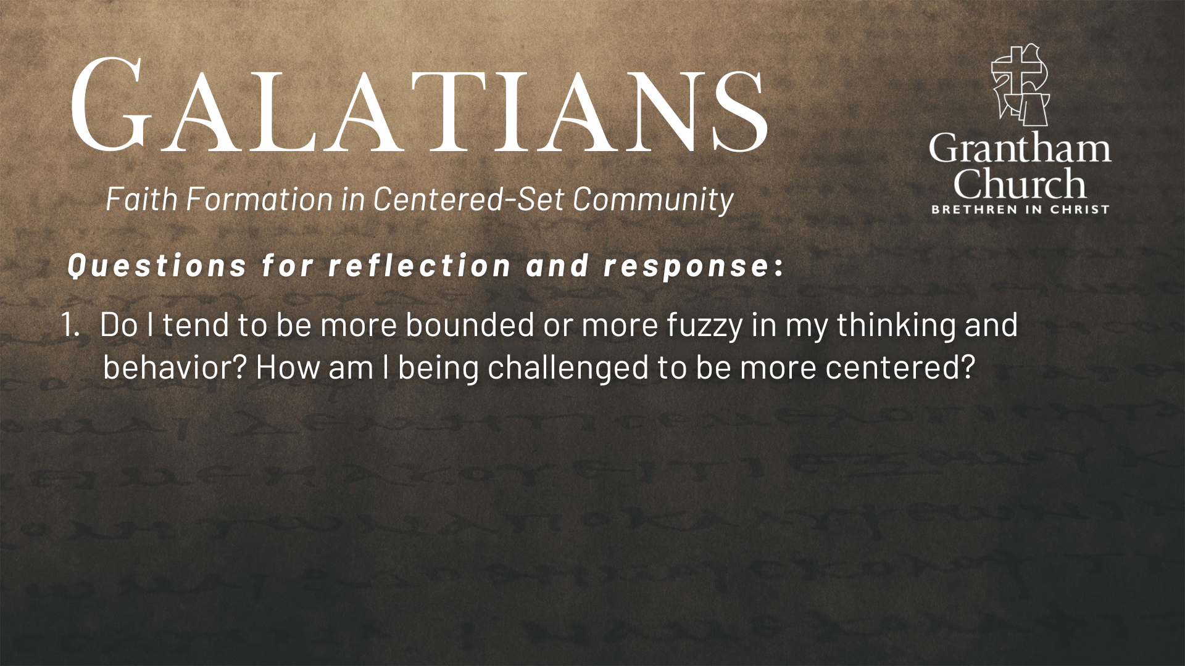

Slide 21
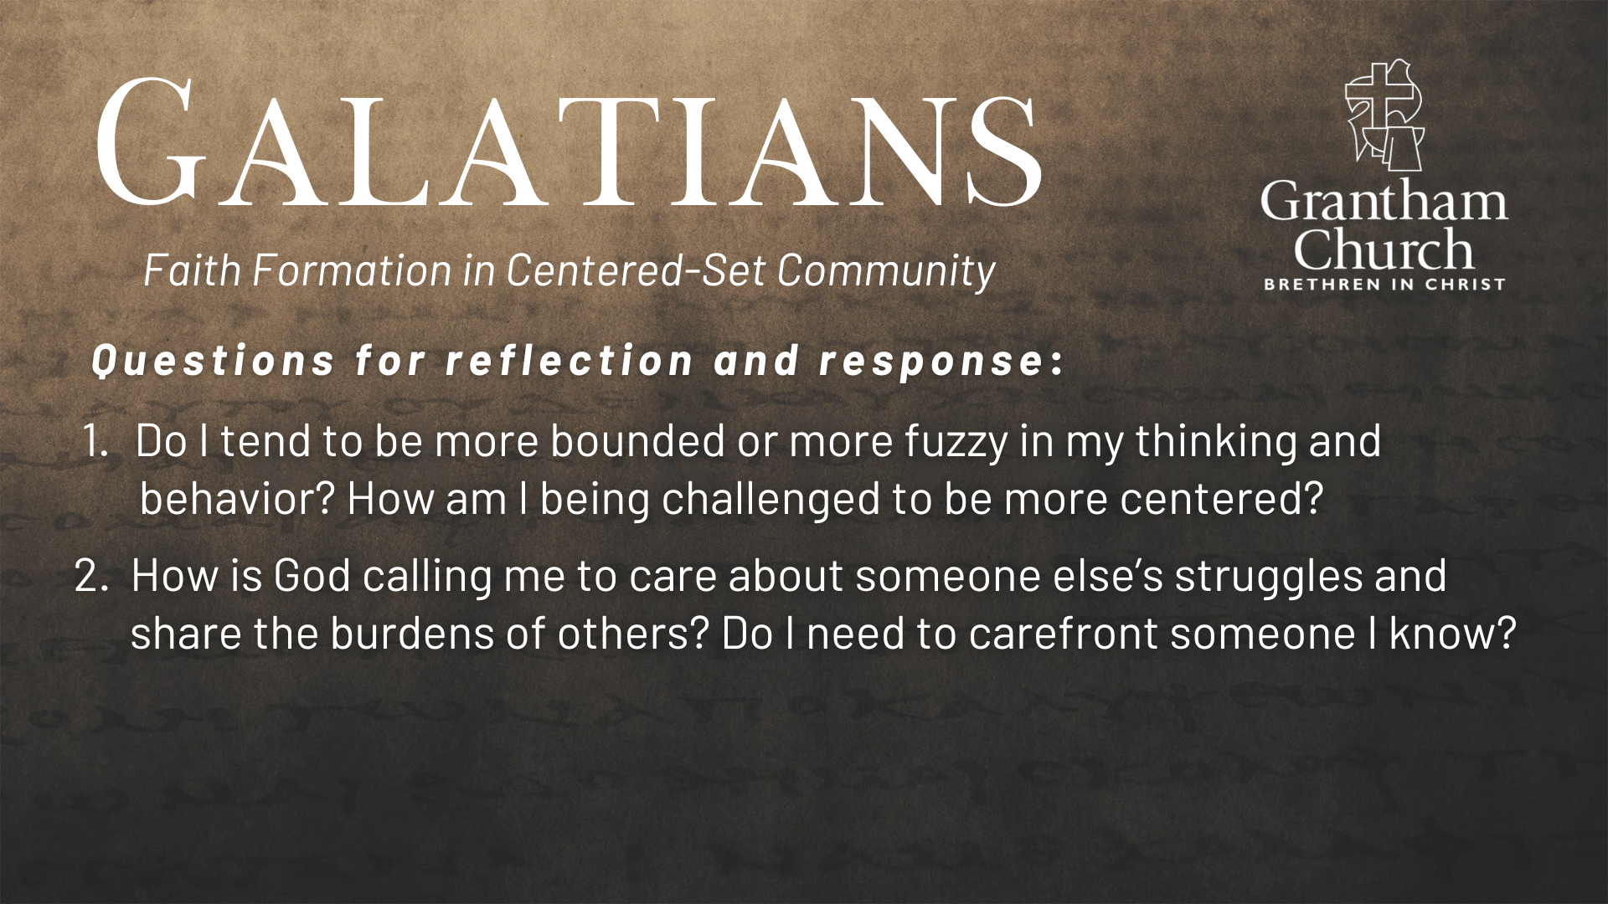

Slide 22
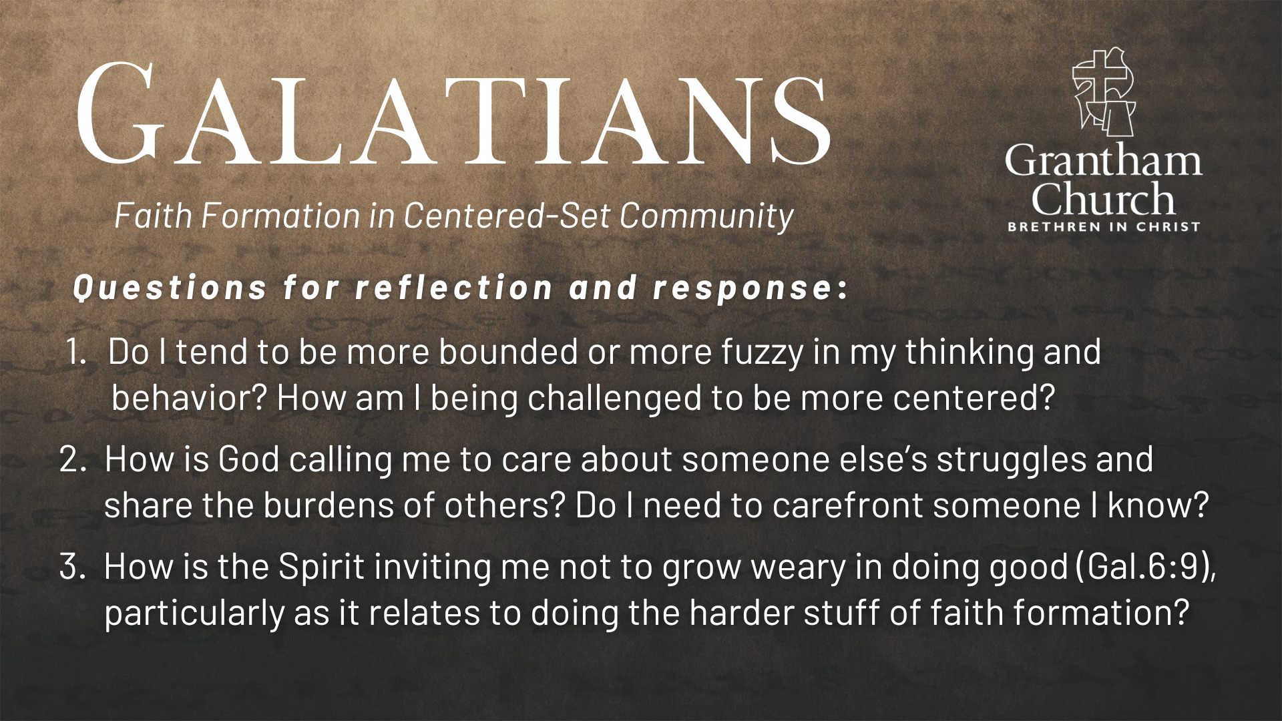
Notes:
[READ & BRIEF COMMENT ON EACH QUESTION]
Do I tend to be more bounded or more fuzzy in my thinking and behavior? How am I being challenged to be more centered?
How is God calling me to care about someone else’s struggles and share the burdens of others? Do I need to carefront someone I know?
How is the Spirit inviting me not to grow weary in doing good (Gal.6:9), particularly as it relates to doing the harder stuff of faith formation?
[CLOSING WORDS]
Let’s pray… [NEXT SLIDE FOR CLOSING PRAYER]

Slide 23

Notes:
[CLOSING PRAYER]
[RESPONSE SONGS]
Announcement: Holy Week Opportunities
Benediction
Brothers and sisters, we’ve been saved by grace through faith to be formed in Christ-centered community. May you only boast in the cross of our Lord Jesus Christ, for we have been freely given (not earned) Gods love and favor. Now let us go and extend that same gift of grace to others—in the church and in the world. In the name of the Father, and of the Son, and of the Holy Spirit. Amen.

