Slide 1

Notes:
[BRIEF INTRO]
Greetings
Second Sunday of Lent
Our series: Seeking God’s Ways
And here are our theme verses for our series… [NEXT SLIDE]

Slide 2

Scripture Reading
Isaiah 55:6-9 NLT
Notes:
[READ ISAIAH 55:6-9 NLT]
In our Lenten series, Seeking God’s Ways, we are exploring the “higher” ways of God so that we might repent of our own way, believe the gospel, and ready our hearts for the cross and the empty tomb.
Last Sunday we looked at how we move from security to generosity. In today’s message we’re being invited to move… [NEXT SLIDE]

Slide 3

Notes:
[BRIEF COMMENTS]
From Fear to Compassion
In this second message… we’re going to reflect on how the Scriptures tell us that we were created by a forgiving God who is gracious and compassionate, slow to anger and abounding in love. And it should come as no surprise that we see this most clearly in the person of Jesus who invites us to know his love and freely share his compassion with others as we testify to the goodness of God and the power of the gospel.
But, if we’re going to embrace his higher way (as we will see this morning), we cannot live in fear.
So, before we go any further… let’s prepare our hearts to receive a word from the Lord.
[BRIEF PRAYER]
[GO TO NEXT SLIDE AFTER PRAYER]

Slide 4

Notes:
In his Brazos Commentary on the Gospel of Matthew, the ethicist Stanley Hauerwas shares a story from the life of Clarence Jordan who lived in Georgia back in the 1950s:
“Jordan led Koinonia, a group of people committed to racial integration living as an intentional farming community in Americus, Georgia. When his religious community experienced some legal problems, Jordan approached his brother, Robert Jordan, who was a lawyer, for help. Robert refused to give aid, for he believed his helping Koinonia might harm his law practice and his political aspirations.”
“Clarence pointed out that the two brothers had joined the Baptist church on the same Sunday when they were boys and answered affirmatively the same questions about Jesus being their Lord and Savior. Clarence’s brother told him, “I follow Jesus, Clarence, up to a point.” Clarence replied, “Could that point by any chance be—the cross?” The brother said back, “That’s right. I follow him to the cross, but not on the cross. I’m not getting myself crucified.”
Clarence said, “Then I don’t believe you’re a disciple. You’re an admirer of Jesus, but not a disciple of his. I think you ought to go back to the church you belong to, and tell them you’re an admirer not a disciple.” Robert said, “Well now, if everyone who felt like I do did that, we wouldn’t have a Church, would we?
“Then the question is…” Clarence said, “‘Do you have a church?’”
This story challenges us in several ways:
It begs the question, “Are we willing to take up our cross and follow Jesus?”
If the church isn’t about embodying the faith and love of Jesus, then we’re not the church.
And we see that fear keeps us from living into the gospel and the compassion of Jesus.
I’m guessing you would agree with me when I say that that fear has a firm grip on many of us today, certainly for us Americans. In his book, Love Over Fear, Dan White writes… [NEXT SLIDE]

Slide 5

“When life is uncertain, when civilization seems unstable, fear is our first instinct. We huddle, we hunker down, we hide, we begin to hate the world. We seek the security of locked doors, gated communities, suspicious thoughts about others, talking through technology, impenetrable border walls, club memberships, and spending $500 billion annually on defense systems. I think Jesus knew something about us that we don’t know about ourselves—we think and do a lot of stuff out of fear.”
Notes:
[BRIEF COMMENT]
Maybe you could add a few more things to Dan’s list. What might those things be?
So, why do we do this? What is happening within us that we act of our fear? [NEXT SLIDE]

Slide 6
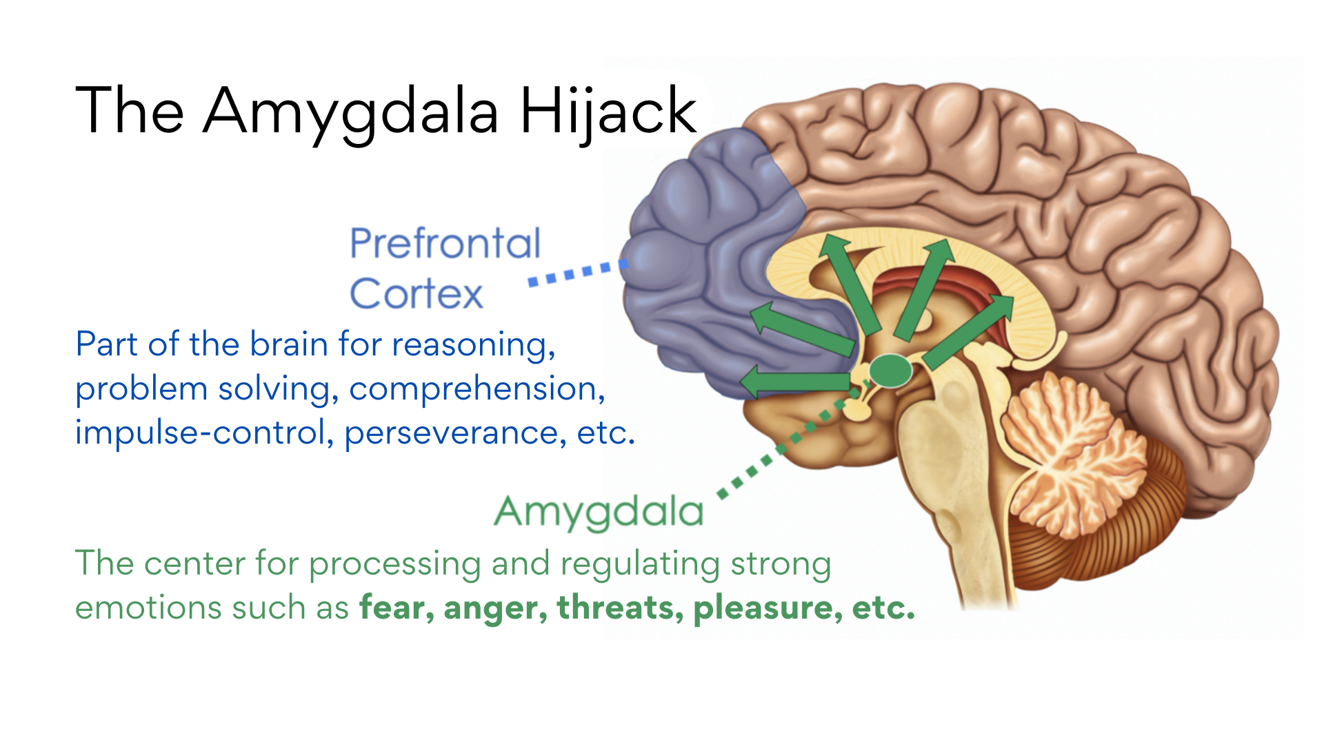
Notes:
[BRIEF COMMENTS ON IMAGE]
There are several parts to the human brain. Let’s look at two: The amygdala and the prefrontal cortex.
The amygdala is the center for processing and regulating strong emotions (e.g., fear, anger, feelings of threat and danger, etc.)—it is the ”fight or flight” center that was especially helpful in the stone age during the nomadic, hunter-gatherer days—it is the most primitive part of the brain
The prefrontal cortex developed later and it’s associated with higher, more complex brain functioning to help us reason, solve problems, control our impulses, have empathy, practice patience, do theology, and so forth. This part of the brain is necessary for rising above our fears.
But you see lots of folks live out of their amygdala and it tends to “hijack” the rest of the brain because it takes intentional effort not to keep feeding it. But the reason we keep feeding it is because when we do it produces dopamine and serotonin (like a drug) as a reward.
And folks, the media, politicians, and American corporations have figured this out. What makes money, increases ratings, and gets votes? A steady diet of fear! Real and imagined.
And we really need to reflect on this. And then remember that the most oft-repeated command in the Bible is: ”Do not be afraid” – It is said over 200 times in the Bible! That’s because it’s bad for you, and as Paul wrote to Timothy, “God has not given us a spirit of fear, but a spirit of power, love, and self-discipline” (2 Tim 1:7). Therefore, if we’re going to have any chance of surviving the hijacking of our amygdala, and not be overcome by our fears, then we must change our thinking and our modus operandi. And the place we start is with our portrait of God. We must see God as he truly is and allow his Spirit to transform us by it.
So, who is God? And how does this God change us and free us from our fears? After having spent time with Jesus during his life and ministry, the disciple John wrote… [NEXT SLIDE]

Slide 7
1 John 4:17-18 MSG
God is love. When we take up permanent residence in a life of love, we live in God and God lives in us. This way, love has the run of the house, becomes at home and mature in us, so that we’re free of worry on Judgment Day—our standing in the world is identical with Christ’s. There is no room in love for fear. Well-formed love banishes fear. Since fear is crippling, a fearful life—fear of death, fear of judgment—is one not yet fully formed in love.
Notes:
[BRIEF COMMENT ON PASSAGE]
v. 18 – NIV – “there is no fear in love because perfect love drives out fear.”
And who is that perfect love? Because it’s a Who not a what. That perfect love is God himself. And so, think with me how the Bible describes this God who is love. [NEXT SLIDE]

Slide 8
The Compassion of God in the OT
“The LORD, the LORD, the compassionate and gracious God…” Exodus 34:6
“But you are a forgiving God, gracious and compassionate, slow to anger and abounding in love… Because of your great compassion you did not abandon [your people] in the wilderness.” Nehemiah 9:16-21
רַח֖וּם (rakhum) adj. – compassionate; (rakhamim) n. – compassion
Both words are related to the Hebrew word for “womb”—indicating an intense emotion within God, like a mother’s love for her child
God is “deeply moved” with affection toward his children—“Can a woman forget her nursing child, or show no compassion for the child of her womb? Even if they forget, yet I will not forget you.” Isaiah 49:15
Notes:
[BRIEF COMMENT ON EACH POINT]
And then we see this even more clearly in Jesus—who is God in the flesh. [NEXT SLIDE]

Slide 9
The Compassion of God in the NT
“When [Jesus] saw the crowds, he had compassion on them, because they were harassed and helpless, like sheep without a shepherd.” Matt 9:36
“Filled with love and compassion, he ran to his son, embraced him, and kissed him.” Luke 15:20 – Parable of the Prodigal Son/Compassionate Father
Σπλαγχνίζομαι (splangchnizomai) v. – to have compassion, literally to be moved in the gut to act lovingly with empathy and affection
The English word “compassion” comes from the Latin compassio, formed by two words “com”- with/together and “passio”- to suffer
Literally compassion means to “suffer with” someone and enter into solidarity with their pain, e.g., “Then a despised Samaritan came along, and when he saw the man, he felt compassion for him.” Luke 10:33
Notes:
[BRIEF COMMENT ON EACH POINT]
That’s what beholding the compassion of God does for us. It compels us to act compassionately. Author and pastor Fredrick Buechner describes what it means to have compassion in this way. He said, "Compassion is sometimes the fatal capacity for feeling what it is like to live inside somebody else’s skin. It is the knowledge that there can never really be any peace and joy for me until there is peace and joy finally for you too.”
In other words, compassion acts. Compassion gets involved. Compassion motivated by love, not fear. And so, to act out of compassion, we must experience the compassion of God and ask the Lord to cast out the fear with his perfect love. Therefore, I want to invite you to do that today by seeing God in Jesus calming the storm in Luke 8:22-25. [NEXT SLIDE]

Slide 10
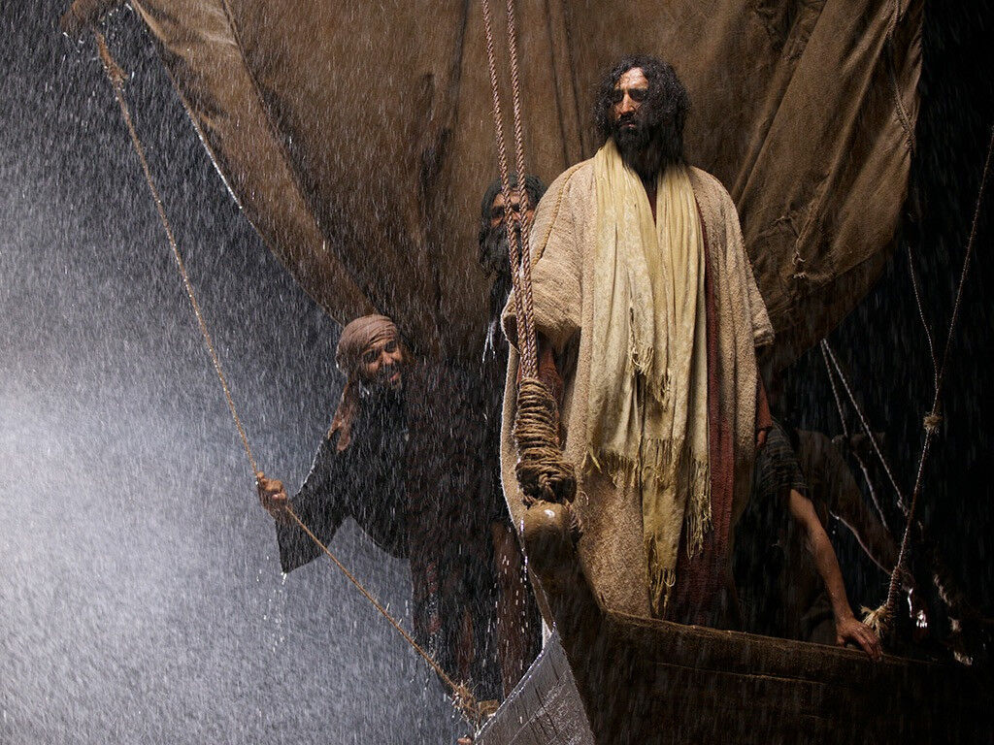
Luke 8:22-25 NLT
Notes:
[READ PASSAGE & COMMENT] – Luke 8:22-25 NLT
²² One day Jesus said to his disciples, “Let’s cross to the other side of the lake.” So they got into a boat and started out. ²³ As they sailed across, Jesus settled down for a nap. But soon a fierce storm came down on the lake. The boat was filling with water, and they were in real danger.
²⁴ The disciples went and woke him up, shouting, “Master, Master, we’re going to drown!”
When Jesus woke up, he rebuked the wind and the raging waves. Suddenly the storm stopped and all was calm. ²⁵ Then he asked them, “Where is your faith?”
The disciples were terrified and amazed. “Who is this man?” they asked each other. “When he gives a command, even the wind and waves obey him!”
That’s right. Because Jesus—full of faith and willing to share his faith for those who have none—not only has power over the storms as the Son of God. But also as the Son of Compassion. [NEXT SLIDE]

Slide 11
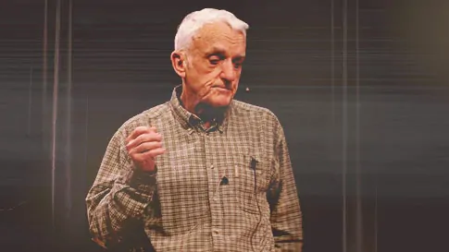
Brennan Manning
1934-2013
Notes:
Brennan Manning shared these words at an even over 20 years ago:
“The compassion of Jesus is the compassion of Almighty God, and Jesus says to your heart and mind, ‘Don’t ever be so foolish as to measure my compassion for you in terms of your compassion for one another. Don’t ever be so silly as to compare your thin, pallid, wavering, moody, depending on smooth circumstances human compassion with mine, for I am God, as well as man.’
When you read in the Gospels that Jesus was moved with compassion, it is saying that His gut was wrenched, His heart torn open, and the most vulnerable part of his being laid bare. The ground of all being shook, the source of all life trembled, the heart of all love burst open, and the unfathomable depths of the relentless tenderness was laid bare.
Your Christian life and mine don’t make any sense unless in the depth of our beings we believe that Jesus not only knows what hurts us, but knowing, seeks us out whatever our poverty, whatever our pain. His plea to His people is, ‘Come now, wounded, frightened, angry, lonely, empty, and I’ll meet you where you live. And I’ll love you as you are, not as you should be, because you’re never going to be as you should be.’
Do you really believe this? With all the wrong turns you made in your past… the mistakes, the moments of selfishness, dishonesty and degraded love? Do you really believe that Jesus Christ loves you? Not the Person next to you, not the church, not the world. But that He loves you—beyond worthiness and unworthiness, beyond fidelity and infidelity. That he loves you in the morning sun and in the evening rain. Without caution, regret, boundary, limit. No matter what’s gone down, He can’t stop loving you. This is the Jesus of the Gospels.”
And as the apostle Paul once wrote, “Nothing will ever separate you from his love.”
And so, brothers and sisters, when you begin really come into that love and know the compassion of Jesus for yourself… you will be compelled to live out of it, by it, and for the sake of others. And that high will be much greater than the dopamine rush you get from watching Fox, CNN, MSNBC, or other news outlets. It’s then that you will understand why Jesus told his disciples… “NEXT SLIDE]

Slide 12
“You must be compassionate, just as your Father is compassionate.”
Luke 6:36 NLT
Notes:
[BRIEF COMMENT ON PASSAGE]
And it’s why other NT authors wrote to the early churches, saying… [NEXT SLIDE]

Slide 13
“Be kind and compassionate to one another, forgiving each other, just as in Christ God forgave you.” Ephesians 4:32
“Therefore, as God’s chosen people, holy and dearly loved, clothe yourselves with compassion, kindness, humility, gentleness and patience. Bear with each other and forgive one another if any of you has a grievance against someone. Forgive as the Lord forgave you.” Colossians 3:12-13
“Summing up: Be agreeable, be sympathetic, be loving, be compassionate, be humble. That goes for all of you, no exceptions. No retaliation. No sharp-tongued sarcasm. Instead, bless—that’s your job, to bless. You’ll be a blessing and also get a blessing.” 1 Peter 3:8-9 MSG
Notes:
[READ & BRIEF COMMENTS]
Finally, here are some questions for reflection and to help us respond to the Spirit… [NEXT SLIDE]

Slide 14

Questions for reflection and response:
Notes:
[BRIEF COMMENT ON EACH QUESTION]
[BRIEF MOMENT OF SILENCE]
To close this message, please join me in this responsive prayer… [NEXT SLIDE]

Slide 15
Questions for reflection and response:
What fears are robbing you of peace and stopping God’s love from being “at home and mature” in you?
Notes:
[BRIEF COMMENT ON EACH QUESTION]
[BRIEF MOMENT OF SILENCE]
To close this message, please join me in this responsive prayer… [NEXT SLIDE]

Slide 16
Questions for reflection and response:
What fears are robbing you of peace and stopping God’s love from being “at home and mature” in you?
How are those fears keeping you from being guided and led by God’s higher way of love and compassion for others?
Notes:
[BRIEF COMMENT ON EACH QUESTION]
[BRIEF MOMENT OF SILENCE]
To close this message, please join me in this responsive prayer… [NEXT SLIDE]

Slide 17
Questions for reflection and response:
What fears are robbing you of peace and stopping God’s love from being “at home and mature” in you?
How are those fears keeping you from being guided and led by God’s higher way of love and compassion for others?
How is the Spirit inviting you to move toward compassion today?
Notes:
[BRIEF COMMENT ON EACH QUESTION]
[BRIEF MOMENT OF SILENCE]
To close this message, please join me in this responsive prayer… [NEXT SLIDE]

Slide 18
One: Your Ways, O God, are higher than our ways.
All: Your thoughts are higher than our thoughts.
One: We seek God’s ways.
All: Lord, move us from our fears and into the light of your loving compassion.
One: As we walk with Christ on this Lenten journey, let us see your way more clearly.
All: and follow your way more faithfully. Amen.
Notes:
[PRAY THE RESPONSIVE PRAYER]
[GO TO FINAL SLIDE]

Slide 19
Notes:
BENEDICTION:
Brothers and sisters, from this time and place into whatever awaits, may you follow God’s way of compassion. May the embrace of Jesus and the gospel ease your fears and encourage you to care for others. As you go, know that our God of the wilderness remains with you on the way.
Now go in peace, to love and serve the Lord.

