Slide 1

Notes:
[BRIEF INTRO]
Sundays before Lent / stand-alone messages
Sun, Dec 31 – congregational exercise & responses
“With God’s help in 2024, I will stop… I will start…”
I’m addressing the most repeated responses we received
Last Sunday we looked at anxiety; a message called, Winning the War on Worry
Another common response had to do with work, how we’re spending our time, the need to set boundaries, and rest.
And so, as you can see, today’s message is entitled, Work & Rest in the Way of Jesus
[BRIEF PRAYER]
If you have a Bible, please open up to our main Scripture reading… [NEXT SLIDE]

Slide 2
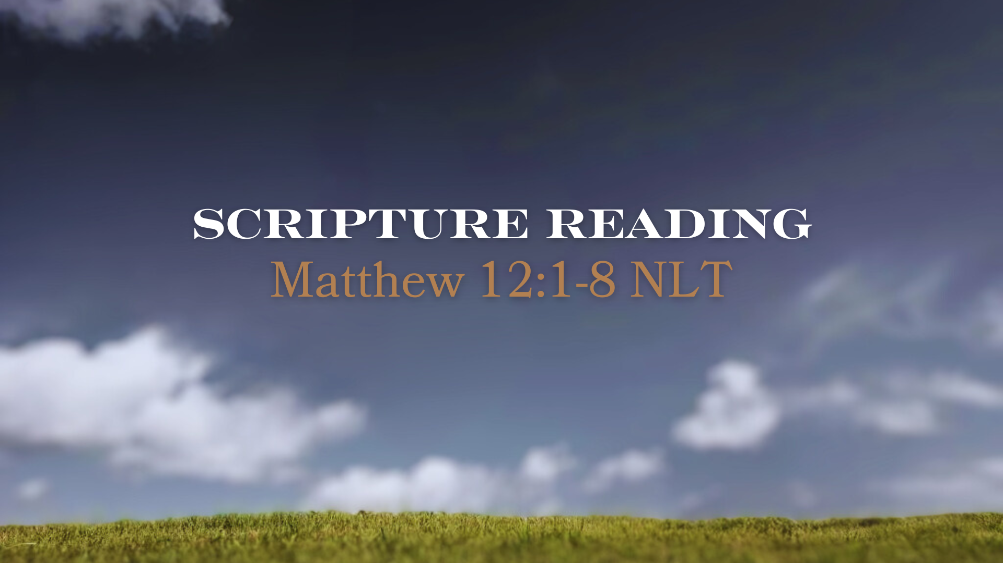
Notes:
[INVITE CONGREGATION TO STAND FOR SCRIPTURE READING]
[READ PASSAGE]
“This is the Word of the Lord…. You may be seated.” [NEXT SLIDE]

Slide 3
Notes:
[BRIEF COMMENTS]
Delivering groceries to a Pharisee
The legalist pastor who mowed his lawn in a suit on Sundays
What is Sabbath and what does it mean to honor it, keep it holy, and to rest? And if we’re going to talk about rest, shouldn’t we also say something about what it means to work? Post-pandemic it seems like there a lot of folks who don’t want to work today. But isn’t it good to work? Doesn’t the Bible say something about that? And what should a healthy rhythm of work and rest look like?
Let’s begin by looking at what the Bible says about work… [NEXT SLIDE]

Slide 4
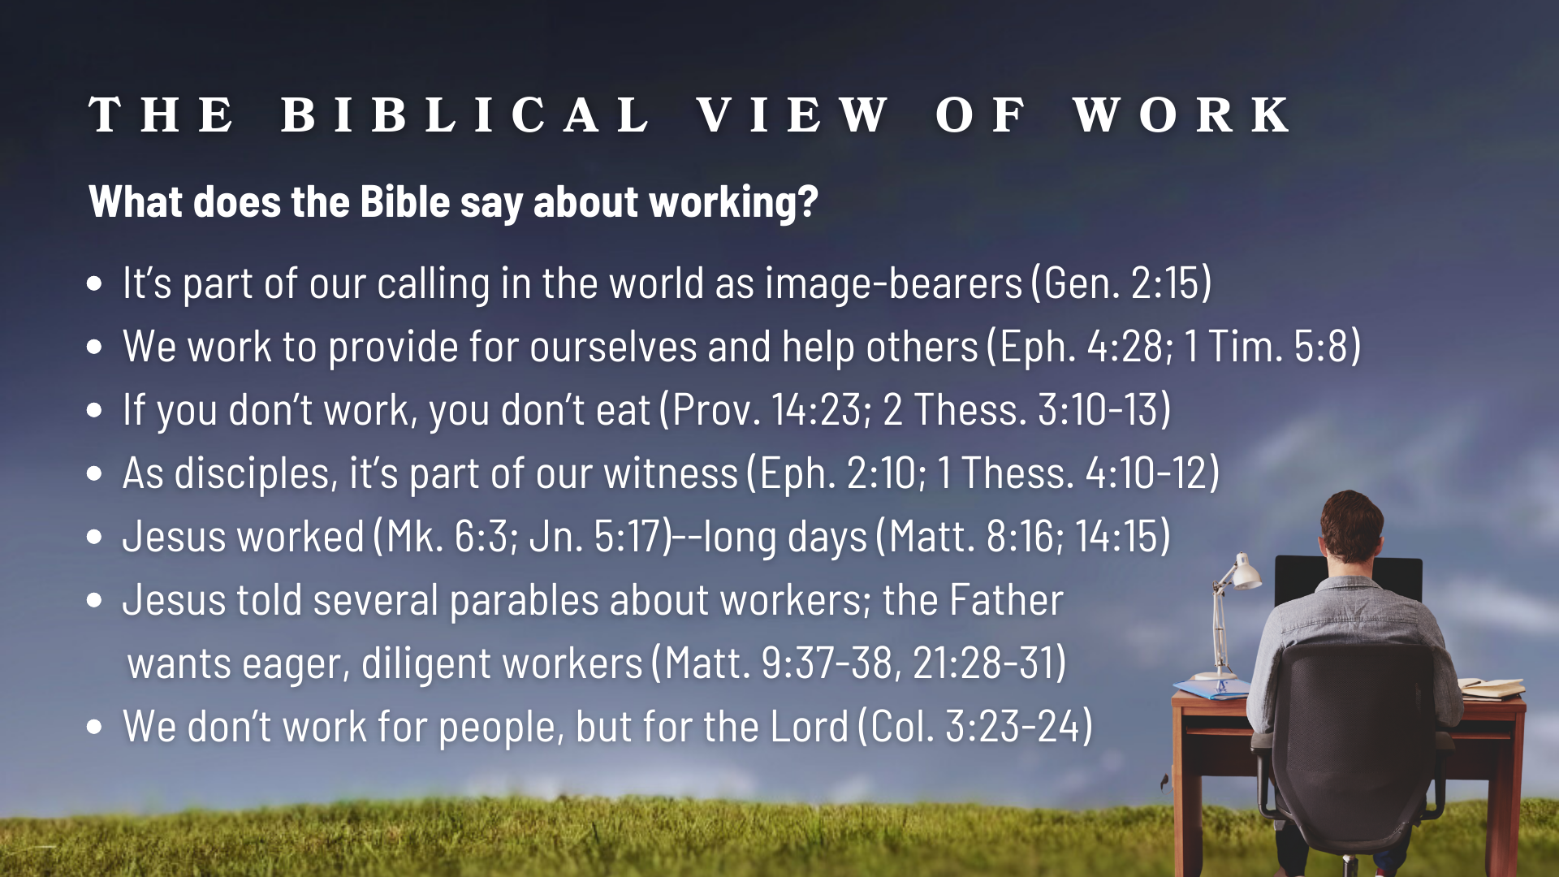
Notes:
[BRIEF COMMENT ON EACH POINT]
It’s part of our calling in the world as image-bearers (Gen. 2:15)
We work to provide for ourselves and help others (Eph. 4:28; 1 Tim. 5:8)
If you don’t work (and you can work), you don’t eat (Prov. 14:23; 2 Thess. 3:10-13)
As disciples, it’s part of our witness (Eph. 2:10; 1 Thess. 4:10-12)
Jesus worked (Mk. 6:3; Jn. 5:17)--long days (Matt. 8:16; 14:15)
Jesus told several parables about workers; the Father wants eager, diligent workers (Matt. 9:37-38, 21:28-31); it’s a Kingdom work ethic to work hard, do our best, and do it for the Lord
We don’t work for people, but for the Lord (Col. 3:23-24)
Listen to what the Apostle Paul wrote in Colossians… [NEXT SLIDE]

Slide 5
“Whatever you do, work at it with all your heart, as working for the Lord, not for human masters, since you know that you will receive an inheritance from the Lord as a reward. It is the Lord Christ you are serving.”
Paul, Colossians 3:23-24 NIV
Notes:
[READ PASSAGE & COMMENT BRIEFLY]
So, work is good. And we should work hard on behalf of the Lord for the glory of God. But we also must be aware of the powers at work in the world that seek to make us slaves to our work, as well as other hobbies, commitments, activities and events that keep us so busy that it stifles our faith.
Stop and consider for a moment why many of us tend to be so busy… [NEXT SLIDE]

Slide 6
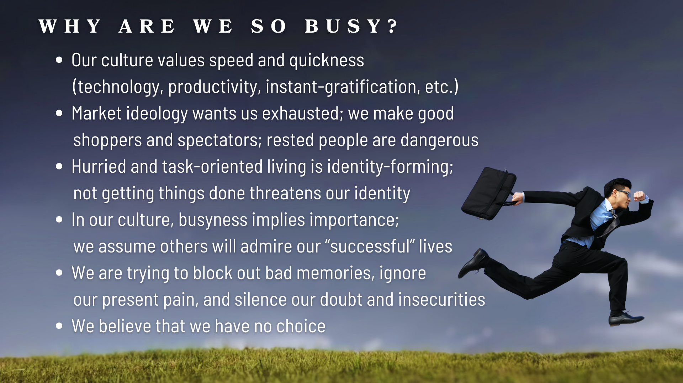
Notes:
[BRIEF COMMENT ON EACH POINT]
Our culture values speed and quickness (technology, productivity, instant-gratification, etc.)
Market ideology wants us exhausted; we make good shoppers and spectators; rested people are dangerous because we’re awake, alert, tuned-in to injustice and quick to respond to it
Hurried and task-oriented living is identity-forming; not getting things done threatens our identity
In our culture, busyness implies importance; we assume others will admire our “successful” lives
We are trying to block out bad memories, ignore our present pain, and silence our doubt and insecurities; we can stay busy so that we don’t have to think about the inner work we need to do
We believe that we have no choice—a sign of cultural captivity. That, my friends, is slavery.
In this book, Answering God, Eugene Peterson wrote… [NEXT SLIDE]

Slide 7
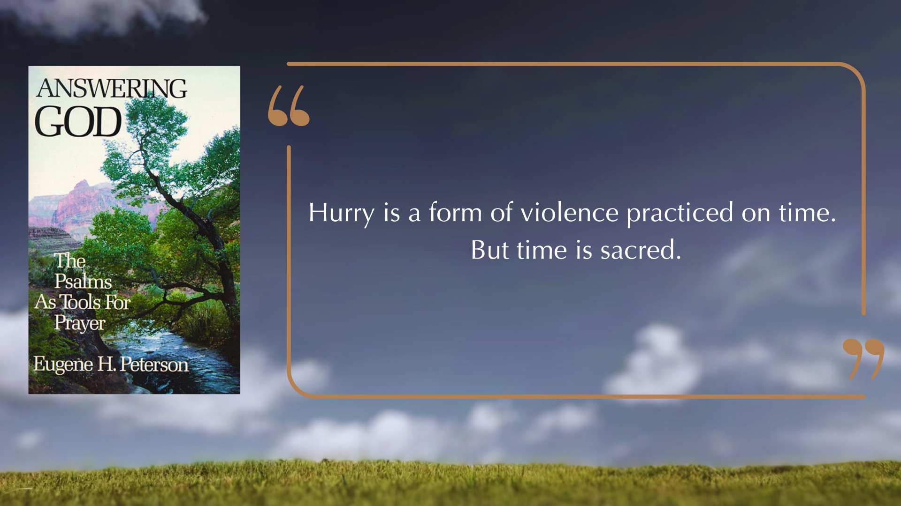
Notes:
[READ & COMMENT]
And one of the ways that God wants to help us understand the sacredness of time (and of a healthy work-rest rhythm) is through the Sabbath.
In Deuteronomy 5:12-15, the generation preparing to enter the Promised Land were reminded of this command given by God through Moses to his people… [NEXT SLIDE]

Slide 8
Deuteronomy 5:12-15 NIV
¹² “Observe the Sabbath day by keeping it holy, as the Lord your God has commanded you. ¹³ Six days you shall labor and do all your work, ¹⁴ but the seventh day is a Sabbath to the Lord your God. On it you shall not do any work… ¹⁵ Remember that you were slaves in Egypt and that the Lord your God brought you out of there with a mighty hand and an outstretched arm. Therefore, the Lord your God has commanded you to observe the Sabbath day.”
Notes:
[BRIEF COMMENTS]
v. 12 – What is Sabbath? Hebrew: Shabbat – “cease” or “desist” from work; Sabbath is Friday evening to Saturday evening for Jews; Sundays for most Christians (resurrection on Sun)
“keeping it holy” – means to dedicate it to God and protect it as a special day
v. 13-14 – again, to “cease” from work on Sabbath
v. 15 – “you were slaves in Egypt” – slaves work 7 days a week; But God did a miraculous work to free you from that bondage! First in outstretched hands over the Red Sea and then with outstretched hands on the cross. The Lord has set you free! You can hear it in the text. Do you don’t want to be a slave again? Well, OK, then. Then receive the Sabbath as a gift and observe it. Keep it holy.
Let’s think more deeply about the purpose of Sabbath… [NEXT SLIDE]

Slide 9
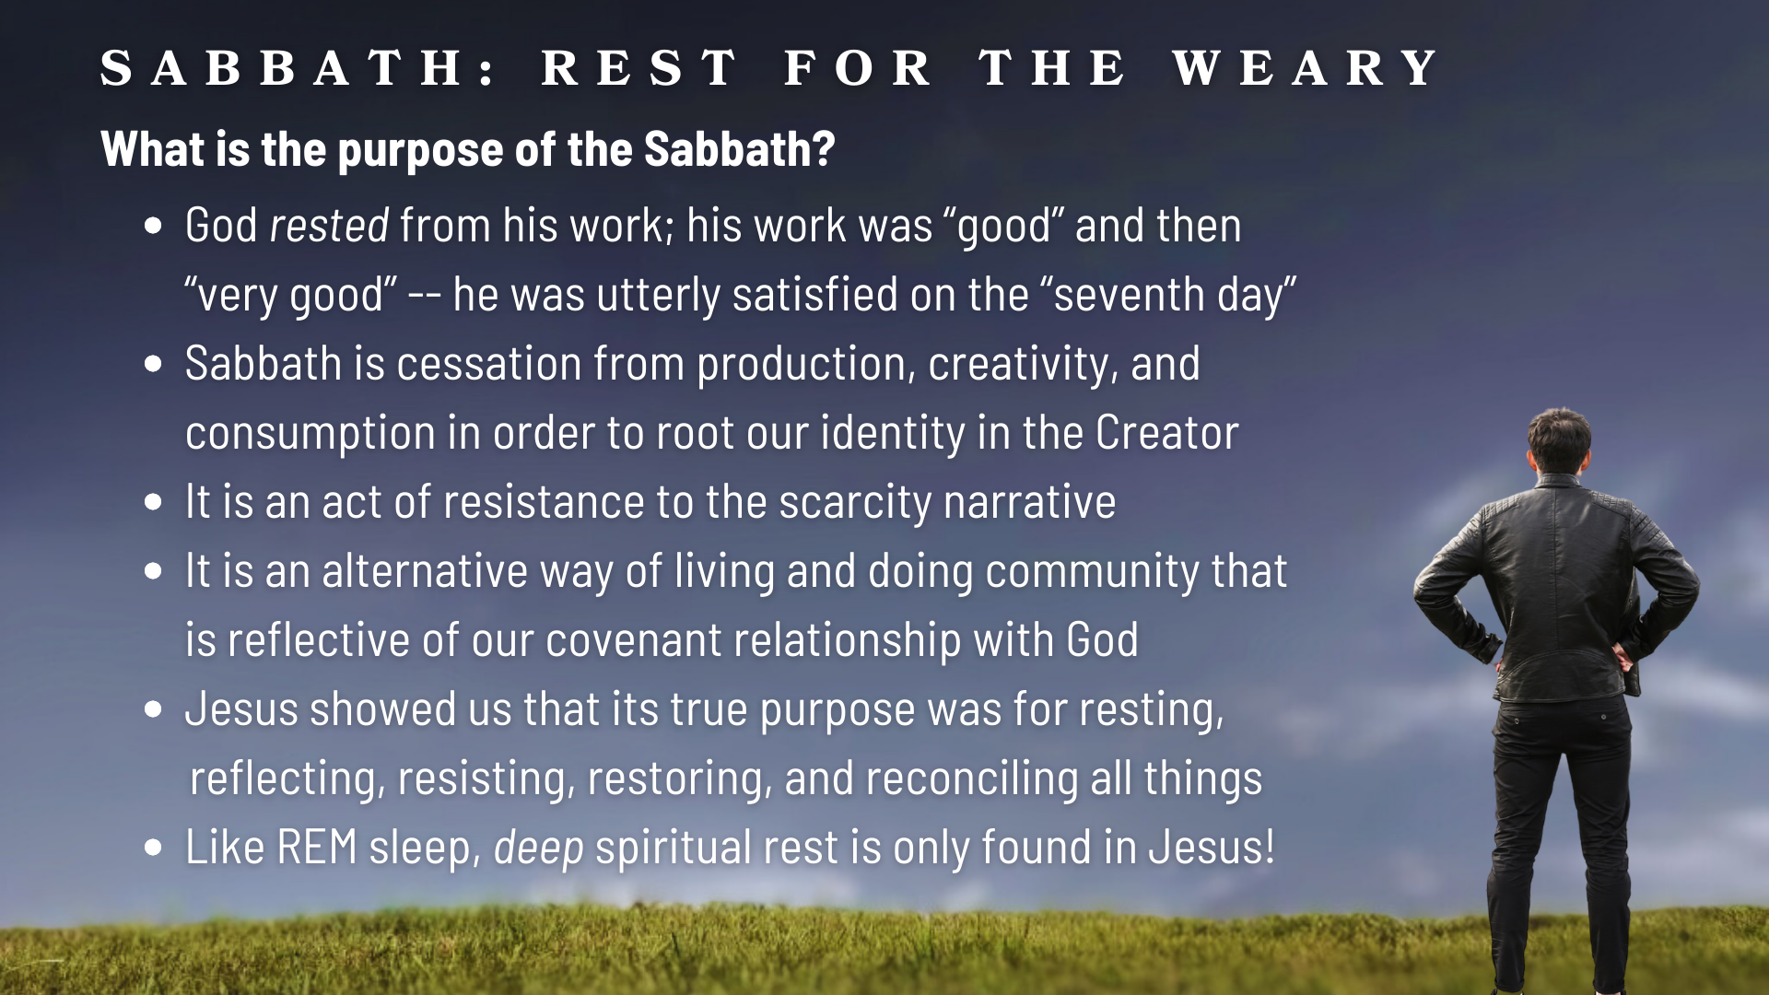
Notes:
[BRIEF COMMENTS ON EACH POINT]
God rested from his work; after each day of creation, he says that his work was “good”; then after the sixth and final day, it is “very good” -- he was utterly satisfied on the “seventh day”!
Sabbath is cessation from production at work, creativity in our work, and consumption throughout the week in order to root our identity in the Creator
It is an act of resistance to the scarcity narrative (i.e., “there is not enough” & “I’m not enough”)
It is an alternative way of living and doing community that is reflective of our covenant relationship with God; because we trust our Father to care and provide for us; Sabbath says we trust him!
Jesus showed us that the true purpose of Sabbath was for resting, creating space to reflect, for resisting the slave-driving powers of empire, restoring us & others, and reconciling all things
Like REM sleep, deep spiritual rest is only found in Jesus! You can’t take short naps in a 24-hr period that equals 6-8 hours of sleep and feel rested. Your body needs to go deeper in REM sleep after resting for several hours straight. And so it is with us spiritually. Sabbath is REM for the soul.
And listen to Jesus in Matthew 11 (before his confrontation with the Pharisees), because he tells us that he himself is that Sabbath rest… [NEXT SLIDE]

Slide 10
Matthew 11:28-30 NLT
Then Jesus said, “Come to me, all of you who are weary and carry heavy burdens, and I will give you rest. Take my yoke upon you. Let me teach you, because I am humble and gentle at heart, and you will find rest for your souls. For my yoke is easy to bear, and the burden I give you is light.”
Notes:
[READ & COMMENT ON PASSAGE]
Honoring the Sabbath doesn’t come by observing a bunch of rules and regulations, or by approaching this holy day legalistically, but rather by recognizing that it is a gift from God for us to enjoy and live freely. In Mark 2:27, Jesus said, “The Sabbath was made for man, not man for the Sabbath.” In other words, a Sabbath day’s rest should be lightening our load not increasing its weight. And don’t miss this… Jesus is saying that he is the very embodiment of Sabbath. Therefore, when you “cease” from work it is by resting in him that we truly honor and observe this day the way God intended.
Again, listen to the words of Jesus in Matthew 12, verse 8… [NEXT SLIDE]

Slide 11
“For the Son of Man is Lord of the Sabbath.”
Matthew 12:8 NLT
Notes:
[READ & COMMENT ON PASSAGE]
That means that Jesus (as the One who created it) shows us what to do with it. And what did he do on the Sabbath? Jesus worshipped on the Sabbath (Luke 4:16); taught on the Sabbath (Mark 6:2); healed people on the Sabbath (Matt 12:9-11), and he ate and drank on the Sabbath (Matt 12:1). He lived freely and treated the Sabbath as a glorious gift, not a restrictive, legalistic burden.
And we can see in the gospels, while Jesus worshipped at the designated time, his “Sabbath-rest” was not fixed to a day or time of the week. Instead, he created a healthy rhythm of work and rest.
How can we do that today as we navigate our modern times? [NEXT SLIDE]

Slide 12
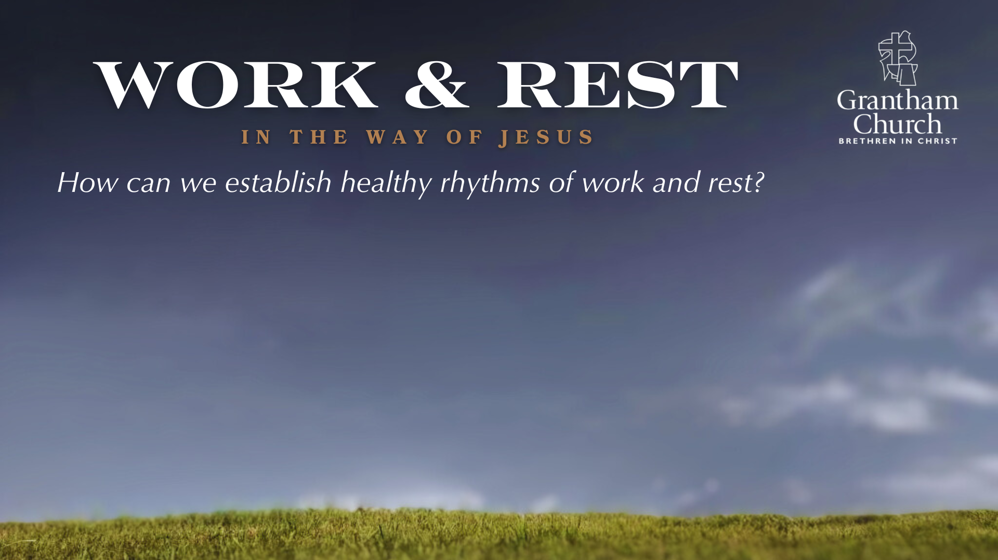

Slide 13
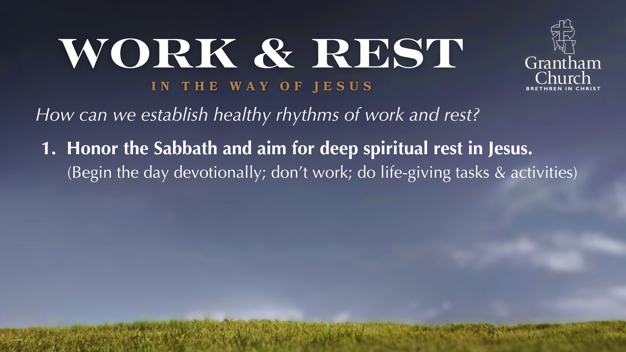

Slide 14
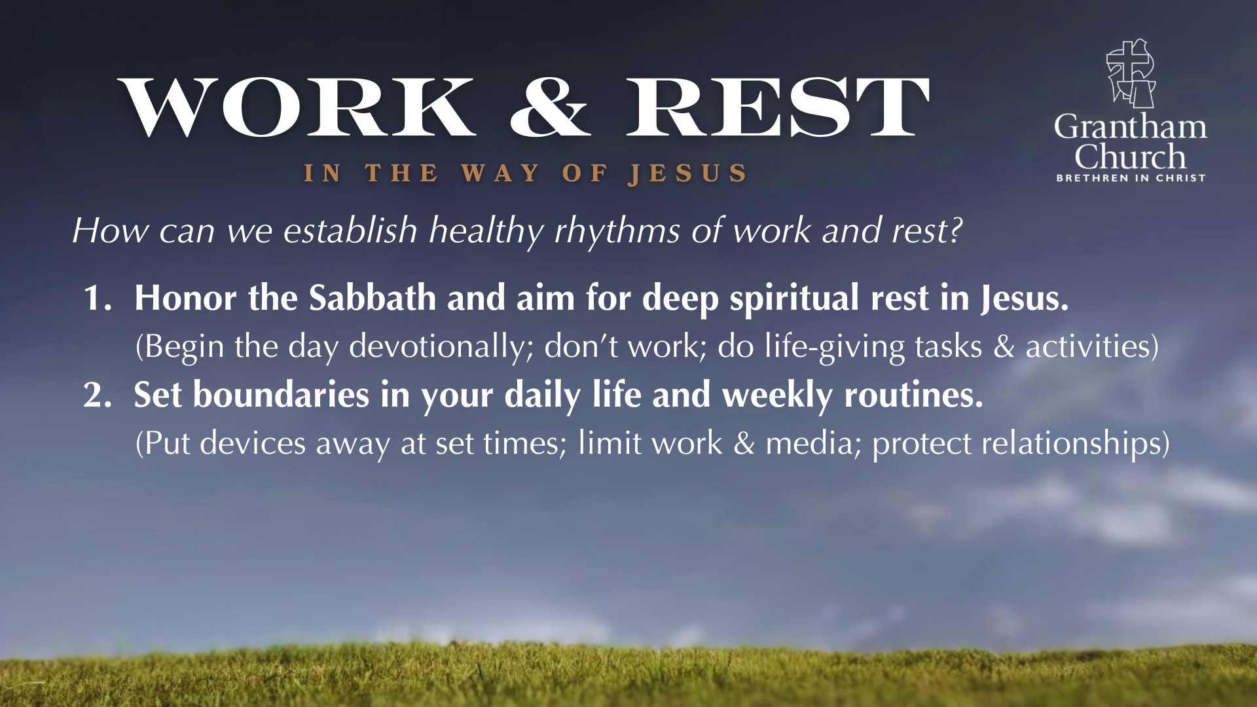

Slide 15
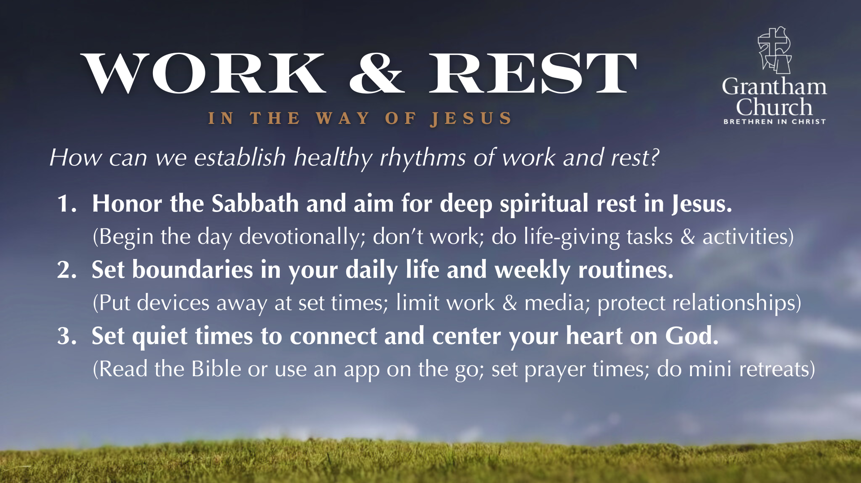

Slide 16
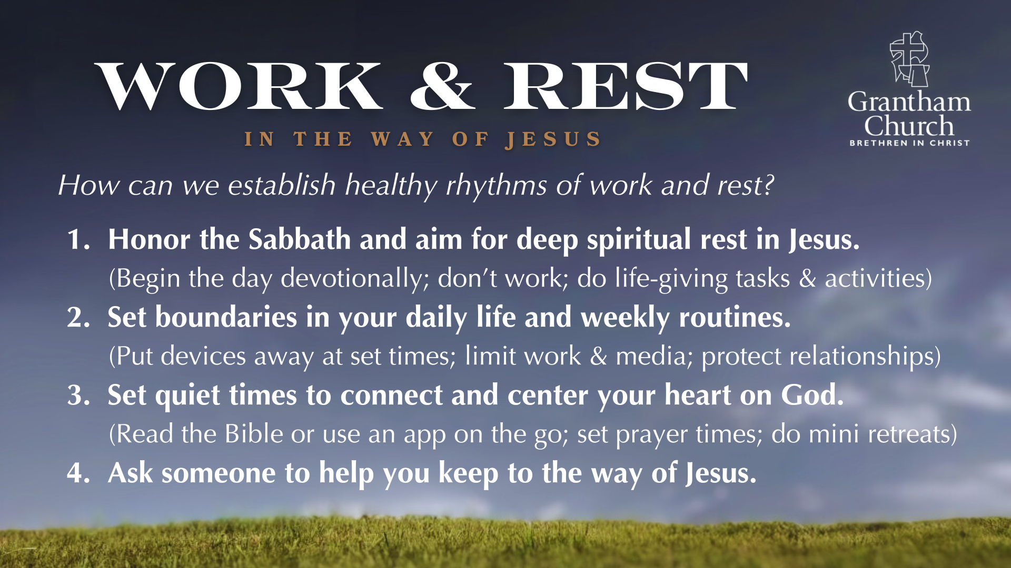
Notes:
[BRIEF COMMENTS ON EACH]
1. Honor the Sabbath and aim for deep spiritual rest in Jesus.
(Begin the day devotionally; don’t work; do life-giving tasks & activities)
2. Set boundaries in your daily life and weekly routines.
(Put devices away at set times; limit work & media; protect relationships)
3. Set quiet times to connect and center your heart on God.
(Read the Bible or use an app on the go; set prayer times; do mini retreats)
4. Ask someone to help you keep to the way of Jesus.
Finally, here are some questions to help us reflect on what God is saying to us and respond to the leading of the Holy Spirit… [NEXT SLIDE]

Slide 17
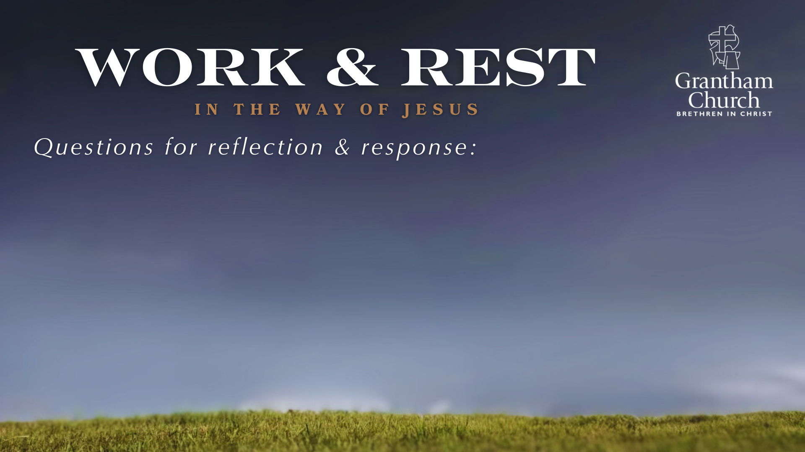

Slide 18
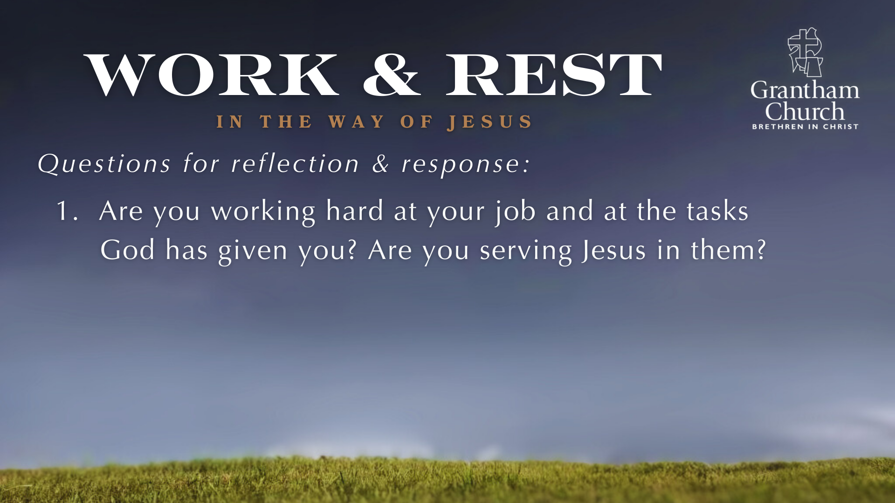

Slide 19
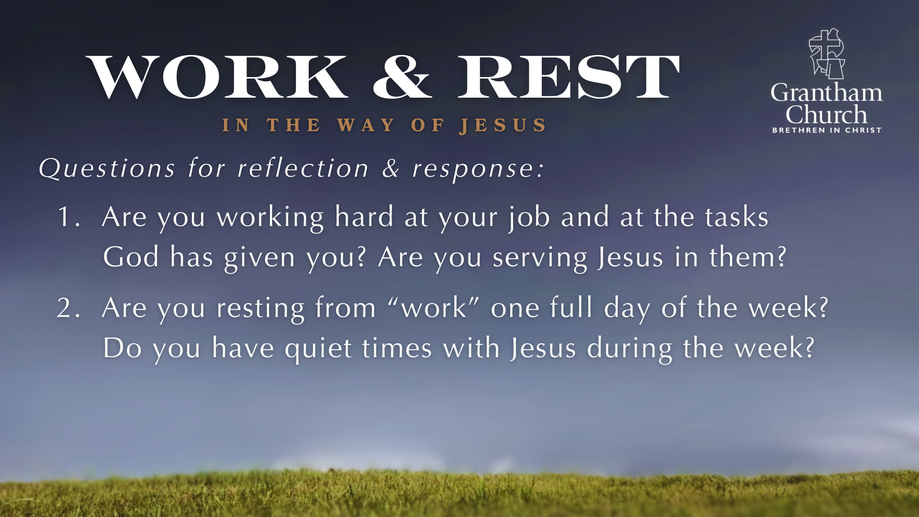

Slide 20
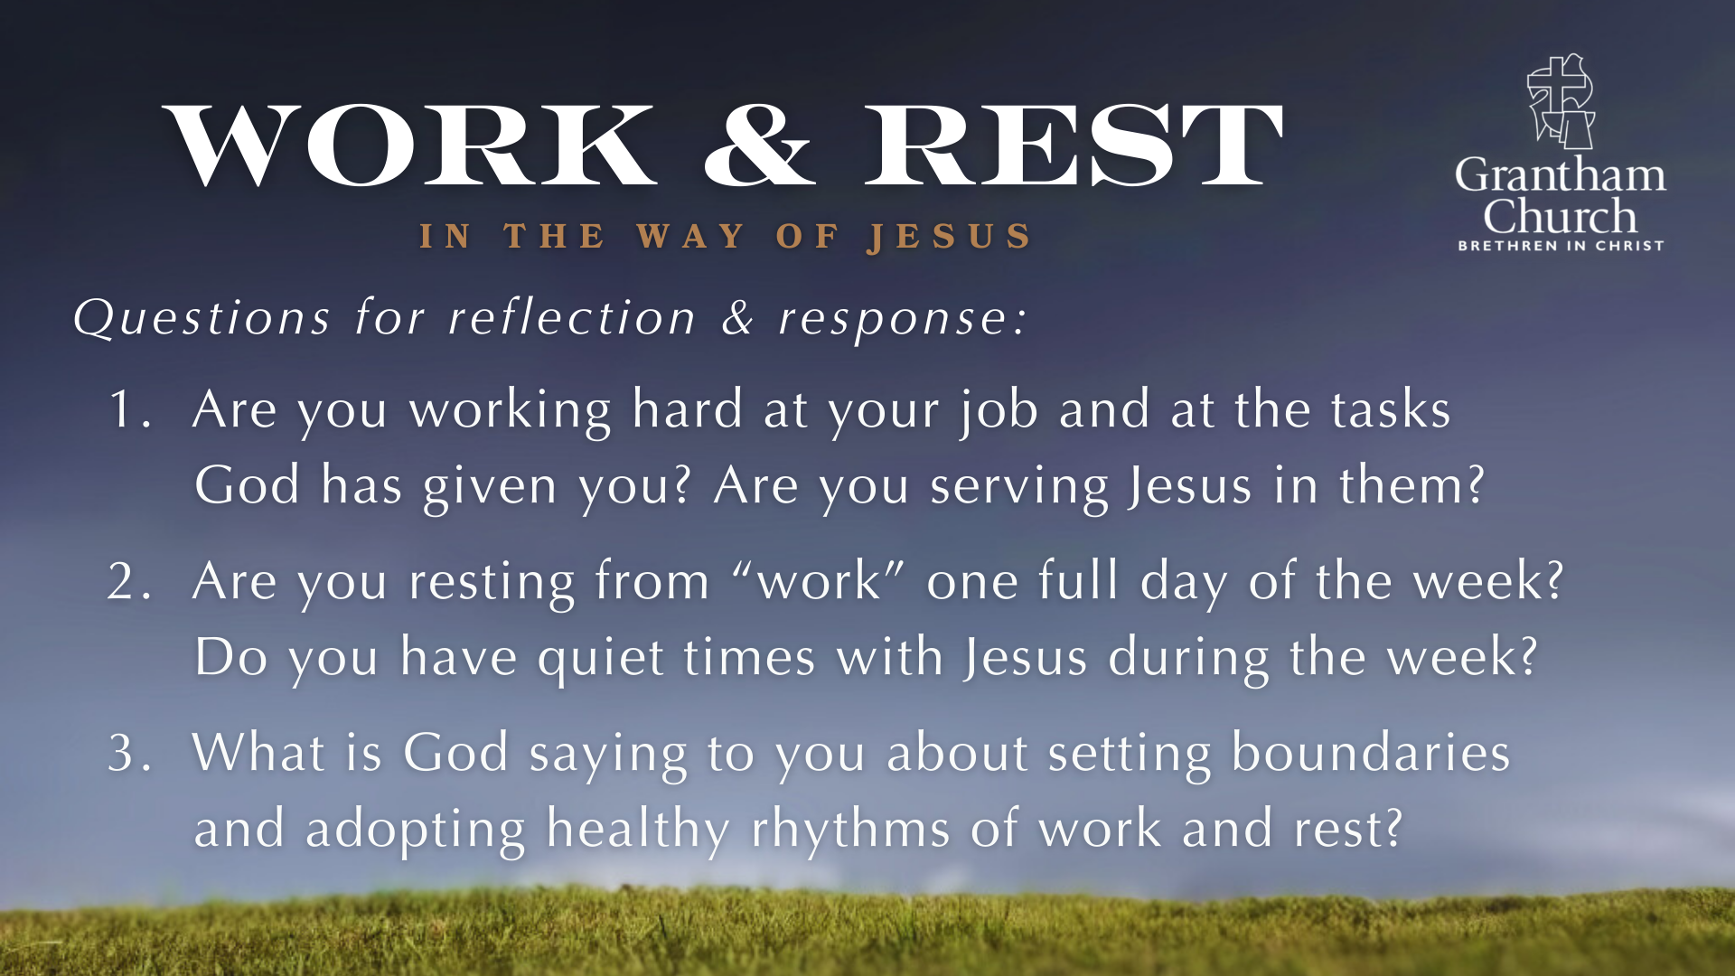
Notes:
[READ & COMMENT ON EACH QUESTION]
Are you working hard at your job and at the tasks God has given you? Are you giving it your very best? Are you serving Jesus in them?
Are you resting from “work” one full day of the week? Are you honoring and observing Sabbath rest in the way of Jesus? Do you have quiet times with Jesus during the week?
What is God saying to you about setting boundaries and adopting healthy rhythms of work and rest? Think about it this way: What is one thing you can do to set up a helpful boundary between work and rest? What can you do to get some REM rest in Jesus?
Brothers and sisters, let’s reflect on what we’ve heard, talk about it with a pastor, partner, or friend, and pray together about how the Lord wants us to slow down and experience true rest for our souls.
Let’s pray… [NEXT SLIDE FOR CLOSING PRAYER]

Slide 21

Notes:
[CLOSING PRAYER]
Benediction
In anxiety may you find peace
In sadness may you find comfort
In sickness may you find healing
In loneliness may you find community
In busyness may you find stillness
In listening may you find wisdom
In following may you find hope
And in the One who meets all our needs
May you find rest.
Go in peace, church, to love and serve the Lord. Amen.

