Slide 1

Notes:
There was once this guy… he was a good guy. He had lots of friends, a great family, and money in the bank. Until one day he lost everything. His loss was so great that it would be hard for anyone not to see what happened as divine punishment. But there was something this guy and all of his friends didn’t know. There was more going on than meets the eye. Unfortunately, he never got the answer to his question “Why did all of this happen to me?” but his experience did change his view of God. It did humble him and grow his faith. And it eventually led to restoration and blessing in his life.
Who am I talking about? That’s right. I’m talking about the epic story of Job, and a biblical book of wisdom that addresses the problem of evil and how we should live in light of its truths—what we are to understand when unexpected tragedies occur in our lives. That is our next stop in our Advent series, Unexpected: Waiting on God When Our Plans Fall Apart. Because if anyone knows about their plans falling apart… it’s Job. And to begin, I’d like to show you a video that captures Job’s story really well, and helps us to understand how the book of Job fits into the Wisdom literature of the Old Testament. So, let’s watch this creative summary of Job by The Bible Project, and then we will dig a little deeper into what this story teaches us: [NEXT SLIDE]

Slide 2

Notes:
[SHOW BIBLE PROJECT VIDEO]
What a story! So, we’ve listened to the unexpected events that befall Job, how he processed it, and how God responds. But before we revisit a few places in his life and think more deeply about what he experienced, I’d like to first address some misapplications that we often make from this story. Think with me about the lessons and theological truths that many have derived from Job, but are actually misguided and miss the whole point of Job’s story: [NEXT SLIDE]

Slide 3
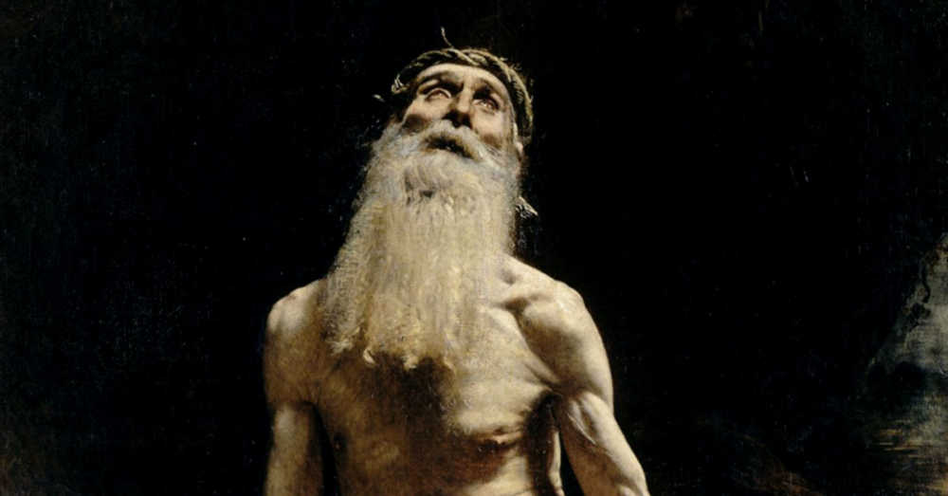
Breaking Bad Theology: Misusing Job’s Story in an Effort to Make Sense of Our Suffering
Everything bad that happens is because God wanted/allowed it.
God is the one who “takes” people away from us, i.e., causes their deaths.
Bad things happen because of something we’ve done or to teach us a lesson (e.g., death, divorce, pain hurricanes, pandemics, etc.
Notes:
[BRIEF COMMENTS ON EACH POINT]
Everything bad that happens is because God wanted or allowed it.
Someone might say, isn’t God “in control” and isn’t he sovereign over everything? And doesn’t Satan ask God permission to hurt Job and God gives it? So why isn’t it accurate to say that everything bad that happens is because God wanted or allowed it. Well, first, let’s think about this part of the story where the Satan, a renegade angel who is not part of the Divine Council, comes to God after having looked for proof on the earth that God is not just and worthy to be worshipped—evidence of what he himself already believes. This scene happens in the prologue of this ancient dramatic poem, and it’s important to know that it works in similar ways to a parable. We’re not meant to press for literal details. And when we do, we’re not reading this story according to its genre and on its own terms.
For example, you don’t stop Jesus in the middle of him telling the parable of the Prodigal Son and ask him, “Jesus, what was the older brother’s name?” It doesn’t matter. It’s irrelevant. In other words, the opening scene of Job is there to help us see that there are things going on behind the scenes that we’re unaware of on a regular basis. So, the purpose of the prologue is to give us a look behind the curtain, that is to say that we’re given a glimpse into the unseen cosmic struggle, which is real, but no one has actually seen (not even the writer of Job). Instead, it’s there to set up the real point of the story so we can learn from it.
Therefore, the book of Job is showing us that there is so much we don’t know or understand about what God contends with, but we can know that God is for us and not against us, as we will see by the end of the story. And that’s what we need to know about sovereignty. One of the lessons of Job is that God “being in control” doesn’t mean that he does everything, causes everything, or wants bad stuff to happen. No, it’s quite the opposite. So, if our understanding of God’s sovereignty looks like a huge bicep coming out of heaven—where God is pulling all the switches and overriding free will—then we need to change our thinking.
The second misapplication… [NEXT SLIDE]

Slide 4
Breaking Bad Theology: Misusing Job’s Story in an Effort to Make Sense of Our Suffering
Everything bad that happens is because God wanted/allowed it.
God is the one who “takes” people away from us, i.e., causes their deaths.
Bad things happen because of something we’ve done or to teach us a lesson (e.g., death, divorce, pain hurricanes, pandemics, etc.
Notes:
God is the one who ”takes” people away from us.
How many times have we heard this, or even said it: “God took my husband away from me” or the softer version, “God took them to heaven.“ It’s still a troubling way to speak of people dying. As if God comes in like a human trafficker and abducts one of your children. Where does this idea come from?
It comes from Job 1:20-22. [NEXT SLIDE]

Slide 5
Job 1:20-22 NIV
²⁰ At this, Job got up and tore his robe and shaved his head. Then he fell to the ground in worship ²¹ and said:
“Naked I came from my mother’s womb, and naked I will depart. The Lord gave and the Lord has taken away; may the name of the Lord be praised.”
²² In all this, Job did not sin by charging God with wrongdoing.
Notes:
Now, to be fair to Job, which is why I think the text tells us that he wasn’t sinning in saying this, a major theological point of the Old Testament is that there is only one God, one cosmic power in the universe, and that all other gods are false gods. It’s not until the intertestamental period (post exile) that their theology progresses to include the belief that the satan (which was a title) is a real personal being, which Jesus affirms later on as Satan. And because of that, we see numerous examples in the Old Testament of biblical authors attributing evil to God, or at least that he is ultimately responsible because he created a free world.
So, it’s from this text in Job that we get songs like “Blessed Be Your Name” with the lyric, “you give and take away.” But hear me church, we see in Job’s story that this line is spoken out of ignorance. The author of Job is not inviting us to affirm this sentiment, but instead to see (as the story unfolds) that it’s not true about God. If anyone takes away—i.e., steals, kills, and destroys, and brings death—it’s the satan, who we know as the devil.
And the third major misuse and misapplication of Job’s story: [NEXT SLIDE]

Slide 6
Breaking Bad Theology: Misusing Job’s Story in an Effort to Make Sense of Our Suffering
Everything bad that happens is because God wanted/allowed it.
God is the one who “takes” people away from us, i.e., causes their deaths.
Bad things happen because of something we’ve done or to teach us a lesson (e.g., death, divorce, pain hurricanes, pandemics, etc.
Notes:
Bad things happen because of something we’ve done or to teach us a lesson (e.g., death, divorce, pain hurricanes, pandemics, etc.
Well, that’s true to an extent. For example, if I live recklessly and disregard God’s will for my life, I will reap what I sow. That’s certainly a biblical principle. Having said that, God is good, gracious, and can restore the years the locusts have eaten. Amen? But it’s also true that unless we’ve been given some special divine insight (which can happen but it’s rare) that something bad happened because of this, that, or the other thing, the Bible (particularly Jesus) says it’s not wise to claim you know why something evil has occurred. Knowing the reason why isn’t nearly important as how we respond to it.
But I submit to you that we often do this out of a distorted view of God’s sovereignty (everything happens for a reason; God must have wanted it), and because we don’t like to live with ambiguity and not knowing why. So, for example, we’ve heard of pastors saying insensitive things to parishioners who can’t get pregnant – “What is God trying to teach you through this?”
Now, I do believe that God wants to teach us in everything, but this implies that God is holding back on them and making it so they can’t conceive. Folks, it’s words like this (informed by bad theology) that has caused so much harm to those grieving like Job.
And we learn this from Job’s friends. [NEXT SLIDE]

Slide 7
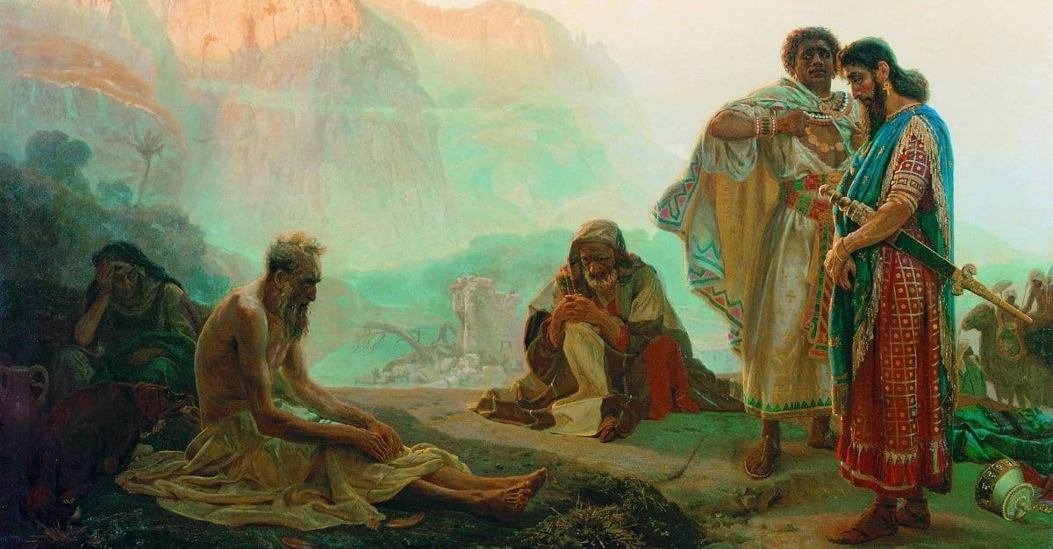
Notes:
If you go and read Job chapters 4-37, you can hear the pitiful and soul-crushing words from Job’s “friends” who make matters worse with their bad theology and words shared out of their own false assumptions about God, and out of their own frustration with the situation and their fears that this calamity could happen to them. Surely God would never let someone as righteous as Job go through so much loss and pain. If this happened to Job, what might happen to us? Job must have done something wrong they think. And so, they press Job. And the more Job cries out in anguish, the more impatient his friends get with Job, pressing him even more.
Job’s response in the beginning of this unexpected tragedy in his life was firm and appeared strong in faith, but the author wants us to notice something. Job’s theology (though some might think it glorious and wise to say, “God gives and takes away, praise be his name!”) wasn’t entirely accurate (as I said), and that he’s also not being totally honest with his feelings. And so, give it some time and his real feelings start to come out in chapter 9. [NEXT SLIDE]

Slide 8
Job 9:14-18 NIV
¹⁴ “How then can I dispute with him? How can I find words to argue with him? ¹⁵ Though I were innocent, I could not answer him; I could only plead with my Judge for mercy. ¹⁶ Even if I summoned him and he responded, I do not believe he would give me a hearing. ¹⁷ He would crush me with a storm and multiply my wounds for no reason. ¹⁸ He would not let me catch my breath but would overwhelm me with misery.
Notes:
It comes out now—how Job is really feeling about the whole thing. He is upset with God, rightfully so. In the next chapter (Job 10) he says things like this to God, “Are you enjoying this? Did you create me for this purpose—to watch me waste away like this?” He says, “I feel like you’re just toying with me like a lion does it’s prey.” He goes on to say, “If I’m guilty, fine, I’ll accept it. But I’ve done nothing wrong, and so your treatment of the righteous and wicked sure seems arbitrary.” Job says, “Why did you even allow me to exist in the first place. I should have never been born.”
And Jobs friends just keep piling it on and making it worse. Each time Job responds he says more and more out of his hurt and pain, convinced now that God must be angry with him. He wants nothing more than to die. “All was well with me” he said, “but God shattered me; he seized me by the neck and crushed me. People look at the way I’ve been treated and think I’m guilty. So, go on, God. Just kill me, please.”
After hearing more “nonsense” from his friends, Job insists that he has every right to feel the way he does. From there he eventually begins to remember the way things used to be, when everything was right in his life. For a moment, he longs for what once was, but then he quickly returns to his lament. “God, will you just let me waste away and say nothing, do nothing.” Job then lists all the ways he was righteous, all the good he had done, all the times he sacrificed for God. How then can God be just and good in allowing these things?
And then after several chapters of listening to Job’s friends preach at him about how God would only allow or cause such terrible things to happen to someone who had really done something wrong or deserving of it, the LORD finally speaks: [NEXT SLIDE]

Slide 9
Job 38:1-3 NIV
¹ Then the Lord spoke to Job out of the storm. He said:
² “Who is this that obscures my plans with words without knowledge? ³ Brace yourself like a man; I will question you, and you shall answer me.
Notes:
God responds to Job saying things like: “Where were you when I created the world and everything in it? Have you ever caused a sun to rise and set? Do you have anything to do with the seasons and the weather? Can you hold constellations in the width of your hand? Do you sustain all of life and enable the world to turn and the cosmos to remain in existence? I do that, Job. And it’s a big universe. There are a lot of moving parts. And I’ve never been one to manipulate, control, and force my will on you or the rest of the world. It’s messy, I know. But that’s the way it is. That’s the necessary risk and consequence of creating a world out of love.”
And God says to Job… so… “Would you discredit my justice? Would you condemn me to justify yourself? What is God doing? Why does the author include these words from the Lord? It is to highlight our human ignorance of the complexity of the cosmos, as well as the chaos and opposition that God must contend with in a free creation. And to be clear, God doesn’t say these things in mockery of Job, but instead to say: “Job, I created everything that your eyes see, so how is it, with a world as magnificent and complex as that—too wonderful for you to comprehend—that you expect me to help you understand why things happen the way that they do? Even if I could, would it really change the way you feel? Really, Job?”
And finally, Job responds: [NEXT SLIDE]

Slide 10

Job 42:3,6 NIV – Job Responds to God’s Questions
“Surely, I spoke of things I did not understand, things too wonderful for me to know… Therefore, I despise [ashamed of] myself and repent in dust and ashes.”
Notes:
If this were a test (certainly it must have felt that way to Job), then Job passed it. But not because his theology was perfect or that he was entirely blameless in his suffering, but because he does not reject God despite his broken theology, and despite his false assumptions and his doubts about God. Not even his impious ranting and complaining was too much for God, nor did it disqualify Job from being righteous in God’s eyes.
In fact, as a professor of mine once said, “It wasn’t until Job started to lament and complain to God that he truly began to live.” You see, church, it was then that God looked down and said, “Yes, that’s it. Now you’re being true to your self. Now you’re letting what’s in you come out of you. That groaning for what is right, just, and fair. The recognition that something isn’t right. I honor that, Job. That’s what real faith is made of, and it’s ultimately what leads to justice. Now you know how I feel.”
As we saw in the video and can read in the final verses of Job, God blesses Job after that. And Job’s view on who he is, what he has, why he has it, and the precious gift that is life has been radically transformed. His view of God, suffering, and justice… has been forever changed. And so let’s talk about some of the lessons we (the readers) can glean from Job. Real quick: [NEXT SLIDE].

Slide 11
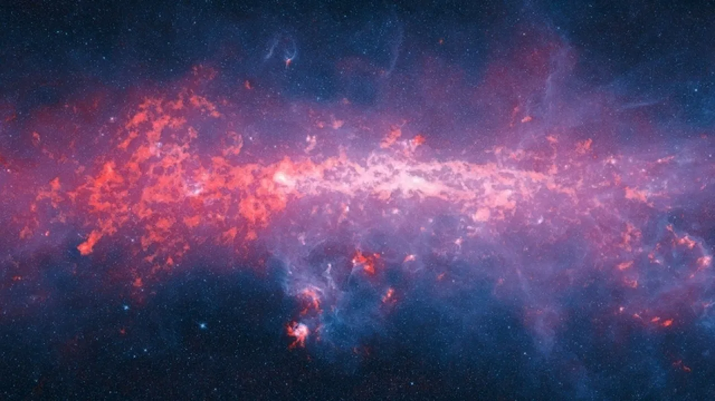
The Problem of Suffering: Lessons from Job
Humans are free creatures
Angels, Satan and demons are free beings
Creation has been impacted by rebellious wills
We are caught in a cosmic struggle within a complex world
Ambiguity abounds, but God is not to blame
We can ask God “Why” and still trust in his good character (i.e., God blesses those who doubt and yet believe)
Notes:
[READ & BRIEFLY COMMENT ON EACH POINT]
Humans are free creatures
Angels, Satan and demons are free beings
Creation has been impacted by rebellious wills It is safe to assume that whatever happens or appears contradictory to the character of God revealed in Jesus Christ, ultimately comes from human or angelic (demonic) agents who oppose God’s will for creation, a creation that groans in travail and cries out for its freedom from decay.
We are caught in a cosmic struggle within a complex world In Ephesians 6:12, Paul says that “we battle not against flesh and blood”
Ambiguity abounds, but God is not to blame Lamentations 3:33 says that God “does not willingly afflict or grieve anyone.”
We can ask God “Why” and still trust in his good character (i.e., God blesses those who doubt and yet believe) Like Job, part of actualizing faith is to wrestle with our doubts
Of course, I think we have to acknowledge that our portrait of God and our understanding of the problem of pain and suffering is not complete without the incarnation of God in Christ. Like any good ”Christ-centered” sermon, we need to filter and factor in what the revelation of Christ does to fulfill, revise, and complete our understanding of Old Testament stories. So, what light does Jesus shine on these things?
In Matthew 5:45, Jesus says that God causes his sun to rise on the evil and the good, and sends rain on the righteous and the unrighteous. Therefore, Jesus affirms that we can’t go along with the thinking that good things happen to good people and bad things happen to bad people. The world is far too complex for that. And then in Luke 13:2-5 – Jesus uses two examples that speak to what we’re to think when bad things happen. Jesus says a bunch of Galileans had been rounded up by Pilate and killed in the Temple, and then there apparently was a tower that had recently fallen and killed 18 innocent people. On both accounts, Jesus says that those who died weren’t more guilty than the person who watched it happen. Jesus says, “So, you best be repenting while you can and get your hearts right.”
Really, everything about Jesus’ ministry revealed that God is not in the business of arbitrarily smiting people, but rather he is rebuking his disciples for wanting to call down fire from heaven, he is opening the eyes of the blind, making the lame walk (lame people who some thought were that way because of their sins or their parent’s sins). Furthermore, our understanding of what God is doing about evil, and the reason we can trust him, isn’t fully complete without the death and resurrection of Jesus. Which is what Paul is going on about in Romans 8. Listen as I read Romans 8:18-39 from The Message: [NEXT SLIDE]

Slide 12

Romans 8:18-39 | The Message
Notes:
Romans 8:18-39 MSG
If we go through the hard times with him, then we’re certainly going to go through the good times with him!
¹⁸⁻²¹ That’s why I don’t think there’s any comparison between the present hard times and the coming good times. The created world itself can hardly wait for what’s coming next. Everything in creation is being more or less held back. God reins it in until both creation and all the creatures are ready and can be released at the same moment into the glorious times ahead. Meanwhile, the joyful anticipation deepens.
²²⁻²⁵ All around us we observe a pregnant creation. The difficult times of pain throughout the world are simply birth pangs. But it’s not only around us; it’s within us. The Spirit of God is arousing us within. We’re also feeling the birth pangs. These sterile and barren bodies of ours are yearning for full deliverance. That is why waiting does not diminish us, any more than waiting diminishes a pregnant mother. We are enlarged in the waiting. We, of course, don’t see what is enlarging us. But the longer we wait, the larger we become, and the more joyful our expectancy.
²⁶⁻²⁸ Meanwhile, the moment we get tired in the waiting, God’s Spirit is right alongside helping us along. If we don’t know how or what to pray, it doesn’t matter. He does our praying in and for us, making prayer out of our wordless sighs, our aching groans. He knows us far better than we know ourselves, knows our pregnant condition, and keeps us present before God. That’s why we can be so sure that every detail in our lives of love for God is worked into something good.
²⁹⁻³⁰ God knew what he was doing from the very beginning. He decided from the outset to shape the lives of those who love him along the same lines as the life of his Son. The Son stands first in the line of humanity he restored. We see the original and intended shape of our lives there in him. After God made that decision of what his children should be like, he followed it up by calling people by name. After he called them by name, he set them on a solid basis with himself. And then, after getting them established, he stayed with them to the end, gloriously completing what he had begun.
³¹⁻³⁹ So, what do you think? With God on our side like this, how can we lose? If God didn’t hesitate to put everything on the line for us, embracing our condition and exposing himself to the worst by sending his own Son, is there anything else he wouldn’t gladly and freely do for us? And who would dare tangle with God by messing with one of God’s chosen? Who would dare even to point a finger? The One who died for us—who was raised to life for us!—is in the presence of God at this very moment sticking up for us. Do you think anyone is going to be able to drive a wedge between us and Christ’s love for us? There is no way! Not trouble, not hard times, not hatred, not hunger, not homelessness, not bullying threats, not backstabbing, not even the worst sins listed in Scripture… None of this fazes us because Jesus loves us. I’m absolutely convinced that nothing—nothing living or dead, angelic or demonic, today or tomorrow, high or low, thinkable or unthinkable—absolutely nothing can get between us and God’s love because of the way that Jesus our Master has embraced us.
So, brothers and sisters, let’s join the book of Job and affirm that while we might not know why everything happens the way that it does, we can trust our wise God. And then let’s affirm that we get the truest portrait of our wise God from Jesus of Nazareth, whose birth we will celebrate next week. And as my friend Greg Boyd has written: [NEXT SLIDE]

Slide 13
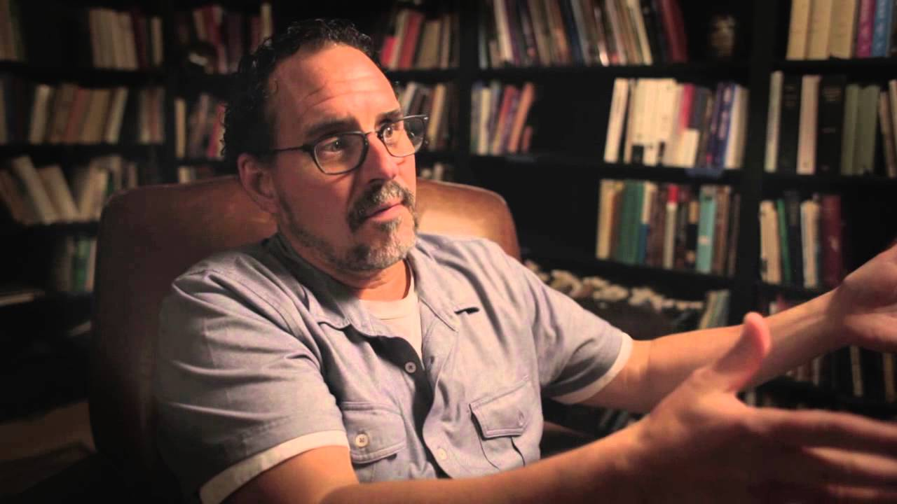
“We must with confidence anchor ourselves in what we can know—that God looks like Jesus—and simply confess ignorance about everything else.”
Greg Boyd, Is God to Blame? Beyond Pat Answers to the Problem of Suffering (pg. 105)
Notes:
Reminds me of what Paul wrote to the Corinthians, “For I resolved to know nothing while I was with you except Jesus Christ and him crucified.”
And that is enough, folks.
Finally, before we end with our Advent 3 reflection… [NEXT SLIDE]

Slide 14
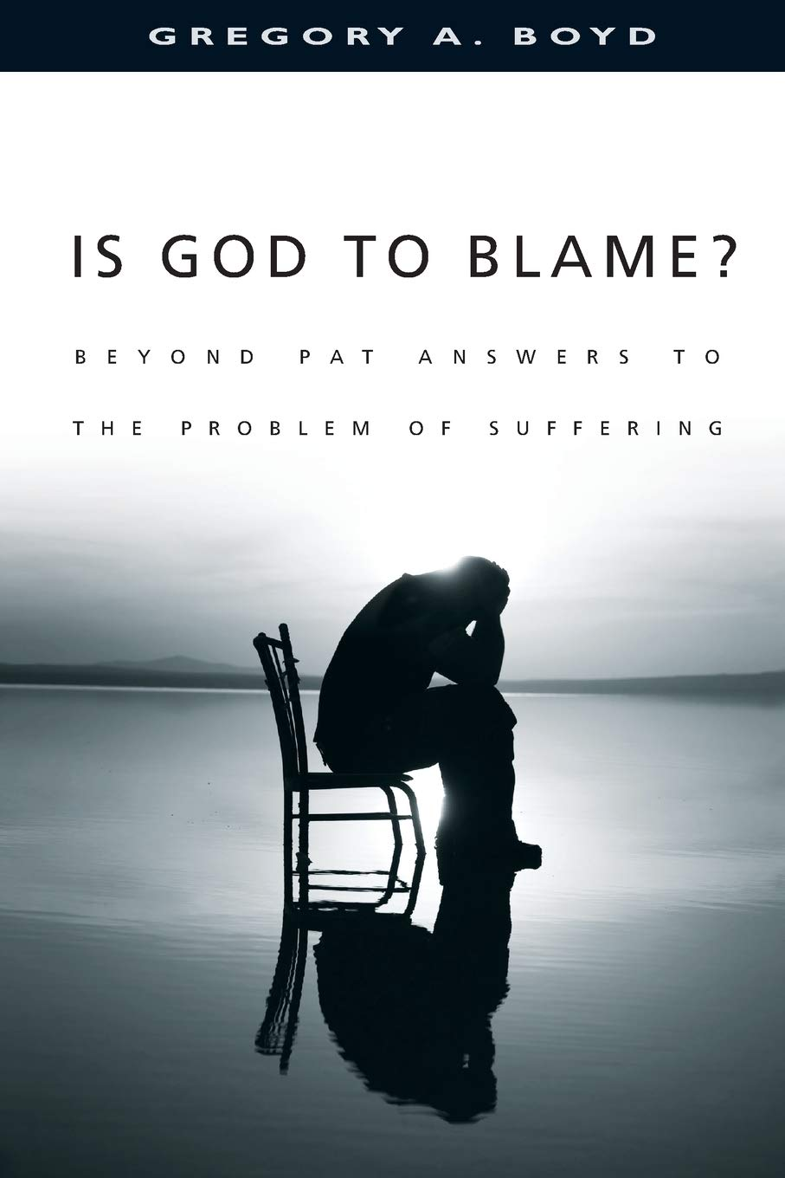

Notes:
[BRIEF COMMENT ABOUT BOOKS]
Boyd’s book: Helps us to rethink our understanding of God’s sovereignty and the problem of evil.
Wright’s book: Addresses the pandemic—where is God in it? How should we respond? Calls us to pray and lament.
Alright, let’s close with a time of reflection on the message today: [NEXT SLIDE]

Slide 15
unexpected Advent 3 Reflection – What does this story teach us?
About God?
About ourselves?
About how we should live?

Slide 16
unexpected Advent 3 Reflection – What does this story teach us?
About God? God is dealing with a complex creation in a cosmic struggle.
About ourselves?
About how we should live?

Slide 17
unexpected Advent 3 Reflection – What does this story teach us?
About God? God is dealing with a complex creation in a cosmic struggle.
About ourselves? It’s important to lament and tell God how we really feel in our grief.
About how we should live?

Slide 18
unexpected Advent 3 Reflection – What does this story teach us?
About God? God is dealing with a complex creation in a cosmic struggle.
About ourselves? It’s important to lament and tell God how we really feel in our grief.
About how we should live? When we encounter unexpected tragedies, we can live like God is with us and for us.
Notes:
[BRIEF COMMENTS]
We live in the middle of a war-torn creation (a fallen world) and God is working according to the rules of love.
Remember, we’re not really living or growing in our faith if we’re not honest with God about our feelings. In his book God and the Pandemic, N.T. Wright says, “If we spend time in the prayer of lament, new light may come, rather than simply the repetition of things we might have wanted to say anyway.”
How freeing it is to know that God is not the cause of our pain, that he isn’t the one who takes away and robs us of joy. When we accept this, we can more easily go to God when we experience unexpected tragedies in our life. We can even partner with him in brining more of the Kingdom.
[CLOSING WORDS]

