Slide 1

Notes:
[BRIEF INTRO]
Third Sunday of Lent
Our series: Seeking God’s Ways
In our Lenten series, Seeking God’s Ways, we are exploring the “higher” ways of God. In Isaiah 55:8-9, the Scripture says, ““For my thoughts are not your thoughts, neither are your ways my ways,” declares the Lord. “As the heavens are higher than the earth, so are my ways higher than your ways and my thoughts than your thoughts.” Therefore, we want to understand God’s ways so that we might repent of our own way, believe in the gospel, and ready our hearts for the wisdom and power of the cross and empty tomb.
So far in our series, we have looked at how God calls us to move from security to generosity and from fear to compassion. In today’s message, we are being invited to move… [NEXT SLIDE]

Slide 2

Notes:
[BRIEF COMMENTS]
From Earning to Receiving
As the summary in your bulletin says: “The New Testament is clear that we cannot earn our salvation or gain access into the Kingdom of God by our good works. We do not merit the Lord’s love and favor. Instead, it is all a gift that we simply receive from a good and gracious God.” I suspect that many of us have heard that before and think we understand it. But if we’re honest, we often live and act as if we must work, perform, and earn the Father’s love—grace is not a lived experience. And my friends, I believe Jesus, our Lord and Master, wants to unify your head, heart, and hands in this message: to receive and embody the grace of God today.
So, once again, let’s prepare our hearts to receive a word from the Lord. “Father, help us to open our hearts to you. We want to be moldable clay in your hands. Jesus, we confess our need for you. For it’s in you alone that we find life. Holy Spirit, help us to repent and receive the scandalous grace of Jesus this morning, so that we can truly live by faith and extend God’s grace to others. Amen.”
Please grab your Bible and let’s go to our main Scripture reading… [NEXT SLIDE]

Slide 3

Scripture Reading
Matthew 20:1-16 NLT
Notes:
[INVITATION TO STAND FOR SCRIPTURE READING]
[READ MATTHEW 20:1-16 NLT] - This is the word of the Lord. Thanks be to God. You may be seated.
[BRIEF COMMENTS ON PARABLES]
Jesus loved to tell stories, and he did this through parables. Parables were Jesus’ way of describing who God is, what life in the Kingdom is like, and what we must do if we’re going to believe the gospel and follow him. And his parables often involved challenging the status quo, as well as systems of abuse, oppression, and exploitation. While the meaning was straightforward at times, at other times it was unclear—only revealed to those who had ears to hear and were willing to align themselves with the truth.
Many of the parables are memorable, likeable, make us feel good, and move us (e.g., Parable of the Lost Sheep, the Unforgiving Debtor, the Good Samaritan, the Prodigal Son)
But I’ve never met anyone who said that the parable we just read is their favorite. That’s because the Parable of the Vineyard Workers doesn’t really have any endearing characters and of course it disrupts our sense of what is right, just, and fair, especially as citizens living in a capitalist society that has conditioned us to get our identity from our work, our wages, and our accomplishments.
So, let’s reflect on this parable and see what insights and inspiration it gives us for moving from earning to receiving. [NEXT SLIDE]

Slide 4
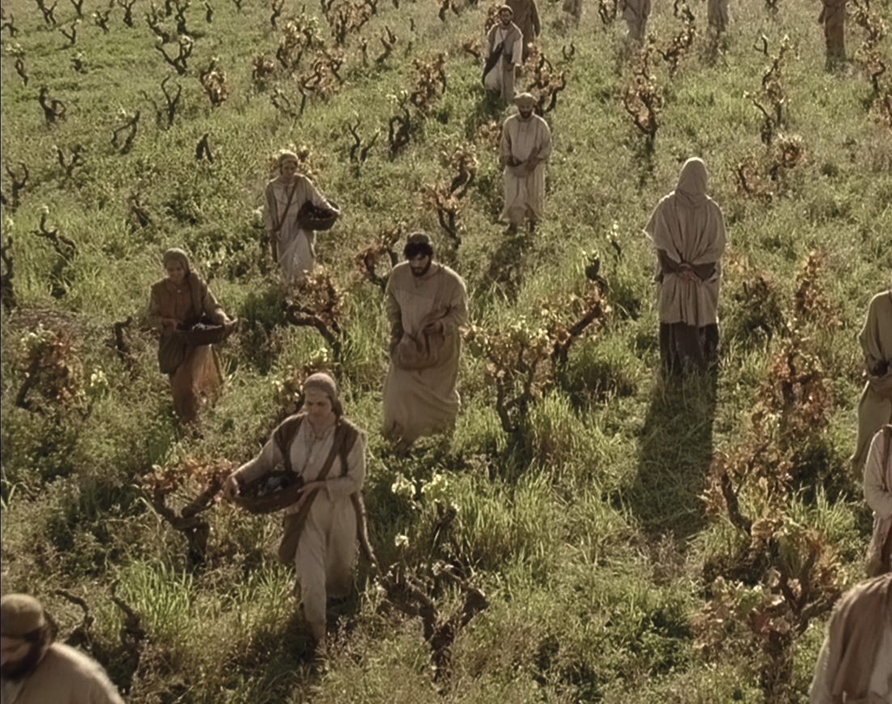
The Parable of the Vineyard Workers
Notes:
[BRIEF COMMENTS ON EACH POINT]

Slide 5
The Parable of the Vineyard Workers
The Historical Context
Notes:
[BRIEF COMMENTS ON HISTORICAL CONTEXT]
The story of a landowner and his day laborers – only the wealthy could pax taxes and keep permanent jobs
The owner of the vineyard goes to the marketplace where he can find workers
The workers agree to a full day’s work: 6am-6pm; 3hr blocks: 6:00, 9:00, noon, and 3:00
The landowner hires the first round and then comes back at the end of the day to find a group waiting there. And why are these folks not working? They say, “Nobody would hire us.” And why not? Who are they? What kind of people in the Lord’s day are the last to find jobs. Nothing in the story suggests that they are irresponsible or lazy, as we might assume. Instead, it’s safe to say they are unwanted. Think about it. Who spends the entire day waiting to be hired and is still there at 5:00? In Jesus' time, these would be the weak, the infirm, the disabled, and the elderly. And possibly other folks who are discriminated against due to prejudices and fear. They are there because they weren’t chosen. And now they fear going home to their families empty-handed.
Have you ever experienced not being chosen, or maybe being picked last? [MY SON CHOSEN LAST]
Back to the parable… so an hour later the landowner tells the foreman to pay the latecomers first, and to pay them for a full day’s work, even though they had only worked an hour. Clearly, this is done this way on purpose.
And then, as we would expect, comes the many questions and objections.
Let’s think then about the intended meaning of this parable… [NEXT SLIDE]

Slide 6
The Parable of the Vineyard Workers
The Historical Context
The Meaning of the Parable
Notes:
[BRIEF COMMENTS ON THE MEANING]
This is a parable about God’s grace, about people in need, and about affirming the dignity and worth of others. And to get its meaning and understand it best, we need to recognize its larger context, particularly the story in the previous chapter.
The Parable of the Vineyard Workers comes immediately after Jesus’ interaction with a rich young man who asked what he needed to do to earn eternal life (Matt 19:16-23). Jesus then told this young man to sell all his possessions and follow Him. As you recall, this wealthy man wouldn’t do it because he prized what he owned more than what Jesus could give him. This rich man failed to accept the way things work in God’s economy. It was not about what he had earned or could ever achieve by his own efforts. It was rather about his attitude, the way he thought of himself (and those beneath him) and what he was willing to give up for Christ. And the last words of Jesus before the parable is a plea for his disciples to rethink who is blessed, to rethink greatness, rethink sacrifice, rewards, and rethink what it means to succeed and win in life, so that they can follow him and live into the Kingdom of God.
And the real scandal of this parable is that we are all equal recipients of God’s gifts. And it requires us being honest with ourselves about our own pride, envy, and feelings of jealousy when God’s gifts and blessings are given to others in equal measure.
Notice, the first group wasn’t cheated. They received the pay that was agreed upon. And notice that it's not the generosity of the landowner that makes the first group of workers angry. Rather, the issue is that by dealing graciously with a group of people that nobody else in town considered worth the trouble of hiring, the landowner has made a clear declaration about their value, their dignity, and their worth. Therefore, in reality, the landowner's kindness denies the full-day laborers the bonus they think they can claim: a sense of privilege and superiority over those who came late, did less, and received the same wages.
And now… lets connect some dots and make some application for us 21st century Christians… [NEXT SLIDE]

Slide 7
The Parable of the Vineyard Workers
The Historical Context
The Meaning of the Parable
The Application for Disciples
Notes:
[BRIEF COMMENTS ON THE CHALLENGE & APPLICATION]
Our attitude as disciples ought to be gratitude and humility, not one of superiority or having a victim mentality. Because if we recognize the generosity and graciousness of God, we will rightfully see, as Paul said, that the “wages” we’ve earned is death.
As justice without mercy is not biblical justice, likewise, fairness without grace is not biblical fairness and equality. If the love, mercy, and grace of God don’t impact your views of justice, fairness, and equality, then your views are likely being impacted by the current zeitgeist or spirit of the age. And I submit to you that you need to run your thoughts by Jesus in whose name you were baptized.
It’s not about what or how much we do, but it’s about saying, “Yes!” to the Master of the vineyard, joining the work (not for the reward but for the sake of mission), and to remain in Christ. And to abide in him, we need to receive his grace and extend it to others.
No matter how or when someone comes to Jesus and into the work of the Kingdom, they are to be welcomed and treated equally. In other words, whether you’ve been in church for decades or minutes, the ground is level, and you have an equal spot at the table.
Jesus is calling us to look around the marketplace of our own communities. Who isn’t being hired? Who isn’t being chosen? Who is being overlooked? Who is being excluded, marginalized, or forgotten? Some of those folks may even be in this room this morning.
My friends, this is the God who says you can’t earn my love or a place in my Kingdom because I give it to you by grace though faith. Remember, that’s what the Apostle Paul wrote to the believers in Ephesus… [NEXT SLIDE]

Slide 8
Ephesians 2:1-10 NIV
¹ As for you, you were dead in your transgressions and sins, ² in which you used to live when you followed the ways of this world and of the ruler of the kingdom of the air, the spirit who is now at work in those who are disobedient. ³ All of us also lived among them at one time, gratifying the cravings of our flesh and following its desires and thoughts. Like the rest, we were by nature deserving of wrath.
Notes:
[BRIEF COMMENT ON EACH VERSE]
Verse 4… [NEXT SLIDE]

Slide 9
⁴ But because of his great love for us, God, who is rich in mercy, ⁵ made us alive with Christ even when we were dead in transgressions—it is by grace you have been saved. ⁶ And God raised us up with Christ and seated us with him in the heavenly realms in Christ Jesus, ⁷ in order that in the coming ages he might show the incomparable riches of his grace, expressed in his kindness to us in Christ Jesus.
Notes:
[BRIEF COMMENT ON EACH VERSE]
Verse 8… [NEXT SLIDE]

Slide 10
⁸ For it is by grace you have been saved, through faith—and this is not from yourselves, it is the gift of God— ⁹ not by works, so that no one can boast. ¹⁰ For we are God’s handiwork, created in Christ Jesus to do good works, which God prepared in advance for us to do.
Notes:
[BRIEF COMMENT ON EACH VERSE]
Therefore, by receiving (not earning) this grace, we are then able to do our good works as a response to God’s grace and thereby become agents of grace, and (as Philip Yancey said) end the “cycle of ungrace” that is at work in the world. A world whose sense of fairness, justice, and equality has been corrupted by our sinful flesh in the form of things like racism, nationalism, crony capitalism, greed, abuses of power, privilege, and so forth. Which again, is why we are called to repent of our own ways and embrace the higher ways and thoughts of God (and life in his Kingdom) and return to the flow of God’s grace. [NEXT SLIDE]

Slide 11

Ending the “Cycle of Ungrace”
The flow of God’s grace:
God embraces you and me and God embraces others and God embraces the whole created order
Then:
You and I embrace God back and We embrace others and We embrace the entire created order
Notes:
[BRIEF COMMENTS]
Brothers and sisters, this is the way to be reconciled to God. It is the way to be ministers of reconciliation to our neighbors. And it is the way in which we see more of the Kingdom of God on the earth—a Kingdom that always looks like Jesus.
So then, let us hear the words of Jesus… [NEXT SLIDE]

Slide 12
John 10:7-10 MSG
I am the Gate for the sheep. All those others [power-hungry, Law-obsessed religious leaders] are up to no good—sheep rustlers, every one of them. But the sheep didn’t listen to them. I am the Gate. Anyone who goes through me will be cared for—will freely go in and out, and find pasture. A thief is only there to steal and kill and destroy. I came so they can have real and eternal life, more and better life than they ever dreamed of.
Notes:
[BRIEF COMMENT ON PASSAGE]
Jesus contrasts himself with the Pharisees, who didn’t understand God’s grace
Who or what are the thieves today that promise you safe pasture?
Jesus offers us abundant life if we will accept him as the doorway to the Kingdom
Finally, here are some questions to help us reflect and respond to what we’ve heard… [NEXT SLIDE]

Slide 13

Questions for reflection and response:

Slide 14
Questions for reflection and response:
Are there ways you have been trying to earn God’s love and acceptance in your life? (e.g., service, spiritual disciplines, etc.)

Slide 15
Questions for reflection and response:
Are there ways you have been trying to earn God’s love and acceptance in your life? (e.g., service, spiritual disciplines, etc.)
What would it look like for you to receive God’s gift of grace?

Slide 16
Questions for reflection and response:
Are there ways you have been trying to earn God’s love and acceptance in your life? (e.g., service, spiritual disciplines, etc.)
What would it look like for you to receive God’s gift of grace?
How is God inviting you to extend his love to someone in your life and show the same grace you have received yourself?
Notes:
[BRIEF COMMENT ON EACH QUESTION]
[BRIEF MOMENT OF SILENCE]
As we’ve been doing each week in this series, please join me in this responsive prayer… [NEXT SLIDE]

Slide 17
One: Your Ways, O God, are higher than our ways.
All: Your thoughts are higher than our thoughts.
One: We seek God’s ways.
All: Lord, move us from feeling that we must earn your love so that we might freely receive it, and then willingly share your grace with others.
One: As we walk with Christ on this Lenten journey, let us see your way more clearly…
All: and follow your way more faithfully. Amen.
Notes:
[PRAY THE RESPONSIVE PRAYER]
[GO TO FINAL SLIDE]

Slide 18
Notes:
BENEDICTION:
Brothers and sisters, from this time and place into whatever awaits, may you follow God’s way of receiving. May you let go of your feelings of unworthiness and accept God’s abundant gifts of love, mercy, and grace. As you go, know that our God of the wilderness remains with you on the way.
Now go in peace, to love and serve the Lord.

