Slide 1
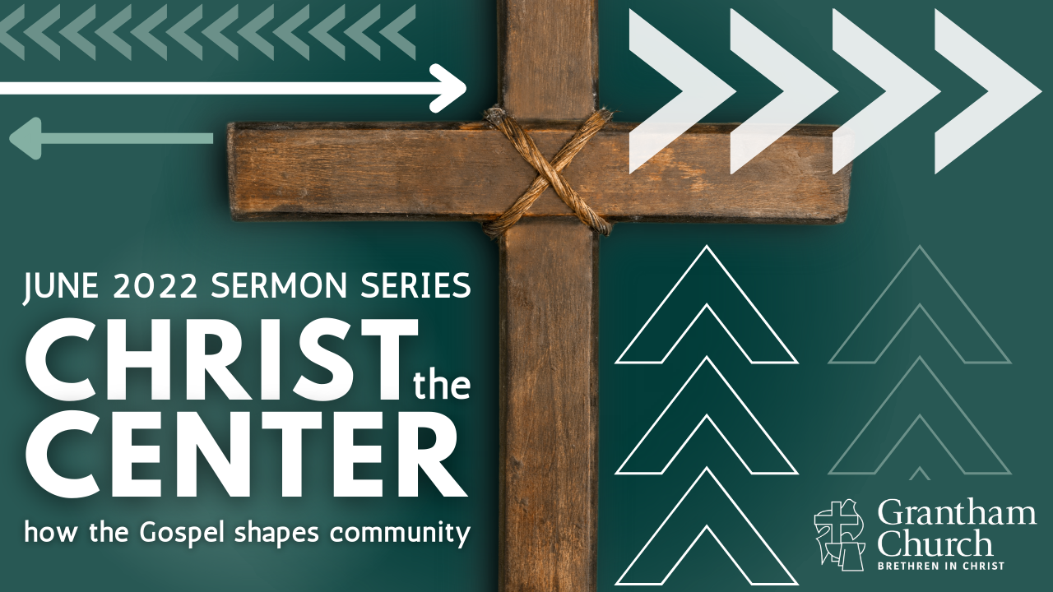
Notes:
[BRIEF INTRO]
This is the third message in a 4-part series: Christ the Center: how the gospel shapes community
What does it look like to be a Christ-centered church that is faithful to the gospel? How can we be a church that doesn’t obsess over boundaries or one that ends up erasing all lines that set us apart as faithful disciples? In this series, we are looking at how Christ is the center of our community when we are pursuing him together, affirming historic Christian beliefs, and living out our values as Christ-followers, as we extend grace to those who are at different places on their journey.
If you’re just joining us, we began our series with… [NEXT SLIDE]

Slide 2
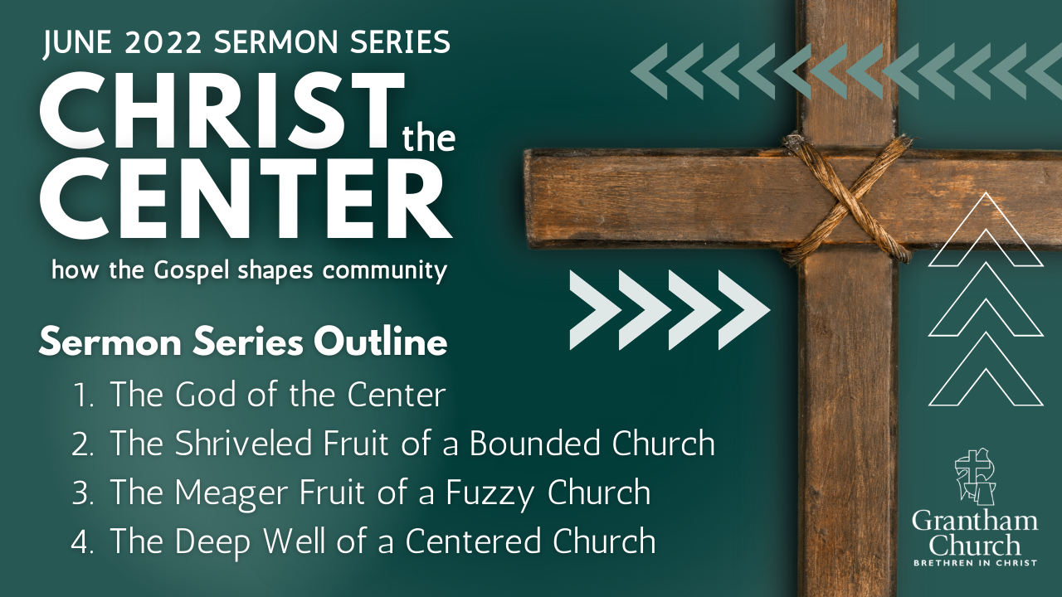
Notes:
[BRIEF COMMENTS]
1. The God of the Center – I addressed how our concept of God, and our understanding of the gospel, will determine the sort of community and culture that exists in the church. At Grantham, we say Jesus shows us what God is like, and so we want to worship and know this Jesus, and follow him with others in the church for the sake of the world—leading others to the God who looks like Jesus. Therefore, the more we seek the God of the center, the more like him we will become, individually and as a community.
2. Last Sunday we looked at how the gospel challenges the “bounded” practice of community in the message, The Shriveled Fruit of a Bounded Church. We recalled how the Pharisees practiced the bounded-set, but Jesus rejected it. And we spent some time in Galatians chapters 1-4, where we heard the Apostle Paul explain why focusing on boundary markers isn’t consistent with Christ or the gospel of grace.
3. This morning we are looking at The Meager Fruit of a Fuzzy Church and what it looks like when we erase all lines and boundaries, when we get loosey goosey with our beliefs and discipleship (either to be non-judgmental—often in reaction to bounded thinking—or to align ourselves with the spirit of the age), and why that is equally a bad idea.
4. And then next week in the final message: The Deep Well of a Centered Church – we will see that there is a third way option of being a community that pursues Jesus together (allowing folks to be at different places), how we discern who is a follower and who isn’t, and hold grace and truth together as we live and worship in relationship with one another.
As most of you know, this series was inspired by Mark Baker’s book… [NEXT SLIDE]

Slide 3
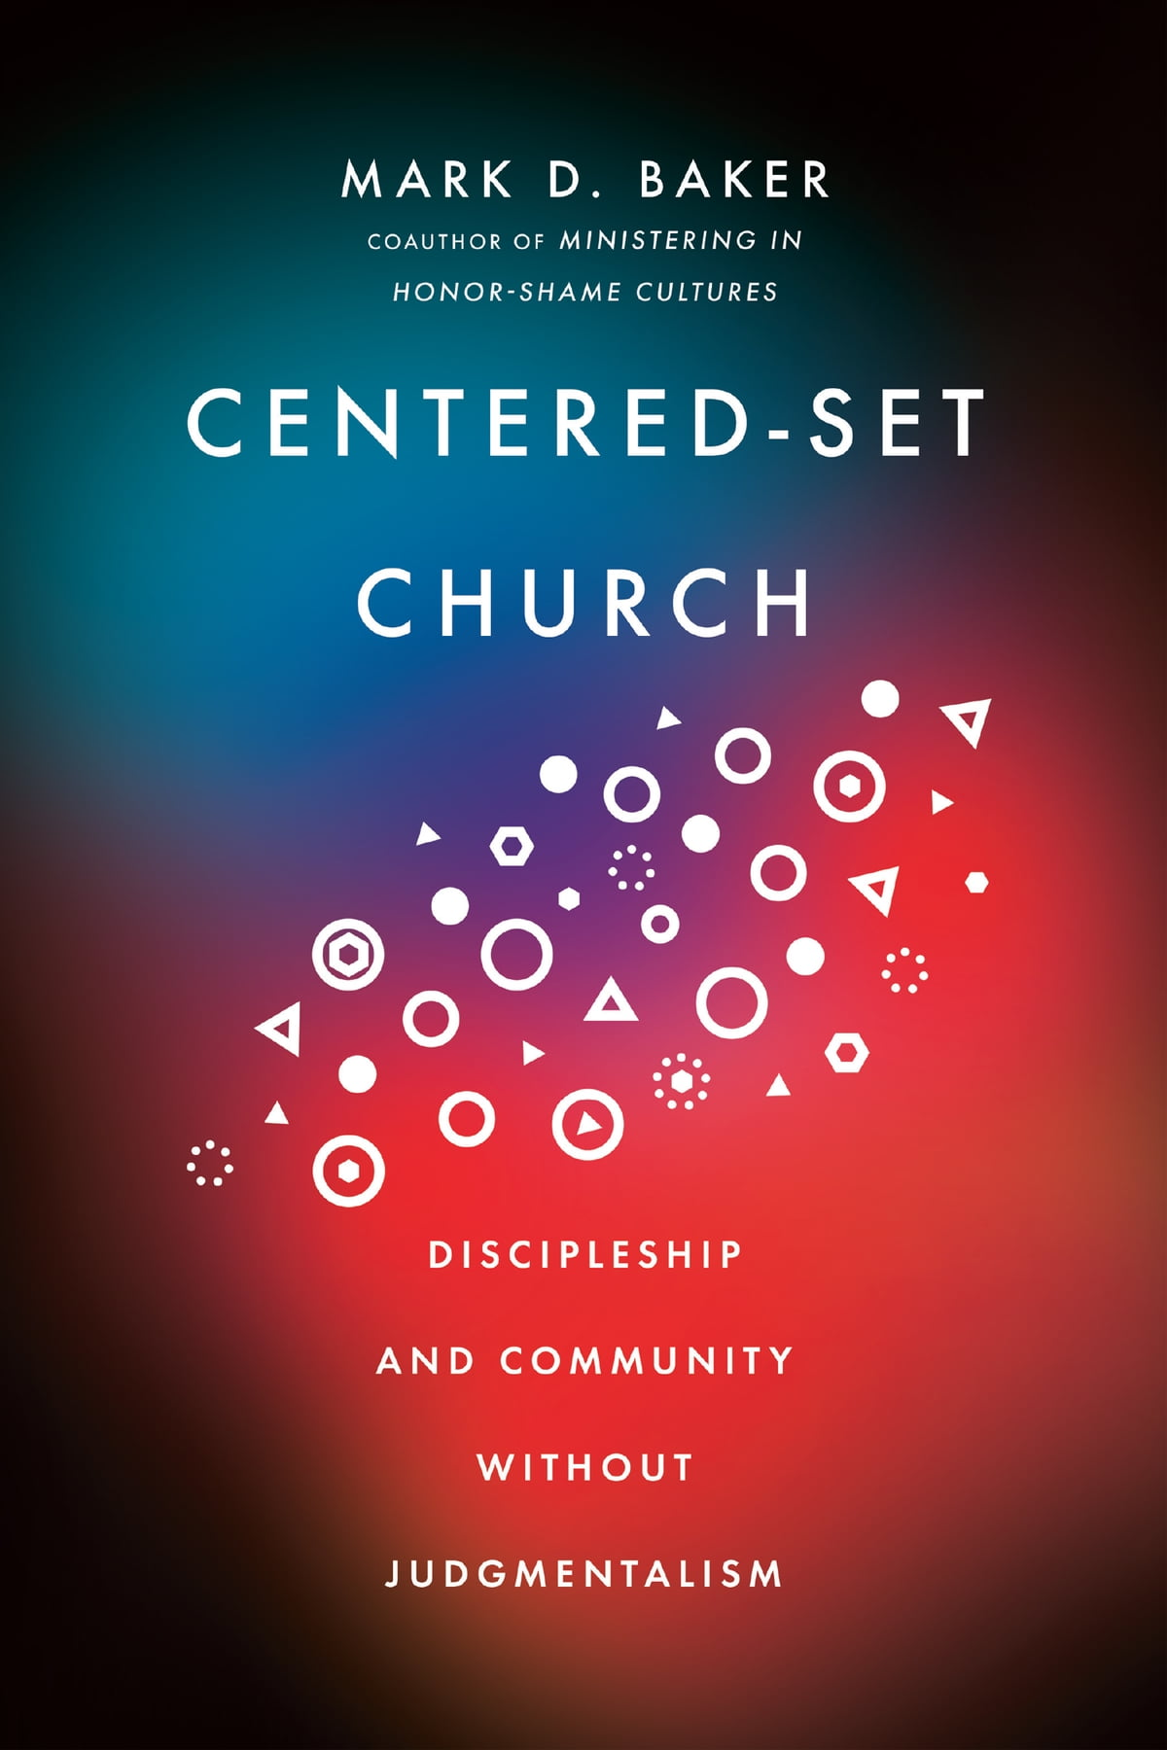
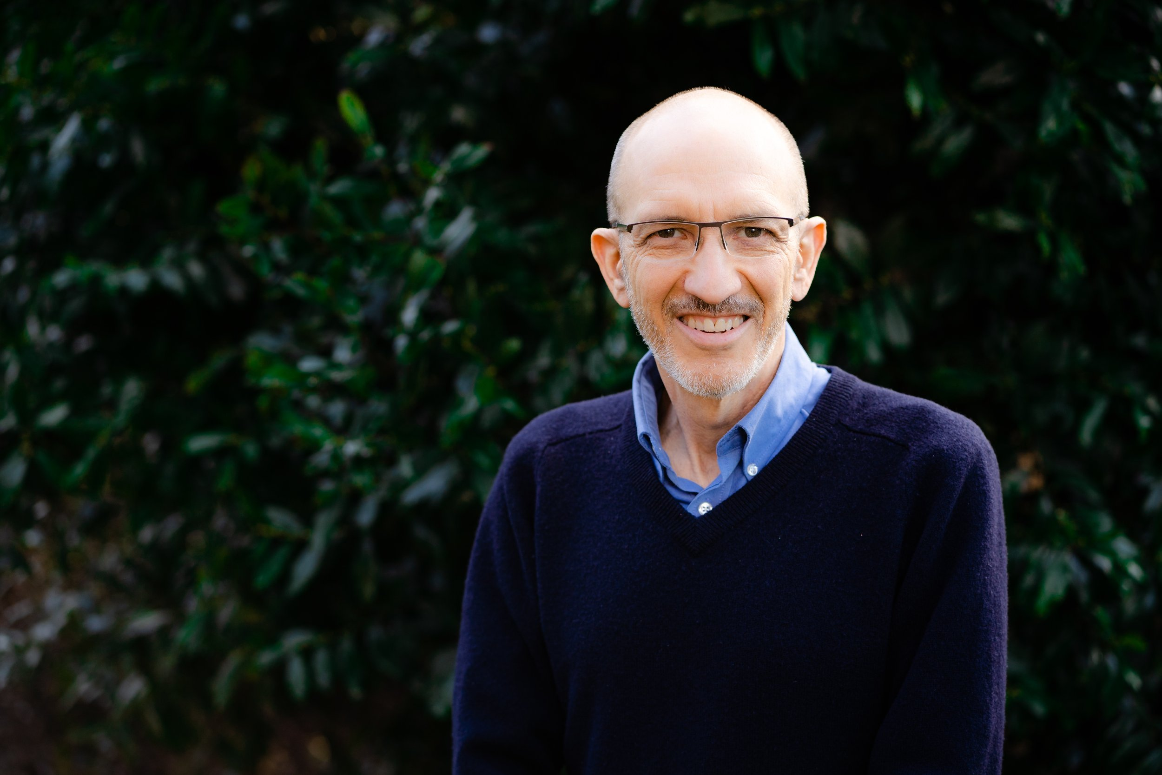
Notes:
Centered-Set Church: Discipleship and Community Without Judgmentalism
And I’d like to begin this third message in our series by reading a story from the very beginning of Mark’s book. [READ pgs. 5-8 – Erasing Lines]
As I’ve told you in the previous messages, Mark expounds on three different ways of being community, and here are the images that are intended to help us grasp what each set looks like in practice. [NEXT SLIDE]

Slide 4


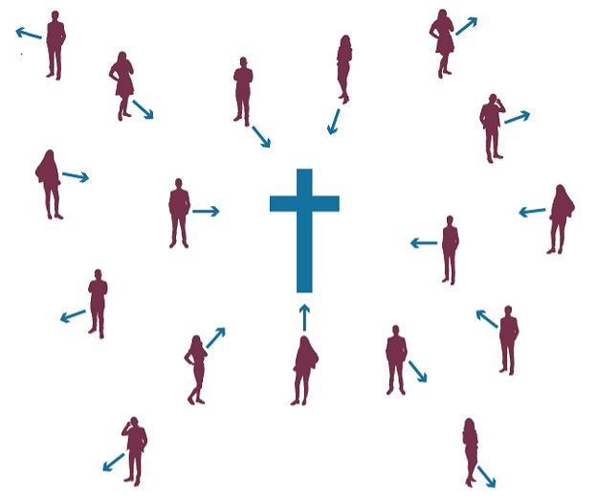
Bounded Church
Fuzzy Church
Centered Church
Notes:
[BRIEF COMMENT ON EACH]
Bounded Church – clear lines of who is in and out; focuses on boundaries.
Fuzzy Church – the removal of all lines and boundaries with no clear direction. This church is a reaction to the bounded and is often seduced by the spirit of the age.
Centered Church – discerns who belongs to the group by observing people’s relationship with the center—Jesus Christ. This church holds grace and truth together, as we meet people where they are and lovingly point each other to Jesus.
Since we are looking at the Fuzzy Church, here is the definition we looked at the beginning of the series… [NEXT SLIDE]

Slide 5
Fuzzy Church
A Fuzzy Church is the opposite of the bounded church. It erases all lines and boundaries. The grounds for distinction (in/out) and shaming judgmentalism are gone, but the fuzziness erodes the group’s sense of identity, lacks a sense of call to a different way of living (holiness), and inhibits loving others fully. It has a tendency toward blandness, low expectations, and it creates a new set of problems in the church.
Notes:
[READ & COMMENT BRIEFLY]
What are some of those problems?
First, any belief or practice formed simply in reaction to an extreme (i.e., Bounded Church), runs the risk of moving to the opposite extreme. And that’s never good.
As the opposite of the Bounded Church, the fuzzy-set still operates according to the in/out, us vs. them thinking. But the fuzzy church simply draws new lines (albeit unclear) all while claiming to be enlightened and more loving than the bounded.
Also, since the Fuzzy Church promotes grace at the expense of truth, which is not reflective of Jesus or the gospel, the bond of “tolerance” and “whateverism” isn’t enough to hold the group together, nor can it be about discipleship, teach holiness, or be on a gospel mission. And of course, when this is the sort of community that has been formed there is no way to distinguish followers of Jesus from non-followers.
Therefore, the Fuzzy Church, while it may at first seem like a refreshing oasis for those who have experienced the extremes of the Bounded Church, after some time this kind of church will eventually discover it has no real purpose for gathering—nothing that can’t be found elsewhere in the world.
And so, this church will eventually die as it fails to place Christ at the center, fails to use cultural discernment in light of Scripture, and fails to grow as a community shaped by the gospel. In other words, the end of the road for the Fuzzy Church is death by assimilation to secular society and culture. It’s lack of rootedness in the gospel gives it no ability to resist that assimilation and offer anything of eternal value to the world. So, the Fuzzy Church ends up parroting the world and mimicking the spirit of the age.
At most… you can only expect… [NEXT SLIDE]

Slide 6
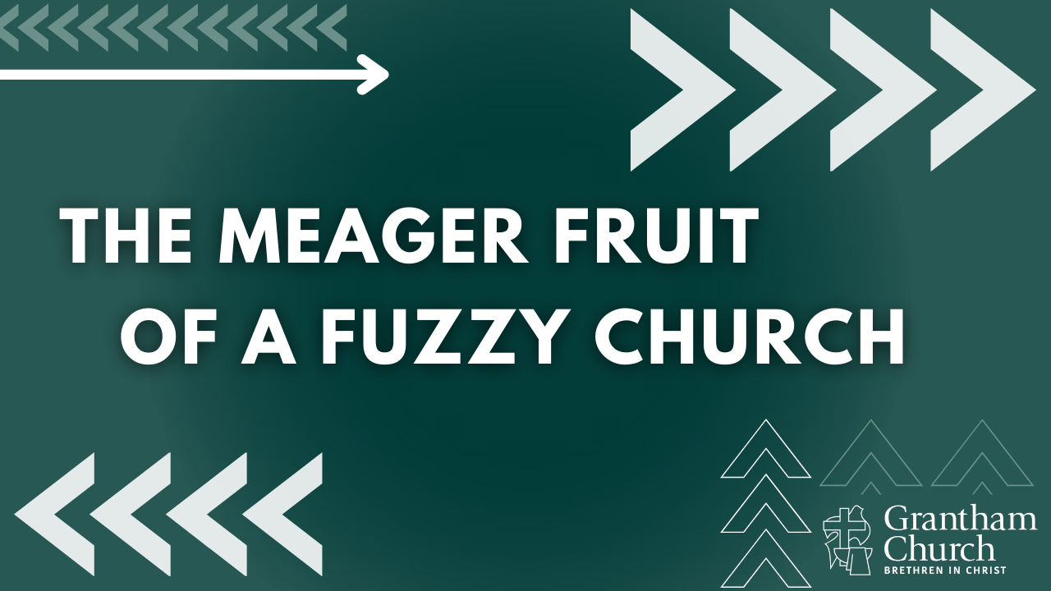
Notes:
Meager fruit. “Meager” meaning lacking in quality and quantity.
In just a moment we are going to be looking at two passages in Paul’s letter to the Corinthians, where Paul is concerned that the Corinthians are on the dead-end road of fuzzy Christianity. But before we look at that, I want to invite us to hear Paul challenging a Fuzzy Church paradigm.
And once again, Paul is quite upset. Keep in mind, like with the Galatians, Paul sees himself as the spiritual father of these young Christians and the churches he helped to plant. And where Paul was witnessing the Gentile Christians of Galatia turn to a bounded-set (and a false gospel) pressed upon them by Jewish agitators of the Law, in Corinth (a Greek city known for, let’s say, being more progressive), Paul is hearing reports of them being divided about a number of things, but also how they are sliding into a fuzzy faith that sets aside discipleship, discipline, and holiness in the name of freedom and self-expression. So, he writes to them about these matters.
Notice, just a few short years after writing to the Galatians about being bounded, we now read Paul’s writings to a fuzzy congregation that was succumbing to worldly ideas of freedom and tolerance, and it threatened the life of the church and its gospel witness. Let’s jump in at 1 Corinthians chapter 5 and catch a glimpse of where this fuzzy faith and community practice had led them. [NEXT SLIDE]

Slide 7
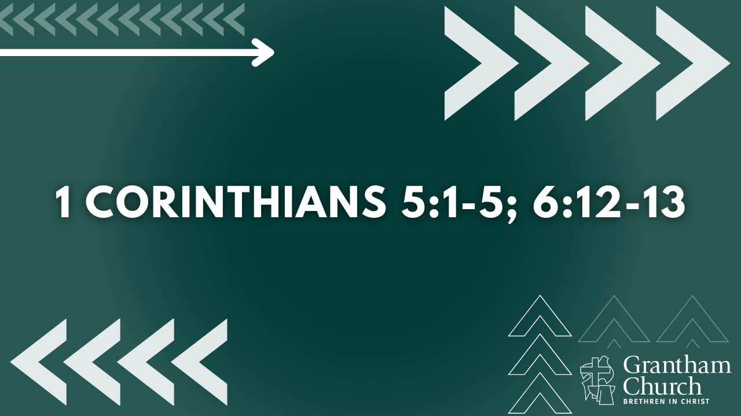
Notes:
[READ PASSAGES AND COMMENT]
NOTES:
Sexual immorality is a big problem in Corinth. Some new believers were apparently worshipping Jesus with the church but still living like lost people during the week (e.g., visiting the pagan temple and their prostitutes, even sleeping with their stepmother)
5:4-5 – church discipline for the individual and the community; while not the focus, boundaries can be good (e.g., children playing in the street or playing with matches)
6:12-13 – Paul is challenging the secular mantras of Corinth; vs.19-20 – don’t you know that your body is a temple for the Holy Spirit, you are not your own!
So, Paul is clearly saying, “Folks, not all boundaries are bad. And true followers of Jesus know this, because Jesus himself said we are to follow him and bear fruit.” [NEXT SLIDE]

Slide 8
Matthew 3:8
NIV: “Produce fruit in keeping with repentance.”
NLT: “Prove by the way you live that you have
repented of your sins and turned to God.”
Notes:
[READ & COMMENT]
So, are we free in Christ or not? Yes, but let’s return to Galatians and hear Paul explain how the grace given to us by Christ, and the freedom we have in him, is to result in a changed life. Beliefs matter. Behavior matters. What then are you doing with the grace and freedom given to you when you first received Christ?
Listen to what Paul says about this… [NEXT SLIDE]

Slide 9
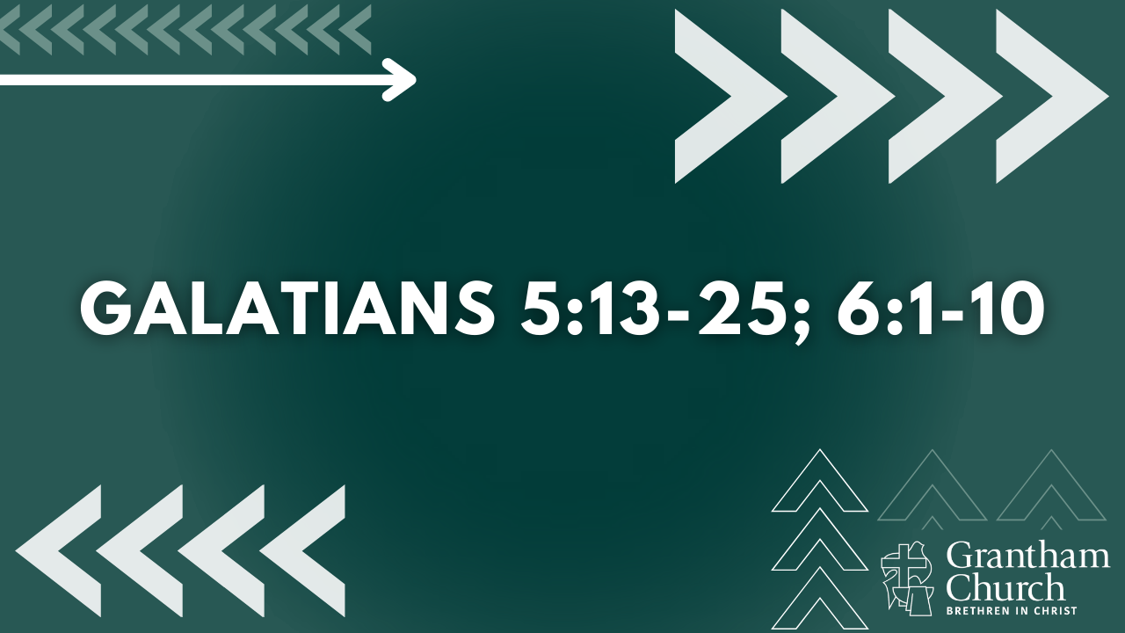
Notes:
[READ & COMMENT ON PASSAGES]
Don’t miss this, church. In his book, Baker writes: “Although Paul does erase some lines that the Jewish Christians are drawing to separate themselves from Gentiles, Paul does not take the fuzzy approach we observed in Dustin’s story. Paul does not write, “Erase the lines—everyone is in!” On the contrary, he centers them on Jesus, and he implores them to live in God’s grace and use their freedom to grow in Christ-likeness. For it is those who do this that identify and include themselves with the Body of Christ.
Before we reflect with some questions and respond to the Spirit, here is a snapshot of what fuzzy thinking and practice leads to, and the sort of community that it creates… [NEXT SLIDE]

Slide 10
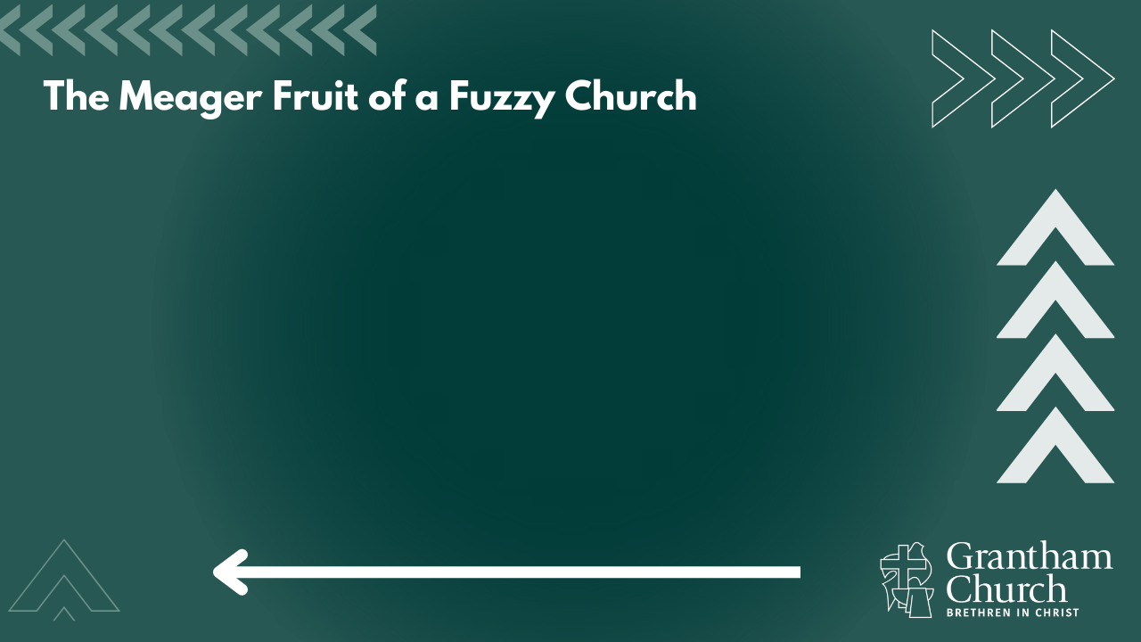

Slide 11
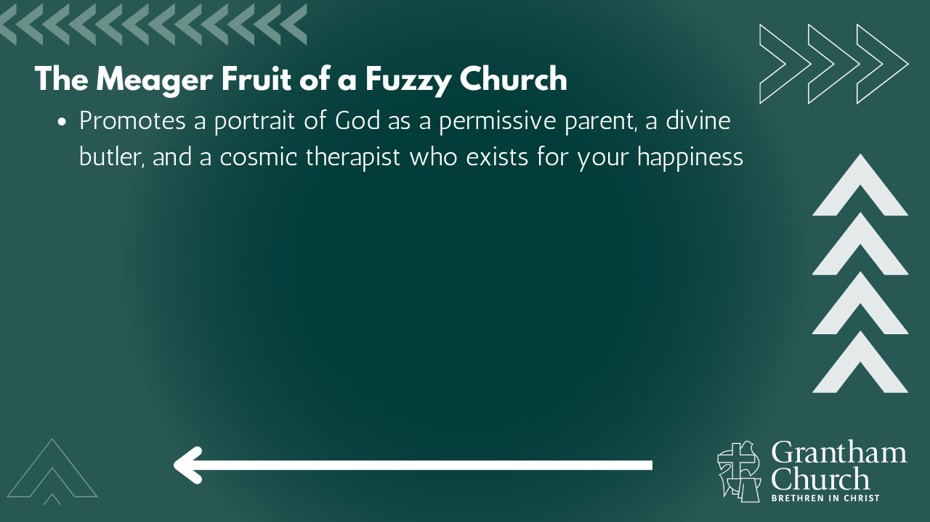

Slide 12
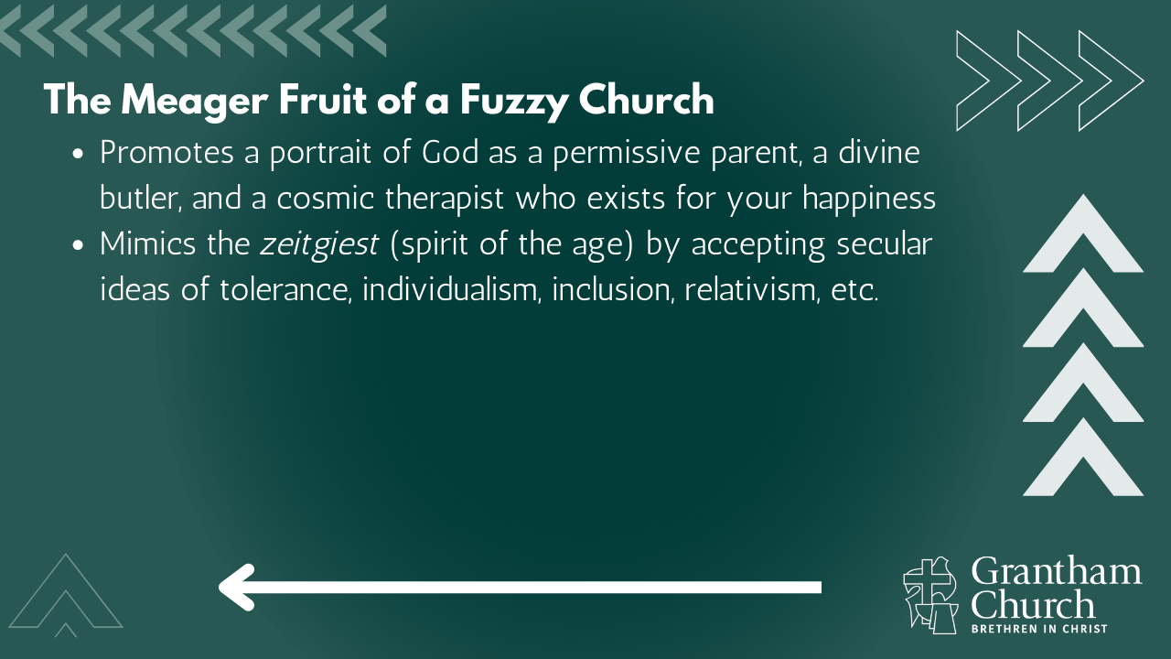

Slide 13
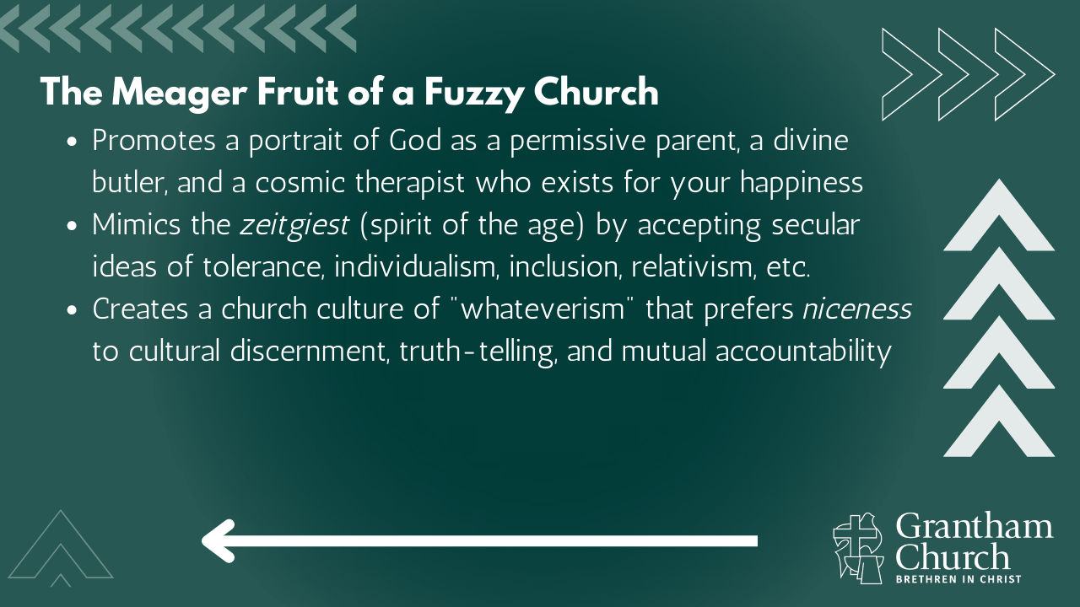

Slide 14
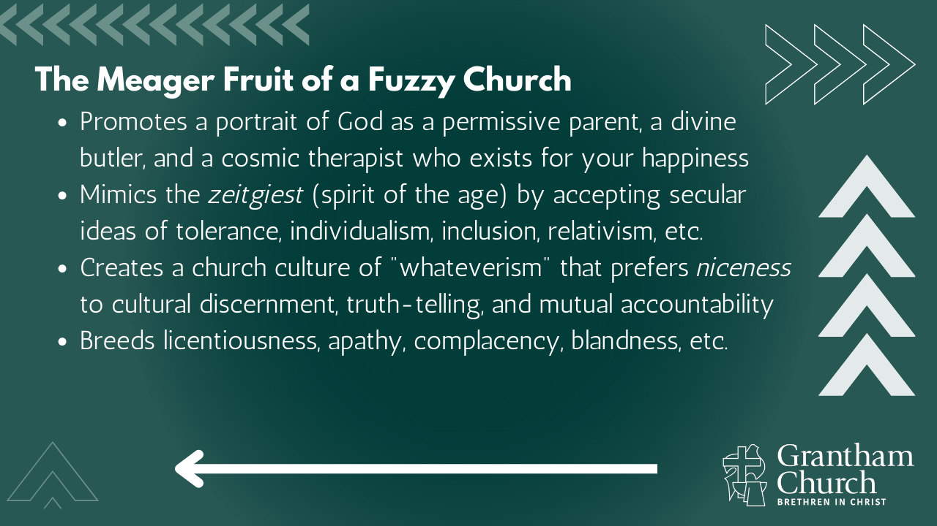

Slide 15
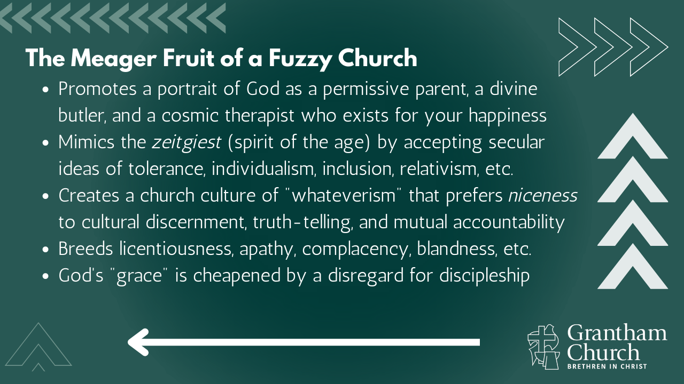

Slide 16
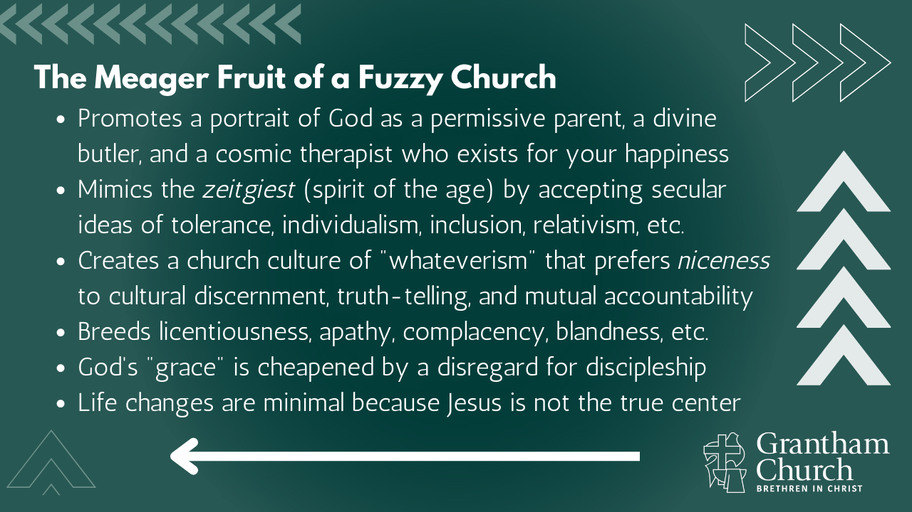
Notes:
[BRIEF COMMENTS ON EACH]
Promotes a portrait of God as a permissive parent, a divine butler, and a cosmic therapist who exists for your happiness – moralistic therapeutic deism
Mimics the zeitgiest (spirit of the age) by accepting secular ideas of tolerance, individualism, inclusion, relativism, etc. – do you recognize these forces at work?
Creates a church culture of "whateverism" that prefers niceness to cultural discernment, truth-telling, and mutual accountability – the flipside is being mean & ugly
Breeds licentiousness, apathy, complacency, blandness, etc.
God's "grace" is cheapened by a disregard for discipleship – “cheap grace”
Life changes are minimal because Jesus is not the true center – instead, where the Bounded Church’s center and focus is on the boundaries that separate, the Fuzzy Church’s focus, or center of gravity, is encouraging people to be their “authentic self” and ensuring that there are few (if any) boundaries, while holding a vague, always ambiguous, not-sure-of-anything “faith” except that we should never hurt someone’s feelings, unless of course they are from a bounded church, they vote republican, or they don’t agree with our theology or politics… then we exclude them. Of course, for the Fuzzy Church… they wouldn’t say they are excluding anyone. No, they “cancel” them. But let’s be clear. It’s a different word, but it’s the same concept.
And I’m intentionally trying to connect some dots here for us. If you’ve not noticed, folks who are more conservative tend to be more bounded, and progressives tend to be more fuzzy. Therefore, I think it is in keeping with the gospel and our aspirations of being a “third way” congregation that we resist these forces that appear to be driven more by our political opinions and extreme ideologies than a faith and a church community that has been shaped by the gospel of the New Testament. Our inability to hold grace and truth together, and our lack of love and unity, proves that. [NEXT SLIDE]

Slide 17
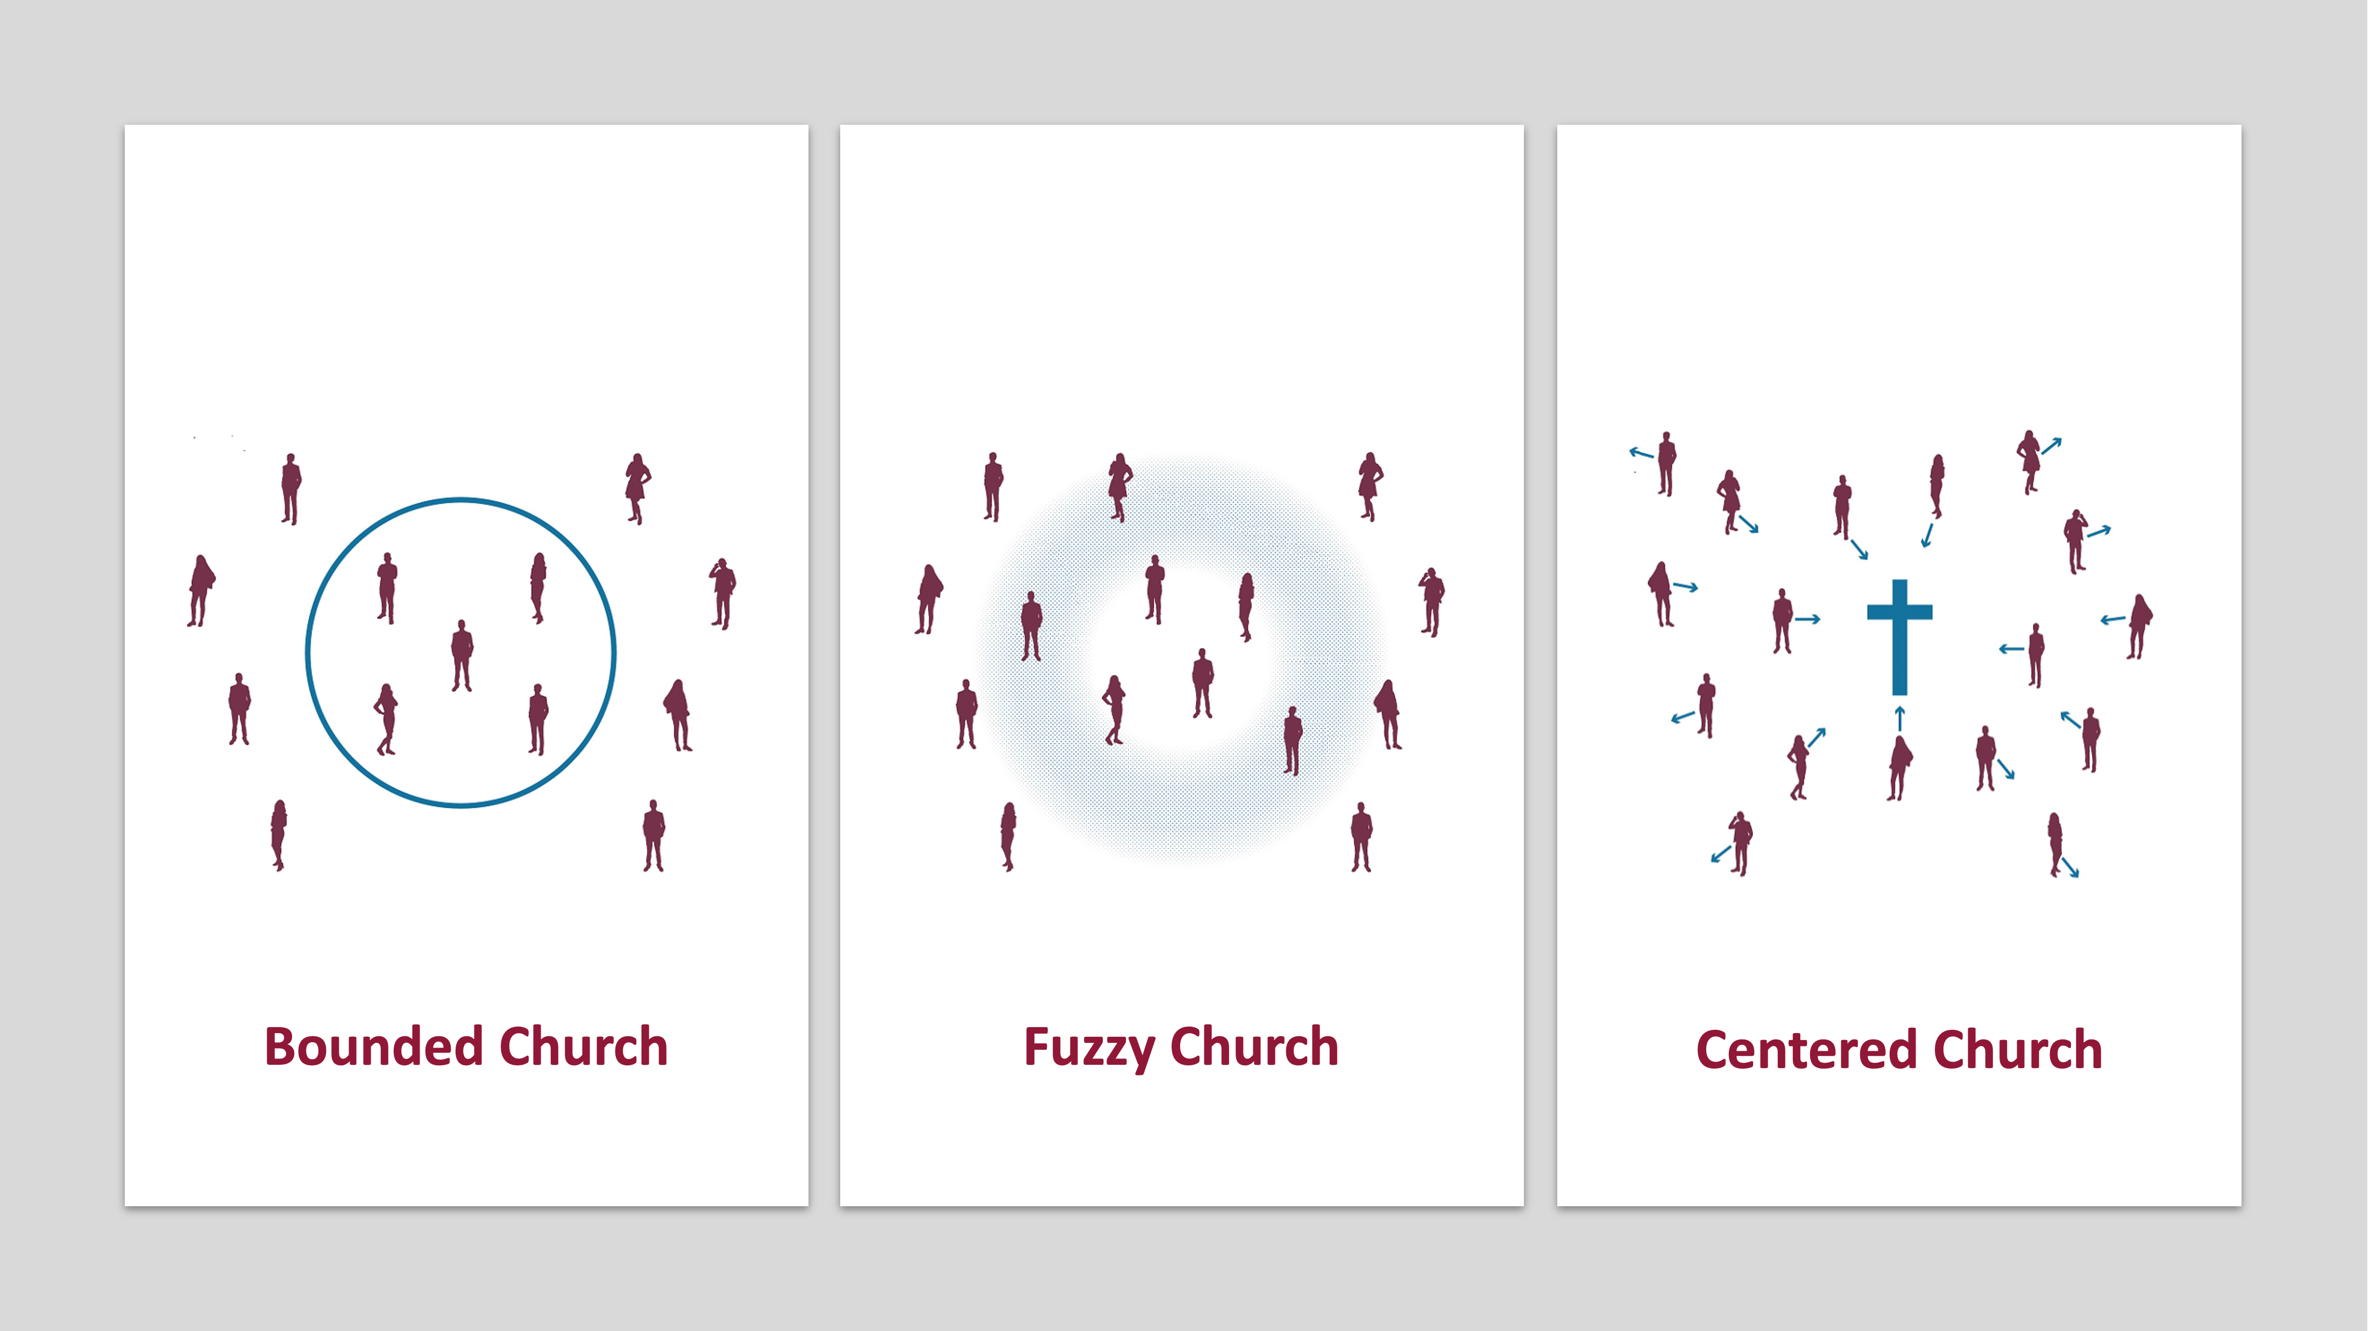
Notes:
So, brothers and sisters, just as we ought to say “No” to the bounded church, let us also say “No” to the fuzzy church, so that we might say “Yes” to Jesus and the gospel which (as we will hear next week) is best known, experienced, and embodied in the Centered Church, where we hold grace and truth together in Jesus Christ.
In closing, here are two questions for reflection and response… [NEXT SLIDE]

Slide 18
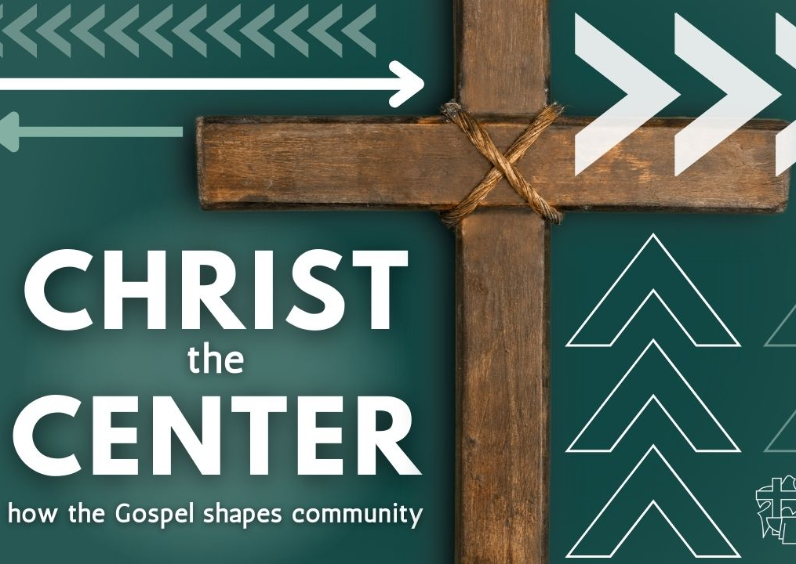
Questions
for reflection and response:

Slide 19
Questions
for reflection and response:
  Have you experienced a fuzzy church before? Is there hurt that you need to name and ask God to heal in you?

Slide 20
Questions
for reflection and response:
  Have you experienced a fuzzy church before? Is there hurt that you need to name and ask God to heal in you?
  Be honest. Is there any fuzzy thinking in you that distorts your view of God and has led to licentiousness, apathy, and accepting the spirit of the age? What about in our church?
Notes:
[BRIEF COMMENT ON EACH QUESTION]
[CLOSING PRAYER]
[NEXT SLIDE FOR CLOSING PRAYER]

