Slide 1

Notes:
[BRIEF INTRO]
Fifth Sunday of Lent
In our Lenten series, Seeking God’s Ways, we are exploring the “higher” ways of God. According to Isaiah 55:8-9, God says, “For my thoughts are not your thoughts, neither are your ways my ways,” declares the Lord. “As the heavens are higher than the earth, so are my ways higher than your ways and my thoughts than your thoughts.” So, we want to understand God’s ways so that we might repent of our own way, believe in the gospel, and follow the way of Christ as we welcome more of his Kingdom upon the earth.
Again, if you’ve missed any of the messages in this series, I encourage you to check those out online. We began this series by looking at how God calls us to move from security to generosity, from fear to compassion, from earning to receiving, and then last week we saw how God invites us to move from exceptionalism to inclusion in the way of Jesus. Which brings us to our fifth installment…. [NEXT SLIDE]

Slide 2

Notes:
[BRIEF COMMENTS]
From Scarcity to Abundance, i.e., moving from a mindset that there isn’t enough, to living with full trust in God’s ability to provide all that we need and more, if we will repent of the narrative of scarcity that enslaves us.
As the summary in your bulletin says: It was in the wilderness that God addressed the scarcity mindset that Israel had learned as slaves in Egypt. He needed to free them from this bondage if they were going to trust in him and receive his abundant provision. And then, as we will see this morning, it’s in the feeding of the five thousand that the Gospel writers want us to discover Jesus as the source of God’s endless supply of resources, as he calls us to view the world through his eyes.
But before we go any further, let’s pray together. [BRIEF PRAYER]
Please grab your Bible and let’s go to our main Scripture reading… [NEXT SLIDE]

Slide 3

Scripture Reading
Luke 9:1-6, 10-17 NLT
Notes:
[INVITATION TO STAND FOR SCRIPTURE READING]
[READ LUKE 9:1-6, 10-17 NLT] - This is the word of the Lord. Thanks be to God. You may be seated.
[BRIEF COMMENTS]
Before our second child was born – “Can we love the second child like we do the first?” In other words, will there be enough love to go around?
This scarcity mindset shows up in a lot of ways in our life, doesn’t it? And that’s what we see Jesus confronting with his disciples in our main Scripture reading today.
Let’s go back now and quickly walk through this text together… [NEXT SLIDE]

Slide 4
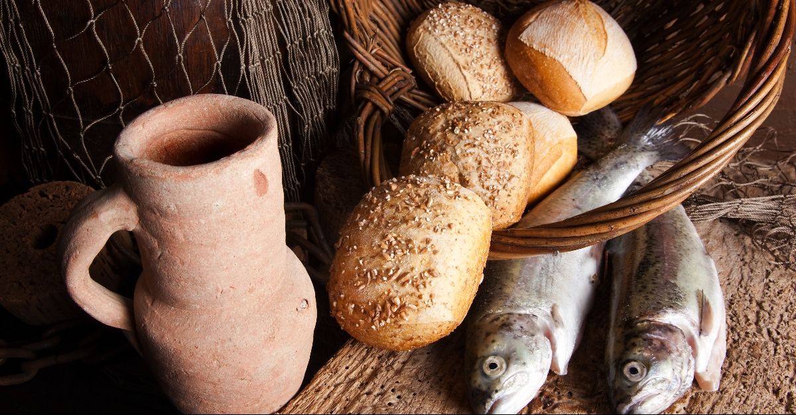
Feeding of the 5,000 | Verse-by-Verse
Luke 9:1-6, 10-17 NLT
Notes:
[BRIEF COMMENTS VERSE-BY-VERSE]
vs. 1-2 – Jesus commission the 12 to do what they had seen him do in his ministry—cast out demons, heal the sick, and proclaim the coming Kingdom of God; Notice, Jesus prioritizes and holds both physical needs and spiritual needs together.
vs. 3-4 – Jesus wants his disciples to trust God with what they will eat, wear, and where they will sleep each night. They must rely upon God working through others.
v. 5 – Jesus doesn’t want them to take rejection personally, but rather entrust the people to God and give them over to their choices. This is always what God does, btw.
v. 6 – Jesus gives them circuit of towns to travel and then report back.
vs.10-11 – They report back and Jesus intends to retreat with them to debrief further and possibly to teach them more, but the retreat is interrupted. Yet Jesus still receives them and will use it to further his lesson to the disciples about God’s provision.
v. 12 – The disciples aren’t being heartless. They seem to truly care and want to do the right thing; at least what they perceive to be the right thing in this situation.
vs. 13-14 – Jesus gives a shocking reply! The crowd was very large, yet Jesus expects them to use what little they have and give it to God so he can multiply it.
vs. 15-16 – This is clearly a prefiguring and foreshadowing of the eucharist or communion. “Eucharist” in Greek means thanksgiving. And that’s what Jesus does as he breaks the bread and asks God to bless it, and provide abundantly for all those in need.
v. 17 – That’s on purpose. We can’t help but notice the excess, which not only says something about God’s provision, but it also references the leftovers in Exodus 16. In fact, this entire episode ought to be seen (in an eschatological sense) as a reenactment of the Exodus 16 wilderness experience. You will recall that is when… [NEXT SLIDE]

Slide 5
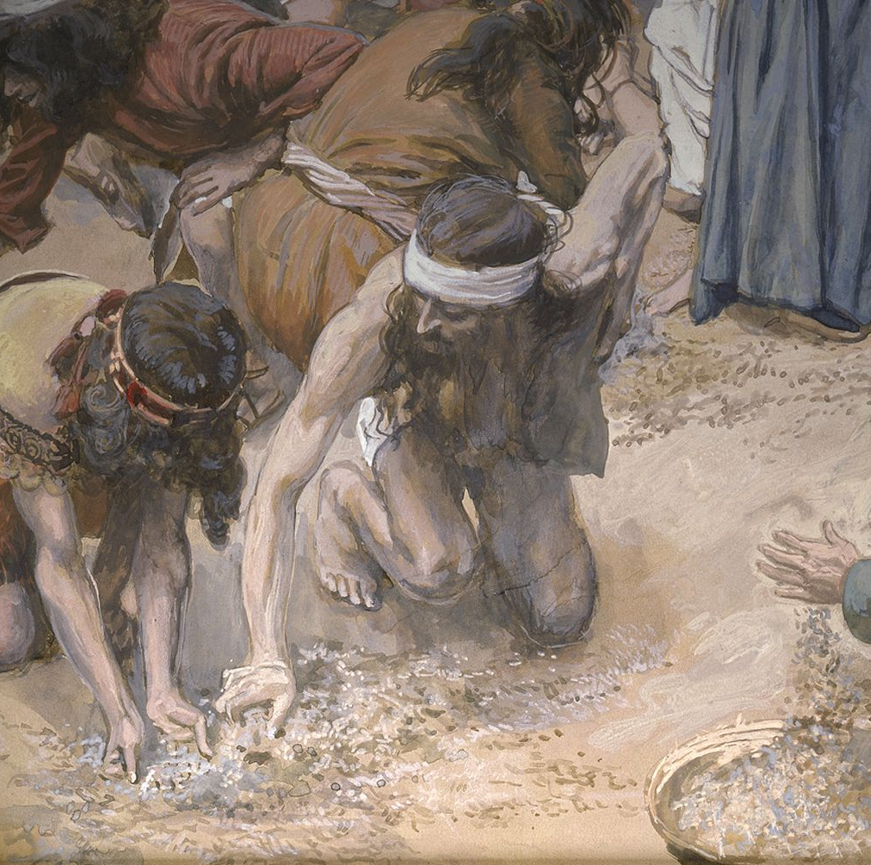
Moving from the Scarcity Mindset of Pharoah’s Egypt to an Abundance Mindset in the Wilderness with God
Exodus 16:1-31
God provides quail and “manna” for them to eat
People want to hoard and store, but it goes bad
Moses instructs them to rest on the Sabbath as a way of trusting God and resisting the mindset of scarcity
Notes:
[BRIEF COMMENTS]
In an article entitled, The Liturgy of Abundance, The Myth of Scarcity, OT scholar Walter Brueggemann said this regarding Exodus 16: “Three things happened to this bread in Exodus 16. First, everybody had enough. But because Israel had learned to believe in scarcity in Egypt, people started to hoard the bread. When they tried to bank it, to invest it, it turned sour and rotted, because you cannot store up God's generosity. Finally, Moses said, "You know what we ought to do? We ought to do what God did in Genesis I. We ought to have a Sabbath." Brueggemann says, “Sabbath means that there's enough bread, that we don't have to hustle every day of our lives. There's no record that Pharaoh ever took a day off. People who think their lives consist of struggling to get more and more can never slow down because they won't ever have enough.”
And isn’t that how we are conditioned today in our consumer culture? We’re always wanting more. What we have is not enough, or we worry about the day we won’t have enough. And all of this gets rooted in our identity. So, we feel that we are not enough. We need to be more, to do more. And this scarcity mindset doesn’t allow us to accept and live into the higher way of God’s abundance.
That’s why, my friends, we need to hear the good news that Jesus graciously invites us to leave this bondage and live freely into his way of trusting God and experiencing that he is enough for us, our families, and for our church. For he will not only meet our needs but provide abundantly so that everyone can enjoy this sort of life.
Remember what Jesus said in John chapter 10 verse 10… [NEXT SLIDE]

Slide 6
John 10:10 NRSV
The thief comes only to steal and kill and destroy. I came that they [“the sheep” – Israel/God’s people] may have life, and have it abundantly.*
* abundantly (Gk: perissos) 1. over and above, more than is necessary 2. superior, extraordinary, surpassing, uncommon
Notes:
[BRIEF COMMENT ON VERSE]
Jesus is speaking about the religious leaders (“shepherds”) of his day, and all those who have claimed to know the truth and offer life, wisdom, and salvation apart from Christ himself, who is the door to the sheep pen—the Kingdom.
So, Jesus is calling us – through these words and in the feeding of the five thousand, and as the fulfillment of Israel’s lesson of trusting God for sustenance and provision, to move from scarcity to abundance in the way we think, pray, work, and follow him.
Let’s consider now what that looks like… [NEXT SLIDE]

Slide 7
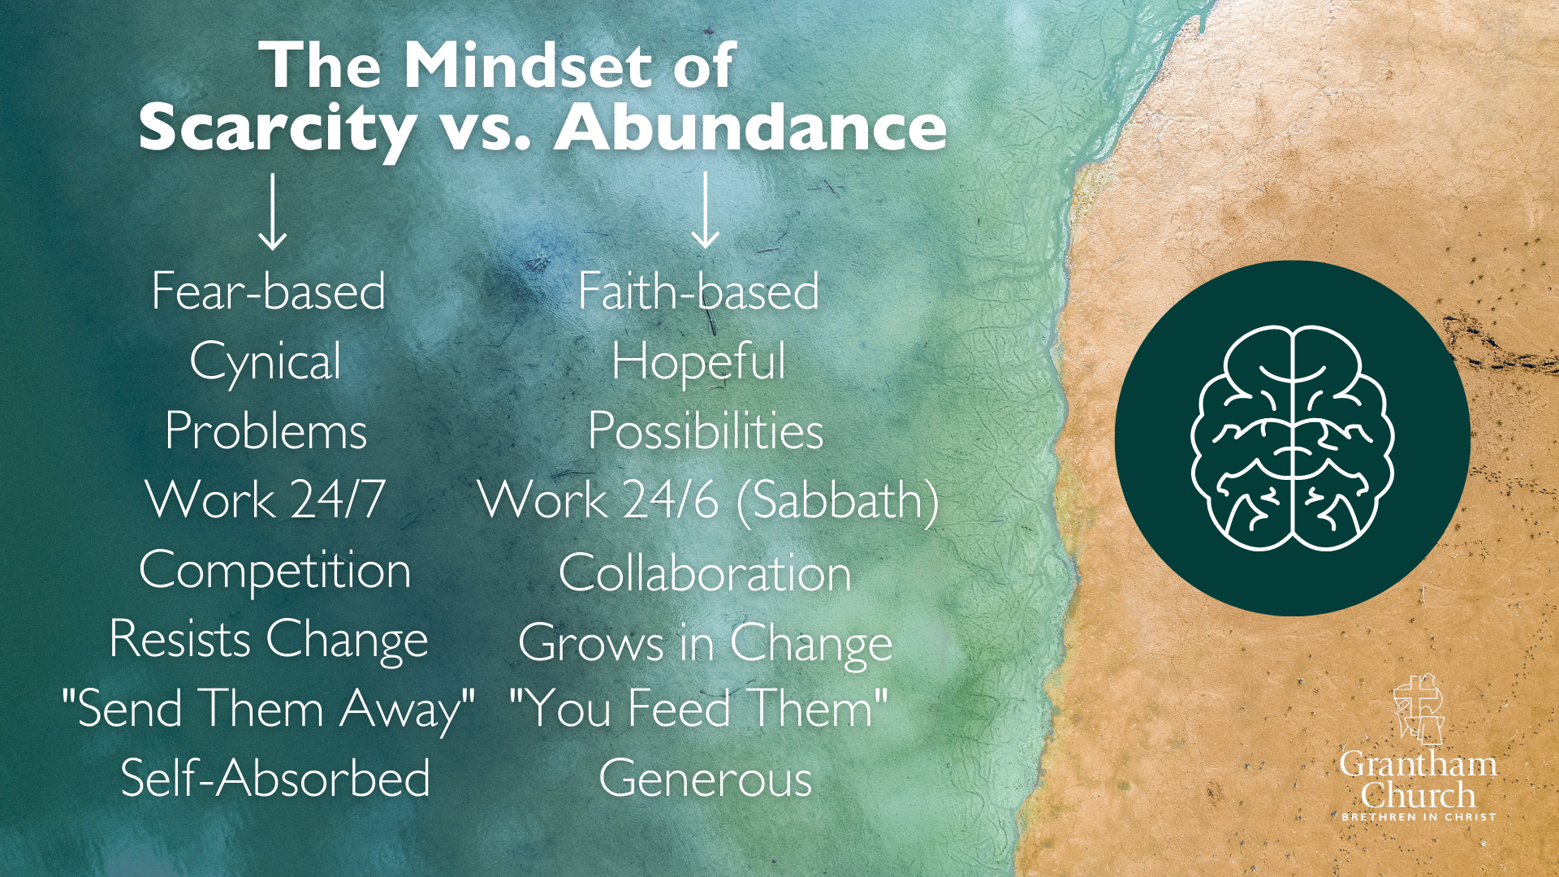
Notes:
[BRIEF COMMENTS ON EACH LINE]
Fear-based vs. Faith-based – faith-based is rooted in love & trust
Cynical vs. Hopeful – the gospel rejects the nihilist, Nietzschean worldview!
Problems vs. Possibilities – all things possible with God
Work 24/7 vs. Work 24/6 – Sabbath is resistance to a culture of scarcity
Competition vs. Collaboration – the harvest is plentiful; the workers are few
Resists Change vs. Grows in Change – those who thrive accept change
“Send Them Away” vs. “You Feed Them” – we can do something to help
Self-Absorbed vs. Generous – generosity is born of an abundance mindset
So, take a look at this list. How is the Spirit speaking to you about your mindset?
Finally, as a way to sum up these things within the entire biblical story, and help us to better understand what it looks like to move from scarcity to abundance, let’s watch this creative animation from the BibleProject… [PLAY VIDEO]

Slide 8

Notes:
[PLAY THE BIBLEPROJECT VIDEO – 5 mins]
[GO BACK TO SLIDES – Questions for Reflection – AS SOON AS VIDEO IS OVER]

Slide 9

Questions for reflection and response:

Slide 10
Questions for reflection and response:
In what ways does your thinking and behavior reflect a scarcity mindset as it relates to your personal life and decision-making?

Slide 11
Questions for reflection and response:
In what ways does your thinking and behavior reflect a scarcity mindset as it relates to your personal life and decision-making?
How might this message apply to our church? How is the Spirit calling us to move “from scarcity to abundance” in ministry, as we seek to lead others to the God who looks like Jesus?
Notes:
[BRIEF COMMENT ON EACH QUESTION]
In what ways does your thinking and behavior reflect a scarcity mindset as it relates to your personal life and decision-making? (e.g., your time, attitude, gifts. finances, walk with God, etc.)
How might this message apply to our church? How is the Spirit calling us to move “from scarcity to abundance” in ministry, as we seek to lead others to the God who looks like Jesus?
[BRIEF MOMENT OF SILENCE]
As we’ve been doing each week in this series, please join me as we close with this responsive prayer… [NEXT SLIDE]

Slide 12
One: Your Ways, O God, are higher than our ways.
All: Your thoughts are higher than our thoughts.
One: We seek God’s ways.
All: Lord, move us from our scarcity mindset so that we might live into your abundance.
One: As we walk with Christ on this Lenten journey, let us see your way more clearly…
All: and follow your way more faithfully. Amen.
Notes:
[PRAY THE RESPONSIVE PRAYER]
[GO TO FINAL SLIDE]

Slide 13
Notes:
BENEDICTION:
Brothers and sisters, from this time and place into whatever awaits, may you follow God’s way of abundance. May you recognize messages of scarcity as lies and open your eyes to the abundant life we have in Christ and the call we have to show the world that God has given us everything we need to live in peace. And as you go, know that our God of the wilderness remains with you on the way.
Now go in peace, to love and serve the Lord.

