Slide 1

Notes:
This is the second Sunday in Lent and week 2 of our sermon series, Galatians: Faith Formation in Centered-Set Community.
We’re going chapter-by-chapter through Galatians and I’m inviting us to understand this passionate letter of Paul by reading it through the lens of bounded, fuzzy, and centered-set community.
I’ll remind you each week of what we’re talking about… NEXT SLIDE]

Slide 2
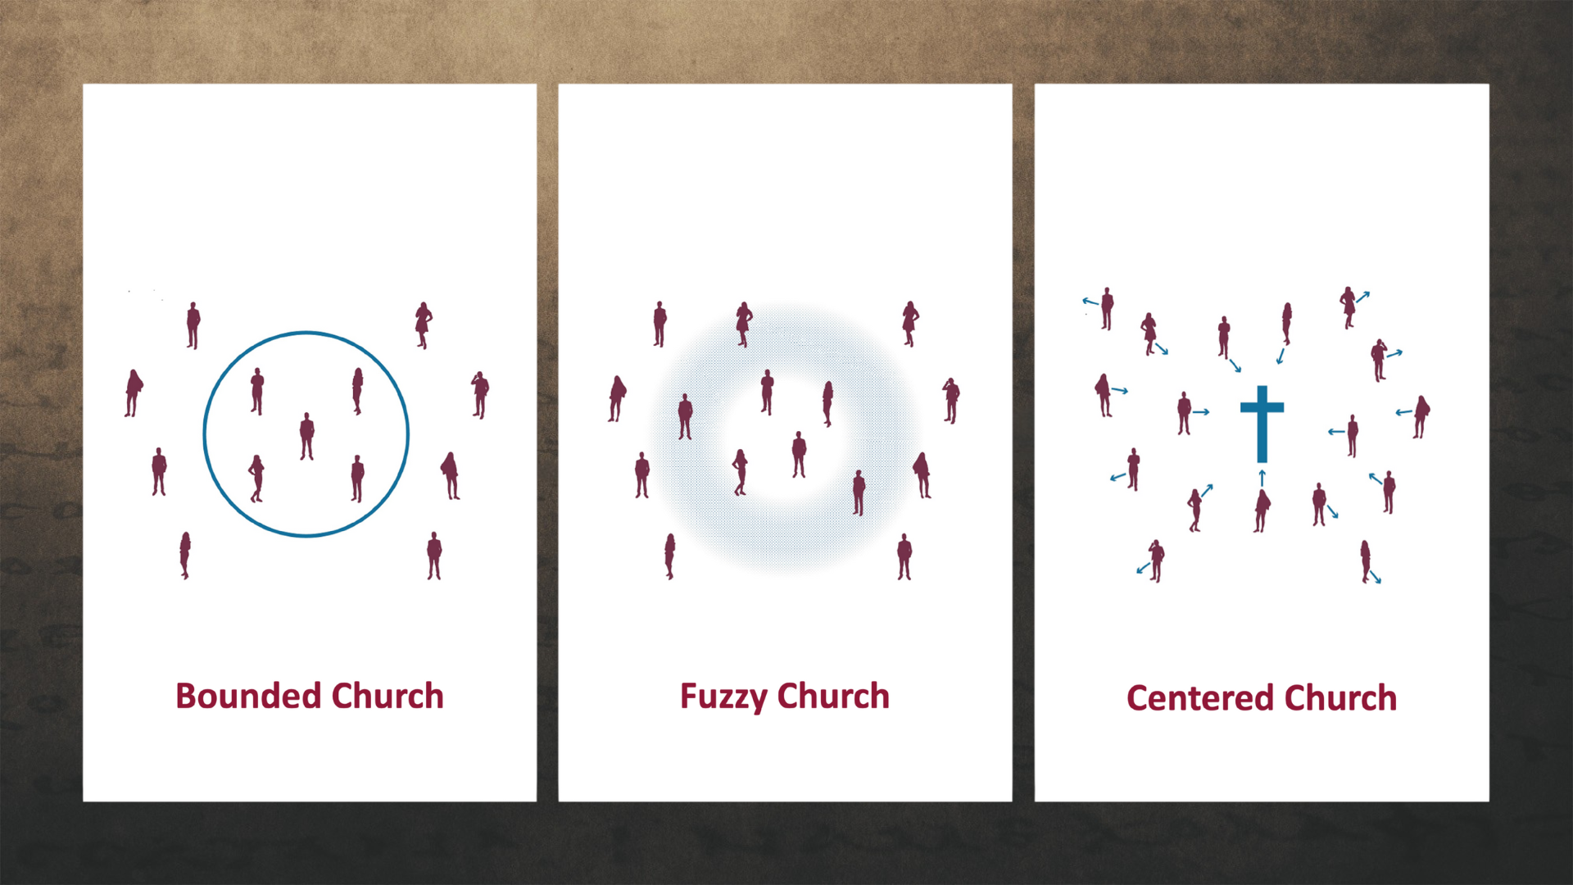
Notes:
A Bounded Church has a clear boundary line that is static and distinguishes Christians from non- Christians, or true Christians from mediocre Christians. The line generally consists of a list of correct beliefs and certain visible behaviors. A bounded church tends to create a sense of superiority and judgmentalism among its core members. And it hinders transparency and shames. This is the sort of thinking that was threatening the Galatian churches, which is why Paul is so concerned.
A Fuzzy Church is the opposite of the bounded church. It erases all lines and boundaries. The grounds for distinguishing who is in and out, as well as shaming judgmentalism, yeah, they’re gone, but the fuzziness about what they believe and who they are erodes the group’s sense of identity. Therefore, it lacks a sense of call to follow Christ and it disregards discipleship and spiritual formation. It has a tendency toward blandness, low expectations, and it creates a new set of problems in the church.
A Centered Church discerns who belongs to the group by observing people’s relationship with the center—Jesus Christ. The group includes all whose hearts are oriented toward the center. Their common direction brings unity. In the centered church, there is space to struggle and fail because they believe that everyone is in process—moving closer to the center. A centered approach remedies the problems of a bounded church that motivate a fuzzy church to blur boundaries, while also avoiding the negative fruit that grows out of a fuzzy approach.
And this centered-set community is what Paul wants for the Galatians. And this is the kind of community they can have if they will embrace the gospel of God’s grace, which makes centered church possible. Last week we began our series with some background information on Galatians. Here is a quick review of that, as well as the context and purpose for Pau’s letter… [NEXT SLIDE]

Slide 3
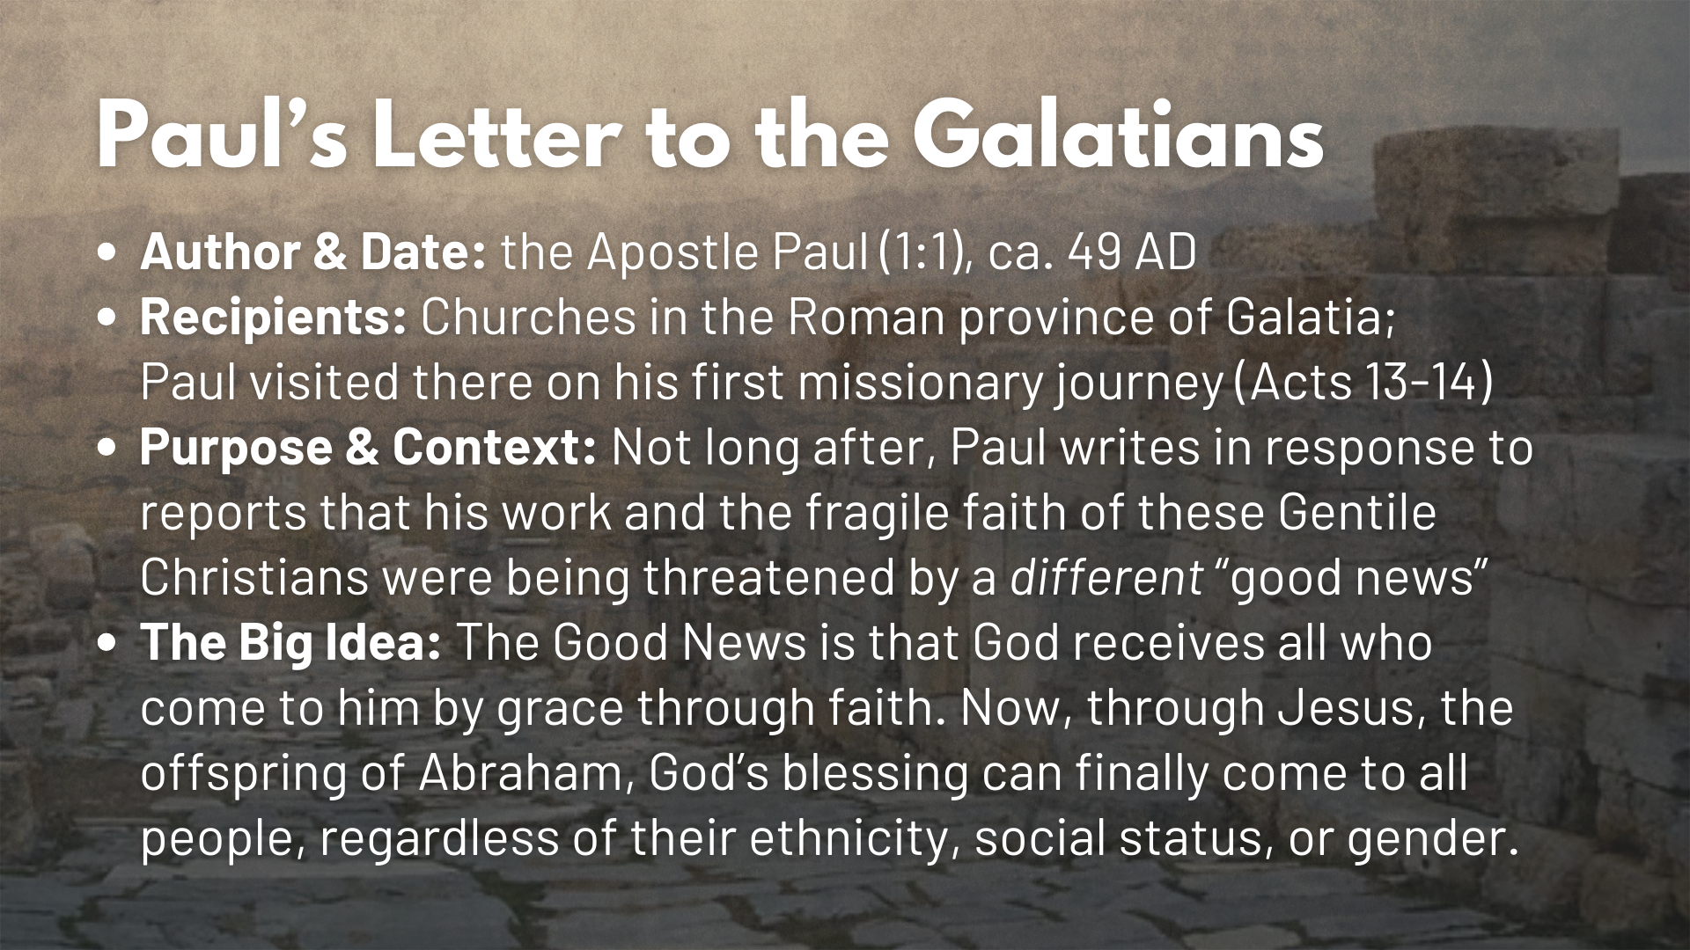
Notes:
[READ SLIDE & COMMENT]
In chapter 1, we heard Paul’s deep concern and frustration beginning with his opening words. In verse 6 he said: “I am astonished that you are so quickly deserting the one who called you to live in the grace of Christ and are turning to a different gospel.” The “grace of Christ” is Paul’s way of referring to the true good news against a false gospel that was being proclaimed by a group of Jewish believers, who were bounded in their thinking; claiming that the male Gentiles in Galatia needed to be circumcised and that all new believers should observe Jewish customs and laws if they wanted to follow Jesus.
And remember how these two gospels compare… [NEXT SLIDE]

Slide 4
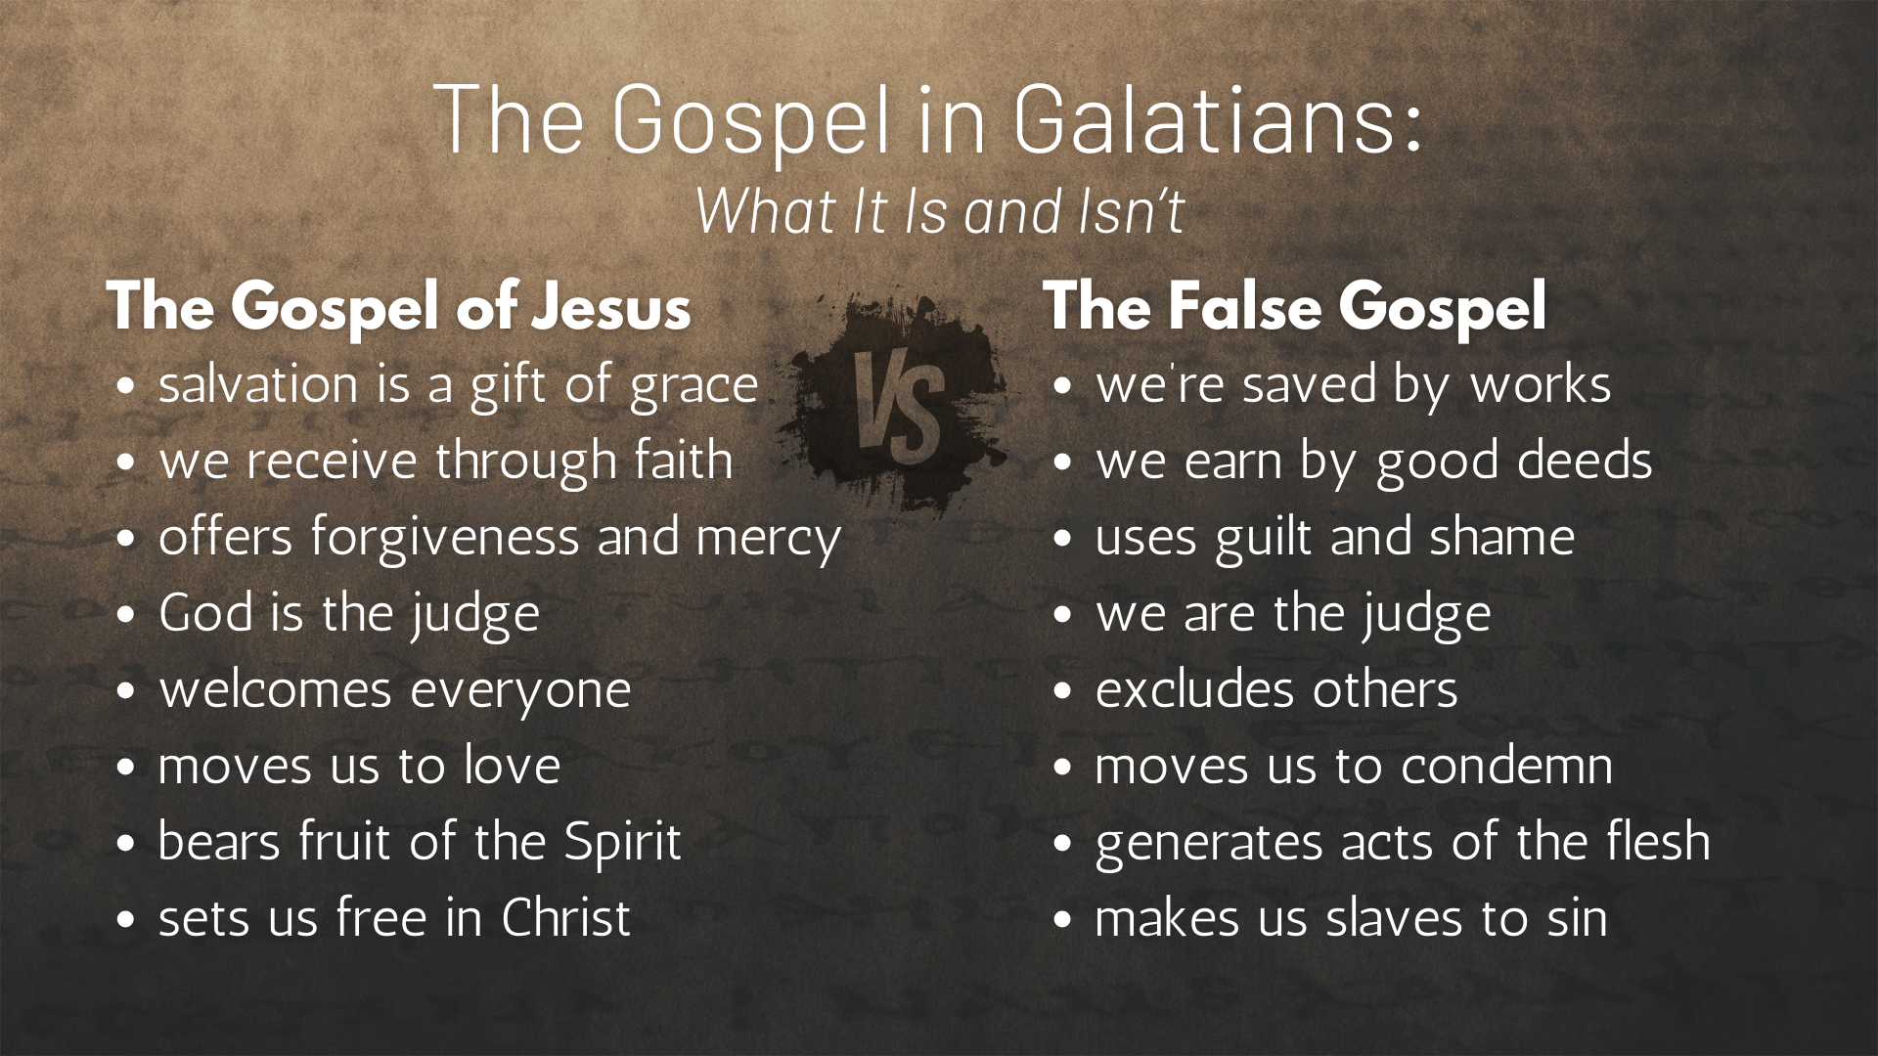
Notes:
[READ EACH POINT & COMMENT]
The Gospel of Jesus and then the False Gospel
And Paul said there is ”no other gospel” than that of the gospel of God’s grace in Christ. He was so adamant about it that he says if he were to ever change his mind, or an angel were to appear and proclaim a different gospel, you should consider them to be anathema—cursed!
And then Paul tells the Galatians that his authority and calling to proclaim the gospel of God’s grace came from the risen Christ himself, whom he met on the road to Damascus, and who later (over a period of years) revealed to Paul all the mysteries about Christ and his good news.
And at the end of chapter 1 he shares why he believes they should listen to what he’s saying. Afterall, he was the last person you’d expect to believe and preach this good news. For he was a zealous Pharisee who once persecuted Christians in the name of a bounded-set God and exclusive community.
And that brings us to Galatians chapter 2… [NEXT SLIDE]

Slide 5

Notes:
Today we’re going to hear Paul tell the Galatians that the leaders of the Jerusalem church had originally accepted him and his ministry, so why are they now listening to a false gospel from some law-abiding, holier-than-thou Jewish agitators? And then we’ll read how Paul confronted Peter in Antioch after he accepted and ate with Gentiles but then changed his mind when the agitators from Jerusalem arrived. This is a big problem for Paul, and I hope to show you why it should be a real concern for us. And then I’ll share how we can lovingly confront bounded thinking today with the gospel of God’s grace.
[BRIEF PRAYER]
Go ahead an open your Bibles to Galatians chapter 2. And while you’re turning there, I’d like (for the sake of context) share the sequencing of events that led up to what Paul will share… [NEXT SLIDE]

Slide 6
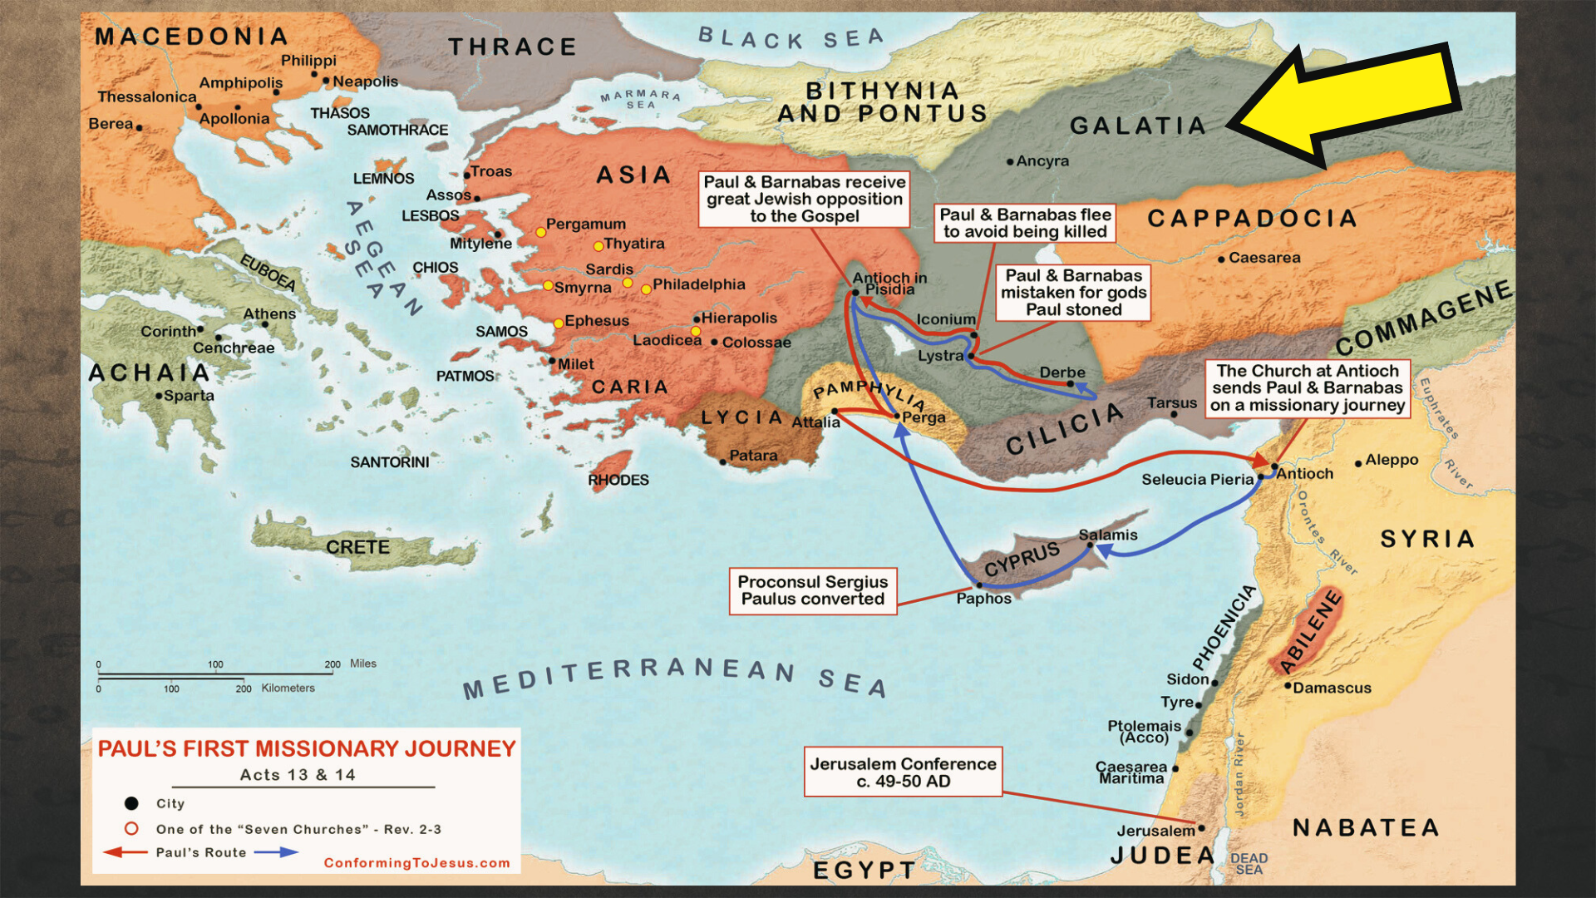
Notes:
[BRIEF COMMENTS ON MAP]
We read in Acts 9:26-28 that not long after his Damascus road conversion experience, Paul went to Jerusalem and “he tried to join the disciples, but they were all afraid of him, not believing that he really was a disciple. But Barnabas took him and brought him to the apostles. He told them how Saul on his journey had seen the Lord and that the Lord had spoken to him, and how in Damascus he had preached fearlessly in the name of Jesus. Saul stayed with them and moved about freely in Jerusalem, speaking boldly in the name of the Lord.” So, they accepted Paul, his calling, and the gospel he preached.
In Acts 11:1-18, Peter is given a vision and God essentially tells him that bounded thinking isn’t a reflection of the gospel of God’s grace. Peter is then questioned about his change of mind by “those in the party of the Pharisees” in Jerusalem who were followers of Jesus. He defends his position and then Luke leads us to believe that all was well with the Jerusalem church and Paul. But the bounded among them are still there and likely scheming against Paul and his ministry.
We then we read that Barnabas goes to Tarsus seeking to partner with Paul in sharing the gospel to Gentiles. They decide to make their ministry hub in Antioch of Syria, where Luke tells us that disciples of Jesus were first called “Christians.” In Acts 13, Paul and Barnabas go on their first missionary journey, passing through southern Galatia, planting churches, and encountering Jewish opposition along the way. Luke says that Paul and Barnabas were “committed to the grace of God” (14:26).
And then in Acts 15:1-2, we learn of a conflict in Antioch brought about by those Jewish believers from Jerusalem that opposed Paul and his gospel. This leads to Paul confronting Peter, which we’re about to read. And the following this confrontation, just before the Jerusalem Council, Paul writes his letter to the Galatians, responding to what has happened and the news that the Jewish opposition had been there.
And with that context in mind, let’s read chapter 2, beginning with verse 1, where Paul shares about his last trip to Jerusalem, before the conflict in Antioch… [NEXT SLIDE]

Slide 7
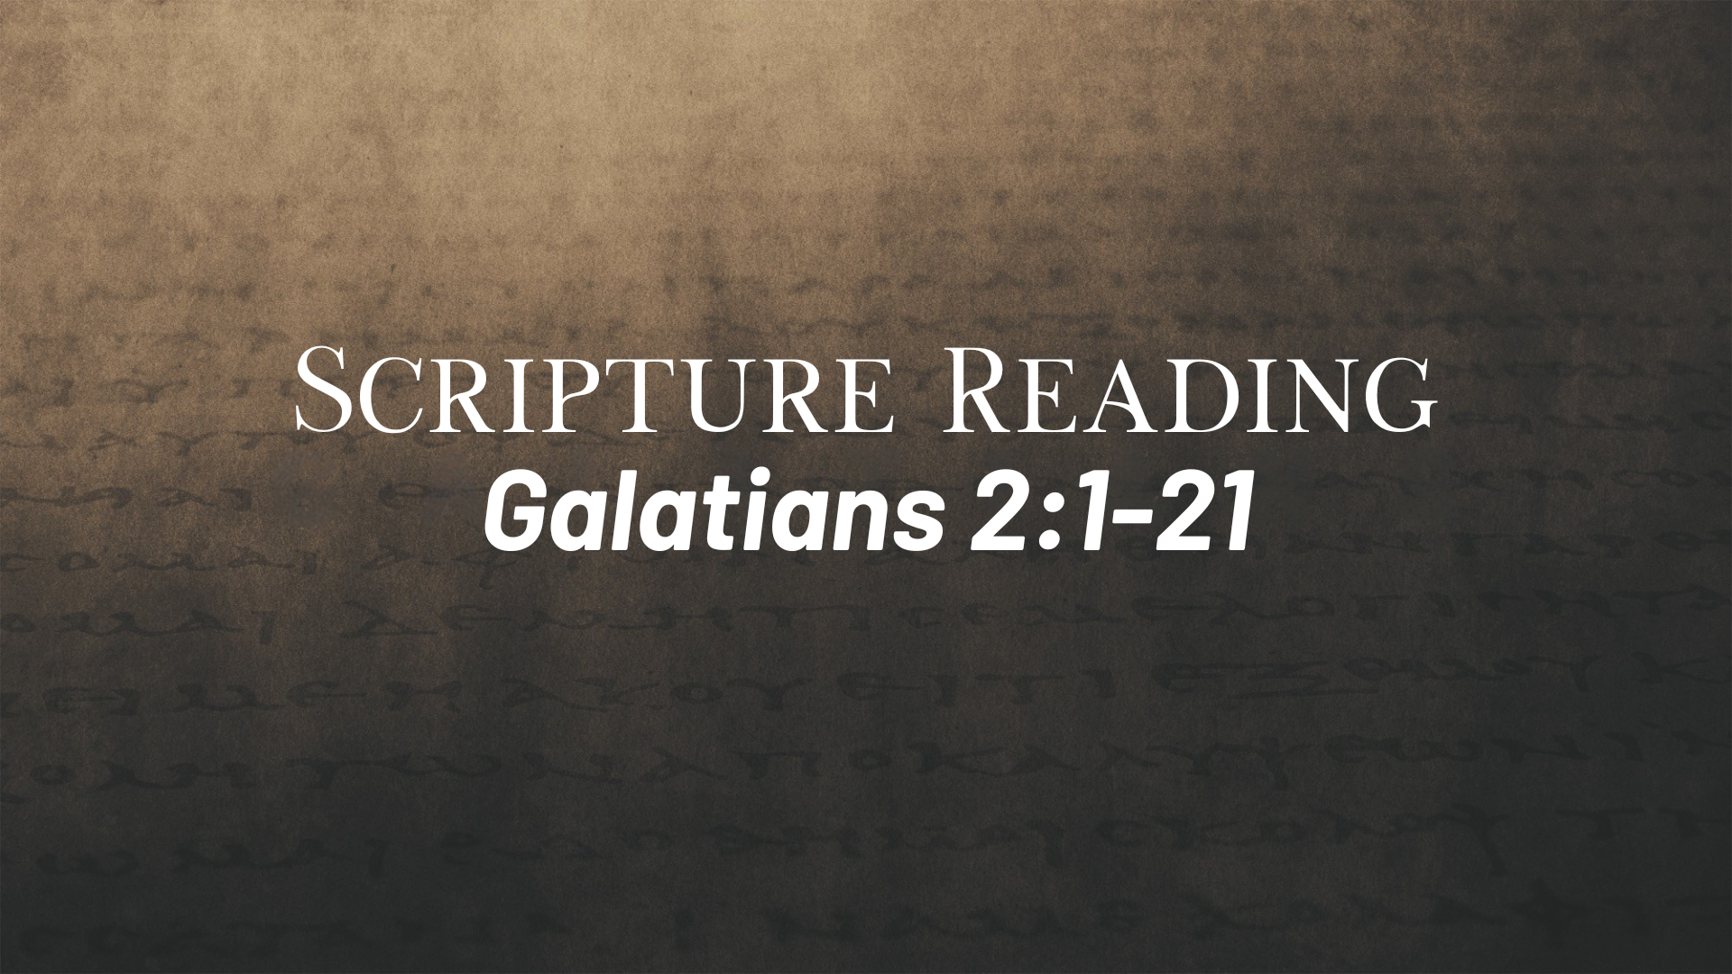
Notes:
[READ & COMMENT]
v. 1 – Titus was a Gentile convert who was growing in his faith; Paul wrote a letter to Titus in the NT; Titus becomes a trusted co-worker and companion of Paul in the ministry
v. 2 – Paul is referencing Isaiah 49:4: “I have labored in vain; I have spent my strength for nothing at all. Yet what is due me is in the Lord’s hand, and my reward is with my God.”
v. 3 – a relief to Titus, I’m sure! And Paul makes it clear this was not an issue.
v. 4 – deception and ”sneakery” was being used by the “bounded” believers opposing Paul; notice how the false gospel and bounded thinking works: it takes away freedom in Christ, it enslaves, it forces people to do things they aren’t being compelled or convicted to do in their faith.
v. 5 – truth matters; and the truth of the gospel of God’s grace matters all the more!
Let’s think about the problem Paul sees a bit more deeply. You’ll remember last week we looked ahead at Galatians 4. Look at verse 3 again… [NEXT SLIDE]

Slide 8
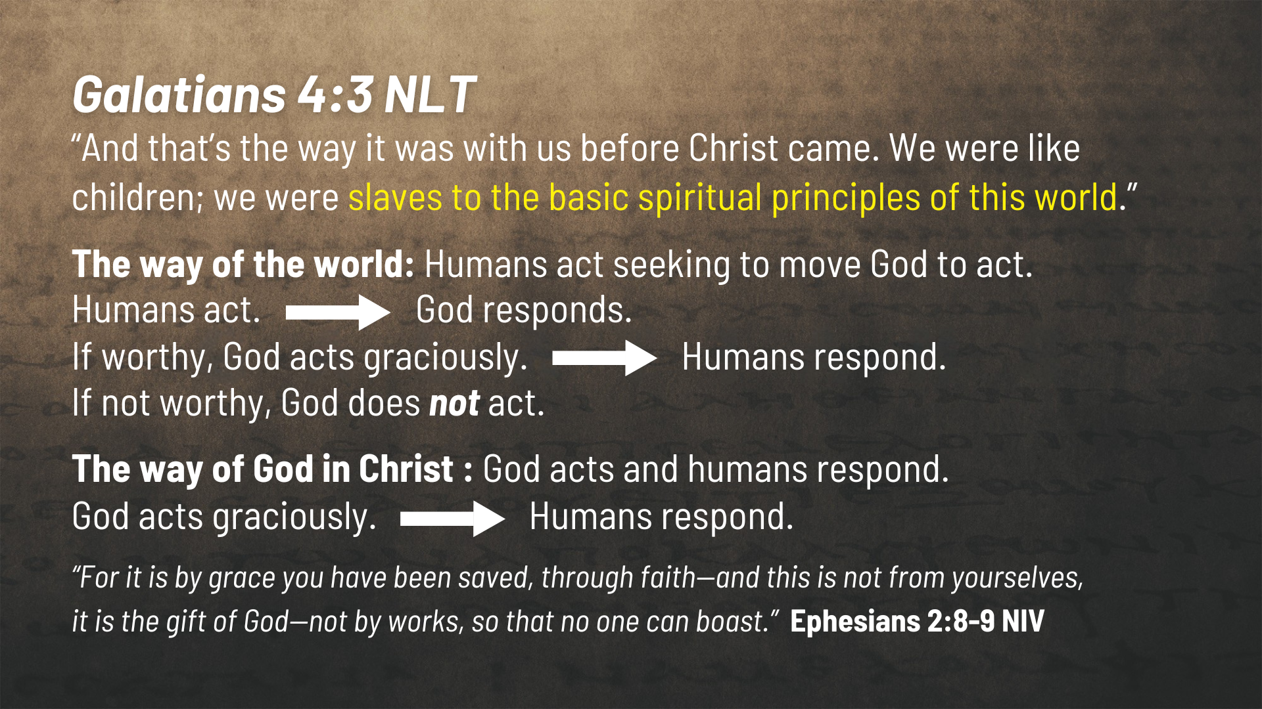
Notes:
[READ & COMMENT ON SLIDE]
Back to Galatians 2, verse 6… [NEXT SLIDE]

Slide 9
Notes:
[READ VERSES 6-10 & COMMENT]
And now Paul shifts to his confrontation with Peter. Verse 11… [NEXT SLIDE]

Slide 10
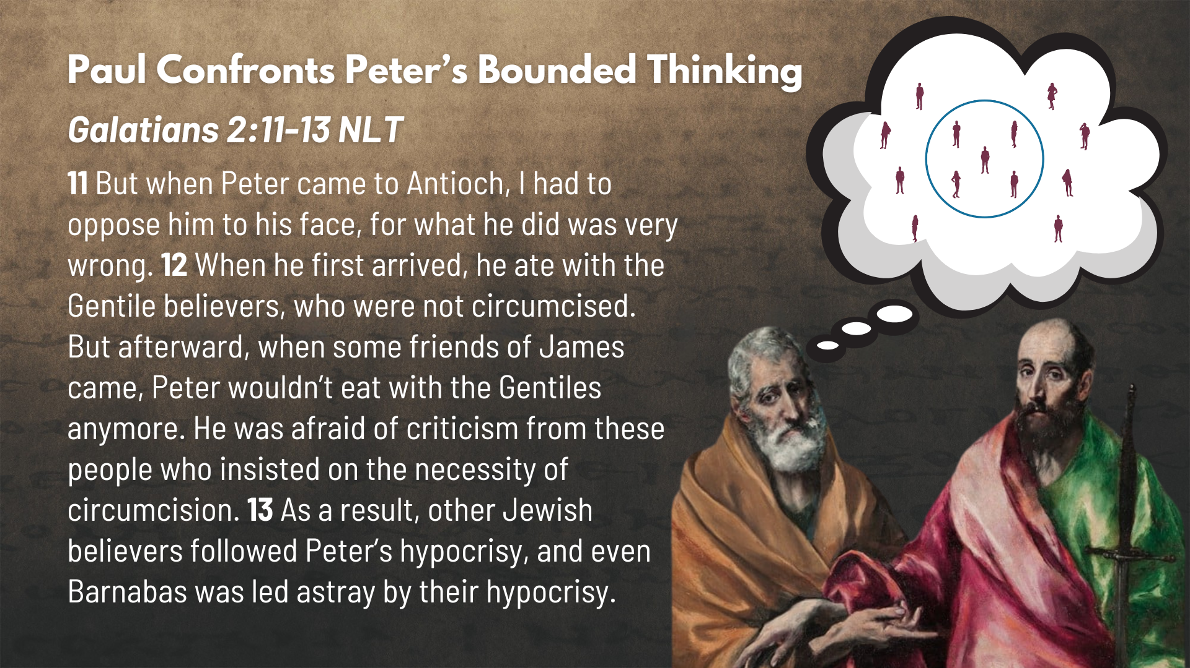
Notes:
[READ VERSES 11-16 & COMMENT] Verse 16 notes:
Read N.T. Wright’s translation of verse 16
Mark Bakers writes: “In Galatians, to be justified is not simply to be declared not guilty of having broken laws, or to be placed in proper relationship with standards recorded in an impersonal code. To be justified is to be placed in proper relationship to God—to be made a full participant in the community of God’s people” (pg.107).
[READ VERSES 17-19 & COMMENT]
And now a verse you’re probably familiar with… verse 20… [NEXT SLIDE]

Slide 11
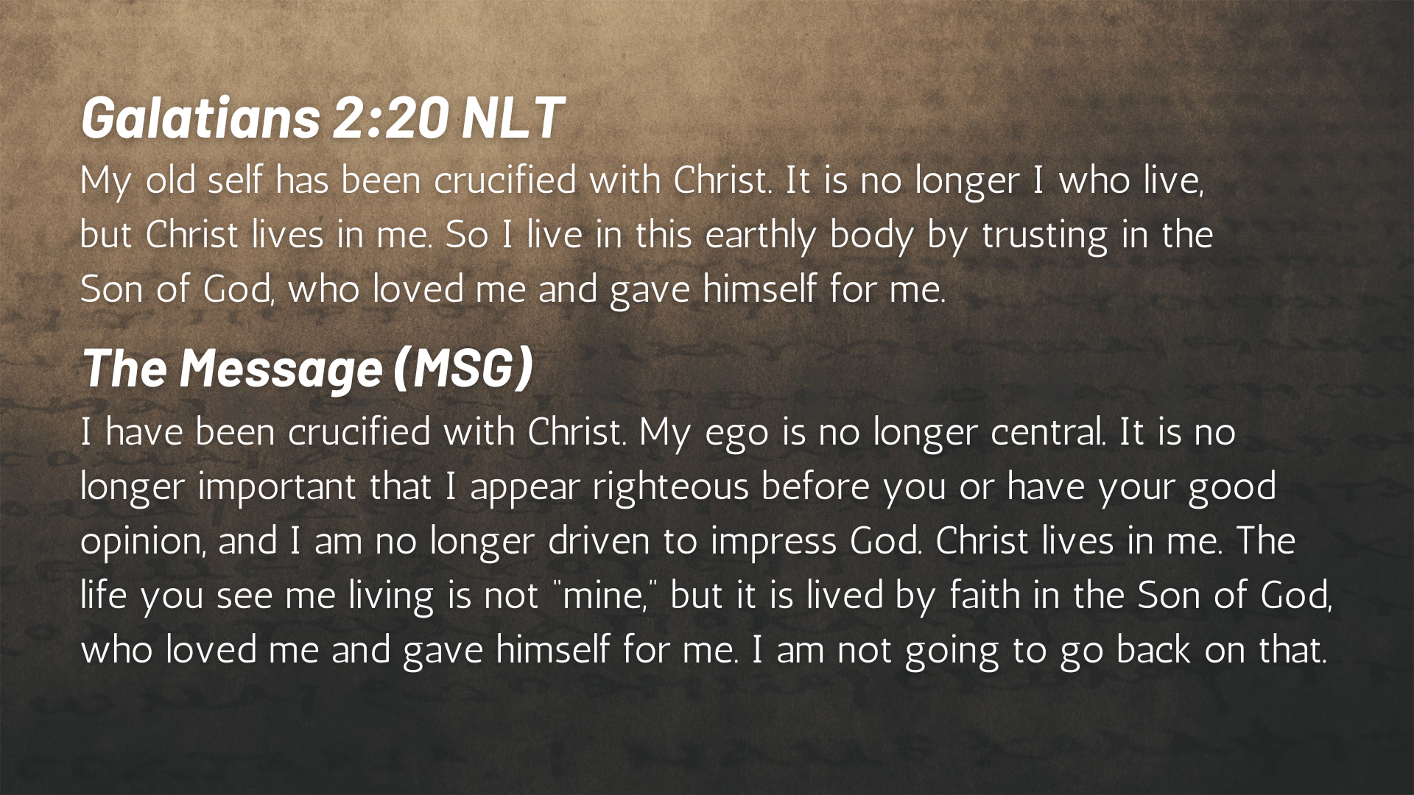
Notes:
[READ VERSE 20 & COMMENT]
Again, N.T. Wright translates the last part of the verse: “And the life I do still live in the flesh, I live within the faithfulness of the son of God, who loved me and gave himself for me.”
[READ VERSE 21]
Brothers and sisters, we can see from Galatians 2 that bounded thinking fueled by a false gospel is a serious matter, and so we can see why the apostle Paul confronts it in a centered way. How then should we respond to bounded thinking and practice with the gospel of God’s grace? And what might that look like? Here are my suggestions… [NEXT SLIDE]

Slide 12
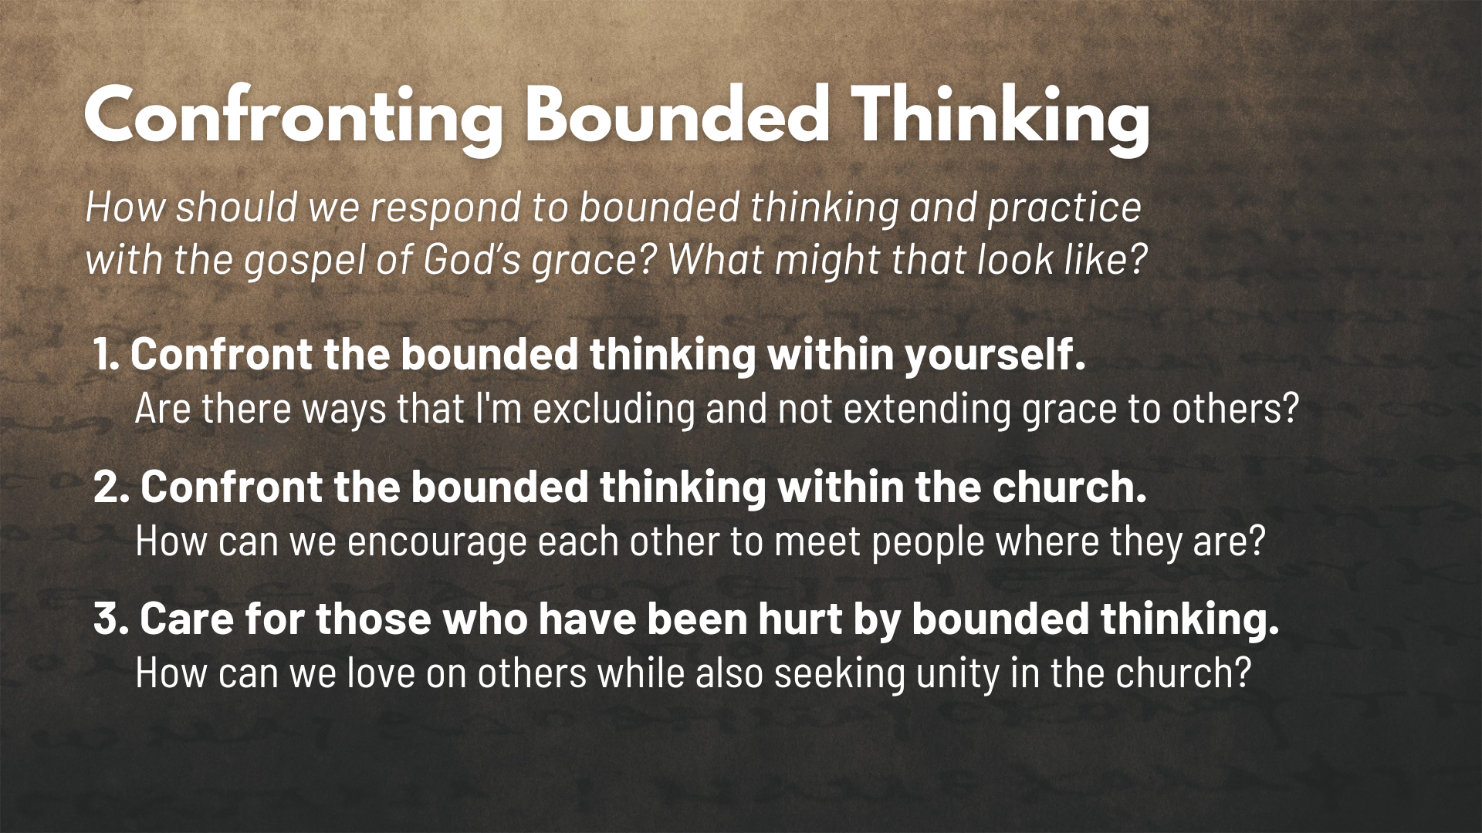
Notes:
[READ EACH POINT & COMMENT]
1. Confront the bounded thinking within yourself. Are there ways that I'm excluding and not extending grace to others?
2. Confront the bounded thinking within the church. How can we encourage each other to meet people where they are?
3. Care for those who have been hurt by bounded thinking.
How can we love on others while also seeking unity in a centered church?
Finally, here are some questions to help us reflect and respond to the message… [NEXT SLIDE]

Slide 13

Notes:
Questions

Slide 14
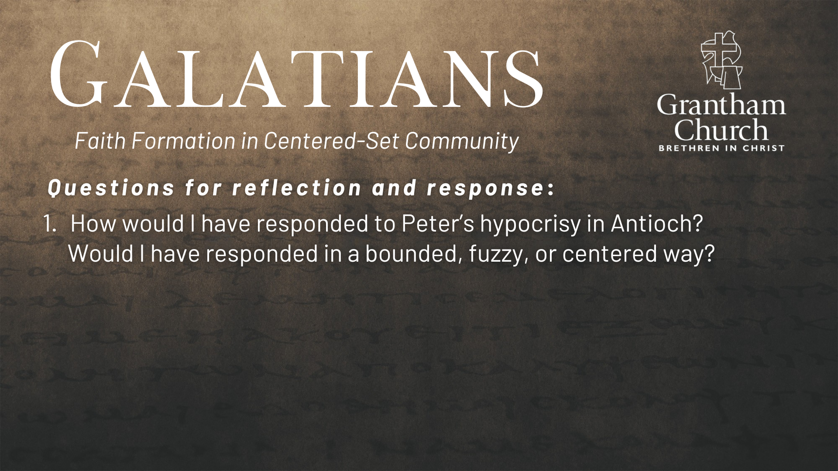

Slide 15
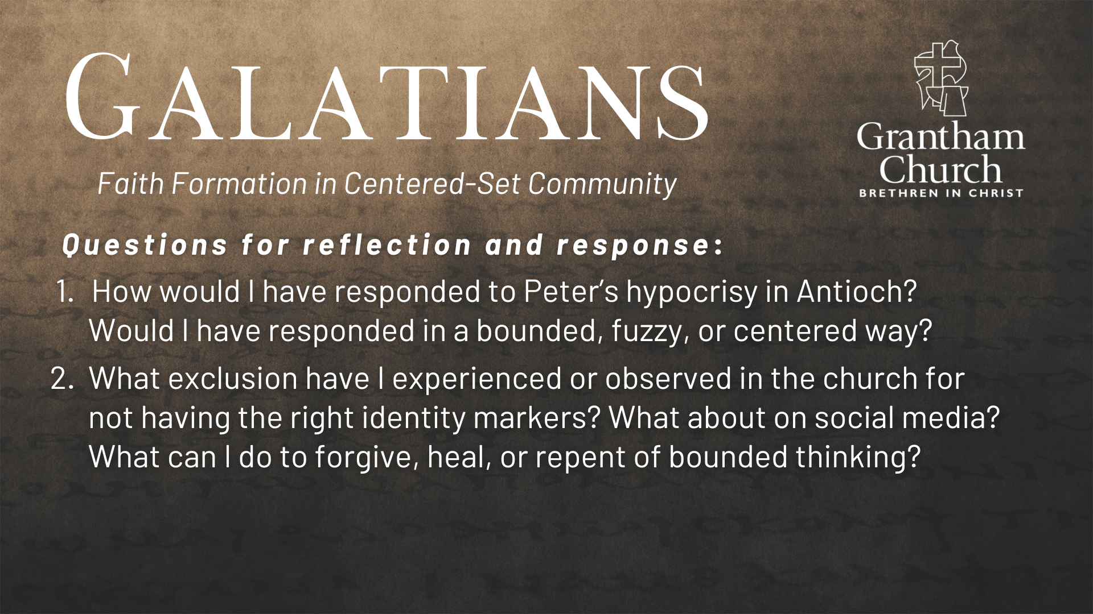

Slide 16
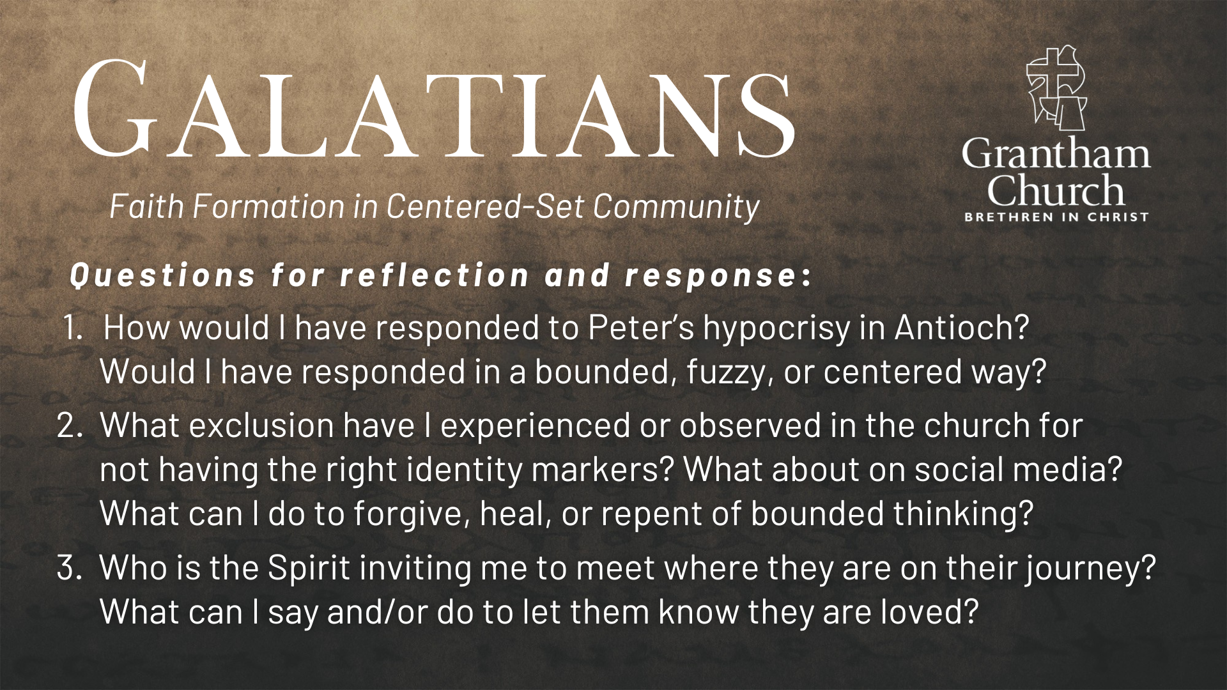
Notes:
[READ & BRIEF COMMENT ON EACH QUESTION]
How would I have responded to Peter’s hypocrisy in Antioch? Would I have responded in a bounded, fuzzy, or centered way?
What exclusion have I experienced or observed in the church for not having the right identity markers? What about on social media? What can I do to forgive, heal, or repent of bounded thinking?
Who is the Spirit inviting me to meet where they are on their journey? What can I say and/or do to let them know they are loved?
[CLOSING WORDS]
Let’s pray… [NEXT SLIDE FOR CLOSING PRAYER]

Slide 17

Notes:
[CLOSING PRAYER]
Announcement
FELLOWSHIP MEAL TODAY! I hope you will join us for lunch. And please be sure to greet the Paxton residents who are with us and allow the residents to go through the line first as some need additional assistance.
Benediction
Brothers and sisters, we’ve been saved by grace through faith to be formed in Christ-centered community. May you only boast in the cross of our Lord Jesus Christ, for we have been freely given (not earned) Gods love and favor. Now let us go and extend that same gift of grace to others—in the church and in the world. In the name of the Father, and of the Son, and of the Holy Spirit. Amen.

