Slide 1

Notes:
[BRIEF INTRO]
This is part 4 of our 6-part series, Jesus, Justice & the Third Way: Following the Lamb in an Age of Idolatry & Division. In this series we’re reflecting on the political nature of the gospel and how we’re called to pledge our loyalty and allegiance to the Lamb—not the donkey or the elephant. And for us to understand what that means, we’re taking a closer look at Jesus’ own posture and approach to religious and political matters, to see how he dealt with political parties, hot-button issues, and the partisan mind. We’re exploring his Third Way of living in the world.
Three weeks ago, we began our series with the message… [NEXT SLIDE]

Slide 2

Notes:
The Gospel is Political – we looked at how the gospel is political in nature, and that it has real-life implications; I made the case for a holistic understanding of the gospel, and that we must beware of political idolatry as we seek to follow the slain Lamb into his upside-down Kingdom.
In the second message, Political But Not Partisan, we saw how the gospel doesn’t fit neatly into our political categories. Jesus is not a cheerleader for any political party. And while he may have agreed with folks on various points, he didn’t fully align himself with any party in his own day. Instead, Jesus intentionally chose a politically and socio-economically diverse group of disciples and said, “Follow me.” And he is still issuing that call to us today.
Then in last week’s message, Jesus and the Justice of God. We saw that Jesus cared deeply about justice. While he rejected the expected path of earthly kingship and political power, Jesus still furthered an ancient vision of God’s justice for all nations. But this “justice” isn’t about vengeance or retribution, it’s about reconciliation and restoration. And we looked at the difference in a Jesus-centered church and a justice-centered church. I said that real Jesus-centered churches will naturally act justly, love mercy, and walk humbly with God. But “justice-centered” churches will simply use Jesus to champion their social-justice causes, and that usually leads to whatever power-over method it takes to win; justice then becomes the reason for gathering, which ultimately leads to disaster. Because once “justice” replaces Jesus, we then adopt the posture and approach of the world, which devolves into power-over others and winning at all costs. But this isn’t the Third Way of Jesus, as we will continue to see today.
If you’re taking notes, I’ve entitled this message, The Third Way for Extreme Days. We’ve come to the point in our series where we’re going to closely examine how Jesus navigated the extremes, the hot-button issues, and polarizing debates of his own day. What were the divisive issues in first century Palestine? And what was his posture and approach to these things? We need to see that if we’re going to faithfully walk in the way of Christ amid our own extremes.
Let’s begin with today’s Scripture reading. Please grab your Bible… [NEXT SLIDE]

Slide 3

Notes:
[MATTHEW 5:38-48 & 22:33-40 - CONGREGATION STAND - READ SCRIPTURE]
This is the word of the Lord. Thanks be to God. You may be seated.
Have you ever felt like you were being setup by someone when they asked you a loaded question with a listening audience? Have you ever felt like someone was trying to trap you, because no matter how you answered the question you were going to look bad or be in hot water with someone? We’ve seen this happen recently on the US political stage.
For example, Kamala Harris was asked on the View if there is anything she would do differently than Joe Biden. Answering “no” wasn’t going to help her win over those who aren’t fans of Biden, and answering “yes” would be bad for her own party. She first said, “not a thing comes to mind” and then appeared to backtrack on that answer. We also saw this sort of thing during the vice-presidential debate. Tim Walz asked JD Vance, “Did Trump lose the 2020 election?” If he said “yes” he would stand in opposition to Donald Trump and many MAGA voters who believe there was voter fraud. If he said “no” then he would appear conspiratorial and a threat to democracy.
Now, regardless of what you think about any of these people and the issues, you can see how questions can be used to bait and trap in pursuit of an agenda. And as we will see in today’s message, this is exactly what Jesus encountered in the first century. Much like today, Jesus lived in an “us vs. them” divided and polarized time. Remember… [NEXT SLIDE]

Slide 4
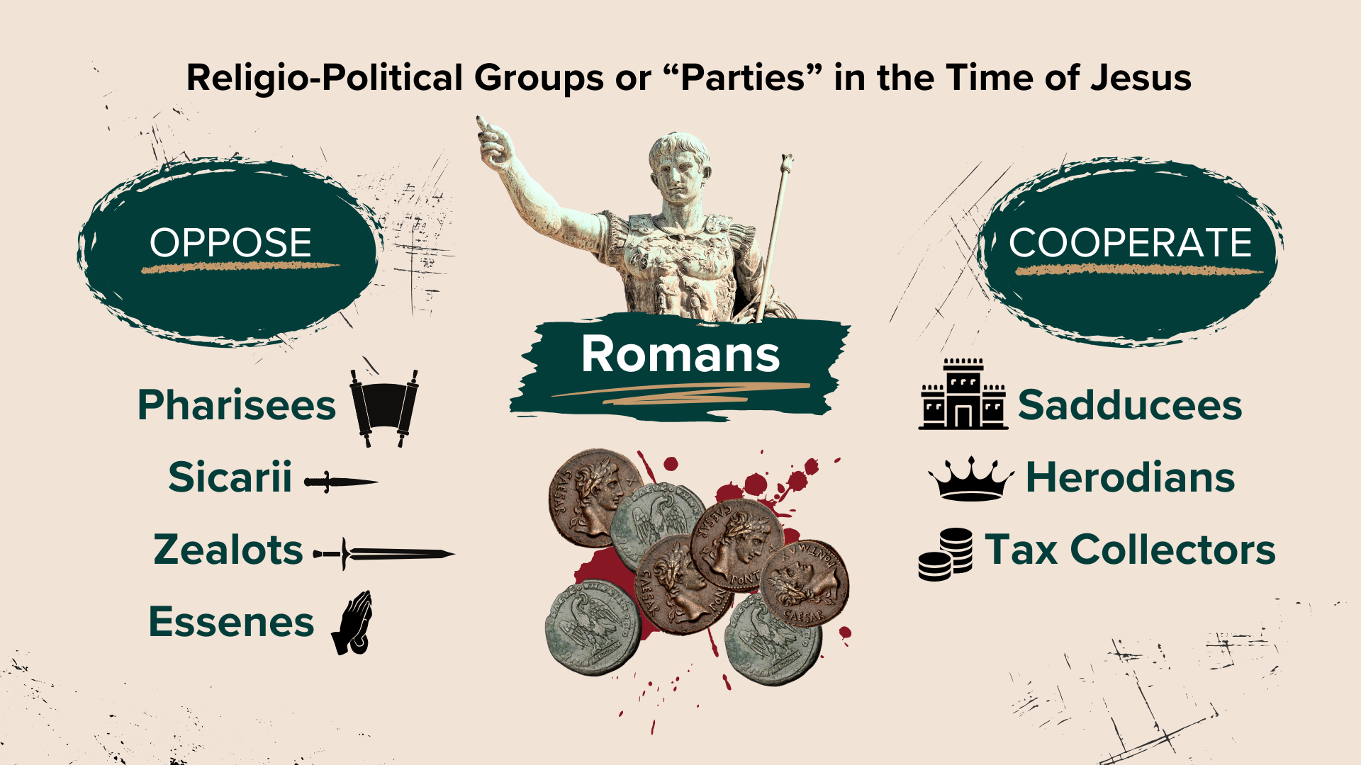
Notes:
The different groups, parties, and perspectives in the first century. Remember how each of them (the Pharisees, the Sadducees, the Sicarii, the Zealots, the Herodians, the Tax Collectors, and the Essenes) all had strong religious and political opinions. And they all had their ideas about how to make Israel great again. They each thought they knew the way forward. And they did what they could so that people would see things their way; so that you would join their group and party; so that you would “take a side” and fully align yourself with their positions and solutions.
And it should be clear by now that Jesus, yes, sided with the oppressed and marginalized, but he did not “take sides” and fully align himself with a party, tribal group-think, or a faction? Instead, Jesus revealed that the gospel couldn’t be fully captured or contained within these groups, and he was careful not to be drawn into the “us vs. them” combative thinking of the partisan mind.
So, since 2017, we have defined Third Way like this at Grantham Church… [NEXT SLIDE]

Slide 5

Notes:
[READ & COMMENT]
The basic conviction is this: No political party contains or represents all the Kingdom concerns of Jesus. Jesus is Lord and he demands total allegiance. Therefore, we should have a healthy skepticism toward every political party, especially when we think that they entirely or “mostly” represent our faith, beliefs, values, etc. Folks, think about it… there are Christians in both major political parties (Republicans and Democrats) who think this way, and this thinking leads to idolatrous adherence to extreme ideologies that are contrary to our faith. And this should serve as a reminder of how politics can have an idolatrous effect over everyone, even Jesus followers.
So, let’s now look at how Christ embodied the Third Way by the pattern he left for us in the Gospels. What does Jesus do when he is put in a difficult situation, asked a baited question, or he’s pressured to adopt the partisan mind? When Jesus is asked to weigh in on a politically controversial and polarizing issue or debate, he reveals the following pattern: [NEXT SLIDE]

Slide 6
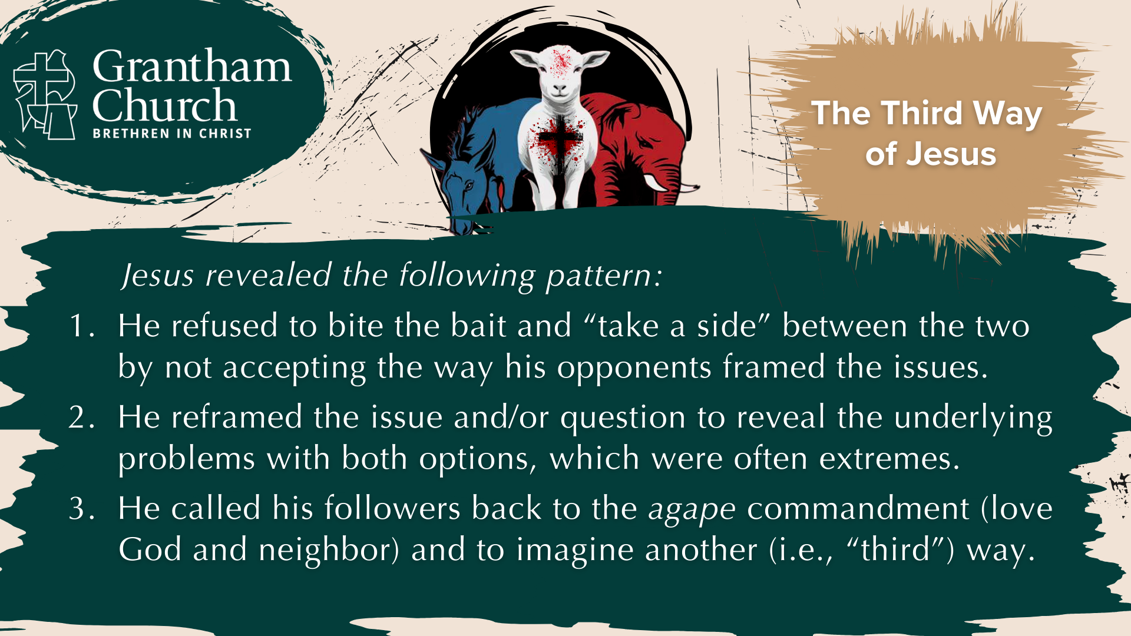
Notes:
[READ PATTERN & COMMENT]
He refused to bite the bait and “take a side” between the two by not accepting the way his opponents framed the issues.
He reframed the issue and/or question to reveal the underlying problems with both options, which were often extremes.
He called his followers back to the agape commandment (love God and neighbor) and to imagine another (i.e., “third”) way.
Next week we will see how this might apply to contemporary issues, but today we’re just going to focus on the context of the New Testament. We’re going to look at five examples from the Gospels where Jesus embodied the Third Way. I’ll need to move at a steady pace through these, so, if you’re interested, you may want to study them more intently later this week.
Here is the first one… [NEXT SLIDE]

Slide 7

Notes:
[READ SLIDE & COMMENT]
The Roman Occupation Debate
Here is one you’re probably familiar with… in Mark 12, verse 13… we read “Later the leaders sent some Pharisees and supporters of Herod to trap Jesus into saying something for which he could be arrested.” This is where they ask Jesus if it’s right to pay taxes to Caesar… [NEXT SLIDE]

Slide 8
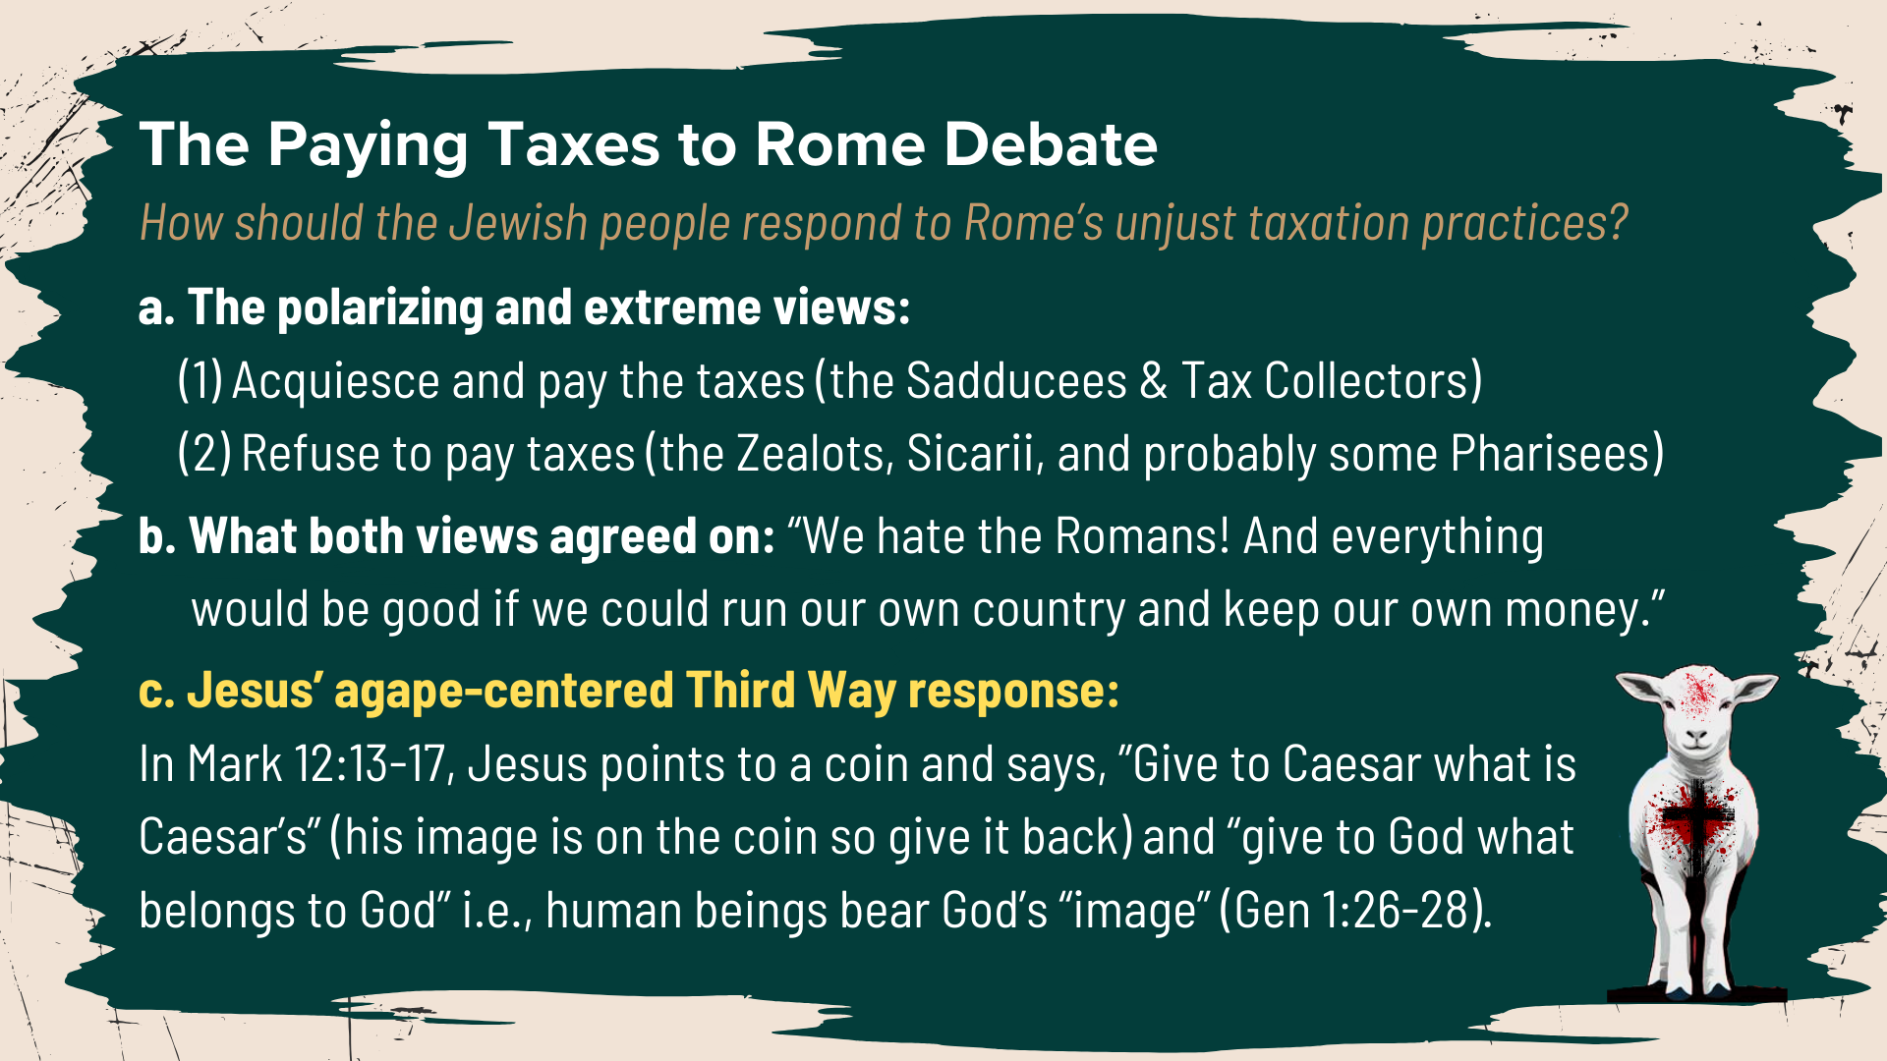
Notes:
[READ SLIDE & COMMENT]
c. Which means we belong to God. We should be more concerned about loving and dedicating ourself to God than about who gets our tax money.
Mark says that Jesus’ reply “completely amazed” them (v.17).
Then there was something a bit more social and familial in nature… [NEXT SLIDE]

Slide 9
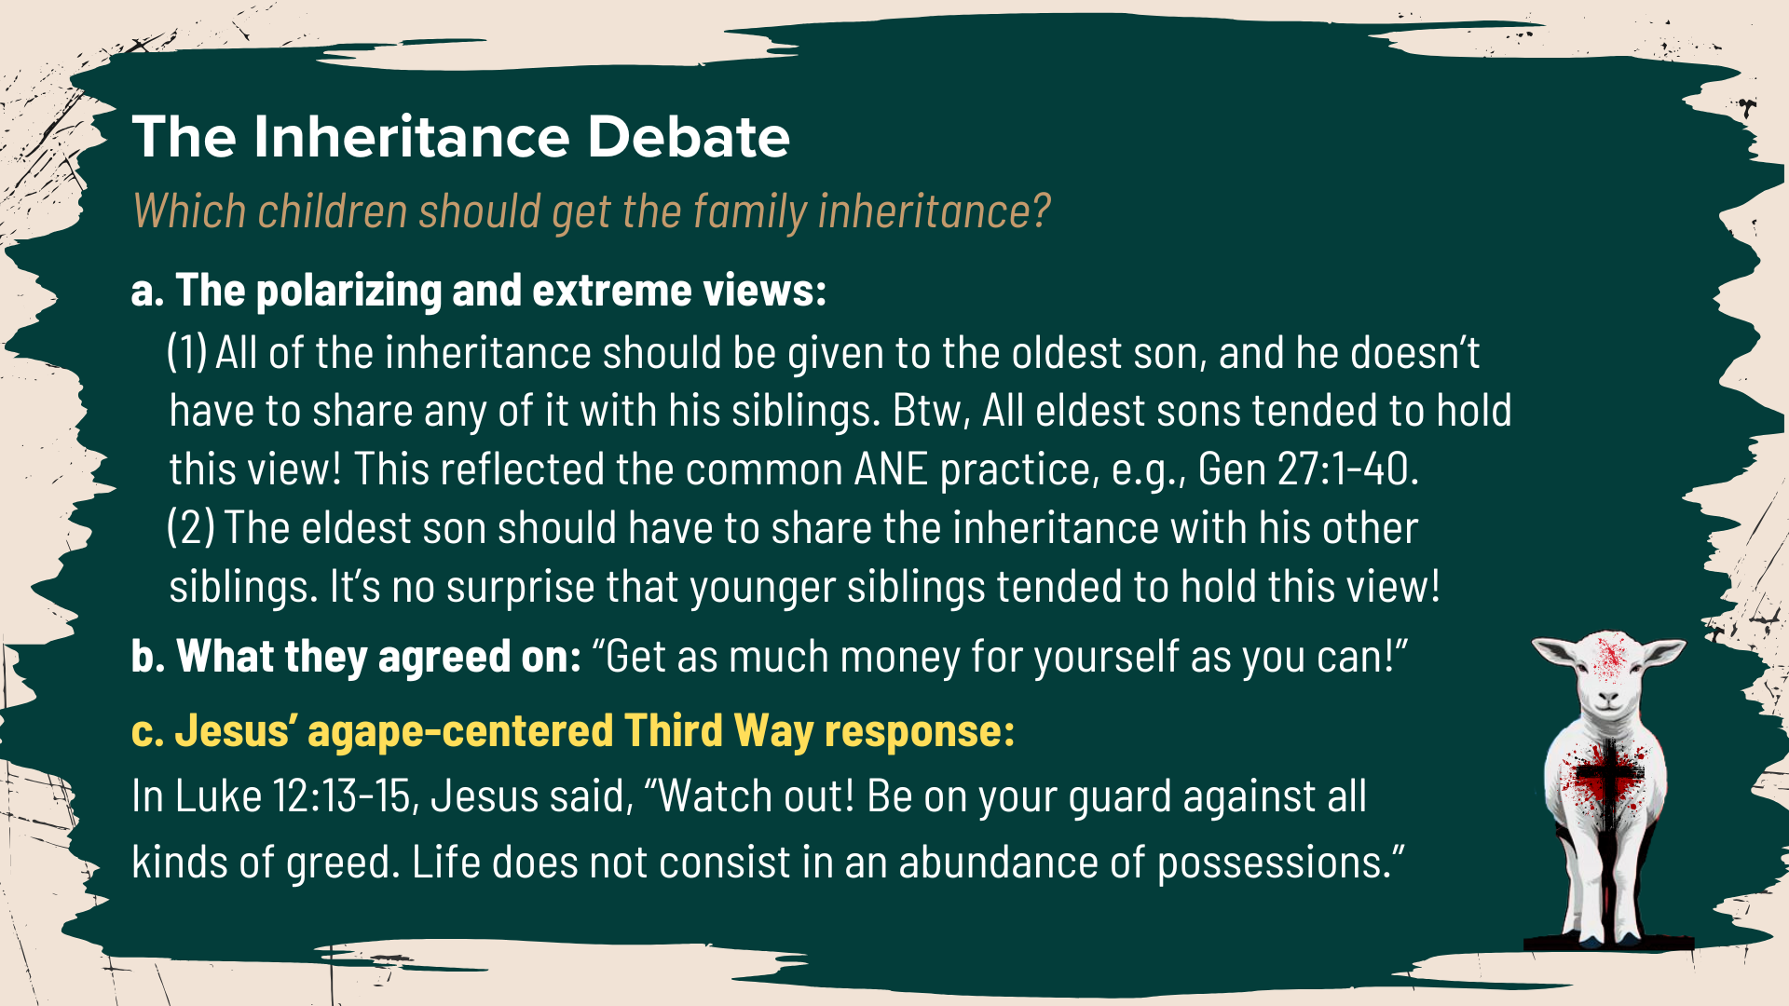
Notes:
The Inheritance Debate. In Luke 12:13, we read, “Then someone called from the crowd, “Teacher, please tell my brother to divide our father’s estate with me.”
[READ SLIDE & COMMENT]
c. Jesus replied, “Friend, who made me a judge over you to decide such things as that?” Then he said, “Beware! Guard against every kind of greed. Life is not measured by how much you own.” And then Jesus told a parable which ended with these words: “Yes, a person is a fool to store up earthly wealth but not have a rich relationship with God.”
Check on this next one… [NEXT SLIDE]

Slide 10
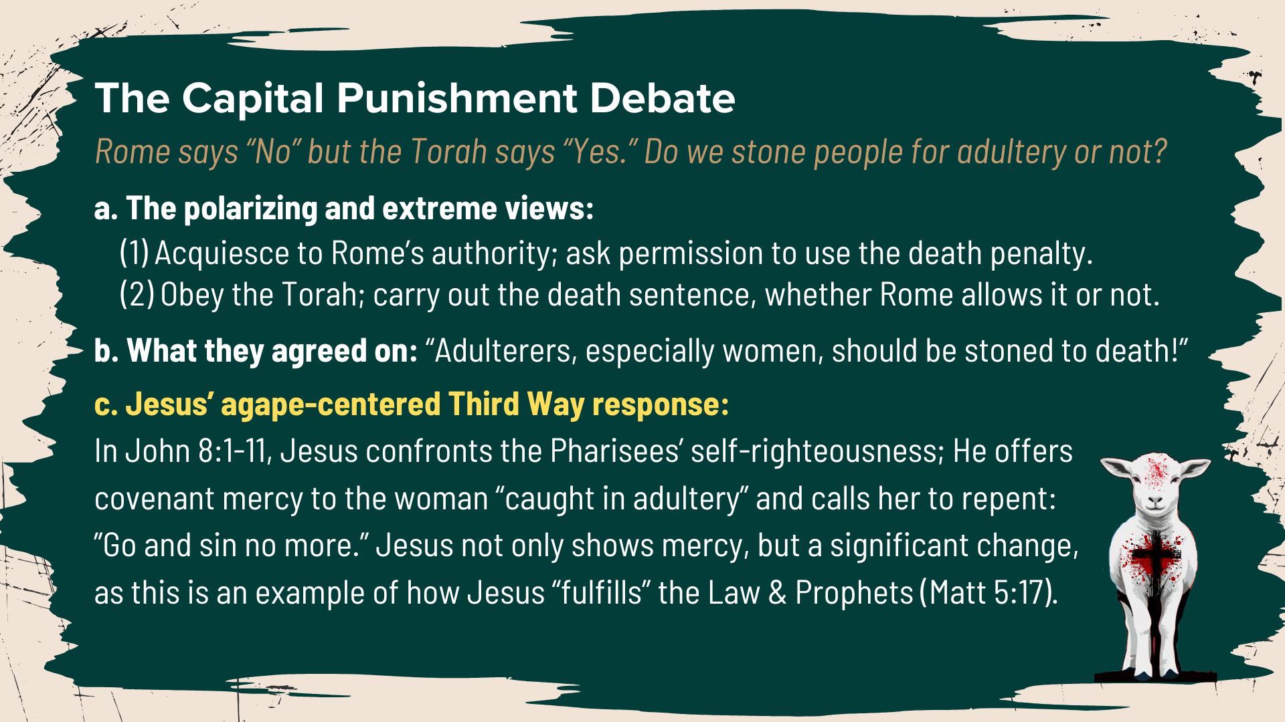
Notes:
The Capital Punishment Debate. In John 8:1-11, the Pharisees, intending to trap Jesus, bring him a woman caught in adultery. They say to him, “The Law of Moses says to stone her. What do you say?” What’s the big issue or debate here?
[READ SLIDE & COMMENT]
And lastly, there was the first century debate about divorce… [NEXT SLIDE]

Slide 11
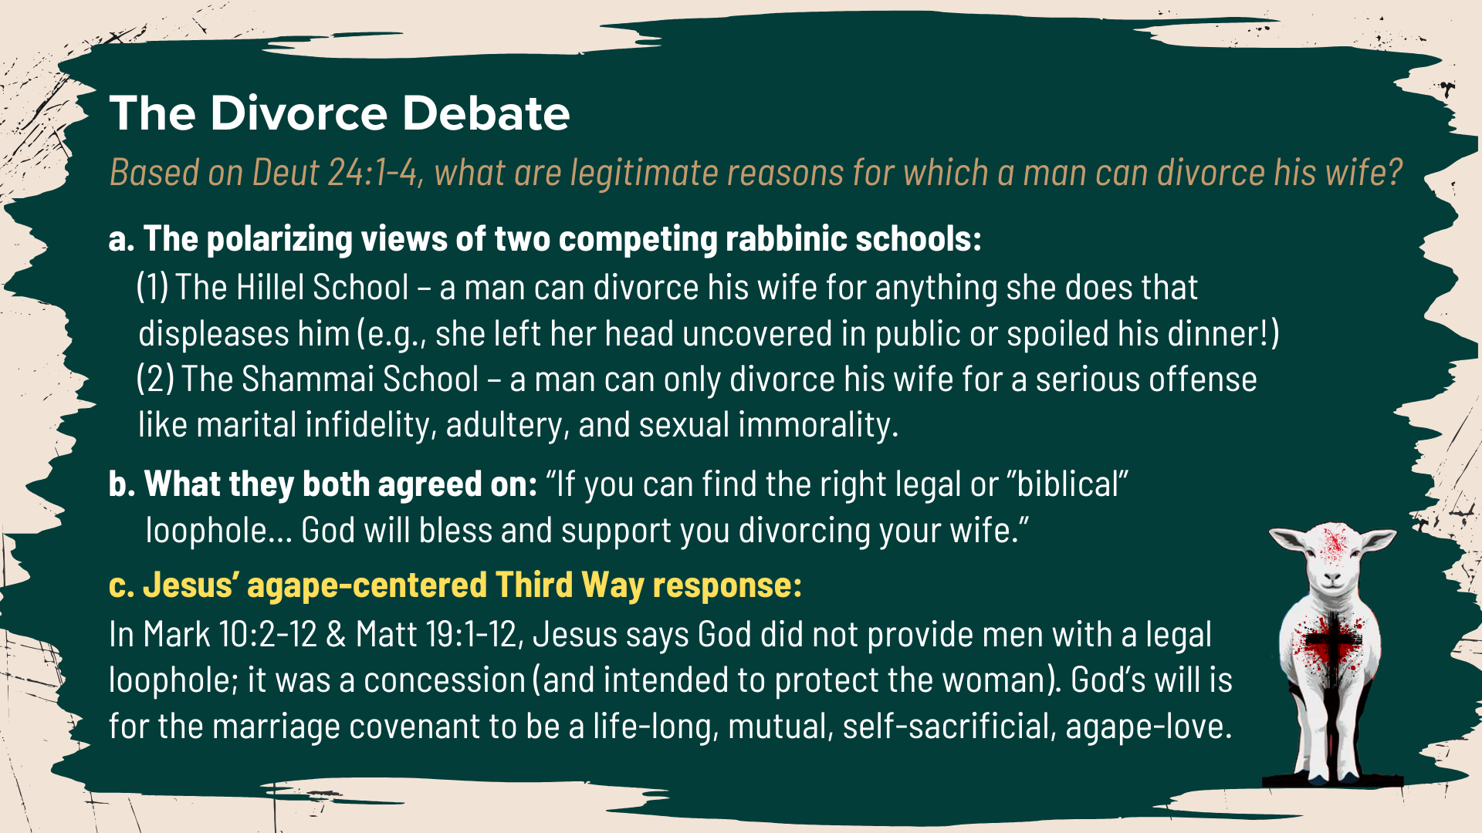
Notes:
[READ SLIDE & COMMENT]
We can hear a Kingdom question or two being evoked by Jesus in this passage: Why are you trying so hard to get out of your marriage? What if you’ve missed the whole point of marriage as a sacred covenant? Imagine what it could be if you treated it as such.
So, in all these examples, we can see the unique approach and posture of Jesus as he evades the traps set for him and refuses to play the “us vs. them” power games. Jesus responds the way he does out of concern for what truly honors God and is reflective of the Kingdom. He is not interested in winning arguments, taking sides, and perpetuating division.
That’s because… [NEXT SLIDE]

Slide 12
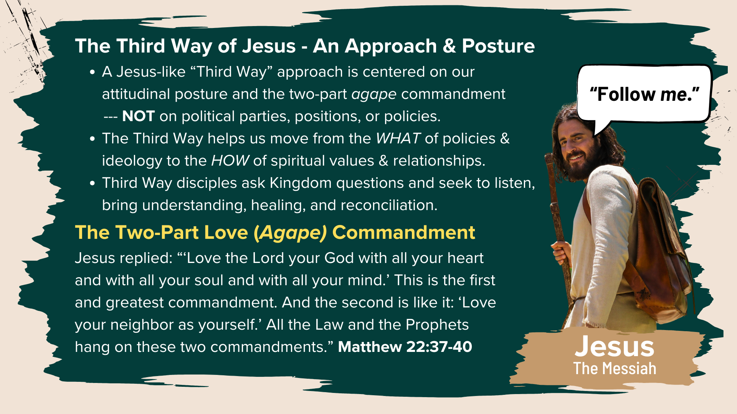
Notes:
A Jesus-like “Third Way” approach is centered on our attitudinal posture and the two-part agape commandment: to love God and love our neighbor. The center is NOT our political parties, positions, or favored policies. And notice how his Third Way of Jesus helps us move from the WHAT of policies & ideology to the HOW of spiritual values & relationships, which helps to deescalate and curb injustice and division. It helps us to humanize each other. And part of that work looks like asking better questions (Kingdom questions) and seeking to listen, to love, to empathize, in order to see differently, to bring understanding, healing, and reconciliation.
Which is why I invite us to accept the attitudinal posture and approach of Jesus; to embrace the two-part love commandment, to get our identity from Christ, our baptism, and the communion table, and to be captured by the Jesus way and the Kingdom vision of our Messiah. For I’m convinced that the Third Way is what faithfulness to Jesus looks like. And it’s the only way to follow the Lamb and escape the idolatry and division we see all around us. Amen?
Here are some main takeaways from the message today… [NEXT SLIDE]

Slide 13
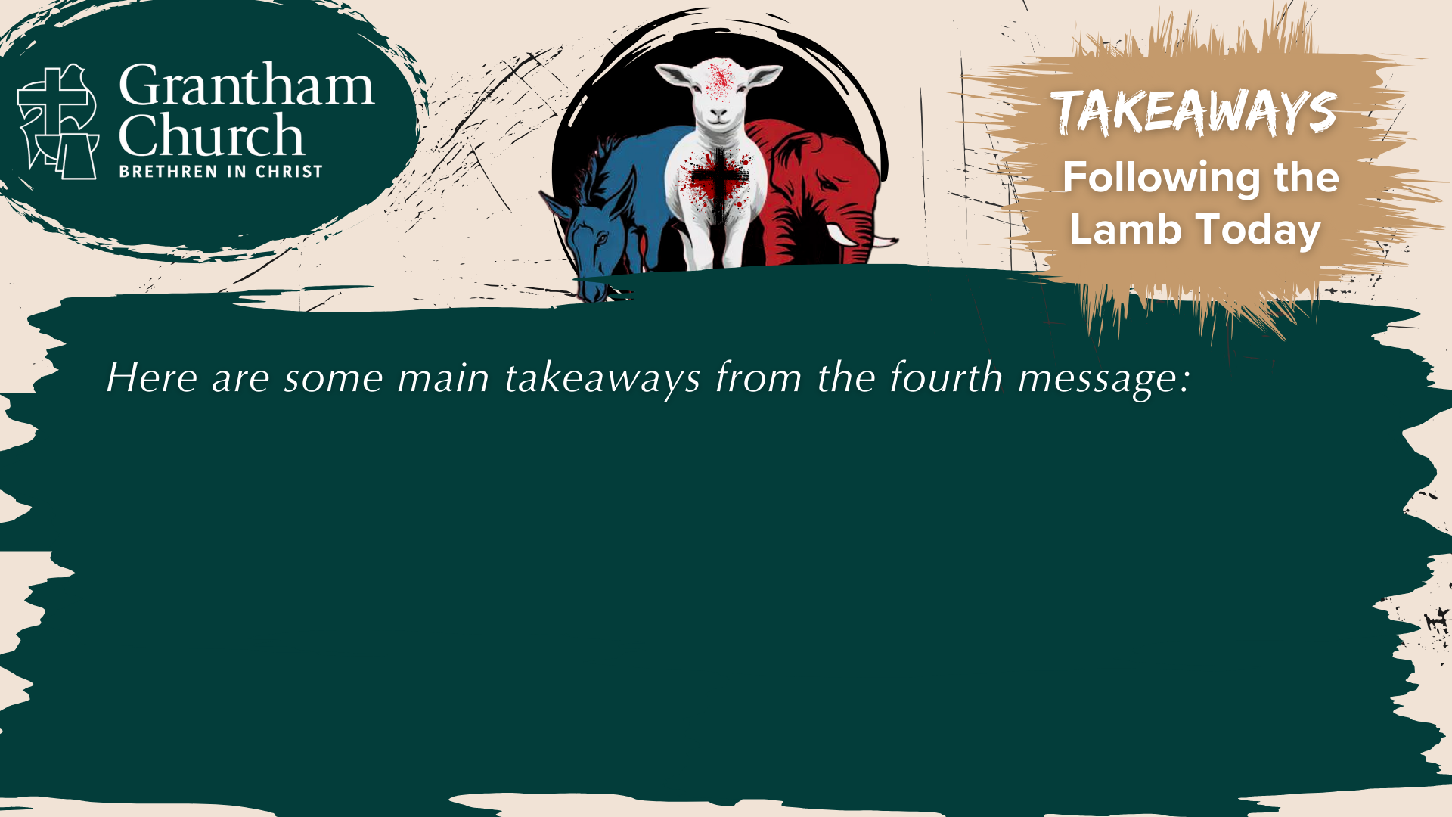

Slide 14
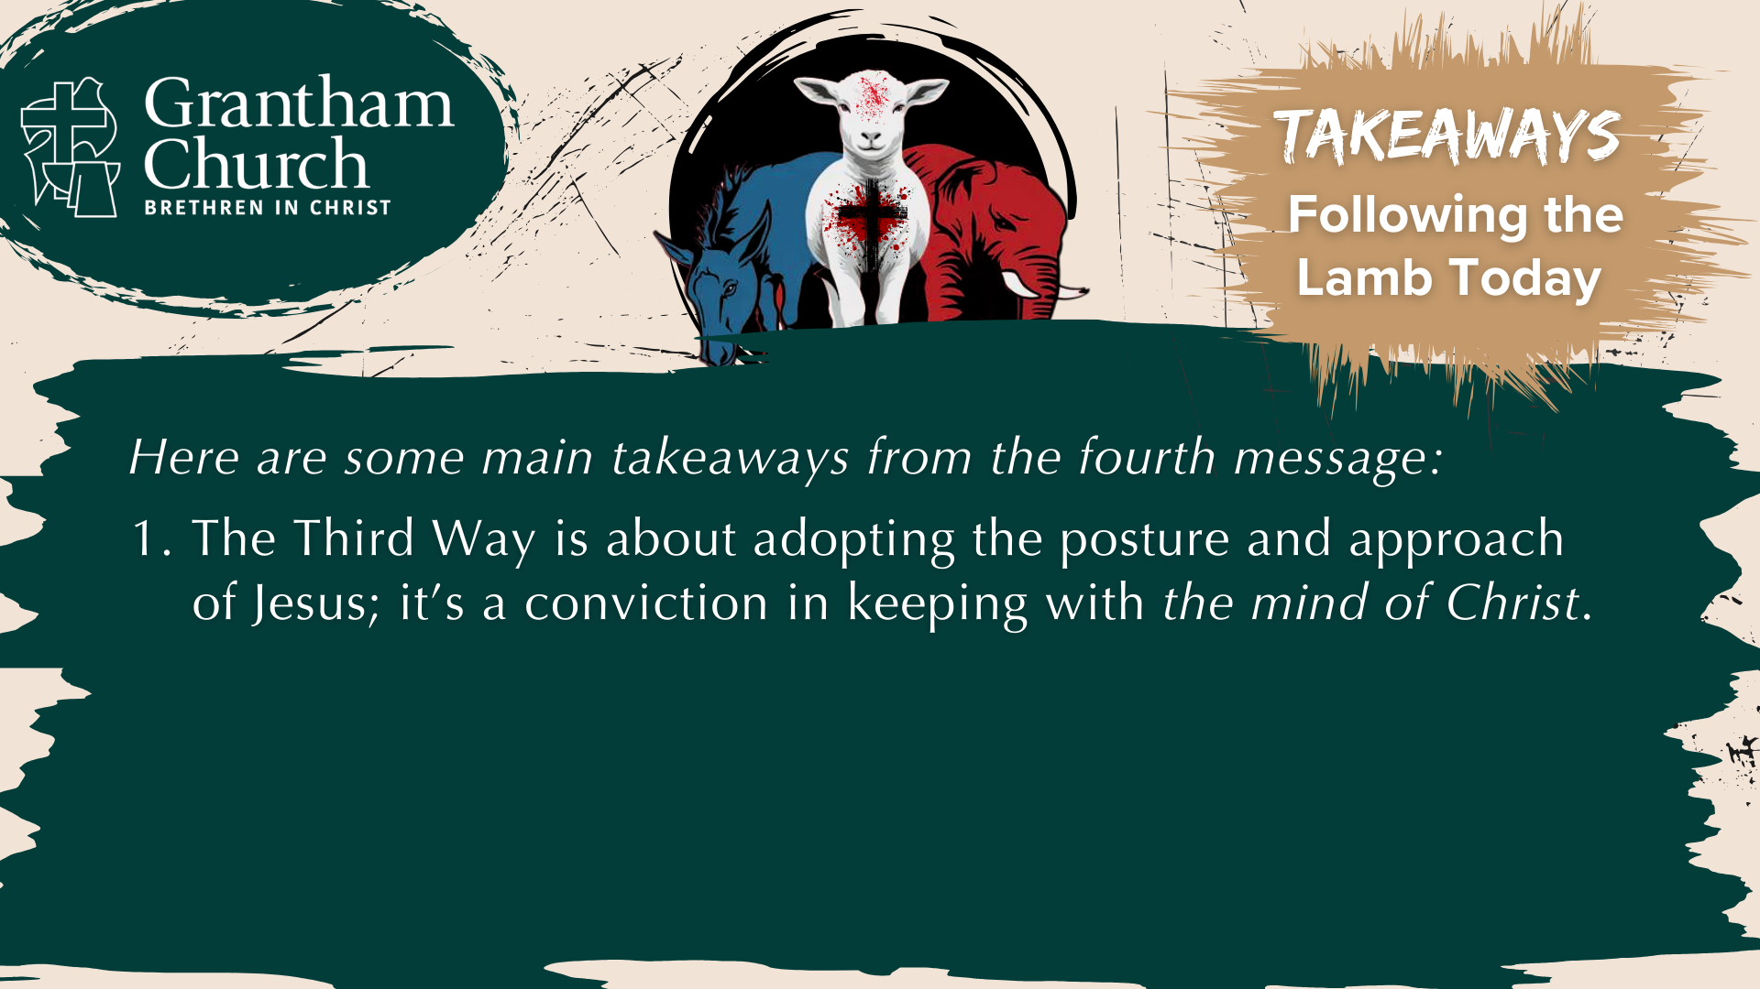

Slide 15


Slide 16

Notes:
[READ & COMMENT ON EACH POINT]
The Third Way is about adopting the posture and approach of Jesus; it’s a conviction in keeping with the mind of Christ. Therefore, we must reject the partisan mind to know it.
The Third Way begins with the two-part agape commandment (loving God & neighbor); relationships come before politics, policies, and ideologies. That’s not to say that those things aren’t important (they are); it just means we recognize the divine order of things.
Disciples following in the Third Way of Jesus will listen well, ask Kingdom sort of questions, and seek truth, justice, shalom, etc.
And finally, here are some questions to help us reflect and respond together… [NEXT SLIDE]

Slide 17


Slide 18
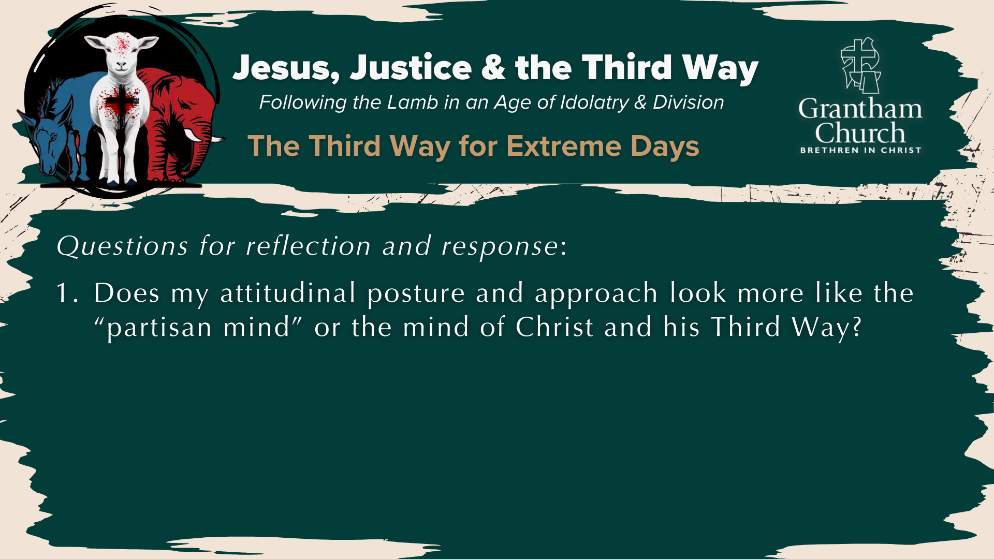

Slide 19
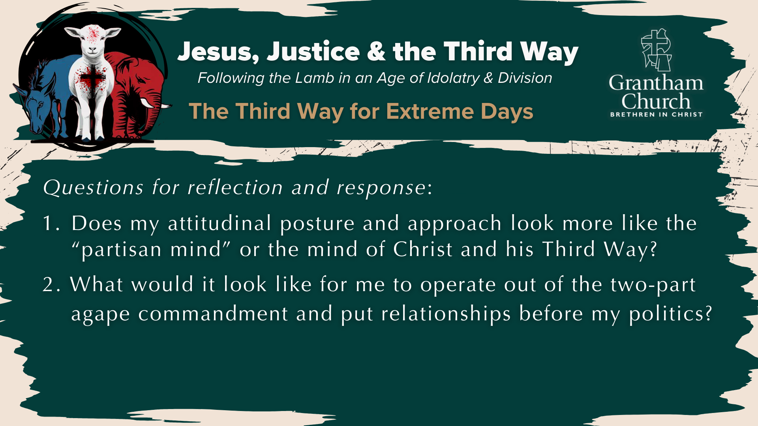

Slide 20
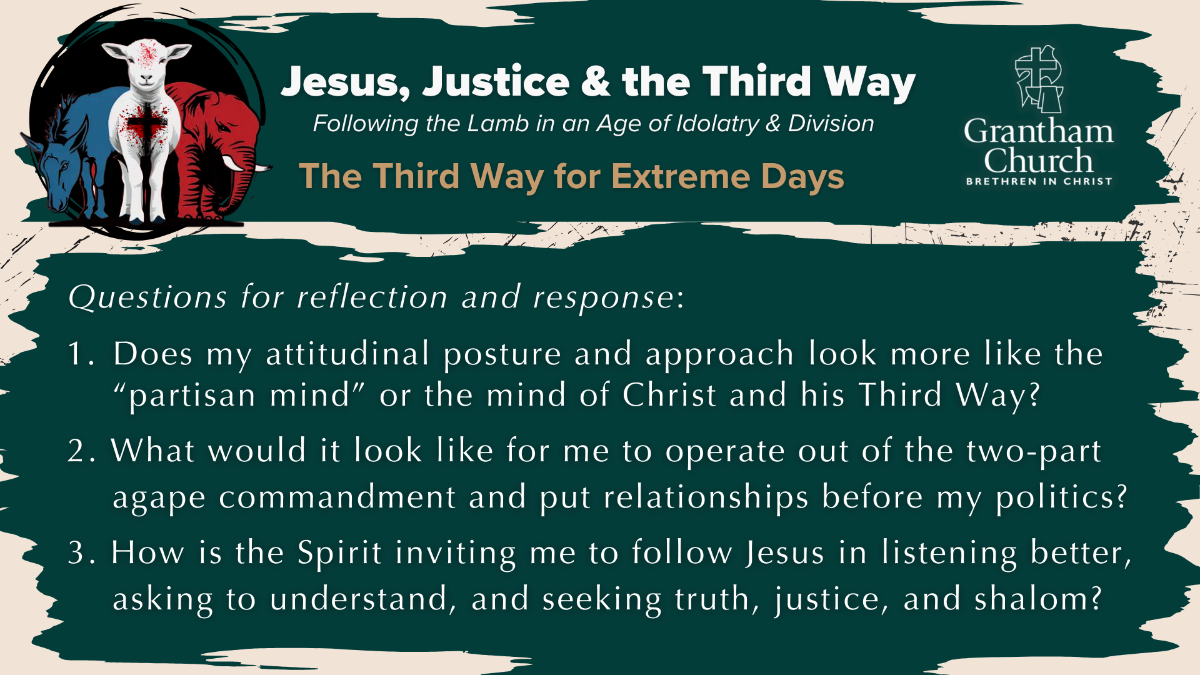
Notes:
[READ & BRIEF COMMENT ON EACH QUESTION]
Does my attitudinal posture and approach look more like the “partisan mind” or the mind of Christ and his Third Way?
What would it look like for me to operate out of the two-part agape commandment and put relationships before my politics?
How is the Spirit inviting me to follow Jesus in listening better, asking to understand, and seeking truth, justice, and shalom?
Let’s pray… [NEXT SLIDE]

Slide 21

Notes:
[CLOSING PRAYER]
[CLOSING HYMN]
ANNOUNCEMENT: TRUNKS & TREATS
ANNOUNCEMENT: PASTOR MELISSA - FULLY CREDENTIALED
[REMINDER ABOUT THE BENEDICTION]
Benediction: Brothers and Sisters, the Lamb has conquered. Let us follow him. And may the God who looks like Jesus equip you with all you need to live for him in a world of competing loyalties and allegiances. In the name of the Father, the Son, and the Holy Spirit. Amen. Go in peace, church.

