Slide 1

Notes:
[BRIEF INTRO TO MESSAGE]
Jesus & the Selfless Life
The Kingdom way to true peace, joy, and freedom (to real fulfillment)
[BRIEF PRAYER]
Have you ever heard of the Greek tragedy of Narcissus? [NEXT SLIDE]

Slide 2
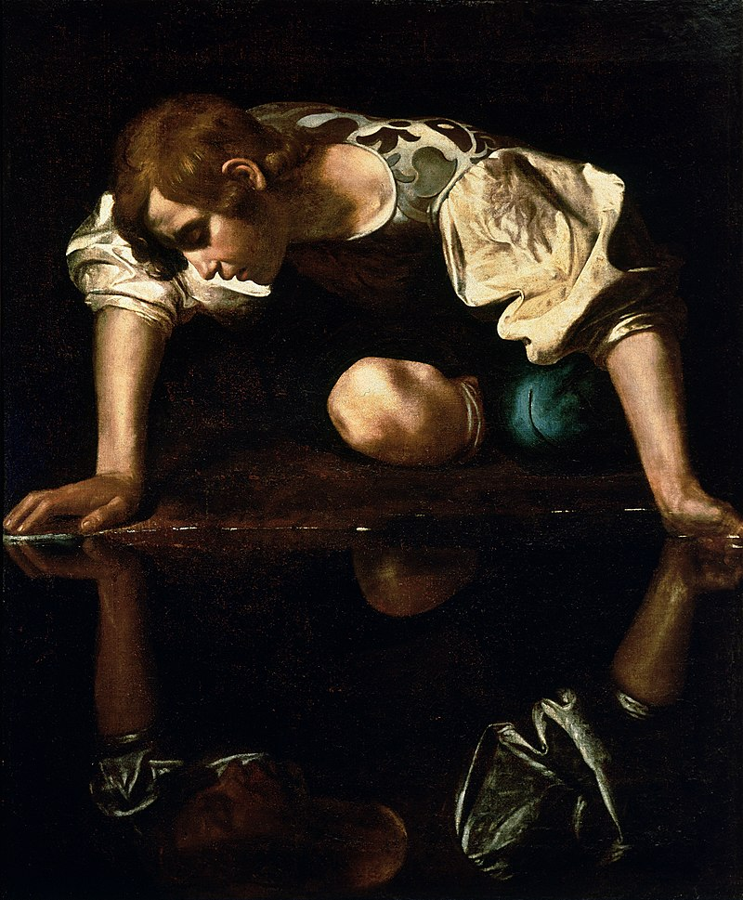
Notes:
[BRIEFLY DESCRIBE THE GREEK MYTH OF NARCISSUS]
A limerick: “There was once a nymph named Narcissus, who thought himself very delicious; so he stared like a fool, at his face in a pool, and his folly today is still with us.” And of course, this story gave rise to the term “narcissism” or narcissistic personality disorder, which is when someone is so self-absorbed and has such an over-inflated ego that they see themselves as special—better than everyone else; also, they’re hypersensitive, fragile, defensive, impulsive, they feel entitled, they exaggerate their good qualities, they lack the ability to empathize with others, they’re power-hungry, oriented toward success at any cost, and their self-absorption is so strong that they can’t see how their views are detached from reality.
True narcissism is the extreme, of course, but we all walk around manifesting a number of these traits, don’t we? And we can certainly see this sort of self-absorption at work in American society today. What we might call a “cultural narcissism” that we should know is much bigger than any narcissistic leader you might want to name (because those leaders truly reflect the entire social, moral, and psychological state of society), and this cultural narcissism that we see today has been a long time coming. [NEXT SLIDE]

Slide 3

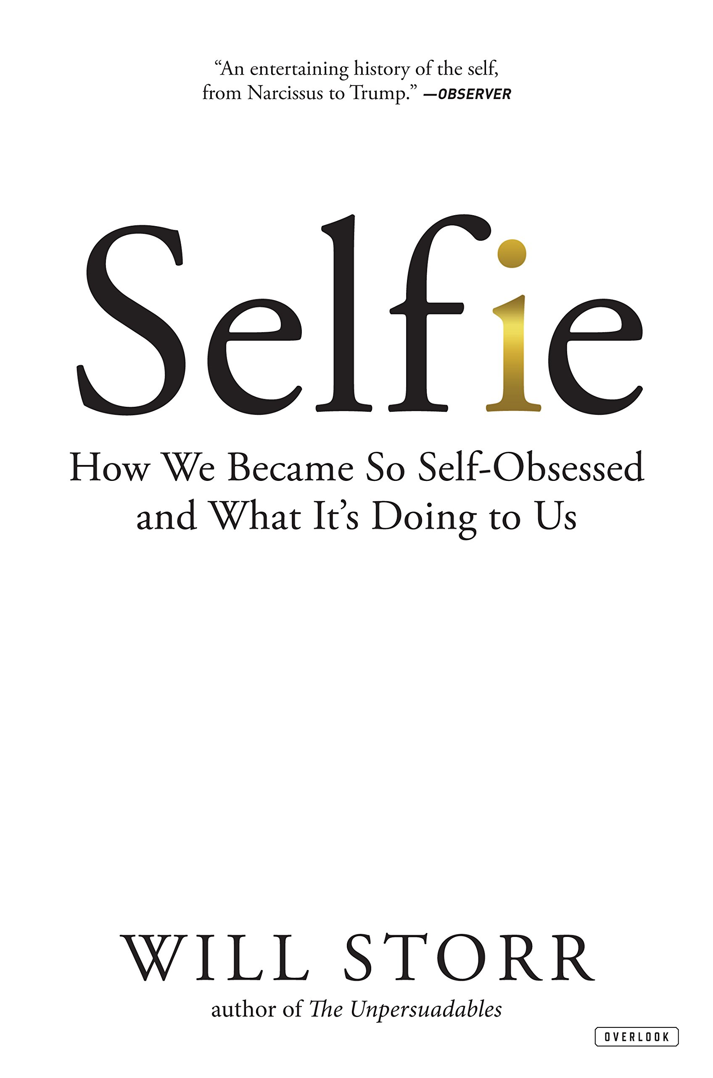
Notes:
In his book, Selfie: How We Became So Self-Obsessed and What It’s Doing to Us, the journalist and novelist Will Storr traces the history of individualism in the West and how we became such a self-absorbed culture.
Until Ancient Greece (2,500 years ago), societies were collective in their thinking. [Explain further – e.g., Asian selfies] But the geography of ancient Greece (many islands) impacted the Greek view of self, their psychology, their politics, and their economics—which then shaped all of Western thought, eventually the founding of our own country. So, rugged individualism (against a more collective, communal mindset—which is what is required for healthy churches, btw), coupled with our own unique geography (isolating Americans from other cultures and ideas) set us on our current path.
And then, as Storr points out in his book, something happened in California in the 1980s that quickly backfired on us and has had some serious consequences. It was the “self-esteem” movement. After almost two millennia of the West being influenced by a Christian view of the self (that says that we are born sinners in need of a savior), some “me generation” hippies decided enough is enough. People don’t need to hear that they are “made in God’s image” but broken and not as they should be. That’s not helpful. It makes people feel bad and we want people to feel good about themselves.
And so, for the first time in human history, we say the reason that people misbehave and aren’t thriving isn’t because they think too much of themselves (which is what all other traditional cultures have said—i.e., hubris or pride was the root of all evil), but rather that we don’t think highly enough of ourselves. In fact, we all just need to see the “divine spark” in ourselves—that we’re all gods and goddesses.
Since then the American collective conscience began to shift by positing that we’re all victims in some way and products of our biology, our upbringing, of evolution, and our environment (which notice… means that we no longer get to make moral judgments about people’s bad behavior). And so, we began to promote the idea that low self esteem is the reason for every social ill in American society (e.g., drug use, abuse, crime, etc.). Therefore, simply promoting a high self esteem was thought to be a social vaccine that would stimulate human health and productivity.
At the same time this is happening, we have the rise of neoliberalism in the 1980s, which meant deregulation, the dismantling of unions and protections for workers (gone are the days of trusting the company will take care of you for life), and essentially making one-to-one competition the defining characteristic of human relations. According to the American empire, human beings are just competitors and consumers. That’s it. And so, this pushes us further away from our neighbors, more toward hyper-individualism and an “every-man-for-himself” mentality. If you’re going to make it in this world, you better look out only for yourself and do whatever you can to stand out and get ahead of the rest.
Are you getting the picture? Where does this lead us? Well, we have found that hyper-individualism, stroking people’s egos, and not confessing our sins… partnered with secularism, neoliberalism, American Idol contests, partisan politics, social media, and a smart phone with a self-facing camera… has led to the most self-obsessed, isolated, lonely, depressed, anxious, consumeristic, and exploitative culture on the planet.
And we have falsely believed that it’s through more self absorption and focusing on ourselves that we will find life. But instead, as we all know, we keep coming up empty. Because that’s what happens when you try to find your identity, meaning, purpose, and your sense of self-worth in anything other than the Creator. This was the thinking behind these words of Jesus in Matthew 22:37-39. Jesus said… [NEXT SLIDE]

Slide 4
Matthew 22:37-39 NIV ³⁷ “‘Love the Lord your God with all your heart and with all your soul and with all your mind.’ ³⁸ This is the first and greatest commandment. ³⁹ And the second is like it: ‘Love your neighbor as yourself.’ ⁴⁰ All the Law and the Prophets hang on these two commandments.”
Notes:
[BRIEF COMMENT]
God loves us, so we ought to love him. Why? Because our soul finds rest in God and his love. As Augustine said, “Thou hast made us for thyself, O Lord, and our heart is restless until it finds its rest in thee.” And so, this new orientation ought to lead us to loving others, because it’s in self-giving (not self-absorption) that we find life.
What does Jesus mean by telling us to love our neighbor as we love ourselves? Jesus is really pointing back to the Golden Rule (do unto others…). Love or agape (which is the word here) is a self-sacrifice in the service of others kind of love. Obviously, this isn’t a self-absorbed, give-so-I-can-get sort of love. Afterall, remember what the Apostle Paul said about love in 1 Corinthians 13… [NEXT SLIDE]

Slide 5
“Love… is not self-seeking”
The Apostle Paul – 1 Corinthians 13:5
Notes:
[BRIEF COMMENT]
And while Paul first directed this to a collective culture (not an individualistic one), it’s obvious in the New Testament that regardless of what time and culture we’ve grown up in, we are all human beings who have an identity problem and live with primitive impulses that drive us to be self-centered, ego-centric, and unloving.
Take for example this story in Mark 10:35-45. [NEXT SLIDE]

Slide 6
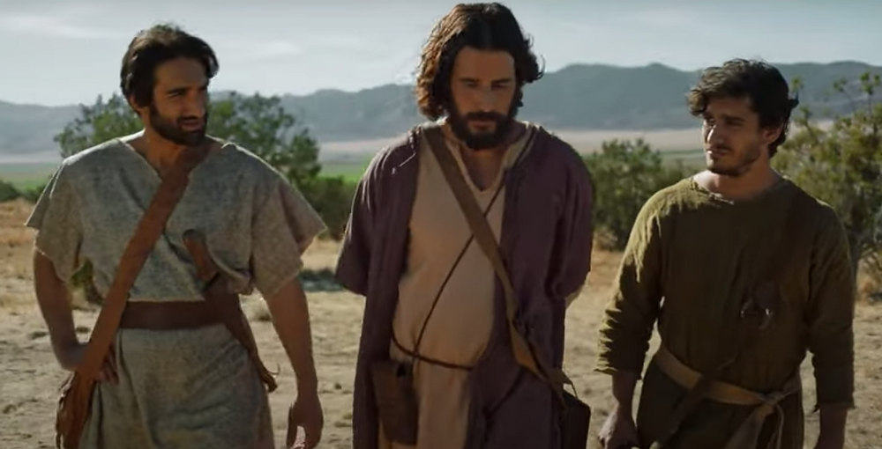

Scripture Reading
Mark 10:35-45 NIV
Notes:
[READ & BRIEFLY COMMENT ON PASSAGE]
Why do we have such a hard time with this? Well, because it’s upside-down, as things are in the Kingdom. This way of Jesus—his way to peace, joy, and freedom—doesn’t appeal to our flesh and animalistic desires. Instead, it’s the path of selflessness that we are being called—to a higher way (a new way) of being human.
But in order to get there, we have to do something that feels counter-intuitive to our fallen selves; something that goes against our nature. Nevertheless, it’s the place every disciple and all those who want to follow Jesus must begin if we’re going to resist the narcissistic patterns of this world and reveal the power of the gospel to our neighbors. Listen to what Jesus said a couple chapters earlier in Mark 8:34-35. [NEXT SLIDE]

Slide 7
Mark 8:34-35 NIV – The Way of the Cross
³⁴ Whoever wants to be my disciple must deny themselves and take up their cross and follow me. ³⁵ For whoever wants to save their life will lose it, but whoever loses their life for me and for the gospel will save it.
Notes:
[BRIEF COMMENT]
v. 34 – “say no” to doing whatever you want (the easy road, the selfish way, the one that benefits you); “take up your cross” means there are sacrifices that need to be made to follow Christ. There is a cost, but it’s worth it!
v. 35 – Put another way: “For whoever wants to operate out of self-preservation and self-absorption will not truly live. But whoever follows in the Jesus way will discover real fulfillment and salvation.
You know this, if you’re honest with yourself. The natural state of the human self (the ego) is empty. It’s fragile and always feeling inadequate. So, it’s busy seeking to find meaning and purpose apart from God, or with God plus something else. That’s what the Tree of the Knowledge of Good and Evil was all about—us trying to find life apart from the one way we were created to receive it. Think about it.
In Genesis 3, the Tree of the Knowledge of Good and Evil is about us getting our worth, identity, purpose, and power from ourselves—remember, “you can be like God” the serpent said. But what the first humans discovered, and we still experience today, is that in order to achieve it (because we are not the Creator) we must resort to comparing ourselves to others, boasting in who we are or what we’ve done (or self-loathing, which is another form of self-obsession), and continually play the ego game in our heads in order to feel good about ourselves. And isn’t that exhausting? What if I told you that Jesus is showing us a way off this crazy train?
I believe that the apostle Paul began to understand this later in life. Listen to what he wrote to the church in Corinth where they were divided over their favorite teachers and competing opinions about who was most qualified to lead them. He wrote this: [NEXT SLIDE]

Slide 8
Paul, 1 Corinthians 4:3-4 MSG
It matters very little to me what you think of me, even less where I rank in popular opinion. I don’t even rank myself. Comparisons in these matters are pointless… The Master makes that judgment.
Notes:
Don’t miss what Paul is saying. He is saying I don’t care what you think, but you know what… I don’t care what I think. I have a low opinion of what you think, but I also have a low opinion of what I think. Now folks, that’s much different than the attitude many Americans have when they say, “I don’t really care what you think.”
It’s usually simply said to protect our ego. And so, what happens is we go on living with thin skin and can’t receive any criticism. Therefore, we fail to listen or learn from what God may be saying to us through others, and we miss an opportunity to root our identity in someone eternal and unchanging. We miss the lesson that Paul had learned.
You see, here is the problem with trying to solve our ego problem in the way of the world. We do not know how to heal low self-esteem (or self loathing and self-hatred) except with puffing ourselves up with pride. That is why I say don’t fall into the trap of high self-esteem or me-centered American pop-psychology. It’s a trap because (1) it’s still taking from the wrong tree; and (2) you can still feel good about yourself while believing something wrong or behaving badly. People do it all the time. Folks, Hitler’s self-esteem was fine when he chose to be a monstrous human being.
Again, that’s why we need something more than the constant inflating and deflating of our ego with the temporary hot air of the world. Instead, we need our souls filled with something solid and life-giving. More specifically, to be given a new identity by being filled with the Spirit of Christ. That is how Paul was walking in the way of the Lord’s peace, joy, and freedom. He knew who he was. As he wrote in Galatians… [NEXT SLIDE]

Slide 9
My old self has been crucified with Christ. It is no longer I who live, but Christ lives in me. So, I live in this earthly body by trusting in the Son of God, who loved me and gave himself for me.
Paul, Galatians 2:20 NLT
Notes:
[BRIEF COMMENT]
This is a divine reality, church. When you receive Christ as Lord, you are a new person. By the cross of Christ, you have come alive to God and received his very life in you. This means, as Paul said in Romans 8 verse 1, there is now no condemnation. The verdict is in. You’ve been forgiven and set free. You have God’s favor (not because of anything you’ve done) and so you can now live freely out of God’s mercy, grace, and love. You have nothing to earn and nothing to prove, just a life of love to live.
But listen to me, you’ve believed lies for a long time. You’ve been conditioned to believe differently by a self-obsessed culture. Your flesh will want to find another way. Don’t do it. Deny yourself over and over as you follow Jesus and immerse yourself in this truth again and again and again—meditate on it, pray about it with friends, sing it in worship, hear it through the preaching of the Scriptures and live into it through the liturgies of the church.
And slowly but surely you will be able to respond to the hurt feelings of your fragile ego with “I know who I am. I’m a son or daughter of the King.” And then, you’ll be able to let God fill your emptiness with the joy that comes by putting others first—by loving others when you just want to lick your own wounds, by living for others when you just want things your way. Because we know that in the Kingdom, the way up is down; the way to wholeness is through selflessness, and the way to peace, joy, and freedom is through serving others.
That’s why Paul wrote and recorded these words in Philippians 2. [NEXT SLIDE]

Slide 10
Paul, Philippians 2:3-4 NIV
³ Do nothing out of selfish ambition or vain conceit. Rather, in humility value others above yourselves, ⁴ not looking to your own interests but each of you to the interests of the others.
Notes:
v. 3 – NRSV - “think of others as better than yourselves” isn’t about your person or your worth, but about your position. We are invited to humble ourselves and act out of a servant’s heart.
v. 4 – live for others; this is servant leadership.
[READ VERSES 5-11 & COMMENT]
Finally, let’s sum up the message this way: [NEXT SLIDE]

Slide 11
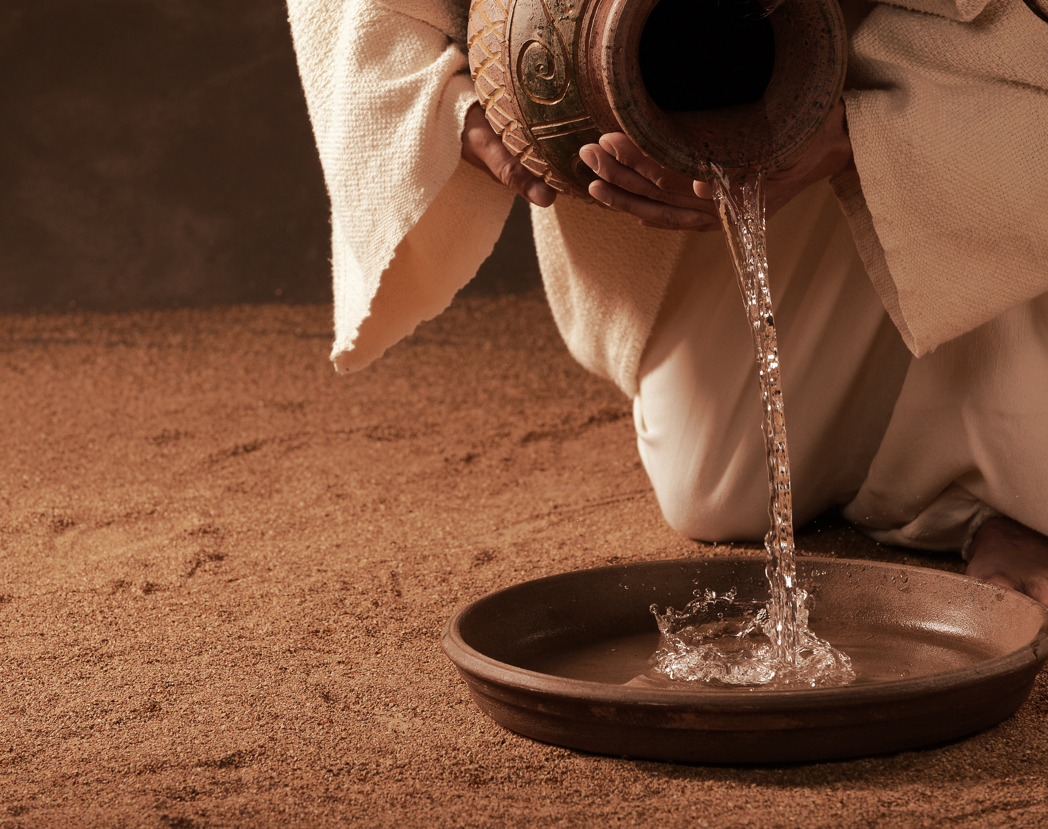
Jesus & the Selfless Life
How can we be selfless like Jesus?

Slide 12
Jesus & the Selfless Life
How can we be selfless like Jesus?
Stop playing the ego game.

Slide 13
Jesus & the Selfless Life
How can we be selfless like Jesus?
Stop playing the ego game.
Root your identity in the gospel.

Slide 14
Jesus & the Selfless Life
How can we be selfless like Jesus?
Stop playing the ego game.
Root your identity in the gospel.
Live an others-oriented life.
Notes:
[BRIEF COMMENT ON EACH]
Stop playing the ego game. Isn’t it exhausting? Don’t you want better for yourself? For others?
Root your identity in the gospel. How? Prayer. Scripture. Worship. Community.
Live an others-oriented life. When you’re feeling self-absorbed, deny yourself and go serve somebody.
Brothers and sisters, in 2 Timothy the apostle Paul wrote that in the last days people will become “lovers of themselves” (3:2). I’d say that we’re certainly seeing that today. Which is why we have the high calling, and a Kingdom opportunity, to follow Jesus and the selfless life… so that the world might know the difference the gospel truly makes when we live for others and not ourselves. May God help us in doing just that.
[CLOSING PRAYER]

