Slide 1
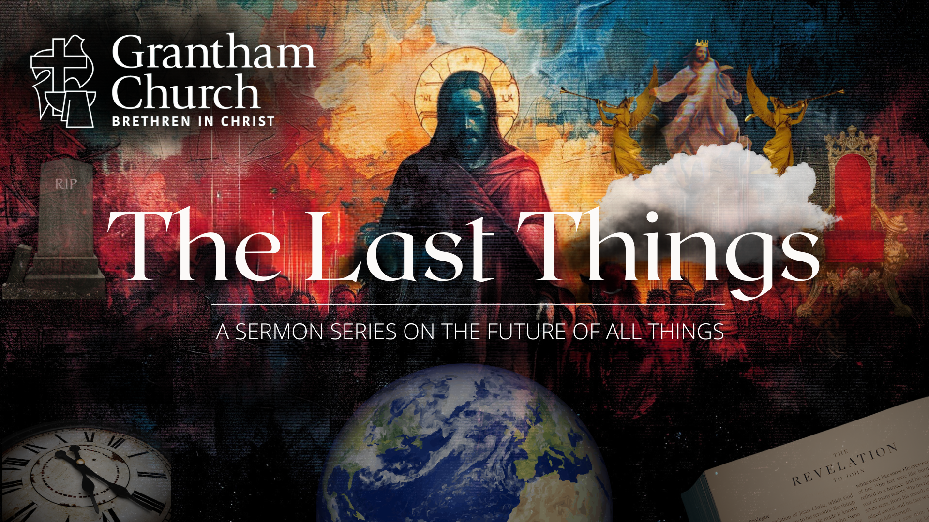
Notes:
[BRIEF WELCOME & INTRO]
This morning we are continuing our series, The Last Things – a 7-week sermon series on the future of all things. This is the third message in the series.
Remember the ”last things” comes from… [NEXT SLIDE]

Slide 2
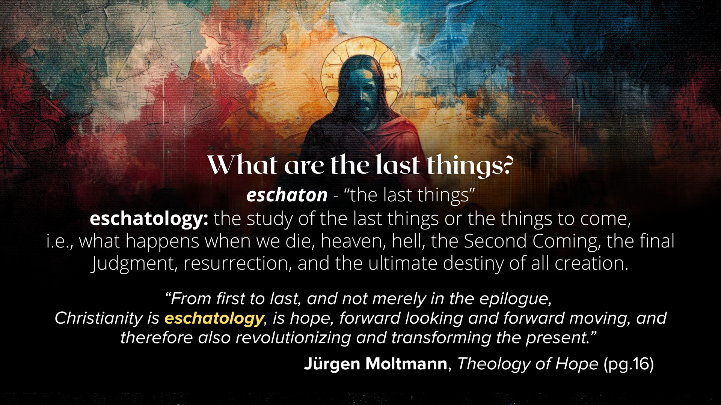
Notes:
[READ SLIDE & COMMENT]
If you’ve been following the series each week, I trust that you’re already seeing and will continue to see that our knowledge of the future can deepen our trust in God in times of fear and uncertainty, ground us in the Christian hope, and help us to live in light of the last things.
Knowing where everything is going and that God is guiding all of human history to its divinely intended goal will help us keep our life and world events in perspective. And here is where the New Testament tells us everything is going… [NEXT SLIDE]

Slide 3
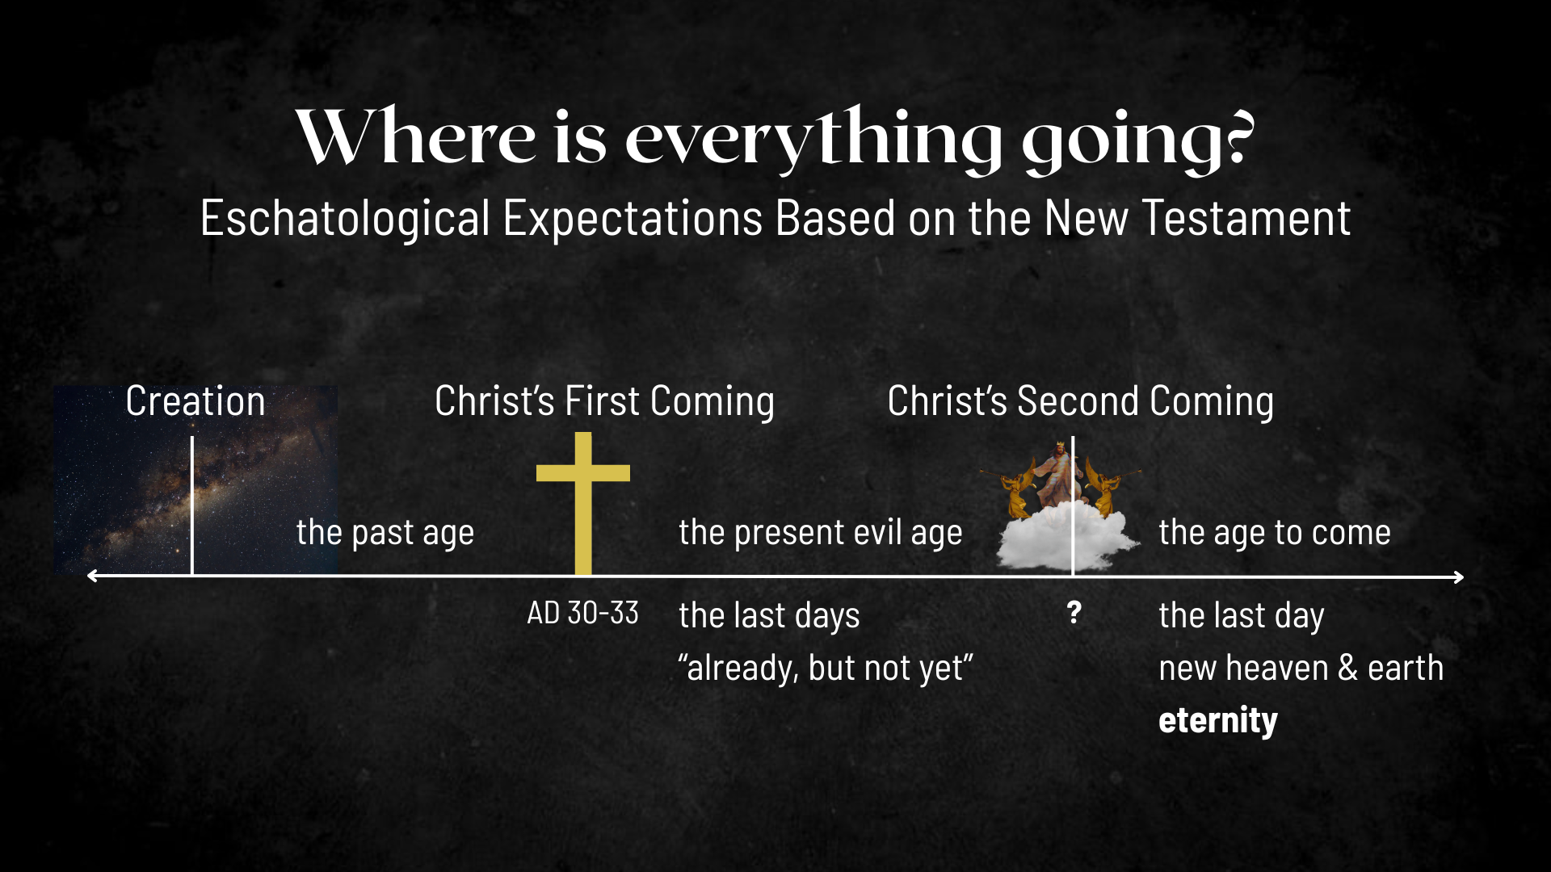
Notes:
[EXPLAIN IMAGE – CREATION TO ETERNITY]
Jesus’ first coming split our historical timeline (the past age & the present evil age)
So, according to the Scriptures, since the life, death, and resurrection of Christ, we’re living in the “last days”; we live in the ”already, but not yet” of the Kingdom of God; the decisive battle has been won, the victory is certain, and the future is secure.
And when Christ returns a second time, the “age to come” will be realized; this is when God raises the dead, brings heaven to earth and we enter the eternal (aionios); and this ”eternal” life is not simply about immortality, it’s about “age to come” life and God’s good future.
We began our series a couple weeks ago with the message… [NEXT SLIDE]

Slide 4
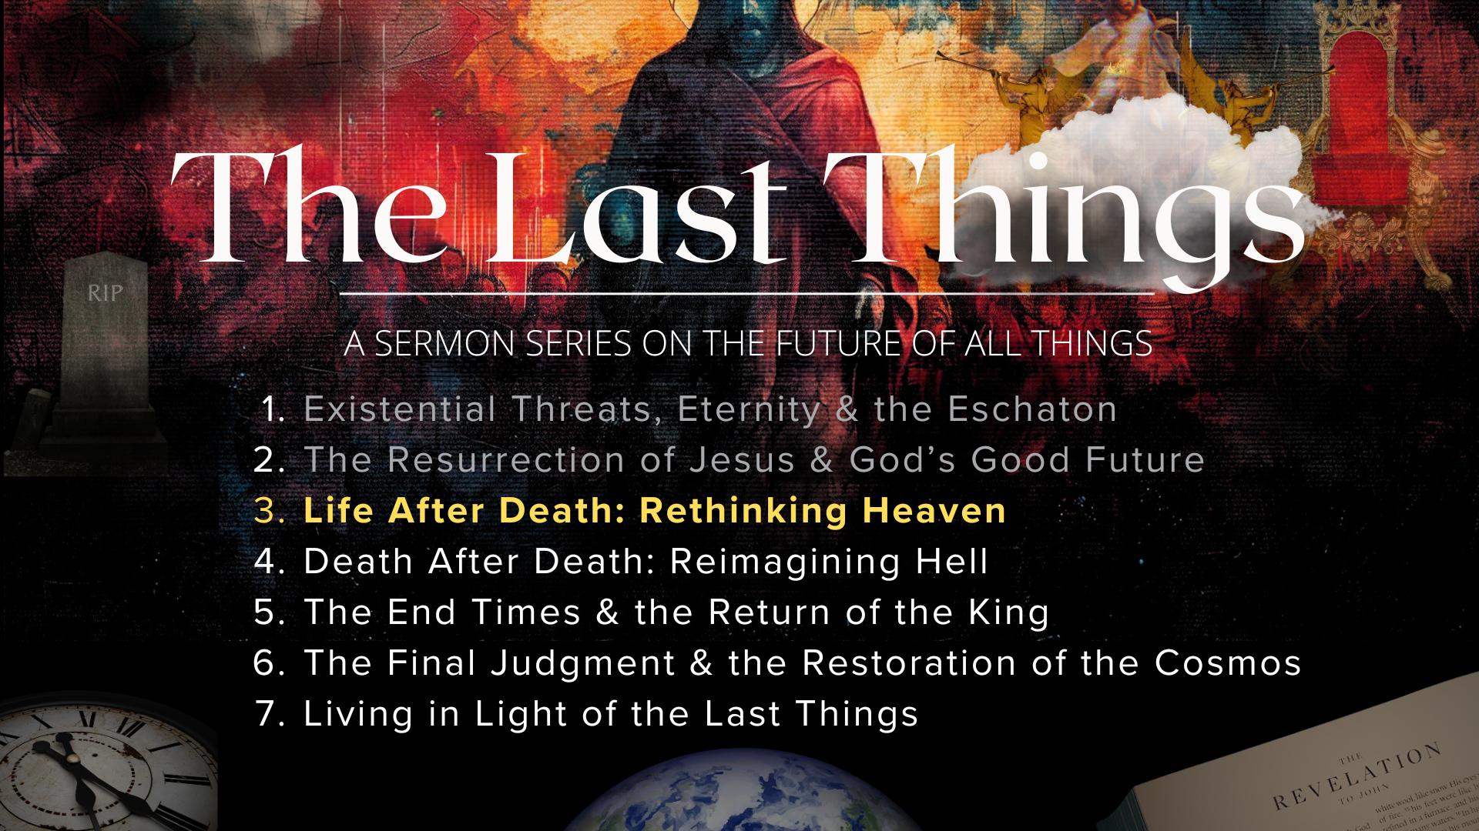
Notes:
Existential Threats, Eternity & the Eschaton - In the intro of the series, I invited us to adopt an eternal perspective, build our lives upon God’s story, and deepen our trust in his power to guide history to its divinely intended goal. In last week’s message, The Resurrection of Jesus & God’s Good Future, we looked at how the resurrection of Jesus changed everything, we reflected on Paul’s words in 1 Corinthians 15 on resurrection as the Christian hope and what we mean when we say we believe in the future resurrection and where God is taking all of creation.
And in today’s message, Life After Death, Rethinking Heaven, I’m going to challenge some popular conceptions of heaven (propagated by culture and the church) and invite us to rethink what Jesus and the New Testament tell us about what happens when we die. We will also look at how “heaven” (as a present reality or dimension) is not the same as the future new heaven and earth, and why that matters. And we will once again see how resurrection is the Christian hope, as we long for God to renew us as unified persons made up of spirit, soul, and body.
But before we dive in to this important topic… [NEXT SLIDE]

Slide 5
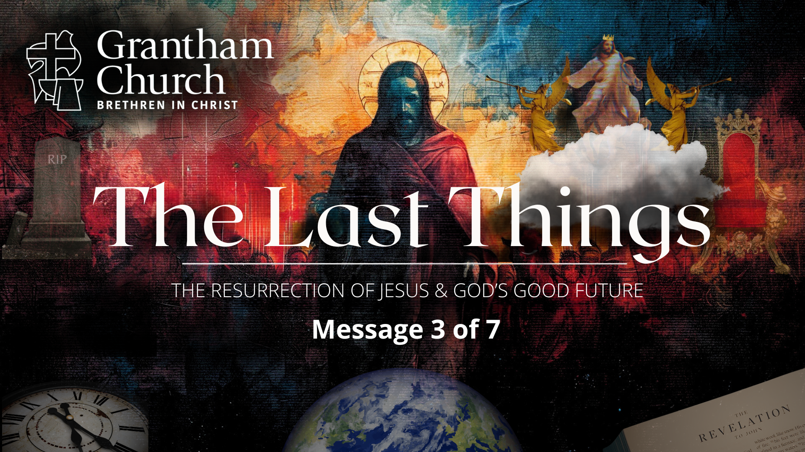
Notes:
Let’s go to God in prayer and ask for him to reveal himself and his truth to us.
[BRIEF PRAYER]
Think with me for a minute. How have you seen the afterlife or “heaven” portrayed in pop-culture through movies, streaming shows, and so forth?
You may recognize some of these images? [NEXT SLIDE]

Slide 6

Notes:
[BRIEF COMMENTS]
What do you see?
”Heaven” or the afterlife is often depicted being anywhere from blissful to boring to downright goofy and cartoonish
It might be depicted as being material and embodied, to somewhat immaterial and disembodied
And most of the time, “heaven” or the afterlife (as it’s depicted in pop-culture) isn’t a place that anyone would want to go; you might want to visit, but likely not want to stay very long.
But for those who have had a positive near-death experience, they all tell a very different story and describe a much different place. What are we talking about? [NEXT SLIDE]

Slide 7
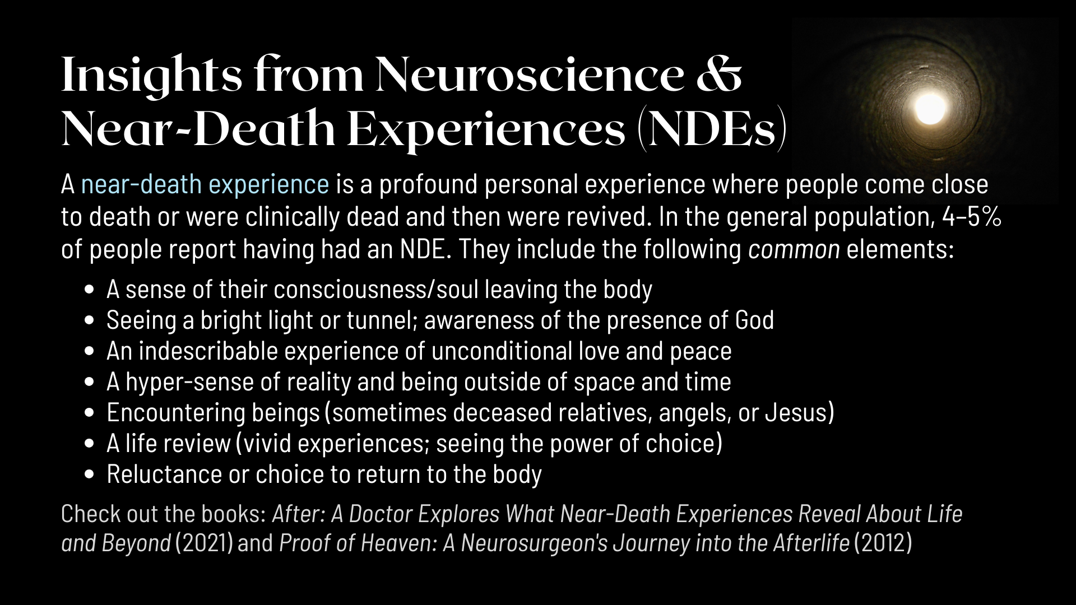
Notes:
A near-death experience is a profound personal experience where people come close to death or were clinically dead and then were revived. In the general population, 4–5% of people report having had a positive NDE. I say “positive” because, as we will see next Sunday when we look at hell, not all of these experiences are pleasant. But the ones that are (and that’s roughly 1 in 25 or over 13 million people in the US alone) include the following common elements:
A sense of their consciousness/soul leaving the body
Seeing a bright light or tunnel; awareness of the presence of God
An indescribable experience of unconditional love and peace
A hyper-sense of reality and being outside of space and time
Encountering beings (sometimes deceased relatives, angels, or Jesus)
A life review (vivid experiences; seeing the power of choice)
Reluctance or choice to return to the body
If you’re interested in learning more, I recommend a couple books: (1) After: A Doctor Explores What Near-Death Experiences Reveal About Life and Beyond by Dr. Bruce Greyson (2021) and Proof of Heaven: A Neurosurgeon's Journey into the Afterlife by Dr. Eben Alexander (2012).
IMPORTANT THINGS TO NOTE:
Observation is one thing, interpretation is another
The NDEs appear to be tailored to the individual
There is no coercion or manipulation by God, even in death
NDEs are real, but they are still subjective experiences
Run everything through what the Bible says (e.g., ”heaven” is not the end of the journey and we’re not fully human without our bodies)
So, we need to be sure that we’re adopting a biblical view of the human person in this life if we’re going to rightly anticipate what is coming in the next… [NEXT SLIDE]

Slide 8
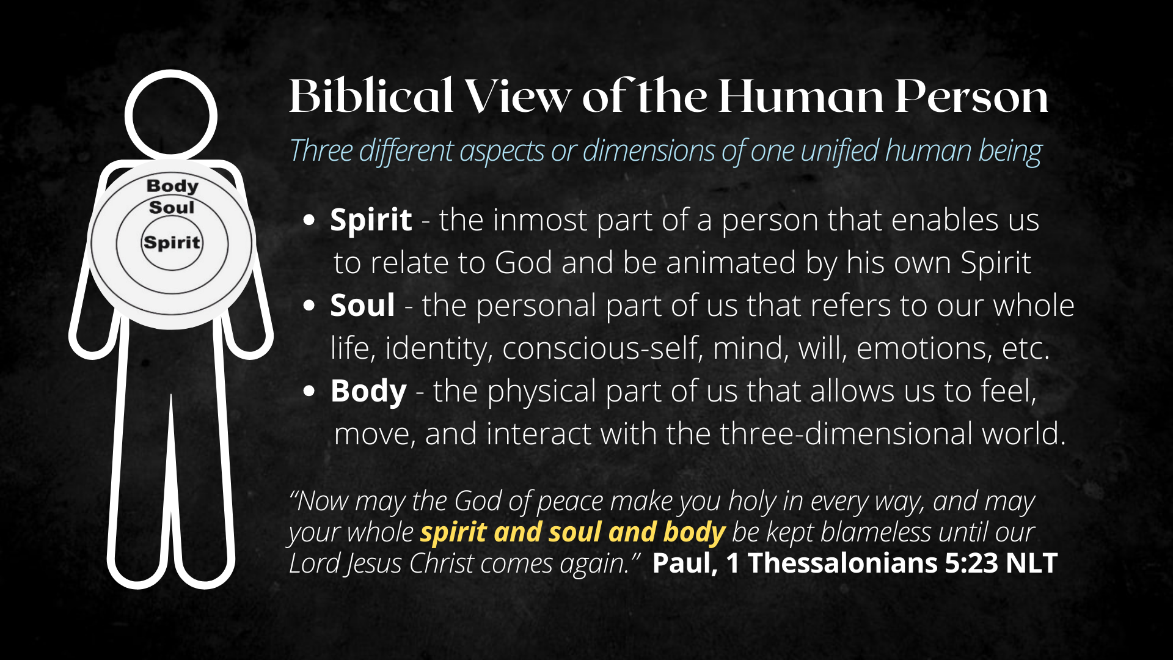
Notes:
According to the Scriptures, there are three different aspects or dimensions to being a unified human being made in the image of God (3-parts to the whole):
Spirit (ruach/pneuma) - the inmost part of a person that enables us to relate to God and be animated by his own Spirit; being “born again” begins here!
Soul (nephesh/psyche) - the personal part of us that refers to our whole life, identity, conscious-self, mind, will, emotions, etc. The Hebrews concept of nephesh was the whole person, not a disembodied part of you that lives on; immortality was not inherent.
Body (basar/soma)- the physical part of us that allows us to feel, experience the 5-senses, move, navigate, and interact with the three-dimensional world.
Again, this is what it means to be a human being made in God’s image. In 1 Thessalonians 5:23, Paul writes: “Now may the God of peace make you holy in every way, and may your whole spirit and soul and body be kept blameless until our Lord Jesus Christ comes again.”
And so, with this view of the tripartite nature of human beings, let’s talk about what happens when we die, rethink heaven, and where things are going… [NEXT SLIDE]

Slide 9
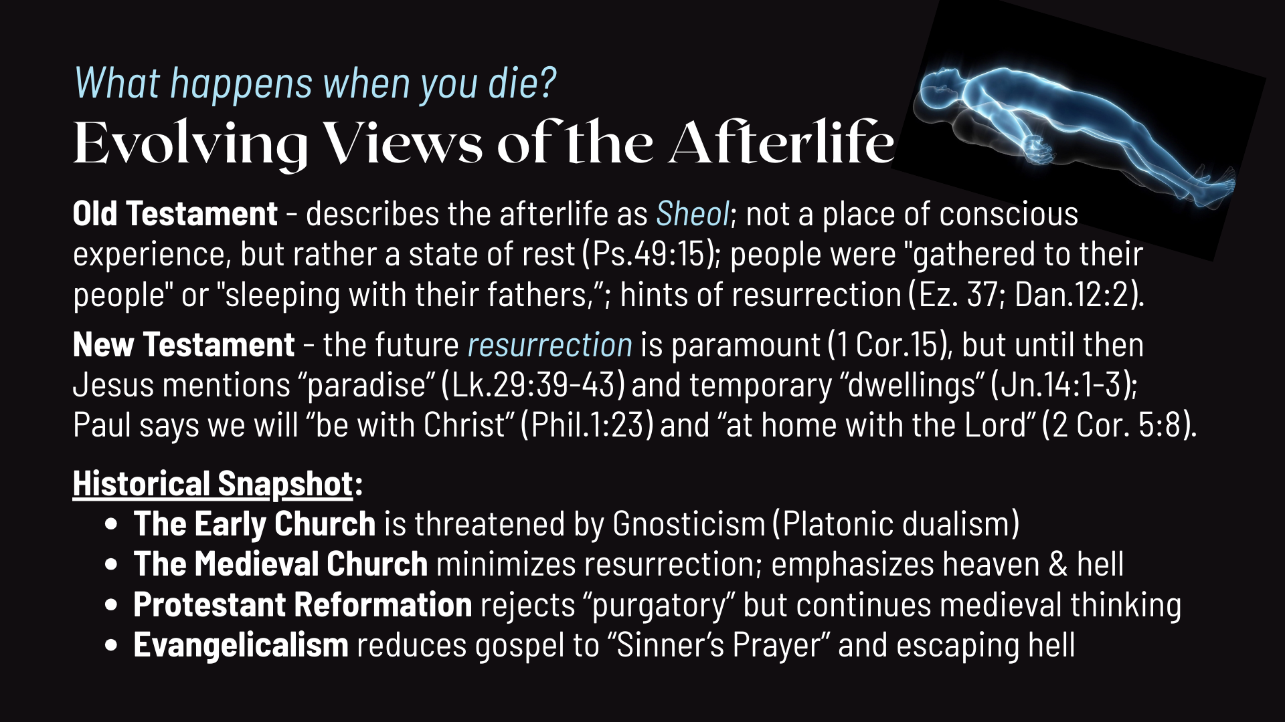
Notes:
[READ SLIDE & COMMENT]
20th Century Evangelicalism has not only reduced the gospel to the “Sinner’s Prayer” (which in and of itself isn’t bad, it’s just usually wrapped up with the message: “say this prayer so that you can go to heaven when you die and not go to hell” downplaying discipleship in the process), but it’s also emphasized escaping the earth altogether before God nukes it with his wrath, and that has caused us to lose the plot and telos of God’s good future. And it has been reinforced with years of teaching bad eschatology, sermons, hymns, media, and escapist cliches.
Here is that view revealed in an image… [NEXT SLIDE]

Slide 10
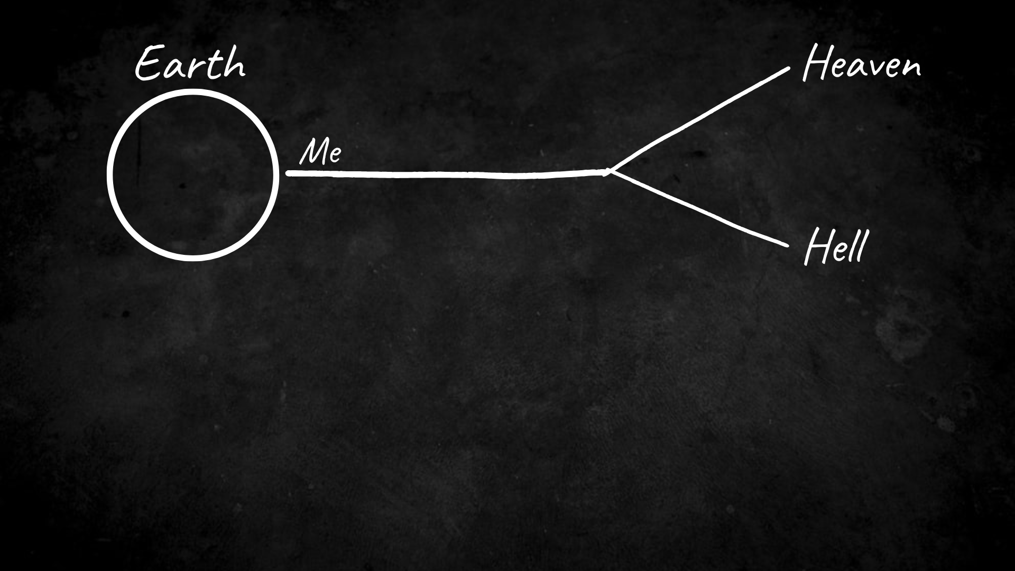
Notes:
[EXPLAIN GRAPHIC]
What’s wrong with this picture? (1) It puts you at the center of God’s story; (2) it places two final and never-ending destinations before us, which I believe are neither final or never-ending; and (3) it leaves out the future resurrection and the promise of the new heaven and earth—which includes a resurrected cosmos and the end of hell.
Which is why we need to correct this view with a more biblical image… [NEXT SLIDE]

Slide 11
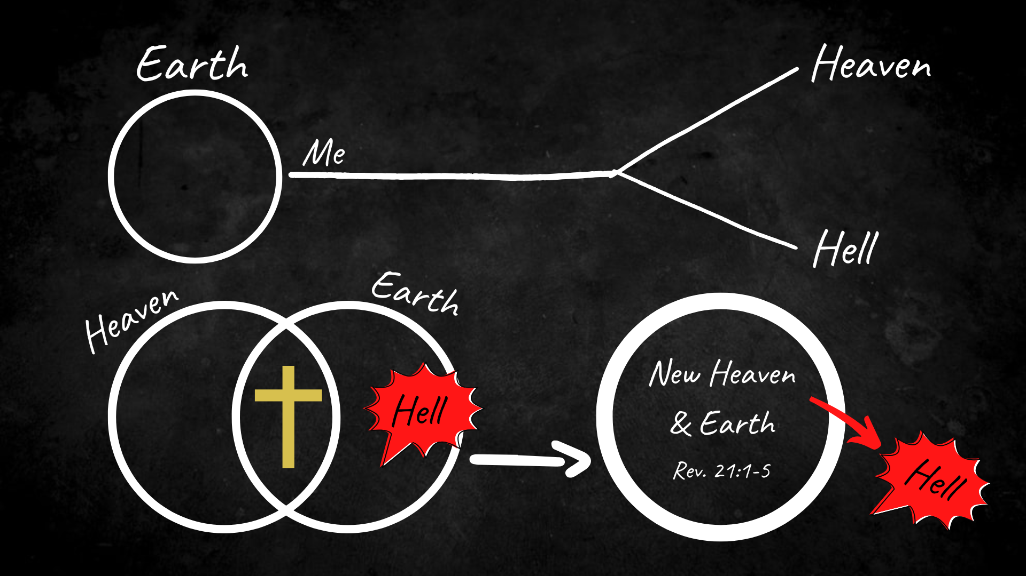
Notes:
[EXPLAIN GRAPHIC]
Heaven and earth: two spheres or dimensions; God’s space and our space overlapping and interlocking; these spaces have experienced a break from each other, but it will be restored
Because in the crucified and resurrected body of Jesus, we see heaven and earth coming together; and we heard from Jesus and his first disciples that he has defeated sin and death, and is driving it out of God’s good creation
Therefore, God will eventually (upon the return of Christ) fully consummate these realms, marry heaven and earth, resurrect and renew the cosmos, and cast out sin, death, and hell forever. Hopefully, you can see that the lower image is more faithful to Scripture.
Again, what does this mean for our concept and the reality of “heaven”? In his book… [NEXT SLIDE]

Slide 12
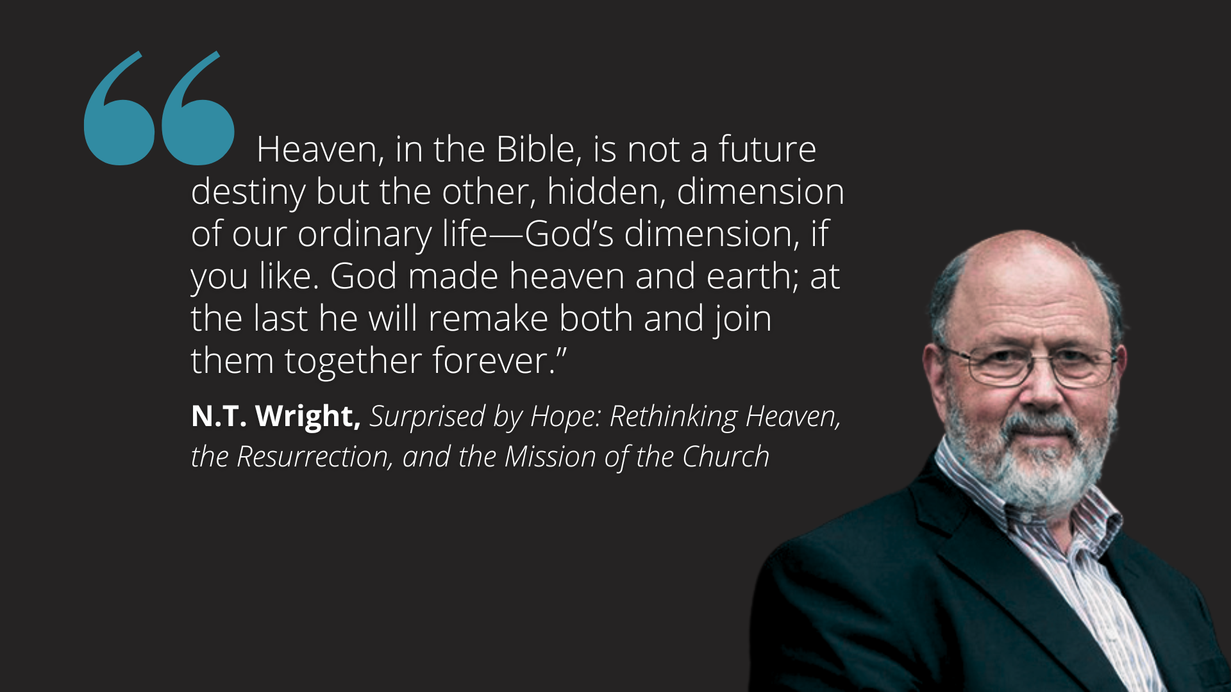
Notes:
Surprised by Hope: Rethinking Heaven, the Resurrection, and the Mission of the Church, N.T. Wright says, “Heaven, in the Bible, is not a future destiny but the other, hidden, dimension of our ordinary life—God’s dimension, if you like. God made heaven and earth; at the last he will remake both and join them together forever.”
So, notice what many Christians have done and are still doing… [NEXT SLIDE]

Slide 13
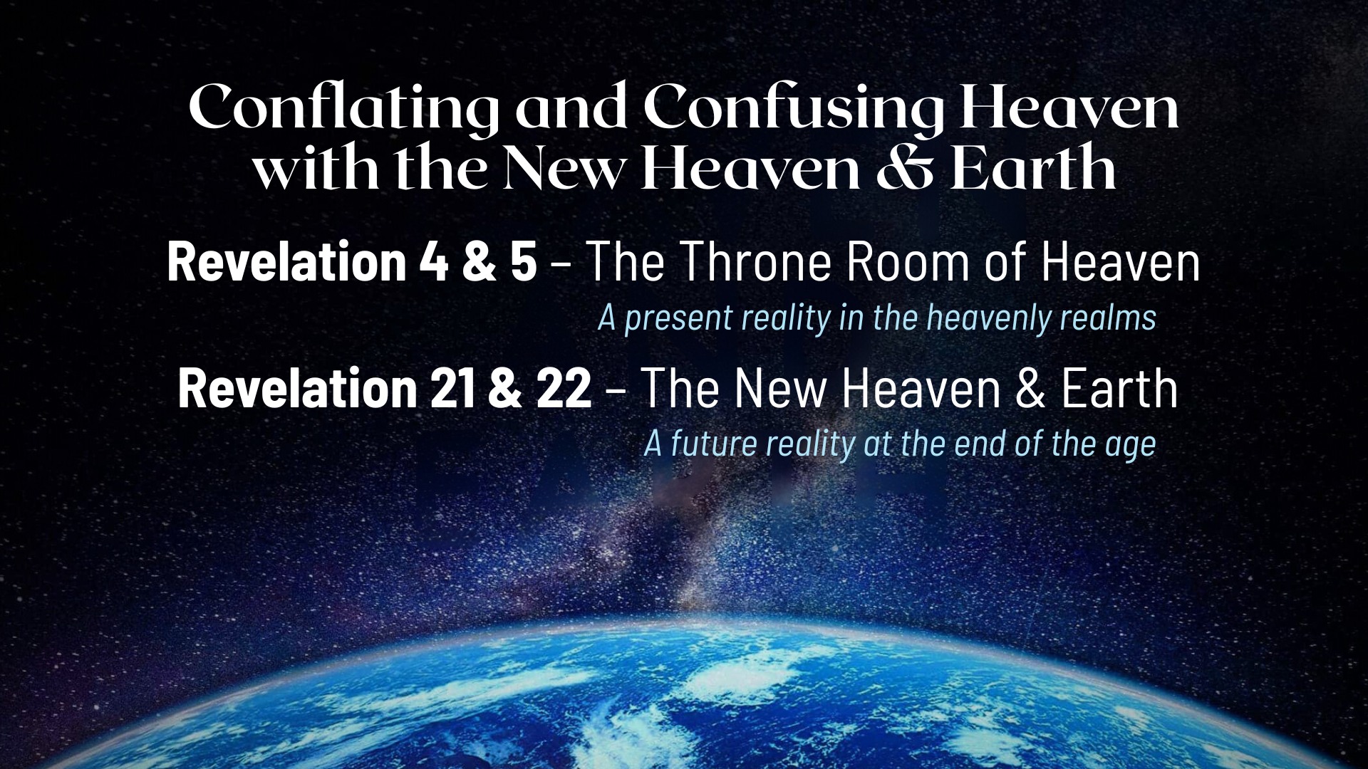
Notes:
For too long we have conflated and confused heaven as John describes it in his throne room vision of Rev 4 & 5—a scene full of angels, saints, and creatures in a blissful spiritual realm worshipping God singing Holy, Holy, Holy—with the future New Heaven & Earth in Rev 21 & 22—where we hear John speak of a massive city with large gates and streets of gold, where there is no more tears, sorrow, or death—where the old order of things has passed away, because heaven has come down to earth.
My friends, one is a present reality. The other doesn’t even exist yet. Therefore, we must sort this out in our thinking and our worship so that the story is clear, so that our gospel message is accurate and so that the second coming and resurrection (not heaven) is championed as the Christian hope. Because until that happens, the saints who’ve gone before us, the earth and all that’s in it, including the universe, eternity, and the age to come, waits in eager expectation for the fulfilment of these things. They say things like, “How long O Lord?” and “Come, Lord Jesus!”
Finally, turn with me in your Bible to… [NEXT SLIDE]

Slide 14
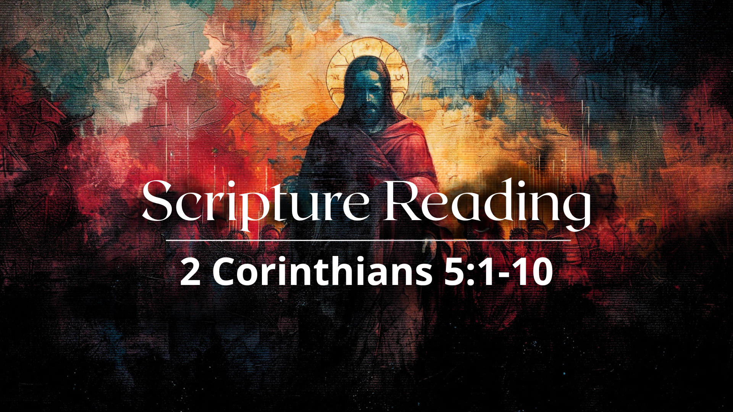
Notes:
[READ 2 CORINTHIANS 5:1-10 & COMMENT]
TO SUMMARIZE:
The resurrection body is a physical, imperishable body, given at Christ’s return, not at the moment of death. “Paradise” or “heaven” is a place of rest and waiting.
2 Corinthians 5:1-10 speaks of the groaning for resurrection, not a longing to escape the body. Paul did not look forward to being “unclothed” (out of his body), but longed for his new resurrected body; yet he would be with Christ and so he’s not going to complain.
And lastly, notice that Paul emphasizes new creation rather than an escape to heaven, so the ultimate Christian hope is not "going to heaven" but being raised from the dead into God’s renewed world at some point in the future.
Now, as you reflect on the entire message, here are some theological takeaways and suggested application based on what we’ve heard… [NEXT SLIDE]

Slide 15
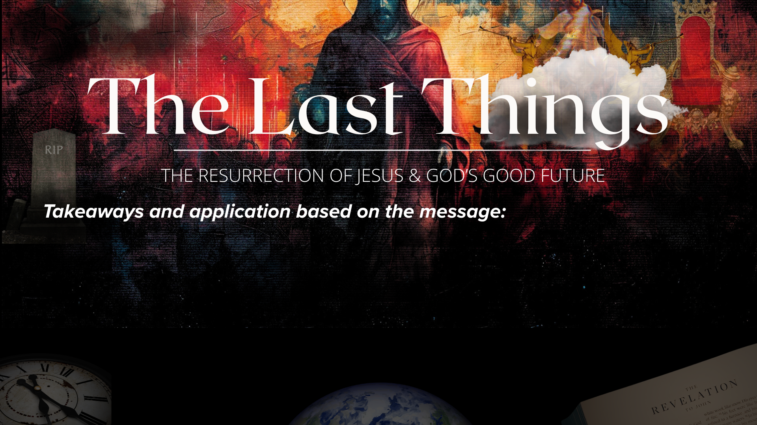

Slide 16
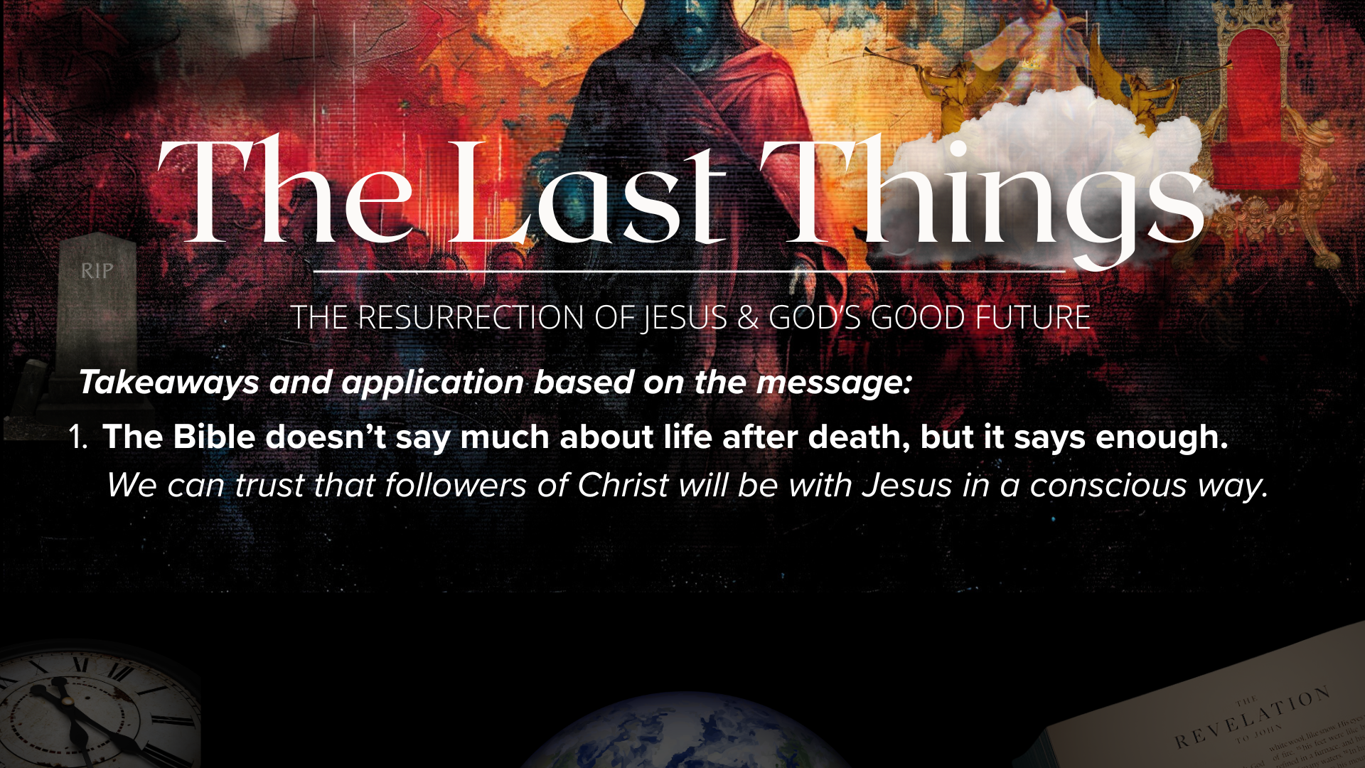

Slide 17
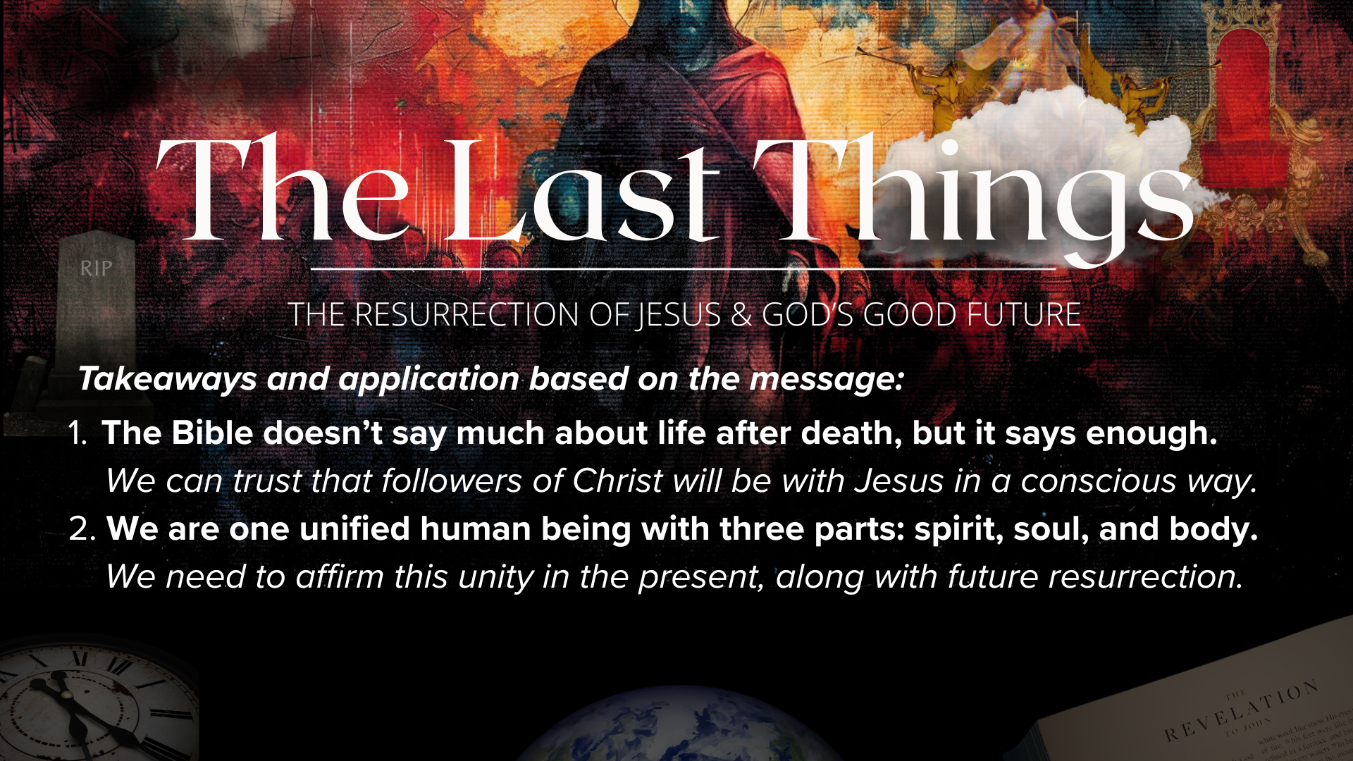

Slide 18
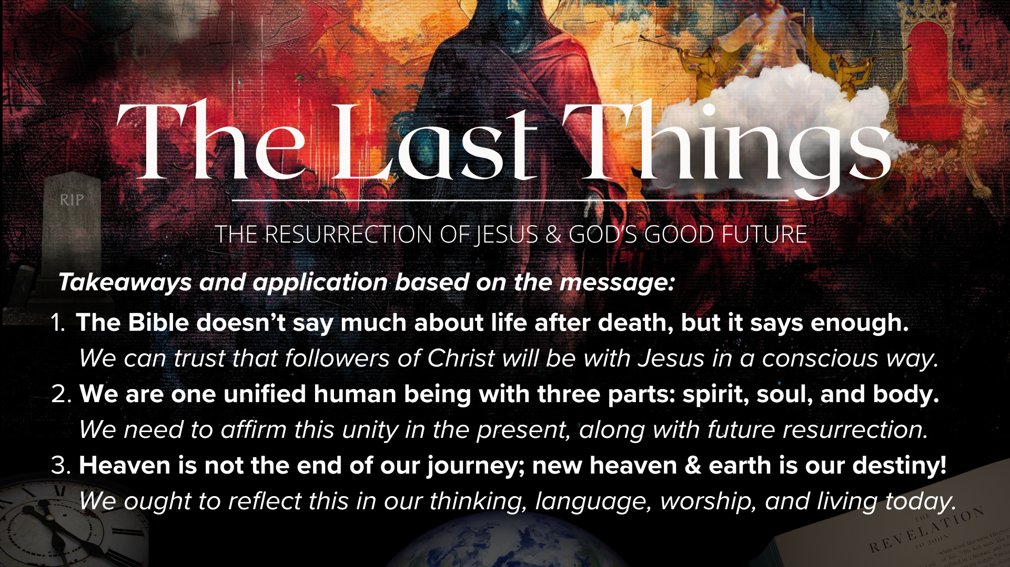
Notes:
[READ & COMMENT ON EACH TAKEAWAY]
The Bible doesn’t say much about life after death, but it says enough.
We can trust that followers of Christ will be with Jesus in a conscious way.
We are one unified human being with three parts: spirit, soul, and body.
We need to affirm this unity in the present, along with future resurrection.
Heaven is not the end of our journey; new heaven & earth is our destiny!
We ought to reflect this in our thinking, language, worship, and living today.
And finally, here are some questions to help us reflect and respond… [NEXT SLIDE]

Slide 19
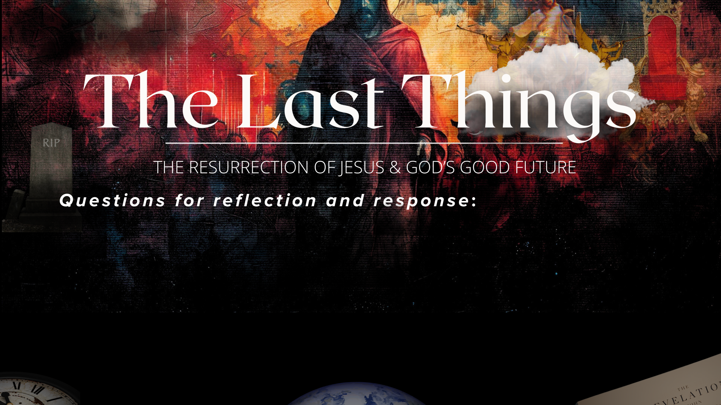

Slide 20
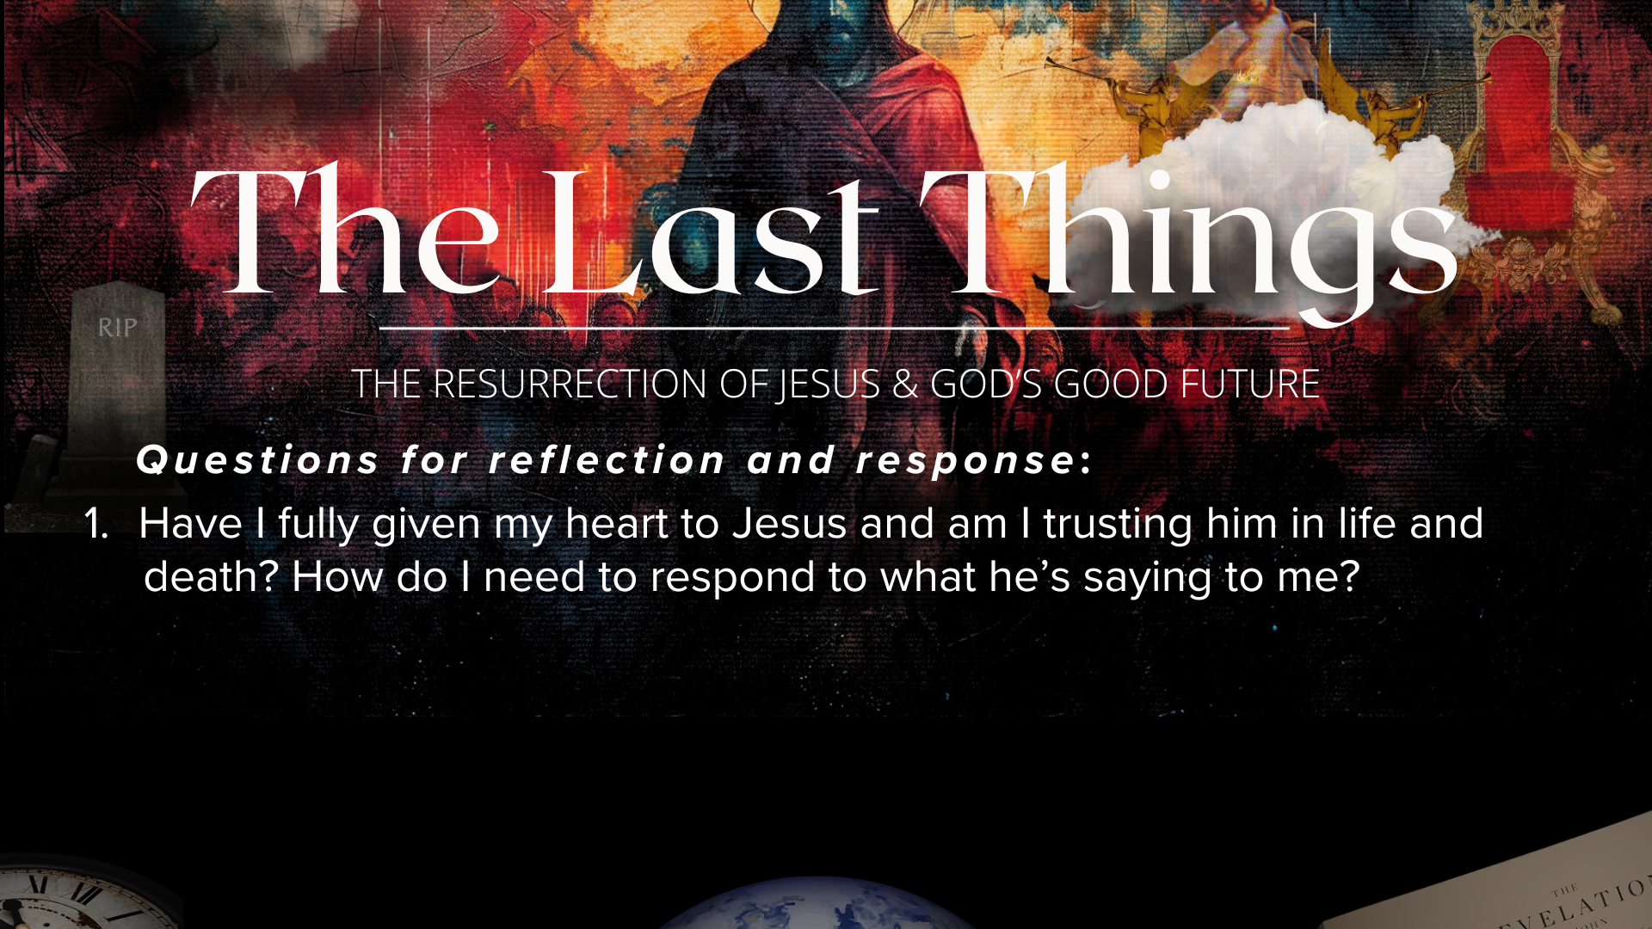

Slide 21
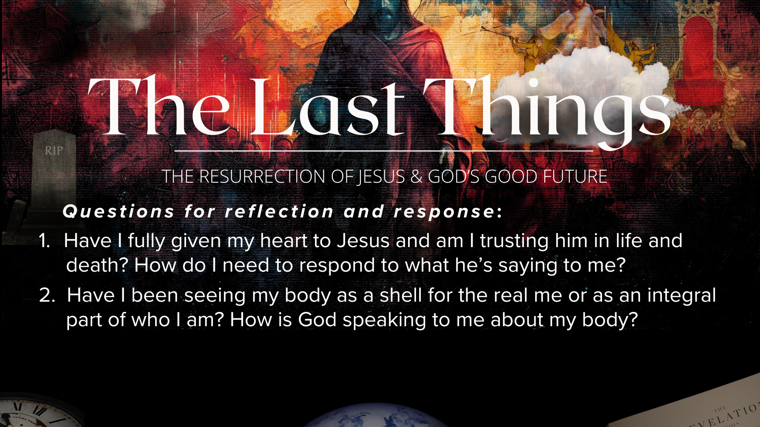

Slide 22
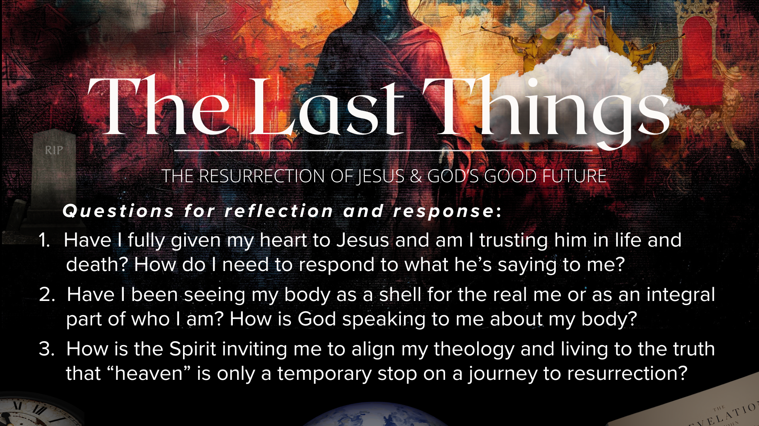
Notes:
[READ & BRIEF COMMENT ON EACH QUESTION]
Have I fully given my heart to Jesus and am I trusting him in life and death? How do I need to respond to what he’s saying to me?
Have I been seeing my body as a shell for the real me or as an integral part of who I am? How is God speaking to me about my body?
How is the Spirit inviting me to align my theology and living to the truth that “heaven” is only a temporary stop on a journey to resurrection?
[CLOSING WORDS]
Let’s pray… [NEXT SLIDE FOR CLOSING PRAYER]

Slide 23
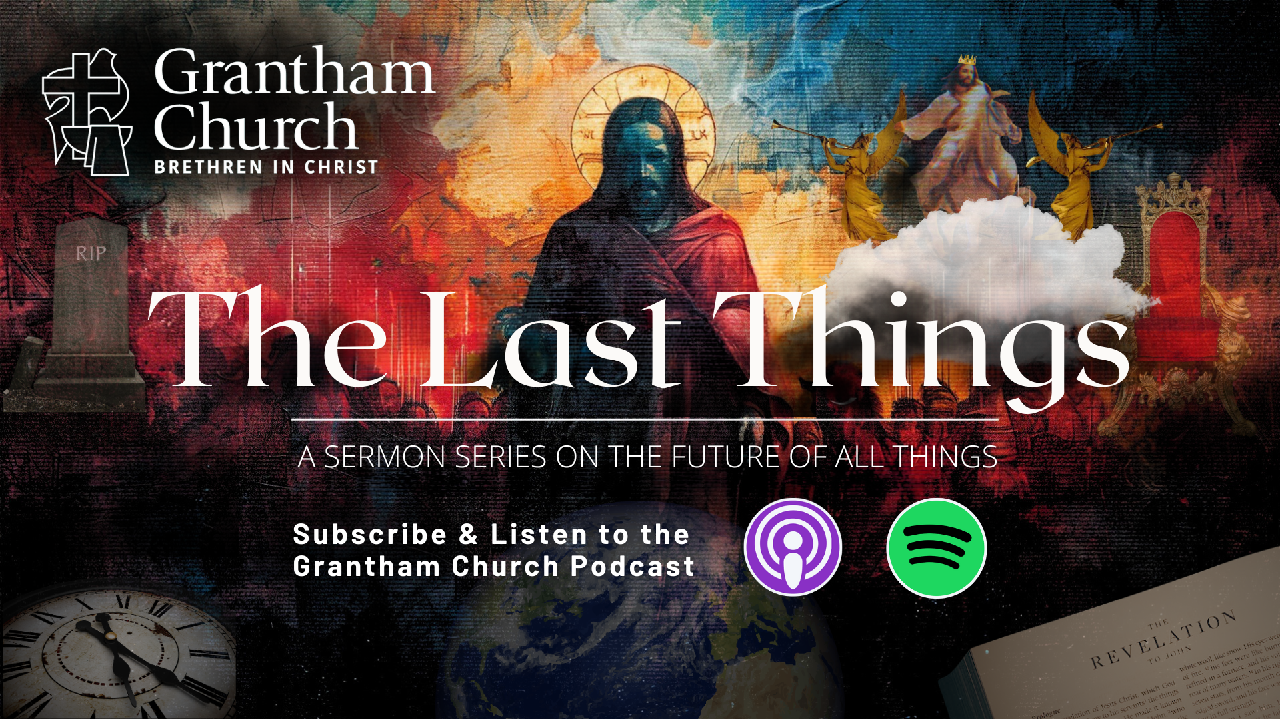
Notes:
[CLOSING PRAYER]
[CLOSING SONG]
Announcement: Seven (Pastor Dave)
ANNOUNCEMENT: FELLOWSHIP MEAL
This is our final meal of the season and then we break for the summer; We encourage you to talk about the sermon or take the opportunity to share about what you’re doing this summer and how you’d like to see God work in your life and family in the coming months.
Benediction
Church, may our sovereign God fill you with peace as you look to the future with faith, not fear. May the promise of resurrection and eternal life anchor your soul in times of uncertainty and give you hope. And may you live in light of the last things with confidence that Christ will return and bring heaven to earth. Until we gather again, go in peace to love and serve the Lord. Amen.

