Slide 1

Notes:
[WELCOME]
[BRIEF INTRO]
Deacons – (1) a biblical foundation for deacons and the NT call to serve others and meet needs in the church; (2) how deacon’s ministry has functioned in the past at Grantham; and (3) the introduction of a new model of deacon’s ministry – Deacon Care Teams
Our main Scripture reading this morning is from Acts chapter 6… [NEXT SLIDE]

Slide 2
Scripture Reading
Acts 6:1-7 NIV
Notes:
[INVITE PEOPLE TO STAND FOR SCRIPTURE READING]
[READ ACTS 6:1-7 NIV]
Pastor: “This is the word of the Lord.” - People: “Thanks be to God!” You may be seated.
[THE APOSTLE PAUL’S BODY METAPHOR] - 1 Corinthians 12:12-14
“Just as a body, though one, has many parts, but all its many parts form one body, so it is with Christ. For we were all baptized by one Spirit so as to form one body—whether Jews or Gentiles, slave or free—and we were all given the one Spirit to drink. Even so the body is not made up of one part but of many.”
Think about how this is a radical, counter-cultural (even subversive) idea of doing community and meeting needs.
So now, let’s consider what we read in Acts 6:1-7. What is happening in the first century church for them to set apart deacons and what else does the New Testament tell us about members of the Body serving in this way? [NEXT SLIDE]

Slide 3
Deacons: What We Know From the NT
Notes:
[BRIEF COMMENT ON EACH POINT]

Slide 4
Deacons: What We Know From the NT
Deacons (diakonos) – means “servant”
Notes:
[BRIEF COMMENT ON EACH POINT]

Slide 5
Deacons: What We Know From the NT
Deacons (diakonos) – means “servant”
The first “deacons” were first set apart to serve food to the poor, specifically to Hellenized Jewish widows
Notes:
[BRIEF COMMENT ON EACH POINT]

Slide 6
Deacons: What We Know From the NT
Deacons (diakonos) – means “servant”
The first “deacons” were first set apart to serve food to the poor, specifically to Hellenized Jewish widows
The call for deacons was how a growing Jewish Church responded to the urgent need for care
Notes:
[BRIEF COMMENT ON EACH POINT]

Slide 7
Deacons: What We Know From the NT
Deacons (diakonos) – means “servant”
The first “deacons” were first set apart to serve food to the poor, specifically to Hellenized Jewish widows
The call for deacons was how a growing Jewish Church responded to the urgent need for care
Deacons were needed to remove the heavy burden of care from the teachers (i.e., apostles, pastors and teachers)
Notes:
[BRIEF COMMENT ON EACH POINT]

Slide 8
Deacons: What We Know From the NT
Deacons (diakonos) – means “servant”
The first “deacons” were first set apart to serve food to the poor, specifically to Hellenized Jewish widows
The call for deacons was how a growing Jewish Church responded to the urgent need for care
Deacons were needed to remove the heavy burden of care from the teachers (i.e., apostles, pastors and teachers)
Deacons were to be faithful men and women of personal and spiritual character (1 Tim 3:8-13; Rom 16:1)
Notes:
[BRIEF COMMENT ON EACH POINT]
In writing to Timothy, Paul tells this young church planter that deacons should be above reproach in their character. He says that deacons should be full of the Spirit, not of themselves or the world. They should be trustworthy, they should be able to make sound judgments, they shouldn’t lie, they shouldn’t be addicted to alcohol (or anything else for that matter); they shouldn’t be selfish, gossips, greedy, or unfaithful to their spouse or the church. Furthermore, Paul says that if they are going to help manage and care for people in the church, they should be doing that in their own home too.
And Paul’s primary point it this: deacons should be mature in their faith. And why is that important? Because these good folks are acting as representatives and lead servants on behalf of Christ and his Church. What they do is being done in the name of Jesus for the sake of the good news to those who are poor, suffering, or in need of basic things, particularly a physical or material need.
Also, as servants in an official capacity for the local church, deacons should see themselves ministering to Christ himself as they tend to the physical needs of people and help care for the congregation, for we know that the physical is intimately connected to the spiritual health of a person. And again, these servants can be men and women. In fact, you could easily make the case that the very first “deacons” were women who served Jesus during his ministry on earth. [NEXT SLIDE]

Slide 9
Matthew 27:55-56 NIV
⁵⁵ Many women were there, watching from a distance. They had followed Jesus from Galilee to care for his needs. ⁵⁶ Among them were Mary Magdalene, Mary the mother of James and Joseph, and the mother of Zebedee’s sons.
Notes:
[BRIEF COMMENT]
So, what does all of this mean for our deacons’ ministry and doing congregational care at Grantham Church? Or we could also put it this way, “Why do we have deacons at Grantham and what do they do?” Well, first, let’s think about what they have done in years past. [NEXT SLIDE]

Slide 10
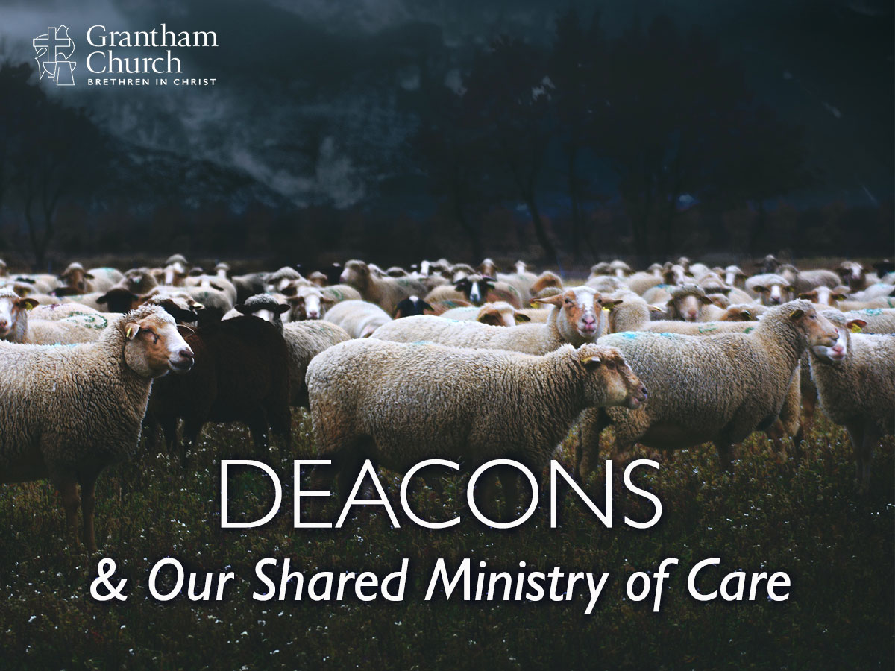
Notes:
[FEB 2020 MESSAGE ON DEACONS]
Deacons have traditionally helped with various tasks (communion, baptisms, meals, the prayer chain, etc.)
The largest part of their role has been caring for a lengthy list of people, as all members were automatically assigned a deacon.
But over the past few years this has become increasingly challenging - signs that we need a new model
The need to be reminded of our corporate call to care for each other
Listen to what Paul wrote to the Galatian church… [NEXT SLIDE]

Slide 11
Paul, Galatians 5:13-14, 6:2 NIV
¹³ You, my brothers and sisters, were called to be free. But do not use your freedom to indulge the flesh; rather, serve one another humbly in love. ¹⁴ For the entire law is fulfilled in keeping this one command: “Love your neighbor as yourself.”
² Carry each other’s burdens, and in this way you will fulfill the law of Christ.
Notes:
[BRIEF COMMENT ON PASSAGE]
I’ve mentioned this several times in the past, but it’s good to be reminded that there are up to 100 imperatives in the NT for God’s people to ”one another” with the rest of the church. Reflect on that a moment… [NEXT SLIDE]

Slide 12
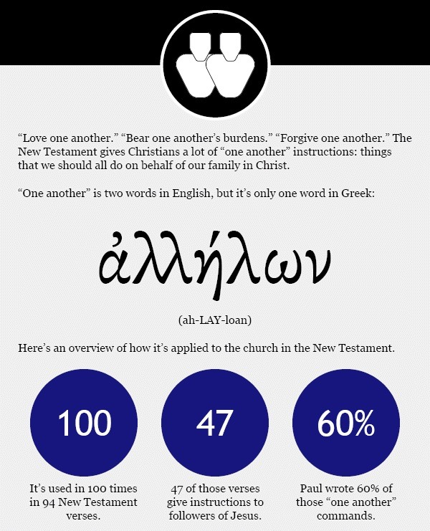
All the “One Another” Commands in the New Testament
Notes:
[BRIEF COMMENTS]
We’re instructed to…
Serve one another (Ga 5:13), or as Jesus said, Wash one another’s feet (Jn 13:14)
Bear one another’s burdens (Ga 6:2)
Comfort one another concerning the resurrection (1 Th 4:18)
Encourage and build up one another (1 Th 5:11)
Stimulate one another to love and good deeds (He 10:24)
Pray for one another (Jas 5:16)
Be hospitable to one another (1 Pe 4:9)
And all of these “one another” commands, the sharing of burdens and care, has a place on our triangle of spiritual balance and health. [NEXT SLIDE]

Slide 13
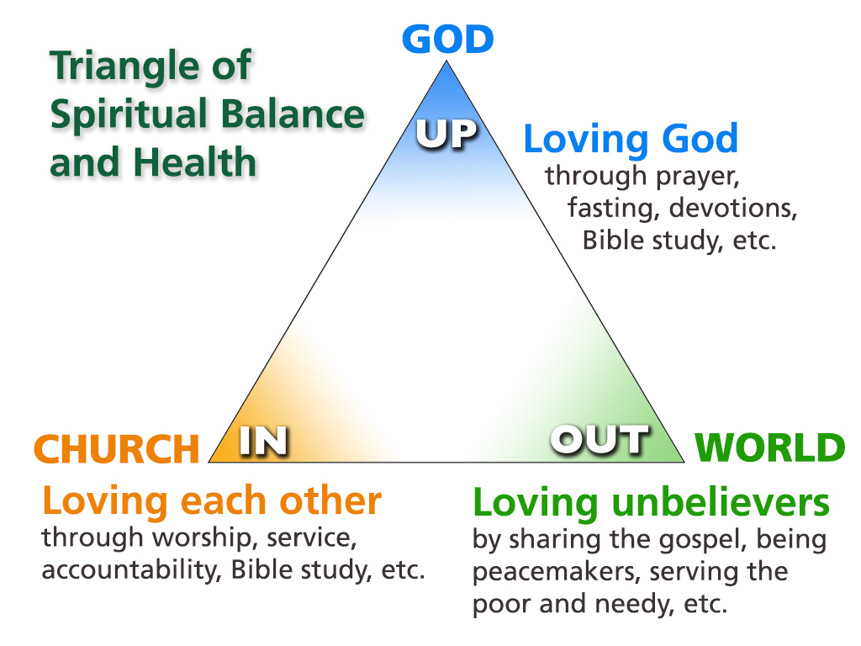
Notes:
[BRIEF COMMENT]
But in order for us to “one another”… we must be working the spaces in the church where mutual care is possible. [NEXT SLIDE]

Slide 14
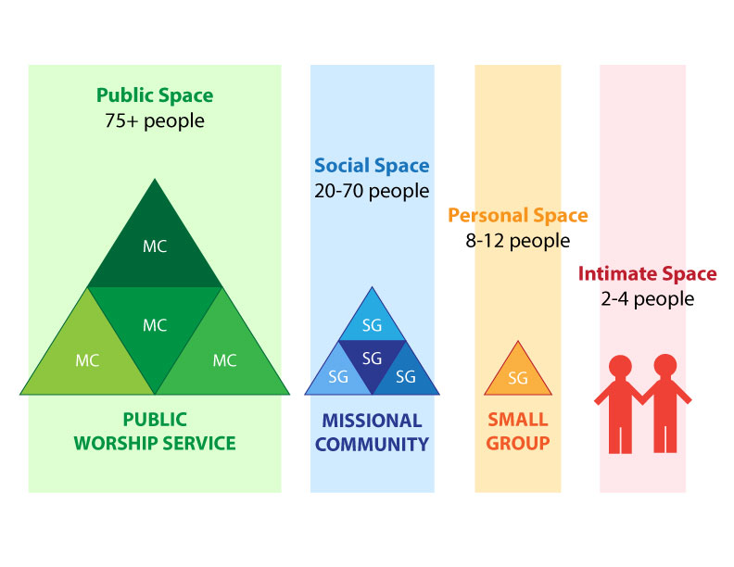
Notes:
[BRIEF COMMENT]
Personal Space & Intimate Space: the spaces where care happens organically and naturally in the Body of Christ. (e.g. my own small group)
As I’ve said before, our pastors envision that our small groups will in time become not just the primary vehicle for discipleship at Grantham Church, but also the place where most of the congregational care is happening—in the intersection of a shared life together. I believe this is not only how we have been wired as human beings, it’s also what Jesus envisioned for his Church in every age, i.e. that we are learning, growing, and caring for one another in close-knit community.
Having said that, we recognize that there is still a need for deacons and for organizing specific kinds of care in our congregation. And so, I’d like to introduce you to the next iteration of deacons ministry and how we’re doing congregational care at Grantham Church. [NEXT SLIDE]

Slide 15
Notes:
[INTRO TO NEW MODEL]
Reasons for the change:
There are a number of long-time deacons whose term is ending at the end of this year that will not be returning, which means we currently have 9 deacon couples or individuals going into 2022. [Invite them to stand]
Recruitment of deacons has been a challenge in recent years, some of that possibly reflective of the role being too broad and not focused enough. As a result, deacons have been burdened with extremely long lists of people to care for (11-19 individuals/families).
We have found that other churches have moved away from a more traditional model of deacon care.
Over the past five years, leadership has been emphasizing the need for engaging in the “personal” spaces where care happens organically.
Based on the New Testament model of deacons ministry (Acts 6:1-7), there is a precedent for deacons responding to need-based care rather than having each congregant assigned a deacon. We already had a few working examples of this at Grantham with meals, a moving team, and baptisms.
Therefore, we began exploring the idea of a hybrid model of deacon care where deacons (in addition to offering care when and where needed) put aside their long burdensome lists of members and became coordinators of care teams that others in our church can join and share in doing congregational care. And so, this is what was proposed to the deacons and the church board and subsequently approved to introduce to you. Our new Deacon Care Teams: [NEXT SLIDE]

Slide 16
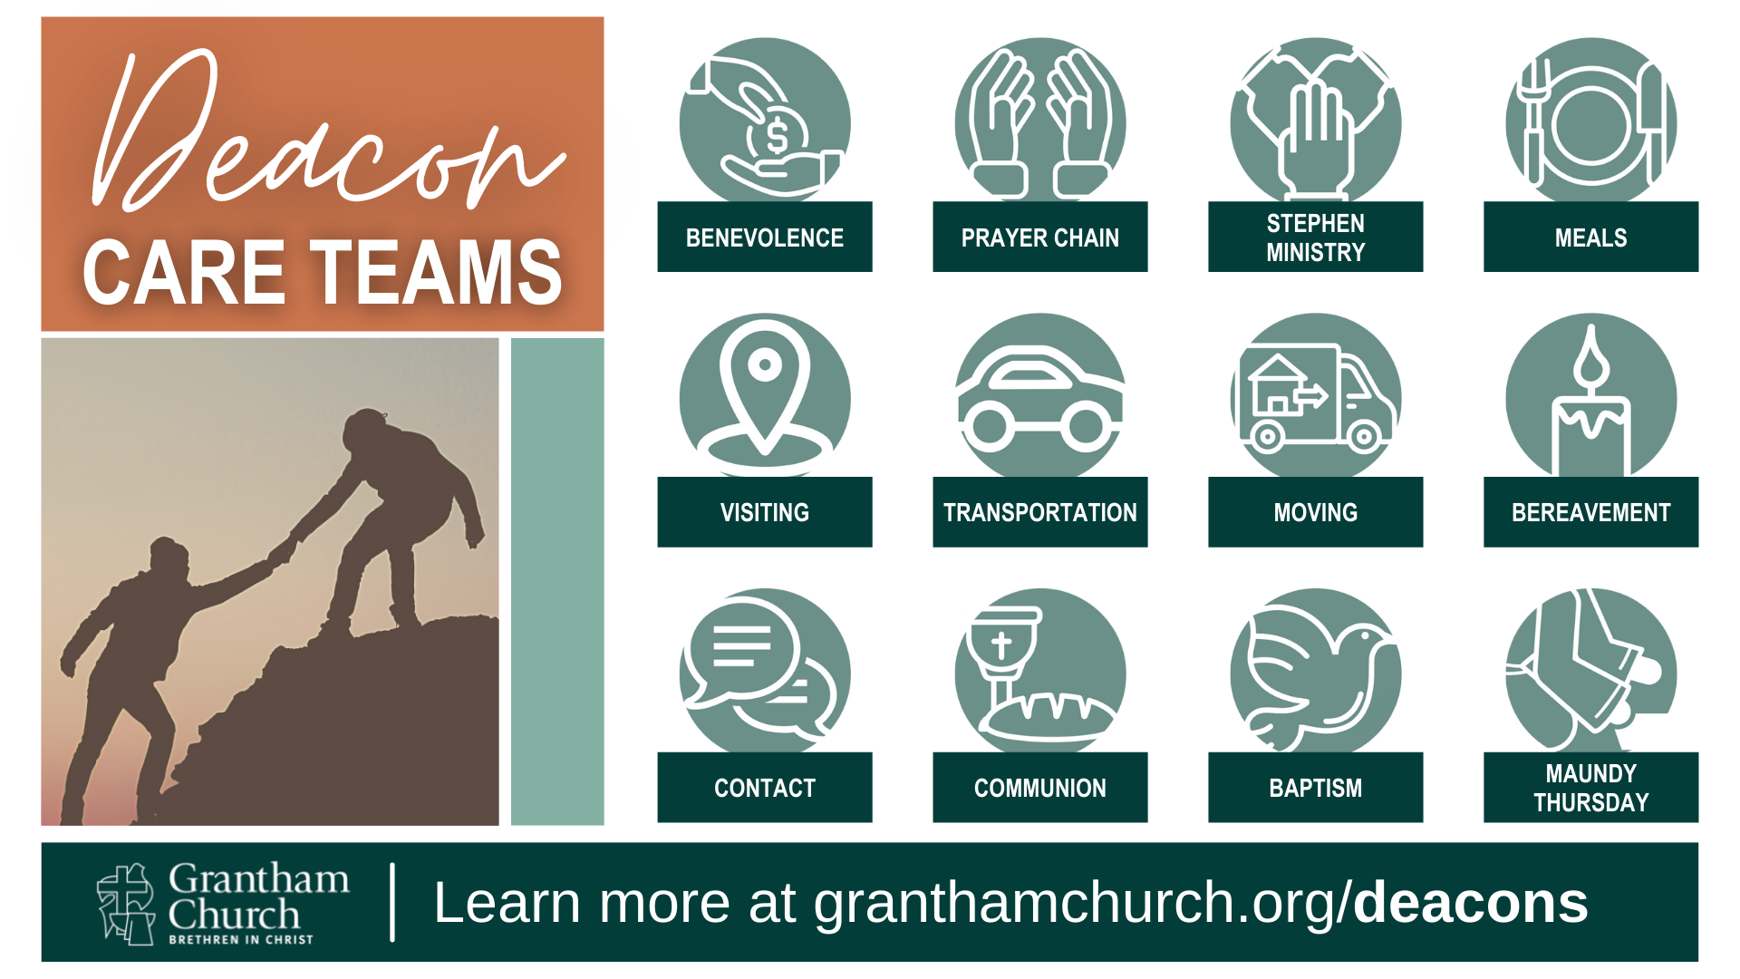
Notes:
We will now meet needs and serve each other through the following care teams:
[BRIEF COMMENTS ON EACH CARE TEAM] – [REFER TO THE BROCHURE]
Now that you have been introduced to how we’re doing deacons ministry and congregational care, I want to invite you to consider how you can be involved, engaged, and meet needs within our church family. In a moment we are going to enter into a time of reflection and discernment before communion, and then at the end of the service you’ll be handed a brochure and given an opportunity to sign up for a care team in the lobby... [NEXT SLIDE]

Slide 17

Notes:
And I want you to notice that there are several ways you can respond:
You can become a deacon coordinator – 3 teams need someone to lead
You can become a deacon and assist the coordinators and care teams
You can join and assist a care team
You can let us know of a specific need that you have
Will you prayerfully discern how the Spirit might be leading you to serve our congregation and meet needs through one of our new Deacon Care Teams?
Finally, here these words from the apostle Paul in 2 Corinthians 9:
⁶ Remember this: Whoever sows sparingly will also reap sparingly, and whoever sows generously will also reap generously. ⁷ Each of you should give what you have decided in your heart to give, not reluctantly or under compulsion, for God loves a cheerful giver. ⁸ And God is able to bless you abundantly, so that in all things at all times, having all that you need, you will abound in every good work. ¹² This service that you perform is not only supplying the needs of the Lord’s people but is also overflowing in many expressions of thanks to God.¹³ Because of the service by which you have proved yourselves, others will praise God for the obedience that accompanies your confession of the gospel of Christ, and for your generosity in sharing with them and with everyone else.
[CLOSING PRAYER]

