Slide 1

Notes:
[BRIEF INTRO]
This is part 5 of our 6-part series, Jesus, Justice & the Third Way: Following the Lamb in an Age of Idolatry & Division. In this series we’ve been reflecting on the political nature of the gospel and how we’re called to pledge our loyalty and allegiance to the Lamb—not the donkey or the elephant. To understand what that means, we’ve been looking at Jesus’ own posture and approach to religious and political matters, to see how he dealt with political parties, hot-button issues, and the partisan mind. We’ve been exploring his Third Way of living in the world.
Back on October 6th, we began our series with the message… [NEXT SLIDE]

Slide 2
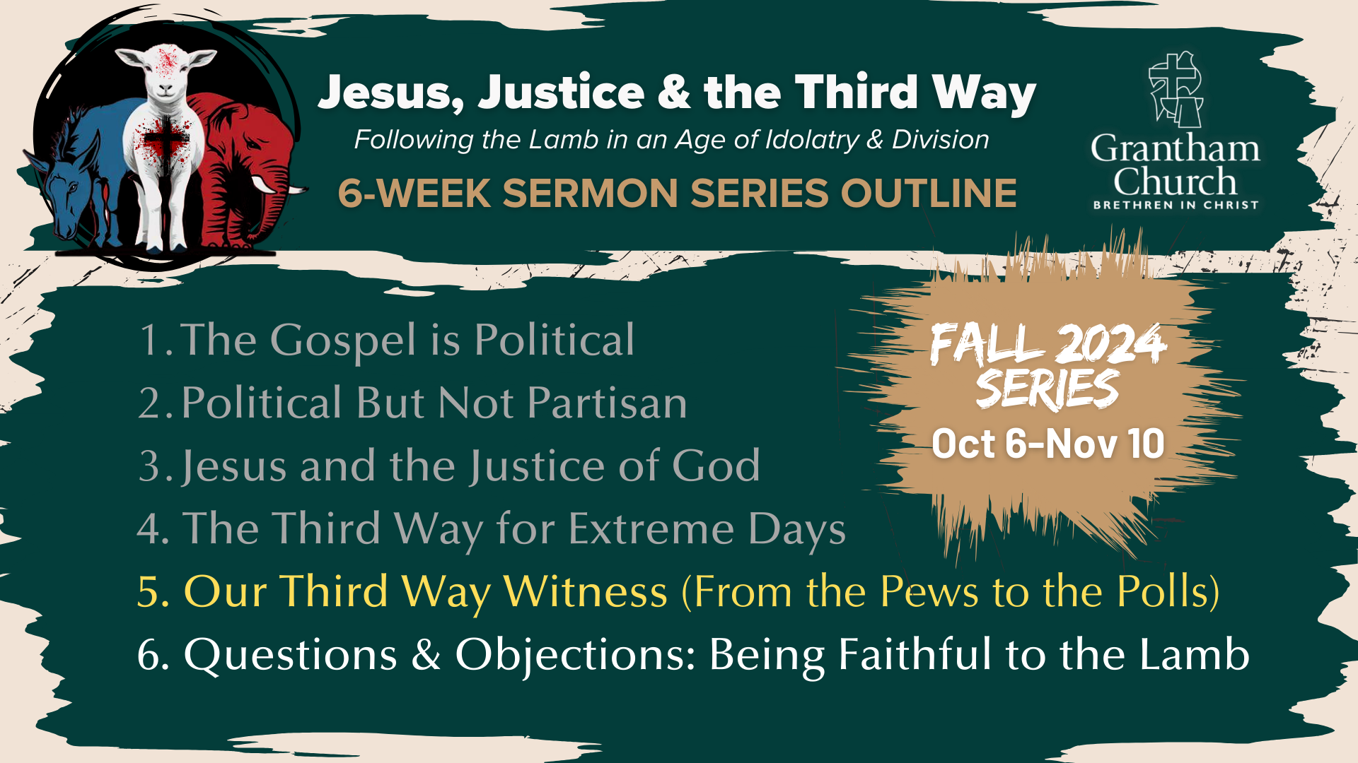
Notes:
The Gospel is Political – we looked at how the gospel is political in nature, and that it has real-life implications; I made the case for a holistic understanding of the gospel, and that we must beware of political idolatry as we seek to follow the slain Lamb into his upside-down Kingdom.
In the second message, Political But Not Partisan, we saw how the gospel doesn’t fit neatly into our political categories. Jesus is not a cheerleader for any political party. And while he may have agreed with folks on various points, he didn’t fully align himself with any party in his own day. Instead, Jesus intentionally chose a politically and socio-economically diverse group of disciples and said, “Follow me.” And he is still issuing that call to us today.
In the third message, Jesus and the Justice of God. We saw that Jesus cared deeply about justice. While he rejected the expected path of earthly kingship and political power, Jesus still furthered an ancient vision of God’s justice for all nations. But this “justice” isn’t about vengeance or retribution, it’s about reconciliation and restoration. And we looked at the difference in a Jesus-centered church and a justice-centered church. I said that real Jesus-centered churches will naturally act justly, love mercy, and walk humbly with God. Therefore, we must remain “Jesus-centered” rather than “justice-centered” if we’re going to adopt the posture and approach of Jesus, which is about power-under, not power-over others.
And then in last week’s message, The Third Way for Extreme Days, we looked at how Jesus navigated the extremes, the hot-button issues, and the polarizing debates of the first century. We identified 5 different debates mentioned in the NT, and we saw how Jesus responded in a Kingdom-oriented, agape-centered, Third Way.
Which brings us to this morning’s message, Our Third Way Witness (From the Pews to the Polls). I’m going to do my best to apply the same approach and posture of Jesus to our own hot-button issues, extremes, and debates; to help us set off on a Third Way as we (with the help of the Holy Spirit), apply the pattern that Christ revealed in his ministry.
Let’s begin with today’s Scripture reading… [NEXT SLIDE]

Slide 3
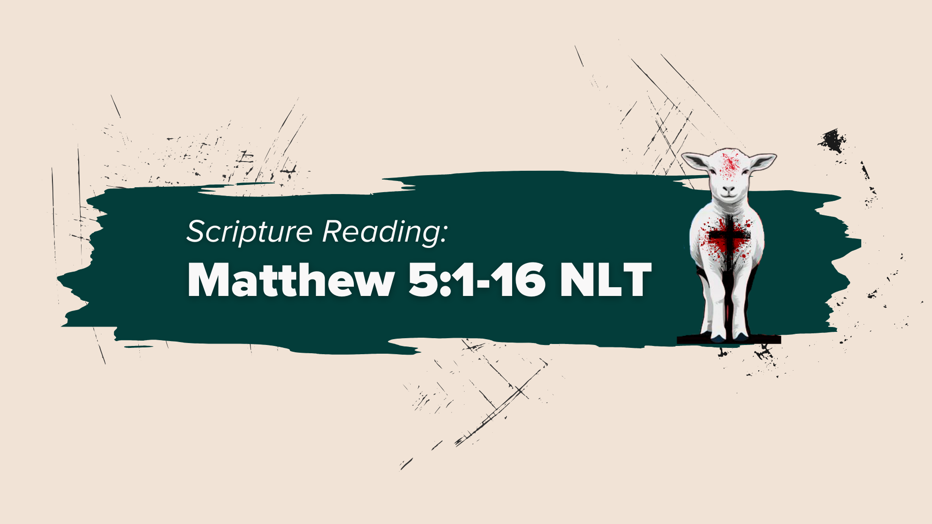
Notes:
[MATTHEW 5:1-16 NLT - CONGREGATION STAND - READ SCRIPTURE]
This is the word of the Lord. Thanks be to God.
[BRIEF PRAYER]
You may be seated.
Before I put my life on the line by addressing some of the hot-button issues today, let’s briefly review what we’ve said about the Third Way of Jesus, his approach and posture, and the pattern he left for us in the gospels. Here is a simple definition of the Third Way… [NEXT SLIDE]

Slide 4
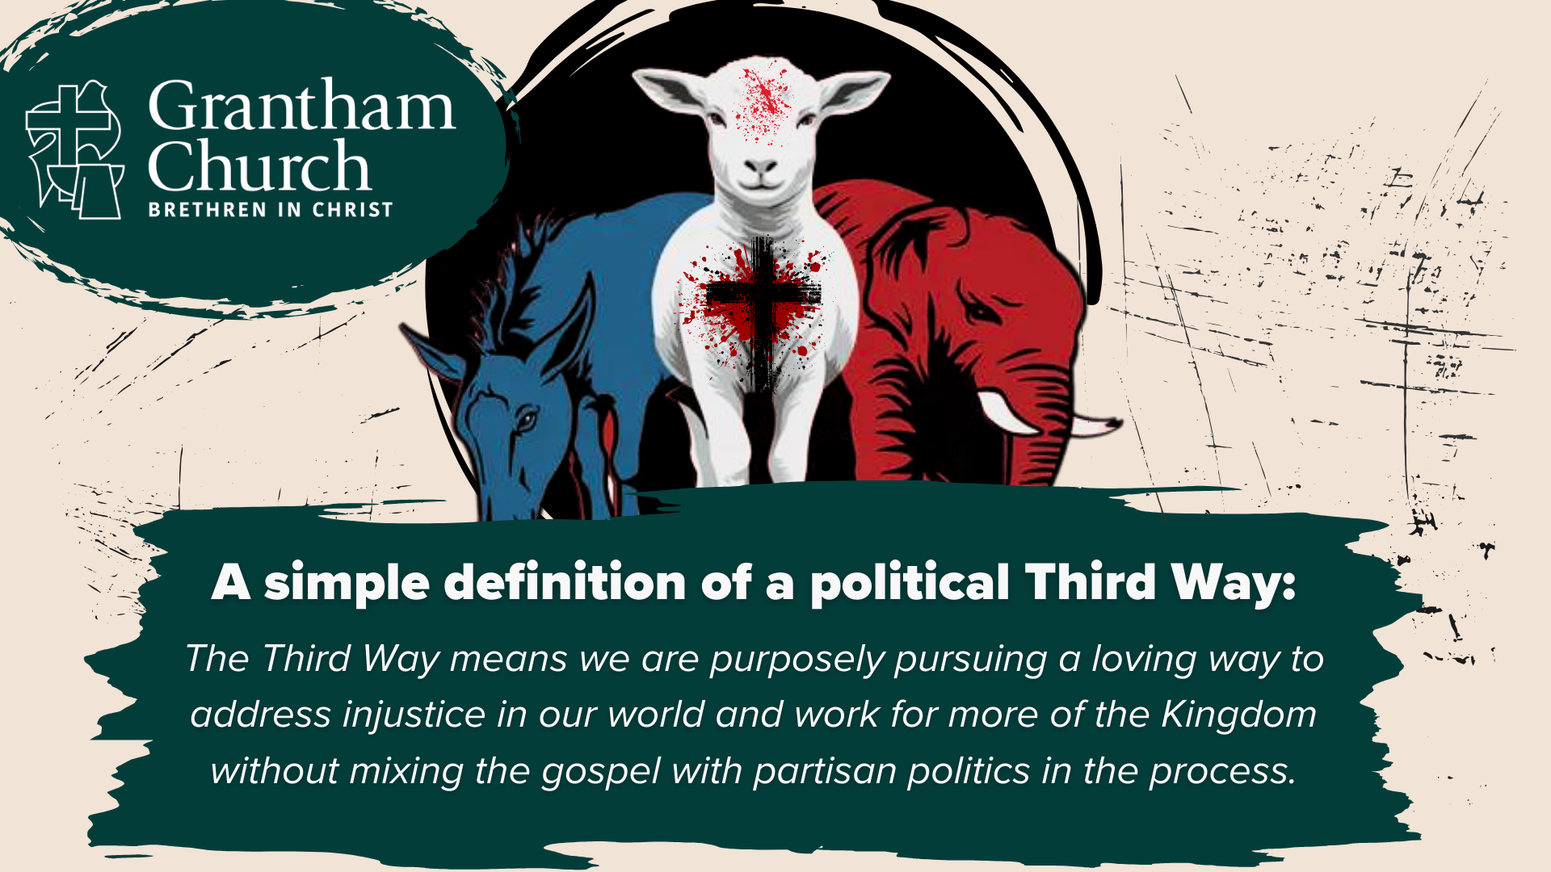
Notes:
[READ & COMMENT]
Again, the basic conviction is this: No political party contains or represents all the Kingdom concerns of Jesus. Jesus is Lord and he demands total allegiance. Therefore, we should have a healthy skepticism toward every political party, especially when they claim Jesus is on their side or that they fully or “mostly” represent his Kingdom concerns. You’re already well on your way to political idolatry if you’re thinking this way. Therefore, beware of the partisan mind.
Also, we said that the Third Way of Jesus… [NEXT SLIDE]

Slide 5
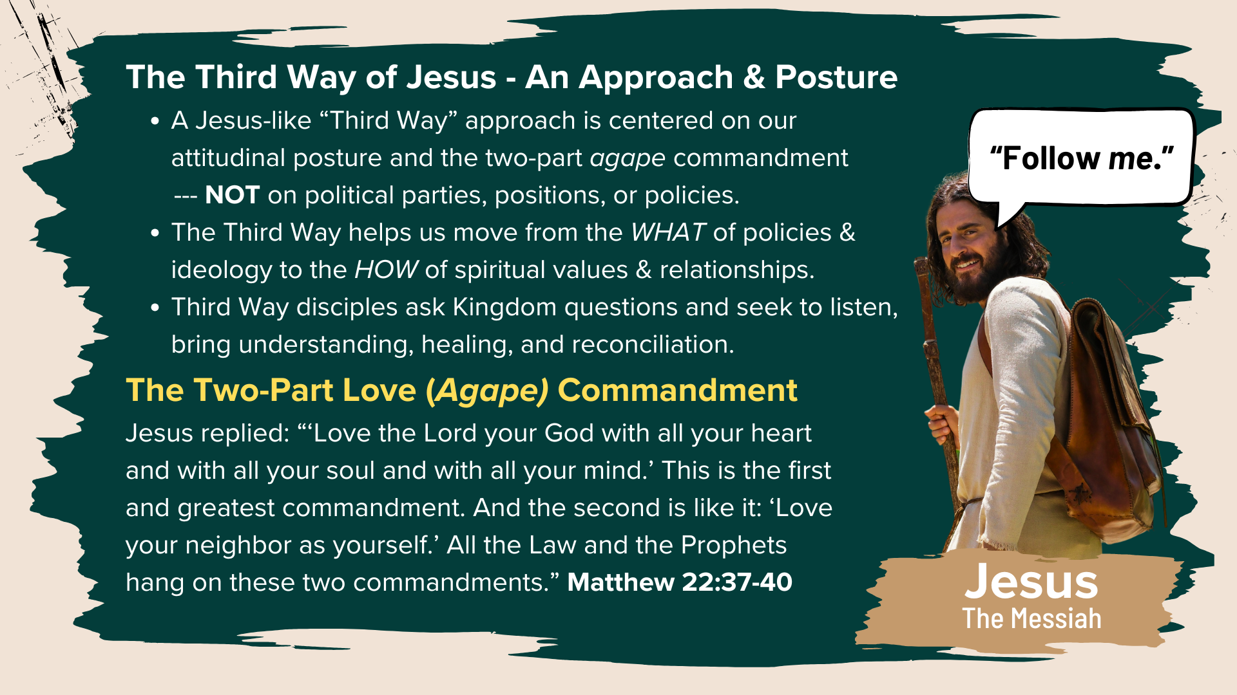
Notes:
... is an attitudinal posture and approach that is centered in the two-part agape commandment: to love God and love our neighbor. The center is NOT our political parties, our positions, or our favored policies. The center is Christ as his call to love God and our neighbor at all times. And notice that this Third Way of Jesus moves us from the WHAT of policies & ideology to the HOW of spiritual values & relationships, which helps to deescalate and curb injustice and division. It helps us to humanize each other. And as I said last week, part of that work looks like asking better questions (Kingdom questions) and seeking to listen, to love, to empathize, in order to see with new eyes; to bring mutual understanding and to discover healing and reconciliation.
So, when Jesus was asked to weigh in on a politically controversial and polarizing issue or debate in his day, he revealed the following pattern: [NEXT SLIDE]

Slide 6
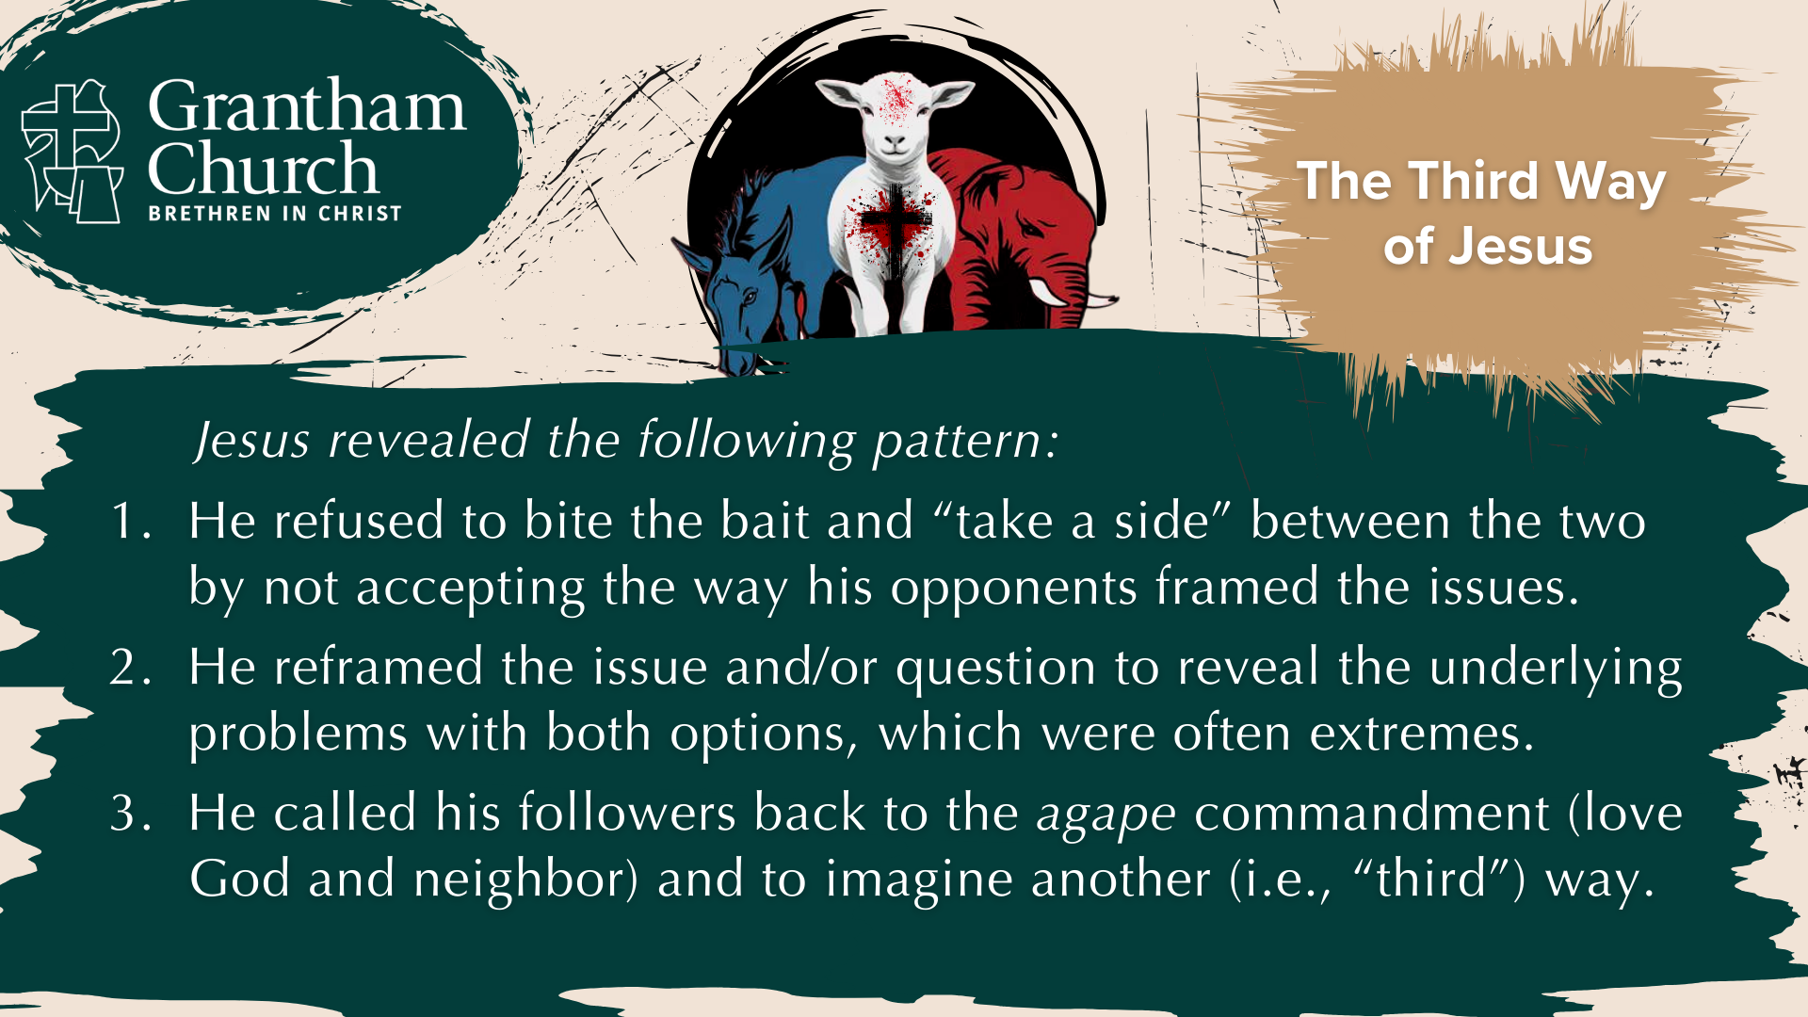
Notes:
[READ PATTERN & COMMENT]
He refused to bite the bait and “take a side” between the two by not accepting the way his opponents framed the issues. E.g., “Daddy, would you rather… or…?”
He reframed the issue and/or question to reveal the underlying problems with both options, which were often extremes. O how we need more disciples to see/break out of the extremes!
He called his followers back to the agape commandment (love God and neighbor) and to imagine another (i.e., “third”) way. So, Jesus charted a course on each issue that honored God (was faithful to him), and ascribed dignity and worth to everyone involved.
And that’s what I’m attempting to do today as we seek to embody the approach and posture of Jesus and apply this Third Way pattern to some of the most contentious issues in American society. Are you ready? Oh… and I do want to give a shout out to my friend Paul Eddy (teaching pastor and Third Way advocate at Woodland Hills Church in MN) for helping me think through these issues. OK. Here is the first one… [NEXT SLIDE]

Slide 7
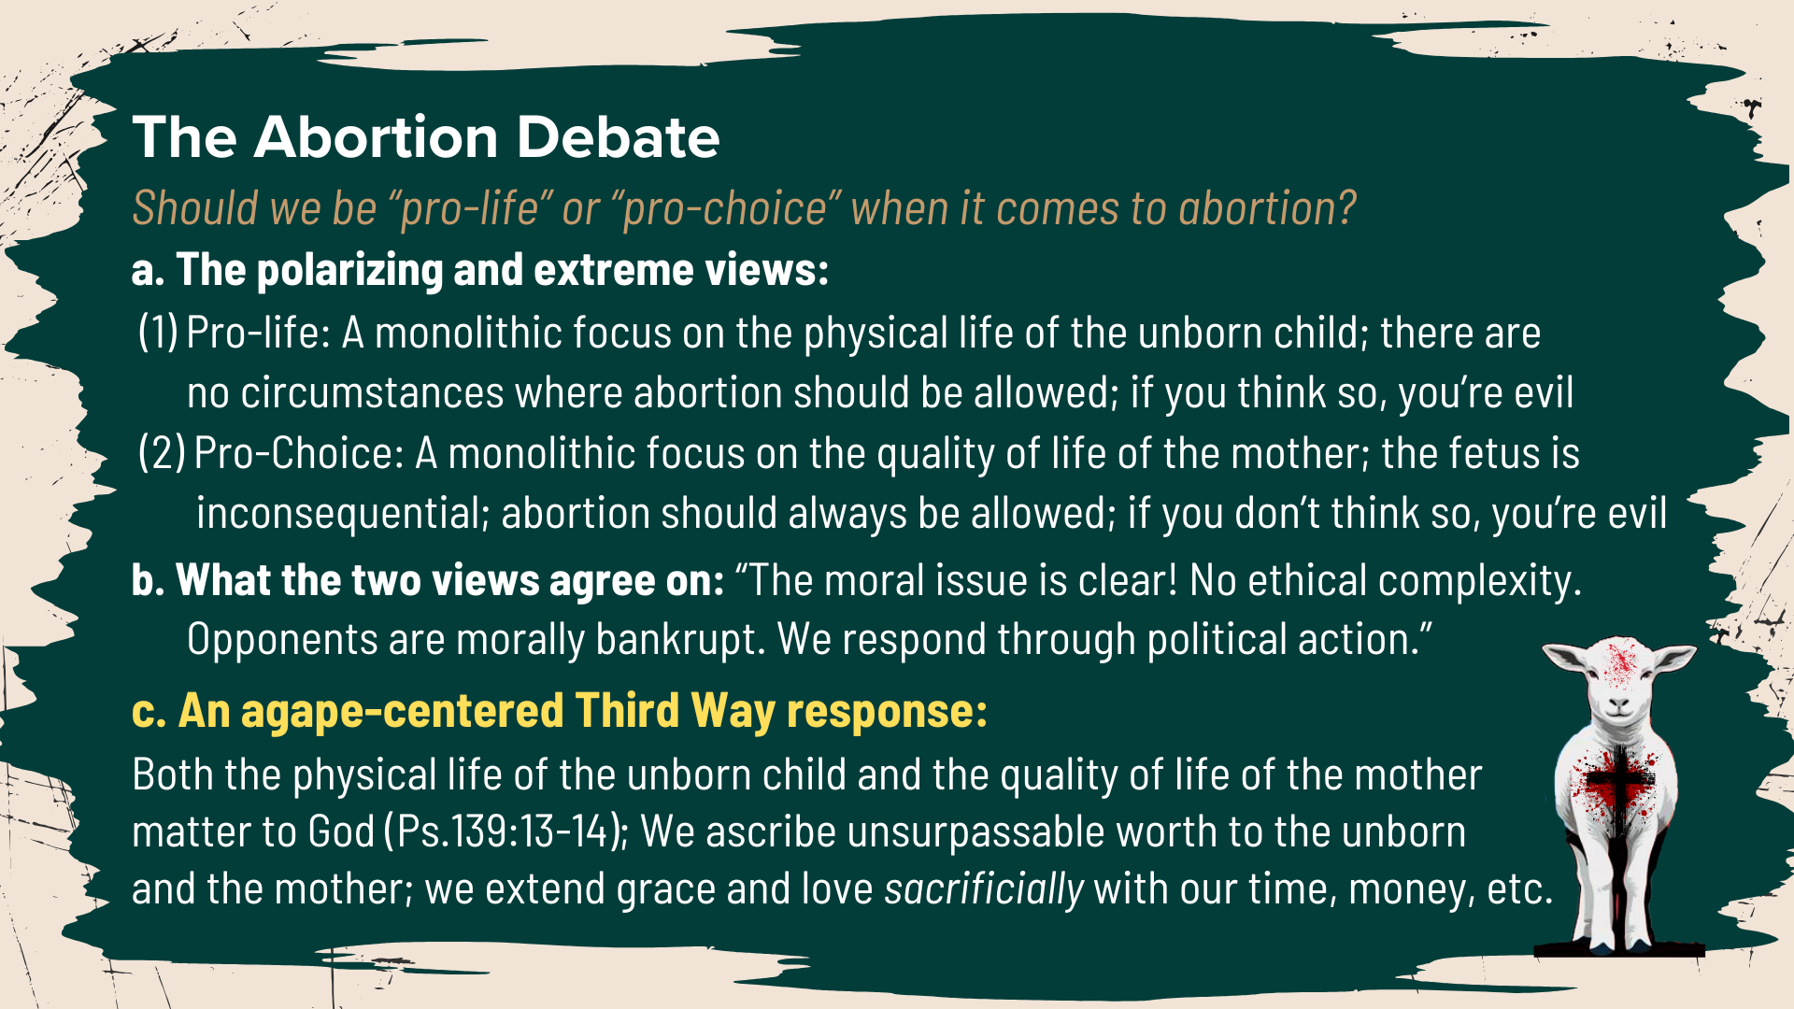
Notes:
[READ SLIDE & COMMENT]
But far more needs to be said than can fit on a slide, and so I’d like to read from Greg Boyd’s book, The Myth of a Christian Nation: How the Quest for Politics is Destroying the Church. He has an excellent reflection on abortion toward the end of chapter 7.
[READ BOYD, PGS. 141-143]
Let’s look at the next issue… [NEXT SLIDE]

Slide 8
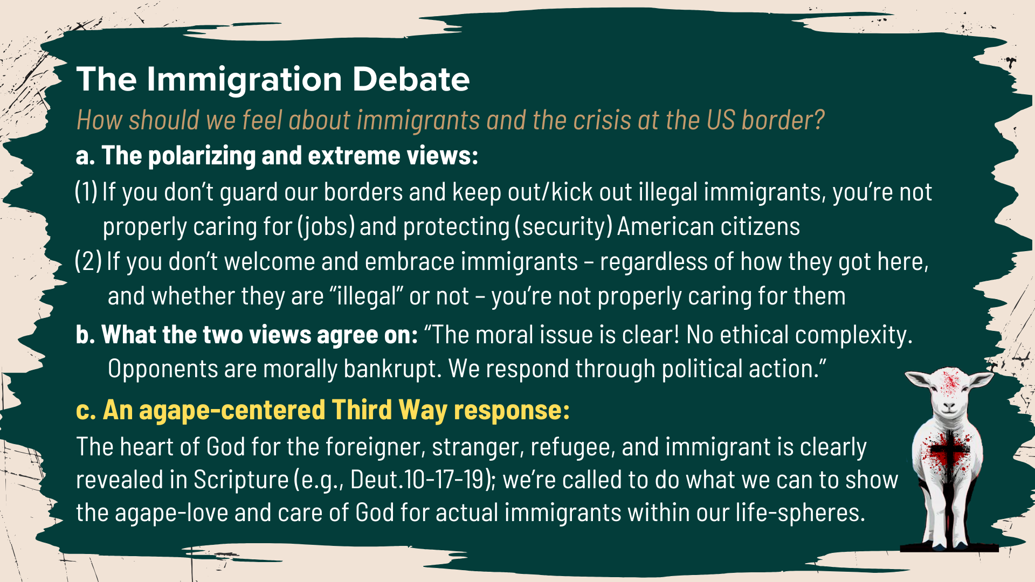
Notes:
[READ SLIDE & COMMENT]
Furthermore, as ambassadors of God’s Kingdom living in America, I think we should acknowledge the complexity this issue poses for a nation who, on the one hand, understandably requires borders to be a functioning nation, yet, on the other hand, recognizes that historically almost all of us (at least our ancestors) were once immigrants ourselves, and so we want the country to be a place that welcomes and embraces immigrants.
We should also recognize that many immigrants (even illegal immigrants) are families who have fled terrible violence and atrocities in their homeland and who are looking for safety and a future on behalf of their children. And so, regardless of what the state decides, we are called to do whatever we can to show the agape-love and care of God for actual immigrants within our life-spheres. And I’m happy to say that we have a history of doing that here at Grantham.
Issue number 3… [NEXT SLIDE]

Slide 9
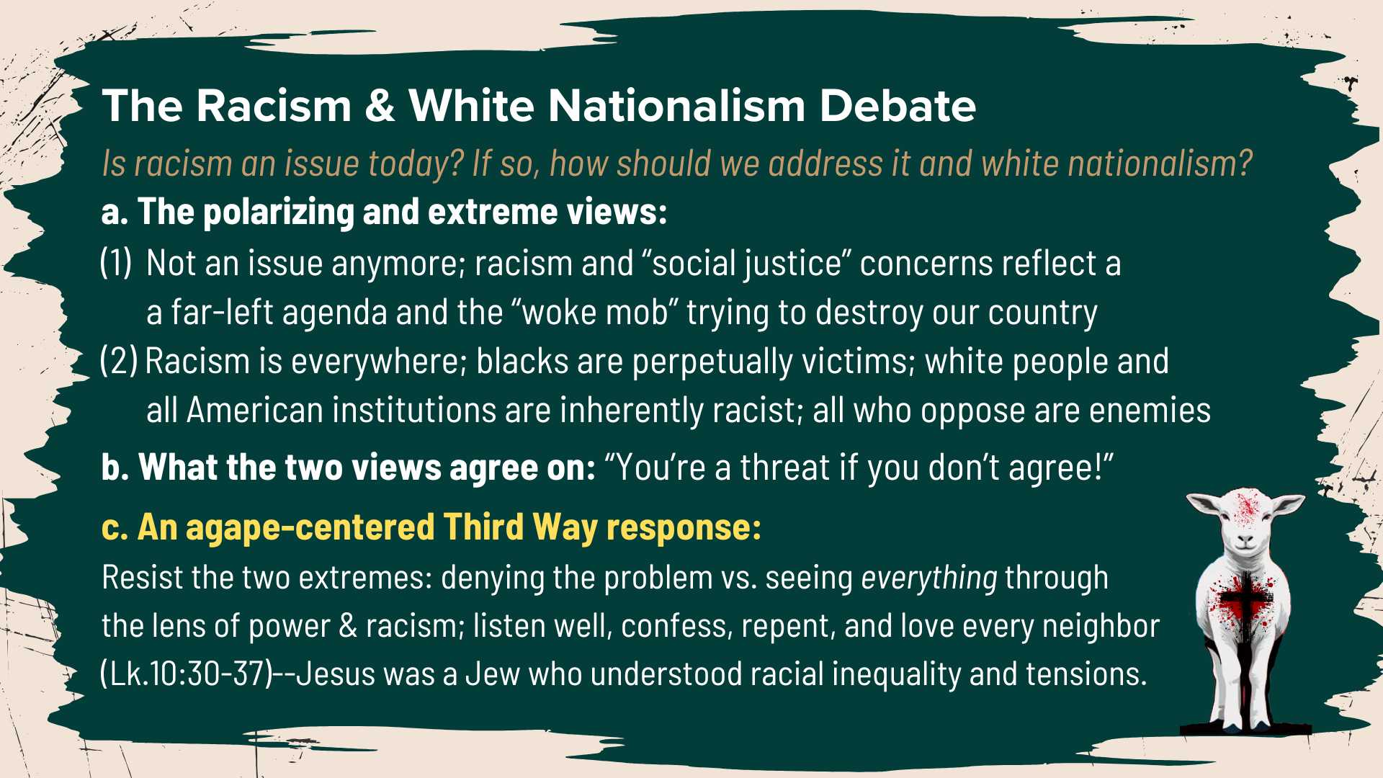
Notes:
[READ SLIDE & COMMENT]
And I’ll add here that disciples should do what we can to self-examine our heart, attitudes, and the words we use about and toward people of color and every culture and ethnicity. We ought to have a posture of learning and being sensitive to the background and experiences of others.
And we should do what we can to “speak the truth in love” when we encounter racism or white nationalism around us; not in a self-righteous way, but from a place of genuine love and concern. And if we’re talking to another self-professing Christian, ask Kingdom questions. For example, ”Can you help me understand how your words and actions line up with Jesus and the gospel?”
The next issue… [NEXT SLIDE]

Slide 10
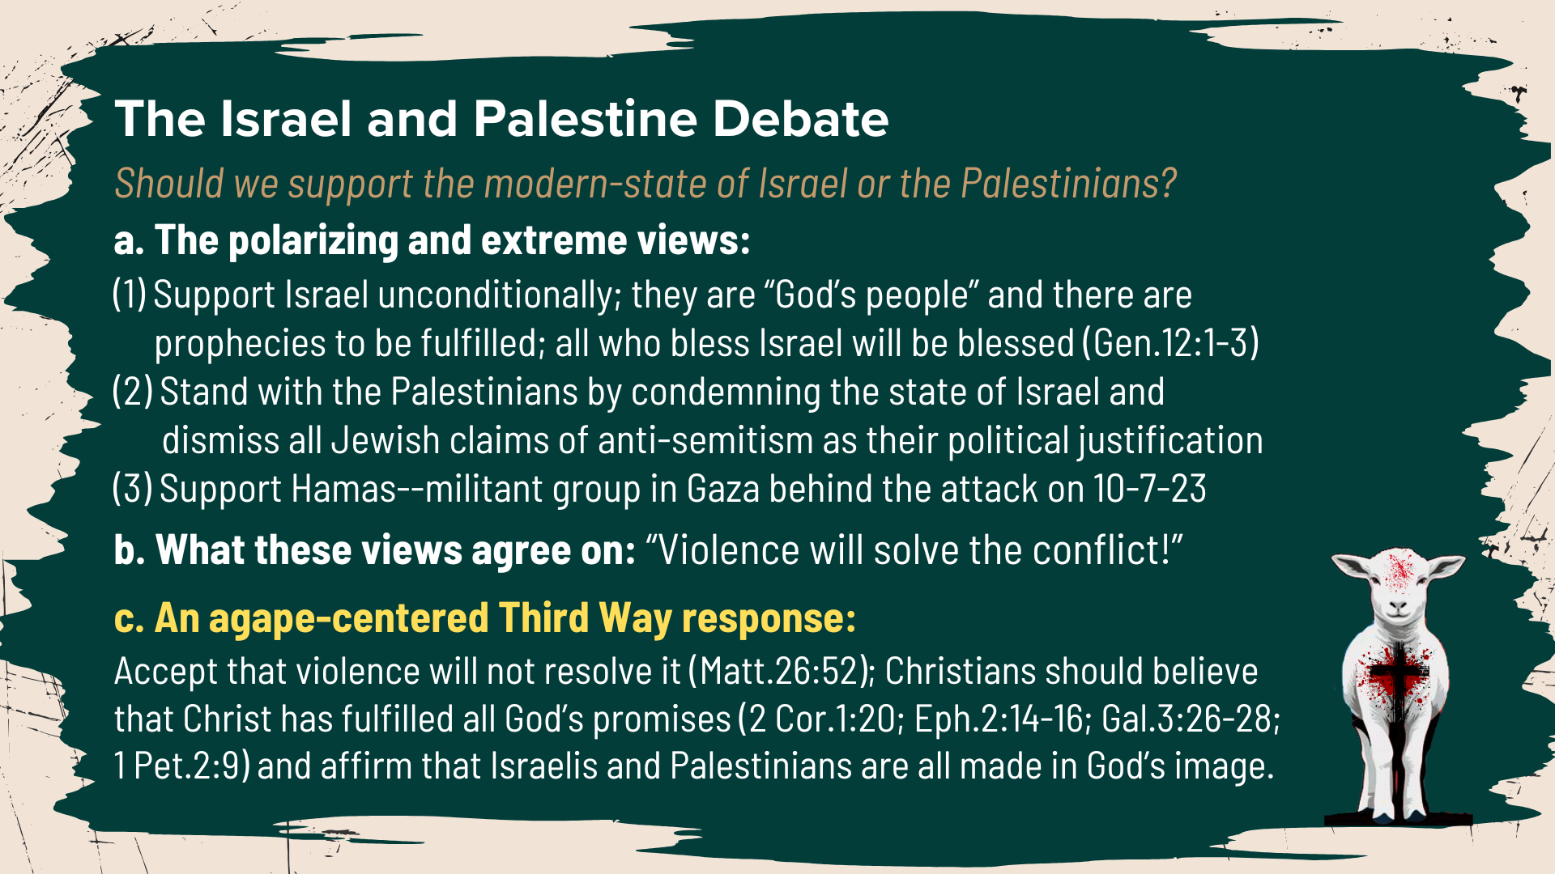
Notes:
[READ SLIDE & COMMENT]
Yes, I’m aware of a popular evangelical view that Israel (as a nation state) has a special destiny. And I’m aware of the Scriptures that are used to make that case. However, I don’t believe that the modern-state of Israel has any role in the future of the planet any more than other nations. We’re not waiting on any prophecies about Israel or the temple to be fulfilled. Folks, Jesus is the Temple (John 2:19)! All of the promises of God have been fulfilled in Christ (2 Cor. 1:20). The thrust of the New Testament is that Jews and Gentiles have become One in Christ (Gal. 3:26-28). And there is now one “holy nation” under Christ, which is his Church (1 Peter 2:9).
Therefore, if a person embraces this truth, you can then see how Christian Zionism in the Church gives people reason to support whatever the modern-state of Israel does, which includes the US backing its war-crimes against Palestinians in Gaza. I submit to you that the enemy is at work in these things, because Christian Zionism is antithetical to the good news of Jesus.
Let’s look at one more hot-button issue… [NEXT SLIDE]

Slide 11
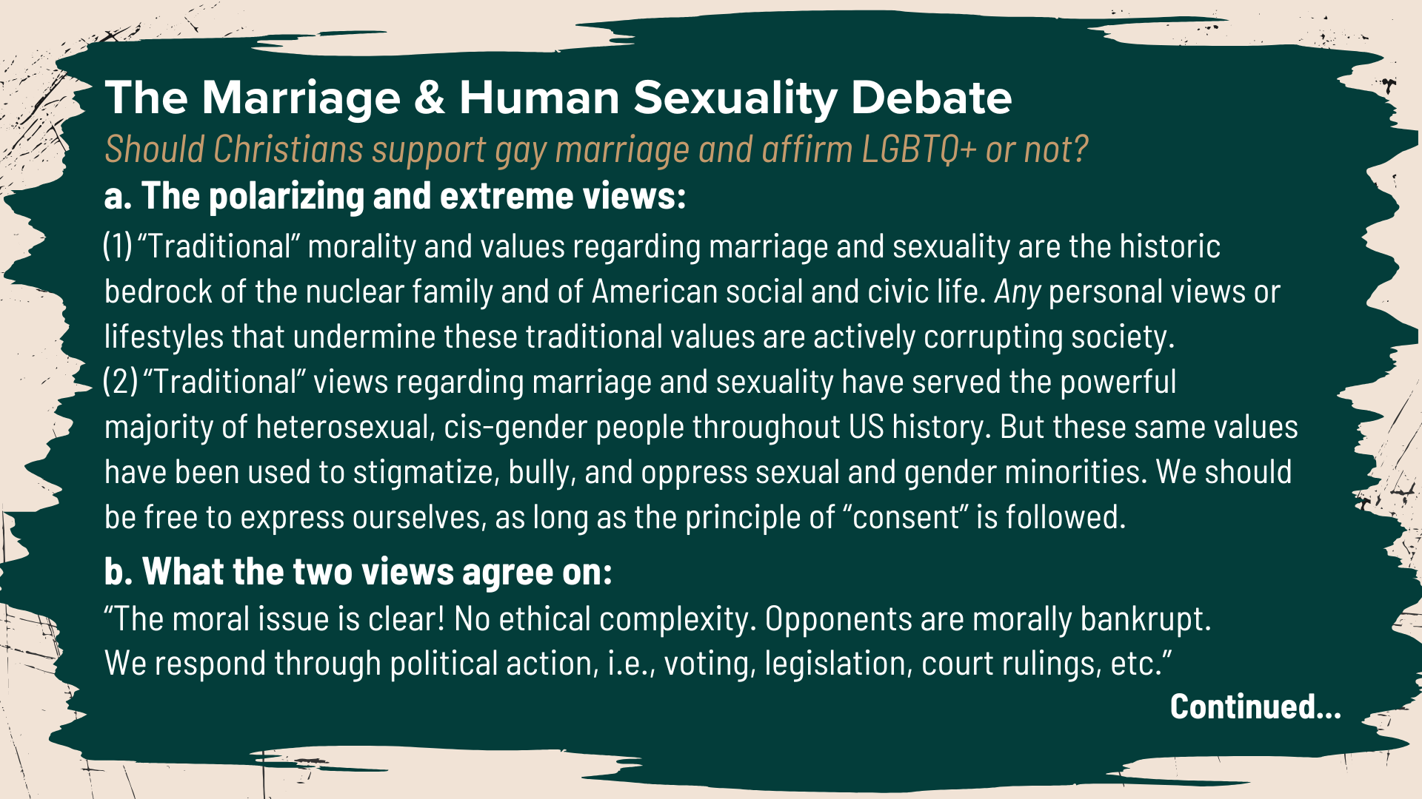
Notes:
[READ SLIDE & COMMENT]
And what might an agape-centered Third Way response look like… [NEXT SLIDE]

Slide 12
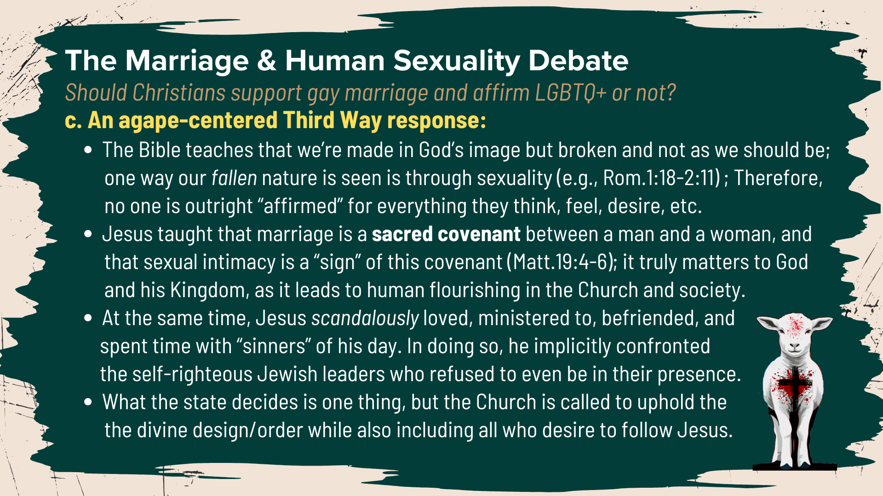
Notes:
[READ SLIDE & COMMENT]
So, we can see how the country (as well as the Church) has been divided on these issues and more. And this has led to what we referred to earlier as… [NEXT SLIDE]

Slide 13
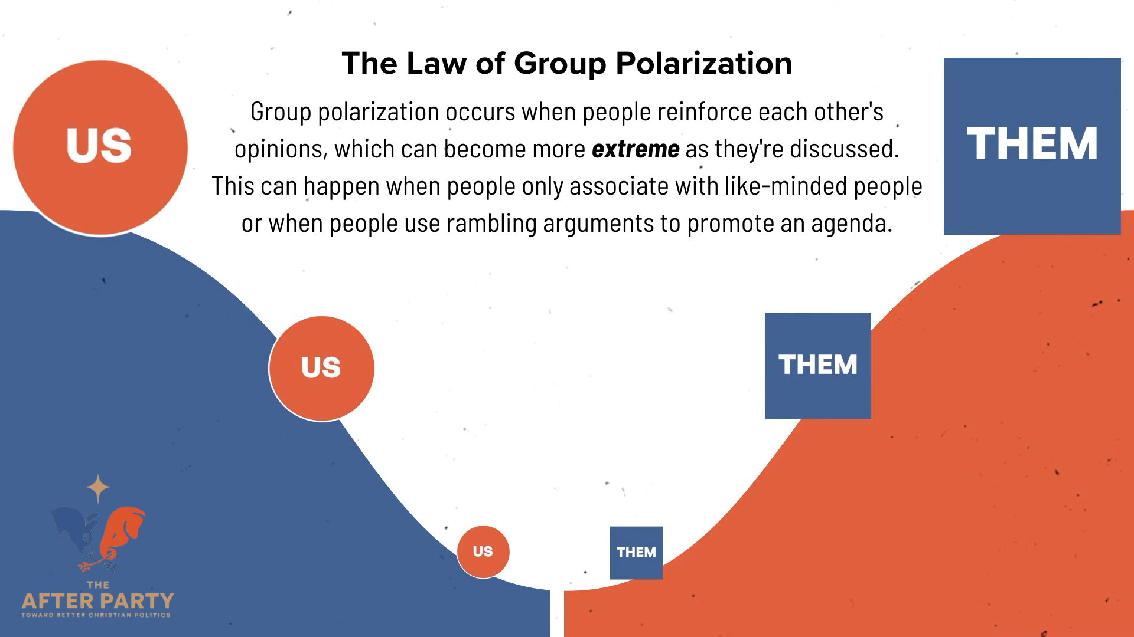
Notes:
The Law of Group Polarization. “Group polarization occurs when people reinforce each other's opinions, which can become more extreme as they're discussed. This can happen when people only associate with like-minded people or when people use discursive or rambling arguments to promote an agenda.” And the only healthy way out of this dynamic is to engage in active listening and learning to understand and empathize with those whom we disagree with.
Again, this helps us to humanize and connect with each other, particularly on an emotional and heart level. And that’s really important. Why? Well, for a couple of reasons.
In his book, The Righteous Mind, social psychologist Jonathan Haidt says that extensive studies reveal that our emotions and passions are what really drive us… [NEXT SLIDE]

Slide 14
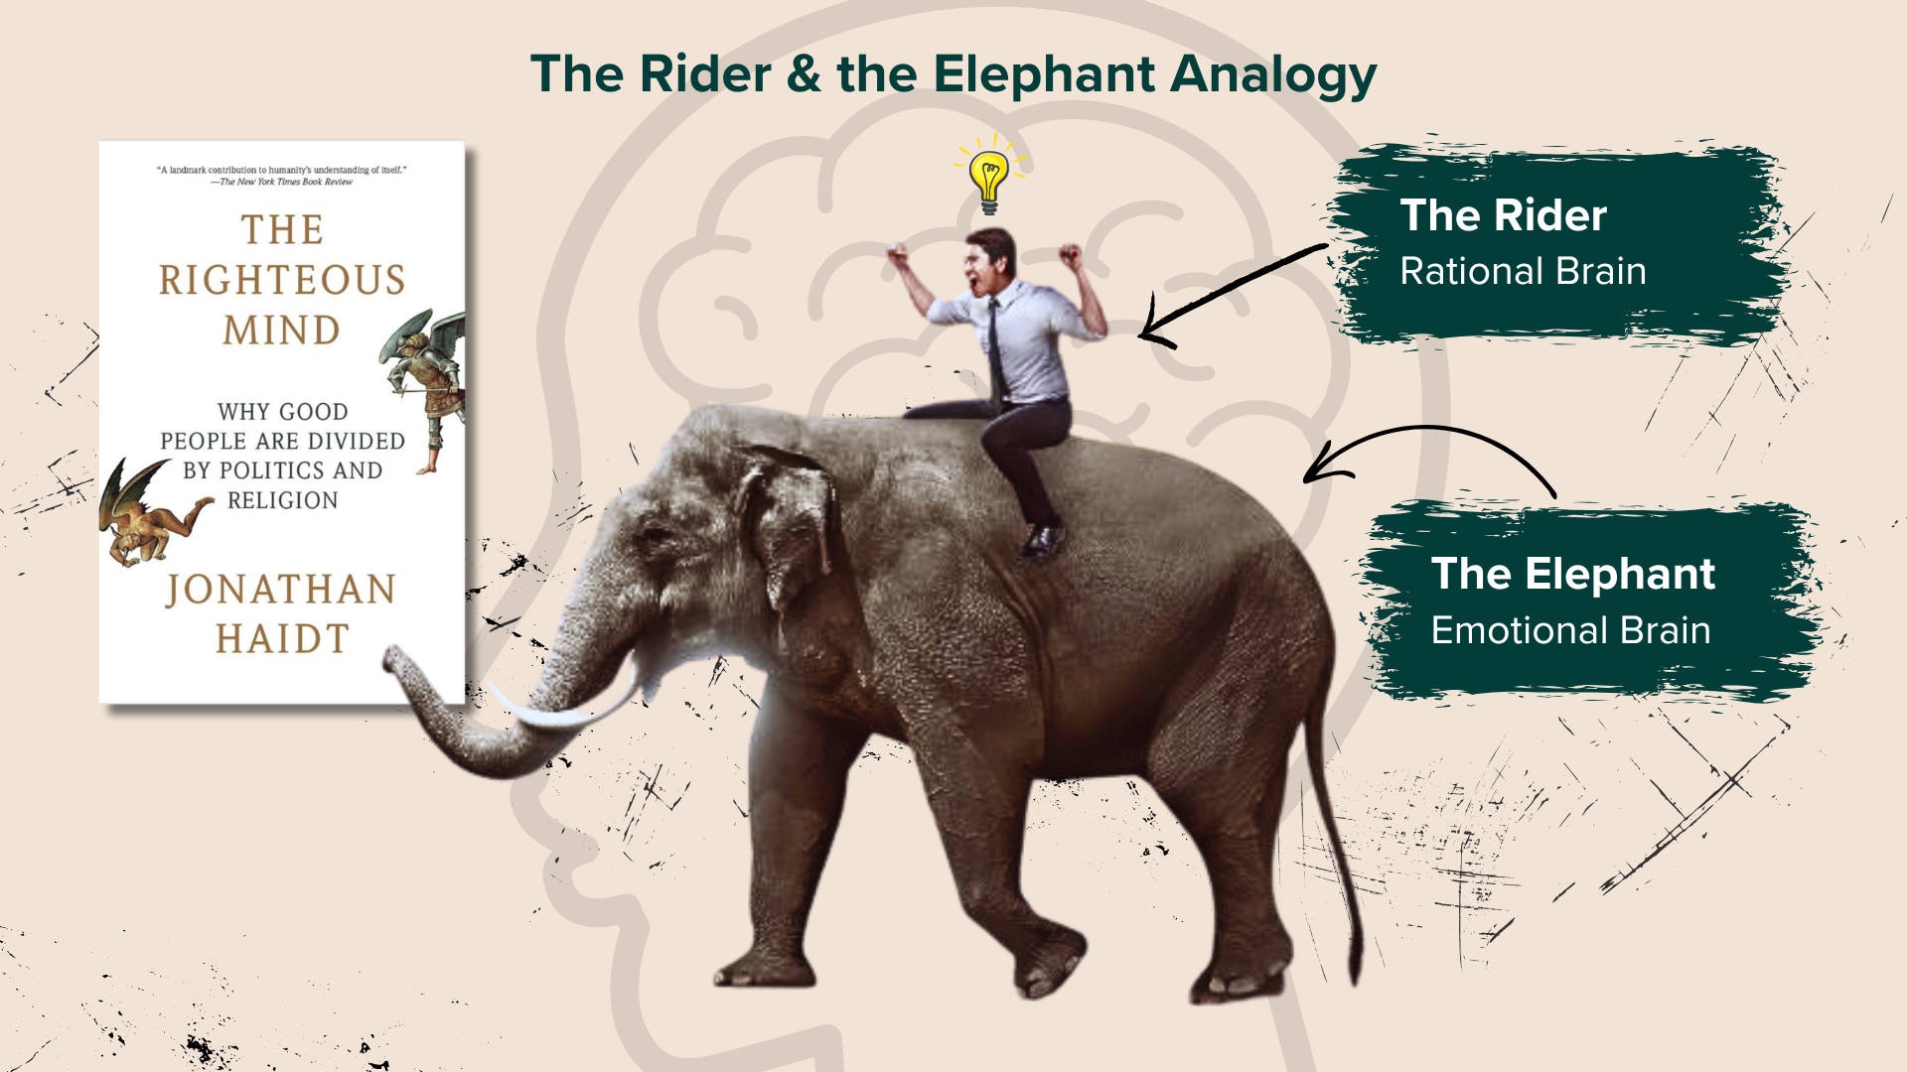
Notes:
Haidt says to imagine a rider on an elephant (not the Republican elephant, just an elephant). The rider is your logic, reasoning, and rational thinking. The elephant (which is much larger and powerful) is your emotions, passions, and gut-reactions. Haidt says, from tons of research and studies galore, that essentially the elephant goes where it wants, even though the rider imagines he/she is calling the shots. In other words, we are all driven primarily by our emotions. And then we seek to rationalize and put arguments to those things we feel instinctively.
Just stop and think about that for a moment. That would explain why your logical arguments aren’t working, eh? Now, add to that the messiness of American politics, which, we can see just from the issues we’ve covered today, are often complicated, sometimes ambiguous, and clearly require humility, compassion, and some level of compromise to work. If democracy is to work, then humility about these things are necessary. And more importantly, if we’re going to be disciples of Jesus and follow his Third Way, then we must see humility as a Kingdom virtue reflecting the mind of Christ. Some of you have been a part of the The After Party class discussions on Monday nights throughout this series. For those not in the class, here is an image that we’ve been unpacking together…[NEXT SLIDE]

Slide 15
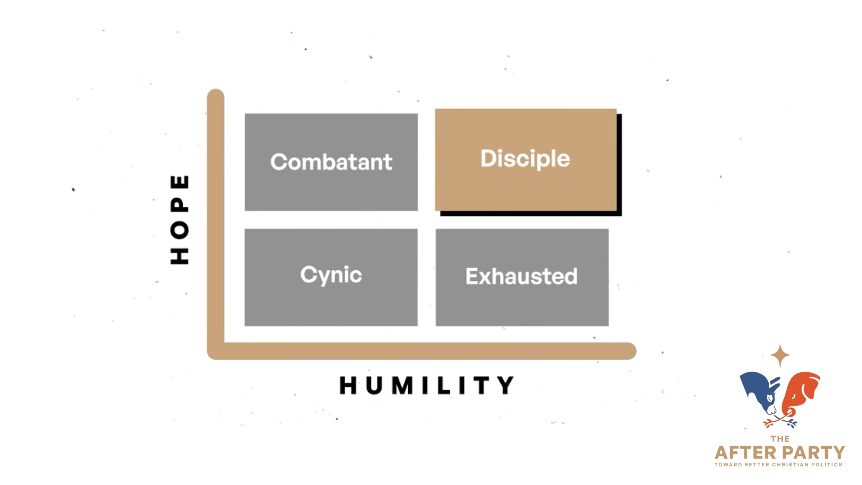
Notes:
[COMMENT ON IMAGE]
Why one are you?
The Combatant – high in hope but low in humility
The Exhausted – mirror image of the combatant; high in humility but low in hope
The Cynic – both low in humility and in hope
The Disciple – high in hope and in humility
Listen to what the Apostle Paul wrote in Ephesians chapter 4, verses 1-6… [NEXT SLIDE]

Slide 16
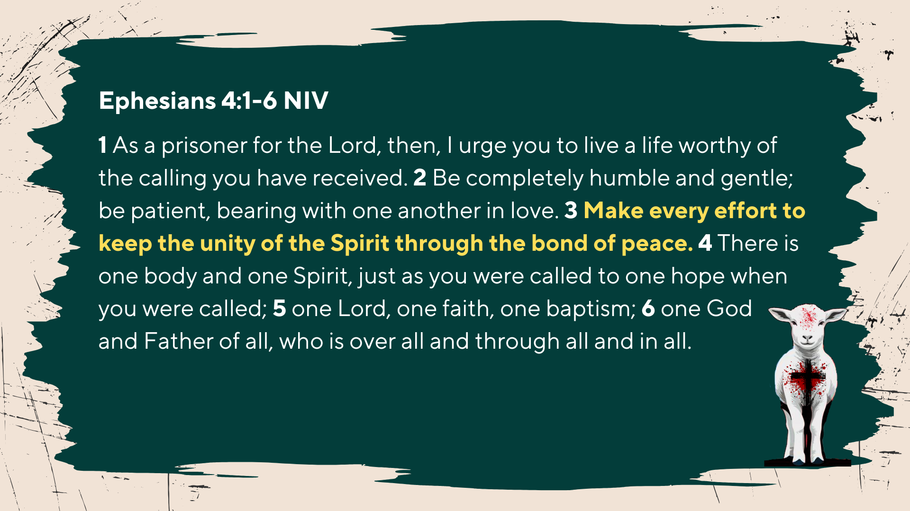
Notes:
[READ & COMMENT]
The Scriptures call us to be humble and full of hope as followers of Christ; to be gentle, and patient; to be agape-centered; to extend grace to others as the Lord has extended it to us. And all these things, as well as our fight for unity, flow from our shared identity in Christ and the mission for which he has conscripted the Church—to testify to the transforming power of the gospel and his coming Kingdom.
And so, when we go out into the world and engage with the politics of this world, we remember what Paul said in Philippians 1:27… [NEXT SLIDE]

Slide 17
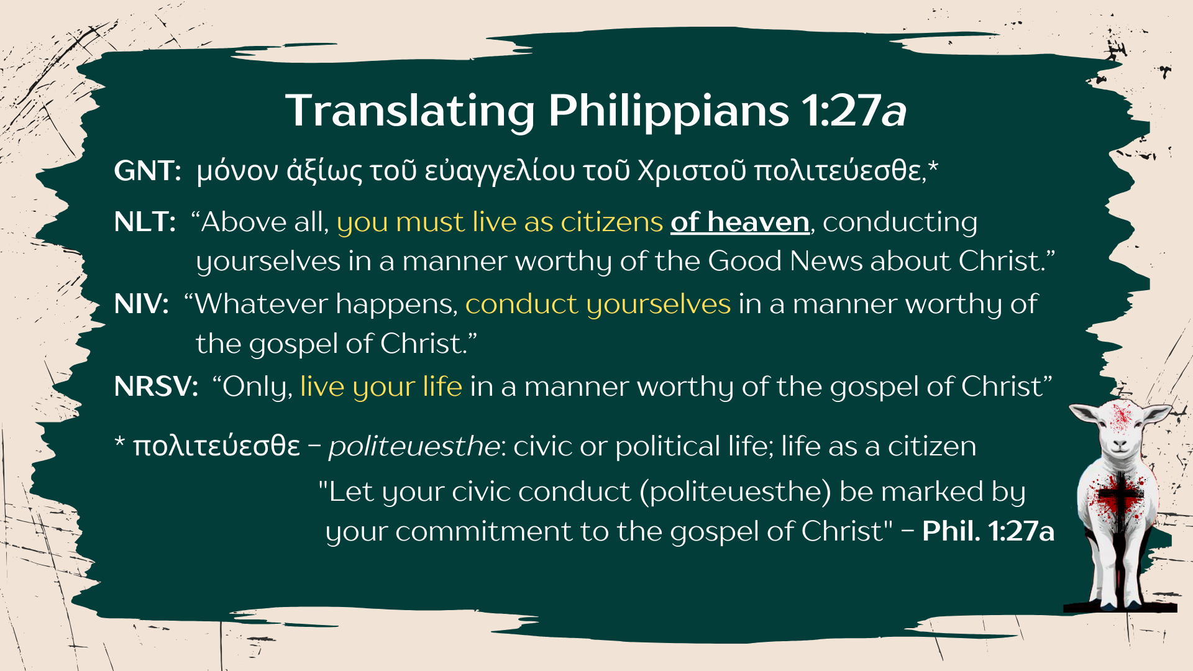
Notes:
"Let your civic conduct (politeuesthe) be marked by your commitment to the gospel of Christ” (Phil.1:27a) And so, how do we conduct ourselves civically in an empire with a representative democracy? Or more specifically, “How should we vote?” After all, there is a presidential election on Tuesday where we’re being asked to share our opinion on how the kingdoms of the world ought to operate. And if we can in good conscience cast our vote, how then should we do that? What are the things that should motivate us as Christians?
Four years ago, I shared a video with you from creative animator, speaker, and podcast host Phil Vischer… [NEXT SLIDE]

Slide 18
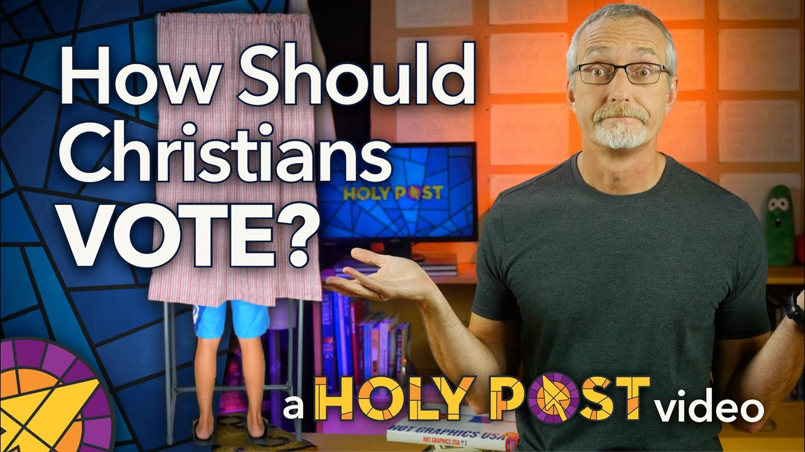
Notes:
We don’t have time to watch it again this morning (and YouTube would stop our livestream if we showed you a 7-minute video), so I’ll share the link with you in the small group discussion questions going up tomorrow on the website. Because I think Phil does a great job of weaving together history, the issues we face, and how Christians should enter the voting booth. And I think his thoughts and perspective accurately reflect the Third Way of Jesus.
But I’ll say this… I know that some of you think it’s not all that hard knowing who to vote for this election. But I also know that there are those of you who feel that neither candidate is worthy of your vote. And some may choose not to vote because of the two candidates, or some may choose to write in the person they’d like. For many, we wish we had another option, a candidate who doesn’t feed off fear, reward greed, encourage immorality, corruption and division, and isn’t persuaded by extreme ideologies. I wish that things were different, but this is where we are.
So, if you’re going to vote, and walk with Jesus into the voting booth, let it be with the understanding that Jesus is the true King and his Kingdom will come despite the powers that rival his rule, despite the ways the world rebels against him, and despite how bad things may seem right now. Therefore, live like you know where the future is going. Fear has no place in the life of the Christian. We should be hopeful realist. Yes, the world is broken, the country is in a mess, but Jesus sits in the Oval Office of heaven, and he is coming again to establish his Kingdom on the earth. So be of good cheer!
Also, if you’re going to vote, may it be to help those who need it most; may it be for the common good, not merely to benefit a few; not to benefit the rich, the powerful, and the privileged; not to further empire. Again, Paul says let your your political life be worthy of Christ. Therefore, let the voiceless, the hurting, the oppressed, and the marginalized vote through you.
And while it may sound a bit cynical, I believe it reflects the true reality of worldly kingdom politics. I think if we’re going to conduct ourselves in a manner worthy of the good news about Christ and vote… well then… vote for the person who will do the least amount of damage to this country and the countries of the world who are waiting to see what happens, so that we might live peacefully with all people, as we seek to further the Kingdom of God on the earth.
And remember this, church: the distinctly Kingdom question is not, “How should we vote?” Rather, the real Kingdom question is, “How should we live?” May we live from the pews to the polls in such a way that when people see us… they see the God who looks like Jesus.
Finally, instead of ending with some takeaways and reflection questions like we normally do, I want to call our focus and attention to the Table of Christ as we prepare to take communion… [NEXT SLIDE]

Slide 19
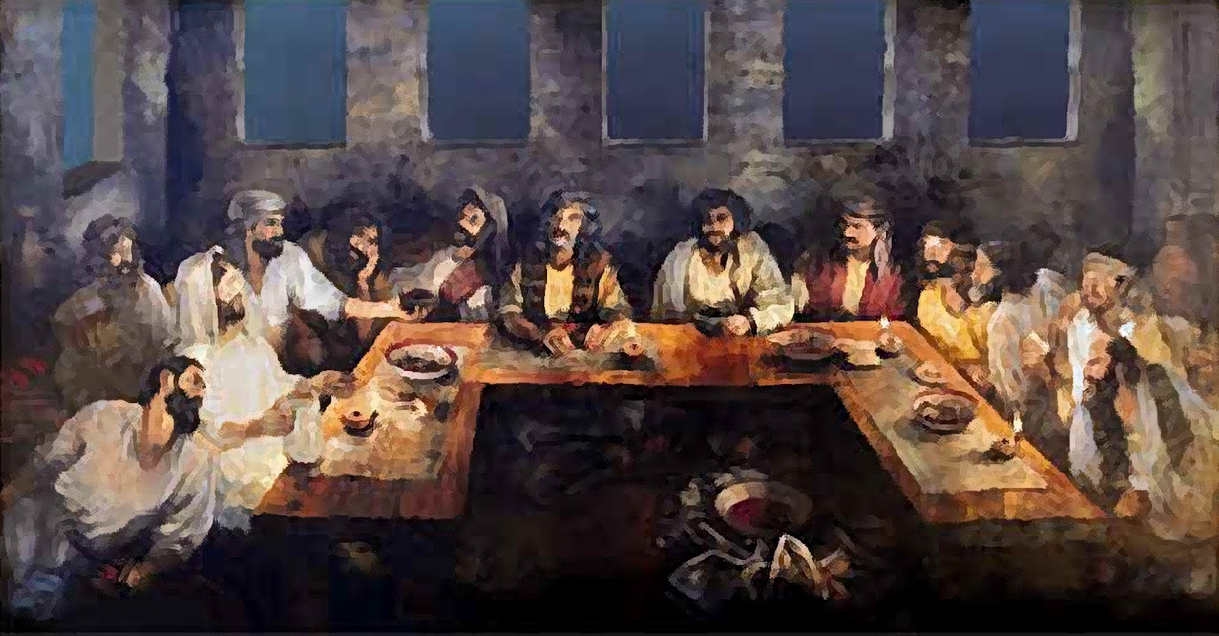
Notes:
Friends, our Lord Jesus called his disciples to be one and to remember who we are in him, what he’s done for us on the cross, and that someday he will return to renew and resurrect this world. In the first century, this communion table included disciples with various opinions about how the kingdoms of the world should operate. There were rural, largely uneducated fishermen, a tax collector who exploited his own people and was despised by the Jews, a Zealot who wanted to kill tax collectors, and a dishonest accountant named Judas. He also called men and women who were despised, considered unclean; people who had been exploited, abused, and cast out. He called all who would come, confess and repent of their sins, and join him at his Table.
And so, it’s at this Table that we remember what Jesus has done and is still doing today:
We remember that Jesus calls disciples from diverse backgrounds who hold differing opinions about various theological and political issues to express their unity in him. We remember that Jesus is forming a new nation, a royal priesthood, set apart from all kingdoms of the world and the politics of idolatrous empire. We remember that real power in this world—the power to save, to transform, to change—ultimately comes from the life, death, and resurrection of Jesus the Messiah, God’s Son. And in our willingness to embody the Messianic agenda.
At the table…
We remember our sin and our need to repent of all that dehumanizes us, so that we can love God, our neighbor, and our enemies as ministers of reconciliation. We remember that we are not to conform to the pattern of this world, but we are to be transformed by the renewing of our minds by the power of the Holy Spirit. And We remember that in communion we identify ourselves as children of the one true King—citizens of heaven and exiles on the earth—until he returns in glory for his Church, and fully establishes his Kingdom on the earth.
My invitation to us today is that we would remember this as disciples of Jesus. In the coming days, remember who you are, what it looks like to embrace the Third Way of Jesus, and where our ultimate hope and help comes from—not in horses and chariots, not in parties and presidents, not in donkeys or elephants, but in the Lamb of God who has called us to subvert the powers of evil and empire by orienting our lives to the Kingdom that is coming, Amen?
Pray with me… [NEXT SLIDE]

Slide 20

Notes:
[CLOSING PRAYER – CONFESSION & UNITY]
[APOSTLES’ CREED]
[COMMUNION]
ANNOUNCEMENT: NEW HIRE!
Benediction: Brothers and Sisters, the Lamb has conquered. Let us follow him. And may the God who looks like Jesus equip you with all you need to live for him in a world of competing loyalties and allegiances. In the name of the Father, the Son, and the Holy Spirit. Amen. Go in peace, church, to love and serve the Lord.

