Slide 1

Notes:
[BRIEF INTRO]
Welcome/Greeting
Lent to Easter series – Waging Peace: A Journey with Jesus Through Holy Week
At the beginning of Holy Week on Palm Sunday, Jesus looked out over Jerusalem and cried aloud, “If only you knew the things that make for peace.” While we envision this scene as a happy one (much like this morning), Jesus was sad because he knew what was coming to those who refused to accept him and his way of peacemaking. But regardless, Jesus spends each day of the week confronting injustice, calling out oppressors, and contending for peace.
And so, in this series we have been looking at each day of Holy Week and how Jesus clearly does not make peace or advance the Kingdom of God the way they expected a Messiah to do that, or the way that we still might expect and want that to happen today. If you’ve missed any of the previous 5 messages in this series, I encourage you to go back and watch those online at our YouTube channel, or listen at our podcast, to help you see the movement throughout Holy Week and the build-up to today’s message.
Yes, it’s Palm Sunday on the Christian calendar, but today our focus is on the day that Jesus was crucified; a day we call Good Friday, in a message entitled… [NEXT SLIDE]

Slide 2

Notes:
No More Hammers & Scapegoats. And as we often do at Grantham, let’s pray before hearing this message so that we will be receptive and sensitive to the voice of the Lord.
[BRIEF PRAYER]
At the beginning of Jason Porterfield’s book… [NEXT SLIDE]

Slide 3

Notes:
Fight Like Jesus, Jason begins his Good Friday chapter by recalling a story his seminary professor once told in class about an experience he had as a child at a Christian summer camp.
[READ PGS. 141-142]
But if we’re honest… this is reflective of what many Christians have been taught about God, the meaning of the cross, and what was happening in Jesus’ death. And what is most concerning about this belief is that it pits the Father against the Son, and in doing so it says that we do not see what God the Father is really like in the life and love of Jesus. Which means you end up with a less-than-Jesus-like portrait of God that not only negatively hinders and impacts our spiritual growth, but it gives us license to think and act like the wrathful god we worship.
So, does Jesus show us what God is really like or not? And if he does, then our understandings of things like wrath, substitution, atonement, and salvation should be shaped by Christ, not by a pagan concept of a god who needs a punching bag, needs a scapegoat, needs to be appeased in some way, or requires a virgin to be tossed into a volcano. My friends, that is not the God who has been revealed in the Christ of the New Testament. And I think this becomes clear when we consider all that Jesus has said and done in his life and ministry before the cross.
On that note, Jason Porterfield writes… [NEXT SLIDE]

Slide 4
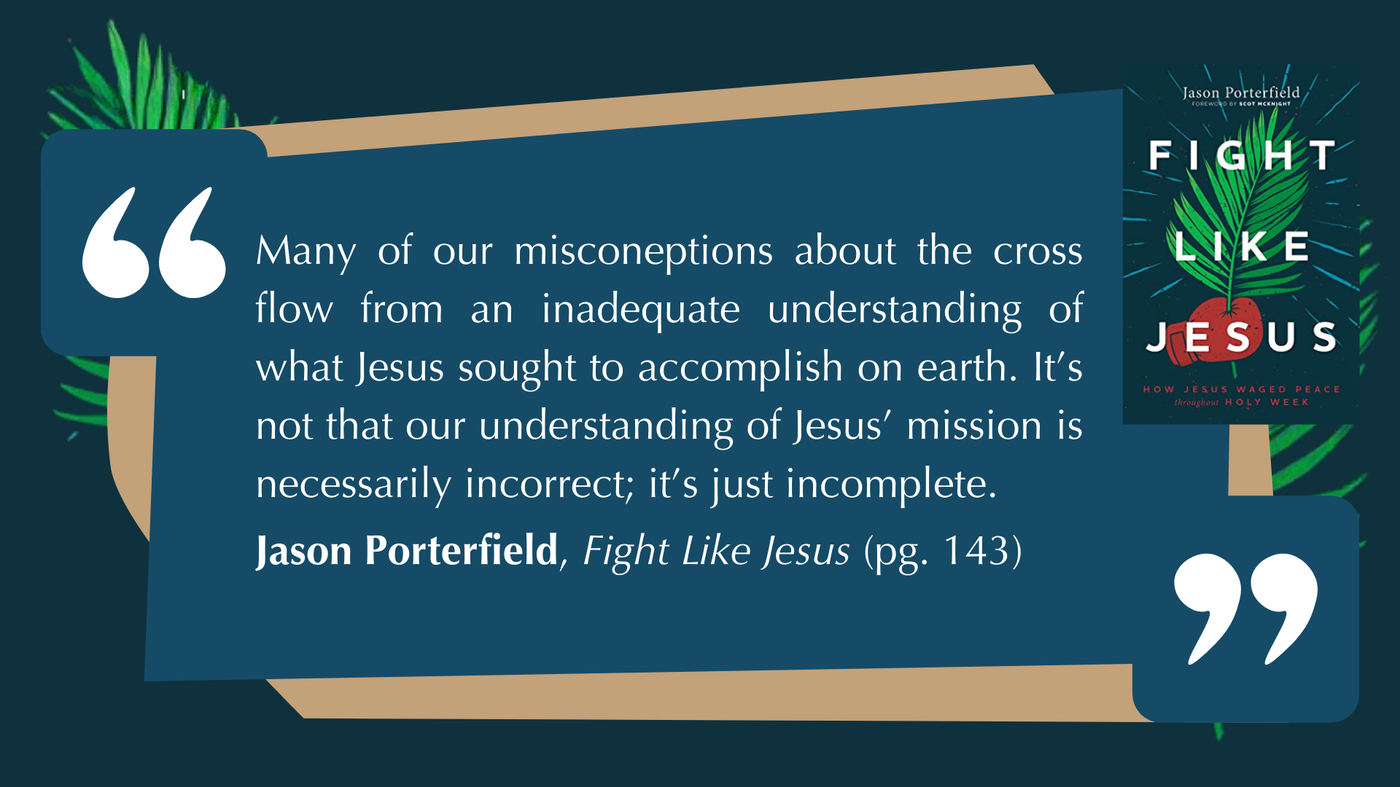
Notes:
[READ QUOTE & BRIEF COMMENTS]
Over 20 years ago I discovered the great evangelical error of ”compartmentalizing” the death of Jesus, i.e., Jesus only said and did things to ensure his horrific, nightmarish execution!
Therefore, the “nice” Jesus was necessary the first time, but the ”warrior” Jesus is coming the second time; Afterall, they say, the God of the OT is full of wrath and kills his enemies.
I hope that we can see that this doesn’t add up, and that this view doesn’t take the incarnation seriously—the God that Jesus reveals to us from the womb to the tomb
Now, since we don’t have time this morning to do a survey of Jesus’ entire life and teachings, let’s just reflect briefly on how he began his ministry and mission in Luke chapter 4… [NEXT SLIDE]

Slide 5

Notes:
[BRIEF SUMMARY OF THE TEMPTATIONS]
These are no ordinary temptations; Jesus was just baptized as the ”Lamb of God”
These temptations are identity & mission defining temptations: ”What kind of Messiah will Jesus be?” The devil comes to Jesus, “If you are the Son of God…”
3 Temptations: (1) stones to bread (economic); (2) kingdoms of the world (political); and (3) a supernatural feat at the temple (religious) – Jesus does the unexpected!
His responses show that he is totally submissive and surrendered to his loving Father, who wants him to be the Messiah and live his life in a way that is consistent with his character
Now… look at Luke 4:14-30. [READ & COMMENT ON PASSAGE]
Is there anything significant about them wanting to throw Jesus off a cliff? Well, yes, actually. It is reflective of the “scapegoat” practice in Lev. 16 on the Day of Atonement; the high priest would pass their sins onto a goat and release it into the wilderness; but another practice emerged by Jesus’ day because sometimes the sin-bearing goat would return!; So, they would instead pass their sins onto the goat and push it off a cliff to ensure its death.
If Jesus had only come to die, this was his chance! The cliff could have accomplished his goal, if that’s all he had in mind. It certainly would have changed our songs! But instead, Jesus has much more to say and do to embody the Father’s love and show us how to live.
This brings us to Lesson 1 for “Lessons in Peacemaking” today… [NEXT SLIDE]

Slide 6

Notes:
Christlike peacemakers live by a spirit of mercy and forgiveness, never vengeance and retribution.
Right away, at the beginning of Jesus’ ministry, we can see that there is more to his work than dying. He also has a mission. And at the heart of that mission is showing us what it means to be fully human (that he’s the way, the truth, and the life), and what it looks like to wage peace as the “Lamb of God” who takes away the sins of the world by laying his life down, because that’s who God is and what God is like, and it’s the God in whose image we have been created.
So, with that in mind… we now turn our eyes upon Jesus on Good Friday… [NEXT SLIDE]

Slide 7
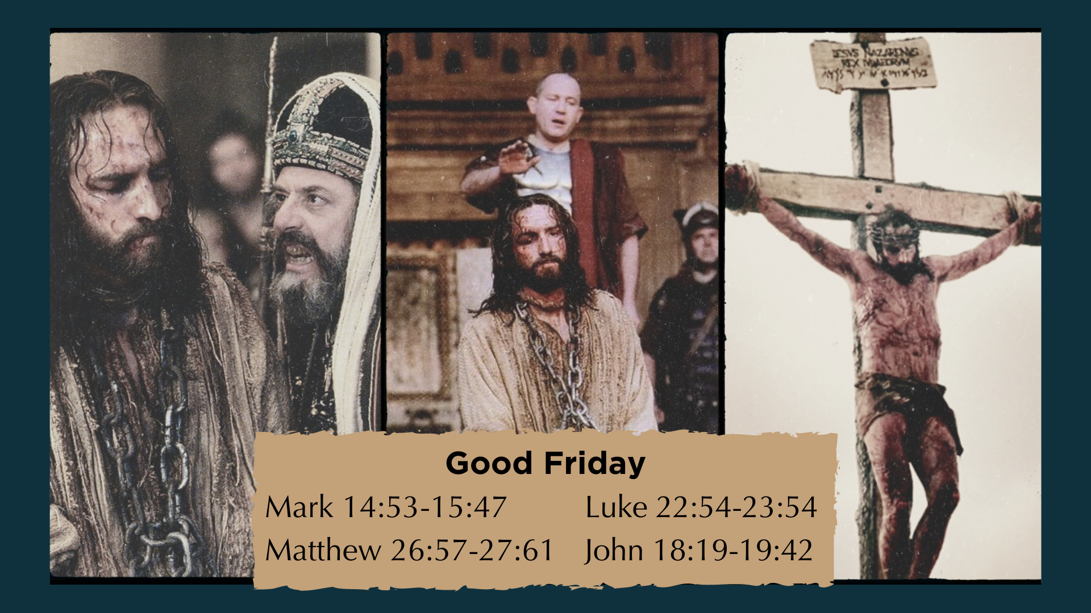
Notes:
[BRIEF COMMENTS]
Each of the 4 gospels record their own account of Friday
After Jesus was arrested, he was quickly rushed through a mock trial in the middle of the night (under the cover of darkness), as the Jewish high council sought a swift judgment. Jesus went before the Sanhedrin, where they brought forth false witnesses, mocked him, hit him, and demanded that he answer their questions meant to trap and condemn him
Then he went to the Roman puppet King Herod and was questioned. But Jesus said nothing, so he was sent back to the Sanhedrin one last time.
“Tell us… are you the Son of God?” “I AM. And you shall see the Son of Man sitting at the right hand of the Mighty One (God the Father) and coming on the clouds of heaven.”
And with a claim to be the Messiah (and something more!), they have their proof of political sedition and treason, so they then go to the Roman prefect, Pontius Pilate
Let’s pick up there in the Gospel of John… [NEXT SLIDE]

Slide 8

Notes:
[READ & BRIEF COMMENTS ON THE PASSAGE]
v. 31 - Pilate had no qualms with executing people; However, it is Passover (a Jewish festival that a had a history of riots and rebellions) and so he proceeds cautiously.
v. 32 – Jesus alluded to crucifixion back in John 12:32-33
v. 33 – The wording in Greek indicates that Pilate is not impressed with Jesus
v. 34 – Jesus knows that Pilate isn’t taking him seriously, but he wants him to
v. 35 – Because Pilate is a Roman and he already has a king—Caesar.
And Jesus answered in verse 36… [NEXT SLIDE]

Slide 9
“My kingdom is not of this world. If it were, my servants would fight to prevent my arrest by the Jewish leaders.
But now my kingdom is from another place.”
John 18:36 NIV
Notes:
[READ PASSAGE & BRIEFLY COMMENT]
“not of this world” is not the same is “not for this world”
Jesus is saying that his Kingdom does not operate like that of worldly kingdoms and empires; it does not advance with weapons, force, and the power of the world; so… neither do or should his followers seek to do this, even in the face of threats and persecution
[READ VERSES 37-40 & COMMENT]
This custom was a way of pacifying the Passover crowd; and Pilate also sees it as a way of letting them take responsibility for their request, while also being in total control
Who was Barabbas? His name Bar-Abbas means “son of the father” and the gospel writers tell us that he wasn’t just an ordinary criminal, he was a violent revolutionary and insurrectionist who murdered someone in a recent uprising (Mk 15:7).
But there’s more. Look at what Matthew’s gospel tells us in chapter 27… [NEXT SLIDE]

Slide 10
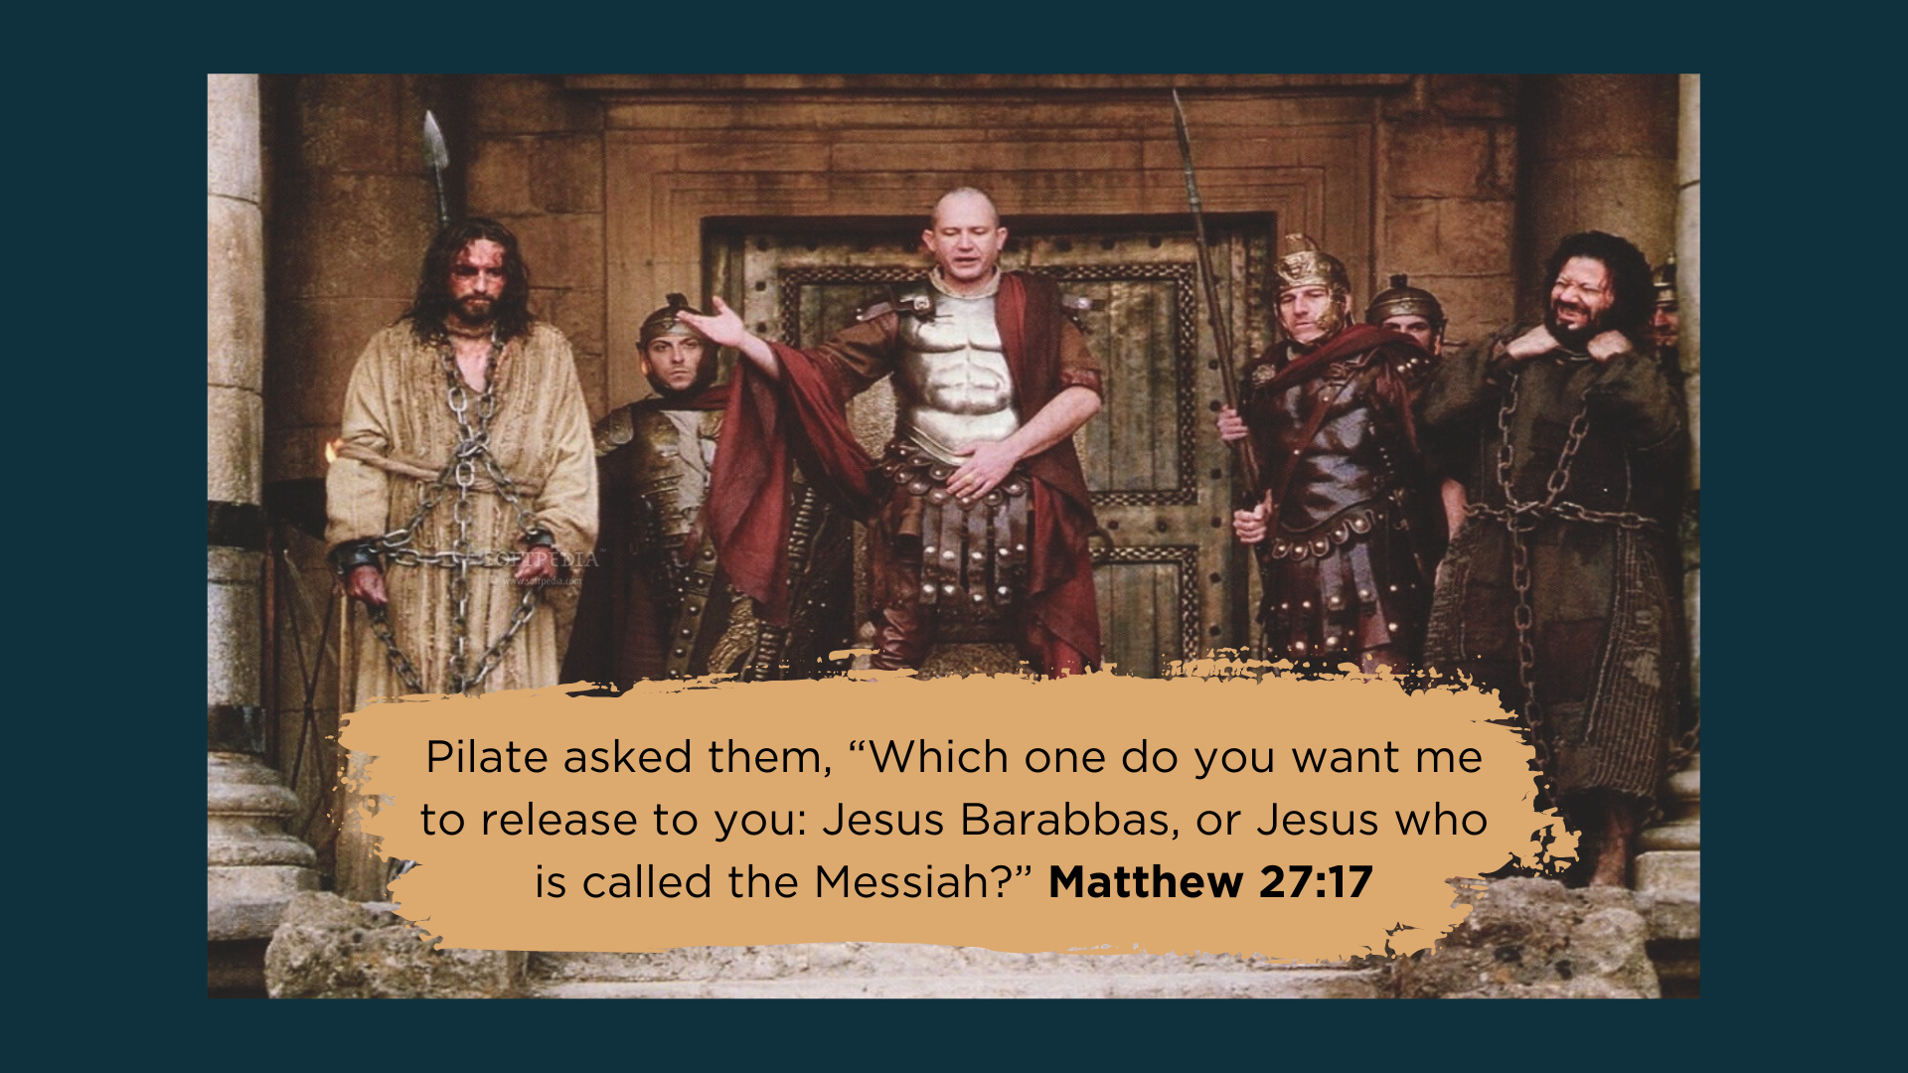
Notes:
Starting in verse 16… “At that time they had a well-known prisoner whose name was Jesus (Yeshua) Barabbas. So when the crowd had gathered, Pilate asked them, “Which one do you want me to release to you: Jesus Barabbas, or Jesus who is called the Messiah?” For Pilate knew it was out of self-interest that they had handed Jesus over to him.”
Of course, Pilate is still testing their hatred and disdain toward Jesus, and possibly putting them in a position to publicly test their submission to the empire (thinking they might choose a dreamer and heretic to live over a violent murderer), but instead they want Yeshua Bar-abba!
And we would certainly be missing what the gospels are saying to us if we failed to hear in this a question or two (and see in this picture) that is being given to us at his point in the story: “Which Jesus do you want? And do you see and accept which Jesus is the true Lord and Christ?” O how similar the church in America can be to the crowds that day who said, “We choose Jesus Barabbas, not Jesus Christ. Barabbas is the sort of Messiah we want.”
And so, another lesson in peacemaking emerges from our story… [NEXT SLIDE]

Slide 11

Notes:
Lesson 2: To embrace Jesus’ way of peace, Christlike peacemakers must reject scapegoating and the Barabbas alternative.
In other words, to choose the Barabbas way of making peace is to reject the Jesus way. They are mutually exclusive. We can’t have it both ways. And when faced with this choice, we must remember that Jesus is Lord of all or he is no Lord at all.
My friends… [NEXT SLIDE]

Slide 12
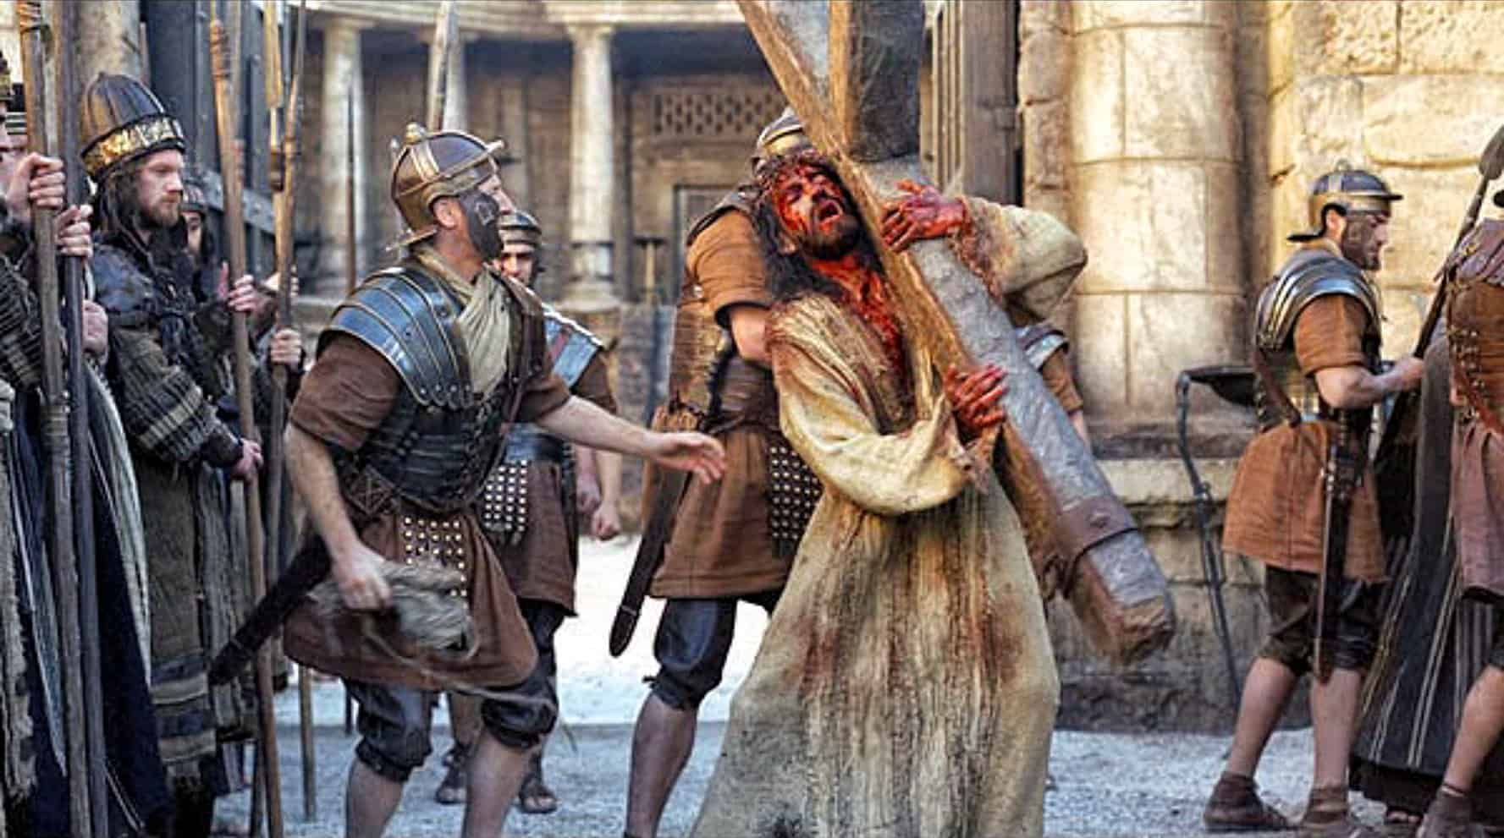
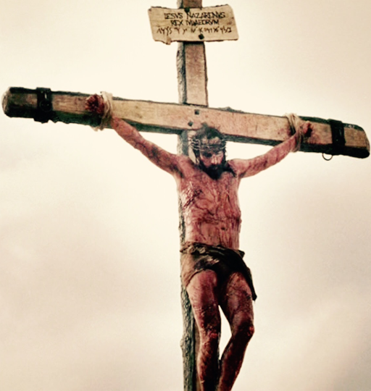
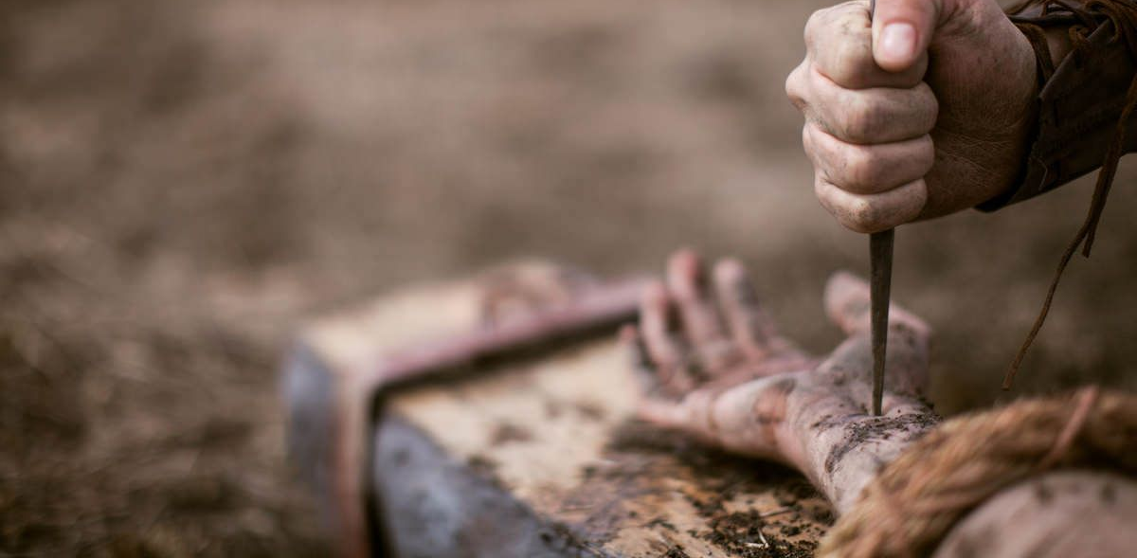
Notes:
If Jesus shows us anything on his way to the cross, and then in his sacrifice (which Jesus says he willingly made our behalf), he reveals to us that he is the last scapegoat. Why? Because he took all of our sins upon himself, went outside the city walls, and simultaneously exposed how evil, unjust, and broken our view of retributive justice is, and why it doesn’t work.
It was always going to end this way for Jesus because this is what Barabbas-loving people do to a holy God in a Good Friday kind of world. Jesus comes to us in a way that is consistent with the character of the Father—loving, merciful, full of grace and truth—and we crucified him. Our way of peace, freedom, and justice—our way of power-over, of weapons, threats, revenge, and rationalizing our violence—killed the Prince of Peace and multiplies death to this day.
And just when you think that this is surely when the wrath of an angry God will justifiably drop on the Lord’s enemies and all of us sinners who love hammers and scapegoats—when we all get what’s coming to us—we hear these words from Jesus echo from the cross… and down through the ages… [NEXT SLIDE]

Slide 13
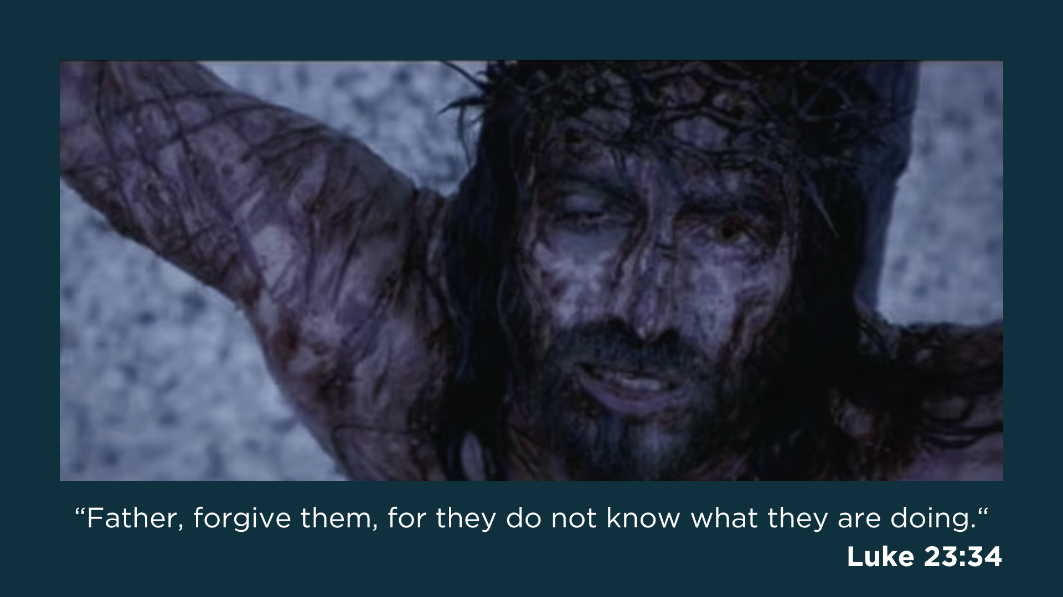
Notes:
“Father, forgive them, for they do not know what they are doing.”
Brothers and sisters, when we hear these words from Jesus being prayed to his Father who sent him to reveal his true nature, and a Father who already knew what would become of his only begotten Son, we will not mistake these words as a prayer of appeasement.
Rather, we will hear these words reflecting the Father’s own heart through a faithful Jesus. We will hear these words and see everything that Jesus has revealed in his life and death as the lens by which we understand everything that has come before him and everything that comes after him. For he is the definitive revelation and exact representation of God in human flesh.
And so… the third and final lesson in peacemaking is… [NEXT SLIDE]

Slide 14

Notes:
Lesson 3: Christlike peacemakers accept that Jesus has revealed what God is really like and what he wants for his disciples.
Have you accepted this? And not just in your head, but also in your heart? Have you accepted this truth and experienced it with a heart that has been born again and a body that has been baptized with new eyes given by God to see the power of the Kingdom?
In 1 Corinthians 1:18, the Apostle Paul wrote, “For the message of the cross is foolishness to those who are perishing, but to us who are being saved it is the power of God.” My friends, only the Holy Spirit can make it possible for us to see what many can’t or simply don’t want to see. But if we will come near to Jesus and survey the wondrous cross, and witness the words, the love, and the peace-making of Christ, we may (by the grace of God) stand in awe of him.
That’s what happened with the Roman centurion who had been with Jesus in his final hours, from Pilate’s praetorium to Calvary’s hill. He concluded… [NEXT SLIDE]

Slide 15
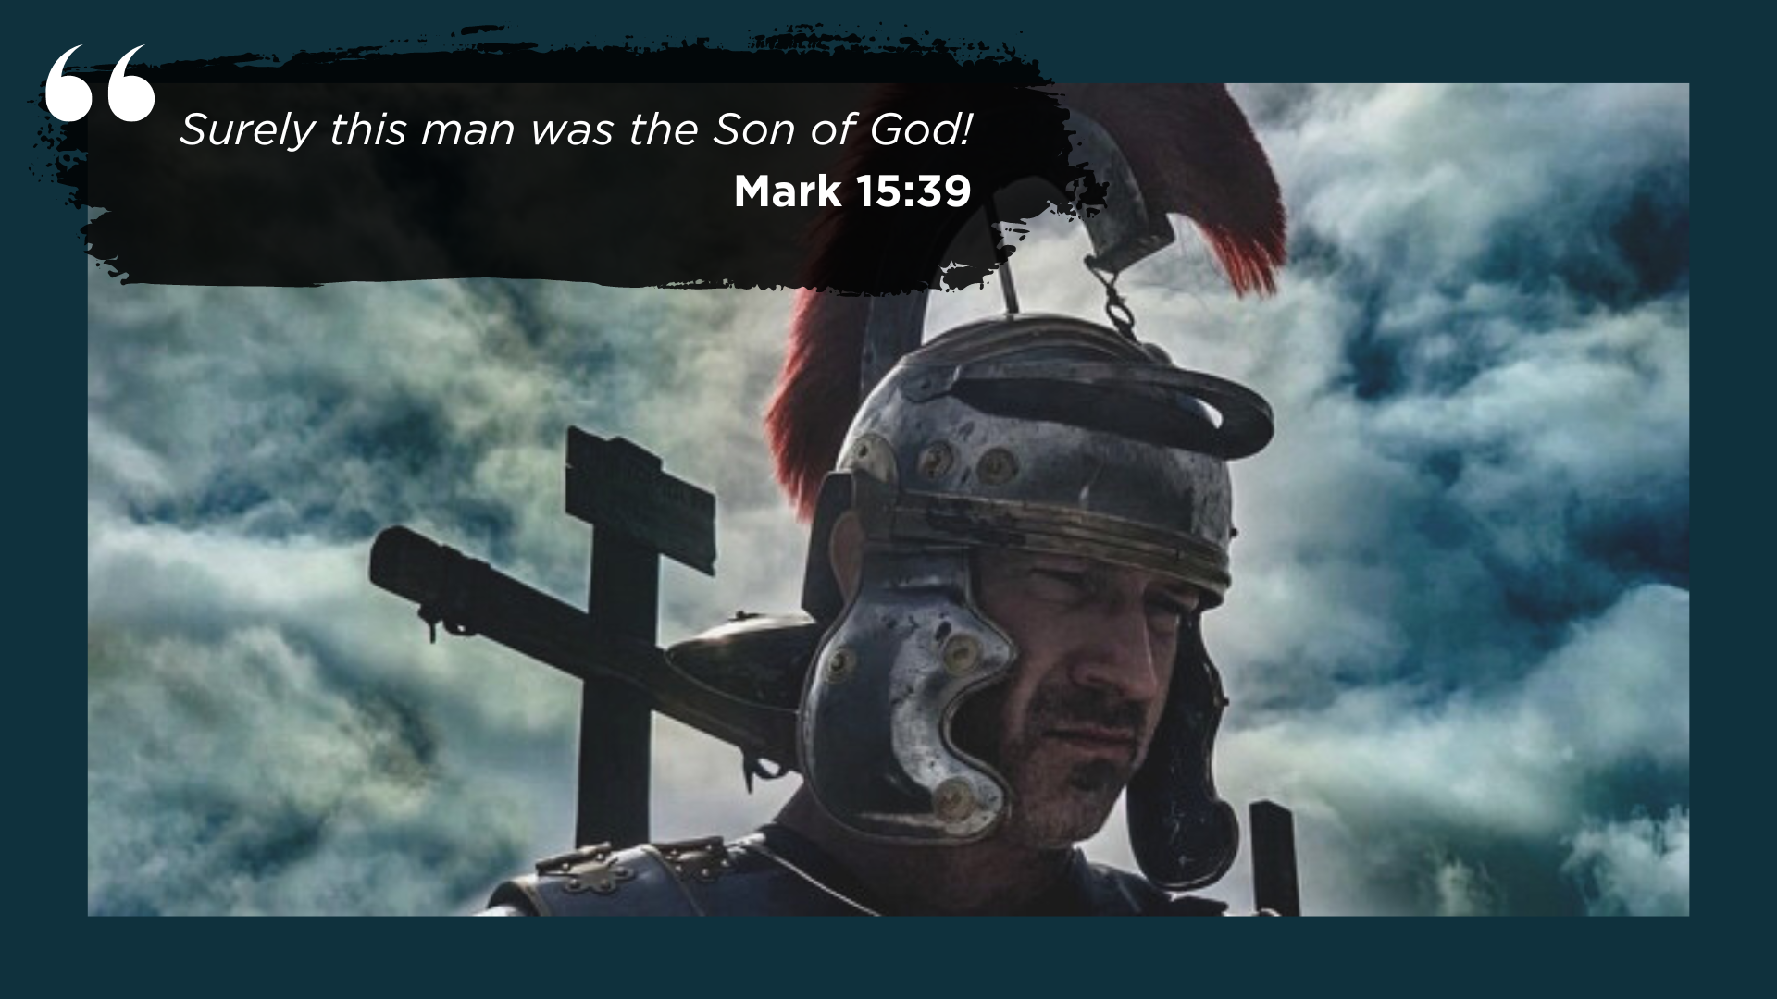
Notes:
How else can it be explained? How can a heart be transformed in such a short amount of time? Well, when you’ve had a front row seat to the suffering of the crucified God, it’s possible. When your heart is tired of the violence, and you open yourself up to another Kingdom, it’s possible.
Once you’ve witnessed the God who loves and blesses his enemies; the God who forgives those who killed him in their ignorance; the God that welcomes thieves who see his holiness and believe by faith, your dead cold heart can be strangely warmed. And once you realize that it’s by your own hands that the Prince of Glory has died… your heart and hands may tremble… but then you will find yourself open to the Lord’s salvation and poised for resurrection.
And then we can say, “Surely… this man was (and is) the Son of God!” May that be the cry of our hearts, as we surrender our souls to Jesus—the only one who can save us.
Finally, here are some questions to help us reflect and respond the voice of the Spirit… [NEXT SLIDE]

Slide 16


Slide 17


Slide 18


Slide 19

Notes:
[READ & COMMENT ON EACH QUESTION]
“What if Jesus really meant what he said?” Have I been thinking that Jesus only came to earth to die for my sins rather than show us how to live and love as he did on the way to the cross?
Would I have chosen Barabbas or Jesus on Friday of Holy Week? Who am I choosing each day with my attitude, words, and actions?
Have I accepted Jesus as the definitive revelation of God? How does my theology and living not align with this truth? What is God saying to me?
Let’s pray… [NEXT SLIDE FOR CLOSING PRAYER]

Slide 20

Notes:
[CLOSING PRAYER]
Series Benediction – adapted from a “Franciscan Benediction”
May God bless you with discomfort…
Discomfort at easy answers, half-truths and superficial relationships,
Discomfort, so that you will hunger and thirst for righteousness.
May God bless you with holy anger…
Anger at injustice, oppression, and exploitation of people,
Holy anger, so that you will work for God’s Kingdom vision of shalom.
May God bless you with tears…
Tears to shed for those who suffer pain, rejection, starvation and war,
Tears, so that you will reach out to comfort them
And turn their pain into joy.
And may God bless you with foolishness…
Foolishness to believe that through the Spirit you can live like Jesus,
Foolishness, so that you will do what others claim cannot be done. Amen.
Grantham Church, go in peace… to love and serve the Lord.

