Slide 1
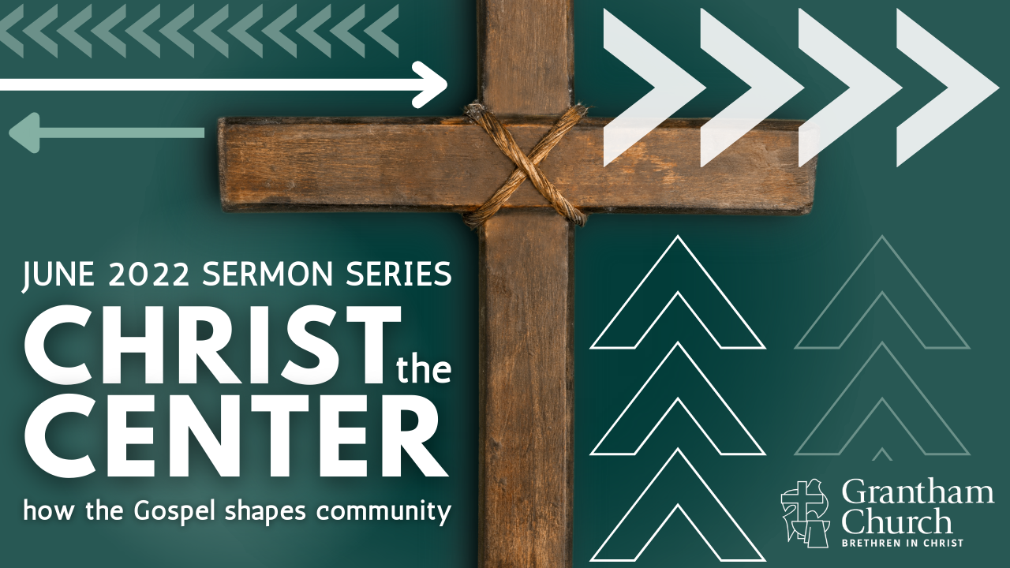
Notes:
[BRIEF INTRO]
Last week we began a new sermon series: Christ the Center: how the gospel shapes community
What does it look like to be a Christ-centered church that is faithful to the gospel? How can we be a church that doesn’t obsess over boundaries or one that ends up erasing all lines that set us apart as faithful disciples? In this 4-part sermon series, we are looking at how Christ is the center of our community when we are pursuing him together, affirming historic Christian beliefs, and living out our values as Christ-followers, as we extend grace to those who are at different places on their journey.
Last Sunday we began our series with… [NEXT SLIDE]

Slide 2
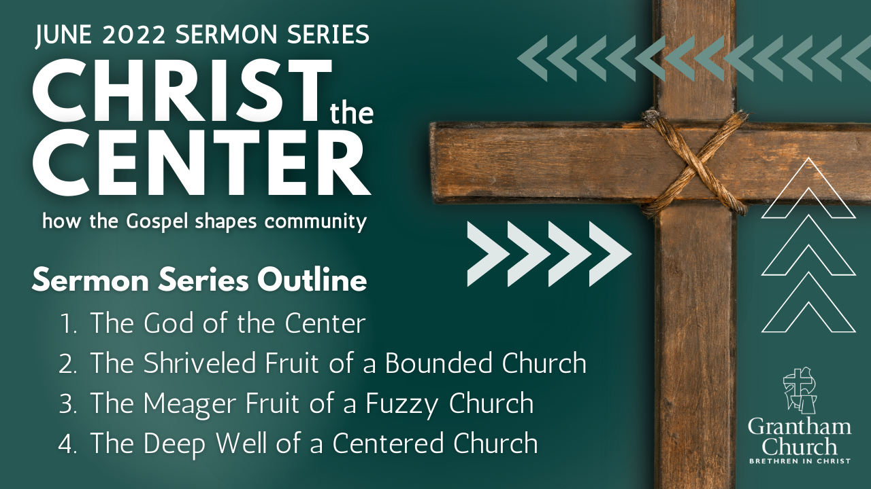
Notes:
[BRIEF COMMENTS]
1. The God of the Center – I addressed how our concept of God, and our understanding of the gospel, will determine the sort of community and culture that exists in the church. At Grantham, we say Jesus shows us what God is like, and so we want to worship and know this Jesus, and follow him with others in the church for the sake of the world—leading others to the God who looks like Jesus. Therefore, the more we seek the God of the center, the more like him we will become, individually and as a community.
2. Today’s message: The Shriveled Fruit of a Bounded Church, we are going to be looking at how the gospel challenges the “bounded” practice of community, which the Pharisees embodied and (as we saw last week) Jesus rejected.
3. Next week will look at The Meager Fruit of a Fuzzy Church – what it looks like when we erase all lines and boundaries (either to be non-judgmental or to align ourselves with the spirit of the age), and why that is equally a bad idea.
4. The final message: The Deep Well of a Centered Church – we will see that there is a third way option of being a community that pursues Jesus together (allowing folks to be at different places), can discern whose life is aimed at Christ, and hold grace and truth together as we live and worship in relationship with one another.
Again, I believe this is a foundational series. And for such a time as this, I’m thankful for the clarity and inspiration that Mark Baker offers in his book… [NEXT SLIDE]

Slide 3
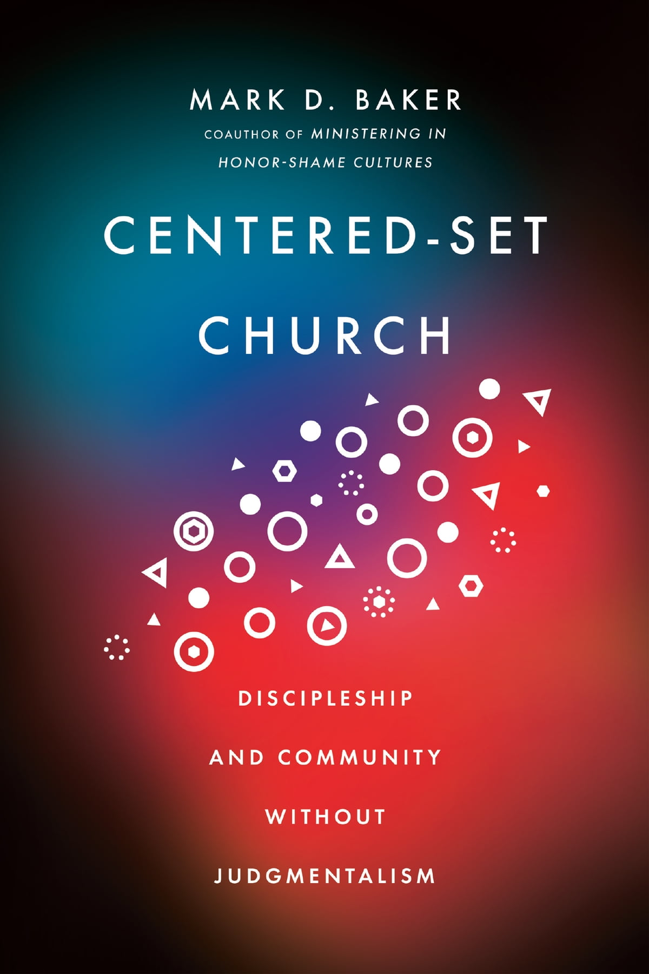
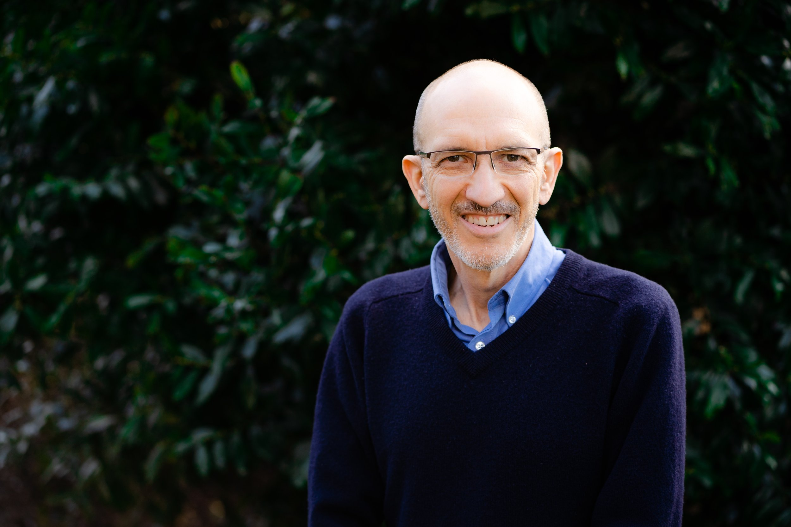
Notes:
Centered-Set Church: Discipleship and Community Without Judgmentalism
If you’re interested in reading it, I linked this book in last week’s Email From the Pastor. If you don’t receive our weekly email (which includes everything going on in the church) please let us know by emailing the church office. Also, we have Baker’s book, and others related to the series, on the church library shelf in the lobby.
As I said last Sunday, Mark Baker expounds on three different ways of being community, and here are the images that help us grasp what each set looks like in practice. [NEXT SLIDE]

Slide 4
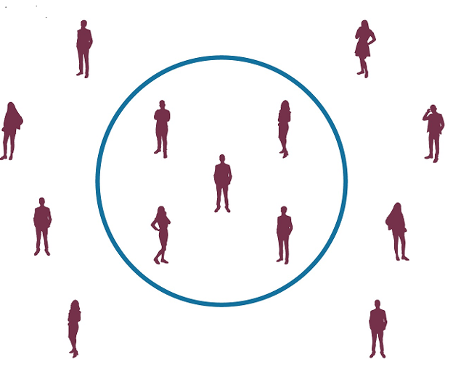

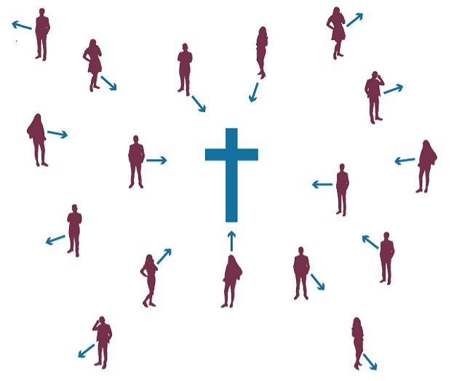
Bounded Church
Fuzzy Church
Centered Church
Notes:
[BRIEF COMMENT ON EACH]
Bounded Church – clear lines of who is in and out; focuses on boundaries.
Fuzzy Church – the removal of all lines and boundaries with no clear direction.
Centered Church – discerns who belongs to the group by observing people’s relationship with the center—Jesus Christ. The group includes all who are oriented toward the center. Their common direction brings unity. There is space to struggle and fail because they believe that everyone is in process—moving closer to the center.
This morning we are looking at the Bounded Church. Again, here is the definition we looked at last Sunday… [NEXT SLIDE]

Slide 5
Bounded Church
A Bounded Church has a clear boundary line that is static and distinguishes Christians from non- Christians, or true Christians from mediocre Christians. The line generally consists of a list of correct beliefs and certain visible behaviors. A bounded church has tendencies toward a sense of superiority and judgmentalism. It hinders transparency and shames.
Notes:
[READ & COMMENT BRIEFLY]
The Bounded Church’s impact on us as…
Individuals – elitist attitudes about your church tradition, heresy hunters, and judgmental attitudes (e.g., people mowing their lawns or fishing on Sunday, real Christians don’t smoke, listen to secular music, or have tattoos, etc.)
Community – we can give folks the clarity or simplicity of mind they seek in a pagan, pluralistic, post-truth, morally-confused world, but at a terrible cost to ourselves and our lost neighbors when it is done through a bounded-set paradigm.
In his book, Baker says, “Most people draw religious lines with sincere concerns and motivations. Yet in a society that is saturated with status-seeing, a bounded group easily absorbs that mentality, and their practices can become tools to grasp at superiority and status. In this way, status, superiority, and privilege can become unconsciously woven into the fabric of bounded churches.”
Can some good come out of bounded churches? Sure. But most often than not they promote a concept of God that doesn’t look like Jesus, and they create modern-day Pharisees who bear shriveled fruit. And that’s what I want us to reflect on today… [NEXT SLIDE]

Slide 6
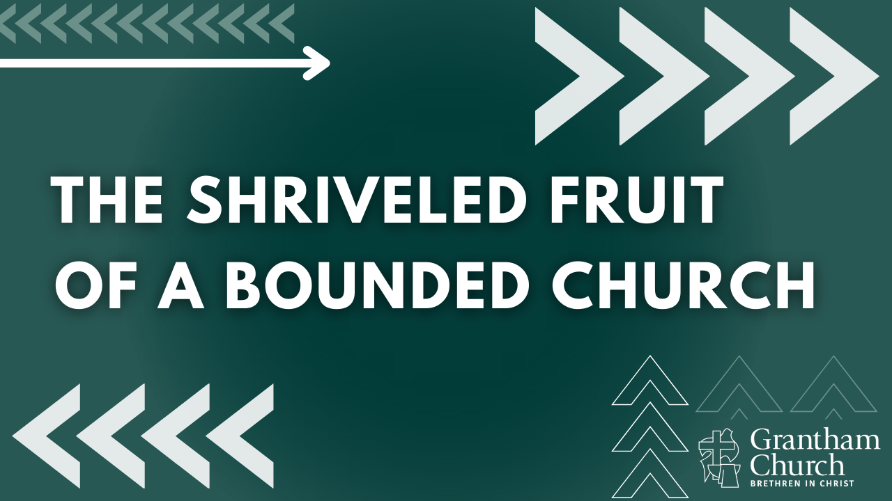
Notes:
In the message, The Shriveled Fruit of a Bounded Church
In just a moment we are going to be looking at various passages in Paul’s letter to the Galatians. But before we do that, I want to invite us to hear Paul challenging a bounded group paradigm that was introduced to these Gentile Christians by Jewish Christians who were undermining Paul’s ministry and the gospel he was proclaiming—a gospel of grace—as he envisioned a multi-cultural church with Christ at the center.
And so, what was the gospel that Paul preached… [NEXT SLIDE]

Slide 7
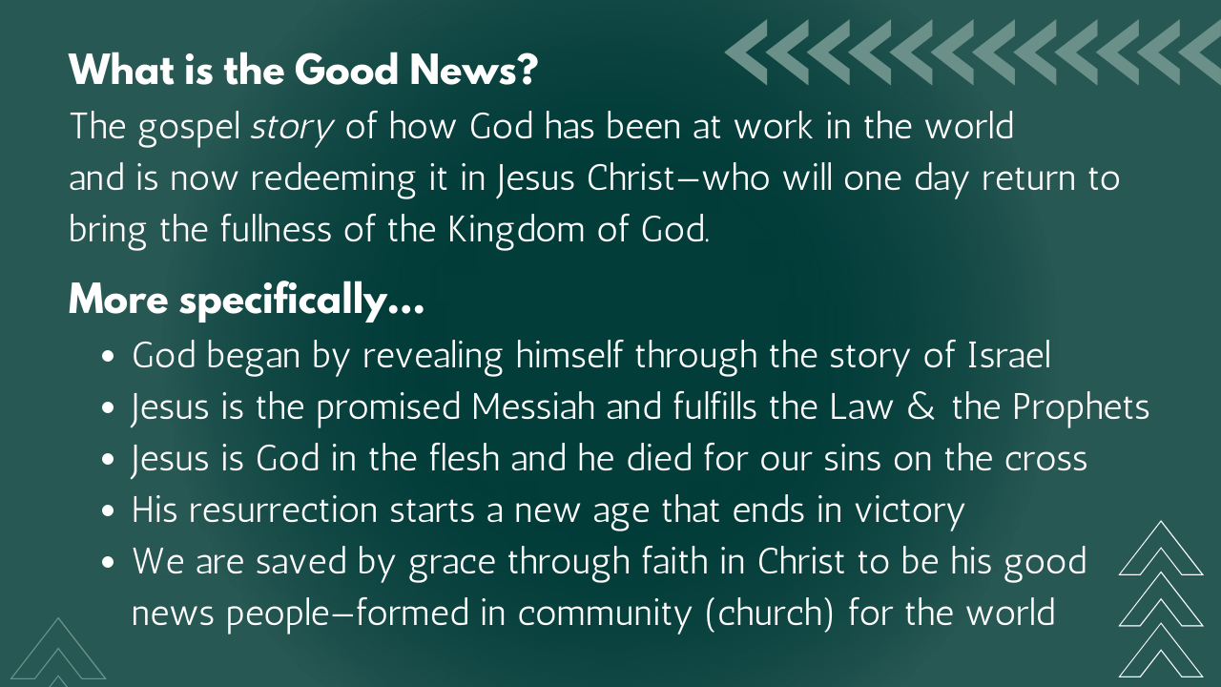
Notes:
[BRIEF COMMENTS]
What is the Good News? - definition from The Gospel of the Kingdom series
More specifically…
NOTES FOR BULLET POINT #2:
Matthew 5:17 – “Do not think that I have come to abolish the Law or the Prophets; I have not come to abolish them but to fulfill them.” (Gal. 3:24-25)
Matthew 22:37-40 – “’Love the Lord your God with all your heart and with all your soul and with all your mind.’ This is the first and greatest commandment. And the second is like it: ‘Love your neighbor as yourself.’ All the Law and the Prophets hang on these two commandments.” In other words, whatever is good and righteous regarding the OT, it is lived out and embodied by fully loving God and others, as we see in Christ.
If you would… go ahead and open your Bible to the book of Galatians… [NEXT SLIDE]

Slide 8
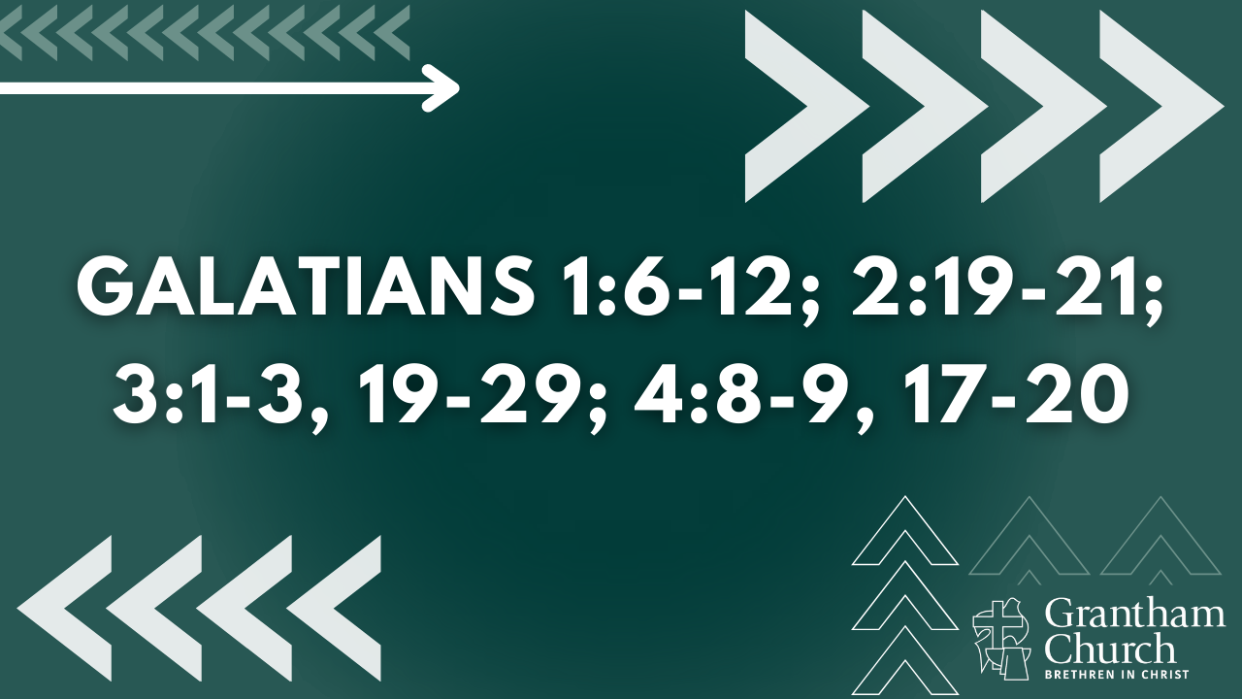
Notes:
[CONTEXT OF GALATIANS]
This is the first letter written by Paul (about 49 AD) to the churches he planted in Galatia, which is in region of southern Turkey today.
At this point, there is just as many Gentiles as Jews in the Jesus movement, prompting a lot of debate, like the one we see at the Jerusalem Council in Acts 15: ”What must Gentiles do to be saved and be included in the church?” Some said that they must embrace the external Jewish boundary markers to be legit, e.g., males must be circumcised, eat kosher, follow the Law, observe the Sabbath, etc.
But the Apostle Paul was preaching that we are saved by grace through faith, and that all who believe can begin pursuing Christ with others in the church. As he will say to the Galatians, the death and resurrection of Jesus has launched a new age and new creation. Therefore, Paul warned them of going backwards, back to the old age, and taking on a bounded-set approach, thus adding to the gospel and obstacles for Gentiles who are attracted to Jesus and pursuing him as the center of the church.
He initially received the approval of the Jerusalem Church (which he didn’t need or ask for), but then later there is some flip-flopping due to pressure from the boundary-marker activists (e.g., Peter backs away from table fellowship at Antioch).
Furthermore, these ”agitators” (Paul calls them) are going around accusing him of bungling the gospel he received from the apostles. So, they tell the Galatian Christians that they must adhere to the Law and observe the boundaries to be true disciples.
We don’t have the letter, but Paul obviously received a report about the tensions and divisions among the Galatians caused by the Jewish “agitators”… and so he responds.
[READ SELECTED PASSAGES FROM GALATIANS & COMMENT]
And so, you can hear Paul’s extreme frustration and his concern for what this ”other gospel” and a focus on old covenant boundary markers (which were pre-Messianic age and tribal in nature) would do to the Galatian churches. For Paul knew, as a former Pharisee himself, that this teaching and practice would undermine the gospel of grace and lead to various forms of bondage and shriveled fruit.
And here is what this bounded thinking and practice leads to, and the sort of community that it creates… [NEXT SLIDE]

Slide 9
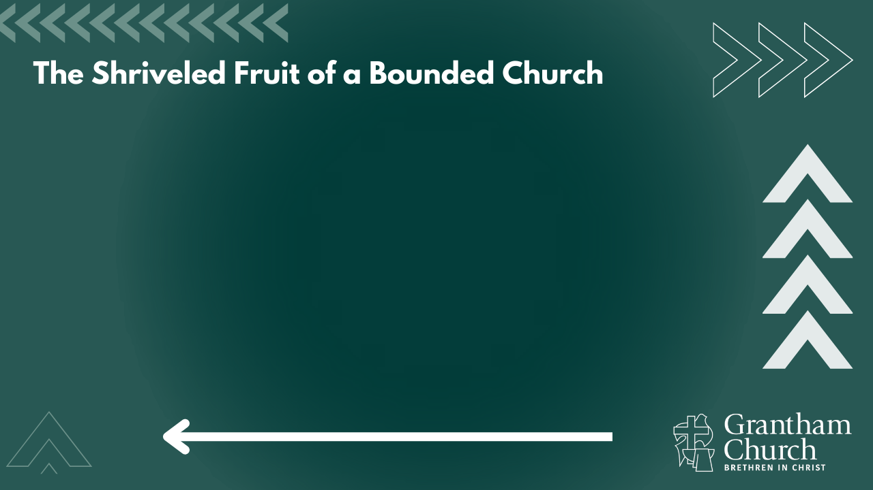

Slide 10
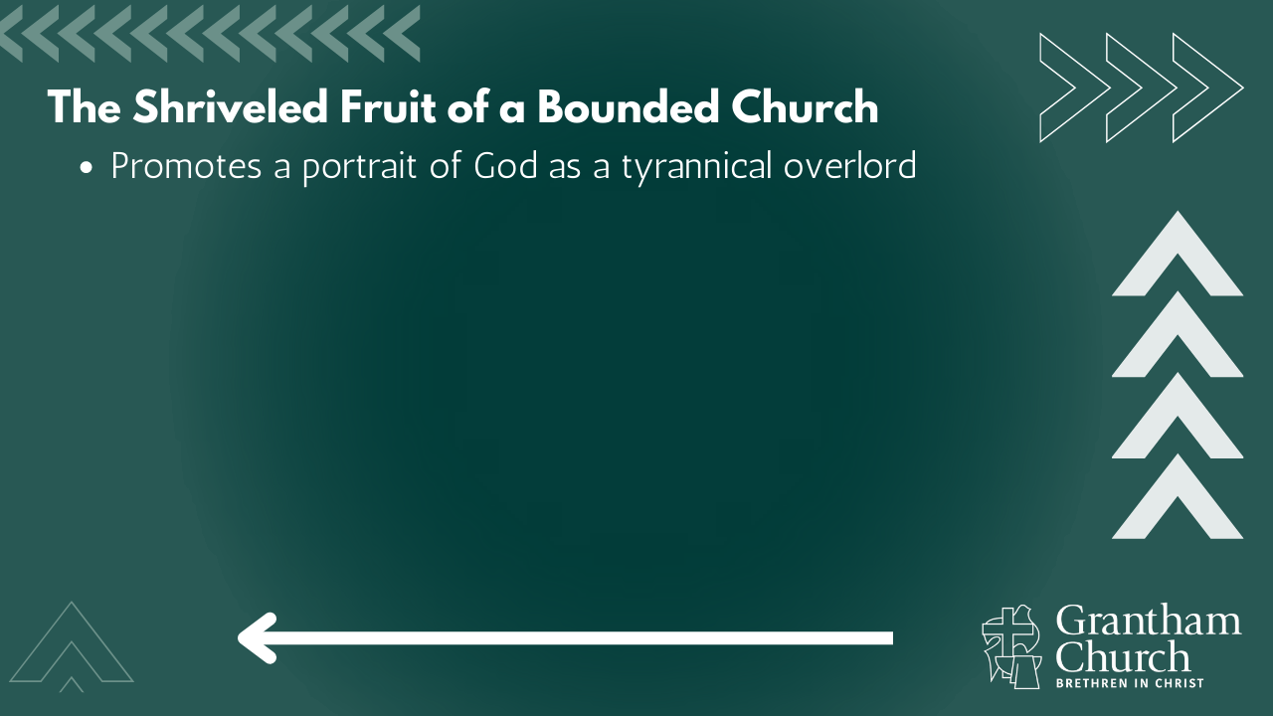

Slide 11
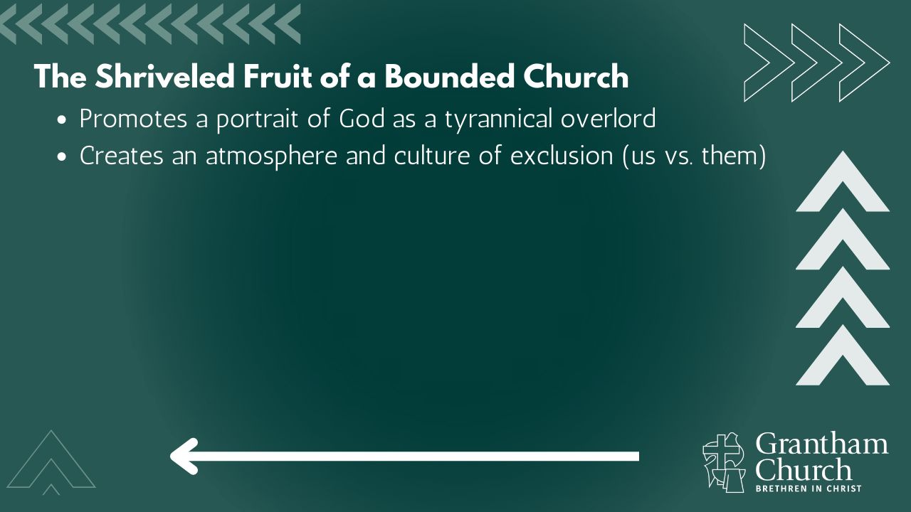

Slide 12
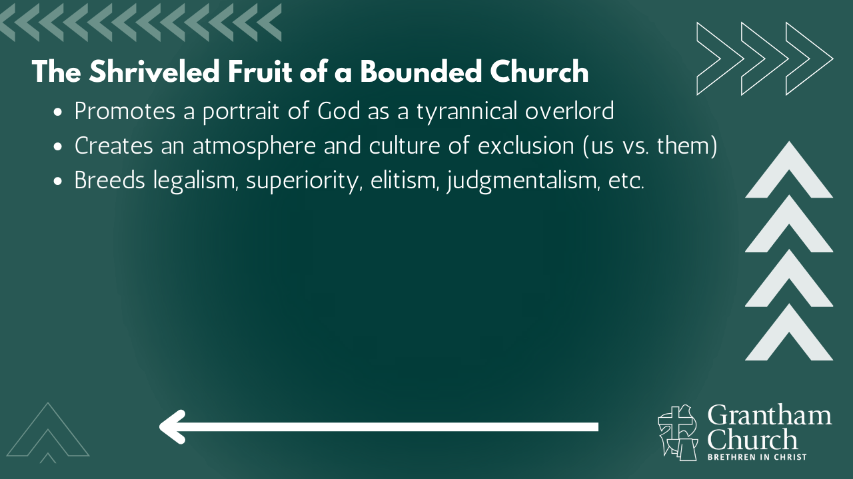

Slide 13
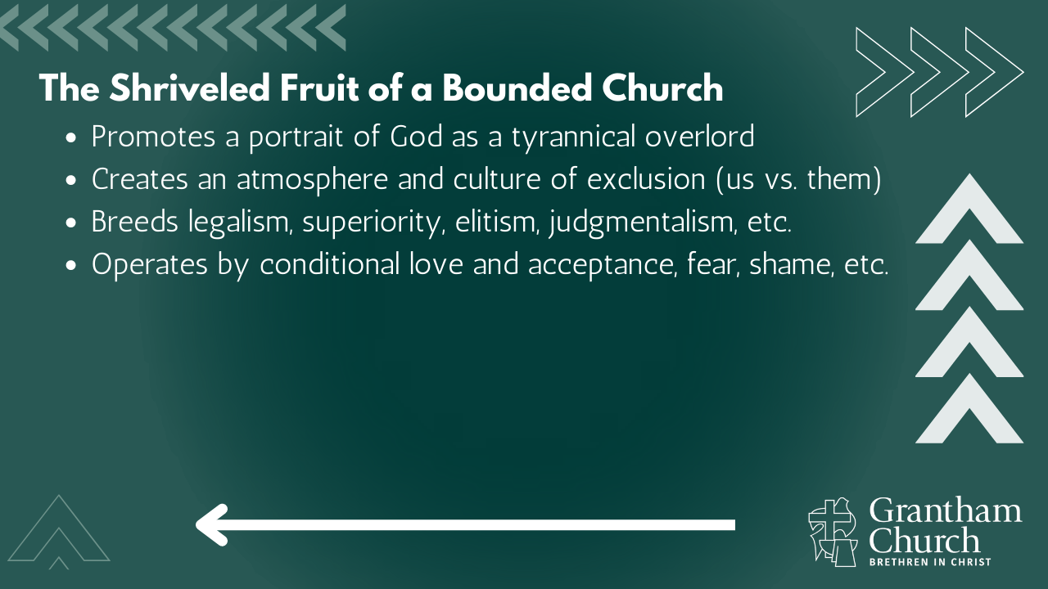

Slide 14
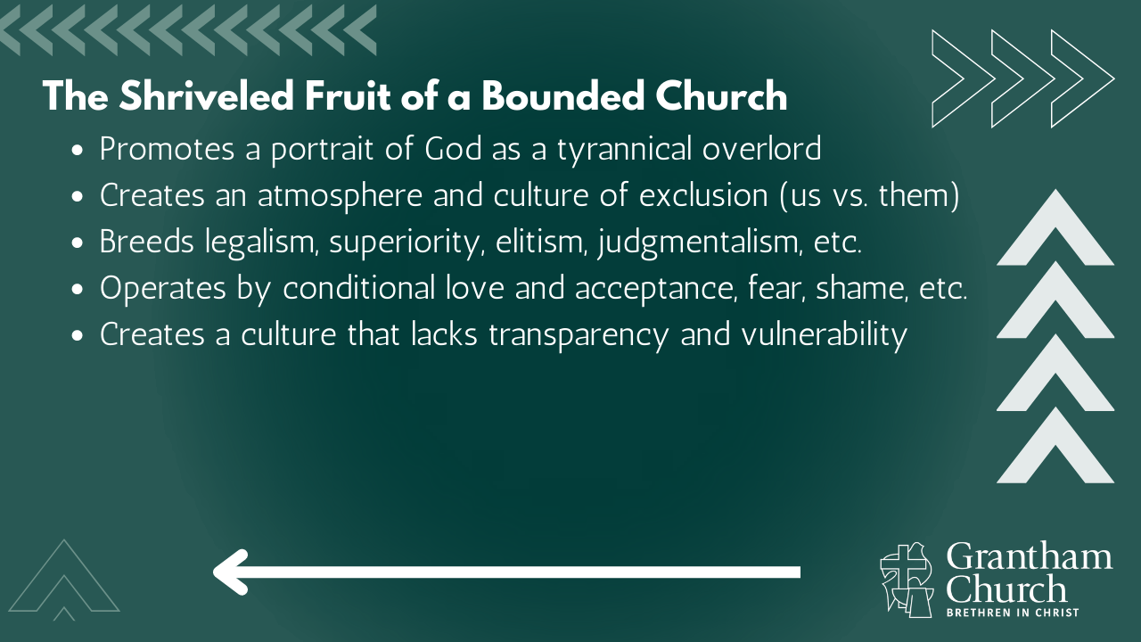

Slide 15
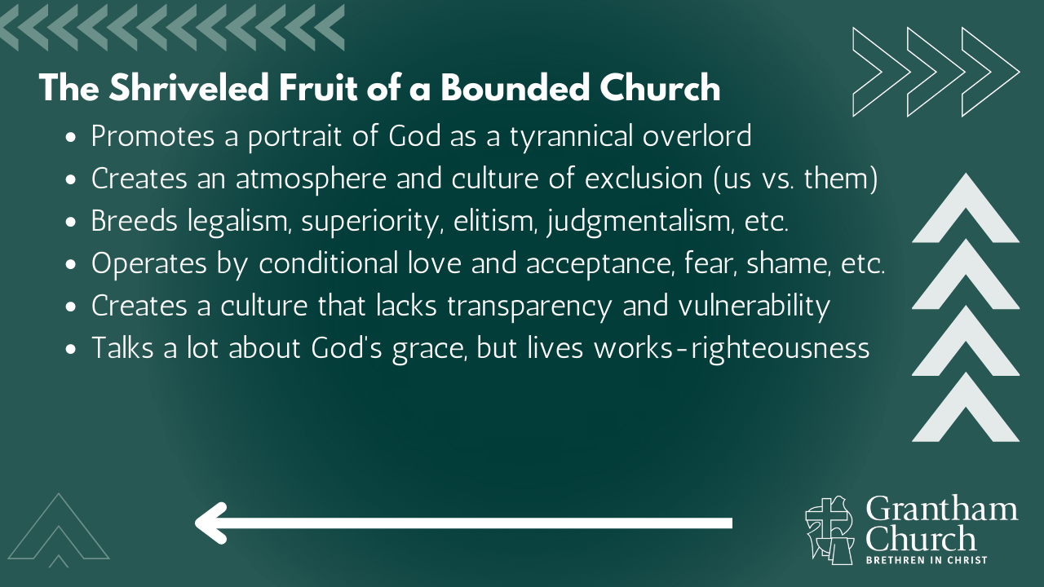

Slide 16
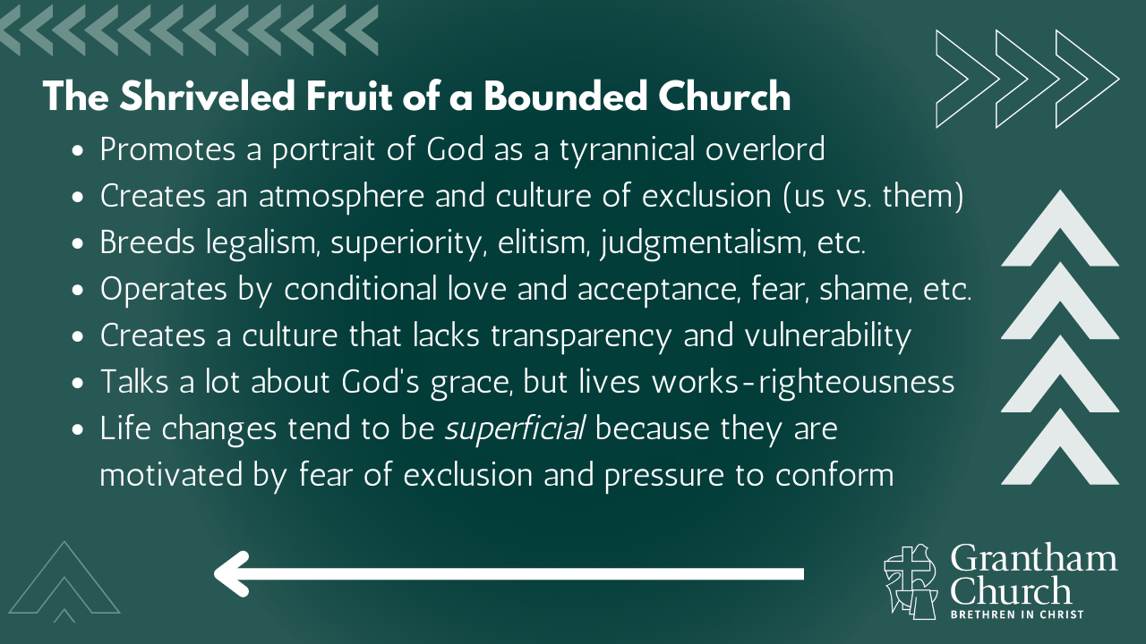
Notes:
[BRIEF COMMENT ON EACH]
Promotes a portrait of God as a tyrannical overlord
Creates an atmosphere and culture of exclusion (us vs. them)
Breeds legalism, superiority, elitism, judgmentalism, etc.
Operates by conditional love and acceptance, fear, shame, etc.
Creates a culture that lacks transparency and vulnerability
Talks a lot about God's grace, but lives works-righteousness
Life changes tend to be superficial because they are motivated by fear of exclusion and pressure to conform – Which is why in Galatians ch.5, Paul says we should learn to use the grace and freedom we’ve been given in Christ to live by the Spirit within (not by the Law) if we’re going to bear the fruit of the Spirit and express our faith in love.
As we will see more next week, boundaries can be good things, but the Bounded Church twists and misuses them in order to exclude and relies upon laws and line-drawing to motivate right-living and behavioral modification. But Paul (like Jesus) is saying there is a better way… [NEXT SLIDE]

Slide 17
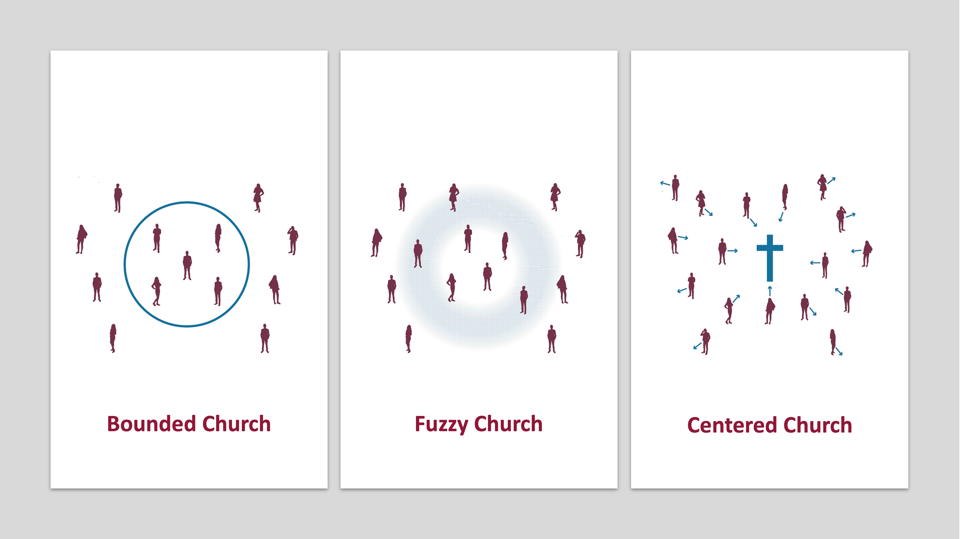
Notes:
[BRIEF COMMENTS]
Once again, Baker writes…
“Bounded churches may state that Christ is at the center, but the paradigm itself acts like a magnet and pulls people to turn and focus on the boundary line that defines the group and provides security. At the other end of the spectrum, a fuzzy church might talk about the centrality of Jesus Christ, but it does not actually have a center. The focus is still on boundary lines, but in this case their identity is defined by not having any boundary lines. In a centered church our security and identity reside in our relationship to the center. Therefore, the paradigm itself, like a magnet, pulls our focus to the center—Jesus Christ.”
Brothers and sisters, despite the good that might come from a bounded approach, Jesus rejected this mindset of the Pharisees in his own ministry. And as we have heard from the Apostle Paul to the Galatians, it is slavery, it is going backwards, it breeds all manner of shriveled fruit, as it reflects a tribalistic mentality born of the flesh, not the Spirit. And it fails to trust in the way that calls us to meet people where they are and journey together toward the God of the center—the God who looks like Jesus.
Therefore, let us say “No” to the bounded church, so that we might say “Yes” to Jesus and the gospel which is best known, experienced, and embodied in the Centered Church.
In closing, here are two questions for reflection and response… [NEXT SLIDE]

Slide 18
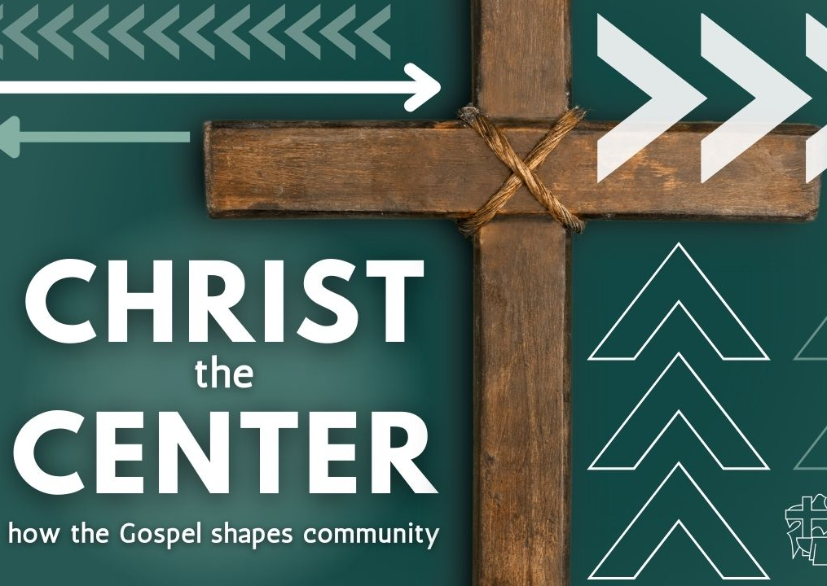
Questions
for reflection and response:

Slide 19
Questions
for reflection and response:
  Have you experienced a bounded church before? Is there hurt you need to name and ask God to heal in you?

Slide 20
Questions
for reflection and response:
  Have you experienced a bounded church before? Is there hurt you need to name and ask God to heal in you?
  Be honest. Is there any bounded thinking in you that distorts your view of God and leads to fear, judgmentalism, and the exclusion of others? What about in our church?
Notes:
[BRIEF COMMENT ON EACH QUESTION]
[CLOSING PRAYER]
[NEXT SLIDE FOR CLOSING PRAYER]

