Slide 1
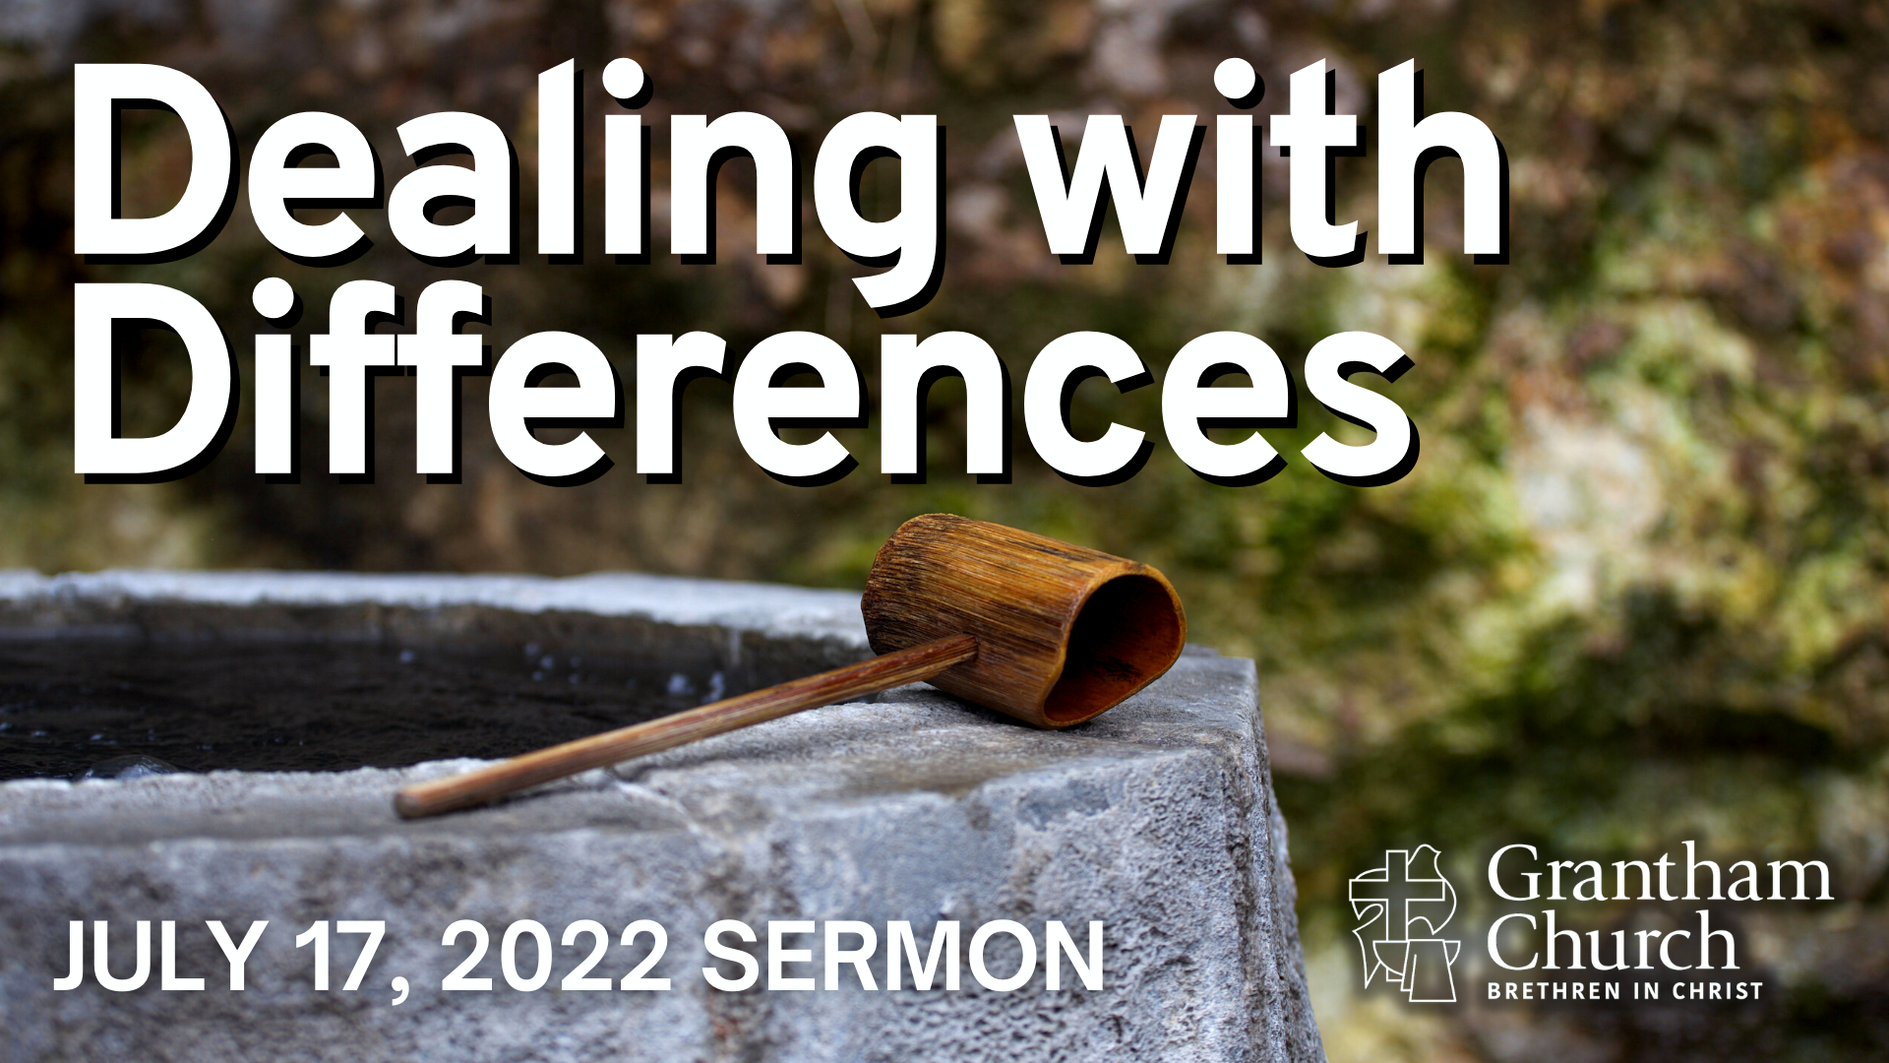

Slide 2
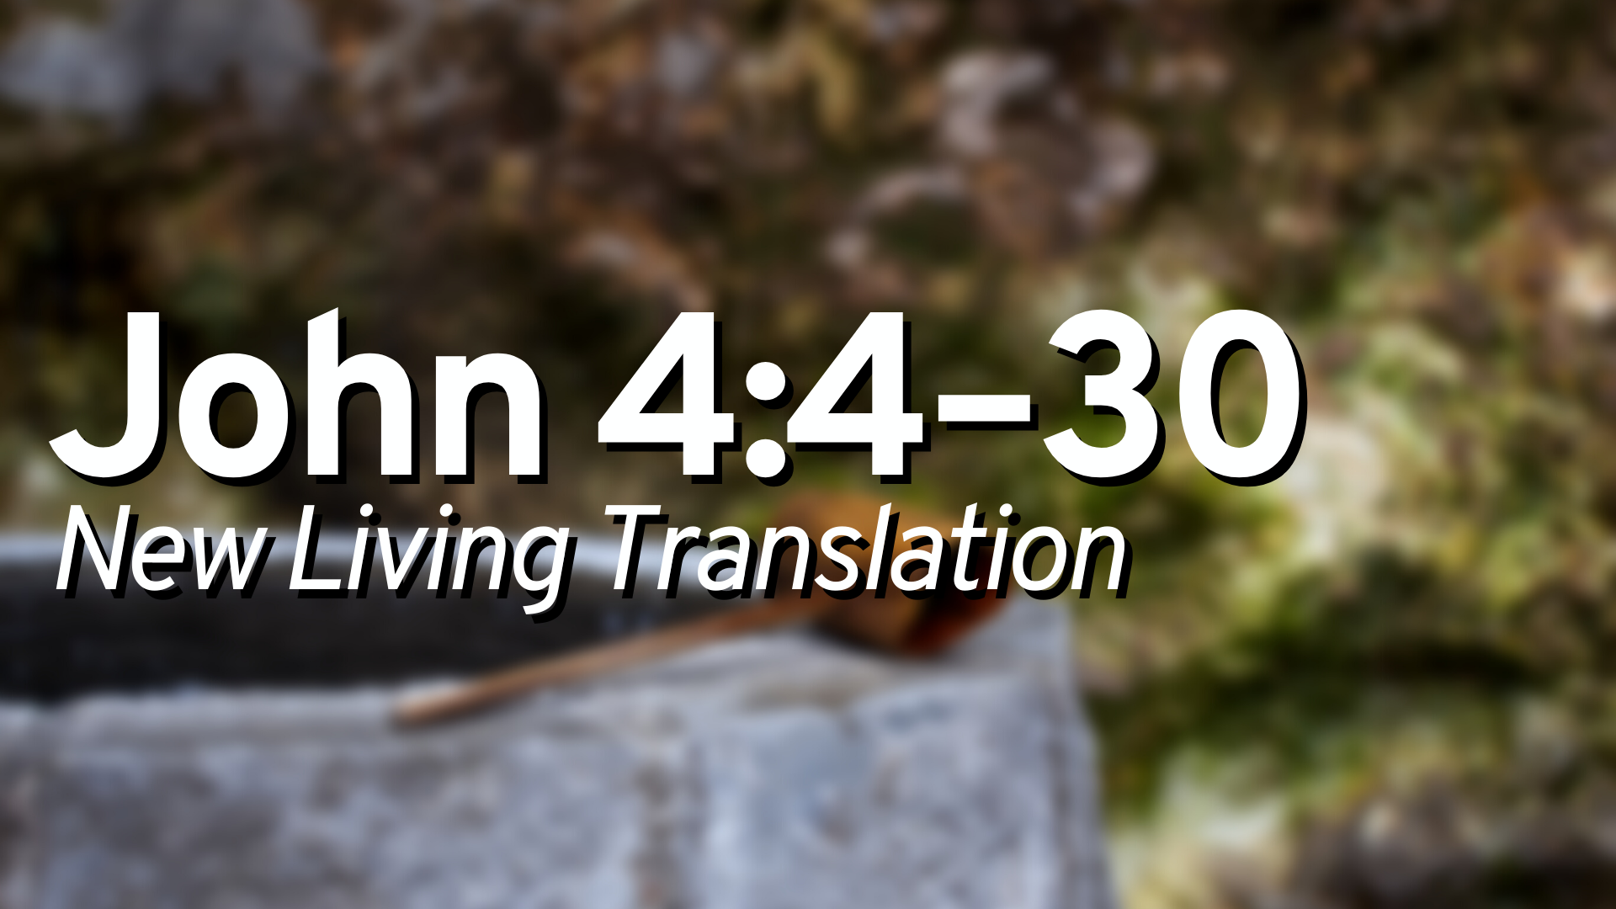

Slide 3
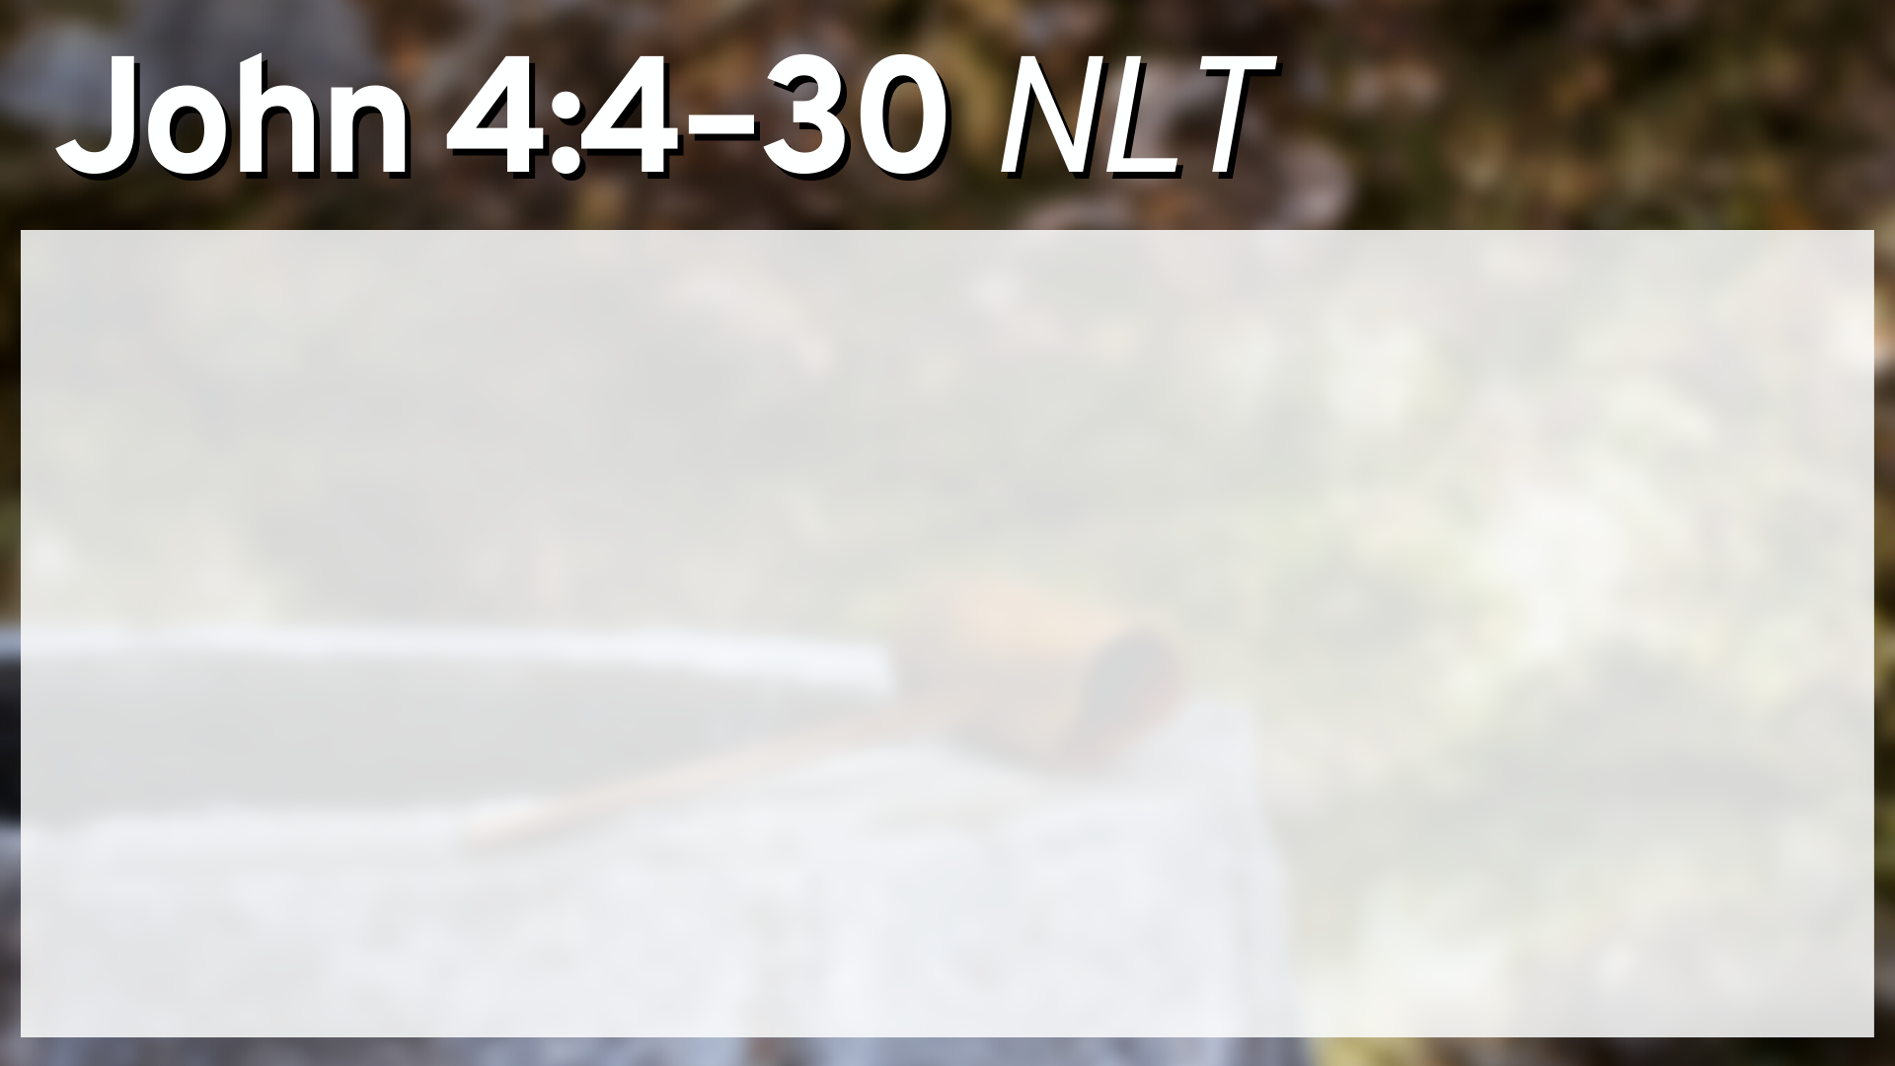
He had to go through Samaria on the way. Eventually he came to the Samaritan village of Sychar, near the field that Jacob gave to his son Joseph. Jacob’s well was there; and Jesus, tired from the long walk, sat wearily beside the well about noontime. Soon a Samaritan woman came to draw water, and Jesus said to her, “Please give me a drink.” He was alone at the time because his disciples had gone into the village to buy some food.
The woman was surprised, for Jews refuse to have anything to do with Samaritans. She said to Jesus, “You are a Jew, and I am a Samaritan woman. Why are you asking me for a drink?”

Slide 4
Jesus replied, “If you only knew the gift God has for you and who you are speaking to, you would ask me, and I would give you living water.”
“But sir, you don’t have a rope or a bucket,” she said, “and this well is very deep. Where would you get this living water? And besides, do you think you’re greater than our ancestor Jacob, who gave us this well? How can you offer better water than he and his sons and his animals enjoyed?”
Jesus replied, “Anyone who drinks this water will soon become thirsty again. But those who drink the water I give will never be thirsty again. It becomes a fresh, bubbling spring within them, giving them eternal life.”

Slide 5
“Please, sir,” the woman said, “give me this water! Then I’ll never be thirsty again, and I won’t have to come here to get water.”
“Go and get your husband,” Jesus told her.
“I don’t have a husband,” the woman replied.
Jesus said, “You’re right! You don’t have a husband—for you have had five husbands, and you aren’t even married to the man you’re living with now. You certainly spoke the truth!”
“Sir,” the woman said, “you must be a prophet. So tell me, why is it that you Jews insist that Jerusalem is the only place of worship, while we Samaritans claim it is here at Mount Gerizim, where our ancestors worshiped?”

Slide 6
Jesus replied, “Believe me, dear woman, the time is coming when it will no longer matter whether you worship the Father on this mountain or in Jerusalem. You Samaritans know very little about the one you worship, while we Jews know all about him, for salvation comes through the Jews. But the time is coming—indeed it’s here now—when true worshipers will worship the Father in spirit and in truth. The Father is looking for those who will worship him that way. For God is Spirit, so those who worship him must worship in spirit and in truth.”
The woman said, “I know the Messiah is coming—the one who is called Christ. When he comes, he will explain everything to us.”

Slide 7
Then Jesus told her, “I am the Messiah!”
Just then his disciples came back. They were shocked to find him talking to a woman, but none of them had the nerve to ask, “What do you want with her?” or “Why are you talking to her?” The woman left her water jar beside the well and ran back to the village, telling everyone, “Come and see a man who told me everything I ever did! Could he possibly be the Messiah?” So the people came streaming from the village to see him.

Slide 9
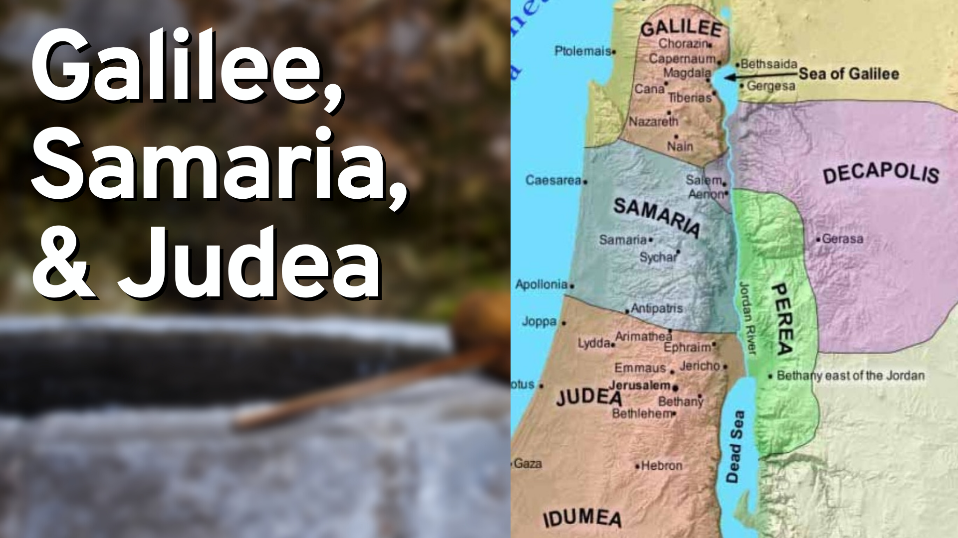

Slide 11
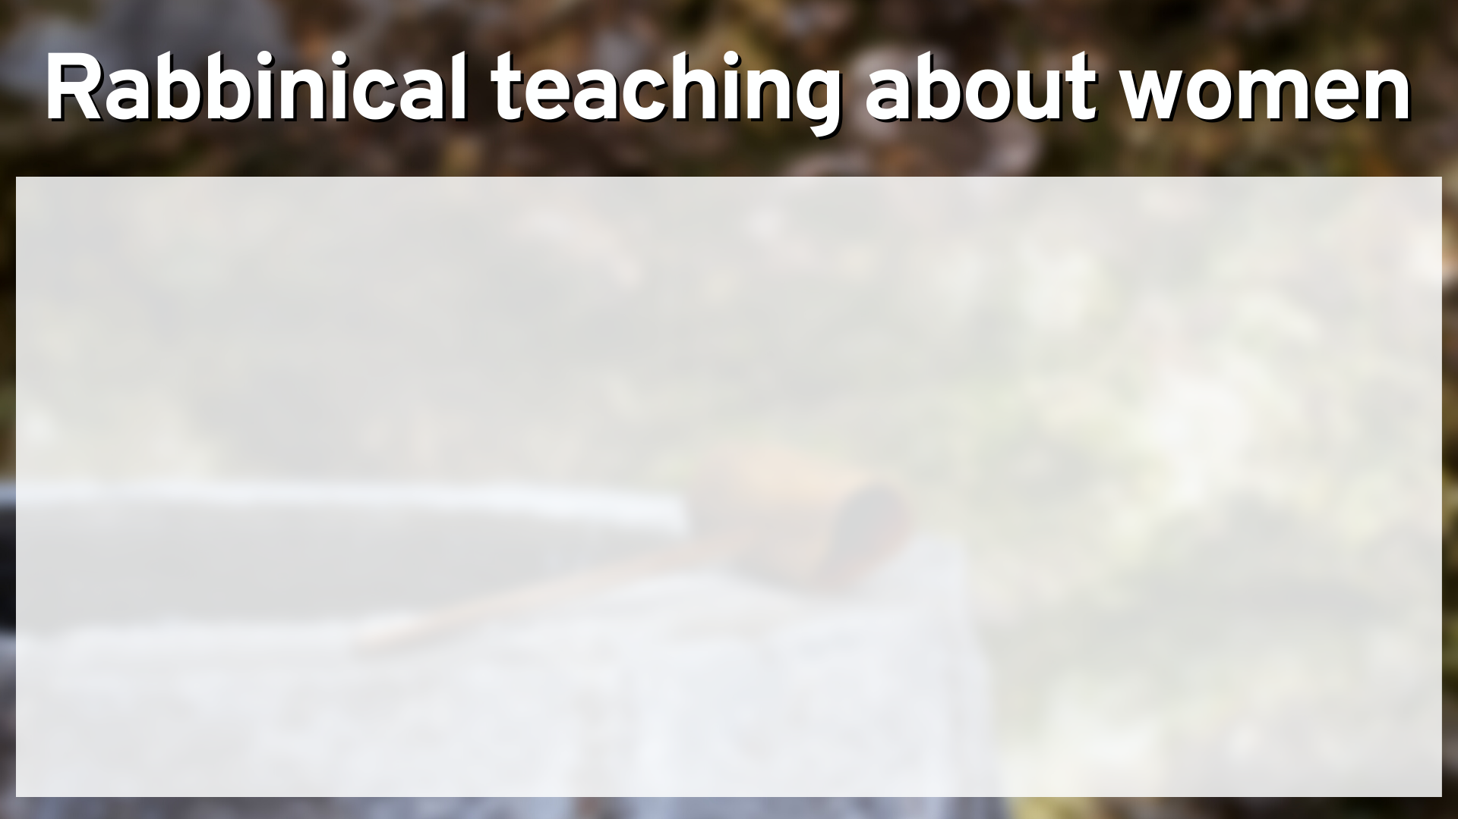
"A man shall not talk with a woman on the street, not even with his own wife, and especially not with another woman, on account of what men may say"
“Daughters of Samaritans are considered to be unclean from the day that they are born”

Slide 13
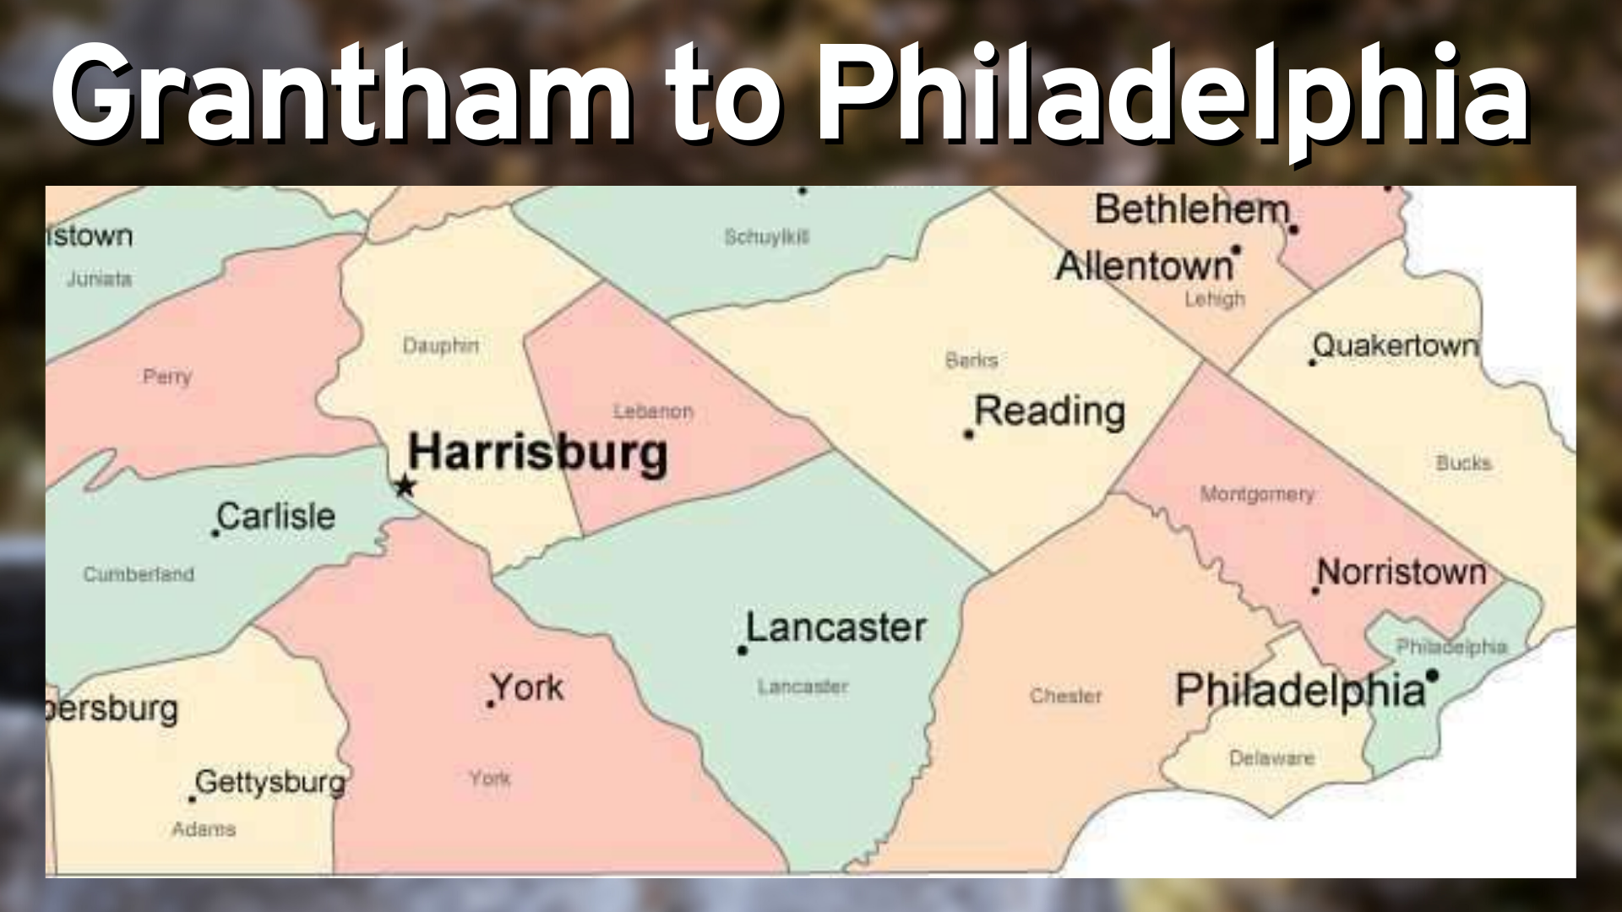

Slide 15
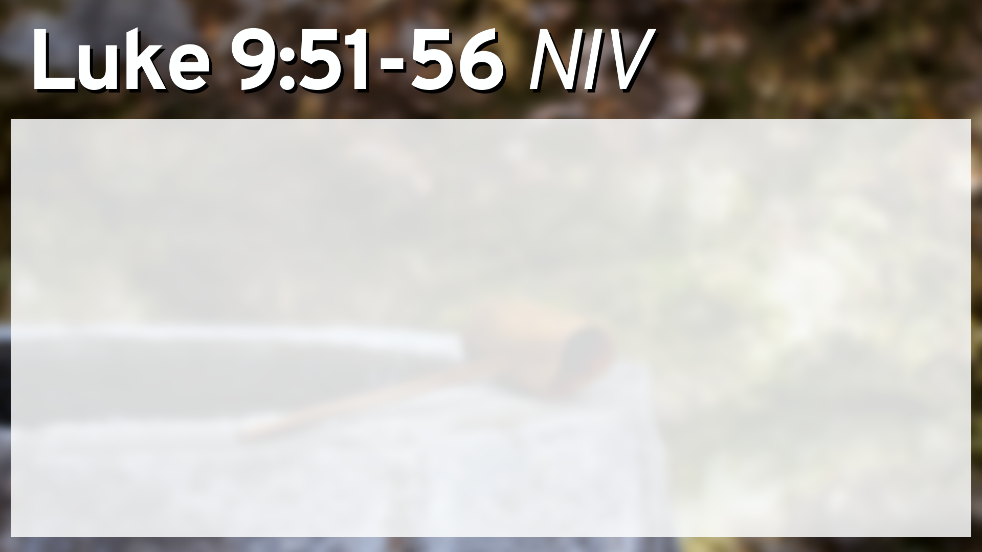
As the time approached for him to be taken up to heaven, Jesus resolutely set out for Jerusalem. And he sent messengers on ahead, who went into a Samaritan village to get things ready for him; but the people there did not welcome him, because he was heading for Jerusalem. When the disciples James and John saw this, they asked, “Lord, do you want us to call fire down from heaven to destroy them?” But Jesus turned and rebuked them. Then he and his disciples went to another village.

Slide 16


Slide 18


Slide 20
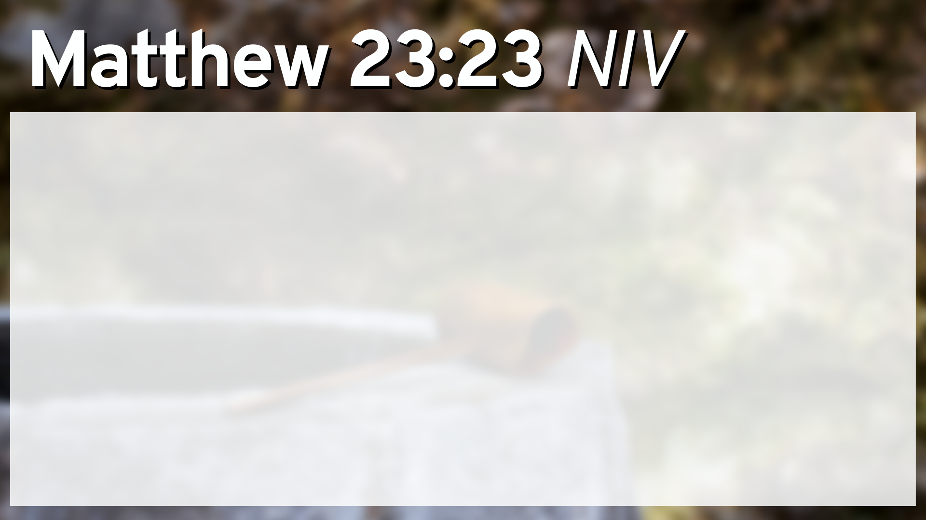
“Woe to you, teachers of the law and Pharisees, you hypocrites! You give a tenth of your spices—mint, dill and cumin. But you have neglected the more important matters of the law—justice, mercy and faithfulness. You should have practiced the latter, without neglecting the former.

Slide 22

Nothing sets the heart on fire like truth. Truth is not cold and dry. On the contrary, it is warm and passionate. And whenever new vistas of God's truth open up to us, we cannot just contemplate. We are stirred to respond, whether to penitence or to anger or to love or to worship. Think of the two disciples walking to Emmaus on the first Easter afternoon while the risen Lord spoke to them. When he vanished, they said to each other, "Did not our hearts burn within us while he talked to us on the road, while he opened to us the scriptures?" They had an emotional experience all right that afternoon. They described their sensation as a burning heart. And what was the cause of their spiritual heartburn? It was Christ's opening up the Scriptures to them!
John Stott

Slide 24
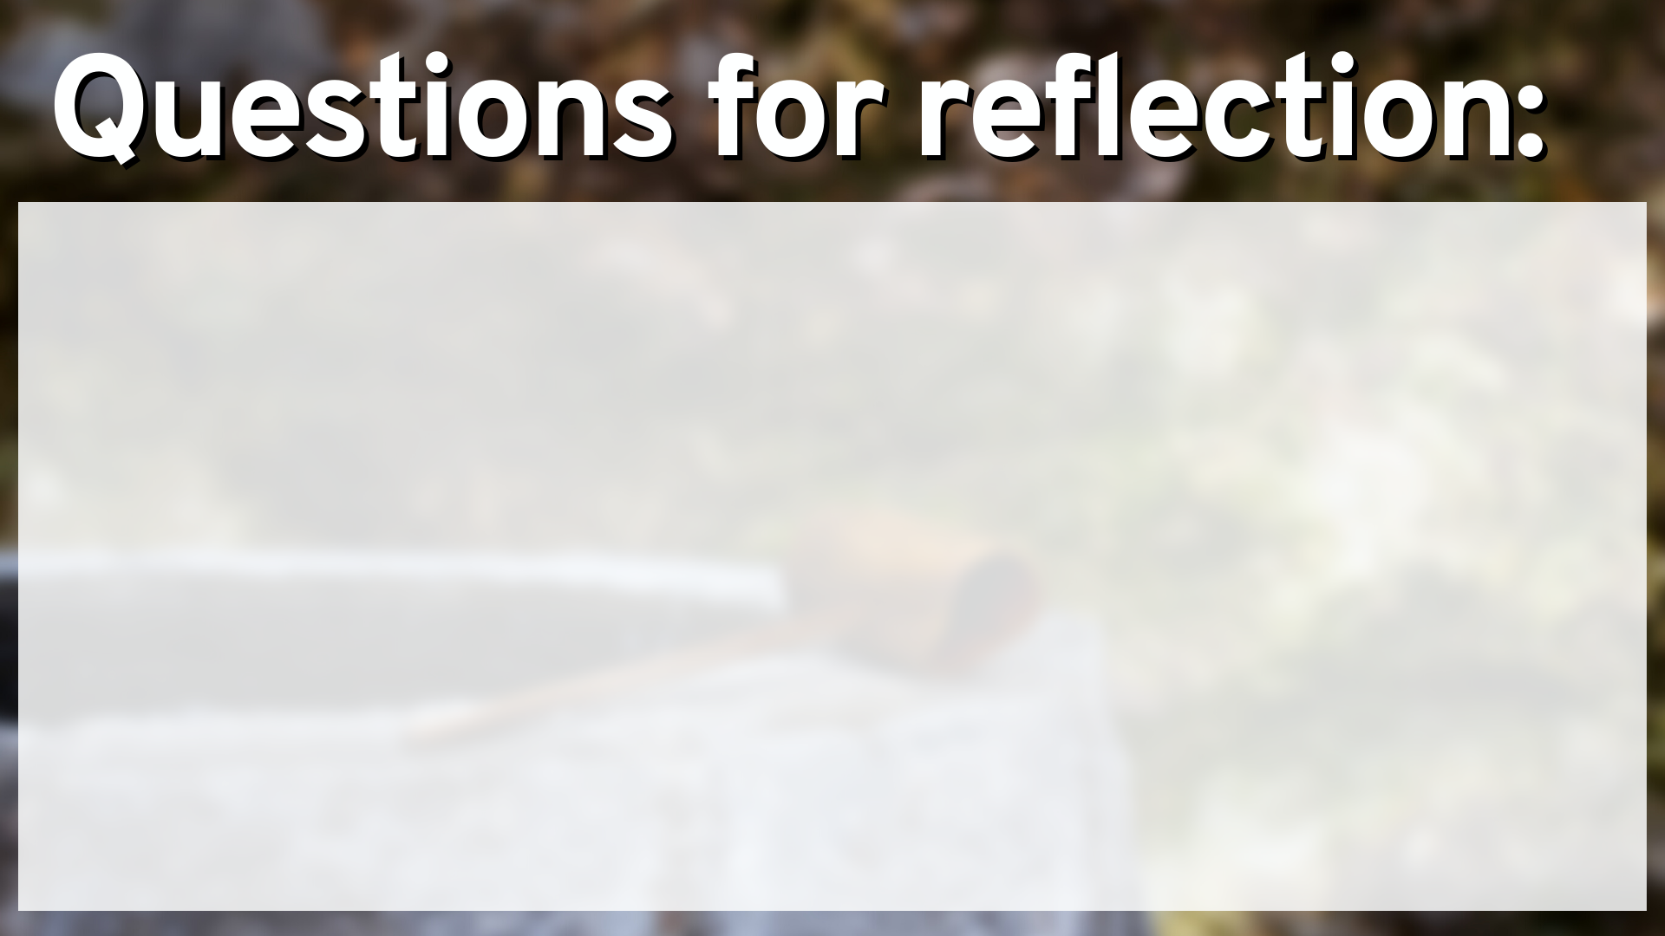

Slide 25
Are you like the Samaritan woman, trying to hide your identity from the Lord? Would you like that fear to end today?

Slide 26
Are you like the Samaritan woman, trying to hide your identity from the Lord? Would you like that fear to end today?
Do you avoid or fear people who are ethnically different, or do you love them as Jesus did?

Slide 27
Are you like the Samaritan woman, trying to hide your identity from the Lord? Would you like that fear to end today?
Do you avoid or fear people who are ethnically different, or do you love them as Jesus did?
Do you divide spirit and truth, choosing one and not the other? If so, how can you seek a better balance?

