Slide 1

Notes:
[BRIEF INTRO]
Welcome
Week 6 in our 7-week fall sermon series – The Gospel of the Kingdom
Jesus said, “The kingdom of God has come near. Repent and believe the good news!” But what is this gospel of the kingdom? And what does it mean to believe in the gospel and partner with God in his Kingdom work? That’s what we’ve been looking at in this series.
And here is how we’ve been defining “good news” and “kingdom of God”: [NEXT SLIDE]

Slide 2

What is the Good News?
The gospel story of how God has been at work in the world and is now redeeming it in Jesus Christ—who will one day return to bring the fullness of the Kingdom.
What is the Kingdom of God?
The reign and rule of God on the earth, which always looks like Jesus (e.g., loving others, healing, reconciling, sacrificing self, showing mercy, doing justice, etc.).
Notes:
[READ GOOD NEWS DEFINITION]
Again, this encompasses…
The story of Israel—the OT (the larger biblical story)
The story of Jesus the Messiah (his life, teachings, death, resurrection & ascension)
The story of what Jesus continues to do through his Church (as we anticipate his return)
[READ KINGDOM OF GOD DEFINITION]
The kingdom is already, but not yet—we live in the overlap of the ages
Heaven is coming to earth; God’s space and our space will be joined in Christ’s return
So here is where we’ve been so far in this series and what we have left… [NEXT SLIDE]

Slide 3
Sermon Series Overview
Gospel as Story
Gospel Truths
Gospel in You
Gospel in Us
Gospel Living
Gospel to Others
Gospel Saturation
Notes:
[BRIEF COMMENT ON EACH]
And if it’s not already etched into your photographic memory, here is how we’ve been depicting and visually capturing the good news story and message… [NEXT SLIDE]

Slide 4
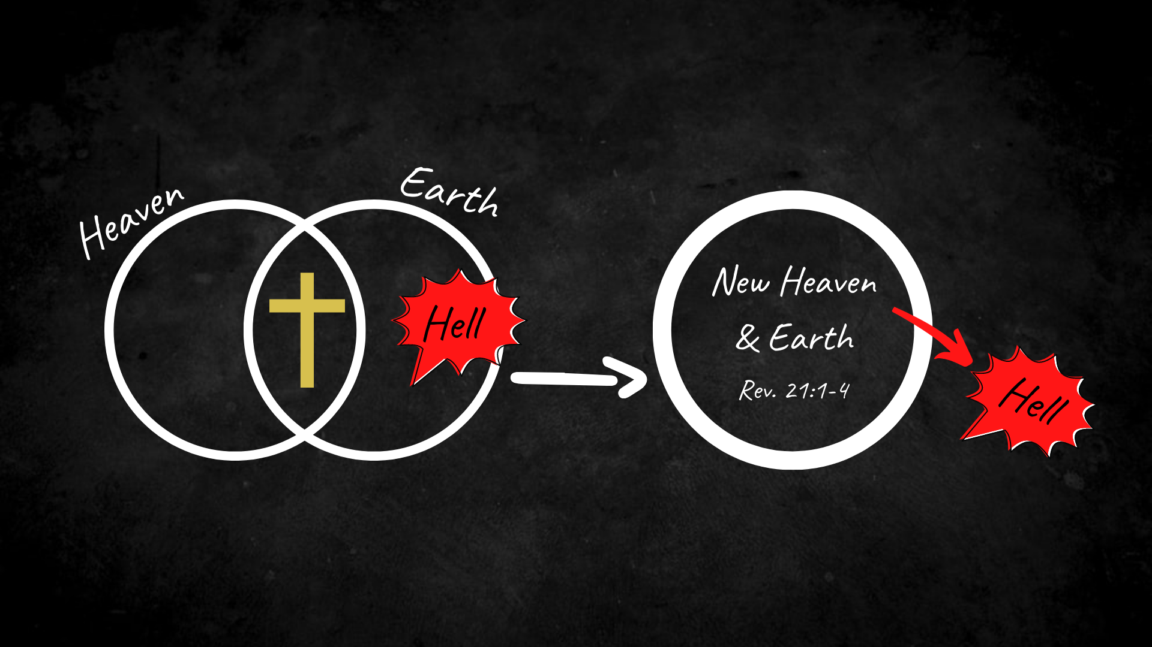
Notes:
[BRIEF COMMENTS]
God created heaven (his space) and earth (our space)
Heaven and earth are coming together in Jesus – the kingdom is coming!
Our belief and embodiment of the gospel confronts the powers of sin, death, and hell… in us and in the world
You may recall that I asked you to think of the gospel as the insurgency of heaven
And with that in mind, we are to proclaim this truth and invite others to come into the kingdom
And I think we see this in our Scripture reading this morning: [NEXT SLIDE]

Slide 5
Scripture Reading
John 1:1-18, 29-51 NIV
Notes:
[INVITATION TO STAND FOR SCRIPTURE READING]
[READ JOHN 1:1-18, 29-51 NIV]
This is the word of the Lord. Thanks be to God
You may be seated. [NEXT SLIDE]

Slide 6

Notes:
It’s quite clear from the New Testament that disciples are called not only to embrace gospel living (i.e., to put our faith into action for others to see), but also to share and proclaim the good news as we have opportunity. But unfortunately, for a variety of reasons, many Christians in the West have an aversion to sharing their faith and inviting people to follow Jesus.
A 2019 Barna study showed that over 90% of millennial Christians (who are now the largest generation in the world) believed that people needed Jesus, but 50% of those believed that it was “immoral” and wrong to share our faith with others. Why is that? Well, I think it’s for a variety of reasons:
a history of colonialism-styled evangelism where the church has imposed and indoctrinated others
bad experiences and recognition of the errors of fundamentalist expressions of Christianity that has too often reduced the gospel down to a “sinner’s prayer” using fear, guilt, shame, and the fires of hell; or peddling the gospel like Avon, Mary Kay, or essential oil products.
we now live in a post-modern culture where truth is mostly relative, and proselytizing is frowned upon
an observation that confrontational evangelism doesn’t lead to sincere conversions and true discipleship
While I can certainly acknowledge these things, even resonate with some of them, we ought never build our theology or our thinking and practice simply in reaction to the errors of the church, nor should we allow the spirit of the age to dictate what we should or shouldn’t do. Therefore, since Jesus calls us to follow him and then extend that “come and see” invitation to others, I want to help us reimagine and adopt a practice of evangelism that lovingly invites others into the gospel story.
As Jesus called his first disciples in John 1 with “come and see” and they then mimicked that invitational posture… I want to call us to do the same. So, it is a call to hold together gospel living with gospel proclamation. Listen to what the apostle Paul said… [NEXT SLIDE]

Slide 7
Paul, Romans 10:14-15 NIV
¹⁴ How, then, can they call on the one they have not believed in? And how can they believe in the one of whom they have not heard? And how can they hear without someone preaching [proclaiming] to them?
¹⁵ And how can anyone preach unless they are sent? As it is written: “How beautiful are the feet of those who bring good news!” (Isaiah 52:7)
Notes:
[BRIEF COMMENT ON PASSAGE]
So, there are really three basic questions that we need to answer this morning: (1) what is this gospel that we are called to preach and proclaim? (2) Why bother sharing it? and (3) How do we lovingly do that in an increasingly secular, post-Christian, pluralistic society?
Let’s start with question number one: What is this gospel that we are called to preach and proclaim? [NEXT SLIDE]

Slide 8
Notes:
Or in other words, what does this [IMAGE] mean for us and our lost and hurting neighbors?
[BRIEF EXPLANATION]
But remember, this [IMAGE] is the 30,000 foot view. So, let’s bring this down to ground level. Yes, God loves all of creation, sent Jesus to prove it, restore it, and one day resurrect it. But you see… functionally (as far as everyday life goes), we risk all of this being high, lofty, abstract ideas until we understand how this gospel intersects with our own lives, and until we experience the love of God for ourselves in the Word made flesh. This is the essence of Christianity. This is good news for us: We know what God is really like in Christ. And because of Jesus, we know that we are loved, and through experiences of his love we are healed and made healthy and whole.
[BRIEF COMMENTS ON GOD’S LOVE]
Our portrait of God & our identity (the way we see ourselves)
All of our healing will come from experiencing God’s forgiveness and love
This is the need of every person on the planet—to be reconciled to the God who looks like Jesus.
So, what then is repentance all about? It is about turning the soul to the light, life, and love of God in Jesus. It’s about turning from your own way… from eating at the world’s table, from your false perceptions of God, from the wells of the world, from the idols of the heart, from trying to save yourself… from the hell in our hearts and our world and receiving the gospel of the kingdom revealed in Christ.
Question number two: Why bother sharing it? Or put another way: Why do people need Jesus and the gospel? Well, listen to what Jesus said… [NEXT SLIDE]

Slide 9
“I am the way and the truth and the life. No one comes to the Father [Abba] except through me. If you really know me, you will know my Father as well. From now on, you do know him and have seen him.”
John 14:6-7 NIV
Notes:
[BRIEF COMMENT]
And was we read earlier in John 1:18 – “No one has ever seen God, but the one and only Son, who is himself God and is in closest relationship with the Father, has made him known.” Yes, of course, plenty of folks knew something of God in the Old Testament, to the extent he had revealed himself. Therefore, Jesus is telling us that he is the full and complete picture of what God is like.
So, don’t miss the progressive revelation and the development of relationship with God through the BIble:
Abraham learned that there is one God and he befriends us and wants to bless those who trust him; and that through a called-out people he would bring about his redemptive plan for the world.
God reveals his glory to Moses on Mt. Sinai with his name – I AM… gracious, compassionate, slow-to-anger, abounding in loving kindness, I am about keeping my promises and blessing faithfulness, etc.
King David says God made himself known to Moses, but David (unlike others who had come before him) understood God as personal, e.g., he said “my God”.. “my shepherd… “my deliverer” – it’s not about tribalism but about a personal encounter; which is why in the Psalms he speaks to God as a divine therapist—confessing sins, sharing his burdens, and expressing his anger and lament.
And then Jesus takes us to a new unprecedented level of intimacy with God; first by revealing himself to be God in the flesh, but also by teaching us to know and relate to God as Abba (papa or daddy). And like a loving Father, this Abba revealed in Jesus accepts us as we are, not as we should be, because we will never be as we should be. Folks, that is good news worth sharing!
God is like the father in the prodigal son story.
That is why Peter and John say this to the Jewish leaders who want them to stop proclaiming the gospel of the kingdom in Acts 4… [NEXT SLIDE]

Slide 10
“As for us, we cannot help speaking about what we have seen and heard.”
Acts 4:20 NIV
Notes:
[BRIEF COMMENT]
And then question number three: How do we lovingly share the good news in an increasingly secular, post-Christian, pluralistic society? To answer that, let’s consider the approach of the early church… [NEXT SLIDE]

Slide 11
Gospeling Others in the New Testament
How do we see early Christians evangelizing non-believers? And what lessons can we learn and embody today?
Notes:
[BRIEF COMMENT ON EACH POINT]

Slide 12
Gospeling Others in the New Testament
How do we see early Christians evangelizing non-believers? And what lessons can we learn and embody today?
We are compelled by love and genuinely care for people.
Notes:
[BRIEF COMMENT ON EACH POINT]

Slide 13
Gospeling Others in the New Testament
How do we see early Christians evangelizing non-believers? And what lessons can we learn and embody today?
We are compelled by love and genuinely care for people.
Meet people where they are and come alongside them.
Notes:
[BRIEF COMMENT ON EACH POINT]

Slide 14
Gospeling Others in the New Testament
How do we see early Christians evangelizing non-believers? And what lessons can we learn and embody today?
We are compelled by love and genuinely care for people.
Meet people where they are and come alongside them.
We look for how God is already at work and join him there.
Notes:
[BRIEF COMMENT ON EACH POINT]

Slide 15
Gospeling Others in the New Testament
How do we see early Christians evangelizing non-believers? And what lessons can we learn and embody today?
We are compelled by love and genuinely care for people.
Meet people where they are and come alongside them.
We look for how God is already at work and join him there.
Develop relationships and look for an opportunity/invitation.
Notes:
[BRIEF COMMENT ON EACH POINT]

Slide 16
Gospeling Others in the New Testament
How do we see early Christians evangelizing non-believers? And what lessons can we learn and embody today?
We are compelled by love and genuinely care for people.
Meet people where they are and come alongside them.
We look for how God is already at work and join him there.
Develop relationships and look for an opportunity/invitation.
On occasion, we may be called to be bold and take a risk.
Notes:
[BRIEF COMMENT ON EACH POINT]

Slide 17
Gospeling Others in the New Testament
How do we see early Christians evangelizing non-believers? And what lessons can we learn and embody today?
We are compelled by love and genuinely care for people.
Meet people where they are and come alongside them.
We look for how God is already at work and join him there.
Develop relationships and look for an opportunity/invitation.
On occasion, we may be called to be bold and take a risk.
We always share in love and leave the results to God.
Notes:
[BRIEF COMMENT ON EACH POINT]

Slide 18
“Be wise in the way you act toward outsiders; make the most of every opportunity. Let your conversation be always full of grace, seasoned with salt, so that you may know how to answer everyone.”
Paul, Colossians 4:5-6 NIV
Notes:
[BRIEF COMMENT ON PASSAGE]
And then listen to Peter comment on the gospel in conversation… [NEXT SLIDE]

Slide 19
1 Peter 3:15-16 NIV
¹⁵ But in your hearts revere Christ as Lord. Always be prepared to give an answer to everyone who asks you to give the reason for the hope that you have. But do this with gentleness and respect, ¹⁶ keeping a clear conscience, so that those who speak maliciously against your good behavior in Christ may be ashamed of their slander.
Notes:
[BRIEF COMMENT ON PASSAGE]
So, let’s get as practical as we can here… [NEXT SLIDE]

Slide 20
The Gospel in Conversation
Helpful ways to meet people where they are and share how you are being changed by Christ and the good news:

Slide 21
The Gospel in Conversation
Helpful ways to meet people where they are and share how you are being changed by Christ and the good news:
Ask good questions.

Slide 22
The Gospel in Conversation
Helpful ways to meet people where they are and share how you are being changed by Christ and the good news:
Ask good questions.
Be a good listener.

Slide 23
The Gospel in Conversation
Helpful ways to meet people where they are and share how you are being changed by Christ and the good news:
Ask good questions.
Be a good listener.
Be patient and let the Spirit lead.

Slide 24
The Gospel in Conversation
Helpful ways to meet people where they are and share how you are being changed by Christ and the good news:
Ask good questions.
Be a good listener.
Be patient and let the Spirit lead.
Witness to the gospel’s power in your own life.

Slide 25
The Gospel in Conversation
Helpful ways to meet people where they are and share how you are being changed by Christ and the good news:
Ask good questions.
Be a good listener.
Be patient and let the Spirit lead.
Witness to the gospel’s power in your own life.
Invite them into the gospel story.

Slide 26
The Gospel in Conversation
Helpful ways to meet people where they are and share how you are being changed by Christ and the good news:
Ask good questions.
Be a good listener.
Be patient and let the Spirit lead.
Witness to the gospel’s power in your own life.
Invite them into the gospel story.
Love them to Jesus.
Notes:
[BRIEF COMMENT ON EACH POINT]
Finally, here are two questions for helping us reflect and respond… [NEXT SLIDE]

Slide 27

Questions for reflection and response:
Gospel to Others
Notes:
[BRIEF COMMENT ON EACH]
[CLOSING WORDS]
[CLOSING PRAYER – NEXT SLIDE]

Slide 28
Questions for reflection and response:
How is God calling you to live out the gospel?
Gospel to Others
Notes:
[BRIEF COMMENT ON EACH]
[CLOSING WORDS]
[CLOSING PRAYER – NEXT SLIDE]

Slide 29
Questions for reflection and response:
How is God calling you to live out the gospel?
How is God inviting you to share your faith?
Gospel to Others
Notes:
[BRIEF COMMENT ON EACH]
[CLOSING WORDS]
[CLOSING PRAYER – NEXT SLIDE]

