Slide 1



Slide 2



Slide 3
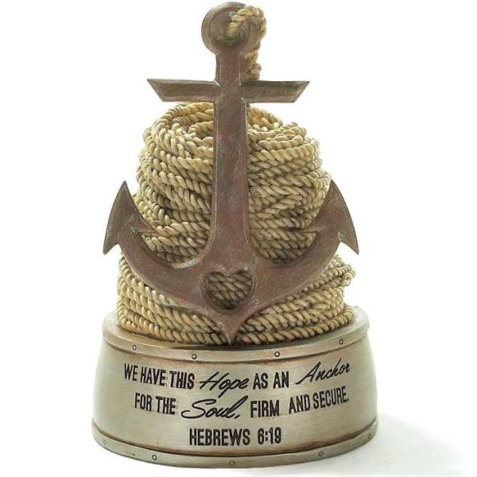
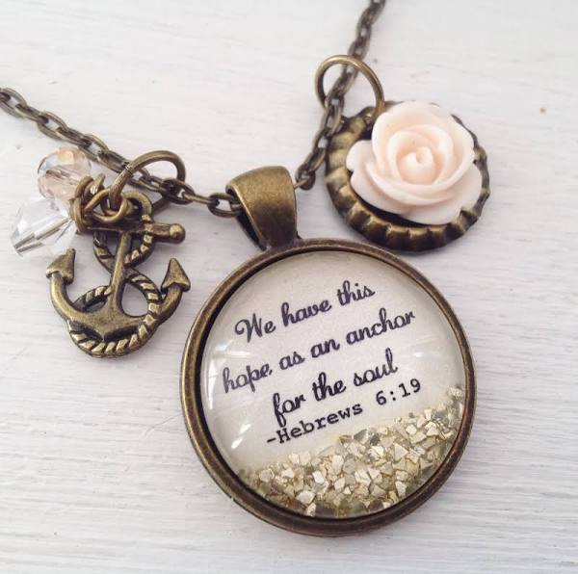

Slide 4


What
is this HOPE?

Slide 5
Hebrews 6:13-20 NIV
¹³ “When God made his promise to Abraham, since there was no one greater for him to swear by, he swore by himself, ¹⁴ saying, ‘I will surely bless you, and give you many descendants. ¹⁵ And so after waiting patiently, Abraham received what was promised.
¹⁶ Men swear by someone greater than themselves, and the oath confirms what is said and puts an end to all argument. ¹⁷ Because God wanted to make the unchanging nature of his purpose very clear to the heirs of what was promised, he confirmed it with an oath.

Slide 6
¹⁸ God did this so that, by two unchangeable things in which it is impossible for God to lie, we who have fled to take hold of the hope offered to us may be greatly encouraged. ¹⁹ We have this hope as an anchor for
the soul, firm and secure.
It enters the inner sanctuary behind the curtain, ²⁰ where Jesus, who went before us, has entered on our behalf. He has become a high priest forever, in the order of Melchizedek.

Slide 7

1.
What
is this HOPE?

Slide 8
1. The Nature of God
What
is this HOPE?

Slide 9
1. The Nature of God
2. The Word of God
What
is this HOPE?

Slide 10
1. The Nature of God
2. The Word of God
3. The Presence of God
What
is this HOPE?

Slide 11
When
do we need an
ANCHOR?

Slide 12
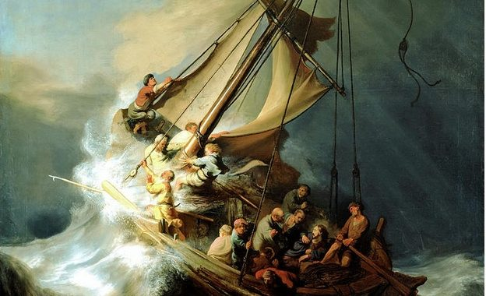

Slide 13
Anchored in hope in 2021

Slide 14
Anchored in hope in 2021
Am I spending time in God’s Word and in
His presence?

Slide 15
Anchored in hope in 2021
Am I spending time in God’s Word and in
His presence?
Are both my praise and my lament rooted in God’s nature?

Slide 16


