Slide 1

Notes:
[BRIEF INTRO]
Greetings
First Sunday of Lent
Our series: Seeking God’s Ways
Please take your Bible and turn to… [NEXT SLIDE]

Slide 2

Scripture Reading
Isaiah 55:6-9 NLT
Notes:
[INVITATION TO STAND FOR SCRIPTURE READING]
[READ ISAIAH 55:6-9 NLT] – *Theme verses for our Lent series
This is the word of the Lord. Thanks be to God. You may be seated.
[BRIEF COMMENTS ABOUT CONTEXT OF PASSAGE]
God was speaking to his people in captivity whose life was hard and future uncertain
And if they were going to have a future, they would need to return to him and trust him
They would need to understand that God’s ways are higher and better (not like their own ways)
So, what are those ways like? Well, as followers of Jesus, we believe that we see them most definitively in Christ, the One who has revealed the Father and shows us what God is like and has always been like. While we can certainly see God’s higher ways throughout the Old Testament, it’s Jesus in the Gospels who brings the higher ways of God into sharp focus for us, allowing us to see them most clearly in the OT.
For example, we see what God is like and how he operates in Jesus through his temptations, and in his life and teachings, and in how he gave his life to defeat sin and death. And that’s what our Lenten series, Seeking God’s Ways, is all about. Over the next 6 weeks, we will be exploring the “higher” ways of God in preparation for Easter Sunday. Here is a brief snapshot and overview of the series… [NEXT SLIDE]

Slide 3
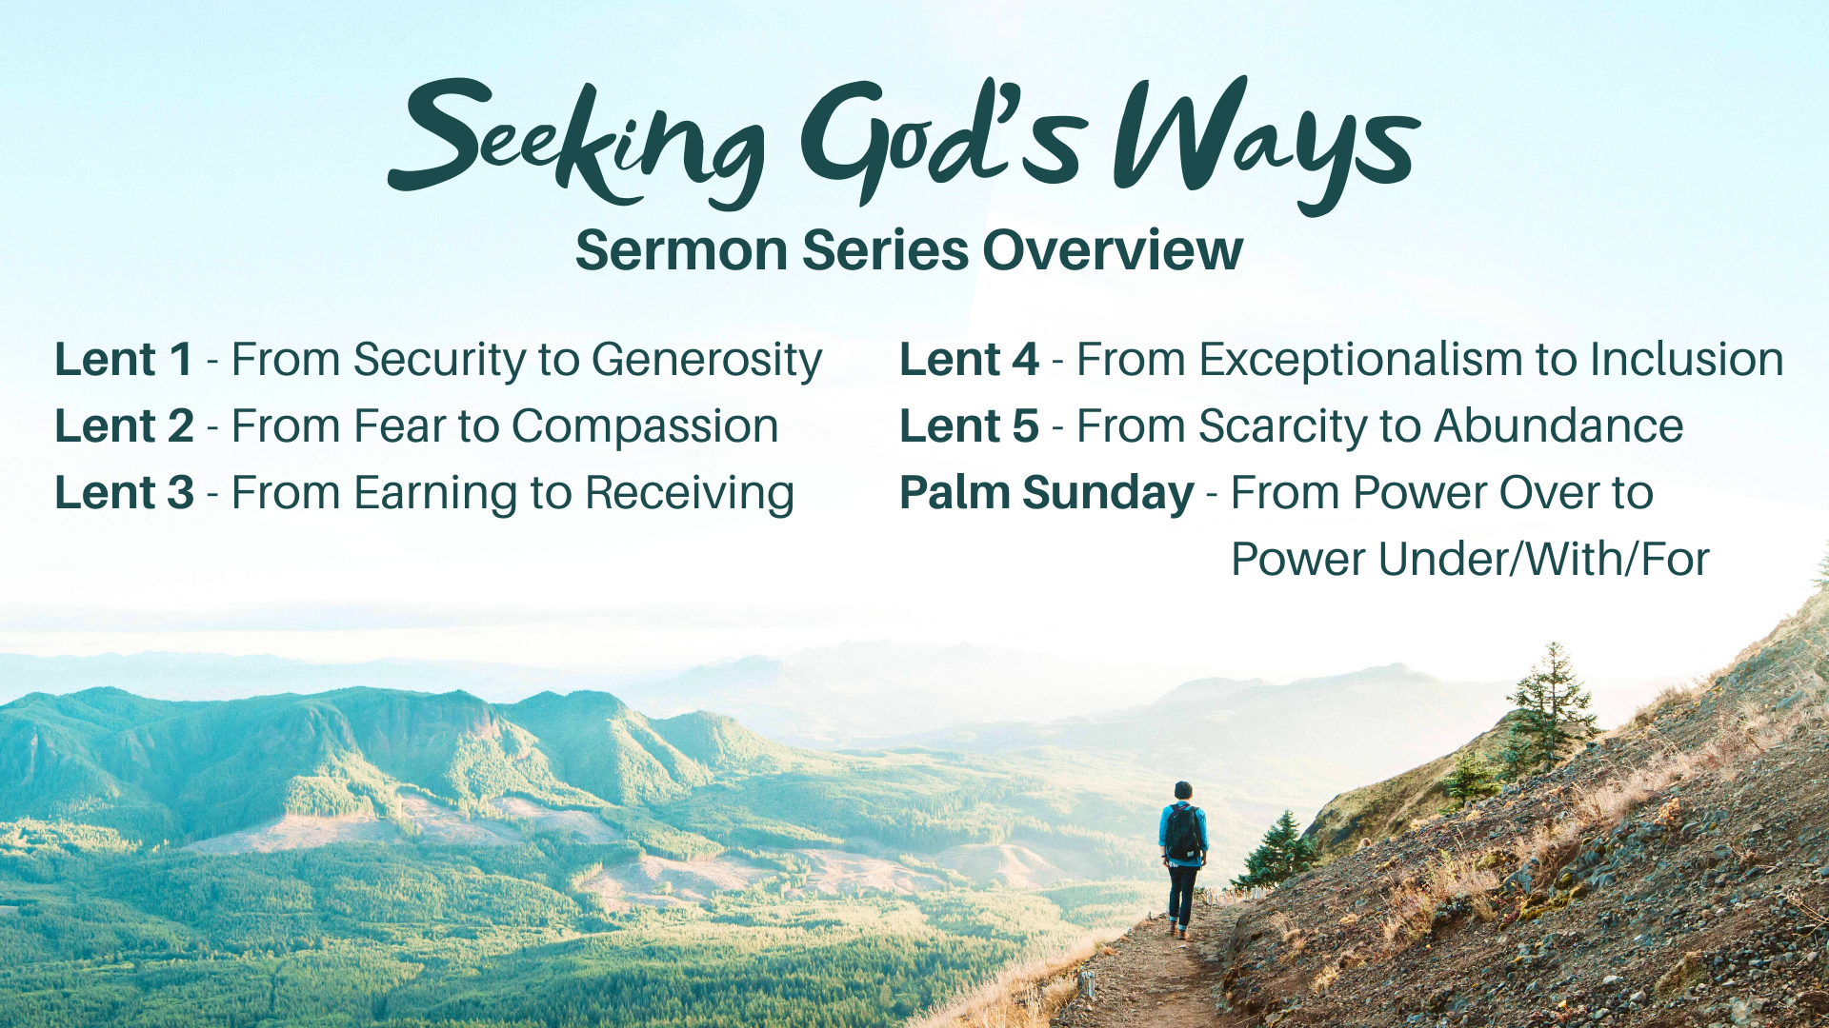
Notes:
[BRIEF COMMENTS ON SERIES OVERVIEW]
[BRIEF PRAYER]
Let’s begin seeking the higher ways of God together… [NEXT SLIDE]

Slide 4

Notes:
[BRIEF COMMENTS]
Sermon title: From Security to Generosity
In this first message, I’d like us to reflect on how Jesus reveals a generous God, and how in the gospel we are being invited to move from prioritizing our own security to living with generosity toward our neighbors and our enemies. And that it’s by repenting of our self-centered security concerns and believing in the generosity of God, that we return to him and experience his life in us, just as Jesus did.
To help us see that, let’s look at a few different passages. Beginning with Luke 4… [NEXT SLIDE]

Slide 5
Luke 4:1-4 NIV – Jesus is Tempted in the Wilderness
¹ Jesus, full of the Holy Spirit, left the Jordan and was led by the Spirit into the wilderness, ² where for forty days he was tempted by the devil. He ate nothing during those days, and at the end of them he was hungry.
³ The devil said to him, “If you are the Son of God, tell this stone to become bread.” ⁴ Jesus answered, “It is written: ‘Man shall not live on bread alone.’”
Notes:
[READ & COMMENT VERSE-BY-VERSE]
v. 1 – Jesus had just been baptized; the Spirit is leading him into the wilderness to be tested
v. 2 – 40 days in the wilderness; Jesus is embodying Israel and her story (Exodus); notice, it’s not God who tempts Jesus, it is Satan; Jesus is alone, fasting, and the temptations come; Jesus will be tempted in three specific ways (i.e., bread, mountain, temple).
v. 3 – The devil attacks Jesus’ baptism, “If you are the Son of God…”; the temptation is about whether Jesus trusts God to provide, but it’s also about whether he will use his power and live his life to satisfy himself—to put himself first. Would he “secure” some food for himself or keep trusting God?
v. 4 – Jesus responds to his temptation by quoting Scripture: Deut. 8:3 – ”[God] humbled you, causing you to hunger and then feeding you with manna, which neither you nor your ancestors had known, to teach you that man does not live on bread alone but on every word that comes from the mouth of the Lord.” [RECALL THE MANNA FROM HEAVEN – Exodus 16]
Now, think about what we pray in the Lord’s Prayer – “give us this day, our daily bread.” In other words, Lord, just give us what we need, and we will be content. For if we accumulate more than we need, we will wander from you, stop trusting you, and stop living generously. That’s because living any other way eats away at our faith and shrinks our capacity to be generous. It leads us to self-absorption, self-reliance, and trapped in a cage of ”security” that we’ve constructed with our own fears, which are often irrational… but not always.
Afterall, we do live in a dangerous world. Just ask the priest and the Levite who passed by the man who had been robbed, beaten, and left for dead in a well-known parable of Jesus. [NEXT SLIDE]

Slide 6
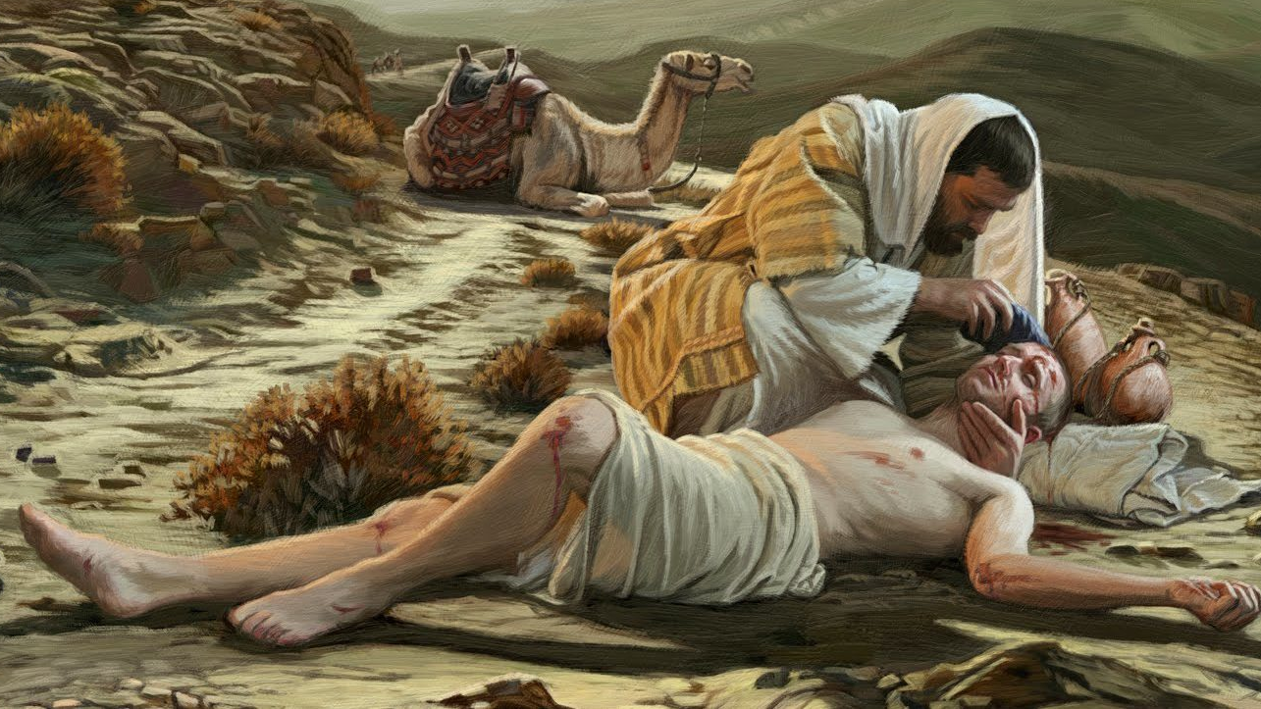
Luke 10:25-37
Notes:
[BRIEF COMMENT ON PARABLE]
Jesus tells a parable in response to the question: “Who is my neighbor?”
Two upstanding religious Jews walk past the man in need, but why? – security concerns!
It’s the “Samaritan” that risks his safety and security to stop and help; and he then extends generosity by ensuring the man has a place to stay and is on the road to recovery.
And so, Jesus wants not only to challenge our prejudices in this parable, but reveal to us that God is loving, and thus he is generous. Generosity is in his nature. As John 3:16 says, “For God so loved the world that he gave…” Folks, when God gives, he sacrifices and risks. Think about this: God’s life is a generous life, and we have been called into this God-life because we were made in his image.
Therefore, when we cling to our security and desire for control, when we operate out of self-preservation or out of what others might think of us if we stopped to help, we forfeit God’s life in us.
Here are some other reasons to move from security to generosity in our faith… [NEXT SLIDE]

Slide 7
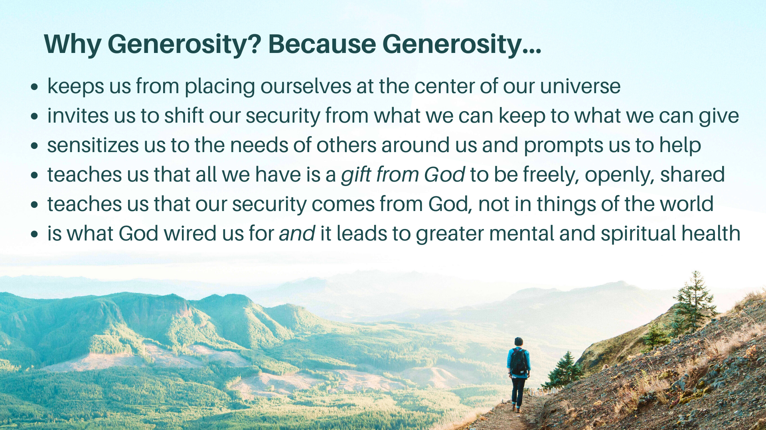
Notes:
[BRIEF COMMENT ON EACH POINT]
And here’s the thing… everyone can be generous. It can be as simple as a smile, a phone call, or a note of thanks. It can be sharing what we have to eat, to wear, or a place to stay. It can be using our gifts and talents to bless others. It might look like opening some time up in your schedule to be available to invest in those who need it or serving others in the church. Of course, generosity might mean releasing the financial resources God has given you to help increase our ministry impact here at Grantham.
In times of uncertainty and security concerns, we need to be generous now more than ever. We need to resist our fears and our fallen impulse to hide and hoard our gifts and resources. Instead, we must let go of any sense that our security is something we can manufacture. Rather, our security must come from grounding ourselves in faith, by trusting in a good, generous God who can provide all our needs.
And remember how the apostle Paul described how the Kingdom works and what the gospel looks like through our generosity, and how God calls us to give and why… [NEXT SLIDE]

Slide 8
Paul, 2 Corinthians 9:6-8 NLT
⁶ Remember this—a farmer who plants only a few seeds will get a small crop. But the one who plants generously will get a generous crop. ⁷ You must each decide in your heart how much to give. And don’t give reluctantly or in response to pressure. “For God loves a person who gives cheerfully.” ⁸ And God will generously provide all you need. Then you will always have everything you need, and plenty left over to share with others.
Notes:
[BRIEF COMMENT ON PASSAGE]
Notice, we reap what we sow (a little or a lot)
God doesn’t desire that you give out of compulsion or obligation
Giving (money or otherwise) should not be set according to a law or rule
God generously provides for us and wants us to share in his life—which at the core is love
And so don’t miss what God wants more than anything: that is for you to know the life and freedom that comes from sharing in his very nature and character. Church… hear me… you might be generous with your service and your money, but if you’re not generous with your love, with your mercy, with extending grace and forgiveness to others… then you may be helping others in some way, but you are hurting yourself, and chances are others notice that you’re a grumpy, critical, unforgiving, unloving charitable giver. And if that’s the case, one must wonder for what reason we are doing our charitable works.
Again, remember what the apostle Paul wrote to the Corinthian church about love… [NEXT SLIDE]

Slide 9
If I give everything I own to the poor and even go to the stake to be burned as a martyr, but I don’t love, I’ve gotten nowhere. So, no matter what I say, what I believe, and what I do, I’m bankrupt without love.
1 Corinthians 13:3 MSG
Notes:
[BRIEF COMMENT ON VERSE]
Finally, to help us reflect on what we’ve heard and respond to the Spirit’s leading, here are some questions that I’d like to invite you to consider.
And then I’ll give us a brief moment to talk with the Lord. [NEXT SLIDE]

Slide 10

Questions for reflection and response:

Slide 11
Questions for reflection and response:
In what area(s) of life do you need to move from wanting safety, security, and control to living generously like Jesus?

Slide 12
Questions for reflection and response:
In what area(s) of life do you need to move from wanting safety, security, and control to living generously like Jesus?
How is the Spirit inviting you to repent and trust God’s way?

Slide 13
Questions for reflection and response:
In what area(s) of life do you need to move from wanting safety, security, and control to living generously like Jesus?
How is the Spirit inviting you to repent and trust God’s way?
Will you respond to the Lord’s voice by walking his path?
Notes:
[BRIEF COMMENT ON EACH QUESTION]
[TIME OF SILENCE]
To close this message, please join me in this responsive prayer… [NEXT SLIDE]

Slide 14
One: Your Ways, O God, are higher than our ways.
All: Your thoughts are higher than our thoughts.
One: We seek God’s ways.
All: Lord, move us from our ways of clinging to
security to your ways of generous living.
One: As we walk with Christ on this Lenten journey,
let us see your way more clearly.
All: and follow your way more faithfully. Amen.
Notes:
[PRAY THE RESPONSIVE PRAYER]
[GO TO FINAL SLIDE]

