Slide 1

Notes:
[BRIEF INTRO]
This is the final Sunday of our 8-week series on Philippians: Cruciformed Community & Our Civic Witness. Each week we’ve been going verse-by-verse through Philippians—one of the most politically subversive books in the NT—as Paul shares how these early Christians ought to think and live in a city that is committed to the empire. He wants their civic and political life within Philippi to reflect Christ and the gospel of his Kingdom.
Which means they can expect resistance to their faith from their Roman neighbors. We began by looking at how Paul had experienced this himself when he planted the church in Philippi in 52 AD, as recorded in Acts 16… [NEXT SLIDE]

Slide 2
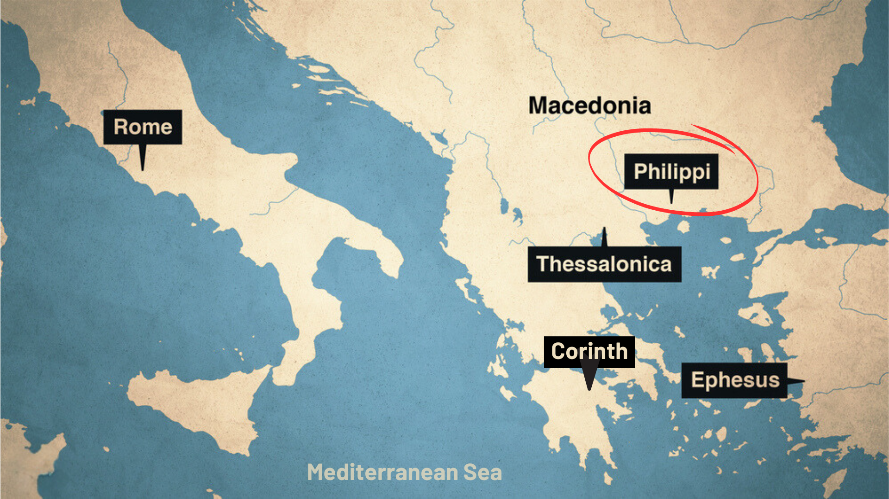
Notes:
And then about 10 years later, Paul writes to the Philippian church from Rome, where he is being kept under house arrest, awaiting his trial before the emperor Nero. The Philippians are concerned for Paul. So, they sent Epaphroditus from Philippi to help Paul and then bring word back about how he is doing.
And that’s the context of Philippians. This letter is Paul’s response to their concerns for him, as well as his reminders of what the gospel means for how they are to follow Jesus in an idolatrous city that demanded more of these Christ-followers than their faith would allow.
Each week we’ve been reminded that… [NEXT SLIDE]

Slide 3
Notes:
[BRIEF COMMENTS]
Philippi was an affluent Roman colony of 10,000 people; full of retired Roman military veterans and patriotic nationalists who are fiercely loyal to empire. They have a special status with Caesar, and they will not tolerate any competing “good news” or rival “Lord”
And there were strong societal and cultural forces that pressured the city’s inhabitants (citizen status or not) to express their patriotism publicly, and an expectation that all Philippians would respect and uphold Roman values and virtues
So, these cultural forces would have impacted every aspect of life: social, political, religious, and economic; and to go against the dominant cultural current was to draw negative attention to yourself, which is what was happening to the church in Philippi
But despite their circumstances, they are trying to stay the course; Paul believes in them and wants to inspire them to remain faithful to Jesus, no matter what happens
Let’s reflect (one last time) on the content and flow of Paul’s letter… [NEXT SLIDE]

Slide 4
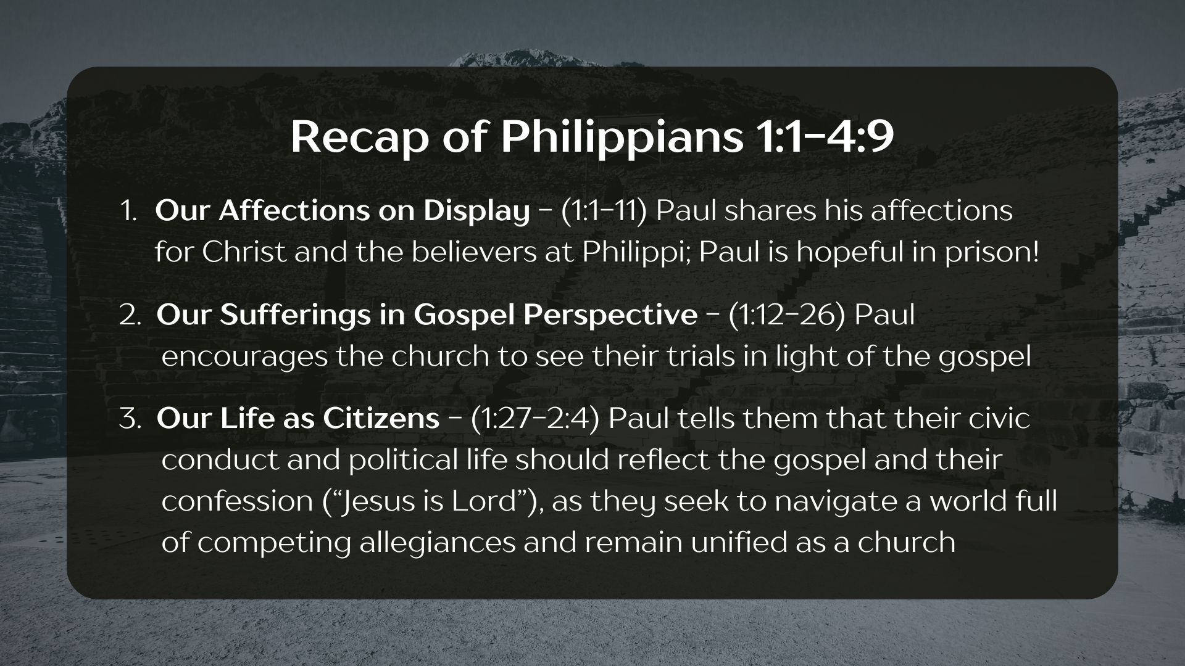
Notes:
[BRIEF COMMENTS]
Paul began by sharing his deep love for Christ and for the believers at Philippi (1:1-11); Even though he is under house arrest, he is hopeful and wants them to be as well.
In the second message (1:12-26), we heard Paul encourage the Philippian Christians to see their own sufferings in light of the gospel and the Kingdom that is coming in Christ, in the same way Paul sees his own sufferings and the possibility that he might be executed
In the third message (1:27-2:4), we heard Paul tell the Philippian believers that their civic conduct and political life should reflect the gospel and their confession that “Jesus is Lord” (not Caesar), as they seek to navigate a world full of competing allegiances and remain unified as a church; and we unpacked chapter 1, verse 27—a key verse in the letter
And then in the fourth message, we saw where… [NEXT SLIDE]

Slide 5
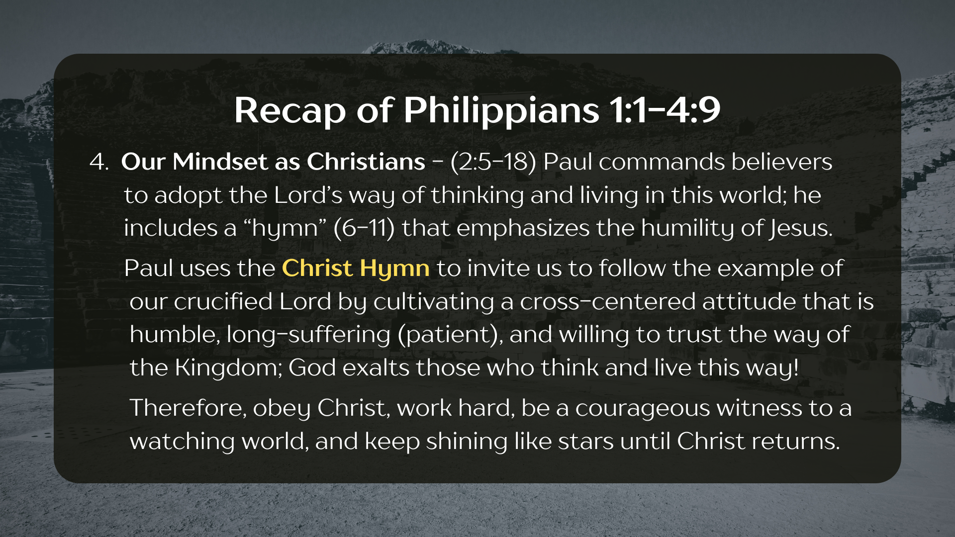
Notes:
[BRIEF COMMENTS]
Paul commanded the Philippian believers to adopt the Lord’s way of thinking and living in this world, and he includes a “hymn” in verses 6-11 that emphasizes the humility of Jesus
Paul uses the Christ Hymn to invite us to follow the example of our crucified Lord by cultivating a cross-centered (or cruciformed) attitude that is humble, patient, and willing to trust the way of the Kingdom, because God exalts those who think and live this way!
Paul’s encouragement is to obey Christ, work hard, be a bold and courageous witness among their neighbors, and keep shining like stars in a dark world until Christ returns
And then we looked at Philippians 2:19-30… [NEXT SLIDE]

Slide 6
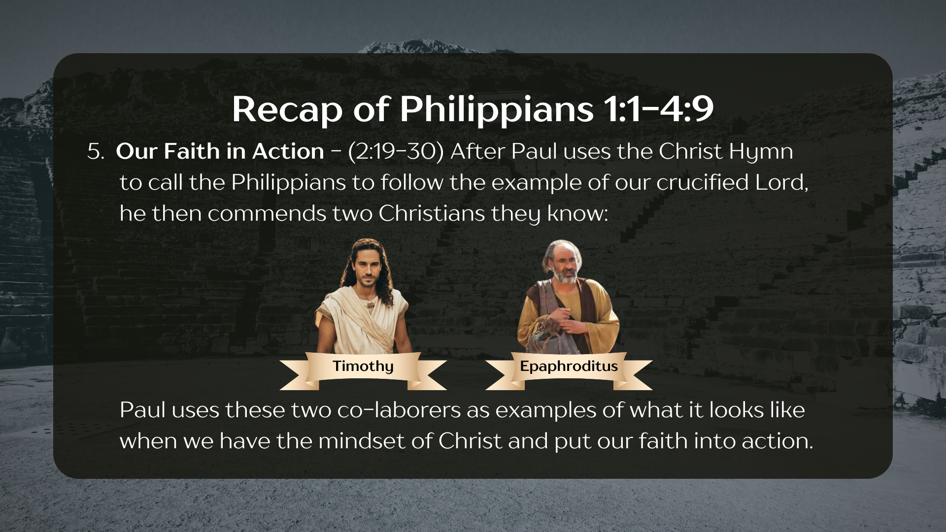
Notes:
After Paul uses the Christ hymn to call the Philippians to follow the example of our crucified Lord, he then commends two Christians they know: Timothy and Epaphroditus.
Paul uses these two co-laborers: Timothy, a young church-planting companion, and Epaphroditus, a messenger sent from Philippi with a care-package, who got sick and almost died trying to bring aid and comfort to Paul in Rome. Paul uses their life and their faithful witness to encourage the Philippians to have the mindset of Jesus and embody Christ to each other and their Roman neighbors, who live by different loyalties and allegiances.
And then in chapter 3… [NEXT SLIDE]

Slide 7
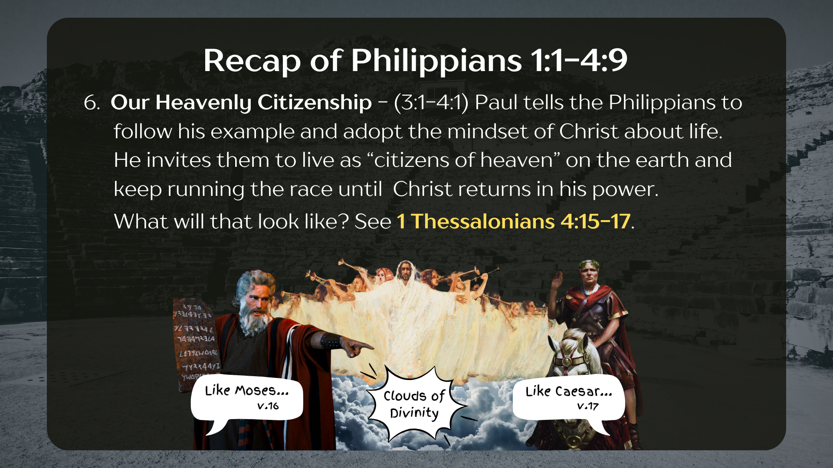
Notes:
Paul tells the Philippians to follow his example of humble service and his willingness to suffer for Christ, and that they should adopt the mindset of Christ about life and the challenges they face living in Philippi. He invites them to live as “citizens of heaven” on the earth and keep running the race until Christ returns to transform the world with his power.
And what will his coming look like? Well, Paul doesn’t go into detail here in Philippians, but we know when he talks about the return of Jesus that he has in mind what he wrote in 1 Thessalonians 4:15-17, when he mixed his metaphors to describe what the second coming of Jesus would be like (i.e., like Moses coming down the mountain or going out to meet a victorious king or Caesar and parading him back into his city).
And then last Sunday, Pastor Melissa walked us through… [NEXT SLIDE]

Slide 8
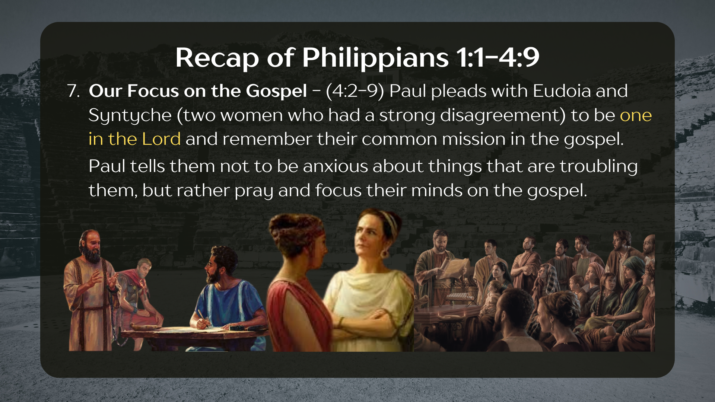
Notes:
Chapter 4, verses 2-9 where Paul pleads with Eudoia and Syntyche (two women who had a strong disagreement) to be one in the Lord. What did they disagree about? Well, we don’t know. But there is a good chance it had something to do with their socio-political context in Philippi. Maybe these women were influential leaders who were letting the political opinions disrupt the unity of the church! Whatever it was, Paul wants them to remember their true identity as disciples and their common mission in the gospel over their differences.
And then Paul tells the Philippians not to be anxious about the many things that might be troubling them about life in Philippi, but rather pray and focus their minds on the gospel.
Which brings us now to the final verses in this letter, and the final message in our series, Our Call to Contentment… [NEXT SLIDE]

Slide 9
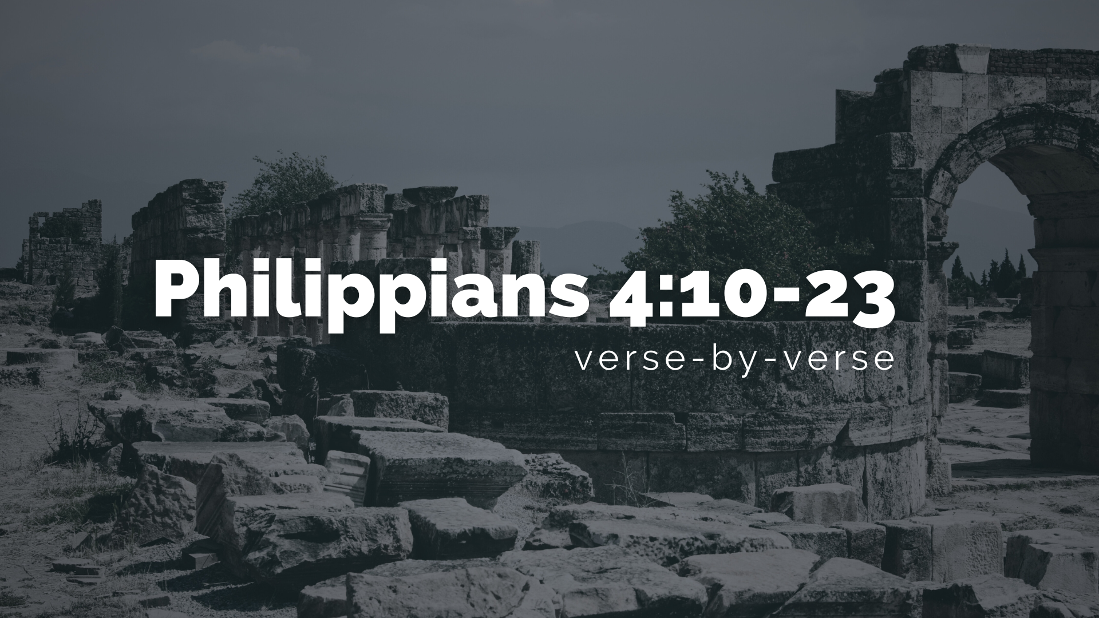
Notes:
[READ & COMMENT ON VERSES 10-14]
v. 10 – Now, you might wonder, why does Paul wait until now to thank them for their financial support? Scholars have pointed out that this would have been noticeable to the Philippians—that Paul waits until the end and the way in which he thanks them. And this is where their socio-political and cultural context comes into play: (1) Paul is carefully navigating (even pushing back) on what is known as the patron-client system of the empire; he does not want to communicate that he is beneath them or below them in social status; they are equal partners in the gospel; and (2) More than the financial gift (which Paul will say he could have done without), he is most concerned that their willingness to give confirms their deep friendship and partnership in the ministry. In other words, more than being helped by their money, Paul rejoices in what it says about their faith in Christ.
Verse 11… [READ VERSE 11 & 12]
v. 11 – “I have learned to be content” would have been counter-cultural in Philippi!
v. 12 – “I have learned the secret” of being content; for Stoics in Paul’s day, contentment or self-sufficiency came about by a person becoming indifferent to their surroundings, but Paul is getting at something else. It’s not indifference. It’s dependence upon Christ.
Here is “the secret” to learning how to be content… verse 13. [READ v.13 & 14]
Notice, Philippians 4:13 is not a promise that Jesus will help you achieve everything you desire or set out to do; this is not a verse to further our American individualism
Phil. 4:13 is in the context of struggling in the faith; of living for the gospel; of seeking to be content in all situations; and being totally dependent upon Christ for doing it
Listen to what Lynn Cohick writes… [NEXT SLIDE]

Slide 10
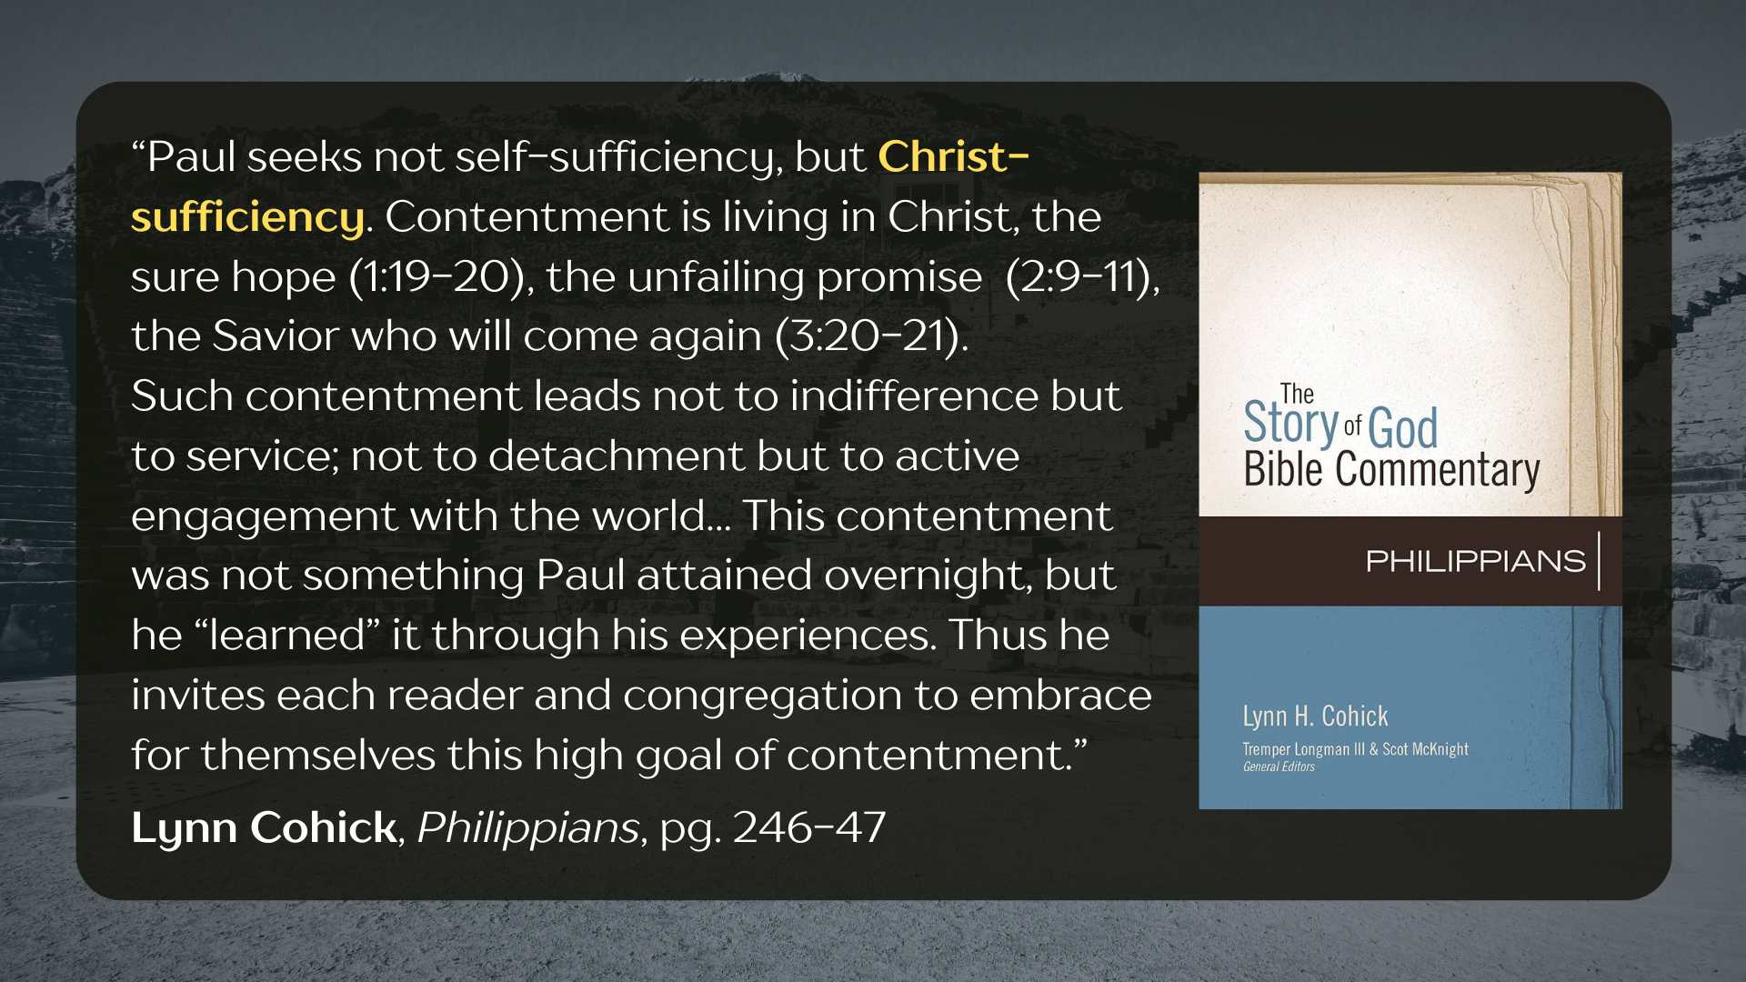
Notes:
[READ & COMMENT]
Remember what Paul wrote in 2 Corinthians 12:9-10 after praying that God would take something away and change his situation: “But he [the Lord] said to me, “My grace is sufficient for you, for my power is made perfect in weakness.” Therefore, I will boast all the more gladly about my weaknesses, so that Christ’s power may rest on me. That is why, for Christ’s sake, I delight in weaknesses, in insults, in hardships, in persecutions, in difficulties. For when I am weak, then I am strong.” This is what Philippians 4:13 is all about.
It’s about being content and relying upon Christ for that contentment. I like how the author Erik Raymond defines contentment in his book… [NEXT SLIDE]

Slide 11

Notes:
[READ & COMMENT]
And again, we’re not being taught self-sufficiency in Christianity. We are being taught Christ-sufficiency. We are being invited into an emptying of self (as described in the Christ hymn) so that we might be filled with the Spirit and have the mind of Christ in all things.
So, don’t look within to find the answers and the strength you’re looking for… look to Christ. I like how one pastor and poet put it many years ago. He said… [NEXT SLIDE]

Slide 12
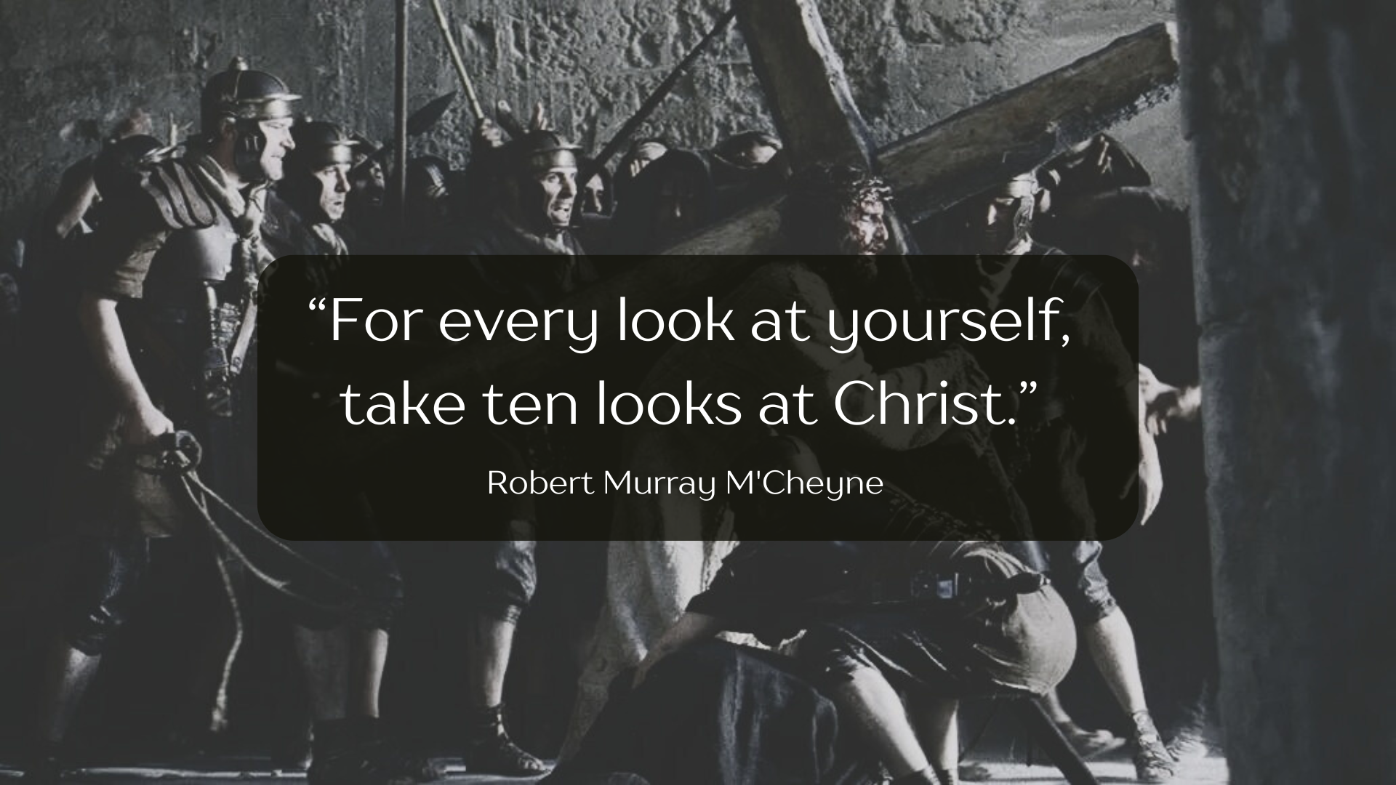
Notes:
[READ & COMMENT]
We know what it means to look at ourselves, but what does it mean to look at Christ in this way? Well, at the very least, it means more prayer, Bible-reading, and gathering with the church than it does looking within or out in the world for strength and meaning.
Also, think about this statement as it could apply to what we’re seeing and experiencing in this political and cultural moment in the US: “For every look at _______, take ten looks at Christ.” Friends, to discover the life of Christ, training of the heart and mind is required.
Back to Philippians 4, verse 15… [NEXT SLIDE]

Slide 13
Notes:
[READ VERSES 15-20 & COMMENT]
This reminds me of what Paul wrote to the Corinthians, who, let’s say, needed to learn more about the sort of generosity the Philippians showed… [NEXT SLIDE]

Slide 14
Paul, 2 Corinthians 9:6-8 NIV
⁶ Remember this: Whoever sows sparingly will also reap sparingly, and whoever sows generously will also reap generously. ⁷ Each of you should give what you have decided in your heart to give, not reluctantly or under compulsion, for God loves a cheerful giver. ⁸ And God is able to bless you abundantly, so that in all things at all times, having all that you need, you will abound in every good work.
Notes:
[READ & COMMENT ON PASSAGE]
Again, Paul wants us to know here and in Philippians that our generous giving reflects a real gospel partnership. When we give together… we show that we truly are together, and that we really believe this stuff about Jesus and the gospel. It reveals a change of heart and of priorities, away from those of empire to those of the Kingdom that is coming.
And we can clearly see how contentment, or our lack of it, usually has something to do with our financial situation as well as our level of generosity. Listen to what Paul wrote to Timothy… [NEXT SLIDE]

Slide 15
Paul, 2 Timothy 6:6-10 NIV
⁶ But godliness with contentment is great gain. ⁷ For we brought nothing into the world, and we can take nothing out of it. ⁸ But if we have food and clothing, we will be content with that. ⁹ Those who want to get rich fall into temptation and a trap and into many foolish and harmful desires that plunge people into ruin and destruction. ¹⁰ For the love of money is a root of all kinds of evil. Some people, eager for money, have wandered from the faith and pierced themselves with many griefs.
Notes:
[READ & COMMENT ON PASSAGE]
And a few verses later, Paul tells Timothy to… [NEXT SLIDE]

Slide 16
Paul, 2 Timothy 6:17-19 NIV
¹⁷ Command those who are rich in this present world not to be arrogant nor to put their hope in wealth, which is so uncertain, but to put their hope in God, who richly provides us with everything for our enjoyment.
¹⁸ Command them to do good, to be rich in good deeds, and to be generous and willing to share. ¹⁹ In this way they will lay up treasure for themselves as a firm foundation for the coming age, so that they may take hold of the life that is truly life.
Notes:
[READ & COMMENT ON PASSAGE]
Don’t miss this, church. Paul is saying that there is an intimate connection between contentment and generosity. That’s because our contentment (i.e., a gracious, quiet spirit that joyfully rests in God’s sovereign care for us) comes from Christ within us and his deepened by our generosity. That’s because our generosity (as it was for the Philippians) keeps our priorities in check, our trust in Christ, and our lives oriented toward others.
Finally, we come to Paul’s final greetings and benediction in verse 21… [NEXT SLIDE]

Slide 17
Notes:
[READ & COMMENT ON VERSES 21-23]
“especially those in Caesar’s household” – these people are likely imperial clients, slaves, or freedmen and freedwomen who helped to manage the emperor’s affairs; clear evidence that the gospel had penetrated the heart of Roman politics and power
Brothers and sisters, what a rich letter! Inspired (God-breathed) through the Apostle Paul to the Philippians… and also to us. An ancient book… with a relevant and timely message. Let us be thankful for how God has used it down through the ages… and is still using it today.
Here are some final questions for reflection and to help us respond… [NEXT SLIDE]

Slide 18


Slide 19
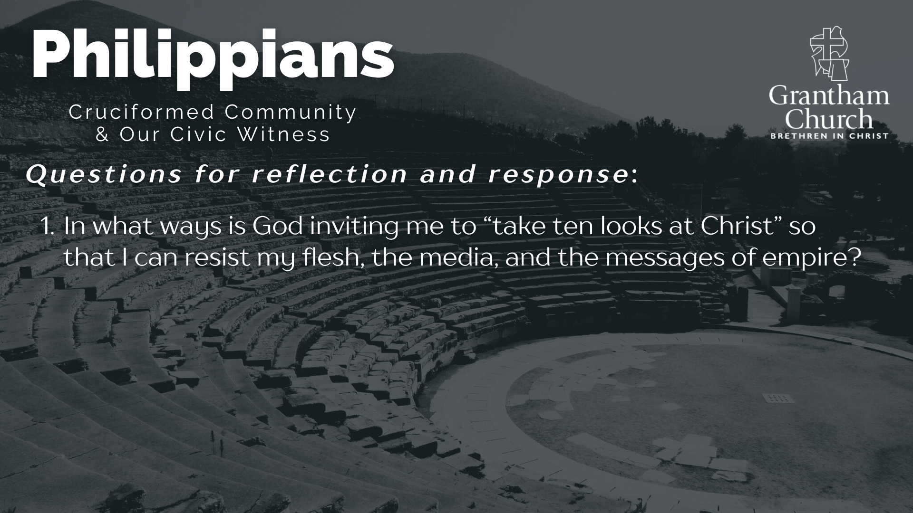

Slide 20
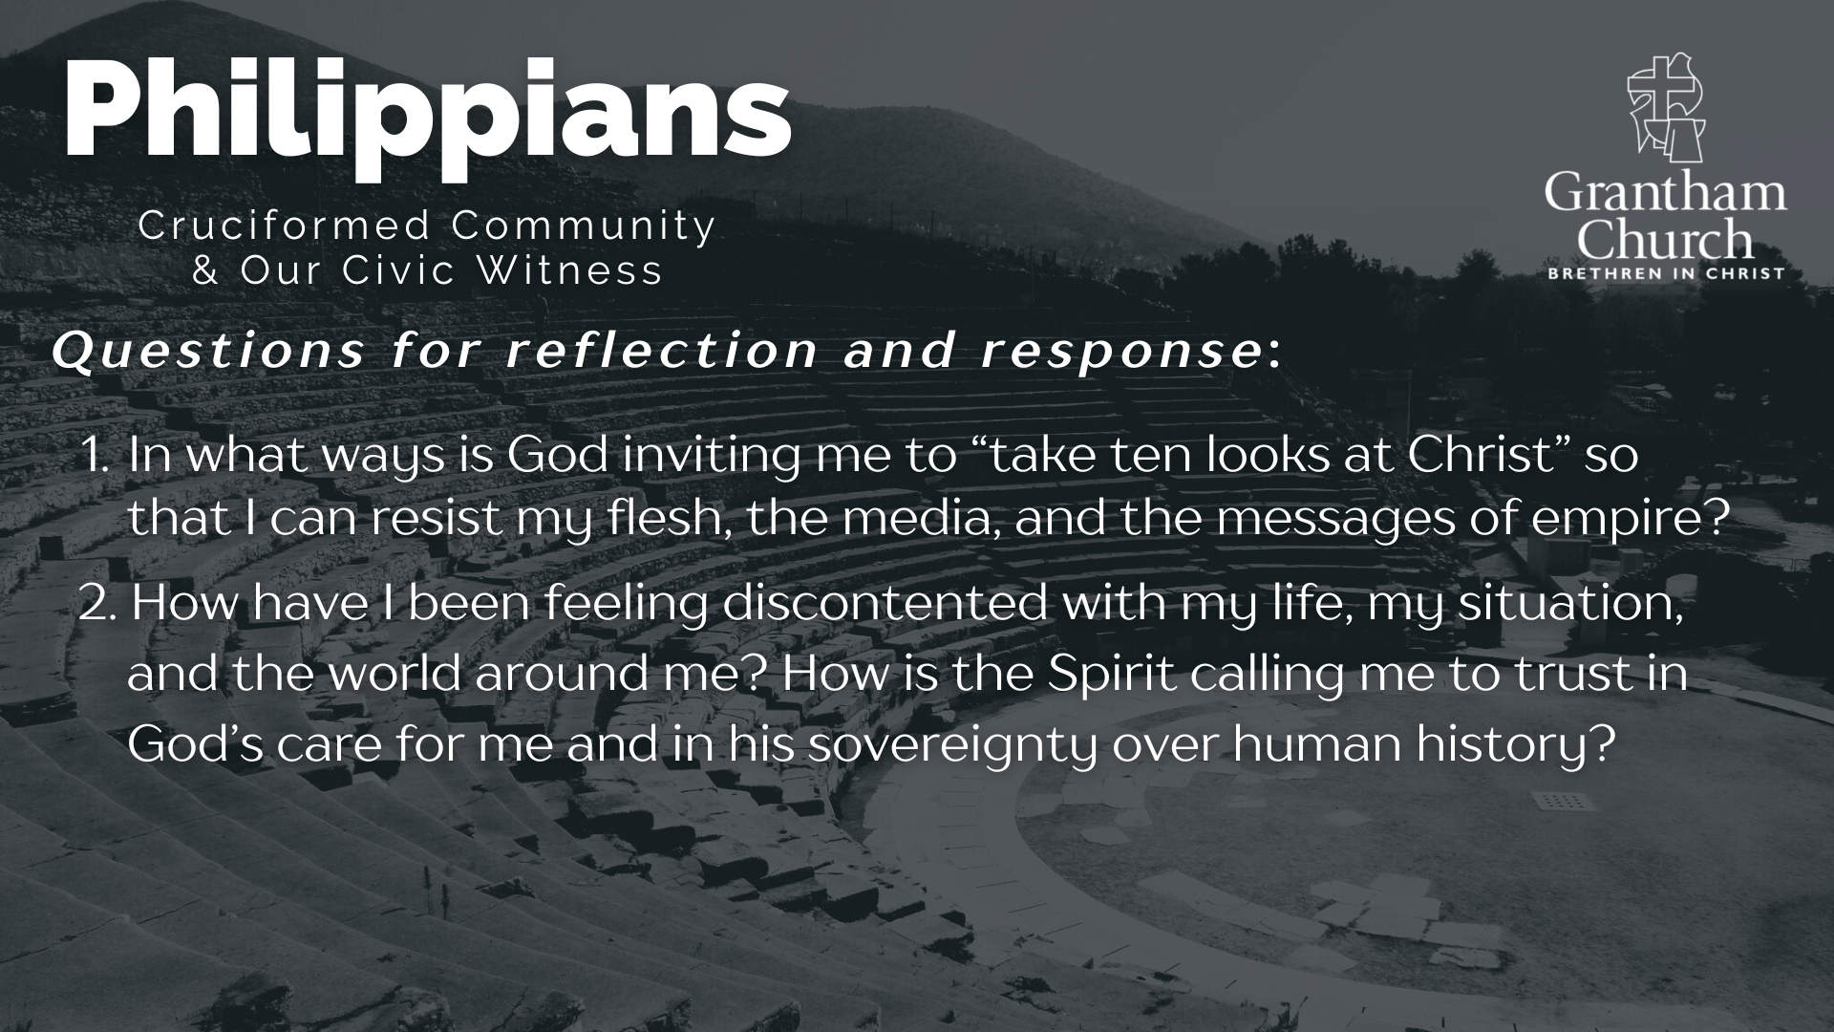

Slide 21
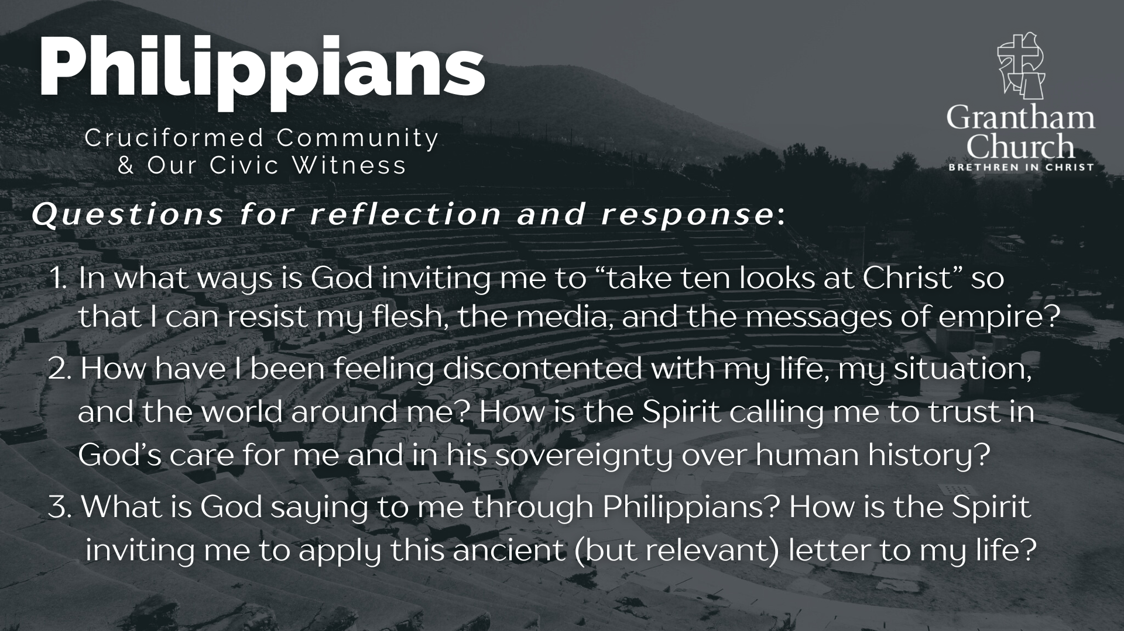
Notes:
[READ & BRIEF COMMENT ON EACH QUESTION]
In what ways is God inviting me to “take ten looks at Christ” so that I can resist my flesh, the media, and the messages of empire?
How have I been feeling discontented with my life, my situation, and the world around me? How is the Spirit calling me to trust in God’s care for me and in his sovereignty over human history?
What is God saying to me through Philippians? How is the Spirit inviting me to apply this ancient (but relevant) letter to my life?
Let’s pray… [NEXT SLIDE]

Slide 22

Notes:
[CLOSING PRAYER]
[INVITE REBEKAH B. FOR INGATHERING OFFERING]
[REMINDER: NEW SERIES NEXT SUNDAY!]
Benediction
May the God who looks like Jesus lead you to faithfully follow him in a world that needs to hear and see the Gospel of Jesus Christ. And may the grace and peace of the Lord Jesus comfort and sustain you as a witness of his coming Kingdom. Amen.

