Slide 1

Notes:
[BRIEF INTRO]
“For to me, to live is Christ and to die is gain.”
“at the name of Jesus every knee should bow, in heaven and on earth and under the earth, and every tongue acknowledge that Jesus Christ is Lord”
“I want to know Christ—yes, to know the power of his resurrection and participation in his sufferings, becoming like him in his death, and so, somehow, attaining to the resurrection from the dead.”
“our citizenship is in heaven. And we eagerly await a Savior from there, the Lord Jesus Christ, who, by the power that enables him to bring everything under his control, will transform our lowly bodies so that they will be like his glorious body.”
“Do not be anxious about anything, but in every situation, by prayer and petition, with thanksgiving, present your requests to God. And the peace of God, which transcends all understanding, will guard your hearts and your minds in Christ Jesus.”
“I can do all this through Christ who gives me strength.”
Those are just a few oft-quoted verses from Paul’s letter to the church in Philippi. And today we begin an 8-week series in the NT book of Philippians. Let’s begin with some context. Where is Philippi? And what do we know about it? [NEXT SLIDE]

Slide 2
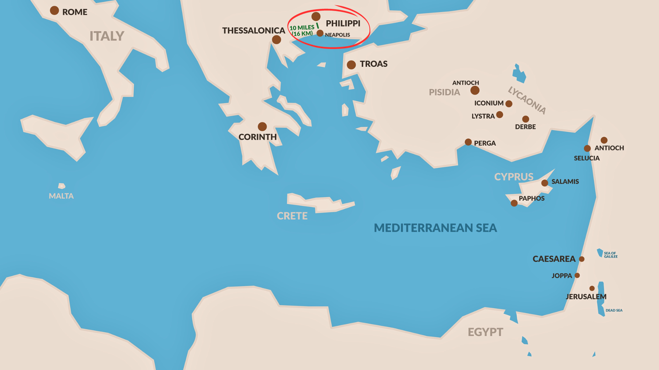
Notes:
[BRIEF COMMENTS]
In the first century AD, Philippi was located in Macedonia, a region in northern Greece
It’s 800 miles from Rome; over 1,400 miles from Jerusalem
It was technically a port-city (8-10 miles from shore) during the time of the NT; and it was along a major trade route in the Roman empire, the Via Egnatia
In Acts 16, we’re told that the Apostle Paul went there on his second missionary journey, about 50-52 AD. Paul traveled to various places within the Roman world to share the good news about Jesus and plant churches where the gospel took root.
Here is what we think ancient Philippi looked like in the first century… [NEXT SLIDE]

Slide 3
Notes:
[BRIEF COMMENTS]
The city of Philippi was so named in the 4th cent BC by Philip of Macedon, the father of Alexander the Great. In 168 BC, the Romans conquered and claimed it. Mark Anthony resettled the city as a Roman military colony in 42 BC and granted land there to veterans of the Roman army. Octavian (Caesar Augustus) would later grant land and citizenship to veterans after his victory over Anthony in 31 BC.
So, in the first cent AD, Philippi was still a Roman colony; full of retired veterans and imperial loyalists. In a lot of ways, Philippi was a miniature version of Rome, with its temples, forum, and large amphitheater. It was considered a “city on Italian soil.” But even though Romans had the money and power in the city, only about 40% of the residents were officially Roman citizens. Afterall, citizenship was expensive and hard to obtain.
As for Philippi’s economy, it was an agricultural center with rich farmland outside the city walls for producing grain and wine products; and being along a major Roman road, it was a center for trade and commerce. Also, there were gold mines not far from town!
It’s believed that up to 10.000 people lived in and around Philippi in the first century. Yet with all the diversity within Philippi, there apparently wasn’t enough Jewish men there to form a synagogue, which is why Paul doesn’t visit one when he first arrives.
Instead, in Acts 16:11-15, we’re told that Paul and Silas make their way down to the river on the Sabbath where he finds a “diaspora” styled prayer gathering… [NEXT SLIDE]

Slide 4
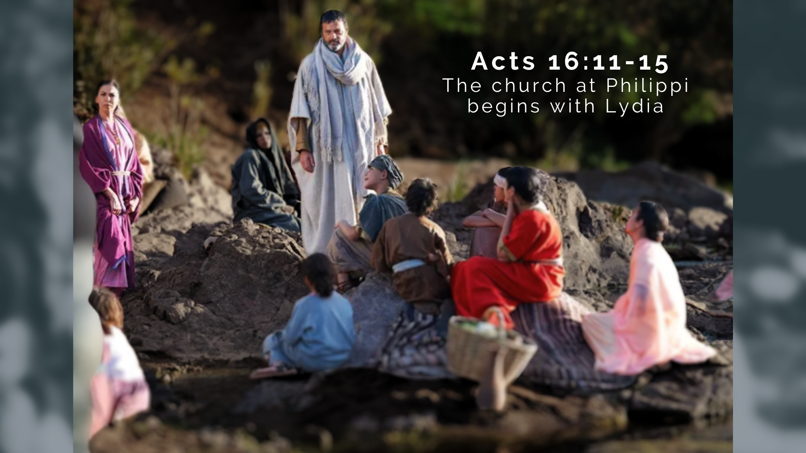
Notes:
Luke writes: “On the Sabbath we went outside the city gate to the river, where we expected to find a place of prayer. We sat down and began to speak to the women who had gathered there. One of those listening was a woman from the city of Thyatira named Lydia, a dealer in purple cloth. She was a worshiper of God. The Lord opened her heart to respond to Paul’s message. When she and the members of her household were baptized, she invited us to her home. “If you consider me a believer in the Lord,” she said, “come and stay at my house.” And she persuaded us (Acts 16:13-15).
So, the church in Philippi begins with Lydia, who was a woman of business, a woman of means. And it appears that Lydia eventually offers her spacious house as a gathering place for the church. Some scholars believe that the church in Philippi was primarily Gentile in make-up; mostly Greek, not Roman, and would have included a broad social spectrum, including farmers, slaves, those living in poverty, people involved in service and trade; with a small percentage of elite Romans. At the time of Paul’s letter to the Philippians, the church may have been over 50 people, and possibly multiple house churches.
Picking back up with Acts 16… [NEXT SLIDE]

Slide 5
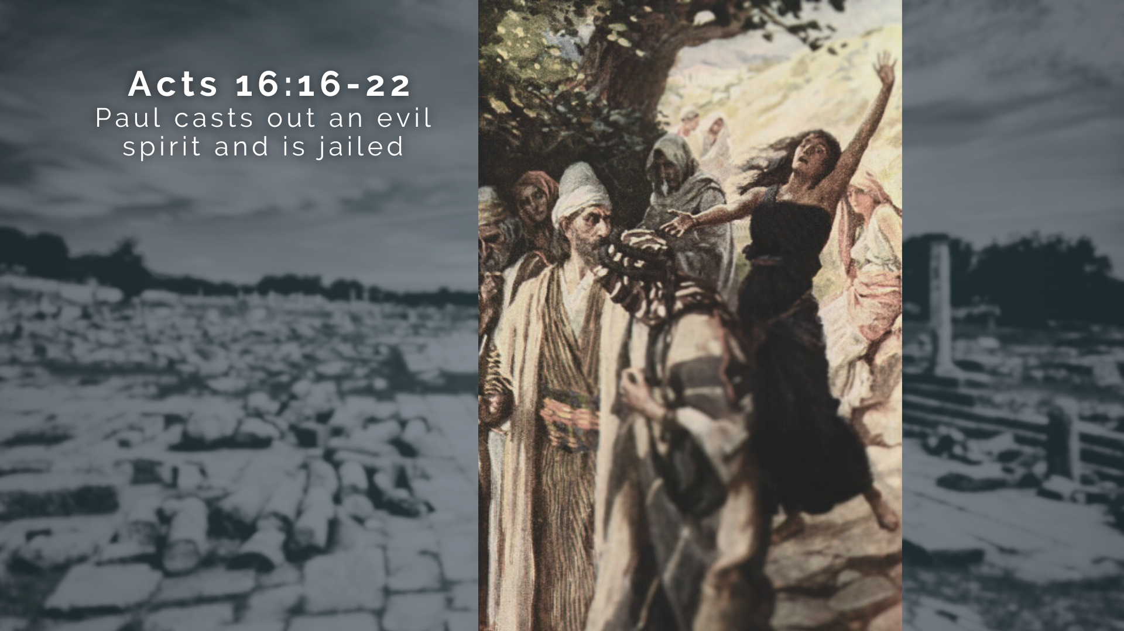
Notes:
Once again, Luke writes…
“Once when we were going to the place of prayer, we were met by a female slave who had a spirit by which she predicted the future. She earned a great deal of money for her owners by fortune-telling. She followed Paul and the rest of us, shouting, “These men are servants of the Most High God, who are telling you the way to be saved.” She kept this up for many days. Finally, Paul became so annoyed (Gk: “grieved”) that he turned around and said to the spirit, “In the name of Jesus Christ I command you to come out of her!” At that moment the spirit left her. When her owners realized that their hope of making money was gone, they seized Paul and Silas and dragged them into the marketplace to face the authorities. They brought them before the magistrates and said, “These men are Jews, and are throwing our city into an uproar by advocating customs unlawful for us Romans to accept or practice.”
Paul and Silas are then stripped and beaten with rods, and they are severely flogged before being thrown in a Philippian jail… [NEXT SLIDE]

Slide 6
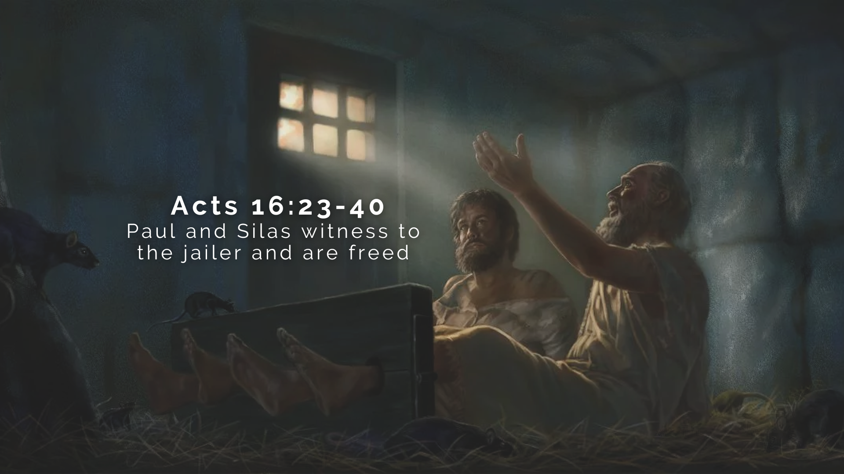
Notes:
[BRIEF COMMENTS]
How do Paul and Silas respond to this mistreatment? They worship!
Luke says around midnight, Paul and Silas are praying and singing hymns for all the prisoners, including the jailer assigned to watch them.
Luke writes: “Suddenly there was such a violent earthquake that the foundations of the prison were shaken. At once all the prison doors flew open, and everyone’s chains came loose. The jailer woke up, and when he saw the prison doors open, he drew his sword and was about to kill himself because he thought the prisoners had escaped. But Paul shouted, “Don’t harm yourself! We are all here!” The jailer called for lights, rushed in and fell trembling before Paul and Silas. He then brought them out and asked, “Sirs, what must I do to be saved?” The jailer and his household accepts Christ and joins the church
The next day when the authorities come to release Paul and Silas, Paul says, “Oh yeah, I forgot to mention that I’m a Roman citizen. And I can’t believe you have treated me this way. Paul essentially says that he isn’t going to press charges, but he would like an escort to safety once he leaves. And they oblige. Luke says they returned to Lydia’s house.
And that’s how we’re told that the church in Philippi begins. Now, skip ahead a decade, and Paul is now at the end of his life… [NEXT SLIDE]

Slide 7
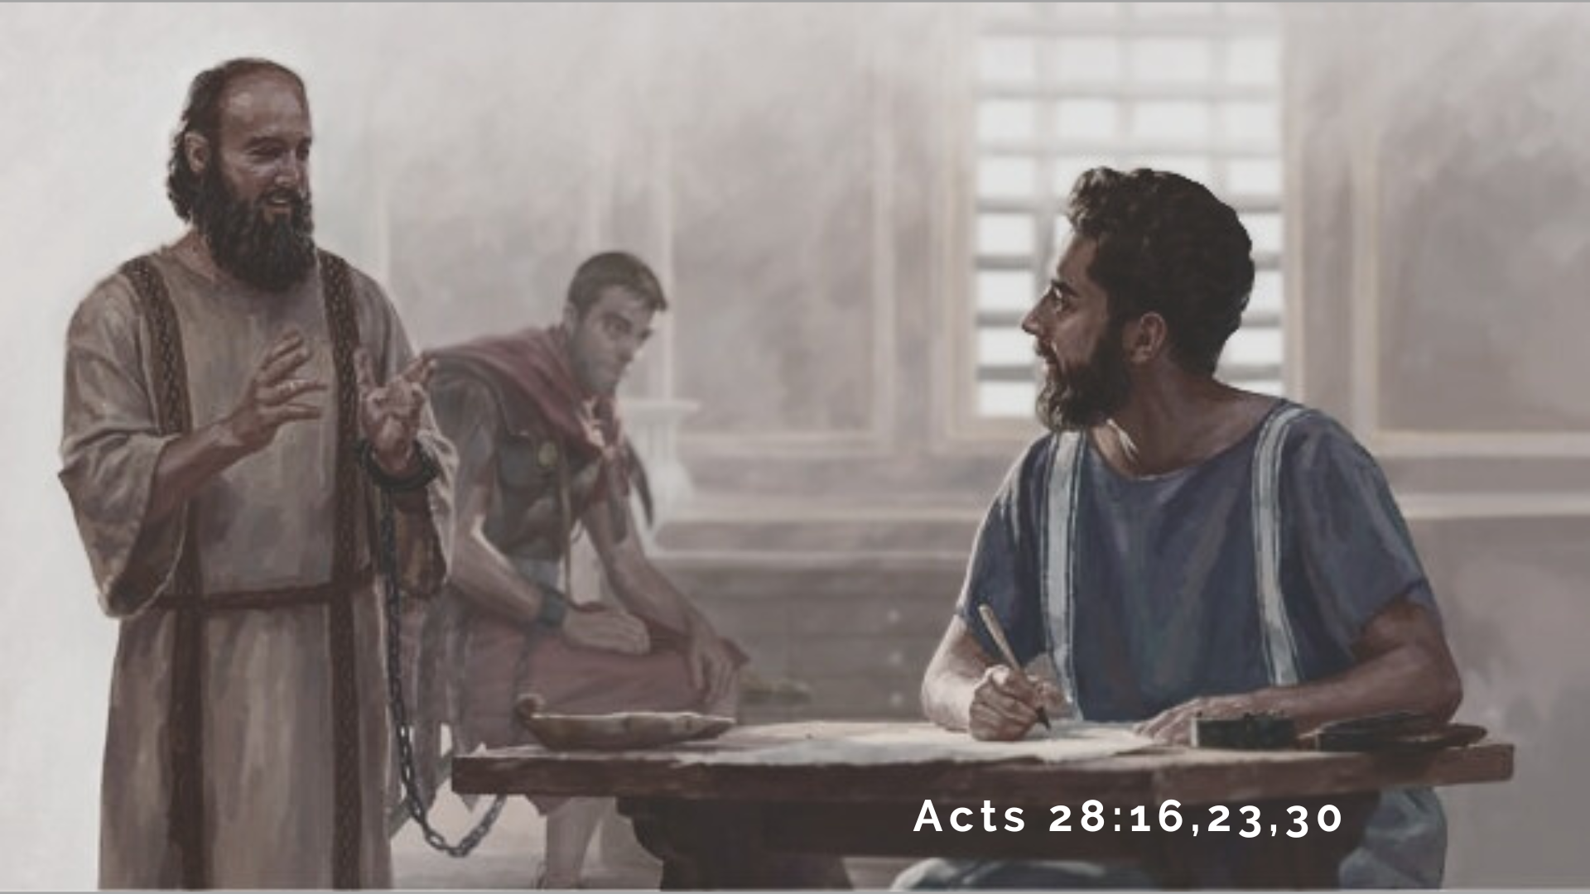
Notes:
He is jailed in Rome as he awaits an audience with the emperor Nero, who he appealed to, as was his right as a Roman citizen, after Paul was almost killed in Jerusalem. We will come back to this later in our series… but notice how Paul uses his citizenship to further the gospel. He wants to go to Rome because he wants to share the gospel with Caesar.
But Paul must wait for his court date. For two years Paul is jailed. And since he is a Roman citizen, he is placed under house arrest. We’re told this in Acts 28, when many scholars believe that, with the help of his young co-worker Timothy, Paul writes one of his final letters. It’s 62 or 63 AD, when Paul authors what we know as the epistle to the Philippians.
The occasion and purpose for the letter? NT scholar Lynn Cohick writes: “As Paul continues to preach and teach under house arrest in Rome, stories of his situation float back to Philippi, creating concern and nervousness among his partners in the gospel. Paul’s letter addresses these accounts… putting them into gospel perspective.”
As we will see later on in the letter, the church at Philippi had sent a brother to check on Paul and offer him financial help. So, Paul writes this letter and sends it back to the Philippians to encourage them about how he is doing, but also to help them see their own concerns, hardships, and struggles in light of the gospel of Christ and his promised return.
Let’s now turn there together and begin our verse-by-verse study with Philippians chapter 1, verses 1-11… [NEXT SLIDE]

Slide 8
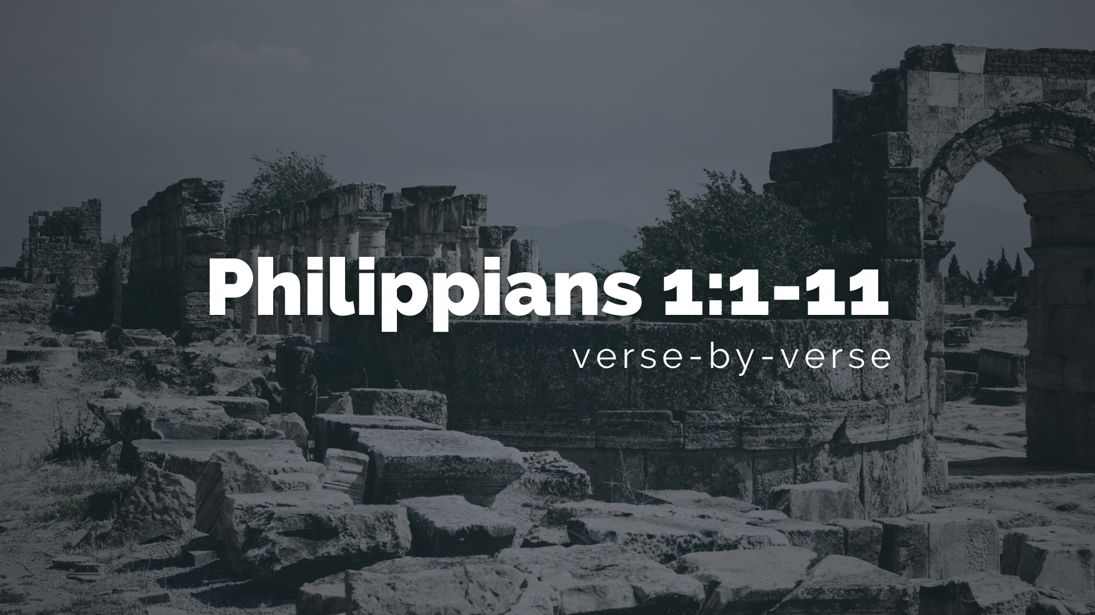
Notes:
As we read the introduction to this letter, pay attention to what Paul says in his greeting, in his words of affirmation, and in his prayer. Because he is going to hint at and foreshadow the concepts and themes he will be addressing in the rest of the letter.
[READ & COMMENT ON PASSAGE VERSE-BY-VERSE]
In summary: Paul is not only sharing his own heart and feelings (his affections for Christ and for the church), but he wants them to have the same attitude, posture, and view on their own situation and circumstances. They (we) are called to be servants for Christ. Our friendship and true fellowship is born from our affections for Christ and his good news. And that will challenge the citizenry that confesses “Caesar is Lord” and is quick to lash out at any who disagree. So, if we undergo suffering or hardships because of our faith, we should see that through the lens of the cross and Christ’s imminent return. In the meantime, we are called to be filled with the Spirit, to become more like Christ (experiencing his love, joy, peace, etc.), and letting our affections for Christ and each other shock and awe a watching world.
Finally, here are some questions to help us reflect and respond… [NEXT SLIDE]

Slide 9


Slide 10


Slide 11
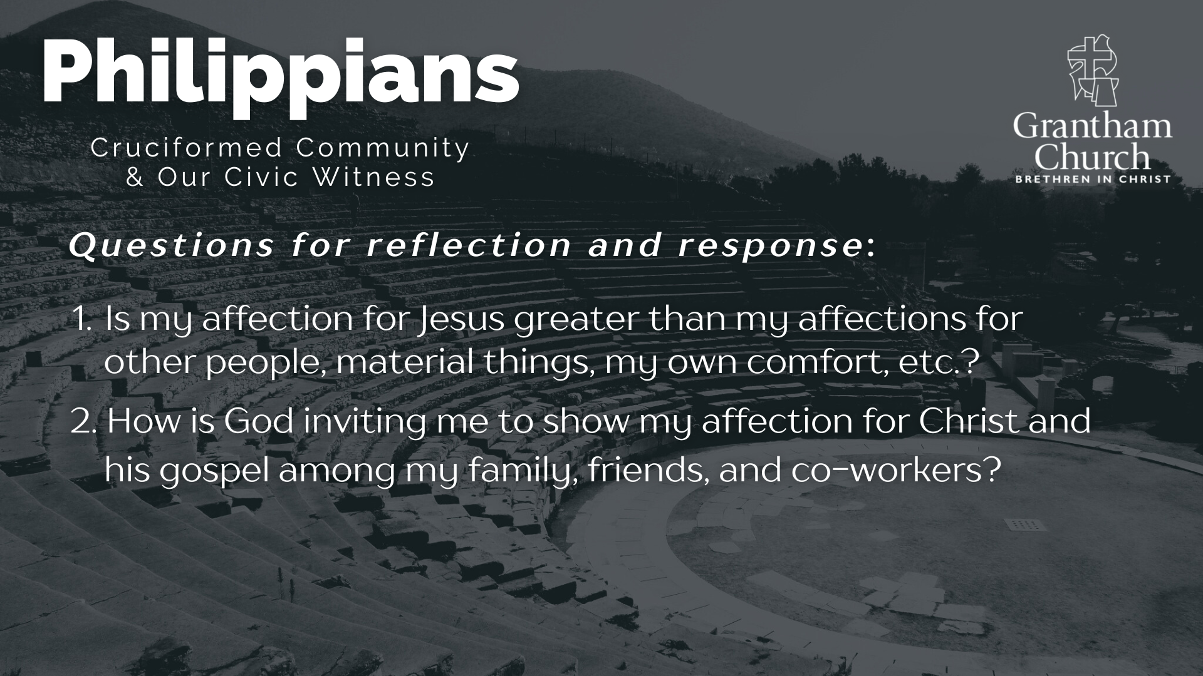

Slide 12
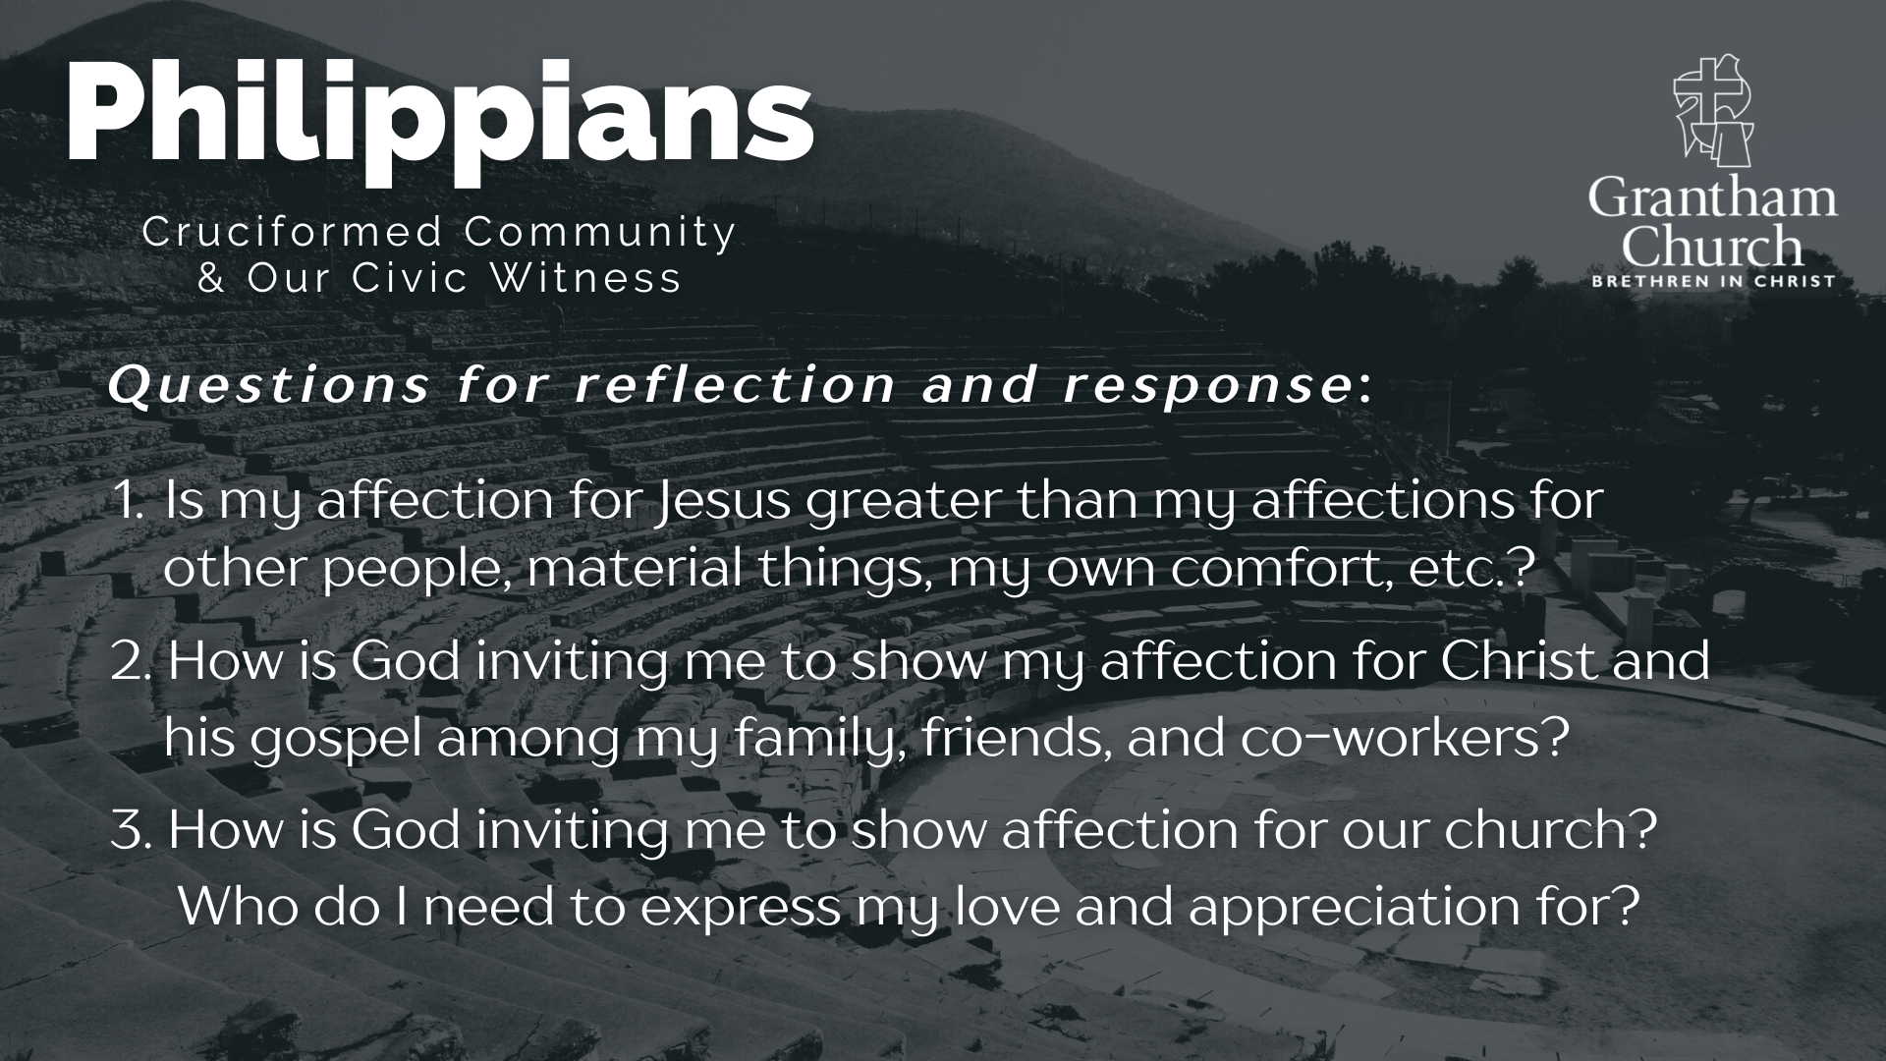
Notes:
[READ & BRIEF COMMENT ON EACH QUESTION]
Is my affection for Jesus greater than my affections for other people, material things, my own comfort, etc.?
How is God inviting me to show my affection for Christ and his gospel among my family, friends, and co-workers?
How is God inviting me to show affection for our church? Who do I need to express my love and appreciation for?
Let’s pray… [NEXT SLIDE]

Slide 13

Notes:
[CLOSING PRAYER]
Benediction

