Slide 1

Notes:
[BRIEF INTRO]
This is the conclusion of our 6-part fall sermon series: We Are Disciples
The words we use our important for mission, vision, and direction
Words are important when it comes to relationships and community (e.g., BIC Japan)
Also, language creates culture (e.g., intergenerational, convergent, third way)
Therefore, what do we mean by “disciple” and “discipleship”?
That’s what we’ve been addressing in this series by unpacking Grantham Church’s definition of disciples… [NEXT SLIDE]

Slide 2

Notes:
[READ DEFINITION & COMMENT]
Each week we have looked at one phrase at a time
We skipped over one phrase; the “em dash” in English is for greater emphasis
So, this morning we end our series with… [NEXT SLIDE]

Slide 3

Notes:
Empowered by the Holy Spirit.
[BRIEF PRAYER]
Please open your Bibles with me to the Gospel of John… [NEXT SLIDE]

Slide 4

Notes:
[INVITATION TO STAND & READ SCRIPTURE]
“This is the word of the Lord. Thanks be to God.” You may be seated.
[BRIEF STORY: CONFERENCE EVENT & WATCHMAN NEE]
Let’s go back now and read the words of Jesus more carefully… [NEXT SLIDE]

Slide 5
John 14:15-18 NLT – Jesus Gives the Holy Spirit
¹⁵ “If you love me, obey my commandments. ¹⁶ And I will ask the Father, and he will give you another Advocate, who will never leave you. ¹⁷ He is the Holy Spirit, who leads into all truth. The world cannot receive him, because it isn’t looking for him and doesn’t recognize him. But you know him, because he lives with you now and later will be in you. ¹⁸ No, I will not abandon you as orphans—I will come to you.
Notes:
[READ & BRIEF COMMENTS]
v. 15 – Notice, Jesus holds our profession together with obedience; stated belief with action; truth claims together with holiness and discipleship
v. 16 – When you profess love for the Lord and seek to obey his teachings, Jesus says that you will be given an “advocate” (NASB: “helper” – assists and works on your behalf) who is always with you
v. 17 – the Holy Spirit in OT times was only given to select individuals; Jesus says the Spirit will be given in a new way to all disciples; his presence is mysterious and unseen, but felt among disciples
v. 18 – Jesus doesn’t leave us like children with no parents!
Let’s go deeper. Who is the Holy Spirit? [NEXT SLIDE]

Slide 6
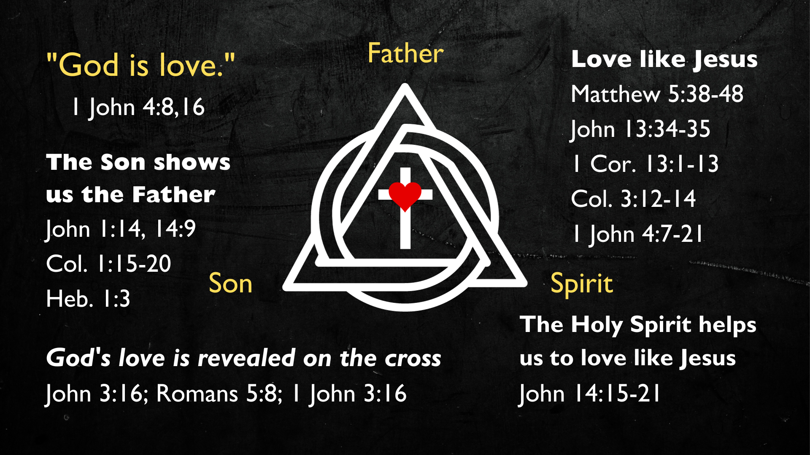
Notes:
[BRIEF COMMENTS ON GRAPHIC]
Jesus revealed to us the Trinity: Father, Son & Holy Spirit
”God is love” (1 John 4:8,16) actually necessitates a multiplicity of persons within the Godhead – there is a Lover, the Beloved, and the Love that is shared between them (divine community)
God is three persons, but one essence (actuality-being); each person having a specific function
The Father is the Originator; the Son is the Revealer, and the Spirit is the Completer
In the OT, the Spirit (ruach) was the life-giving force in creation; the Spirit empowered certain individuals with an anointing to do certain tasks, to help carry out the mission of God
And what about the New Testament? Well, as we read in John 14, Jesus spoke about the coming of the Spirit (the helper) to his disciples. And in Acts 2 (after his ascension) the Lord sends the Holy Spirit at Pentecost to each disciple so that he can be present with every disciple. So, let’s consider the role of the Holy Spirit… [NEXT SLIDE]

Slide 7
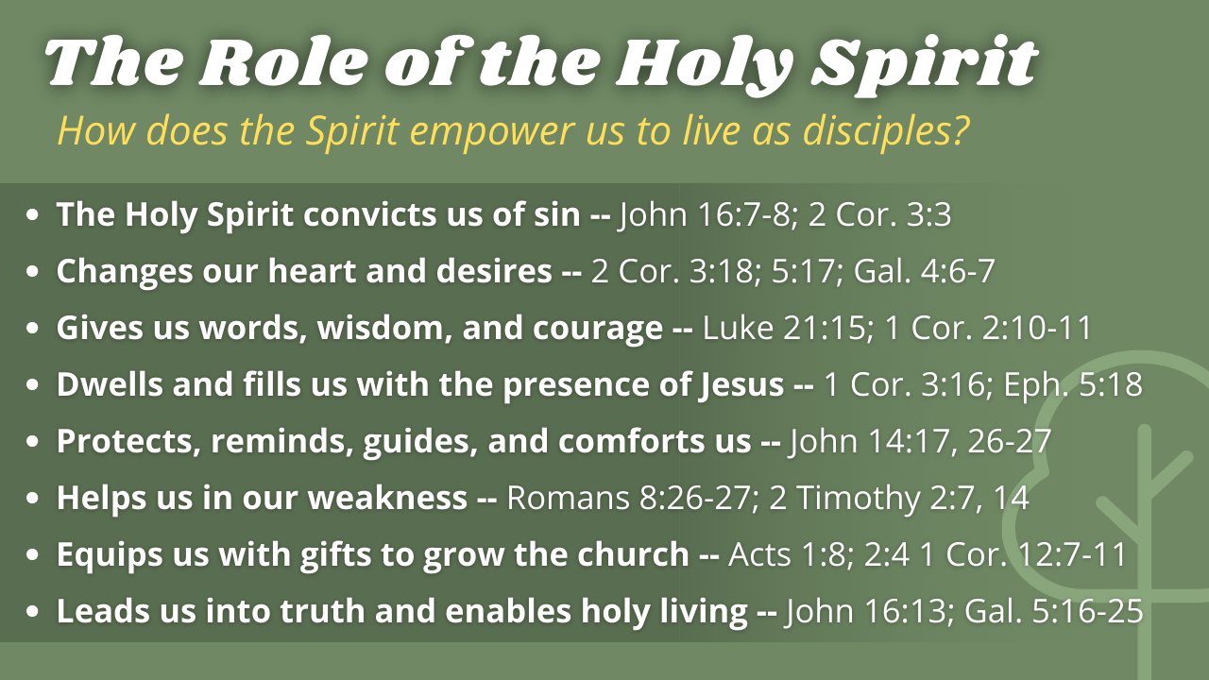
Notes:
[READ EACH POINT & COMMENT]
Read each point
Have you received this Spirit into your life?
But the Apostle Paul says that we need to recognize that there is an internal war between our flesh (sinful nature) and the Spirit that lives within us as disciples of Jesus.
Open up now to Galatians… [NEXT SLIDE]

Slide 8

Notes:
[READ & COMMENT ON PASSAGE]
Comment on verses 13-21.
And now verse 22… [NEXT SLIDE]

Slide 9

Notes:
[CONTINUE READING - GALATIANS 5:22-25]
My friends, is this Spirit active within you?
Are you being intentional about bearing fruit?
Are you listening to the voice and the promptings of the Spirit?
Are you calling on the Advocate and Helper as a disciple?
[EXAMPLE OF THE SPIRIT’S WORK]
So, my prayer for us is the same as the Apostle Paul prayed for the church in Ephesus… [NEXT SLIDE]

Slide 10
Paul, Ephesians 1:18-21 NIV – Resurrection Power!
¹⁸ I pray that the eyes of your heart may be enlightened in order that you may know the hope to which he has called you, the riches of his glorious inheritance in his holy people,¹⁹ and his incomparably great power for us who believe. That power is the same as the mighty strength ²⁰ he exerted when he raised Christ from the dead and seated him at his right hand in the heavenly realms, ²¹ far above all rule and authority, power and dominion, and every name that is invoked, not only in the present age but also in the one to come.
Notes:
[READ VERSE & BRIEFLY COMMENT]
Finally, here are some questions to help us reflect on what we’ve heard and respond to the voice and prompting of the Holy Spirit… [NEXT SLIDE]

Slide 11

Notes:
Questions begin here

Slide 12


Slide 13


Slide 14

Notes:
[READ & COMMENT ON EACH QUESTION]
Have you been trying to follow Jesus in your own strength? What areas of your life do you feel stuck or discouraged?
Will you pray and ask the Lord Jesus to empower you and exhibit “fruit” (evidence) of the Spirit where you’re lacking?
What has the Spirit been saying to you in this series? What is one thing you can do in response to what you’ve heard?
[CLOSING WORDS]
[NEXT SLIDE FOR CLOSING PRAYER]

Slide 15

Notes:
[CLOSING PRAYER]
Benediction
May the Father help you to live this day and everyday to the full,
being true to Him, in every way.
May Jesus, the Son, help you to give yourself away to others,
being kind to everyone you meet.
And may the Spirit help you to love the lost,
proclaiming Christ in all that you do and say.
Go in peace, church, to love and serve the Lord. Amen.

