Slide 1
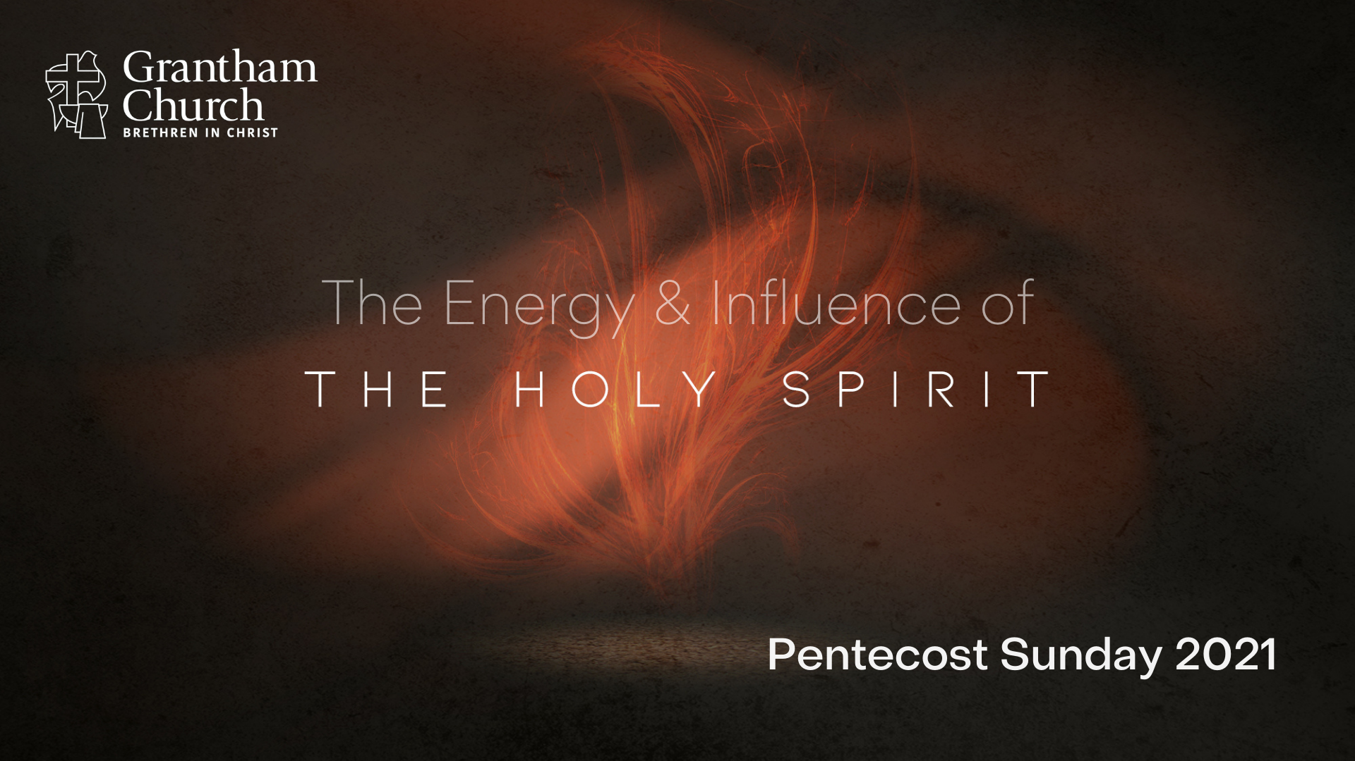
Notes:
It’s Pentecost Sunday. And this is the day on the church calendar when we remember how Christ (after he ascended) gave his disciples the Holy Spirit and his church was officially born. And we’re going to see today that if it weren’t for the Holy Spirit, not only would the church be unable to follow Jesus and make any difference in the world, but there would be no “saved” people, no personal transformations, and no way to become all that Christ wants us to be as his disciples. Because without the energy and influence of the Holy Spirit, we are on our own—left with nothing but our sinful (ungenerated) flesh and our limited abilities.
You may recall the story in Acts 19 when the Apostle Paul traveled to Ephesus. He found some disciples there and he asked them, “Did you receive the Holy Spirit when you believed?” And they answered, “No, we have not even heard that there is a Holy Spirit.” So, seeing that this was quite the contradiction (a disciple without the indwelling Spirit), they were then baptized into the name of the Lord Jesus. And when Paul placed his hands on them in prayer, the Holy Spirit came on them and they outwardly manifested this change. They came alive to God in Christ and could now begin to live by the Spirit and truly make a Kingdom difference, where before they were just well-intentioned and doing a lot of busy work.
You see, their minds had accepted something that their hearts had yet to experience. We’ve seen several examples of this throughout church history—folks who for years gave mental ascent to the faith, operated out of their own strength, but had not truly experienced the indwelling Christ through the filling of the Holy Spirit.
One of the most well-known examples of this, and one that many of us are familiar with, is the story of John Wesley, the founder of the Methodists. John and his brother Charles grew up in a devout Anglican home. John learned Hebrew, Greek, and Latin as a kid. And when he was old enough, he went to Oxford. So, he was a bright guy who had decided to give himself to the ministry. He was a teacher, a preacher, and he made an attempt to be a missionary to Native Americans in the new American colonies.
And after a failed missionary attempt to the colony of Georgia, at the age of 35, John Wesley traveled back home burned out, depressed, and defeated. It was in his own journal that he recorded the event on May 24th 1738. Wesley reluctantly and rather unwillingly attended a service that evening on Aldersgate Street in London. As he listened to the preacher read from Martin Luther's Preface to the Epistle to the Romans, he said that he felt his "heart strangely warmed." Wesley wrote, "while he was describing the change which God works in the heart through faith in Christ, I felt my heart strangely warmed. I felt I did trust in Christ, Christ alone for salvation; and an assurance was given me that He had taken away my sins, even mine, and saved me from the law of sin and death.” Wesley said, “I felt that God loved me.”
You know it’s been said that if it weren’t for Wesley’s Aldersgate experience, then Wesley and Methodism would likely be nothing more than an obscure footnote in the pages of church history. And of course, the Brethren in Christ (our denomination) never would have been influenced by Wesley’s theology and practice. So, we can see (in more ways than one) what a difference the Holy Spirit can make in our lives and in the church.
Therefore, I want to invite us this morning to reflect on the importance of the Holy Spirit. And specifically, let’s ask ourselves: (1) does the Spirit dwell in me and am I living by the Spirit?; and (2) do we recognize our need for the Holy Spirit at Grantham Church—that we need much more than “brains and brawn” if we’re going to grow as a congregation and be all that God wants us to be? Let’s seek the answers to those questions today. [NEXT SLIDE]

Slide 2

https://bibleproject.com/explore/video/holy-spirit/
Notes:
Before we dive into our Scripture reading for today, I thought a broader biblical background and understanding of the Spirit would be helpful. And there is really no better way to do that but to show you this short video on the Holy Spirit from the Bible Project. Let’s watch that together.
[SHOW VIDEO] – stop video before two guys appear at the end (exactly 3:49).

Slide 3

Notes:
[BRIEF COMMENTS ON BACKGROUND & CONTEXT]
The book of Acts is Luke’s Gospel, vol. 2
Luke, an educated Greek-convert, highlights the work of the Spirit and records the story of the first few decades of the Early Church; ultimately to inspire the church in future generations.
And the first chapter provides a brief introduction to the narrative of the Spirit’s outpouring, beginning with the disciples’ last moments with the resurrected Christ and his Ascension.
In chapter 2, Luke records the day of Pentecost—the birth of the Church through the coming of the Holy Spirit, as Jesus promised would happen.
And for Jews who knew their Scriptures, the coming Spirit was associated with the last days when all would have access to God’s power, calling, and gifts.
As we will see, without the Holy Spirit, the Church cannot continue the mission of Jesus in the world.
To set the scene, in Acts 1:12-14, we’re told that the 11 Apostles (together with 120 believers) gather in the Upper Room to pray and seek God as they wait on the gift and the power he promised.
And now Acts chapter 2, the Holy Spirit comes. [NEXT SLIDE]

Slide 4
Acts 2:1-13 NIV
¹ When the day of Pentecost came, they were all together in one place. ² Suddenly a sound like the blowing of a violent wind came from heaven and filled the whole house where they were sitting. ³ They saw what seemed to be tongues of fire that separated and came to rest on each of them. ⁴ All of them were filled with the Holy Spirit and began to speak in other tongues as the Spirit enabled them.
Notes:
v. 1 – “the day of Pentecost” (Pentecost-Gk for “fiftieth” – 50 days after Passover); also known as the “Feast of Weeks” or “the day of first fruits” of the wheat harvest; it’s celebrated as the day Moses gave the Law at Mt. Sinai; Luke says, “they were all together” – the Apostles with the 120 people mentioned in the previous chapter, likely in the Upper Room (maybe a rented hall, possibly above King David’s tomb, which is a historic site in Jerusalem today).
v. 2 – “like the blowing of a violent wind came from heaven” – The “wind” (ruach) from an OT perspective (as we saw from the video) is the creative, energizing force of God (e.g. prophets, kings, Ezekiel 37, etc.); Jesus said the coming of the Kingdom would be like the “wind” in his conversation with Nicodemus; what is happening is definitely understood to be supernatural, what they had been promised!
v. 3 – “what seemed to be tongues of fire” – In Luke 3:16-17, John the Baptist said the Messiah would baptize with wind and fire; notice, the manifestation of the Spirit is visible and audible; also “fire” in the OT represented the power and presence of God (fire by night & burning bush); fire is also symbolic of judgment and purification, as Charles Wesley penned in the hymn, O Thou Camest from Above, with those words, “the pure, celestial fire to impart” as Luke says, “came to rest on each of them” – i.e. every follower of Jesus is receiving the Holy Spirit!
[Read verse 4 and then NEXT SLIDE]

Slide 5
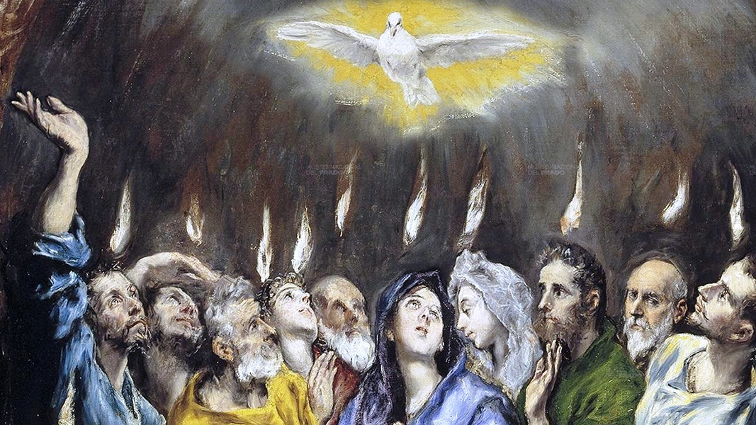
Notes:
v. 4 – “filled with the Holy Spirit” – v.3 indicates an initial “baptism of the Spirit” and v.4 implies that there is a “filling” that is repeatable for the carrying out of effective ministry; In Eph 5:18, Paul commands us to be filled with the Holy Spirit. So, the “filling of the Spirit” isn’t just a one-time event.
What does it mean that they spoke “in other tongues”? In this case, it means that they spoke in different known languages. And according to verse 8, which we will see in a moment, this appears to be a miracle of the ear, not of the tongue. In other words, people were hearing the gospel in their own language the way someone might hear through a headset and a translator at the United Nations.
And I think it’s important to note two things: (1) that “speaking in tongues” in Acts was always a sign that the gospel had overcome another ethnic and geographical boundary—the Spirit was breaking through worldly obstacles and divides; and (2) this example is different than the “tongues” that Paul addresses in 1 Corinthians. We don’t have time to go into that today, but we should say that this event is a unique occurrence.
Verse 5… [NEXT SLIDE]

Slide 6
⁵ Now there were staying in Jerusalem God-fearing Jews from every nation under heaven.
⁶ When they heard this sound, a crowd came together in bewilderment, because each one heard their own language being spoken. ⁷ Utterly amazed, they asked: “Aren’t all these who are speaking Galileans? ⁸ Then how is it that each of us hears them in our native language?
Notes:
[READ ALL 4 VERSES]
v. 5-8 – So, “God-fearing Jews” from “every nation” were in town for Pentecost and they are amazed and confused by what they are seeing and hearing; and of all people, it’s Galileans!
And then Luke tells us where many of them were from. Verse 9… [NEXT SLIDE]

Slide 7
⁹ Parthians, Medes and Elamites; residents of Mesopotamia, Judea and Cappadocia, Pontus and Asia, ¹⁰ Phrygia and Pamphylia, Egypt and the parts of Libya near Cyrene; visitors from Rome ¹¹ (both Jews and converts to Judaism); Cretans and Arabs—we hear them declaring the wonders of God in our own tongues!”
Notes:
[READ ALL 3 VERSES]
v. 9-11 – Obviously, Luke doesn’t mean literally “every nation” but rather a broad representation.
Check out this map of the nations present on the day of Pentecost. [NEXT SLIDE]

Slide 8
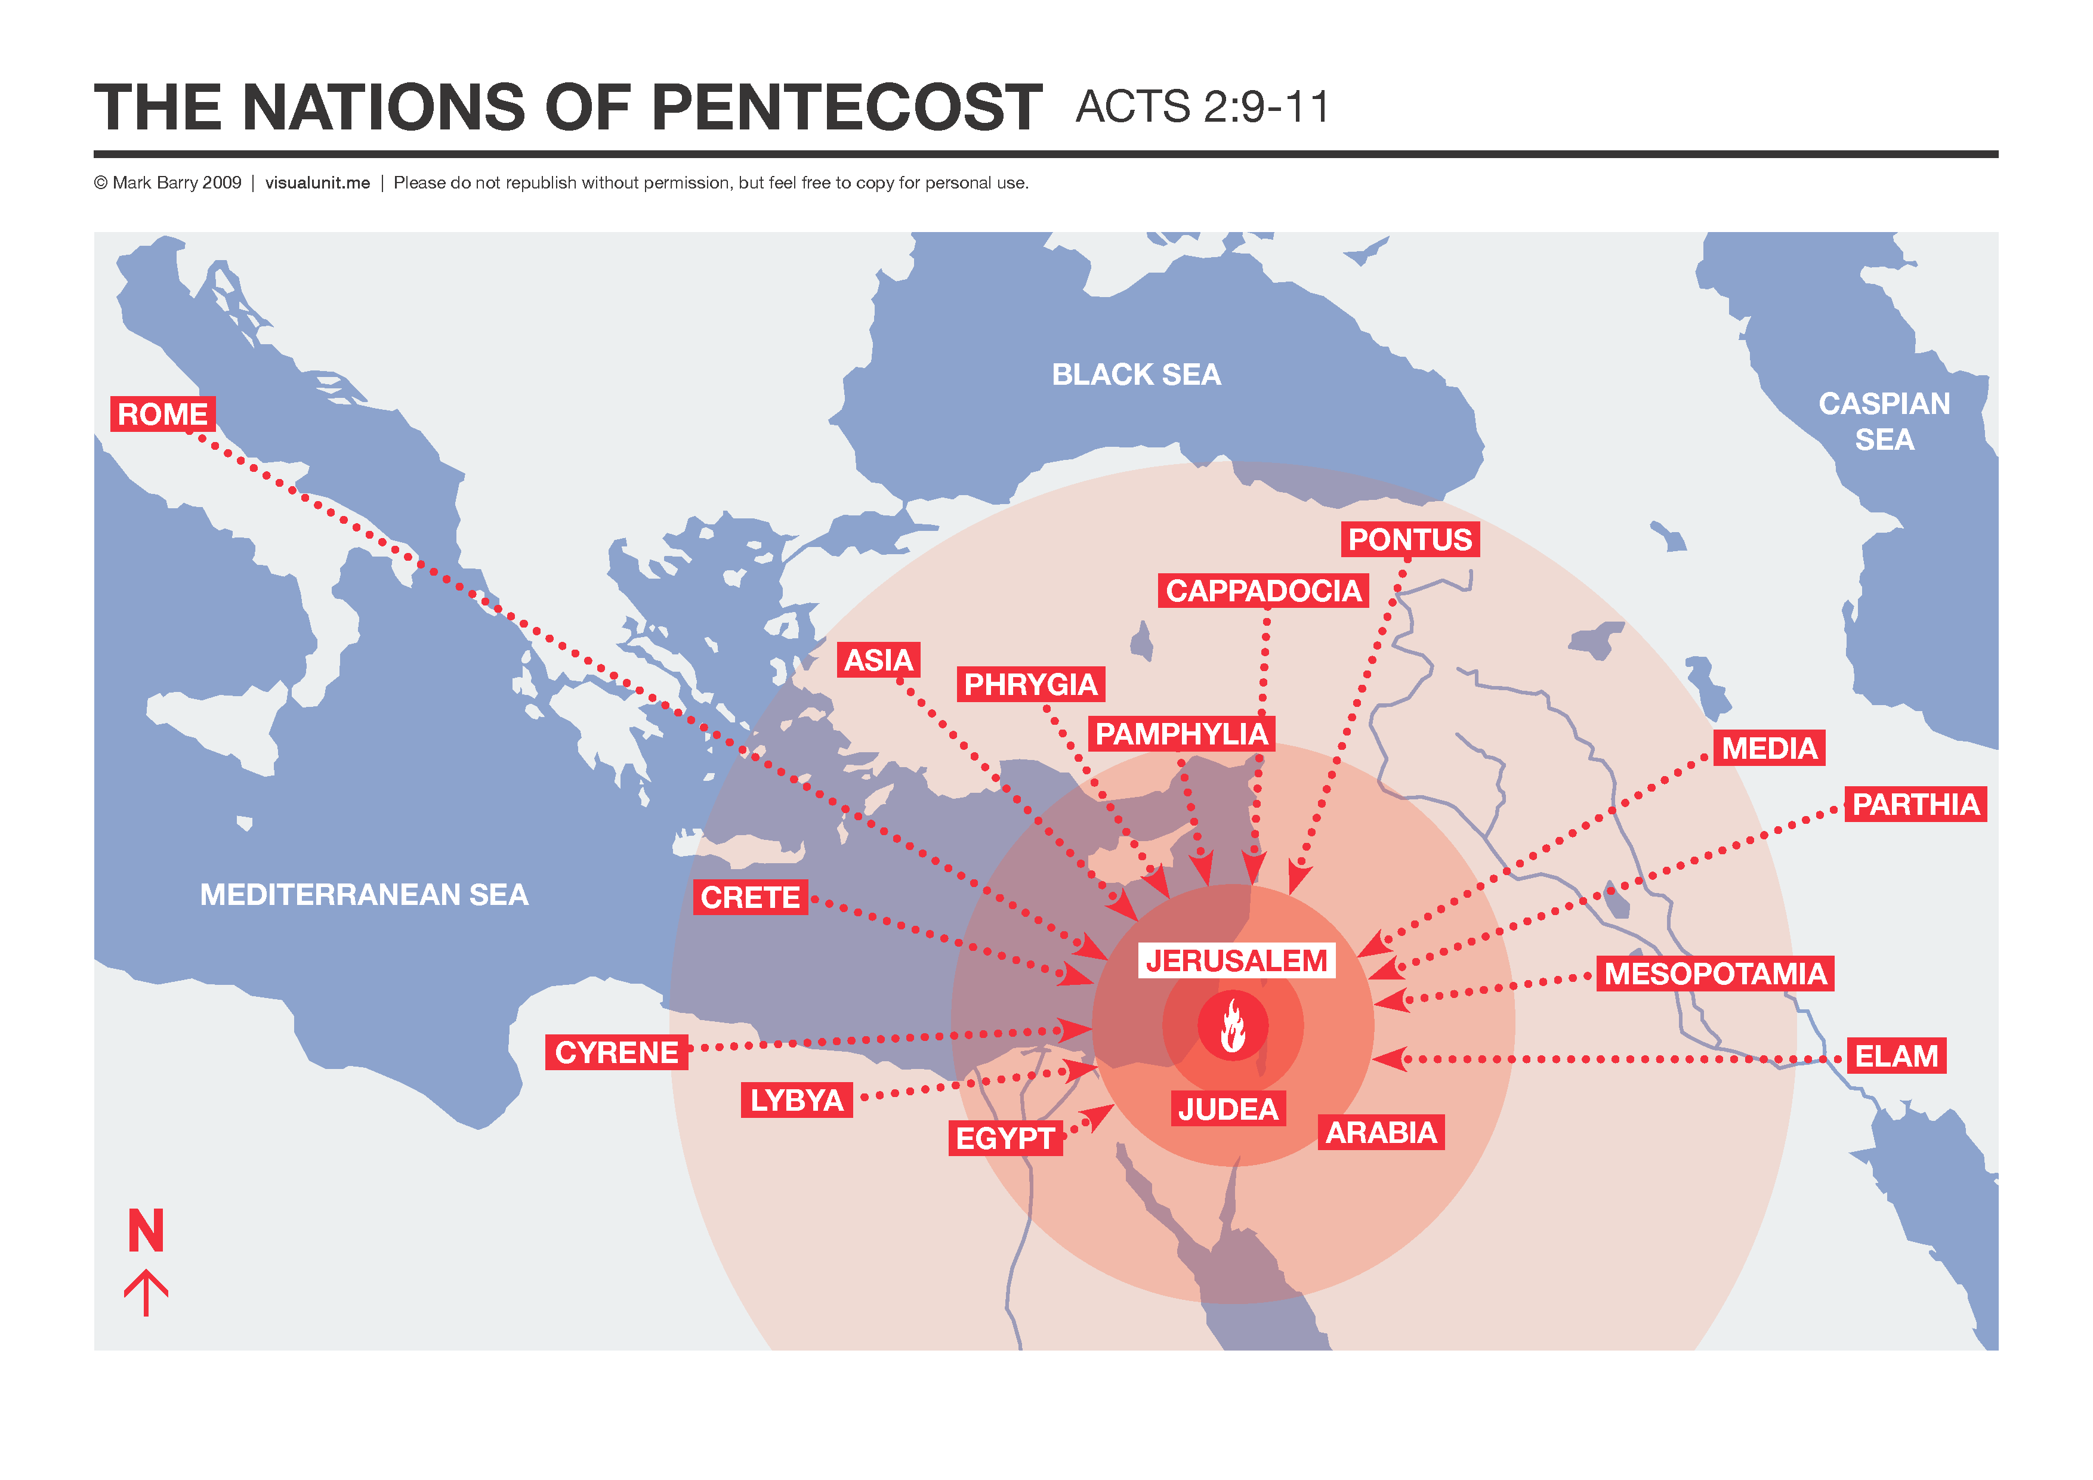
Notes:
[BRIEF COMMENT]
The Jewish diaspora are in town for Pentecost.
It’s likely that the gospel spread to Rome before Peter or Paul because of Pentecost.
Verse 12… [NEXT SLIDE]

Slide 9
¹² Amazed and perplexed, they asked one another, “What does this mean?”
¹³ Some, however, made fun of them and said, “They have had too much wine.”
Notes:
v. 12 – “Amazed and perplexed” – they recognized it being significant, but unsure of its meaning.
v.13 – “They have had too much wine” – a reminder that the Spirit’s activity can be easily scoffed at by those who have not been baptized and filled by the Holy Spirit, for those who have merely a head knowledge.
And then Peter will respond in a spontaneously powerful way in verses 14-39. [NEXT SLIDE]

Slide 10

Acts 2:14-39 – Peter Preaches
Scripture Reading: Joel 2:28-32
Notes:
[SUM UP ACTS 2:14-21]
We are not drunk, God is fulfilling his promises.
He quotes Joel 2:28-32 – “In the last days, God says, I will pour out my Spirit…”
Joel says, all who call on the name of the Lord shall be saved!
And by the end of Peter’s sermon, Luke tells us that many accepted his message and were baptized. And by the end of the day, about 3,000 people became followers of Jesus. Folks, that is what the Holy Spirit can do. And of course, this is what Jesus meant when he said, “Do not leave Jerusalem, but wait for the gift my Father promised, which you have heard me speak about. For John baptized with water, but in a few days you will be baptized with the Holy Spirit” (Acts 1:4-5).
So, real quick, let’s consider why we have been given the Holy Spirit. I’ve summed it up this way: [NEXT SLIDE]

Slide 11

The Energy & Influence of the Holy Spirit
Why have we been given the Holy Spirit?
So that we might experience God’s…
Peace
Power
Provision
Notes:
First, his peace. [NEXT SLIDE]

Slide 12
The Energy & Influence of the Holy Spirit
Why have we been given the Holy Spirit?
So that we might experience God’s…
Peace
Notes:
[BRIEF COMMENTS]
Stephen (the first martyr)
Paul and Silas singing in prison
Perpetua and Felicity’s peace in the arena (3rd cent. martyrs)
John Wesley’s experience sailing with the Moravians to Georgia
Where does this peace come from? It comes from Christ and the Spirit that he gives to us. [NEXT SLIDE]

Slide 13
John 14:25-27 NIV
²⁵ “All this I have spoken while still with you. ²⁶ But the Advocate, the Holy Spirit, whom the Father will send in my name, will teach you all things and will remind you of everything I have said to you. ²⁷ Peace I leave with you; my peace I give you. I do not give to you as the world gives. Do not let your hearts be troubled and do not be afraid.
Notes:
[BRIEF COMMENT]
Friends, the Jesus who slept through the storm when his disciples were all panicked thinking they were going to die, offers us his peace through the power of the Holy Spirit.
And secondly, we’ve been given power. [NEXT SLIDE]

Slide 14
The Energy & Influence of the Holy Spirit
Why have we been given the Holy Spirit?
So that we might experience God’s…
Peace
Power
Notes:
[BRIEF COMMENTS]
The faith and the courage of the early church
The gifts the Spirit gives the church
The power to change the world around us
Remember, what Jesus said in Acts 1:8. [NEXT SLIDE]

Slide 15
“But you will receive power when
the Holy Spirit comes on you…”
Acts 1:8 NIV
Notes:
[BRIEF COMMENT]
And lastly, the Spirit has been given so that we might experience God’s provision. [NEXT SLIDE]

Slide 16
The Energy & Influence of the Holy Spirit
Why have we been given the Holy Spirit?
So that we might experience God’s…
Peace
Power
Provision
Notes:
[BRIEF COMMENTS]
What kind of provision are we talking about here? Well, several kinds. First, we’re given…
Insight into what is right and wrong (conviction & discernment)
We’re given divine reminders of his truth and how to walk in it
Listen to what Jesus said in John 16. [NEXT SLIDE]

Slide 17
John 16:8, 12-13 NLT
⁸ And when he [the Holy Spirit] comes,
he will convict the world of its sin, and of God’s righteousness, and of the coming judgment.
¹² “I have much more to say to you, more than you can now bear. ¹³ But when he, the Spirit of truth, comes, he will guide you into all the truth.
Notes:
[BRIEF COMMENT]
Also, because of the Holy Spirit…
We’re given a guide to be more like Christ
And he is able to show us a way forward when there seems to be no way
But in order to experience this life in us, we must be intentional and focused on living in the Spirit. Listen to what the Apostle Paul said in Romans 8:5-13. [NEXT SLIDE]

Slide 18
Paul, Romans 8:5-13 (VOICE)
⁵ If you live your life animated by the flesh—namely, your fallen, corrupt nature—then your mind is focused on the matters of the flesh. But if you live your life animated by the Spirit—namely, God’s indwelling presence—then your focus is on the work of the Spirit. ⁶ A mind focused on the flesh is doomed to death, but a mind focused on the Spirit will find full life and complete peace. ⁷ You see, a mind focused on the flesh is declaring war against God; it defies the authority of God’s law and is incapable of following His path. ⁸ So it is clear that God takes no pleasure in those who live oriented to the flesh.
Notes:
[BRIEF COMMENTS]
Verse 9… [NEXT SLIDE]

Slide 19
⁹ But you do not live in the flesh. You live in the Spirit, assuming, of course, that the Spirit of God lives inside of you. The truth is that anyone who does not have the Spirit of Christ living within does not belong to God. ¹⁰ If Christ lives within you, even though the body is as good as dead because of the effects of sin, the Spirit is infusing you with life now that you are right with God. ¹¹ If the Spirit of the One who resurrected Jesus from the dead lives inside of you, then you can be sure that He who raised Him will cast the light of life into your mortal bodies through the life-giving power of the Spirit residing in you.
Notes:
[BRIEF COMMENTS]
Verse 12… [NEXT SLIDE]

Slide 20
¹² So, my brothers and sisters, you owe the flesh nothing! You do not need to live according to its ways, so abandon its oppressive regime. ¹³ For if your life is just about satisfying the impulses of your sinful nature, then prepare to die. But if you have invited the Spirit to destroy these selfish desires, you will experience life.
Notes:
[BRIEF COMMENTS]
If we’re honest, we don’t really like this part. Why? It’s because American society and culture has a negative sense and understanding of freedom, and it’s this individualistic and hedonistic view that impacts our thinking. It says, “If I can’t do whatever I want, then I’m not really free.” But folks, that’s not the Christian understanding of freedom.
Once again, listen to what the Apostle Paul said about this in Galatians 5:13-25. [NEXT SLIDE]

Slide 21
Paul, Galatians 5:13-25 NIV
¹³ You, my brothers and sisters, were called to be free. But do not use your freedom to indulge the flesh; rather, serve one another humbly in love. ¹⁴ For the entire law is fulfilled in keeping this one command: “Love your neighbor as yourself.” ¹⁵ If you bite and devour each other, watch out or you will be destroyed by each other.
Notes:
[BRIEF COMMENT]
Verse 16… [NEXT SLIDE]

Slide 22
¹⁶ So I say, walk by the Spirit, and you will not gratify the desires of the flesh. ¹⁷ For the flesh desires what is contrary to the Spirit, and the Spirit what is contrary to the flesh. They are in conflict with each other, so that you are not to do whatever you want. ¹⁸ But if you are led by the Spirit, you are not under the law.
Notes:
[BRIEF COMMENT]
Verse 19… [NEXT SLIDE]

Slide 23
¹⁹ The acts of the flesh are obvious: sexual immorality, impurity and debauchery; ²⁰ idolatry and witchcraft; hatred, discord, jealousy, fits of rage, selfish ambition, dissensions, factions ²¹ and envy; drunkenness, orgies, and the like. I warn you, as I did before, that those who live like this will not inherit the kingdom of God.
Notes:
[BRIEF COMMENT]
Verse 22… [NEXT SLIDE]

Slide 24
²² But the fruit of the Spirit is love, joy, peace,
forbearance, kindness, goodness, faithfulness,
²³ gentleness and self-control. Against such things there is no law. ²⁴ Those who belong to Christ Jesus have crucified the flesh with its passions and desires. ²⁵ Since we live by the Spirit, let us keep in step with the Spirit.
Notes:
[BRIEF COMMENTS]
So, how do we keep in step with the Spirit and experience his energy and influence? [NEXT SLIDE]

Slide 25
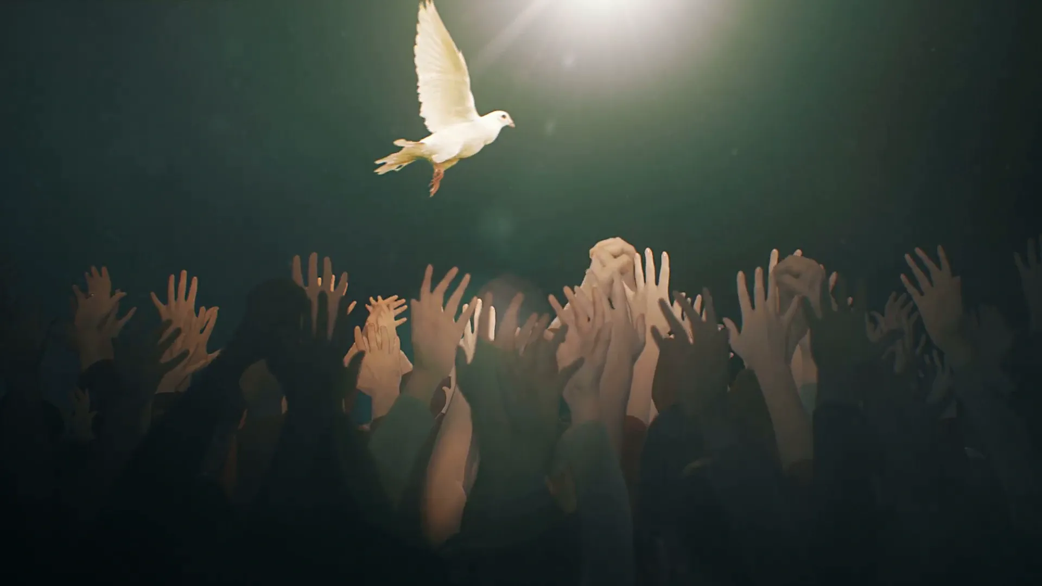
How do we “keep in step” with the Spirit?

Slide 26
How do we “keep in step” with the Spirit?
Active Awareness

Slide 27
How do we “keep in step” with the Spirit?
Active Awareness
Persistent Prayer

Slide 28
How do we “keep in step” with the Spirit?
Active Awareness
Persistent Prayer
Christian Community
Notes:
Active Awareness
This involves; (1) looking for how the Spirit is at work around you; and (2) listening to the voice of the Spirit.
Persistent Prayer
Jesus prayed before he chose his disciples.
Jesus prayed before multiplying the fish and the loaves.
Jesus prayed before performing other miracles.
The disciples were praying with the Holy Spirit came at Pentecost.
Paul prayed when the disciples at Ephesus received the Spirit they had not heard of before. Because when we pray, Kingdom stuff happens. When we pray, we tap into the energy and the influence of the Holy Spirit.
Christian Community
“There are no lone ranger Christians” – we need each other to hear and follow the Spirit.
Discipleship and becoming more like Christ happens in community.
Unclear about God’s will on a matter? Be like the Bereans! (Acts 17:11)
Need to make an important decision or need God’s provision? Be willing to pray with other disciples.
Need a fresh encounter with God? Stay committed to all of the spaces in the church.
Brothers and sisters, I want to leave us with these words this morning… [NEXT SLIDE]

Slide 29
Notes:
…from the Lord Jesus as they are recorded in Luke 11:9-13 (NIV):
Jesus says, “So I say to you: Ask and it will be given to you; seek and you will find; knock and the door will be opened to you. For everyone who asks receives; the one who seeks finds; and to the one who knocks, the door will be opened. “Which of you fathers, if your son asks for a fish, will give him a snake instead? Or if he asks for an egg, will give him a scorpion? If you then, though you are evil, know how to give good gifts to your children, how much more will your Father in heaven give the Holy Spirit to those who ask him!”
[CLOSING WORDS & PRAYER]

