Slide 1
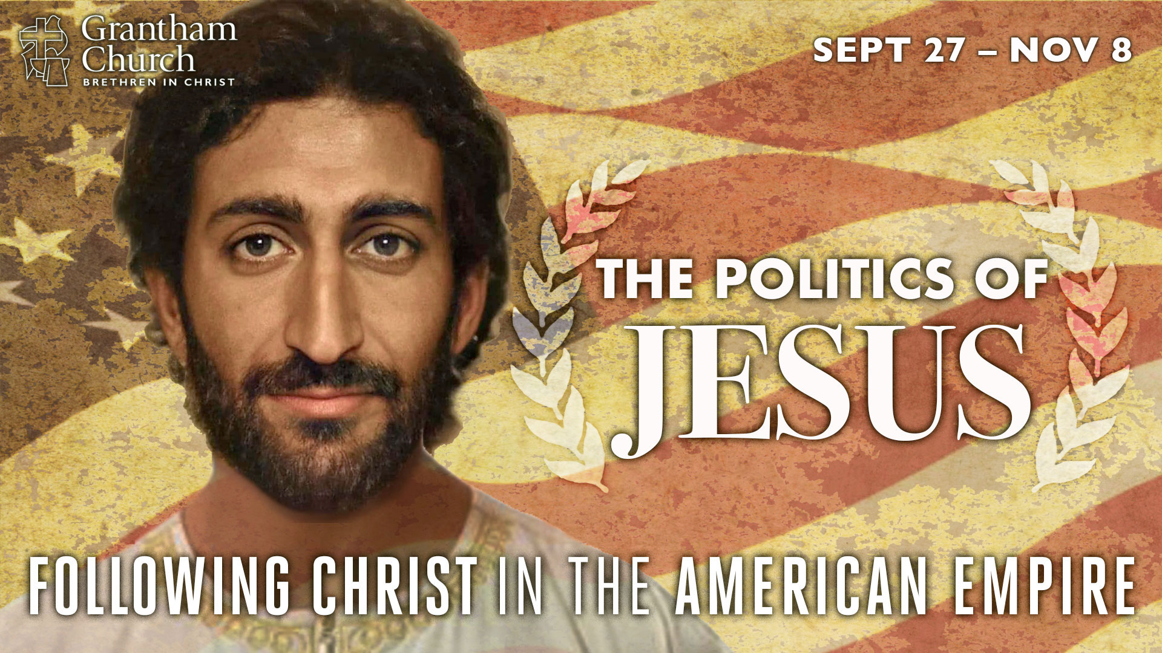
Notes:
This is the sixth message in our seven-part sermon series, The Politics of Jesus: Following Christ in the American Empire—a series intended to help us navigate this election season by letting the Messiah from Nazareth shape our portrait of God, reveal the radical nature of our faith, and call us to live out the politics of Jesus in a modern-day empire.
This is the Sunday before Election Day in the US. And that means that many of you are having a hard time thinking about anything else, and that will likely be the case for the next few days or more, depending on how long it takes to know the results of the 2020 presidential election.
And then we wait to see how the country will respond to the results. If you’re like me, you’re a little concerned about that due to the growing violence and unrest we’ve seen in the last several years. And in a year that has included so much unrest—an economic recession, the rise of conspiracy theories and white supremacy groups, a civil rights movement, a pandemic, and a much-anticipated election… we’re all sitting on the edge of our seat waiting to see what is going to happen next.
Because “Election Day” is when the US government, as it does every 4 years, asks you for your opinion about who should lead the country, who should represent the people, and about whose vision for the nation should be pursued, at least for the next few years. And so, you’ve either already sent in your ballot by mail or you’re likely preparing to vote in person this Tuesday. And for many of us, we’ve done that or will do that as followers of Christ, as worshippers of the One we call our Lord and King.
And that’s what I want to talk to you about today. I’d like to call us to reflect on who we are as disciples, what it means to embrace the political agenda of Jesus and belong to his Body, the church, and why we should get our life from Christ and not our vote, nor should we put our hope (or the hope of the world) in any political party or president. And I’d like to do that in a message I’m calling, Jesus, You & the Voting Booth.
You will recall that earlier in this series I explained some of the meaning behind the series graphic, specifically the picture of a middle-eastern Jesus that was created by a Dutch artist using AI technology. But what I haven’t addressed is the usage of “American Empire” in the subtitle. So, I’d like to begin there today.
Why do I refer to the US as the American Empire? I know that I shouldn’t assume my listeners understand why I’m describing the country that way, and I don’t want you to think it’s just some clever way of telling you what I think about the past four years. Hardly. I’ve personally viewed America as an empire for about 15 years now. And here are some reasons why. Not an exhaustive list, but enough that should put some things into perspective for the church.
First, it’s evident that the United States had imperial aspirations from its inception, which may come as a surprise, since the Founding Fathers rebelled against the British empire, throwing off tyranny, in order to create the best possible form of limited-government and the greatest republic the world has ever known.
So, founders like George Washington, Thomas Jefferson, and John Adams (who were all classically educated) drew inspiration from the Greco-Roman world. They purposely embraced what they believed to be the best of Roman law and government, Greek philosophy, imperial military strategies, classical virtues, and religious tolerance. Their admiration for these ancient empires are clearly visible in how the US adopted the Roman eagle as a symbol of majestic power and how they incorporated Latin (the language of Rome) in founding documents, monuments, and currency.
We can also see it in the architecture of federal buildings in Washington DC (modeled after Roman temples and imperial structures, which includes a giant Egyptian obelisk to commemorate the first president, George Washington), who by the way fancied himself as the legendary Roman military leader and statesman, Cincinnatus, a farmer who nobly led the armies of Rome in victory against their enemies, held supreme power, but then laid down his power after the war and went back to farming, instead of ruling as a king or emperor.
But here’s the thing, you don’t actually need an emperor to have an empire. And I submit to you that the founders knew this and believed they could create an “empire of liberty” as Jefferson called it. But an empire, nonetheless. And like all empires, myths and legends would form to mythologize and divinize America’s beginnings. The Romans did it to propagate the idea that Rome had the blessing of the gods to rule, occupy, and extend their empire in the name of peace, freedom, and the betterment of the world. And if we’re honest, we can see how America has done the same.
For the US, it’s reflected in the notion of manifest destiny—that the expansion of the American empire throughout the continent and beyond was justified and inevitable because the US was destined by God to spread democracy and capitalism to the entire world. What began with the Puritans who viewed America has the new promised land and the Indian savages as the Canaanites, eventually led to the extermination of entire tribes, and then to building this new empire on the backs of African slaves. America wasn’t just the new Rome, she also had divine approval from the God of the Bible, so they believed and taught. It was the “new imperialism” and what Woodrow Wilson and later presidents would call the “new world order” brought about by the shining city on a hill.
In a book that just came out this year, we can see how it is that America is an empire, and why most of her citizens seem oblivious to it. [NEXT SLIDE]

Slide 2
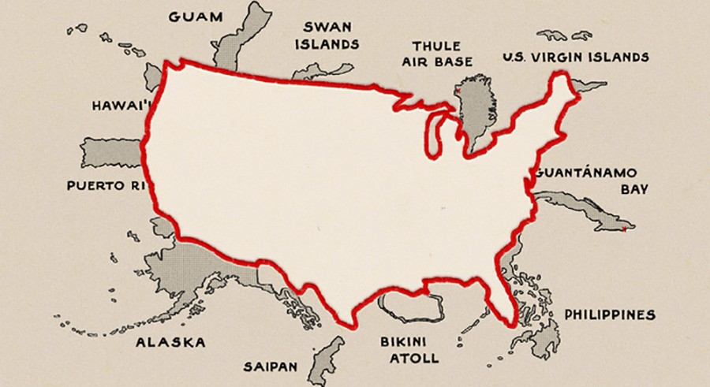
Notes:
In his book, How to Hide an Empire, Daniel Immerwahr, associate professor of history at Northwestern in Chicago, tells the fascinating and often surprising story of the United States outside the United States. Take a look at this. We are familiar with maps that outline all fifty states. If we close our eyes we can picture it. But the US logo map doesn’t accurately reflect the dominion of the empire. In fact, the map you’re accustomed to see was only like that for 3 years in US history. Instead, this image on the cover of Immerwahr’s book shows the actual territories this country has governed and inhabited to establish American presence around the globe. And presidents and politicians over the years were intentional not to call them colonies, but instead to call them territories, in an attempt to avoid the obvious.
In the years after World War II, when the world had been torn apart by empires, Immerwahr notes that the United States moved away from colonialism. Instead, it took a different approach. It’s called globalization. [NEXT SLIDE]

Slide 3
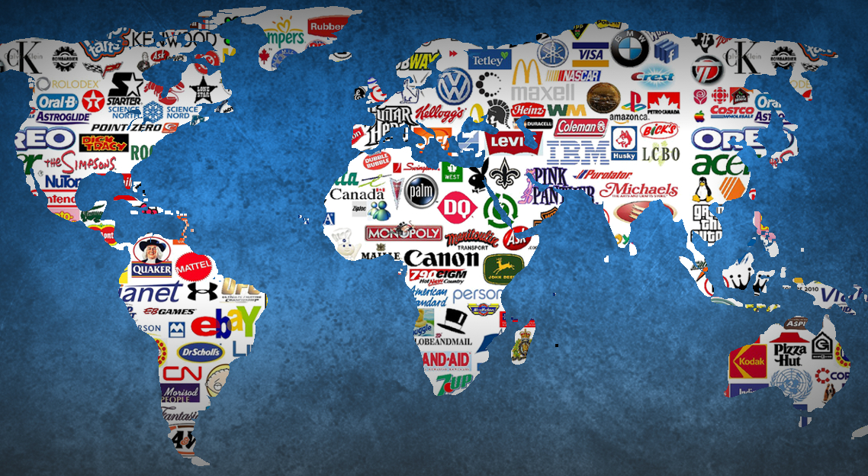
Notes:
Globalization is about spreading American culture and influence through technological innovation, through American corporations (from food, to clothing, to high-tech industries, to big banks and big oil), through controlling the global market, by positioning ourselves with strategic allies around the world so that we can ensure American dominance. Which is why we’ve seen foreign intervention by the US government since WWII, from toppling regimes that don’t coincide with American interests to invading and occupying sovereign nations in the name of freedom and democracy, while often turning a blind eye to grave injustices, like the Rwandan genocide, or more recently the atrocities committed by Syrian President Bashar al-Assad, which has led to 5.6 million refugees.
At some point, we have to come to terms with American imperialism, that the US isn’t nearly as concerned about peace, freedom, and democracy as much as it is in policing the world and maintaining total military dominance over the nations of the world. [NEXT SLIDE]

Slide 4
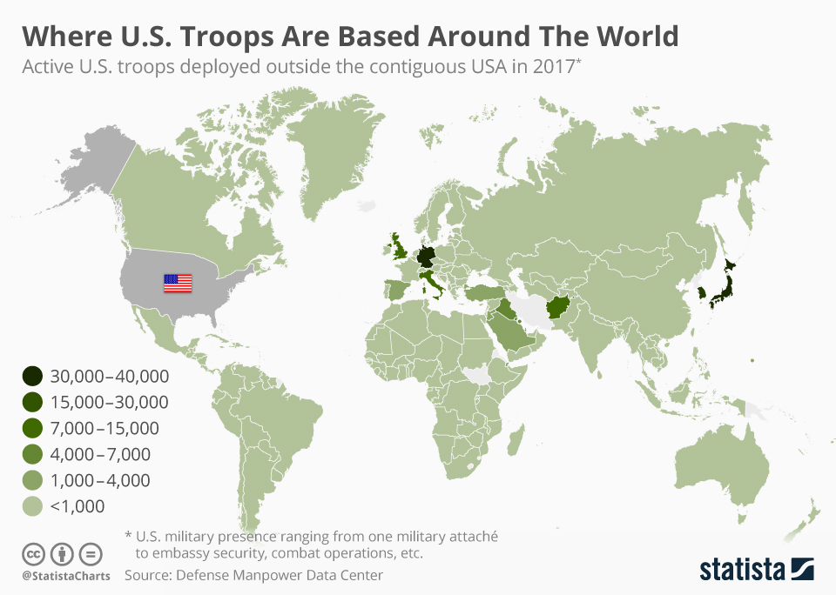
Notes:
Think about this. There are currently more than 800 US military bases around the world. Last year defense spending on the military was over 718 billion dollars. And in the 244 year history of this country, we’ve only seen about 20 years of peace. And as I said, the US was careful not to “colonize” others, but instead they annexed territories and strategically placed military bases around the world, as you can see in this graphic. This is the so-called “empire of liberty.”
This reminds me of President Dwight D. Eisenhower’s farewell speech given from the White House in 1961. After seeing the rise of American preeminence and the official creation of an American empire post 1945, Eisenhower, in his parting words to the country, said, as a result of WWII, ”we have been compelled to create a permanent armament industry of vast proportions.”
He went on to warn against the growing “military industrial complex” and said that the “potential for the disastrous rise of misplaced power exists and will persist.” Eisenhower knew that war could become profitable and we might see more of it. Which we have. I have to say that his speech is rather haunting when you look at where we are today in 2020.
So, reflecting on what I’ve shared about the American empire, I think we need to also acknowledge that this whole imperial enterprise rules out the idea that America is, ever was, or ever could be a Christian nation. In his recent book, Scandalous Witness, Lee Camp sums it up this way: [NEXT SLIDE]

Slide 5
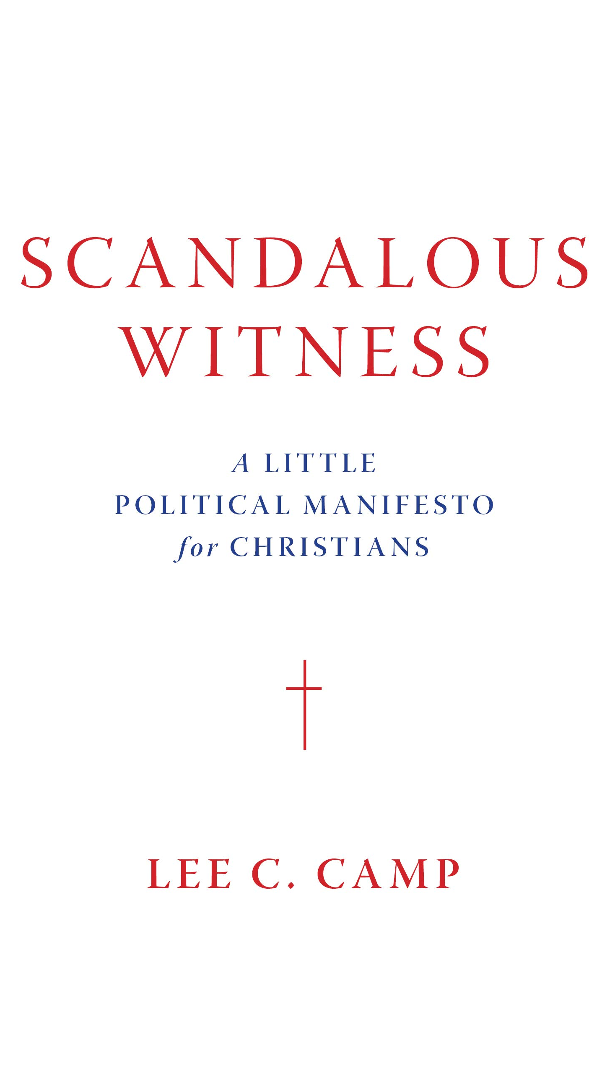
Is the United States a Christian Nation?
“This claim that the United States was, is, or can be a Christian nation is (a) historically false; (b) theologically false, and (c) strategically alienating.”
Scandalous Witness, pg. 68
Notes:
How is it historically false? Well, consider this. Neither God nor Christianity is mentioned in the US Constitution. While some founding leaders were Christians, and some even loved the idea of America being Christian, the key founders were Deists who believed in God (or the Creator), but that he was distant, aloof, and not the Father of Jesus. They wanted religious tolerance, and there is no doubt that Christianity influenced their thinking, but as the Treaty of Tripoli stated in 1797 under John Adams: “The government of the United States is not, in any sense, founded on the Christian religion.”
How is it theologically false? As Camp writes, “American cannot possibly be a Christian nation because no nation-state can be a Christian nation-state.” Think about it. Nation-states are bounded geographically by border, but the Kingdom of God and Christ’s work in creating a new humanity on the earth is transnational and multi-ethnic. Nation-states are bound by their own laws, Christians are bound by Christ’s law. Also, and most importantly, the theocracy project was a failure with Israel, according to the Bible. It was never what God wanted, and it’s not what Jesus came to establish. I’ll come back to that in a minute.
And how is the “Christian nation” idea strategically alienating for the church? Simply put. When we put our love for America, our identity as Americans, and our hope in America—when we accept the maddening wine of empire—we compromise our allegiance to Christ, we distort the beauty and distinctiveness of his Kingdom, and we betray our brothers and sisters in Christ who are not American.
Furthermore, we bastardize our faith to unbelievers by wedding the gospel with empire, by putting down the cross to pick up the sword. And folks, all we need to do is look to history (going back to Constantine, and before that to ancient Israel) and see that this has never worked out for God’s people or for the world. The gospel is most striking and captivating when the church sets herself apart from empire and trusts in the foolishness of cross-power.
And that’s what Jesus is inviting us to with his words in John 18:36 when he said: [NEXT SLIDE]

Slide 6
“My Kingdom is not an earthly kingdom. If it were, my followers would fight to keep me from being handed over to the Jewish leaders. But my Kingdom is not of this world.”
Jesus, John 18:36 NLT
Notes:
As I’ve said before in this series, Jesus is not saying that his Kingdom is far off and far removed from real life, from real concerns, and from injustice. No, he is saying while my Kingdom isn’t of this world, it is for this world. But let’s be clear about this… his Kingdom (i.e. the reign and the rule of God on the earth, which always looks like Jesus) operates differently. Folks, this is the “better country” Hebrews 11:16 speaks of, the one we really long for; not the cheap imitations and parodies we see in the nations and empires of the world. Instead, we long for a better one, a “heavenly” one. That country will never let you down.
But we need to know, this country—God’s Kingdom—is not about power-over, it’s about power-under. Worldly kingdoms can threaten law breakers, go to war against their enemies, and create policies to combat evil and promote justice (which can help, to be sure), as Paul gets at in Romans 13, but the kingdoms of the world can never change hearts. They can not bring the peace and freedom they promise. Only the Kingdom of God can do that. Worldly kingdoms can only suppress evil, they can’t overcome it, as Paul tells us in Romans 12. And so how do we overcome with the power of the Kingdom and the truth of the gospel? We believe in the way of Christ. And we believe in his Messianic Agenda. Remember, it’s about… [NEXT SLIDE]

Slide 7
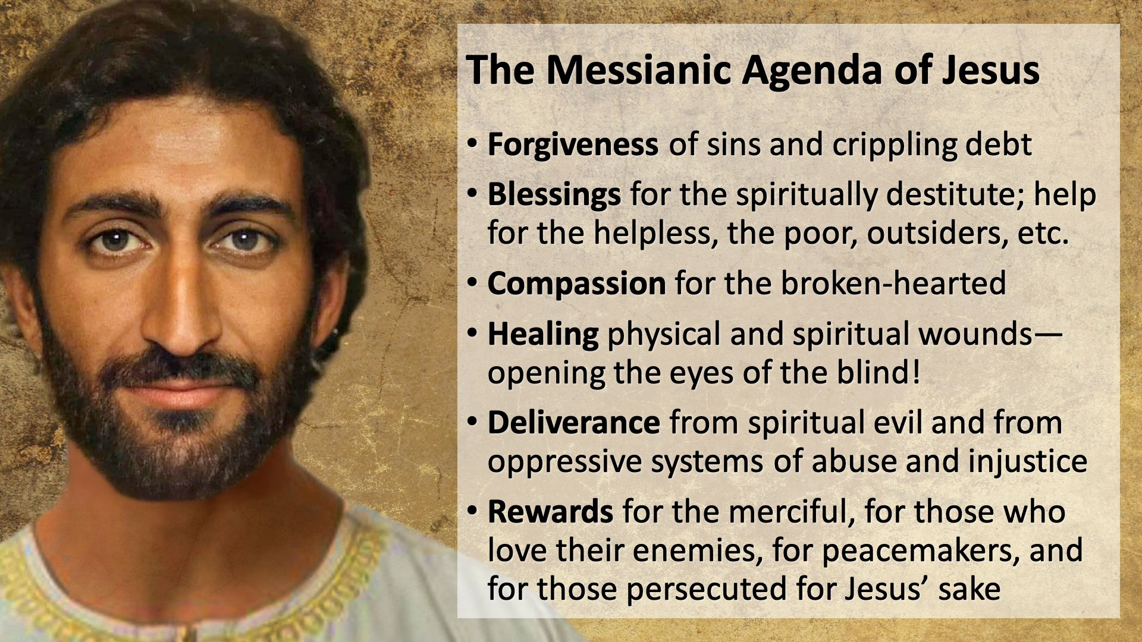
Notes:
[BRIEF COMMENTS]
And the first Christians took Jesus’ political agenda seriously. They understood that Jesus was calling for a new world order. He was challenging the status quo, challenging the empire, and casting a new vision for the world; which again, comes by patiently living out his teachings and trusting in cross-power. As we saw a couple weeks ago, the early church did this and they experienced explosive growth in the face of opposition, against all odds. They had no political power, no privilege, no vote. Yet the Kingdom advanced through them.
Remember how they furthered the Kingdom despite how they were despised by the empire. Despised for… [NEXT SLIDE]

Slide 8
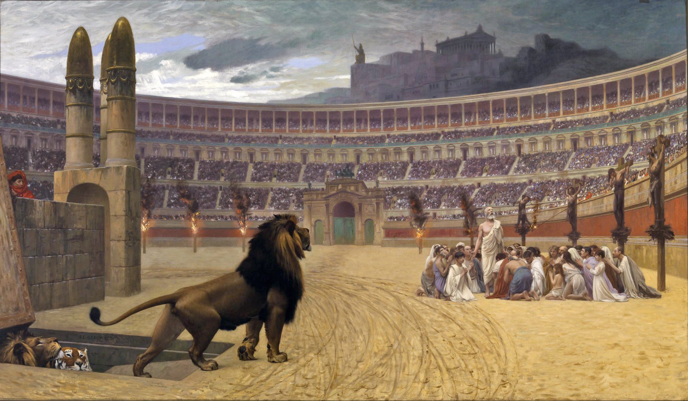
Roman Imperial Opposition to the Early Christians
Christians were despised for…
Not swearing & pledging to Caesar
Refusing to glorify violence & war
Having high ethical & moral standards
Denouncing lust, greed & materialism
Valuing all life (the unborn, the poor, women, widows, the marginalized, etc.)
Rejecting the gods of Rome to worship a crucified criminal as the one true God
Rumors due to novelty & secrecy
Notes:
One particular place where the early Christians were given a difficult time was in the Roman colony of Philippi. This was a city filled with the rich, powerful, elite. Scholars say that it was populated by many retired Roman soldiers and other imperial loyalists and patriots. It wasn’t the place that any marginalized person would want to be. For example, it appears there weren’t any Jews who lived there because it took 10 Jewish men to start a synagogue, and there was no synagogue in Philippi.
That certainly explains why the church in Philippi was started by a Gentile merchant woman named Lydia (as Luke tells us in Acts 16), and why the Apostle Paul was thrown into prison there for casting a demon out of a poor servant girl who made money for her master by telling fortunes. You may recall, this is where Paul and Silas were in jail praying and singing when the earth quakes, and the Roman jailer who witnessed it accepted their message and his whole family became Christians.
So, imagine that Roman colony as you read Paul’s letter to the Philippian Christians. All throughout the letter Paul uses politically subversive language; that “Jesus is Lord” and Savior—political titles that Romans used to speak of Caesar; he spoke of the “good news” (the euangelion) of Jesus, which was a word used by Romans to describe what Caesar’s empire gives the world. And look, his audience knew how this sounded and what it meant for their identity, their allegiance, their loyalties, and their citizen status.
Remember, it’s in this political letter that Paul writes, “that at the name of Jesus every knee should bow, in heaven and on earth and under the earth, and every tongue declare that Jesus Christ is Lord, to the glory of God the Father.” Friends, we must hear how politically subversive and transcendent the gospel of the Kingdom is to those who have pledged their allegiance to empire, to protect a certain way of life, and to fighting with the weapons of this world. That is why we must remember who we are and the agenda that we’re called to embrace, which cannot be contained or lived out fully through any party or nation.
And please hear me, church. I don’t say that to discourage us from civic participation, but to remember that only so much can be achieved by worldly kingdom means. And we should never forget it. The NT teaches us this. And we can look to the early church and Christians around the world today who testify to the fact that the fulfillment of the Great Commission and the success of the church does not depend upon politics and worldly kingdom power. It never has. And it never will.
Nevertheless, let’s think about those Christians in Philippi. While they likely couldn’t vote, as the voting system was very different in ancient Rome, they were still very political. So, let’s listen to what Paul says to them, and what the Spirit wants to say to us who live in a representative democracy, where if you’re a citizen and registered, you can vote. Paul says this in Philippians 1:27. [NEXT SLIDE]

Slide 9
“Above all, you must live as citizens of heaven, conducting yourselves [politeuesthe] in a manner worthy of the Good News about Christ.“ Paul, Philippians 1:27 NLT
Notes:
Citizens of heaven – we’re “aliens and exiles” and strangers in the world, Peter said. And here the Apostle Paul is saying that we’re ambassadors for the Kingdom; our passport reads “citizen of the Kingdom of God” and it’s out of this identity, this calling, and this concern that we live and engage with the polis, with the city-state. Paul is saying, this citizenship trumps all others, and it ought to inform how we conduct ourselves wherever we happen to live in the world.
Conducting yourselves – the Gk word politeuesthe refers to our civic life, our civic conduct; how we behave politically should reflect (i.e. be worthy of) the gospel of Jesus. It should reflect the politics of Jesus. It should show that we value what Jesus valued; that we believe in the Messianic agenda, and that we get our marching orders from Christ and his teachings, not from a political party or from a political ideology.
So, with this in mind, you’re probably wondering… How do we conduct ourselves civically in an empire with a representative democracy? And more specifically, How should we vote? To help us answer that question, I thought it best to let the creative animator, speaker, and podcast host Phil Vischer do what he does best—take something that can be really complicated and make it a bit simpler for all of us.
Give Phil a listen and then I’ll close with some final thoughts. [NEXT SLIDE]

Slide 10
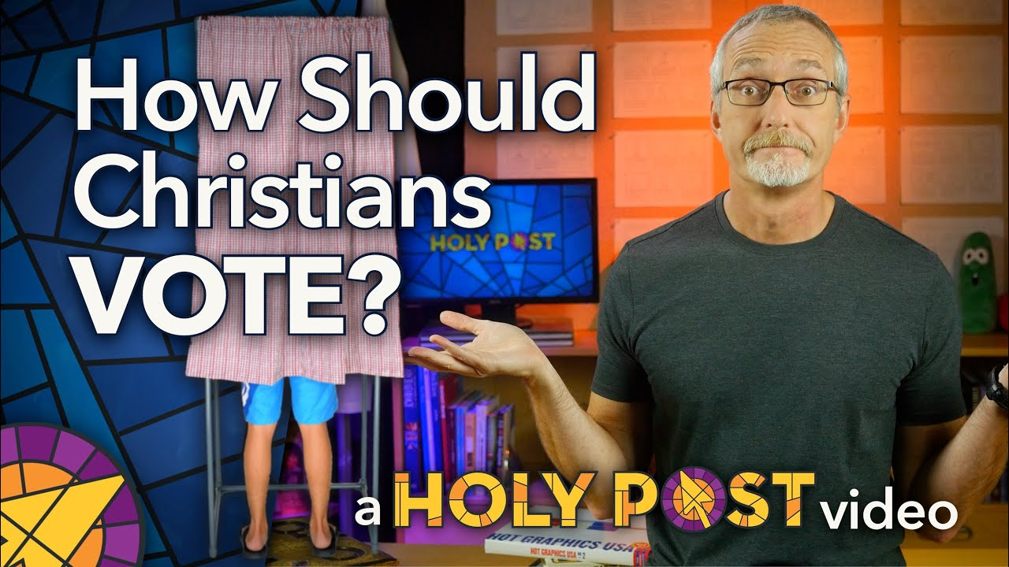
Notes:
[SHOW VIDEO]
Brothers and sisters, I know that some of you may not think it’s very hard knowing who to vote for this election. But I also know that there are those of you who feel that neither candidate is worthy of your vote. Some may choose not to vote because of the choices, or some may choose to write in the person they’d like. For many, we wish we had another option, a better candidate with better polices. I wish that things were different, but this is where we are.
So as your pastor, let me say this. If you’re going to vote, and walk with Jesus into the voting booth, let it be with the understanding that Jesus is the true King and his Kingdom will come despite the powers that rival his rule, despite the ways the world rebels against him, and despite how bad things may seem right now.
Also, if you’re going to vote, as Phil said, may it be to help those who need it most; may it be for the common good, not merely to benefit a few; not to benefit the rich, the powerful, and the privileged; not to further empire. No, Paul says let your politeuesthe (your political life) be worthy of Christ. Therefore, let the voiceless, the hurting, the oppressed, and the marginalized vote through you. And then carry on with voting everyday with each decision you make to follow Jesus instead of your flesh, by trusting in small acts of love, justice, and fairness—in the accumulative power of our choices.
And while it may sound a bit cynical, I believe it reflects the true reality of worldly kingdom politics. I think if we’re going to conduct ourselves in a manner worthy of the good news about Christ, and vote… here it is: vote for the person who will do the least damage to the country and to the world, so that we might live peaceful lives in all godliness and holiness, as we seek to further the Kingdom of God on the earth. [NEXT SLIDE]

Slide 11
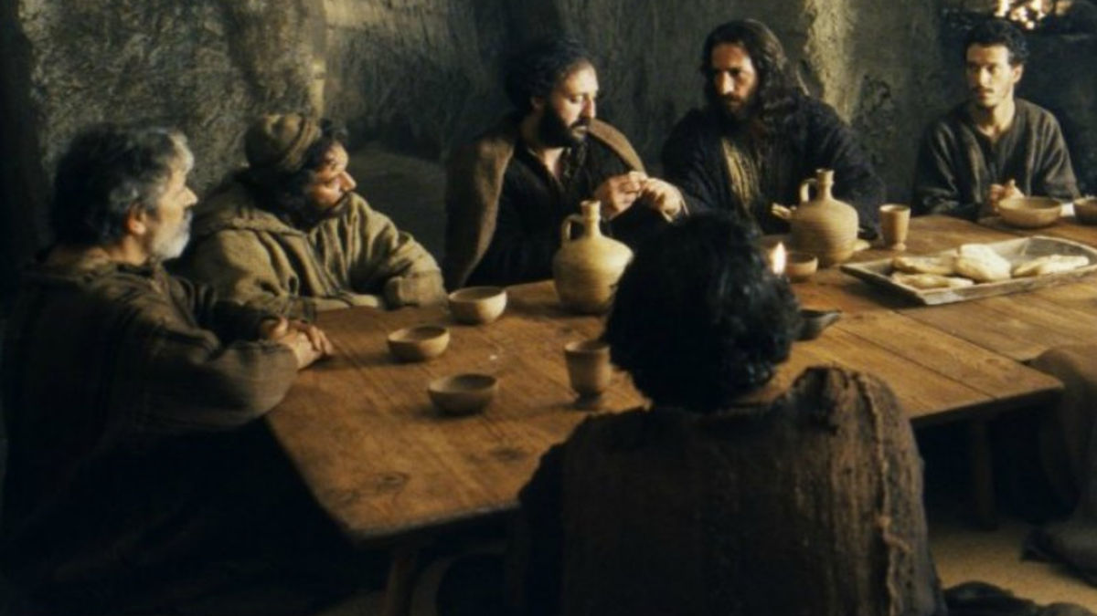
Notes:
Finally, I want to call our focus and attention to the table of Christ as we prepare for communion.
Friends, our Lord Jesus called his disciples to be one and to remember who we are in him, what he’s done for us on the cross, and that someday he will return to renew and resurrect this world. This communion table included disciples with various opinions about how the kingdoms of the world should operate. Just think about it—rural, largely uneducated fishermen, a tax collector who exploited his own people and was despised by the Jews, a Zealot who wanted to kill tax collectors, and a dishonest accountant named Judas. And yet, these are the kinds of people that Jesus called to the table.
And it’s at this table that we remember what Jesus has done and is still doing today:
We remember that Jesus calls disciples from diverse backgrounds who hold differing opinions about various theological and political issues to express their unity in him. We remember that Jesus is forming a new nation, a royal priesthood, set apart from all kingdoms of the world and the politics of idolatrous empire. We remember that real power in this world—the power to save, to transform, to change—ultimately comes from the life, death, and resurrection of Jesus the Messiah, God’s Son. And in our willingness to embody the Messianic agenda.
At the table…
We remember our sin and our need to repent of all that dehumanizes us, so that we can love God, our neighbor, and our enemies as ministers of reconciliation. We remember that we are not to conform to the pattern of this world, but we are to be transformed by the renewing of our minds by the power of the Holy Spirit. And We remember that in communion we identify ourselves as children of the one true King—citizens of heaven and exiles on the earth—until he returns in glory for his Bride.
My invitation to you today is that you would remember this as disciples of Jesus. In the coming days, remember who you are, what it looks like to embrace the way of Jesus, and where our ultimate hope and help comes from—not in horses and chariots, not in parties and presidents, not in donkeys or elephants, but in the Lamb of God who has called us to subvert the powers of evil and empire by orienting our lives to the Kingdom that is coming, Amen.

