Slide 1
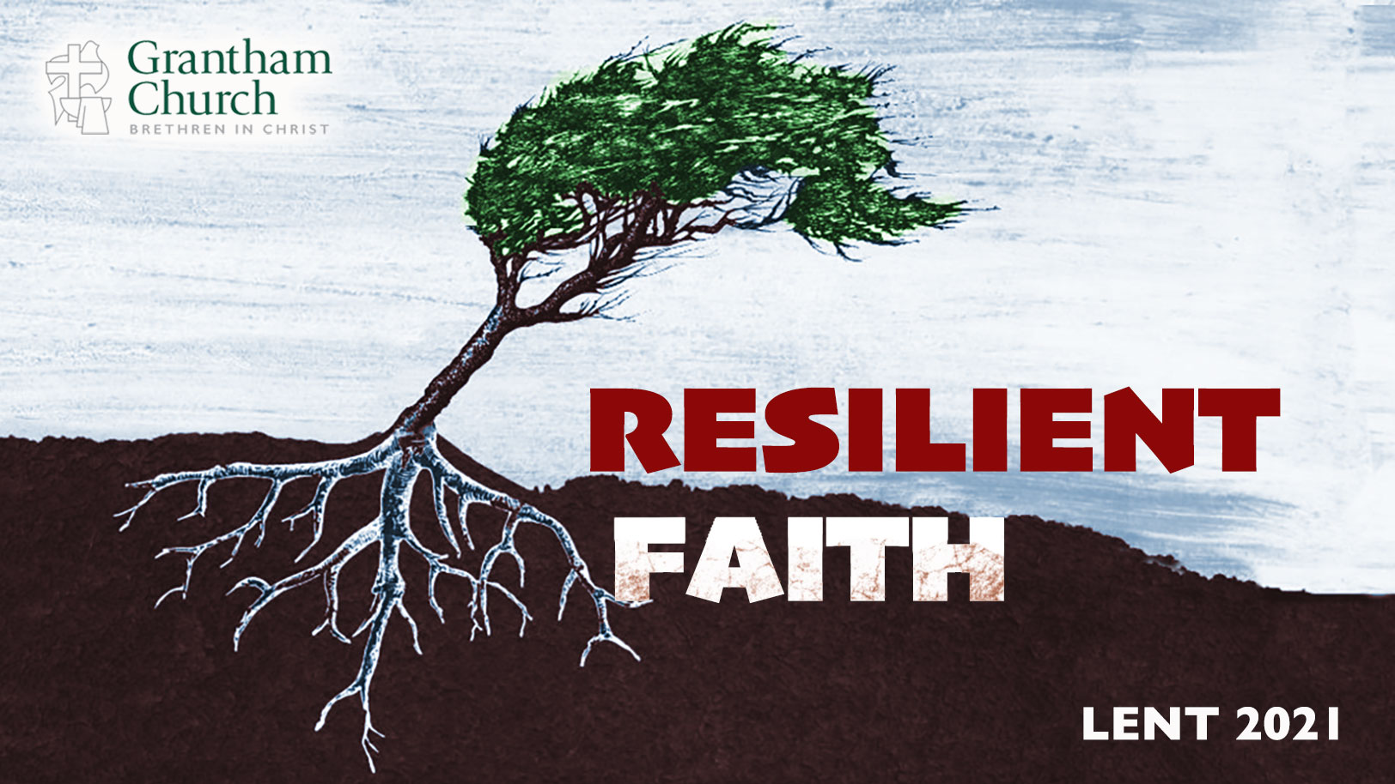
Notes:
For the past 5 weeks we have been in our Lenten series, Resilient Faith—a series that aims to deepen our trust in Christ and grow our faith to withstand the trials, challenges, and storms of life; to develop the grit, adaptability, and resilience of our Lord Jesus.
So far in this series we have looked at how God wants to use the wilderness to shape our character and our faith (if we will let him). We have seen how we must resist evil and temptation if we’re going to overcome hardships and live into God’s best for us. And we have also reflected on the necessity of lament in building resilient faith; that there is a healthy way to do that, otherwise, our faith will be malformed.
And last week we looked at how important it is to know who you are in Christ. As we see with Jesus at his baptism, knowing who you are enables us to overcome the trials and opposition encountered in the wilderness. Because it’s in the wilderness where our identity is challenged the most.
And it’s my hope this morning that you will see how knowing who you are in Christ is connected to what I’m going to address in this message: the biblical view of humility. In this fifth installment of our series, I want to invite us to consider: What is humility and why is it needed for building a resilient faith? Also, how do you know if you’re being humble, teachable, and adapting through your circumstances? I like us to reflect on that today in a sermon I’ve entitled, It’s the Humble Hearts that Grow. [BRIEF PRAYER]
In this series we’ve been going back and forth from Jesus’ time in the wilderness to the first wilderness experience in the Bible with the people of Israel, which you can read about in Exodus and Deuteronomy. And it’s in Deuteronomy chapter 8 that I’d like to begin this morning. [NEXT SLIDE]

Slide 2
Deuteronomy 8:2-3 NLT
² Remember how the Lord your God led you through the wilderness for these forty years, humbling you and testing you to prove your character, and to find out whether or not you would obey his commands.
Notes:
So, Moses tells God’s people, who have gone through the wilderness and are about to come out of it to inherit the promised land, what was happening to you back there was a test. And this test wasn’t so that you would fail (God never wants that), but rather so that you would learn, grow, and rise to the occasion—so that you would become everything that God has created you to be. Putting off the old and putting on the new. Because if you don’t allow the wilderness to purge you, you’re wasting your suffering.
You can think of it this way: the wilderness is a classroom. And so, the questions for the class would be, “Are you paying attention? Are you taking notes? Are you going to pass the test?”
Again, notice that Moses says the wilderness was for God to humble you and test your character. How so? Well, when you’re humbled you are brought to a place of total submission and reliance upon God instead of having an independent, self-reliant, look-what-I-can-do without God sort of attitude. When you’re humbled, your heart is moldable, your soul is malleable, and your mind is teachable.
Also, the testing out in the desert went two ways: Israel wanted to know if God could really be trusted, and God wanted to know if they would be faithful to the covenant and act like his children. And often what is revealed in the testing isn’t very pretty, but it’s necessary if we want to grow. Because that’s what the wilderness is intended to do. It causes you to look deep within and face who you are—the good, the bad, and the ugly.
It reminds me of a tv show I recently started watching. Maybe you’ve seen it. It’s called, Alone. [NEXT SLIDE]

Slide 3

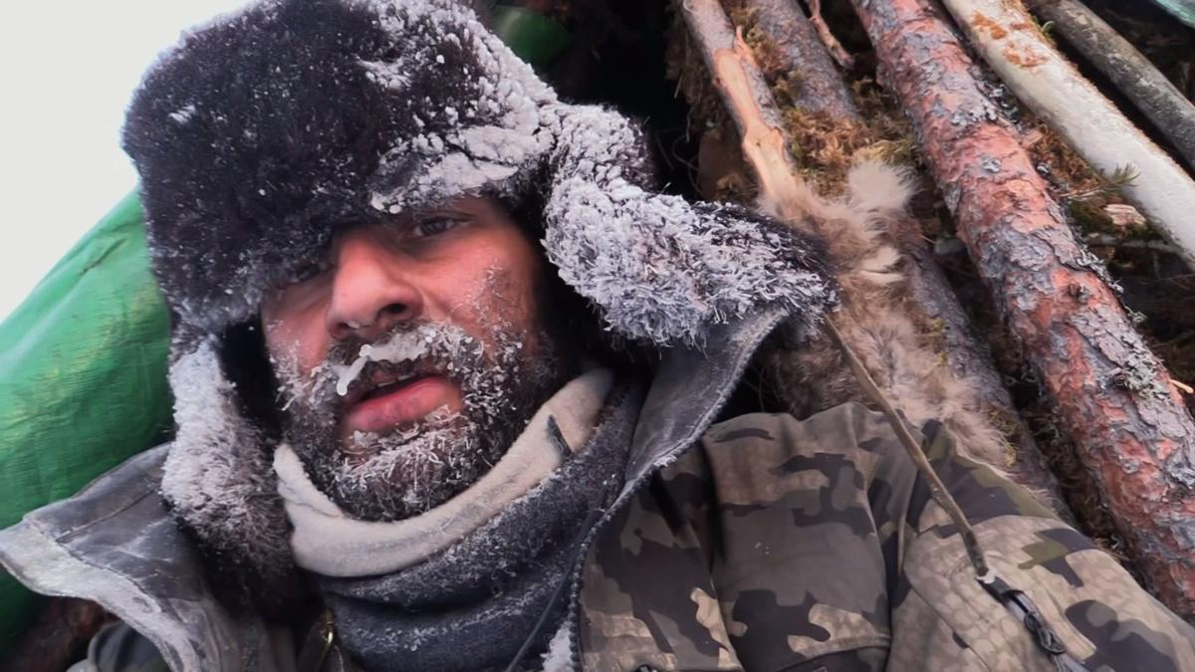
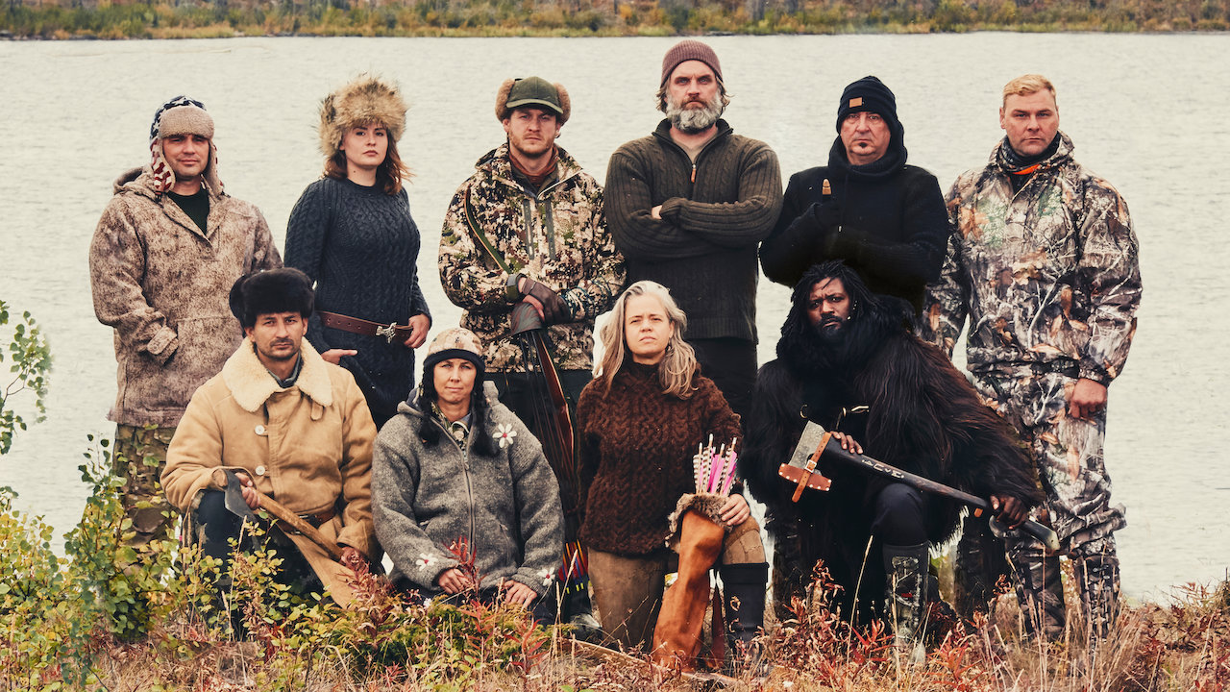
Notes:
Alone is a reality series where a handful of contestants are placed in a remote location with only a limited number of supplies. Then they have to fend for themselves and survive as long as possible. The goal of course is to be the only contestant who doesn’t quit due to the harsh conditions and extreme isolation. The show is a reminder that the wilderness, which is a place of testing, can produce blessings in the end for those who persevere.
I just finished watching season 6 where 10 people were placed in the Arctic, by far the most extreme environment on the planet. And if you’ve seen the show, you know that it’s really hard to watch grown men and women fight through the physical, mental, and spiritual challenges that come with their own private tests.
But yet, they do it. Why? Well, you could say it’s the cash reward of half a million dollars to the winner. But as you watch, you discover that while the reward is certainly motivating, you must have something more going on inside of you if you’re going to make it—i.e., a willingness to face your fears, a desire to push yourself beyond what you thought was possible, and a humility to learn, grow, and adapt to your situation and surroundings.
And just like the show Alone, where hunger is a constant battle, we see that the Bible aims to teach us a spiritual lesson about basic human need. You can go a long time without eating, but you can’t go anywhere without a deep connection, trust, and reliance upon God. Back to Deuteronomy. [NEXT SLIDE]

Slide 4
³ Yes, he humbled you by letting you go hungry and then feeding you with manna, a food previously unknown to you and your ancestors. He did it to teach you that people do not live by bread alone; rather, we live by every word that comes from the mouth of the Lord.
Notes:
In other words, we all live hand-to-mouth for the sustenance and life that God alone can give us. We live by faith, not by sight, the Bible says. We learn to trust God more (and less in things that aren’t trustworthy) when we are humbled. Which of course isn’t fun when you’re going through it. But let this be a reminder that it’s for a purpose. With God, nothing is wasted. It can all be worked together for our good.
Also, think about this. The wilderness for Israel was preparation for living in a better land, but one that would be filled with idols, material comforts, and a different set of temptations that come when times are good. When the wilderness is over, what’s next? Because times will get better. The desert life will make way for a land flowing with milk and honey. But make no mistake, it’s there that you will be tested in different ways. If anything, you’ll be tempted to live like you don’t need God in the same way you did in the desert. So be alert! Take with you what you’ve learned. And remember, you need God more than anything else.
“People don’t live by bread alone.” Where else have we heard that? Yeah, Jesus said that in the wilderness. [NEXT SLIDE]

Slide 5
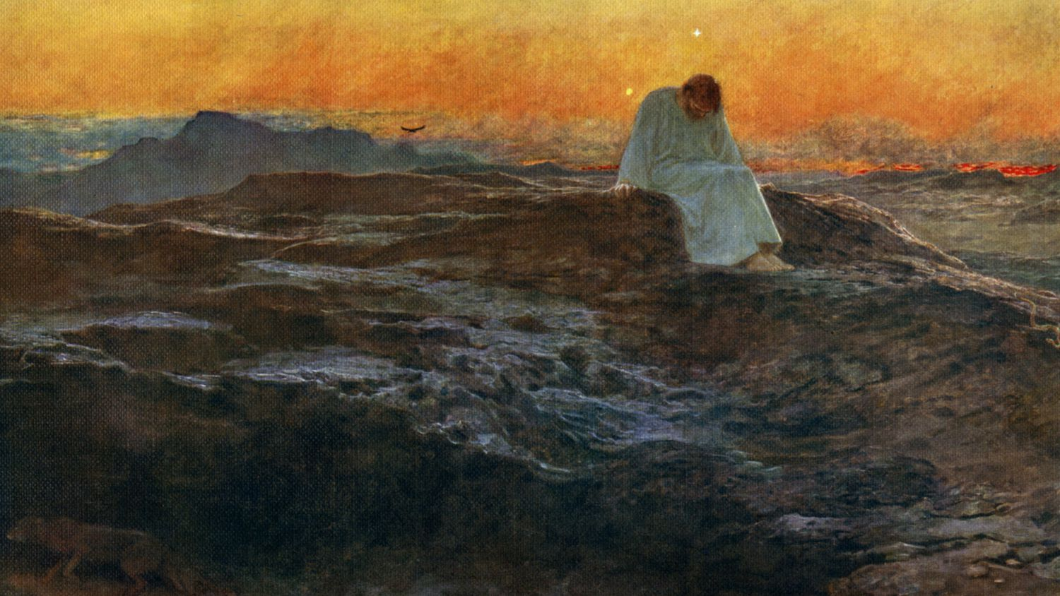
Notes:
When Jesus responded to Satan’s temptation to turn stones to bread by quoting from Deuteronomy 8:3, Jesus was showing that he could deny himself and trust God, despite his hunger. That’s what fasting is all about. It teaches us that we can surrender our strongest desires (good or bad) over to God and trust him. In that simply act of denial we are saying that God’s will and ways are better. Afterall, he will provide in his way and in his time. Therefore, I shouldn’t seek to satisfy myself and escape the test until it’s completed.
And while you might not normally think of it this way, this way of Jesus requires humility. It requires a trust in God, a submission to him in the waiting (no matter how painful or unjust), and a teachable spirit. Because real humility is about the posture of our heart toward God, ourselves, and others. But unfortunately, I think there is a lot of misunderstanding about what humility is and what it isn’t.
Check out this quote from Rick Warren: [NEXT SLIDE]

Slide 6


“Humility is not thinking less of yourself; it’s thinking of yourself less.”
Notes:
You see, church, humility is really about recognizing the truth about who God says he is, who we are, and how he feels about others. This is how our identity and humility are linked. Follow me here. What is the opposite of pride? You may want to say it’s humility, but it’s not. The opposite of pride is shame and feeling like your worthless. Just like the exact opposite of feeling superior is feeling inferior. And neither of those please God. They are both extremes that should be rejected. That isn’t what Christ wants for us.
Because when we know who we are in Christ (that God loves us and others with an unsurpassable love), then our sin and our shortcomings should only be a reminder that we must remain humble, teachable, and aware that we are always in need of grace. And we should also extend that grace to others. So, humility is about seeing yourself the way God sees you and treats you, and how he sees and treats others.
So why don’t we see more of this humility today, particularly in the church? I’d like to submit to you that a lack of humility (i.e., being prideful or even having a poor self-image) is usually an indicator of insecurity, which is often rooted in our childhood, the family we were raised in, or a traumatic experience in our career or personal lives. And if that describes you, then I want to encourage you to confess it today. Because admitting that can be extremely helpful in your healing, and in learning humility and becoming a teachable person.
And look to Jesus, because there is no greater example of humility than Christ. Listen to what Paul writes in Philippians… [NEXT SLIDE]

Slide 7
Philippians 2:3-5 NLT
³ Don’t be selfish; don’t try to impress others.
Be humble, thinking of others as better than yourselves.
⁴ Don’t look out only for your own interests, but take an interest in others, too. ⁵ You must have the same attitude that Christ Jesus had.
Notes:
[BRIEF COMMENTS]
Humility was not a virtue in the ancient world – humility was humiliation!
The belief that we’re better than others is a delusion that we’re born into
Galatians 3:28 – we’re all one and of equal status in Christ
Jesus said, ”I came to serve, not to be served” (Mk 10:45) – this is life-giving!
Again, look at verse 5. Paul says that we should have the same attitude that Jesus had. And he says it looks like this: [NEXT SLIDE]

Slide 8
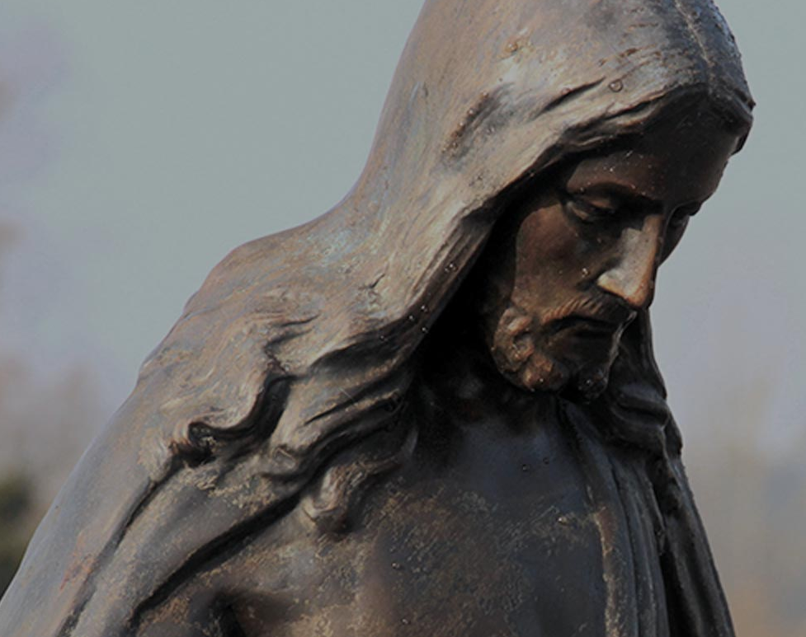
Philippians 2:6-11 NLT
Notes:
[READ & COMMENT]
Jesus understood that if you want to go high then you gotta get low. Just as he said the first will be last and the last first. It’s the physics of the Kingdom. If you want to move up, then you gotta go down and be the servant of all. It doesn’t matter who you are or what position you hold. This is how it works with God.
That’s what he meant when he said… [NEXT SLIDE]

Slide 9
For all those who exalt themselves will be humbled, and those who humble themselves will be exalted. Jesus, Luke 14:11 NIV
Notes:
Brothers and sisters, don’t miss what Jesus is saying. This is for all of us. It’s for the kings and the presidents, it’s for the CEOs and the leaders of business, it’s for the pastors and the preachers, it’s for teachers and the coaches, it’s for the actors and entertainers, it’s for doctors and nurses, it’s for police officers and first responders, it’s for the cafeteria workers and the janitors. It’s for all of us.
And it’s also for the church that wants to make a difference and lead others to the God who looks like Jesus. “Those who exalt themselves will be humbled, and those who humble themselves will be exalted.” This is important to hear because the wilderness and tough times can bring out the worst in us. Which is why Peter said this to those Christians who were suffering in the Roman empire. He said… [NEXT SLIDE]

Slide 10
1 Peter 5:5-7 (VOICE)
⁵ All of you should treat each other with humility,
for as it says in Proverbs,
God opposes the proud
but offers grace to the humble.
⁶ So bow down under God’s strong hand; then when the time comes, God will lift you up. ⁷ Since God cares for you, let Him carry all your burdens and worries.
Notes:
What a wonderful promise. When we humble ourselves and recognize who we really are and how we desperately need the Lord, he will in time deliver us. But in the meantime, we can give him our burdens.
Reminds me of the words of Jesus, which we know Peter would have heard: [NEXT SLIDE]

Slide 11
Jesus, Matthew 11:28-29 NLT
²⁸ Then Jesus said, “Come to me, all of you who are weary and carry heavy burdens, and I will give you rest.²⁹ Take my yoke upon you. Let me teach you, because I am humble and gentle at heart, and you will find rest for your souls. ³⁰ For my yoke is easy to bear, and the burden I give you is light.”
Notes:
Look at that. ”Let me teach you, because I am humble.” Let me teach you. Are you teachable? Or do you think you already know everything; or if you don’t… that you can figure it out on your own? Maybe you have a few degrees and a lot of training, but folks, degrees don’t make disciples. Jesus does. Jesus makes disciples-who-make-disciples through humble learners, with people who are teachable.
So, we need to consider what it looks like to be teachable and live into that. [NEXT SLIDE]

Slide 12
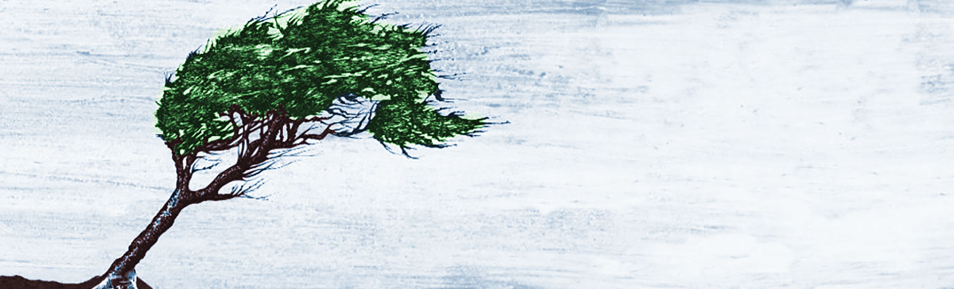
It’s the Humble Hearts that Grow
What does it look like to be teachable?

Slide 13
It’s the Humble Hearts that Grow
What does it look like to be teachable?
Having a good attitude and a growth mindset.
Notes:
A good attitude and a growth mindset means that you want to learn (that you don’t have all the answers); it means that you believe you can grow and change (and have a desire to do so), and that your determined to press on (not bail out) when times get tough. Because if you jump ship, you don’t grow.
What does it look like to be teachable? It looks like… [NEXT SLIDE]

Slide 14
It’s the Humble Hearts that Grow
What does it look like to be teachable?
Having a good attitude and a growth mindset.
Embodying regular practices of learning.
Notes:
What would be some regular practices of learning? Well, it could be a number of things. For starters, it might entail reading books that challenge you, listening to podcasts, or taking some classes. It could also look like having conversations with people from different backgrounds or from people who hold different beliefs and positions than you. It could be learning a new hobby or a new language.
Or think about this, it might be ”reverse mentoring” where you form a relationship, listen, and learn from someone who is younger or less experienced. Let them coach you on some things. Yeah, that takes some humility right there. What does it look like to be teachable? It means… [NEXT SLIDE]

Slide 15
It’s the Humble Hearts that Grow
What does it look like to be teachable?
Having a good attitude and a growth mindset.
Embodying regular practices of learning.
Saying things like, “I was wrong. I’m sorry.
I don’t know. Can you help me?”
Notes:
Church, disciples who are humble and teachable will do this because we all regularly mess up or reach the limits of our knowledge and experience, if we’re honest. And if we’re honest and humble, we don’t need anyone telling us this because humble people tend to be self-aware. They are aware of their weaknesses, are eager to improve themselves, and are appreciative of other people’s strengths, which allows them to compliment others with ease.
But I’m guessing that we all struggle with this to some extent. And I’m also guessing that most of us in this room, or those watching at home, want to be teachable. Why? Because we don’t want to be stuck. We want to move. We don’t want to be arrogant know-it-alls. We want to be humble learners who get what’s to be gotten from the wilderness so we can be used by God when our desert days are over. And most of all, we want to experience the life of Christ and the favor of God on us and on our church. Which is why I believe that you’ll affirm with me this morning: it’s the humble hearts that grow.
To conclude this message, here are some questions for reflection and response: [NEXT SLIDE]

Slide 16
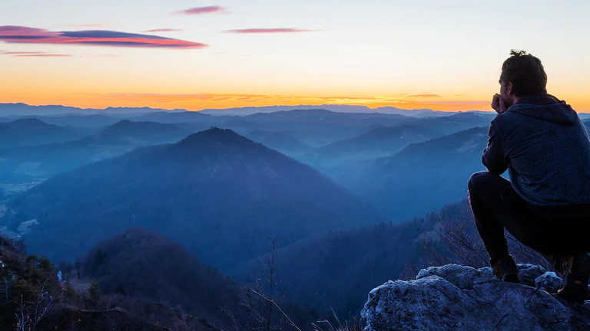
Questions for reflection and response:

Slide 17
Questions for reflection and response:
How is your attitude and mindset? Are you seeing crises and challenges as an opportunity for personal growth?

Slide 18
Questions for reflection and response:
How is your attitude and mindset? Are you seeing crises and challenges as an opportunity for personal growth?
Do you think too highly of yourself? If you’re not sure, ask yourself: “Am I willing to learn from those below me?

Slide 19
Questions for reflection and response:
How is your attitude and mindset? Are you seeing crises and challenges as an opportunity for personal growth?
Do you think too highly of yourself? If you’re not sure, ask yourself: “Am I willing to learn from those below me?
How is God inviting you to be more humble and teachable? Also, what does that look like for our congregation?
Notes:
[READ QUESTIONS]
[CLOSING PRAYER]

