Slide 1
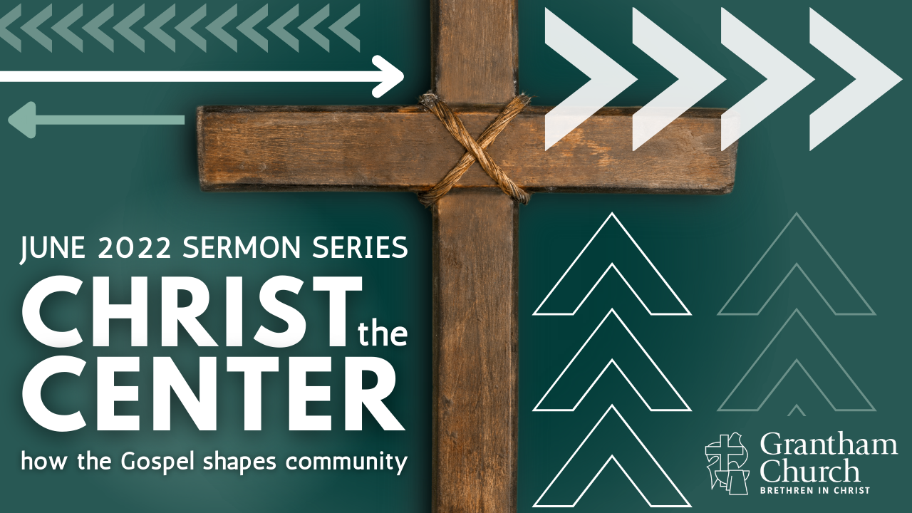
Notes:
[BRIEF INTRO]
This is the final message in our 4-part sermon series: Christ the Center: how the gospel shapes community
What does it look like to be a Christ-centered church that is faithful to the gospel? How can we be a church that doesn’t obsess over boundaries or one that ends up erasing all lines that set us apart as faithful disciples? In this series, we have been looking at how we can know that Christ is the center of our community when we are pursuing him together, affirming historic Christian beliefs, and living out our values as Christ-followers, as we extend grace to those who are at different places on their journey.
To recap our series… [NEXT SLIDE]

Slide 2
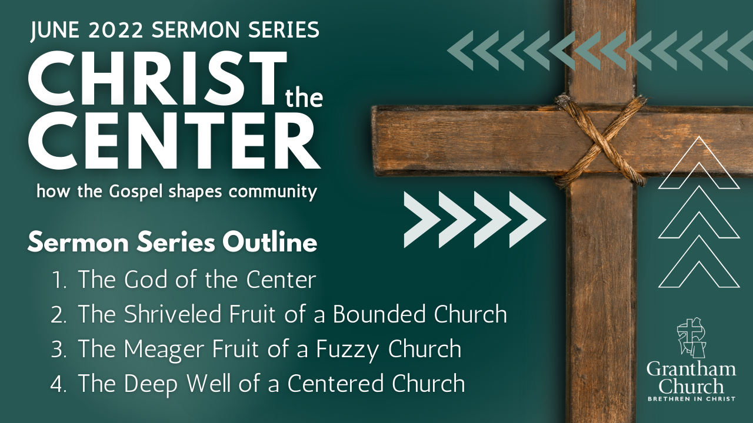
Notes:
[BRIEF COMMENTS]
1. The God of the Center – I addressed how our concept of God, and our understanding of the gospel, will determine the sort of community and culture that exists in the church. At Grantham, we say Jesus shows us what God is like, and so we want to worship and know this Jesus, and follow him with others in the church for the sake of the world—leading others to the God who looks like Jesus. Therefore, the more we seek the God of the center, the more like him we will become, individually and as a community.
2. In part 2, we looked at how the gospel challenges the “bounded” practice of community in the message, The Shriveled Fruit of a Bounded Church. We recalled how the Pharisees practiced the bounded-set, but Jesus rejected it. And we spent some time in Galatians chapters 1-4, where we heard the Apostle Paul explain why focusing on boundary markers isn’t consistent with Christ or the gospel of grace.
3. And then last week we covered The Meager Fruit of a Fuzzy Church and what it looks like when we erase all lines and boundaries, when we get careless with our beliefs and discipleship (either to be non-judgmental—often in reaction to bounded thinking—or to align ourselves with the spirit of the age), and why that is equally a bad idea.
4. Which brings us to the final message: The Deep Well of a Centered Church – we will see that there is a third way of being a community that pursues Jesus together (allowing folks to be at different places in their walk with Christ), how we discern who is a follower and who isn’t, and how we can hold grace and truth together as we live and worship in relationship with one another.
[BRIEF WORD ABOUT LEARNING MORE ABOUT CENTERED CHURCH]
We have just begun to discover and learn – keep growing with us!
If you have questions or want to explore further, let’s talk.
And you can also read Mark Baker’s book… [NEXT SLIDE]

Slide 3
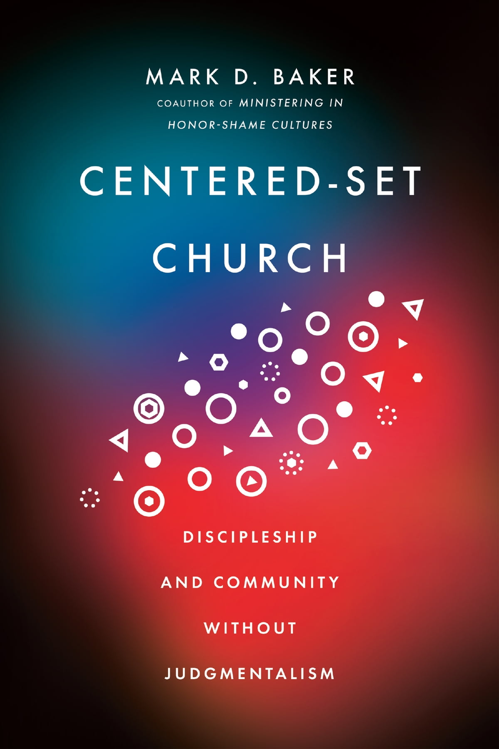
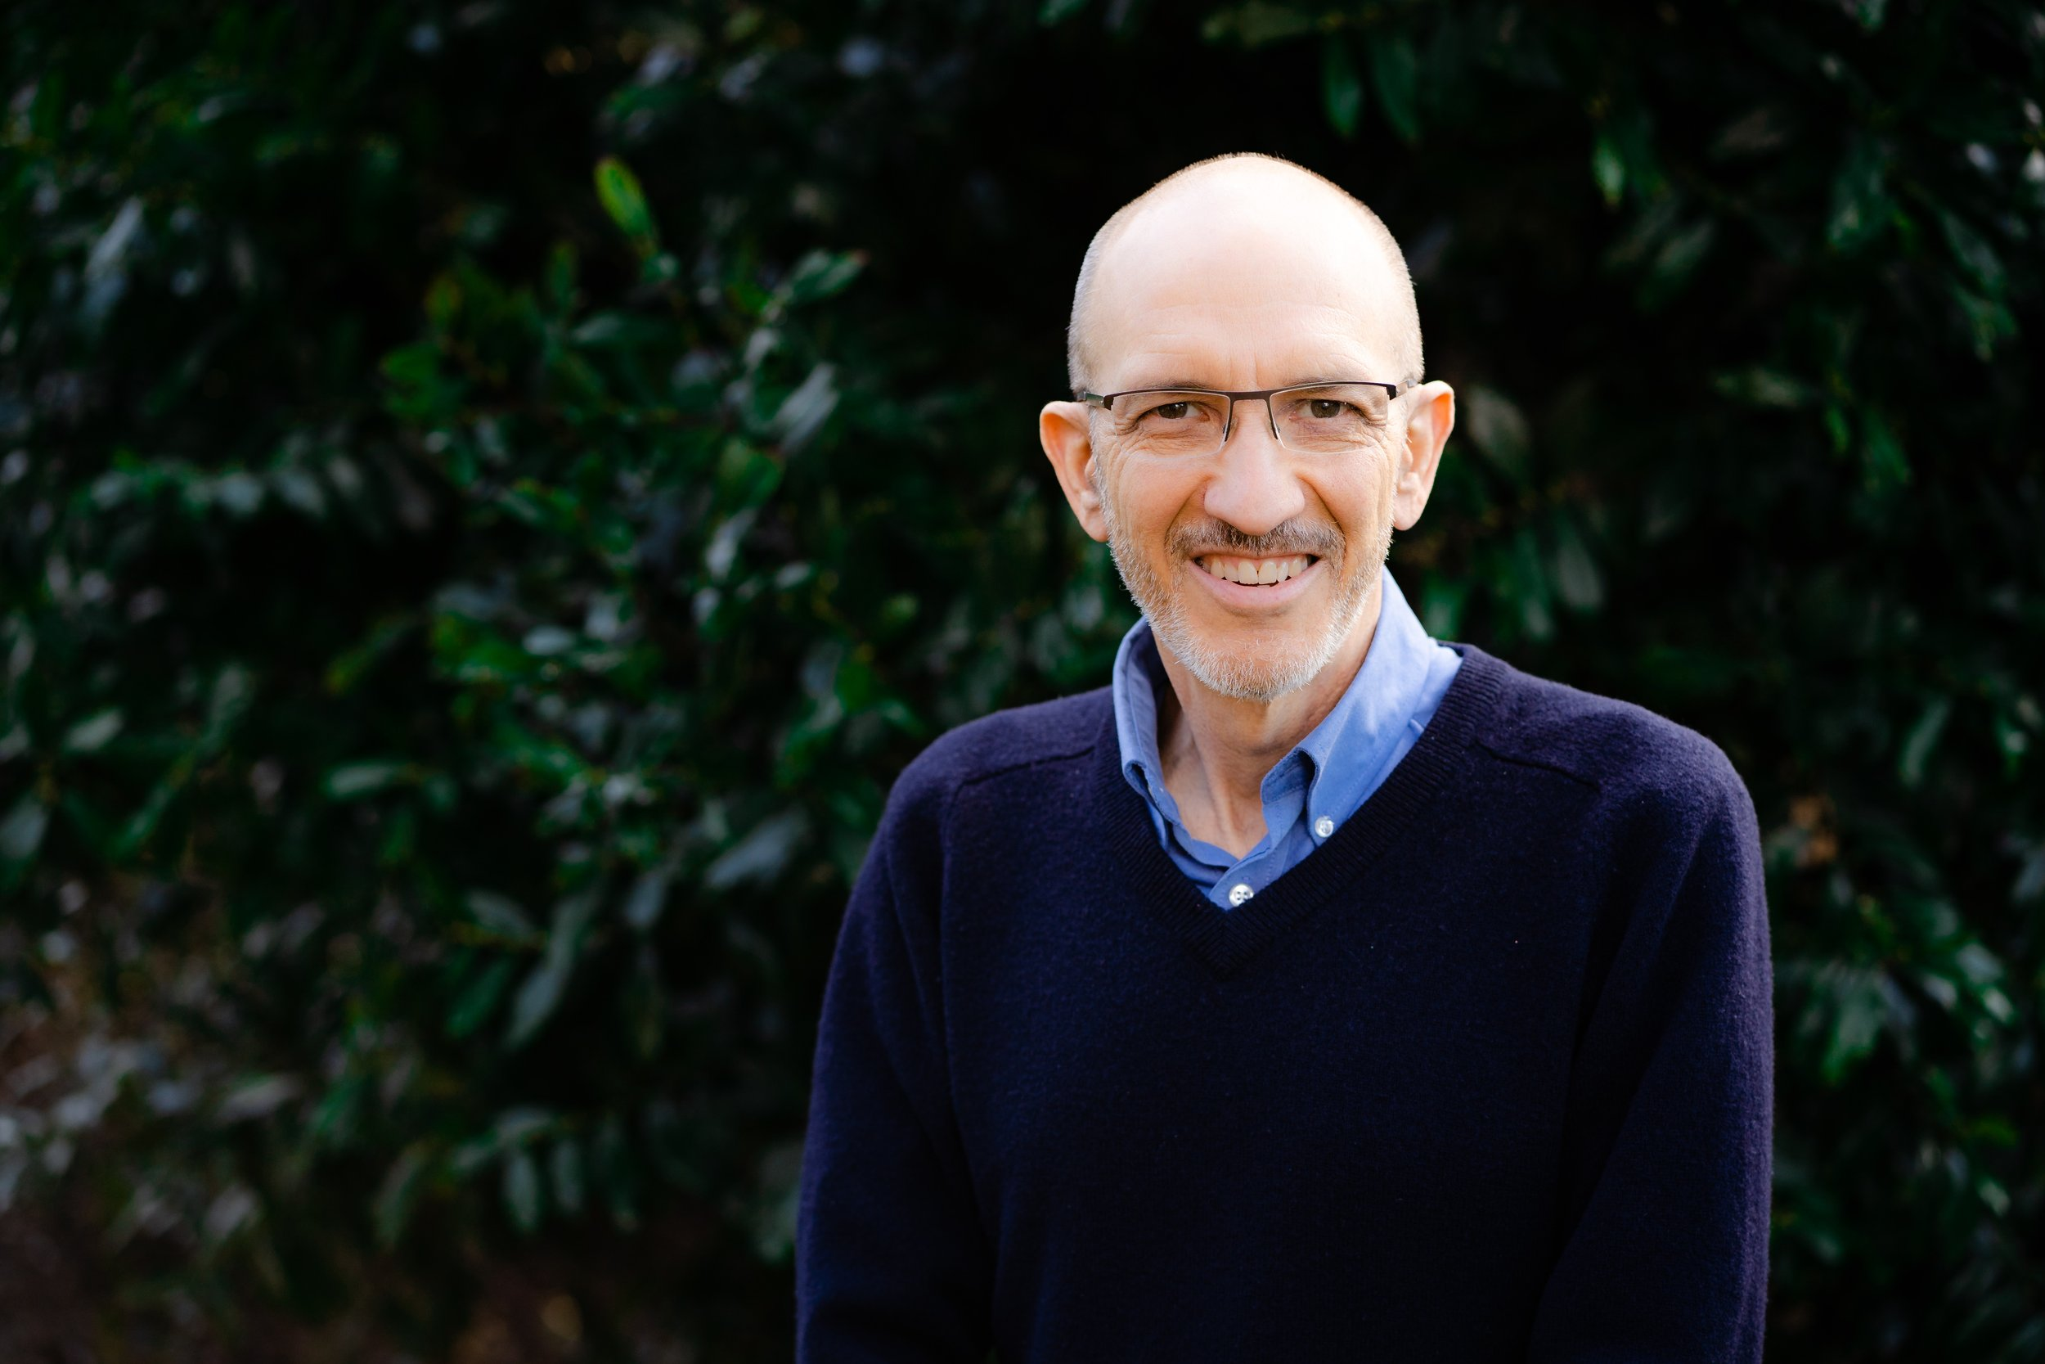
Notes:
Centered-Set Church: Discipleship and Community Without Judgmentalism
As I’ve said each week, I have received both inspiration and guidance from Mark’s book to do this series as we at Grantham pursue a centered-set approach to being a faith community shaped by the gospel of grace. And so, I hope that resonates with you.
Again, Mark expounds on three different ways of being community, and here are the images that are intended to help us grasp what each set looks like in function and practice. [NEXT SLIDE]

Slide 4
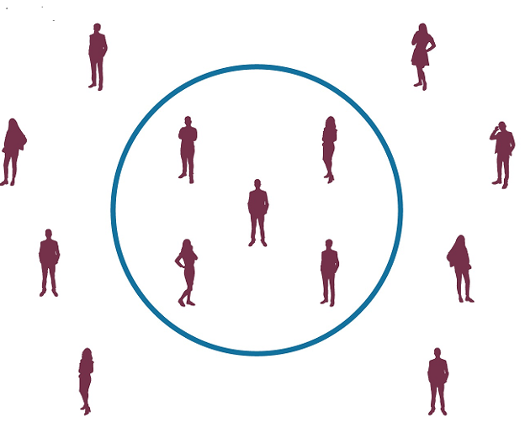

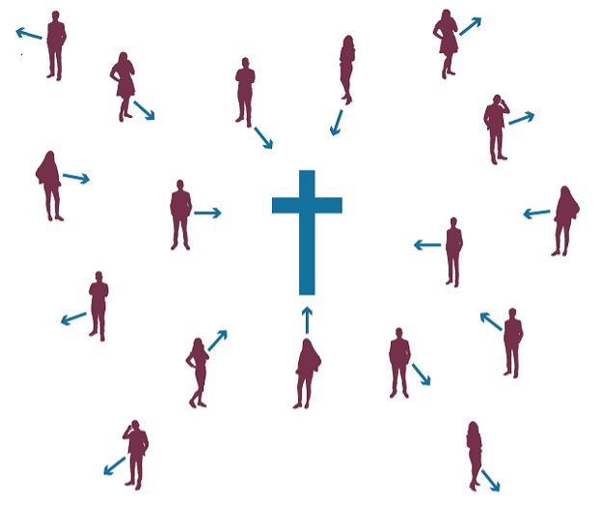
Bounded Church
Fuzzy Church
Centered Church
Notes:
[BRIEF COMMENT ON EACH]
Bounded Church – clear lines of who is in and out; focuses on boundaries.
Fuzzy Church – the removal of all lines and boundaries with no clear direction. This church is a reaction to the bounded and is often seduced by the spirit of the age.
And then there is the Centered Church.
Here is the definition we looked at the beginning of the series and the way of community that we want to follow the Spirit into at Grantham Church… [NEXT SLIDE]

Slide 5
Notes:
[READ & COMMENT BRIEFLY]
So, as Baker says, “The focus of a centered church is on helping people move closer to the center rather than trying to make sure they are not crossing any lines. This process invites people to explore one another’s stories, which creates space for nuance and complexity.” And I’ll add, this means that this form of community is entirely dependent upon the Holy Spirit at work within real, authentic relationships.
Therefore, rather than relying upon boundary makers, which breeds self-righteousness and utilizes law, guilt, and shame to motivate change, and one-size-fits-all rules, which often hurts and excludes people as the Pharisees did, we believe in the power of God’s grace (experienced through Christ and his church) to free people and compel us to orient our lives to the cross and pursue the God of the Center with other disciples.
And we become a Centered Church by holding grace and truth together as we love and worship God, and disciple people in Christ, the Scriptures, and the Spirit’s power to radically love our neighbors and our world. And so, remember what the Scriptures tell us in John chapter 1, verses 14 and 17. [NEXT SLIDE]

Slide 6
John 1:14, 17 NIV
¹⁴ The Word [Jesus Christ] became flesh and made his dwelling among us. We have seen his glory, the glory of the one and only Son, who came from the Father, full of grace and truth.
¹⁷ For the law was given through Moses; grace and truth came through Jesus Christ.
Notes:
[READ AND BRIEF COMMENTS]
One way to think about the extremes of the Bounded and Fuzzy Churches is to say the Bounded Church emphasizes truth often without grace and the Fuzzy Churches tend to emphasize grace but let the truth go, either because they’ve lost the truth entirely and assimilated to the secular age, or they still believe some truth but don’t want to hurt people’s feelings. But folks, neither of those look like the love of Jesus.
While both often come from a place of sincere concern, they both fall short of what Christ lived, taught, and envisioned for his church. That’s why the Bounded folks need to know that line-drawing won’t get us closer to God’s ideal. And the Fuzzy folks need to see that erasing the lines and removing the word “sin” from our vocabulary is also not the way Jesus calls us to love God and our neighbor. No, God’s grace to us does not mean we give up on denying our self to carry the cross or give up on accountability and holiness.
Listen to what the Apostle Paul said in Romans chapter 6:15-16. [NEXT SLIDE]

Slide 7
Paul, Romans 6:15-16 NLT
¹⁵ Well then, since God’s grace has set us free from the law, does that mean we can go on sinning?
Of course not! [NIV: “By no means!]
¹⁶ Don’t you realize that you become the slave of whatever you choose to obey? You can be a slave to sin, which leads to death, or you can choose to obey God, which leads to righteous living.
Notes:
[READ & COMMENT BRIEFLY]
v. 15 - “Of course not!” – strong language in Greek; our attitude toward sin hasn’t changed, rather the way we seek to overcome it has—it’s by grace and freedom
v. 16 - In True to Our Native Land: An African American NT Commentary, Thomas Hoyt Jr. writes: “There is no such thing as “absolute” human freedom. Humans are not free in themselves. They must live under a lordship. They are “obedient slaves” either to sin, whose end is death, or to righteousness, whose end is life.”
And so, we hold grace and truth together. Just as Jesus showed us in John 8 with the woman caught in adultery, we extend grace: “Woman, where are your accusers? Neither do I accuse you.” and also truth, “Now, go and sin no more.” And it’s people like this woman who experience the grace of God and respond to the truth that we are loved by God and made in his image, but we are broken and not as we should be. We have sinned, but we can be restored. We fall short, but there is mercy and grace. We stumble and fall, but we can get back up again and continue pursuing the Center together.
But if we’re going to experience this sort of community together, we must… [NEXT SLIDE]

Slide 8
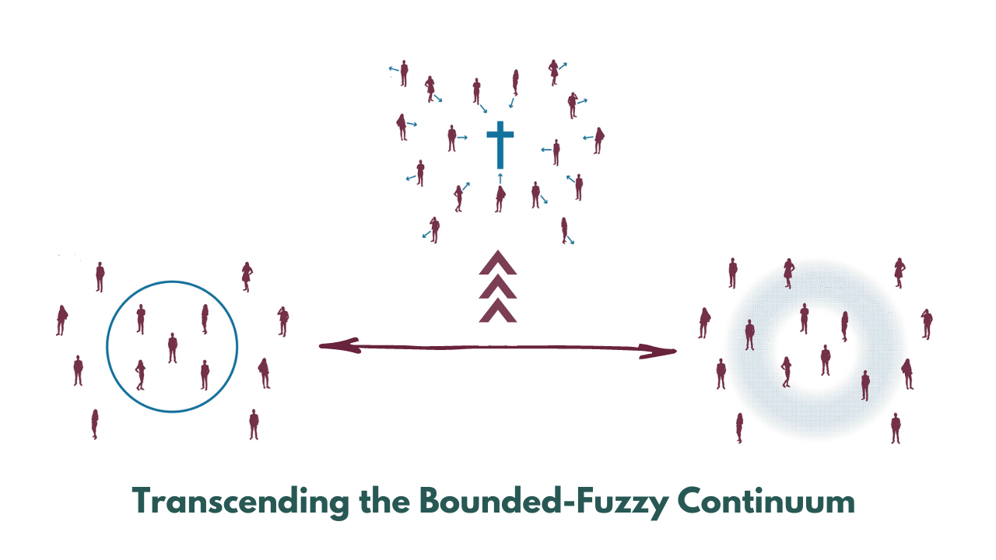
Notes:
…transcend the Bounded-Fuzzy continuum.
[BRIEF COMMENT ON GRAPHIC]
The Centered Church is a “heavenly” community that has left the world’s way of thinking; it holds “grace and truth” together and lives by the Spirit
It does away with the fences and boundary markers (and the fuzzy secular ideas of tolerance and inclusion), but don’t miss this: there is a gravity to Christ the Center
But how does that work? Well, let’s think about it this way… [NEXT SLIDE]

Slide 9
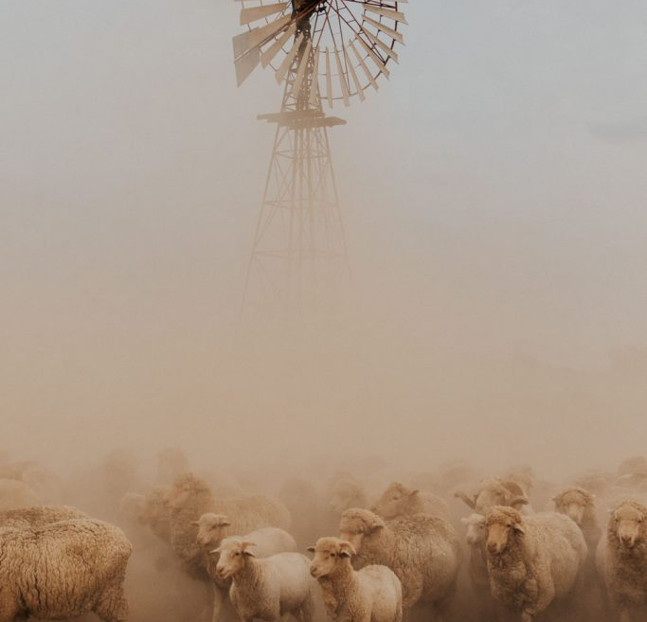
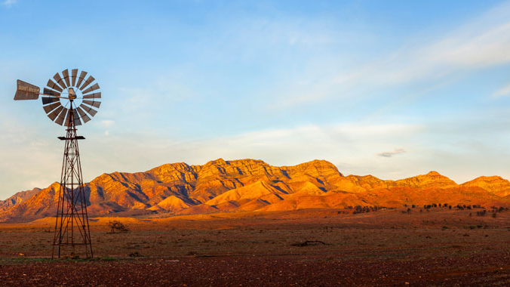
Notes:
[BRIEF COMMENTS]
The Australian Outback covers more than 70% of the continent!
The land is so dry and the landscape so massive, that ranchers and farmers have an interesting way of managing and containing their cattle and sheep
Since it costs famers too much to build fences, they dig wells
The livestock will roam, but not too far from the water source because they must keep returning to the well to drink and live
And so it is with Christ and the Centered Church. And this metaphor of Jesus being a well is actually one he himself used in John chapter 4. You may recall… [NEXT SLIDE]

Slide 10
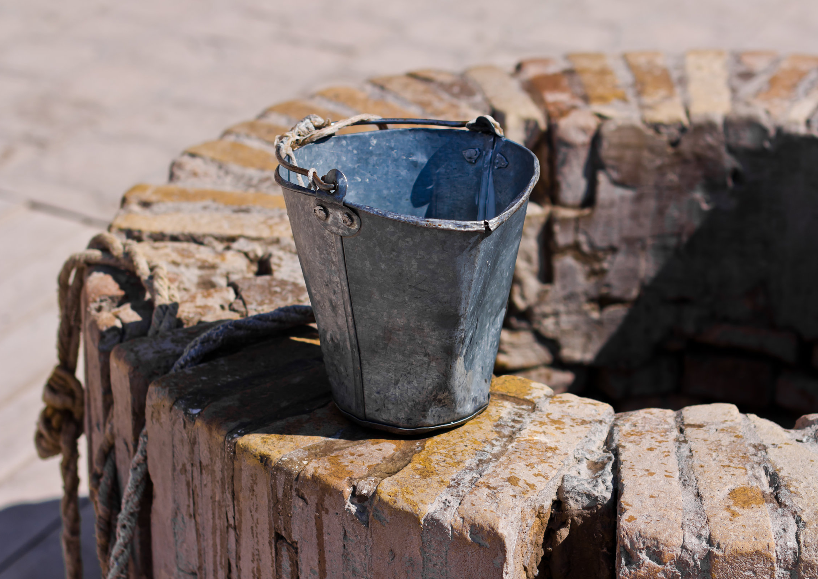
John 4:13-14 NIV
“Everyone who drinks this water will be thirsty again, but whoever drinks the water I give them will never thirst. Indeed, the water I give them will become in them a spring of water welling up to eternal life.”
Notes:
[READ & COMMENT]
So, get this picture… in our own congregation, how do we know who is a Christ-follower and with us on gospel mission? Well, as Jesus said, we only need to look at the “fruit” of their life and the orientation of their heart. Is their life aimed at Christ? [NEXT SLIDE]

Slide 11
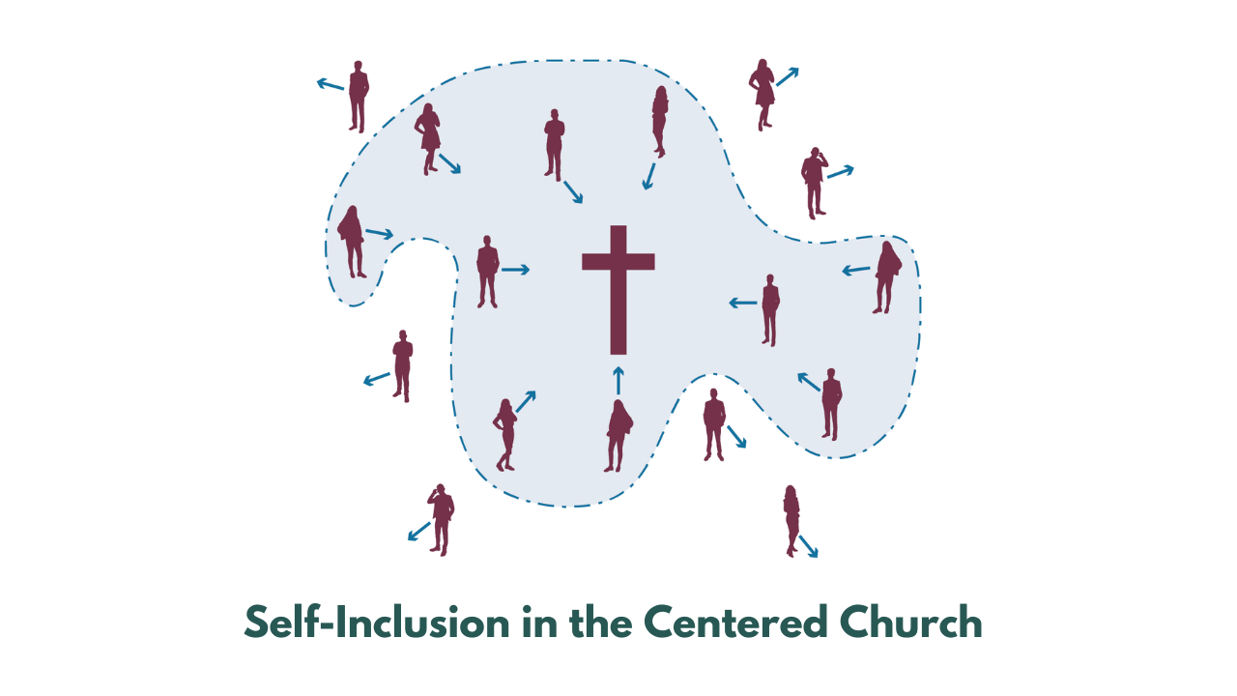
Notes:
[BRIEF COMMENT ON IMAGE]
What evidence or ”fruit” reveals that we are pursuing the center? Well, lots of things. We are present with the church, we are growing in our faith, we are repenting of sins, we are displaying the fruit of the Spirit, we are submitting to biblical instruction and correction, we are are including ourselves in on what the Spirit is doing at Grantham.
In his book, Reading Paul (2008), NT scholar Michael J. Gorman writes: “The inclusion that Paul experiences, preaches, and practices is not an inclusion lacking teeth or limits. His gospel does not say, “All are welcome just as they are,” but rather, “All are welcome just as they are to be apprehended by, and fully converted to Jesus Christ the Lord.” And so, as Baker writes, “We quite appropriately must recognize that some people are not centering their lives on Jesus.” Therefore, “We need language to describe those who are not part of our Jesus-centered communities—those we want to invite to come and join us as we drink from the life-giving water of Jesus” (pg.49).
Now, let’s Zoom in further at Christ the Center for a better understanding of what it looks like to be including yourself with us here at Grantham and drinking from the well. [NEXT SLIDE]

Slide 12
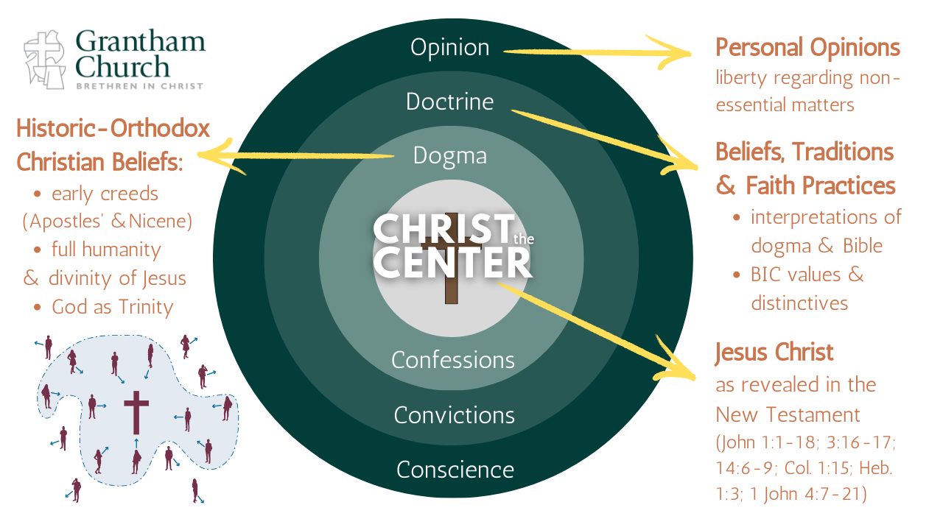
Notes:
[BRIEF COMMENTS ON GRAPHIC]
Baker writes: “Shifting from fence building to digging a well also changes the role of beliefs within a church. When doctrines are treated as a fence, they function as a litmus test. In a bounded church, doctrine can degenerate to mostly a means of defining who is in and who is out. A centered church frees doctrine to be much more than right belief. Doctrine becomes life-giving well water by helping people in the church align with and journey toward the center” (pg.81).
Therefore, when disciples who identify with us are not making decisions in keeping with their aim (their arrow is pointing away from Christ), then we must restore them gently, as Paul tells us in Galatians 6:1. And to help us see that in practice, I want to share a few stories from Baker’s book. Listen to these centered-set examples to how we lovingly show concern, practice accountability, and lead each other to the deep well of Christ.
[READ STORIES OF CENTERED-SET INTERVENTION]
Finally, let’s sum up what the deep well of a Centered Church looks like. [NEXT SLIDE]

Slide 13
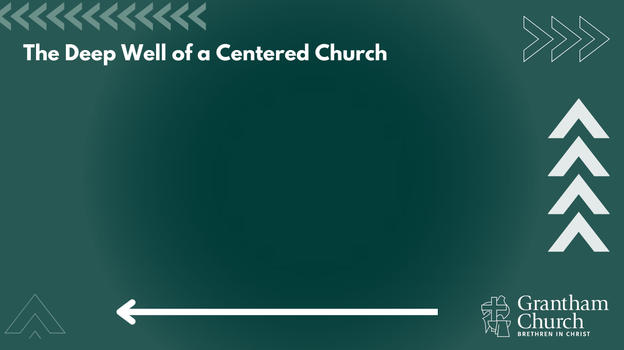

Slide 14
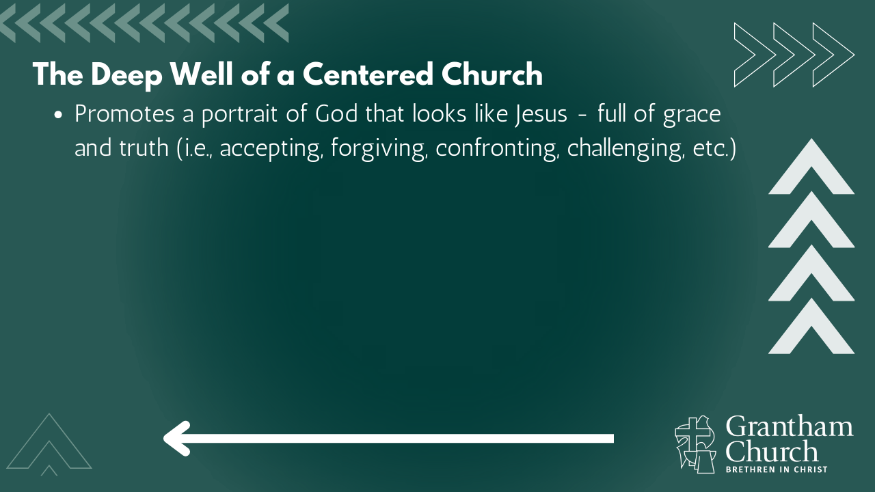

Slide 15
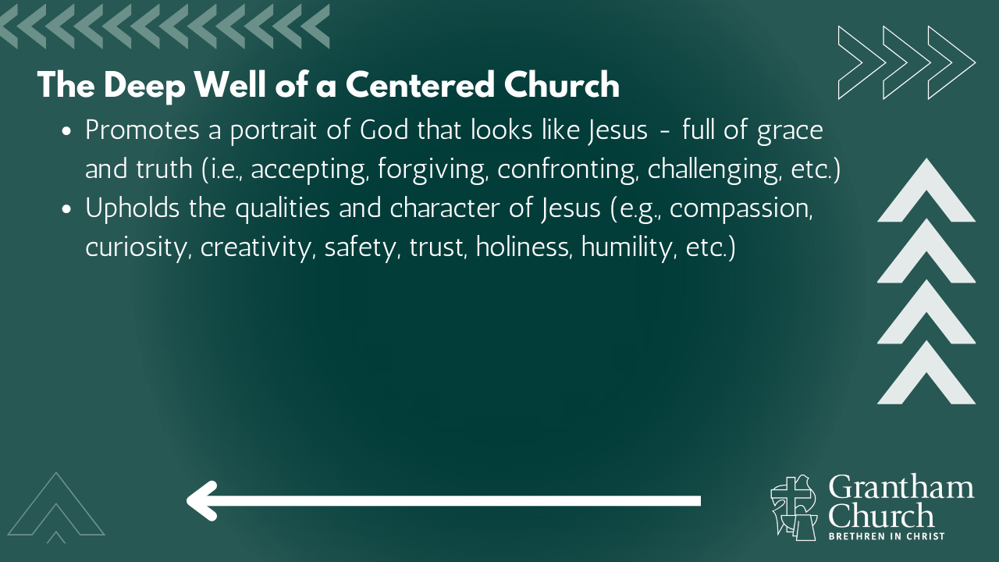

Slide 16
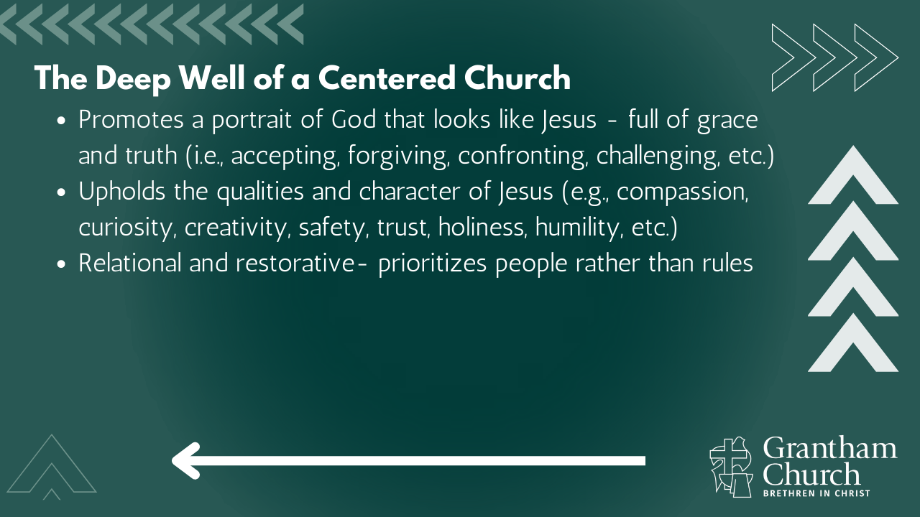

Slide 17
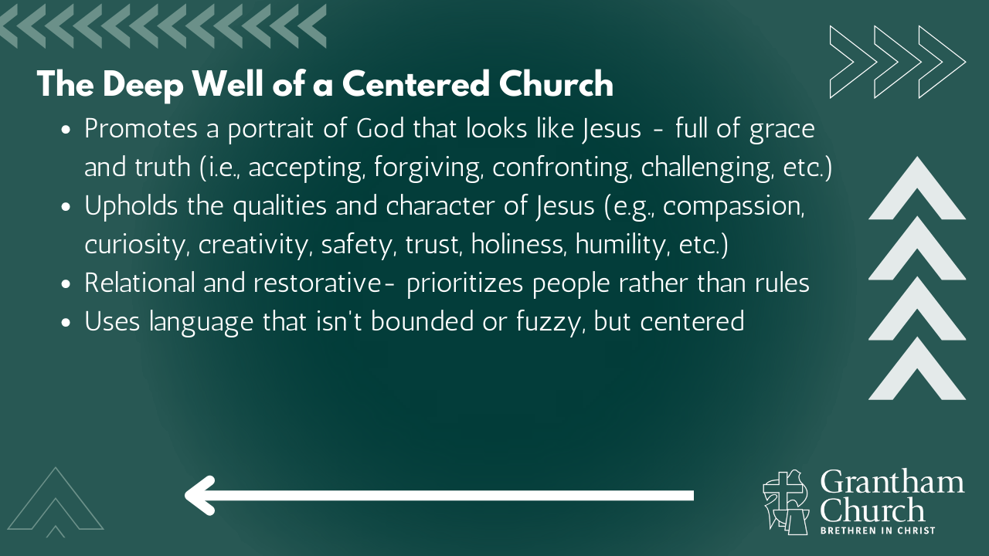

Slide 18
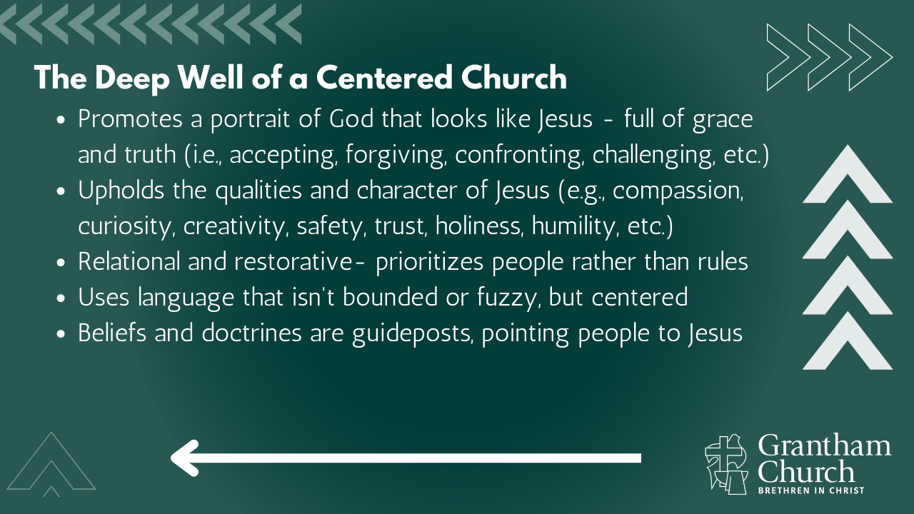

Slide 19
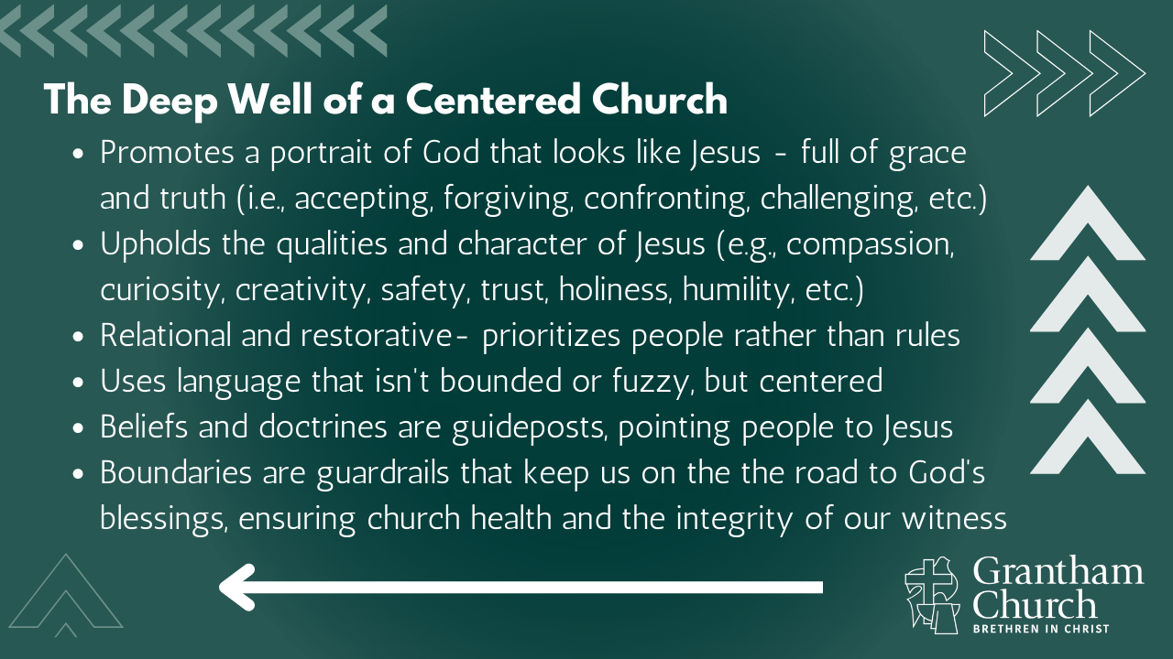
Notes:
[BRIEF COMMENTS ON EACH]
Promotes a portrait of God that looks like Jesus - full of grace and truth (i.e., accepting, forgiving, confronting, challenging, etc.)
Upholds the qualities and character of Jesus (e.g., compassion, curiosity, creativity, safety, trust, holiness, humility, etc.)
Relational and restorative- prioritizes people rather than rules
Uses language that isn't bounded or fuzzy, but centered
(e.g., don’t use “should” or “ought” but “If you…” and ask questions, etc.)
Beliefs and doctrines are guideposts, pointing people to Jesus
Boundaries are guardrails that keep us on the the road to God's blessings, ensuring church health and the integrity of our witness
In closing, here are some questions to help us respond to the Spirit… [NEXT SLIDE]

Slide 20
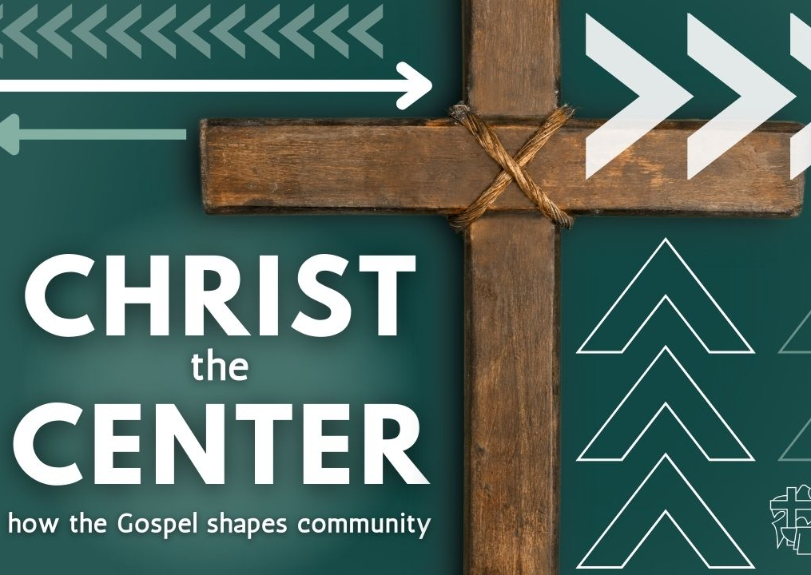
Questions
for reflection and response:

Slide 21
Questions
for reflection and response:
  Is your life oriented around Christ and the gospel? Is Jesus the aim of your heart ? Is your “arrow” pointed at the Center?
Notes:
[BRIEF COMMENT ON EACH QUESTION]
[CLOSING PRAYER]
[NEXT SLIDE FOR CLOSING PRAYER]

Slide 22
Questions
for reflection and response:
  Is your life oriented around Christ and the gospel? Is Jesus the aim of your heart ? Is your “arrow” pointed at the Center?
  How is the Spirit calling you to live into the Centered Church?
Notes:
[BRIEF COMMENT ON EACH QUESTION]
[CLOSING PRAYER]
[NEXT SLIDE FOR CLOSING PRAYER]

Slide 23
Questions
for reflection and response:
  Is your life oriented around Christ and the gospel? Is Jesus the aim of your heart ? Is your “arrow” pointed at the Center?
  How is the Spirit calling you to live into the Centered Church?
  What steps can you begin to take today that would lead you closer to the Center with others here at Grantham Church?
Notes:
[BRIEF COMMENT ON EACH QUESTION]
[CLOSING PRAYER]
[NEXT SLIDE FOR CLOSING PRAYER]

