Slide 1

Notes:
Last week’s message – “Jesus & the Selfless Life”
Hyper-individualism is one of the greatest threats to NT church life. Why exactly?
Stanley Grenz wrote, “God’s purpose is the salvation of individuals.” That’s true. Grenz continues, “But God saves us together, not in isolation. And he saves us for community, not out of it.”
And that “community” is Christ and the church. So, what is the purpose of the church?
[BRIEF PRAYER] & [NEXT SLIDE]

Slide 2

Notes:
“Disruption” – a word that describes our current state of affairs
a recent Gallop poll indicated that religious membership in the U.S. has fallen to 47%
Christianity in America (specifically “white” evangelicalism) is in decline
the pandemic has accelerated a post-Christian society
Some reasons for the decline in church attendance:
increasing secularization
anti-institutionalism (distrust in institutions)
competing idols and liturgies (e.g., sports, hobbies, driven by civic calendar, etc.)
our crazy-busy, fast-paced lives – little to no time for the church
partisan politics, identity politics, and political polarization
moral failures of high-profile church leaders
cynicism, lack of trust, and a suspicion of others
Consumerism (the church is for meeting my expectations)
the church’s failure to properly orient us to God and make disciples
American individualism – we retreat into self-absorption, isolation, and disconnection
And this doesn’t just make being and doing church impossible (because it requires people in continual relationship, ministry, and service for it to work), but it’s also harmful to our own souls. Why is that? Well, it’s because we were created for community. And to be even more specific, we were created for community by a communal God. Take a look at Genesis 1:26. [NEXT SLIDE]

Slide 3

Then God said, “Let us make human beings in our image, to be like us.”
Genesis 1:26 NLT
Notes:
[BRIEF COMMENT ON VERSE]
OT scholars would say the “us” is reflective of the heavenly court – monotheism
Reading the OT through a NT lens – we see the Trinity
From all eternity there was the Father, Son & Holy Spirit (lover, the beloved & the love shared between them)
Therefore, we were created by a communal God to know him and live in harmonious community with others. This means that we can’t be a fully functional (healthy) human being simply as an individual—we need to be connected to other human beings in community.
That’s what he meant when the American novelist, theologian, and preacher Frederick Buechner said these words: “You can survive on your own; you can grow strong on your own; you can prevail on your own; but you cannot become human on your own.”
And innately we know this (if we’re honest with ourselves), and so since The Tower of Babel human beings have naturally sought to group themselves together to create a common sense of identity, purpose, belonging, protection, an ethical code or law (what’s right and wrong), religious or spiritual beliefs about mystery and the transcendent, and then a way of understanding yourself and the collective group based on the past, present, and expectations regarding the future.
Just consider all of the ways we see this happening in a fallen world. How we group ourselves into community: [NEXT SLIDE]

Slide 4

Notes:
The world’s idea of community looks like:
tribalism (stick to our own)
nationalism (our country is better than yours—a divine right to rule over others)
race & ethnicities (color of skin and place of origin)
customs & cultures (the way we do things)
social & economic status (our financial category makes us better)
affinities (our common bond is our likes and preferences)
Idolatry – all of these in some sense replace God and circumvent his design.
The Great Rescue – story of Israel and the Trinitarian God’s redemptive plan.
And so, Jesus doesn’t just offer us individual salvation, but he invites us into relationship with God and his people. Remember what Jesus said in Matthew 16:18. [NEXT SLIDE]

Slide 5
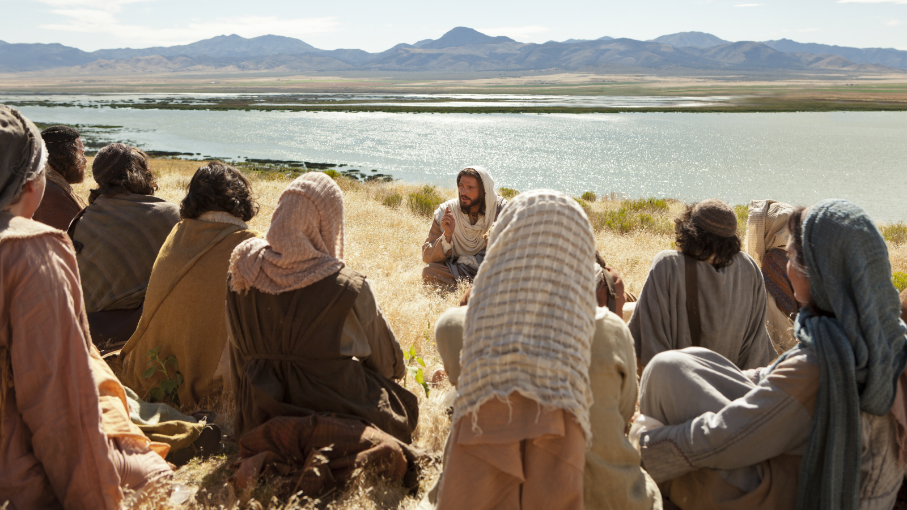
Jesus said, “I will build my church…” Matt 16:18
ekklēsia – “called out” ones
used 114 times in the New Testament
the assembly or gathering of God’s people
Notes:
[BRIEF COMMENTS ON EKKLESIA]
The Scriptures tell us that this was God’s eternal purpose, his plan from the beginning. Listen to what the apostle Paul wrote in Ephesians 3:10-11 (NLT): “God’s purpose in all this was to use the church to display his wisdom in its rich variety to all the unseen rulers and authorities in the heavenly places. This was his eternal plan [purpose], which he carried out through Christ Jesus our Lord.”
Don’t miss this, folks. God calls out his people (his family) to be united in one common faith, through one baptism, and in worship of one Lord, setting aside all other loyalties and allegiances to accept the identity, the purpose, and the way of living that Jesus gives to all who chooses to follow him through the local church.
Of course, there is the universal or “holy catholic Church” all across the plant (Apostles’ Creed). But the NT shows us that God’s eternal purpose, this grand vision for the church, is to be lived out locally. The Church is made up of churches in every place where people gather in community to live, work, shop, and play. These churches are like Kingdom embassies or outposts spread out in every place that humans gather. And we are to be a witness on behalf of Christ and the gospel, showing a watching world that Jesus changes everything.
And based on our knowledge of the New Testament, archaeology, and Roman history, an early house church would likely have looked something like this: [NEXT SLIDE]

Slide 6
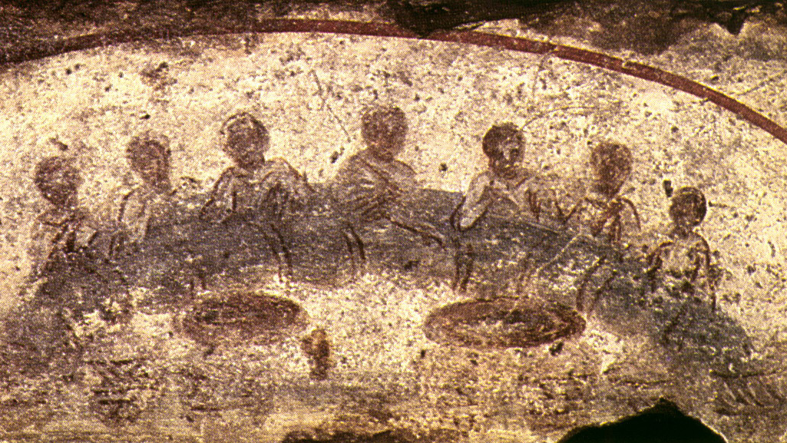
Portrait of an Early House Church in Rome
Met in larger house (a dozen or so people - 30 max)
Men and women
Roman citizens and non-citizens
Single, married, divorced, and widows
Jews and Gentiles (different political, religious and moral backgrounds – views ranging from strange to offensive)
Various ethnicities with different customs and traditions
Freed slaves and slaves who had no legal rights
Folks from elite classes down to the poor and the homeless
Notes:
[BRIEF COMMENT ON EACH]
I hope you’re beginning to grasp God’s grand vision and eternal purpose for the church.
This is so important if we’re going to follow Christ, live in Christian community, and prioritize the life of the church. Listen to what NT scholar Scot McKnight writes in his book, A Fellowship of Differents: [NEXT SLIDE]

Slide 7
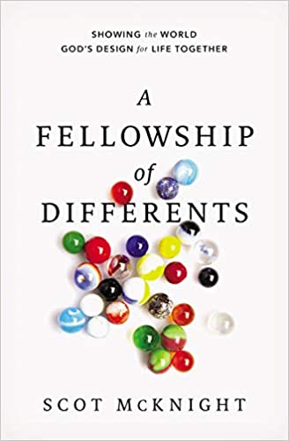
”Getting the church right is so important. The church is God’s world-changing social experiment of bringing unlikes and different to the table to share life with one another as a new kind of family. When this happens, we show the world what love, justice, peace, reconciliation, and life together are designed by God to be. The church is God’s show-and-tell for the world to see how God wants us to live as a family.” (pg. 16)
Notes:
[BRIEF COMMENT]
You see, the truth is, until we come to Christ and enter into the life of the church, we are (from a biblical perspective) homeless. Oh, you may have a nice house, you may have family and friends, you may take comfort in the nation you were born into, the color of your skin, your culture, your social status… you may find meaning and purpose through any number of groupings the world has to offer, but the Scripture says that you’re really homeless and not a part of God’s divine program of bringing heaven to earth; not until you’ve joined the ekklesia of God and committed to sharing life together with other disciples who are seeking to strategically impact their community and the lost around them with the gospel of Christ.
The early Christians (of all people) understood that to receive Christ and join his church was like coming home. That’s why the apostle Paul wrote this in Ephesians 2:19-22. [NEXT SLIDE]

Slide 8

Paul, Ephesians 2:19-22 MSG
You’re no longer wandering exiles. This kingdom of faith is now your home country. You’re no longer strangers or outsiders. You belong here, with as much right to the name Christian as anyone. God is building a home. He’s using us all—irrespective of how we got here—in what he is building.
Notes:
[BRIEF COMMENT]
He goes on… [NEXT SLIDE]

Slide 9
He used the apostles and prophets for the foundation. Now he’s using you, fitting you in brick by brick, stone by stone, with Christ Jesus as the cornerstone that holds all the parts together. We see it taking shape day after day—a holy temple built by God, all of us built into it, a temple in which God is quite at home.
Notes:
[BRIEF COMMENT]
Stone mason metaphor – Christ is chiseling us to fit in the church to form his building; we need to see the larger view and the local view of this metaphor as it applies to the church.
The apostle Peter used similar language when he wrote this… [NEXT SLIDE]

Slide 10

As you come to him, the living Stone—rejected by humans but chosen by God and precious to him—you also, like living stones, are being built into a spiritual house to be a holy priesthood, offering spiritual sacrifices acceptable to God through Jesus Christ.
1 Peter 2:4-5 NIV
Notes:
[BRIEF COMMENT]
How are we built into a spiritual house? Through relationships and in community. This isn’t something you can do by regularly attending church online from the couch at home. This is one cultural trend we mustn’t succumb to at Grantham Church. For the Body of Christ to be what the Lord desires, we must remain committed to embodied worship, fellowship, and discipleship. We must practice incarnational ministry.
Think about this. Real Christian community isn’t even possible without us being in close proximity to each other and committed to walking with other disciples as we follow Christ together. We can see this clearly in the “one anothers” of the New Testament. Check this out. [NEXT SLIDE]

Slide 11
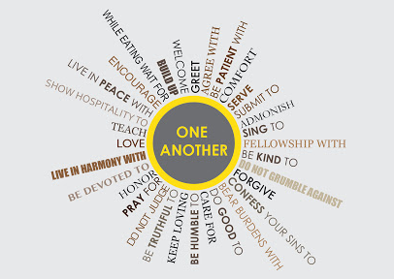
The phrase “one another” occurs 100 times in the New Testament!
59 of those are commands of how (and how not) to relate to others in close community.
Notes:
[BRIEF COMMENTS]
So, what does this look like practically? How do we do this at Grantham Church? I’ve invited us to think of engaging with the church to grow and serve in community through several spaces. [NEXT SLIDE]

Slide 12
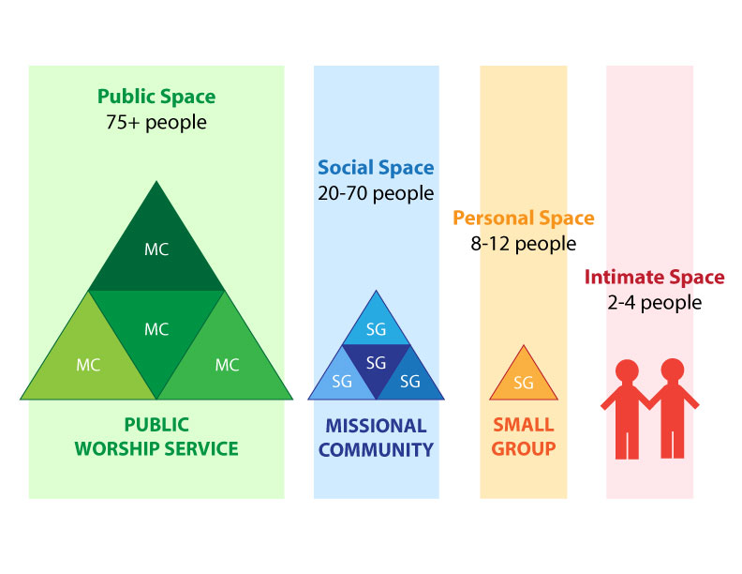
Notes:
[BRIEF COMMENT ON GRAPHIC]
Leaving “the institutional church” for a few years
What I discovered in house churches – organized churches can make a great impact if its members are engaging with and growing in all of the spaces.
We work these spaces so that we can be equipped, refueled, and be sent into the world to be the hands and feet of Jesus; we gather and we go (I’ll talk more about that next week)
Why is American individualism a threat? It’s because our culture’s influence on you has led you to believe that you don’t need any of these to follow Jesus. It’s just Jesus and you. I don’t need Christian community. Folks, this is a dangerous lie, and it will lead to some destructive consequences for you, your children, and our congregation if you believe it. We must resist the internal and external forces that tell us otherwise.
That is why I like to use another graphic to help us live into a healthy balance. [NEXT SLIDE]

Slide 13
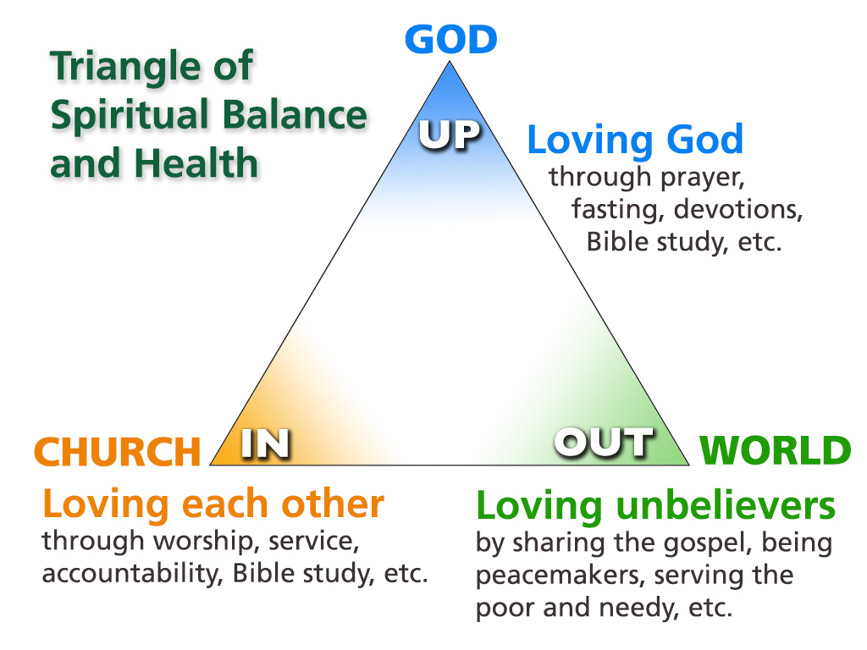
Notes:
[BRIEFLY EXPLAIN GRAPHIC]
So, when we understand God’s eternal purpose and we seriously consider the wisdom and the power of the Christian church—how it shapes disciples and prepares us for mission—then I think we can better understand what the author of Hebrews had in mind when he wrote these words: [NEXT SLIDE]

Slide 14
Hebrews 10:23-25 (VOICE)
²³ Let us hold strong to the confession of our hope, never wavering, since the One [Jesus] who promised it to us is faithful. ²⁴ Let us consider how to inspire each other to greater love and to righteous deeds, ²⁵ not forgetting to gather as a community, as some have forgotten, but encouraging each other, especially as the day of His return approaches.
Notes:
[BRIEF COMMENT]
Finally, I want to invite us to reflect on what we’ve heard, what the Spirit might be saying to us, and how the Lord would have us respond this morning.
[NEXT SLIDE]

Slide 15
Created for Community
Questions for reflection and response:

Slide 16
Created for Community
Questions for reflection and response:
Do you agree with the Scriptures that you were created for community, not hyper-individualism or isolation? If so, are you moving toward “one-anothering” or away from it?

Slide 17
Created for Community
Questions for reflection and response:
Do you agree with the Scriptures that you were created for community, not hyper-individualism or isolation? If so, are you moving toward “one-anothering” or away from it?
Now that we’re coming out of the pandemic, how is God calling you to re-engage with the spaces of the church?

Slide 18
Created for Community
Questions for reflection and response:
Do you agree with the Scriptures that you were created for community, not hyper-individualism or isolation? If so, are you moving toward “one-anothering” or away from it?
Now that we’re coming out of the pandemic, how is God calling you to re-engage with the spaces of the church?
Since participation in the local church is God’s way of changing us and the world around us, how might you need to (re)direct your time, talents, and treasure to support the mission and vision of Grantham Church moving forward?
Notes:
[BRIEF COMMENT ON EACH QUESTION]
[CLOSING PRAYER]

