Slide 1

Notes:
He is risen!
[INTRO - BRIEF COMMENTS]
Easter Sunday is about the resurrection of Jesus
For those who don’t believe or are agnostic or unsure
For those who believe and have heard this story a million times
[BRIEF PRAYER]
Before we look at our Scripture reading, let’s begin by reflecting on what the church believes the resurrection means… NEXT SLIDE]

Slide 2
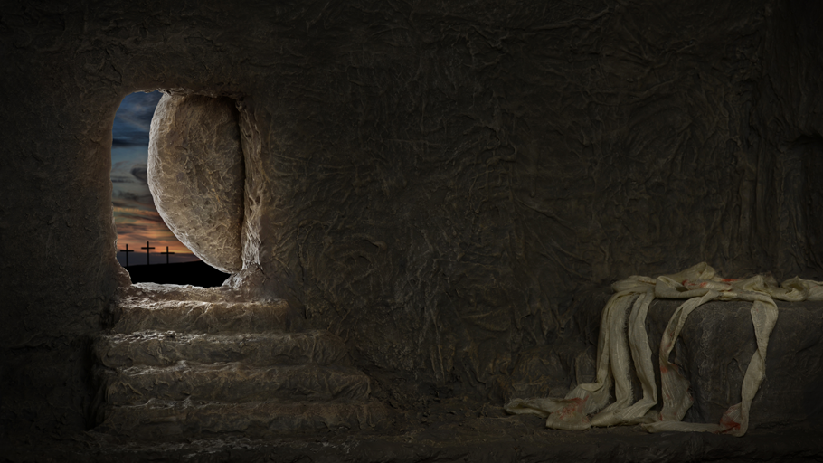
The Meaning of the Resurrection of Jesus
If/since the resurrection is true, what does it mean?

Slide 3
The Meaning of the Resurrection of Jesus
If/since the resurrection is true, what does it mean?
God the Father approves of Jesus’ life, claims, and teachings.
Notes:
God the Father approves of Jesus’ life, claims, and teachings. Jesus has been vindicated by God the Father as the legitimate Son of God. What he did was done in God’s power—his healings, his miracles, his exorcisms, his teachings, calming the storm, and forgiving people’s sins. His hard sayings, his rebukes of the religious leaders, and his turning over tables, it all has God’s stamp of approval. And it means that Jesus isn’t just teacher, prophet, and Messiah, he is the Word made flesh.
The second thing… [NEXT SLIDE]

Slide 4
The Meaning of the Resurrection of Jesus
If/since the resurrection is true, what does it mean?
God the Father approves of Jesus’ life, claims, and teachings.
The cross proves God’s love for us and has saving power!
Notes:
The cross proves God’s love for us and has saving power! The resurrection means that a victory had been won over Satan and the forces of darkness, over the principalities and powers. It means that the power of sin and death has died with Jesus on the cross. It means that our sins were nailed to the cross with Christ. All of it: our guilt for wrongdoing, our shame for what we’ve done, our complicity with evil, our idolatry, the times we denied or betrayed him, and every dark hidden thought we’ve ever had—crucified with Jesus of Nazareth on a hill far away. That’s because he chose to forgive and love instead of condemn and judge.
Number three… [NEXT SLIDE]

Slide 5
The Meaning of the Resurrection of Jesus
If/since the resurrection is true, what does it mean?
God the Father approves of Jesus’ life, claims, and teachings.
The cross proves God’s love for us and has saving power!
What happened to Jesus will happen to all who believe.
Notes:
What happened to Jesus will happen to all who believe (1 Cor 15). That’s because Jesus is the proto-type. Jesus was the first to go through death and be transformed. In his resurrected body, heaven and earth have come together. And the Scriptures say the same will happen to us who believe in Christ. In fact, Jesus himself said that. He said, “I am the resurrection and the life. Anyone who believes in me will live, even after dying” (Jn. 11:25). But what about the brokenness in the world now? What about my aging, dying body now? Paul wrote, “outwardly we are wasting away, yet inwardly we are being renewed day by day” (2 Cor. 4:16). In other words, for those who believe in Christ, resurrection has already begun in an inward way. So, to accept Jesus is to receive his indwelling Spirit that makes us new. Jesus says, we become born again. And this is how the Kingdom of God has broken through into the old order of things and has already begun the work of resurrection in the here and now. It is doing a work within the hearts of those who receive him, those who make up his church, the Body of Christ on the earth.
The fourth thing… [NEXT SLIDE]

Slide 6
The Meaning of the Resurrection of Jesus
If/since the resurrection is true, what does it mean?
God the Father approves of Jesus’ life, claims, and teachings.
The cross proves God’s love for us and has saving power!
What happened to Jesus will happen to all who believe.
We have a living hope, despite our current sufferings.
Notes:
We have a living hope, despite our current sufferings. It means that a whole new life, a new creation, something the first disciples thought would happen at the end of time, has happened in Jesus and is happening now. Yes, we are assured of being with him when we die. But the Christian hope is much bigger and better. Again, it means that heaven and earth have come together in the risen Jesus, making Jesus the first to undergo what God promises to do with all of creation and all those who trust in Christ. The risen Jesus is evidence of God’s good future. But you don’t get any of that—none of it is true—unless Jesus was physically raised from the dead and metaphysically transformed. You can’t get there by spiritualizing the resurrection to make it more acceptable or palatable to our post-Enlightenment, anti-supernatural age. And that’s because if you don’t have a physical resurrection then we can’t be assured that God is going to redeem and renew the material world, so we then just slip into a Platonic or gnostic understanding of the world where we are bound to someday “fly away” and escape for an ethereal existence in a disembodied heaven, which means we can then abandon any concern for creation and how we treat the planet. And we can also disregard God’s design for our bodies, for human sexuality, for marriage, and so forth. Actually, nothing holds together without resurrection.
And this is what many evangelicals have done—reducing the gospel down simply to saving souls, flying away to heaven, and not caring so much about suffering bodies in society, or that we live on a planet in peril, a creation that is groaning for salvation. But the resurrection of Jesus means that we are compelled to care about all of those things.
And number five, since the resurrection is true, it means that… [NEXT SLIDE]

Slide 7
The Meaning of the Resurrection of Jesus
If/since the resurrection is true, what does it mean?
God the Father approves of Jesus’ life, claims, and teachings.
The cross proves God’s love for us and has saving power!
What happened to Jesus will happen to all who believe.
We have a living hope, despite our current sufferings.
All things are possible with God, for those who believe.
Notes:
All things are possible with God. And that’s what I’d like to emphasize in my message this morning.
At the beginning of the service, I read a portion of the resurrection account from John chapter 20. In our Lenten series leading up to Holy Week and Easter Sunday, we have interacted a bit with the Gospel of Luke, since it is the lectionary gospel text this year. So, let’s look now at Luke’s account. Luke chapter 24, verses 1-12. [NEXT SLIDE]

Slide 8
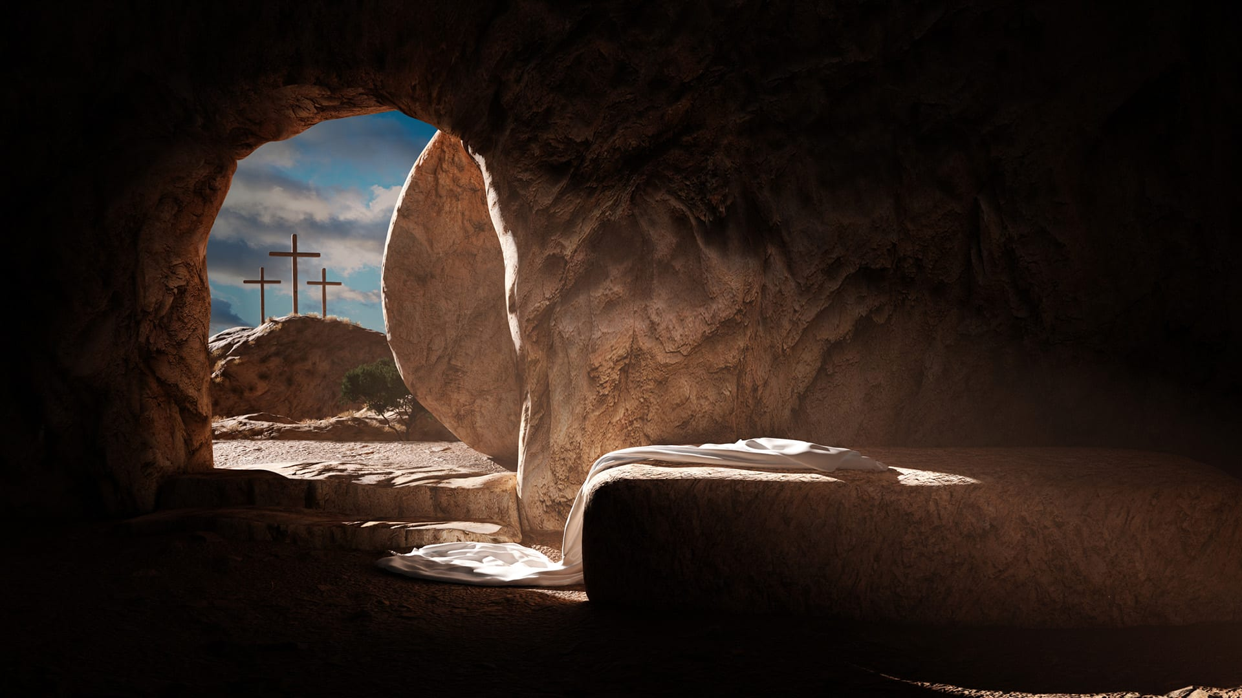
Luke 24:1-12 NLT
¹ But very early on Sunday morning the women went to the tomb, taking the spices they had prepared. ² They found that the stone had been rolled away from the entrance. ³ So they went in, but they didn’t find the body of the Lord Jesus. ⁴ As they stood there puzzled, two men suddenly appeared to them, clothed in dazzling robes.
⁵ The women were terrified and bowed with their faces to the ground.
Notes:
[BRIEF COMMENT ON PASSAGE]
Verse 5 continues… [NEXT SLIDE]

Slide 9
Then the men asked, “Why are you looking among the dead for someone who is alive? ⁶ He isn’t here! He is risen from the dead! Remember what he told you back in Galilee, ⁷ that the Son of Man must be betrayed into the hands of sinful men and be crucified, and that he would rise again on the third day.” ⁸ Then they remembered that he had said this. ⁹ So they rushed back from the tomb to tell his eleven disciples—and everyone else—what had happened.
Notes:
[BRIEF COMMENT ON PASSAGE]
Verse 10… [NEXT SLIDE]

Slide 10
¹⁰ It was Mary Magdalene, Joanna, Mary the mother of James, and several other women who told the apostles what had happened. ¹¹ But the story sounded like nonsense to the men, so they didn’t believe it. ¹² However, Peter jumped up and ran to the tomb to look. Stooping, he peered in and saw the empty linen wrappings; then he went home again, wondering what had happened.
Notes:
[BRIEF COMMENT ON PASSAGE]
As the angels pointed out to the women, we know that Jesus did speak of his death and resurrection while he was alive, but to his disciples, even to the faithful women who followed him, his words were confusing and cryptic, a bit vague. But mainly, their surprise was because they had no category for what Jesus was trying to say to them. They had no room in their thinking for a dying and rising Messiah.
So, when Jesus died, all of their hopes died with him. So, think about that. The disciples weren’t sitting around after Good Friday thinking, “Well, that was all very unpleasant yesterday, but never mind… on the third day he’ll be back.”
They may have lived 2,000 years ago, but the first disciples knew what we know now. When people die, they stay dead. And while they did believe in a future resurrection of the dead (as most Jews did in that day), that wasn’t supposed to happen until the end of time. Nobody expected it to happen to one person in the middle of human history.
So, in response to those who might assume, “O those silly disciples! They actually believed that dead people could be raised. I’m so glad that science has proven otherwise,” listen to what N.T. Wright recently said in a BioLogos podcast on the subject… [NEXT SLIDE]

Slide 11
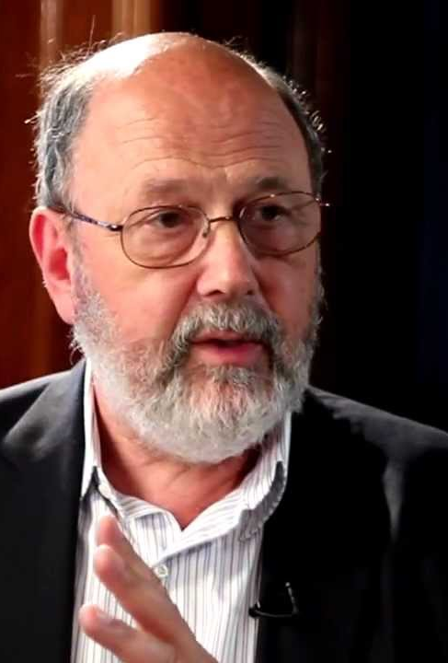
“Do you think that it was only with Descartes or Locke and Berkeley and Hume or Kant or somebody that people suddenly realized that dead people didn’t come back?
Look at the history: Socrates knew that, Aeschylus says very clearly that there is no such thing as resurrection, and Seneca knew that, Cicero knew that. Early Christianity was born into a world where everybody knew that dead people didn’t come back. They laughed at St. Paul in Athens, when he said that God had raised Jesus from the dead. This is not a new thing that modern science has suddenly discovered.”
N.T. Wright, Senior Research Fellow - Oxford BioLogos Podcast – episode 111 (April 14, 2022)
Notes:
Wright goes on to say, ”If a scientist says, well, I’m a scientist, so I really can’t believe in this stuff… well fine, science studies that which we can repeat, which we can test in the laboratory. Of course, that’s what science does extremely well, it has done that very successfully. But the whole claim here is that something new has launched upon the world, which in the nature of the case, you wouldn’t expect to be able to repeat in the laboratory, except in so far that the claim is about a new community, a new way of being human, a new way of living, which actually goes out into the world and has had a transformative, though still controversial impact upon the world. That’s where the claim really comes home to roost.”
But if you’re still a bit skeptical, I would encourage you to consider a few things:
Historians take the resurrection of Jesus seriously. They conclude that there was an empty tomb, but why? Of all the theories, the resurrection makes the most sense.
The explosive growth of the early church!
The conversions of James (half-brother of Jesus) and Saul of Tarsus
The unwavering faith of the disciples—the martyrs.
Do you believe that God created the world? Why can’t he raise Jesus from the dead?
Remember, Jesus isn’t looking for your certainty, he wants your trust—your faith. And genuine faith looks at the evidence, listens with the head and the heart, and responds in faith, where doubt is often a constant companion.
That’s right. It’s OK to have doubts. I have doubts. But I also doubt my doubts. That’s why I can relate to Thomas… [NEXT SLIDE]

Slide 12
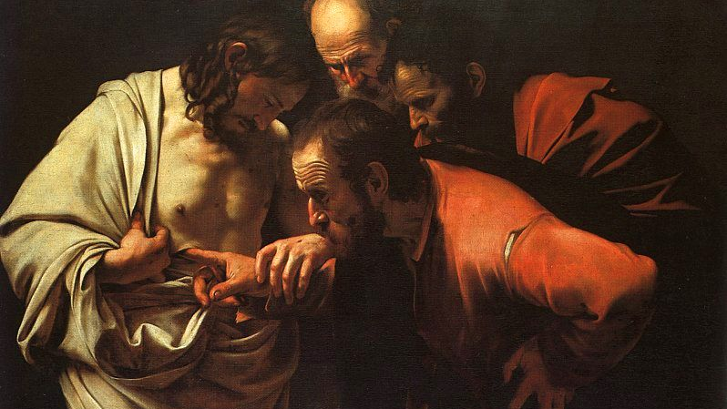
John 20:24-29 NLT
Notes:
[READ PASSAGE & COMMENT]
Thomas shows:
Courage in the face of fear – he was willing to die for Jesus (Jn. 11:26)
Honesty in the pursuit of faith – he wanted to see too!
Despite his doubts, he shows a commitment to relationships – he stayed
And notice, yes, Jesus did tell him to "stop doubting," but only after he was willing to accommodate Thomas in order that he might believe like the rest. So, in a way, Thomas’ doubt opened the door to a unique experience with Jesus.
And this is what it is all about. We can examine the evidence, we can think on the theology of the resurrection and its implications, but if we do not have a lived experience that comes through an active faith in the resurrected Christ, it doesn’t matter. Which is what I want to invite us into this Easter Sunday. To either begin or renew your faith relationship with the living Jesus, which comes with the added invitation to believe that all things are possible with God. You may recall that Jesus said this himself… [NEXT SLIDE]

Slide 13
“Humanly speaking, it is impossible. But with God everything is possible.”
Matthew 19:26 NLT
Notes:
[BRIEF COMMENT ON PASSAGE]
In the context – it’s hard for a rich person to enter the kingdom
But this can equally apply to all seemingly impossible ideas and tasks
Therefore, let’s consider how all things are possible with God. What does that look like? And specifically, how has the resurrection of Jesus made these things possible? [NEXT SLIDE]

Slide 14

Because of the death and resurrection of Jesus…

Slide 15
Because of the death and resurrection of Jesus…
Forgiveness, mercy, grace and redemption are possible

Slide 16
Because of the death and resurrection of Jesus…
Forgiveness, mercy, grace and redemption are possible
Love, joy, peace, patience, etc. are possible

Slide 17
Because of the death and resurrection of Jesus…
Forgiveness, mercy, grace and redemption are possible
Love, joy, peace, patience, etc. are possible
Restorative justice and reconciliation are possible

Slide 18
Because of the death and resurrection of Jesus…
Forgiveness, mercy, grace and redemption are possible
Love, joy, peace, patience, etc. are possible
Restorative justice and reconciliation are possible
Signs and wonders (miracles) are possible

Slide 19
Because of the death and resurrection of Jesus…
Forgiveness, mercy, grace and redemption are possible
Love, joy, peace, patience, etc. are possible
Restorative justice and reconciliation are possible
Signs and wonders (miracles) are possible
Repenting and starting over (new life) are possible!
Notes:
[BRIEF COMMENTS ON EACH POINT]
[CLOSINIG WORDS]
Brothers and sisters, the resurrection of Jesus invites us to move from the certainty of “that’s the way things are” to the unsettling openness that God can do the impossible.
How is he calling you to be open (and to believe) in his power to change you and your situation. Remember, the same power that raised Jesus from the dead is available to us. All we must do… is believe.
[GO TO FINAL SLIDE FOR CLOSING PRAYER]
Father God, thank You that you gave your only begotten Son, so that whoever believes in Him should not perish, but have everlasting life. He is risen! Those who believe are risen! Hallelujah! Jesus, You are the Living One; You were dead, and now look, You are alive for ever and ever! And behold, You are making all things new. You are risen! Those who believe are risen! Hallelujah! Holy Spirit, thank You that You, the same spirit that raised Christ Jesus from the dead lives in your people today, giving life to our mortal bodies. He is risen! Those who believe are risen! Hallelujah! Amen.

