Slide 1


Slide 2
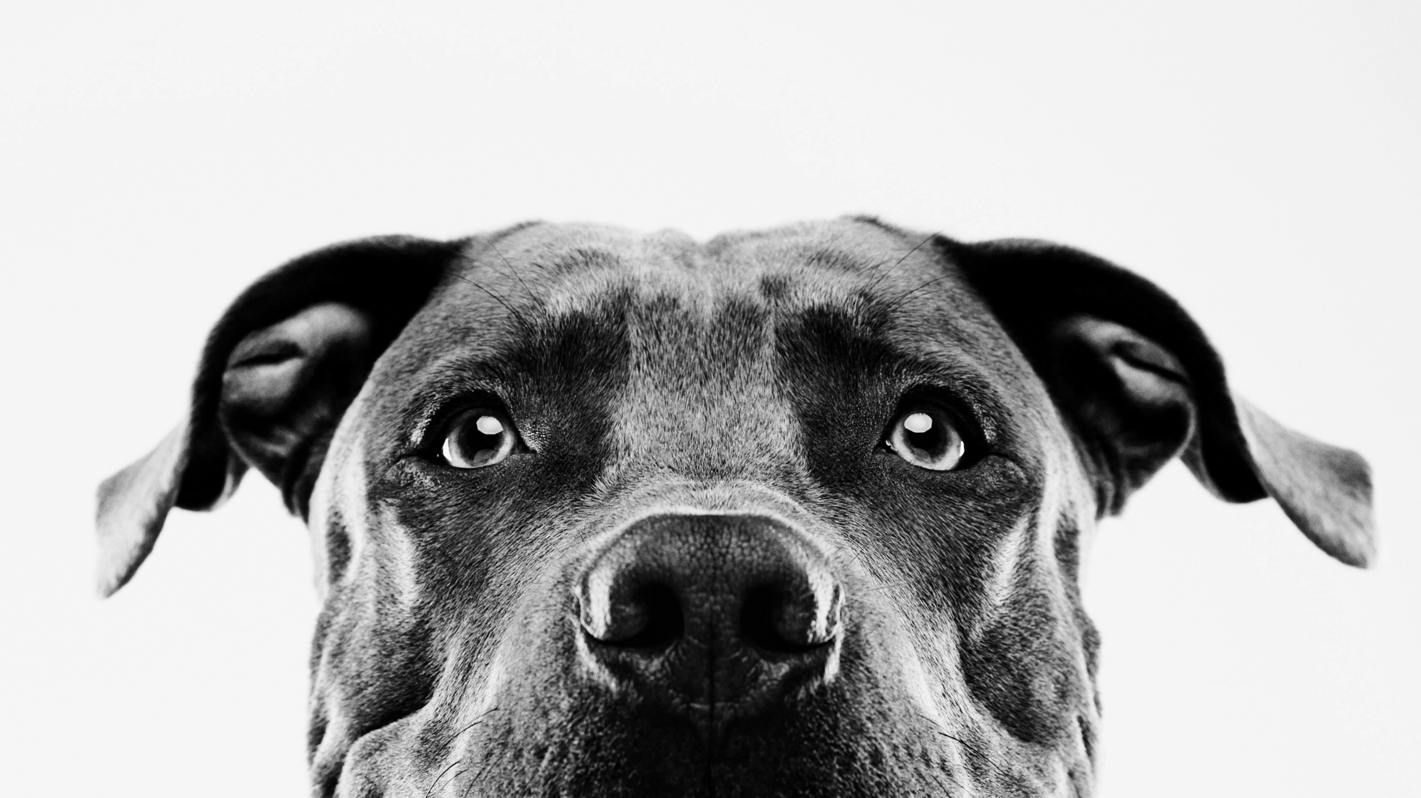
Does God have pets?
When bad theology causes real harm
Acts 10:24-35

Slide 3
Acts 10:34-35
“I truly understand that God shows no partiality, but in every nation, anyone who fears God and does what is right is acceptable to God.”

Slide 4
Does god have pets?
Our theology – what we believe about God – has life-and-death implications for others.

Slide 5
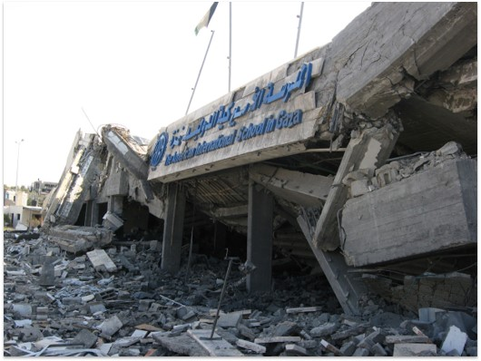
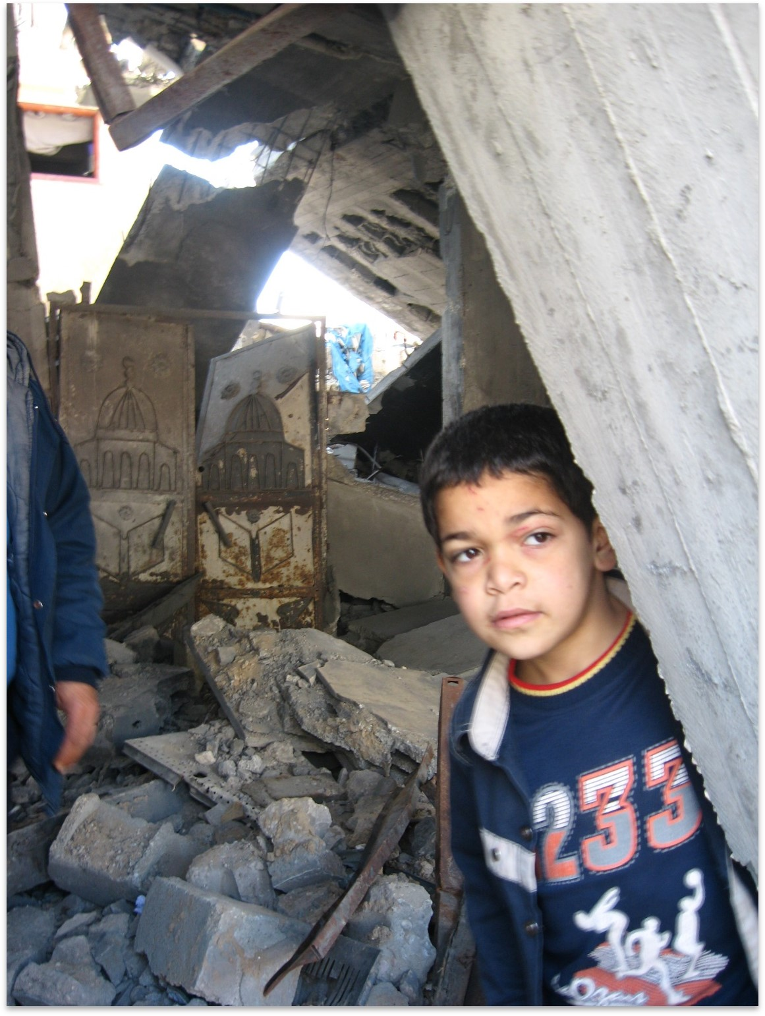
Gaza – January 2009

Slide 6
Impact of anti-jewish theology
Across the centuries, Jews had their property confiscated; they were forcibly baptized; their children were taken and given a Christian education; their synagogues were burned (sometimes with Jews inside). It culminated with the Holocaust, resulting in the deaths of more than six million Jews.

Slide 7
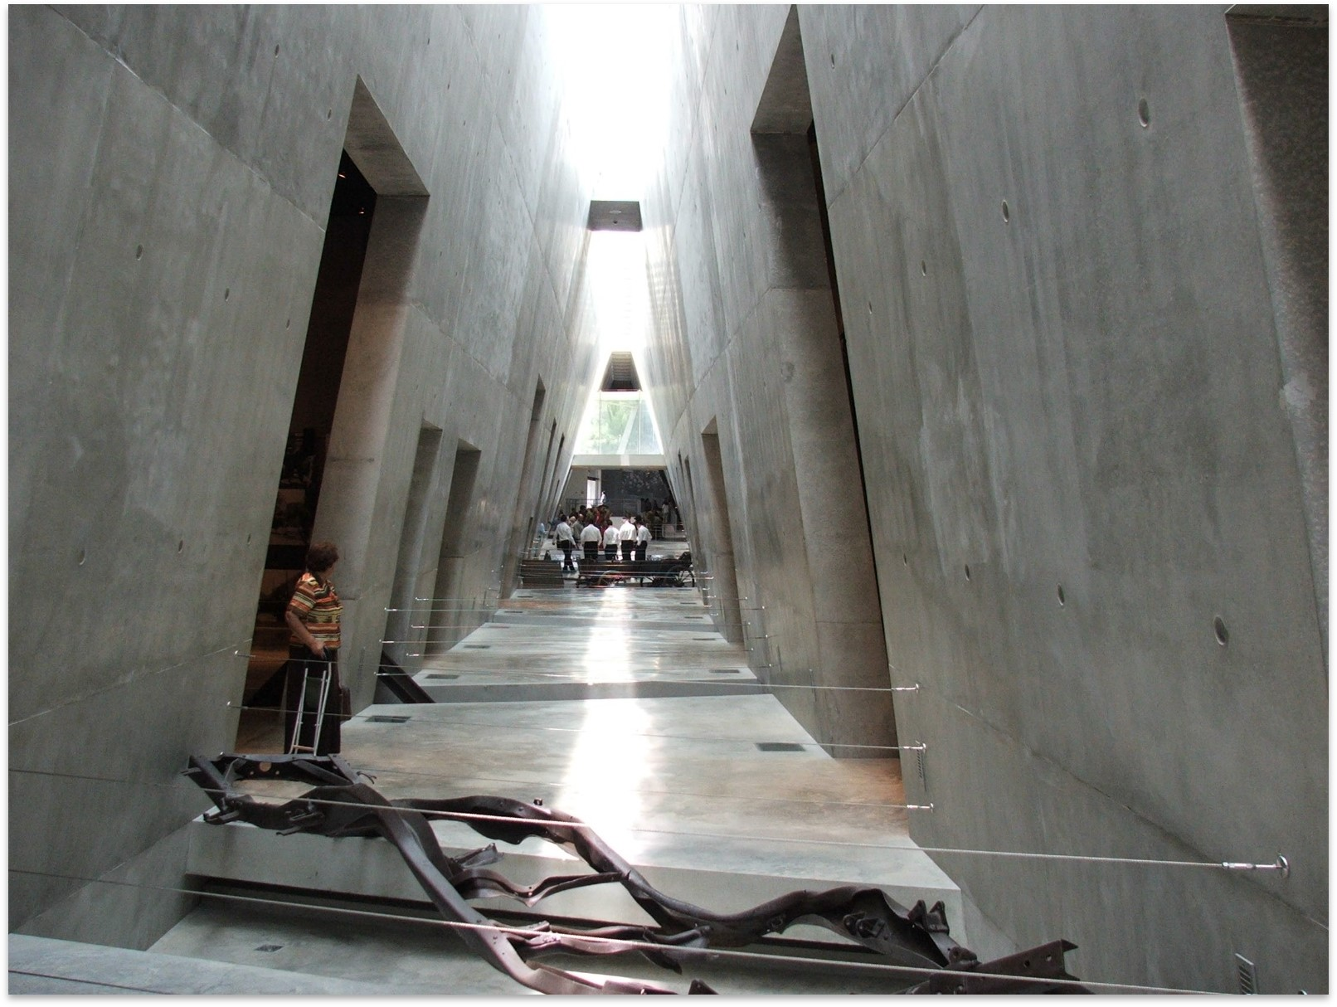
Yad Vashem – holocaust museum (Jerusalem)

Slide 8
Does god have pets?
Our theology – what we believe about God – has life-and-death implications for others.

Slide 9
Impact of Christian Zionist theology
500 Palestinian villages depopulated
7 million Palestinian refugees
Military occupation and economic siege
Land confiscation and settlements
House demolitions
Separation barrier and checkpoints
Betrayal of Palestinian Christians

Slide 10
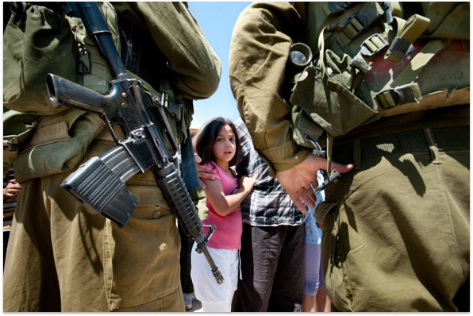
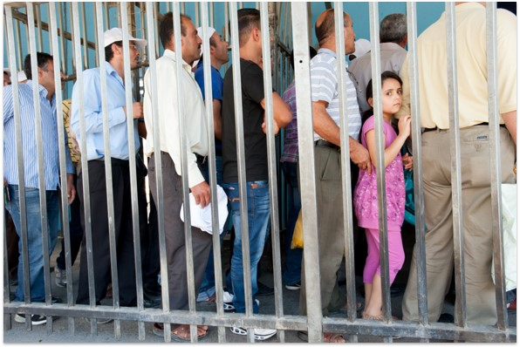
Military occupation and checkpoints

Slide 11
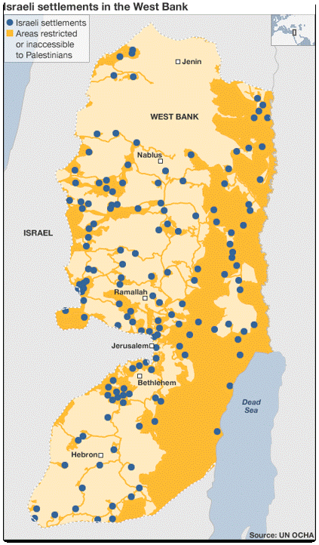
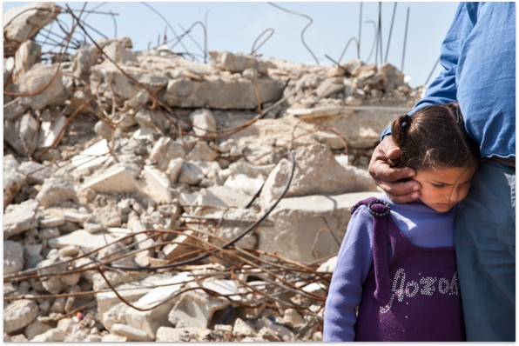
Settlements and home demolition

Slide 12
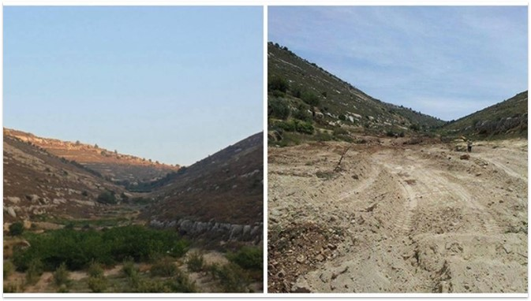
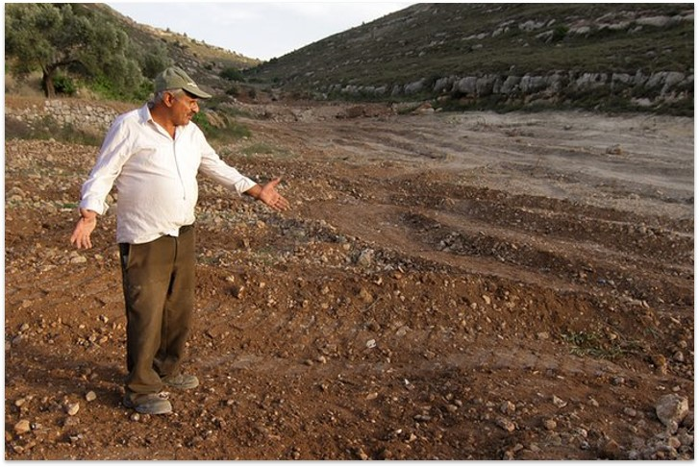
Destruction of trees and livelihoods

Slide 13
Kairos Palestine (2009)
“We Palestinian Christians declare that the military occupation of our land is a sin against God and humanity … any theology that legitimizes the occupation is far from Christian teachings because true Christian theology is a theology of love and solidarity with the oppressed, a call to justice and equality among peoples.”

Slide 14
Does god have pets?
Our theology – what we believe about God – has life-and-death implications for others.

Slide 15
Does god have pets?
Whenever our theology creates a hierarchy of human value, we are skating on thin ice – or perhaps no ice at all. God does not have pets.

Slide 16
Does god have pets?
Our theology – what we believe about God – has life-and-death implications for others.

Slide 17
Toward a theology of healing and justice
An attention-getting experience

Slide 18
Toward a theology of healing and justice
An attention-getting experience
God opens a door and calls us to take a step of faith

Slide 19
Toward a theology of healing and justice
An attention-getting experience
God opens a door and calls us to take a step of faith
We gain new understandings of self, others, and God

Slide 20
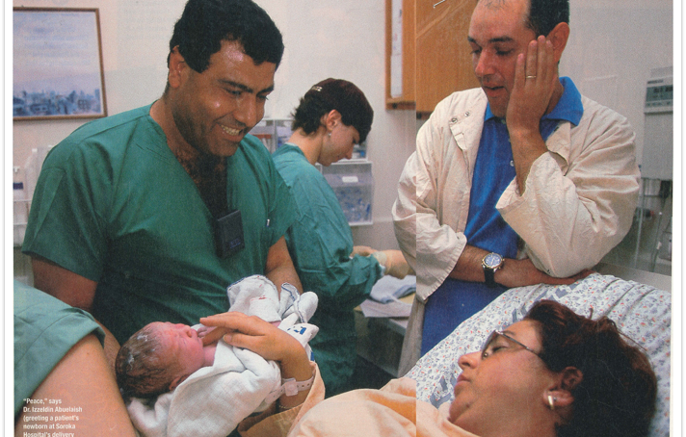
Dr. Izzeldin abuelaish

Slide 21


