Slide 1
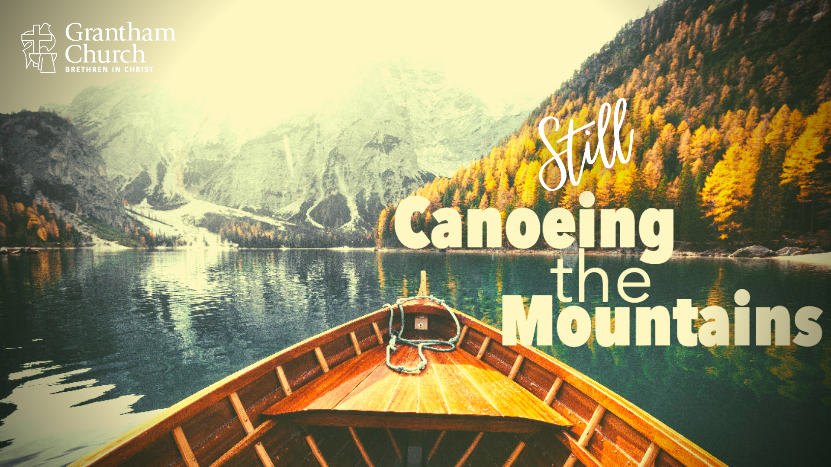
Notes:
DON’T SHOW SERMON TITLE GRAPHIC UNTIL SLIDE 3
[BRIEF INTRO]
Last week I told you at the end of the service, and then in the weekly Email From the Pastor, that this morning I would be sharing about the mission and vision work our leadership has done this past year, and the plan for how you will be invited into the strategic planning process this fall. So, I’d like to do that today, and begin by telling you that I’m very excited to share this message. And I hope that you’re excited to hear it.
Some of you will recall that it has been about a year and half since I shared a message solely on our church’s mission and vision. That was when our leadership had just begun having discussions about who we are, what we’re about, and where we are going as a church, right before 2020 happened to all of us. A lot has happened since then, but if you think real hard back to the end of 2019, some of you will remember that I shared a Vision Sunday 2019 message called, Canoeing the Mountains, after the book title by the same name. [NEXT SLIDE]

Slide 2

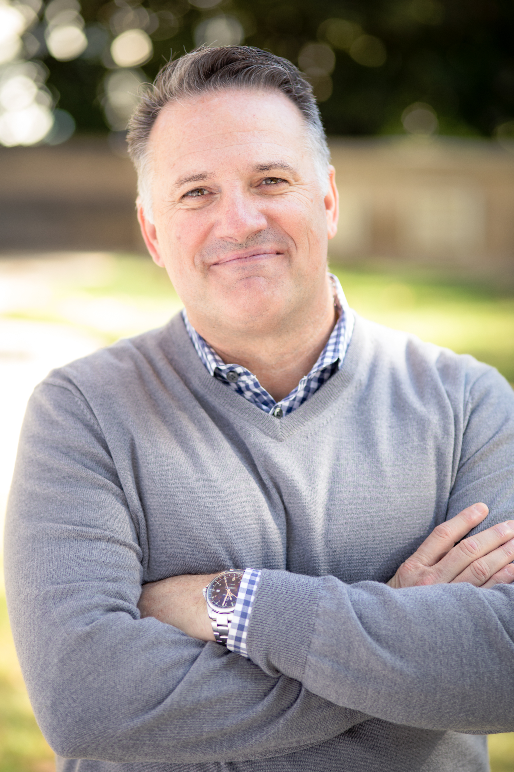
Notes:
[DESCRIBE THE BOOK]
Lewis & Clark sought a waterway to the Pacific but found the Rockies - mariners had to become mountaineers
Our increasingly post-Christian culture is requiring new ways of thinking and of being and doing church – “What does it look like to be the church in a culture that no longer privileges Christianity, where our faith is pushed to the margins?”
Bolsinger explicitly addressed, “How should leaders guide their churches and organizations through those changes?”
And of course, we are now seeing what was predicted in Spring 2020: A perfect storm made up of the pandemic, political polarization, and racism has accelerated a post-Christian America and it has divided churches and denominations.
From the decline in church attendance, to the closing of churches all across the country (including several in our own conference), to seeing folks who grew up in right-wing fundamentalism leading the charge in their cynical efforts to endlessly deconstruct the Christian faith (some thinking that adopting a radical leftist political worldview is the answer), to the outright repudiation of Judeo-Christian values (especially related to human sexuality), it’s obvious that America is changing rapidly and we’re not entirely sure what to do about it, or how faithful disciples should respond.
So, it’s safe to say that we are… [NEXT SLIDE]

Slide 3
Notes:
[BRIEF COMMENT] – An Invitation to see the bigger picture
Let’s think about where we are in this moment of our history
And let’s reflect on how we (with God’s help) can respond as a church
Where has God been leading us? And where is the Spirit taking us now?
[BRIEF PRAYER] & [NEXT SLIDE]

Slide 4
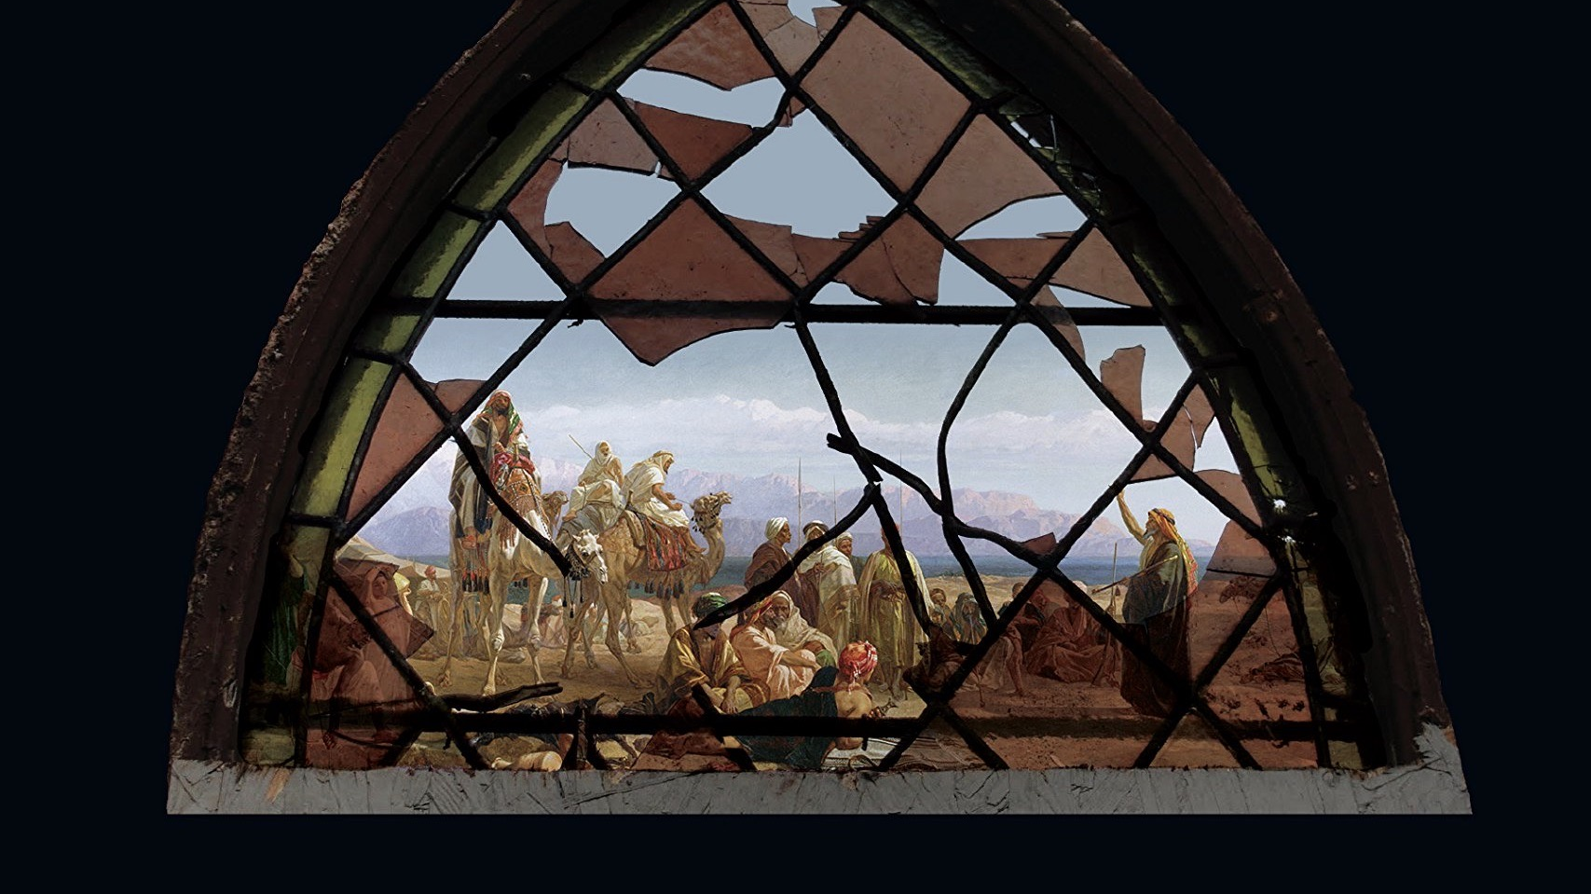
Notes:
[BRIEF COMMENTS] – We are living in an exile of sorts
God’s People in Exile – (The Exodus/wilderness & Babylon)
The American Church in Exile? Why?
We must develop cultural discernment and learn to live in exile
So, if we’re going to talk about mission and “vision” for the future, it’s important that we recognize where we are and correctly interpret the signs: signs that our world is changing (that we can’t go back), signs that we need God to teach us how to live on the margins, and signs that God is present with us despite our challenges in the world and in the church today. That doesn’t mean everyone needs to be a prophet, but it does mean we all need to understand our place in time.
Remember what Jesus said in Luke 12:54-56. [NEXT SLIDE]

Slide 5
Jesus, Luke 12:54-56 NIV
⁵⁴ He said to the crowd: “When you see a cloud rising in the west, immediately you say, ‘It’s going to rain,’ and it does. ⁵⁵ And when the south wind blows, you say, ‘It’s going to be hot,’ and it is. ⁵⁶ Hypocrites! You know how to interpret the appearance of the earth and the sky. How is it that you don’t know how to interpret this present time?
Notes:
[BRIEF COMMENT ON PASSAGE]
Jesus is saying, “Can’t you see? If you can’t see, how can you know where you’re going? If you can’t see, how are you going to join God in what he’s doing?”
Throughout the Scriptures, we see that vision is necessary for God’s people to follow his Spirit into his good future. Probably the most well-known verse related to vision is this one from Proverbs 29, verse 18. Some of you learned it this way: “Where there is no vision, the people perish.” What does that mean exactly?
I like how Eugene Peterson translated it in the Message: [NEXT SLIDE]

Slide 6
“If people can’t see what God is doing, they stumble all over themselves; But when they attend to what he reveals, they are most blessed.”
Proverbs 29:18 MSG
Notes:
[BRIEF COMMENT]
Listen to that, brothers and sisters. Vision involves seeing the signs (i.e., interpreting what is going on around you) and how God is at work—how his Spirit is moving—in the world and in our church. Where is he taking us? What is he trying to teach us? What do we need to repent of, heal from, change our thinking about, prepare us for… so he can move us forward into his good future? It’s important that we ask these questions and be intentional with our response to the Spirit’s leading.
And as I said, it’s important that we see the bigger picture and the larger narrative that is God’s story to know our place in it and what we ought to be doing, particularly here at Grantham. [NEXT SLIDE]

Slide 7
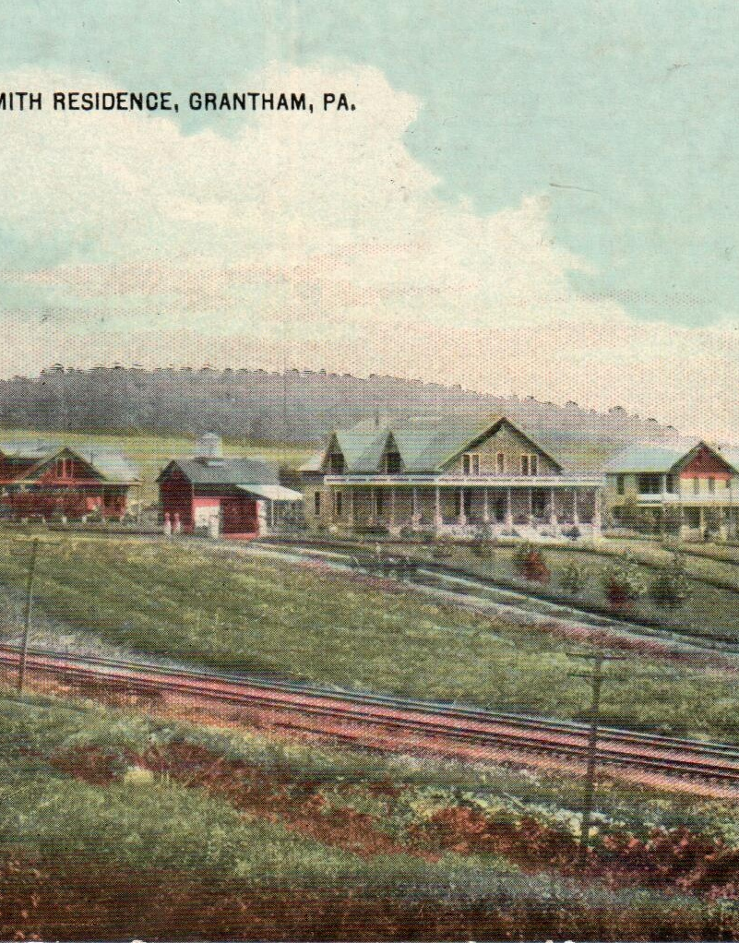
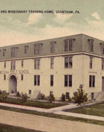
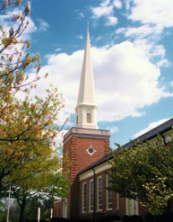
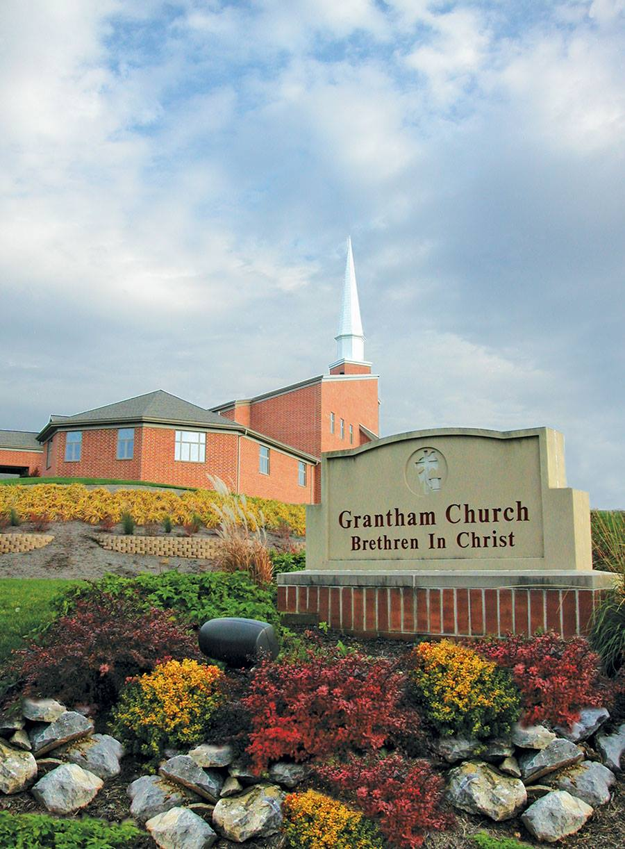
Grantham Church: Our Story
Notes:
In my Vision Sunday 2019 message, I shared a bit about the story of Grantham Church, beginning with the founding of Messiah in 1909. We then looked at the various stages of church development and growth throughout our history. If you missed that, I’m not going to share all of that again. But I will encourage you to go back and listen to that message, or just pick up a free copy of Morris Sider’s book in our library. Of course, a lot has happened in the last 20 years or so (it’s been more than 10 after Morris’ book). And so, I’d like us to think about that to better grasp where we are today.
[BRIEF SUMMARY OF LAST TWO DECADES]
In 1998 the church moved off campus and struggled to adjust – “What does it mean to be a church of the college and the community? And how should the church change in a changing world?”
An outside consultant was brought in to help, but that work stopped in 2009
And as many of you know, Internal strife followed for a few years and then the healing and rebuilding began
But despite the conflict and the challenges, even those of 2020, I still believe, as I said in 2019, that God has been preparing the foundations, inching us closer to a renewed sense of identity, mission, and vision… and positioning us to make a greater gospel impact alongside other churches in our region. And again, I invite you to see the larger story and not focus on the bumps along the way. Just as you would the tough places in your marriage or a relationship, we need to put them into perspective and trust that God can bring good out of those things and will use them for our good if we will press on, do our part, be hopeful, and love our way through it. Amen?
Knowing all of those things (our past but also our changing culture), it should make sense why we’ve emphasized certain values and practices that not only address needs in our own congregation, but are also a response to the polarized and increasingly secular culture around us, and how we are called to be the church, for such a time as this. And so, we’ve said… [NEXT SLIDE]

Slide 8
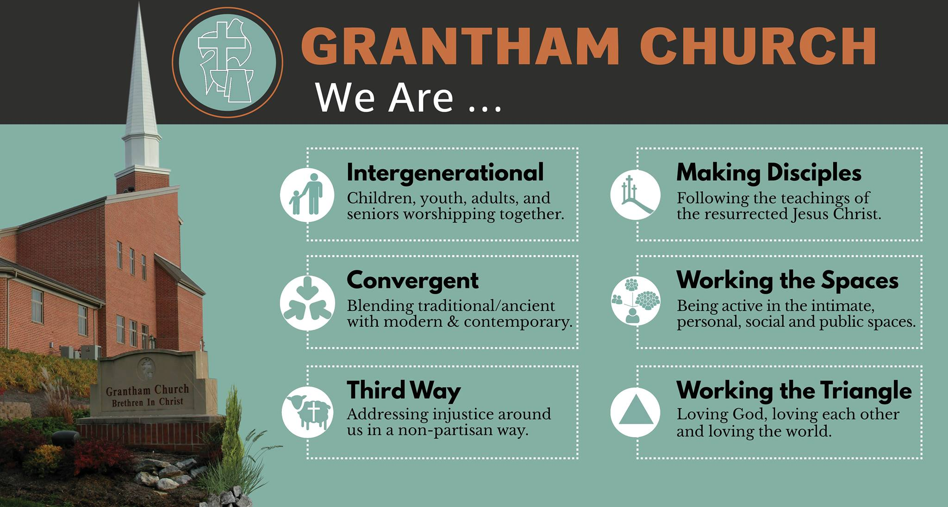
Notes:
[BRIEFLY EXPLAIN EACH ONE]
And so we’ve used the next two images to further this understanding and disciple-making practice. [NEXT SLIDE]

Slide 9
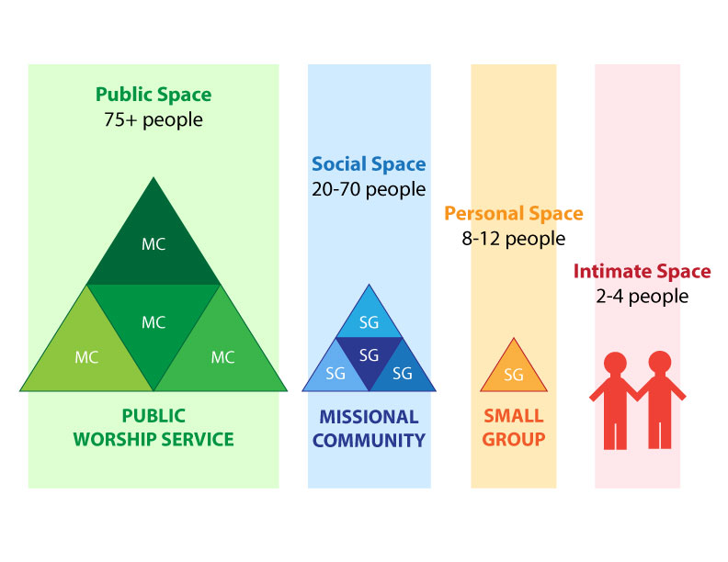
Notes:
[BRIEF COMMENT]
And then the triangle of spiritual balance and health: [NEXT SLIDE]

Slide 10
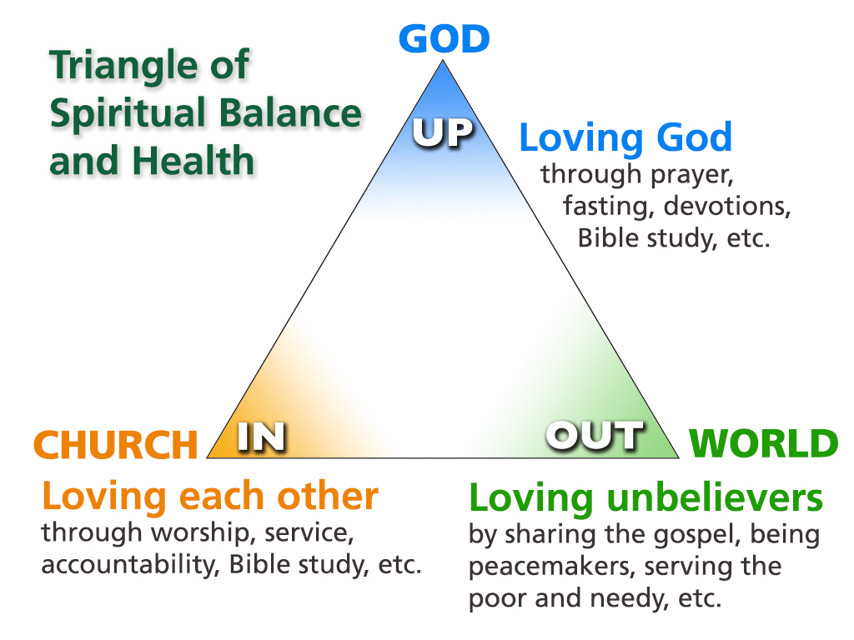
Notes:
[BRIEF COMMENT] – Up-In-Out
As we saw last Sunday, We are called to gather, grow, give, and go. We go out to the world and live out the gospel because that’s what disciples do, and it’s why the church exists in the first place.
That’s what Dietrich Bonhoeffer said this in his classic book, Life Together… [NEXT SLIDE]

Slide 11

”The church is the church only when it exists for others.”
Dietrich Bonhoeffer
Notes:
[BRIEF COMMENT]
And so… when 2020 happened, church leadership decided that we would use the challenges we faced to recalibrate and return to the work that had begun over 10 years ago. We decided not to sit on our hands and waste the opportunity that a global pandemic presented us with—mainly... time and a major upheaval of normal life. Therefore… [NEXT SLIDE]

Slide 12
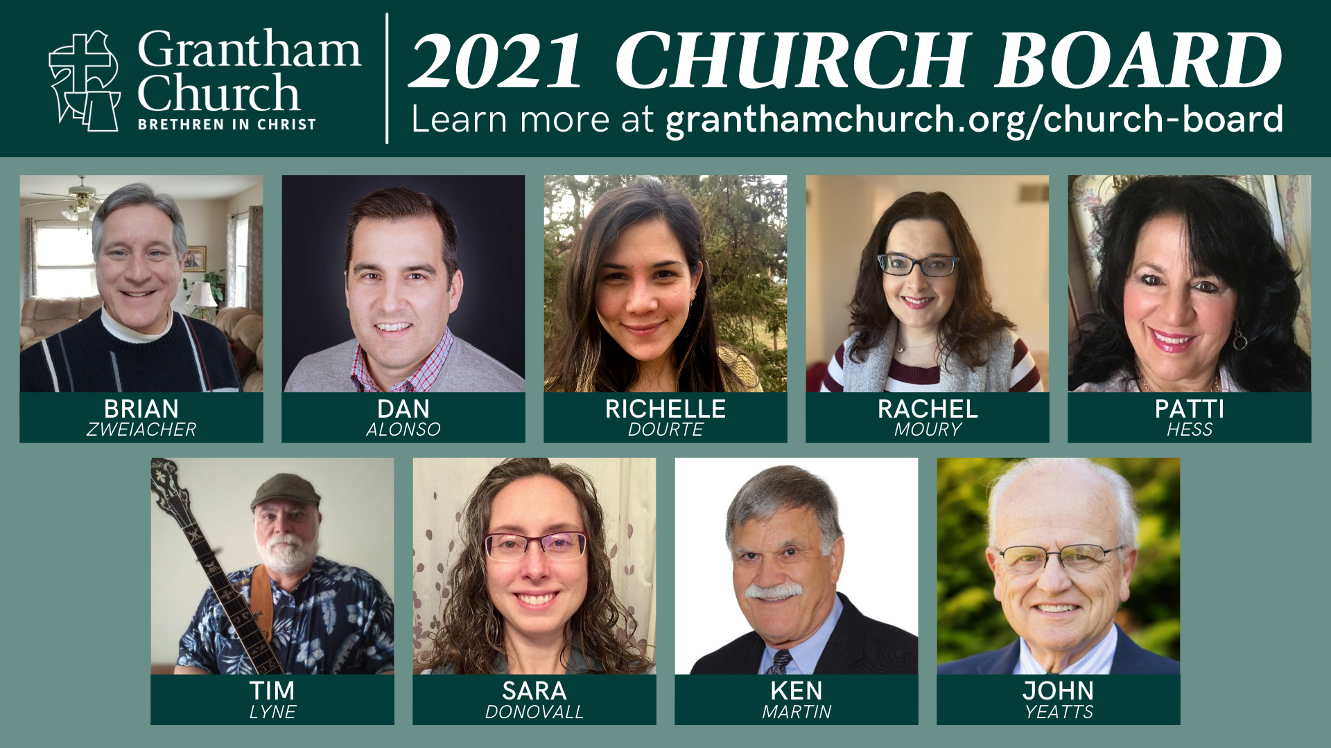
Notes:
Your pastoral staff and church board asked Jim Rowell, the church consultant that came in to help us with staff challenges in March 2020, to also help us begin the process of finally getting clarity on who we are , what we’re about, and where we’re going as a congregation. As Brian (our board chair) shared with you at the Spring Congregational Conversation, Jim did not create any of the things I’m about to share with you, he simply guided your leaders through the process to a place where we were ready to invite the rest of the church family to help us finalize the vision and strategic planning portion.
In other words, your leaders have done the hard work you’ve called them to do in their roles (after many hours of meetings this past year), and now we are sharing that work with you and inviting you to participate in the remaining work. So, I want to encourage you to think about what you’re going to see here as the scaffolding (or the framework) for the vision and strategic planning we will be working on this summer and completing this fall with your help.
OK. Are you ready to see it? Let’s start with our mission statement: [NEXT SLIDE]

Slide 13
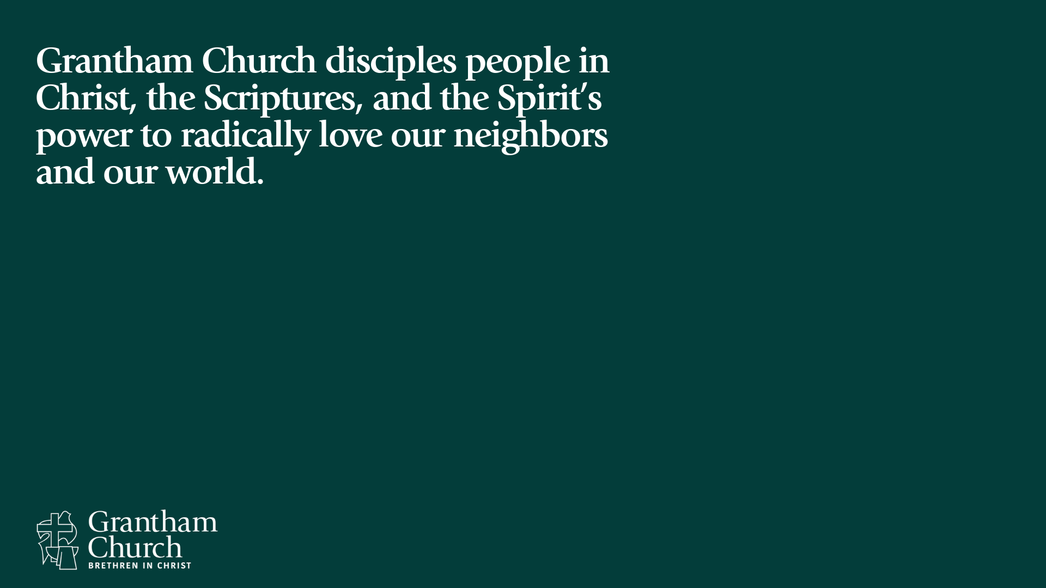
Notes:
Our mission says what we’re about. What are we about? – [READ MISSION STATEMENT & EXPLAIN]
And to sum that up (and the rest of our vision as well), we want it to be known that we’re about… [NEXT SLIDE]

Slide 14
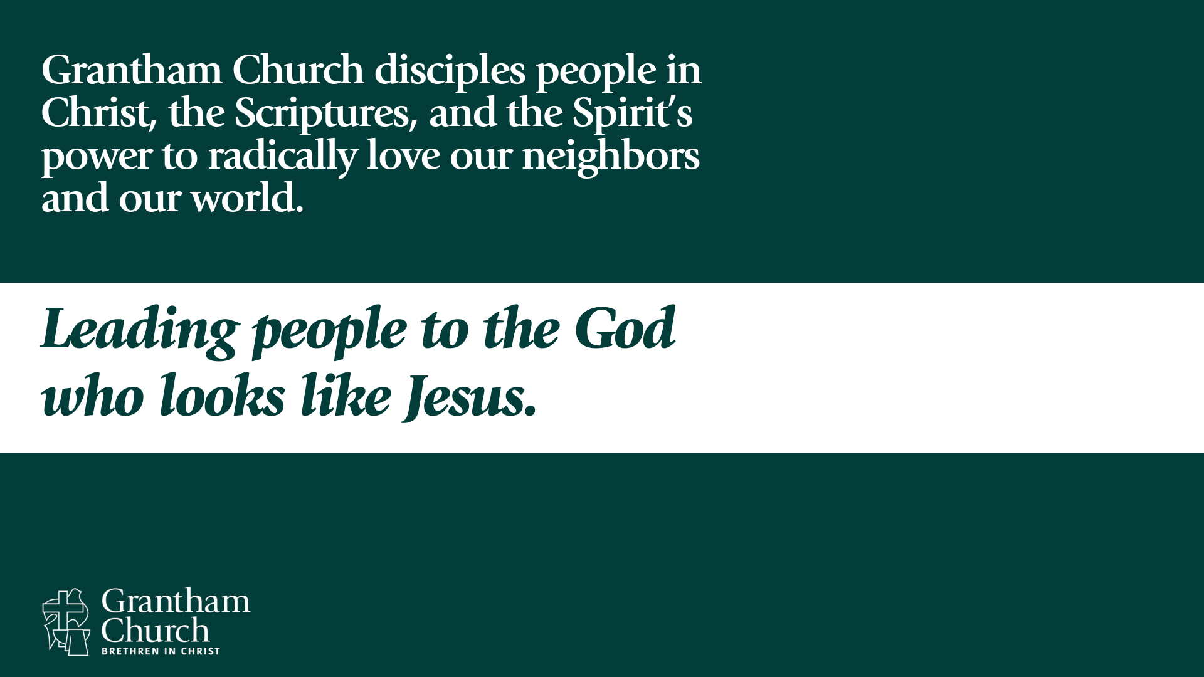
Notes:
[BRIEF COMMENT]
What does this mean? Why do we say this?
And now… here are 5 words that we believe best describe what the Spirit has called us to be about and live into at Grantham in the years to come. I’ll introduce those to you and say a few words about each one.
The first word is… [NEXT SLIDE]

Slide 15
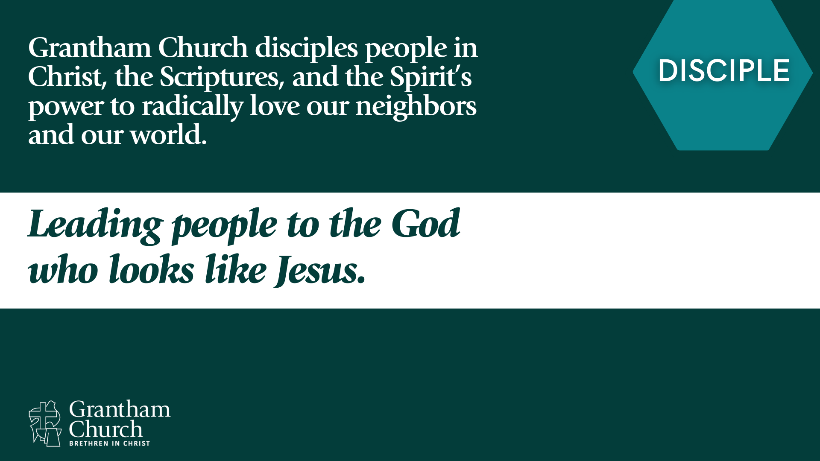
Notes:
[BRIEF COMMENT]
We are committed to spiritual formation and making disciples by “working the spaces” through public worship, learning communities, sermon-based small groups, and intimate friendships and accountability groups.
The second word is… [NEXT SLIDE]

Slide 16
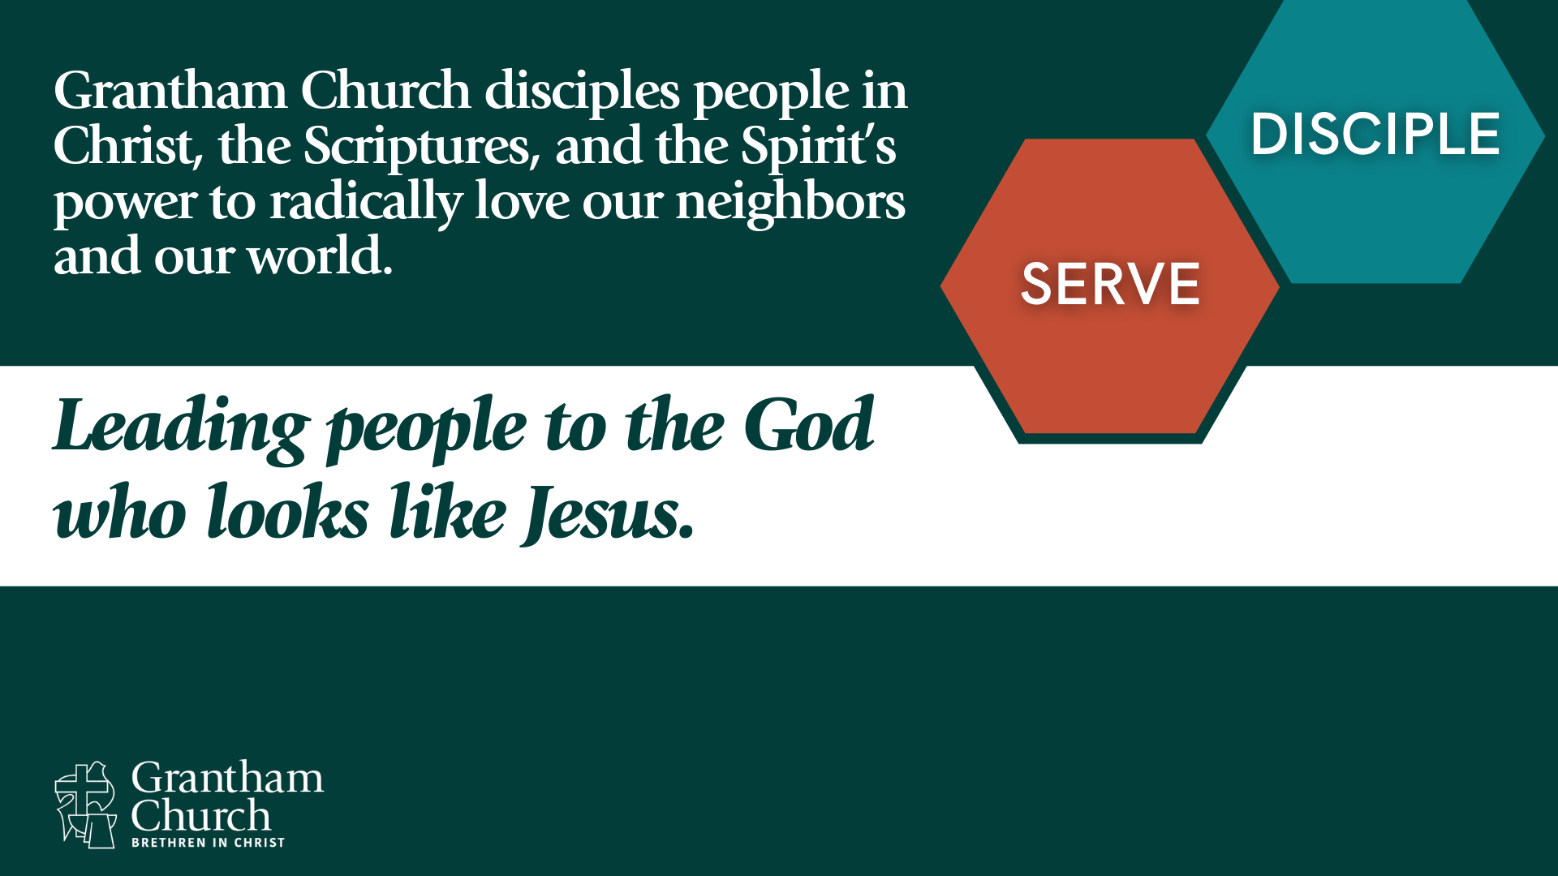
Notes:
[BRIEF COMMENT]
We want to help our members understand their spiritual gifts, talents, and skills as followers of Jesus and identify corresponding service opportunities in the church and in the broader community.
The third word is… [NEXT SLIDE]

Slide 17
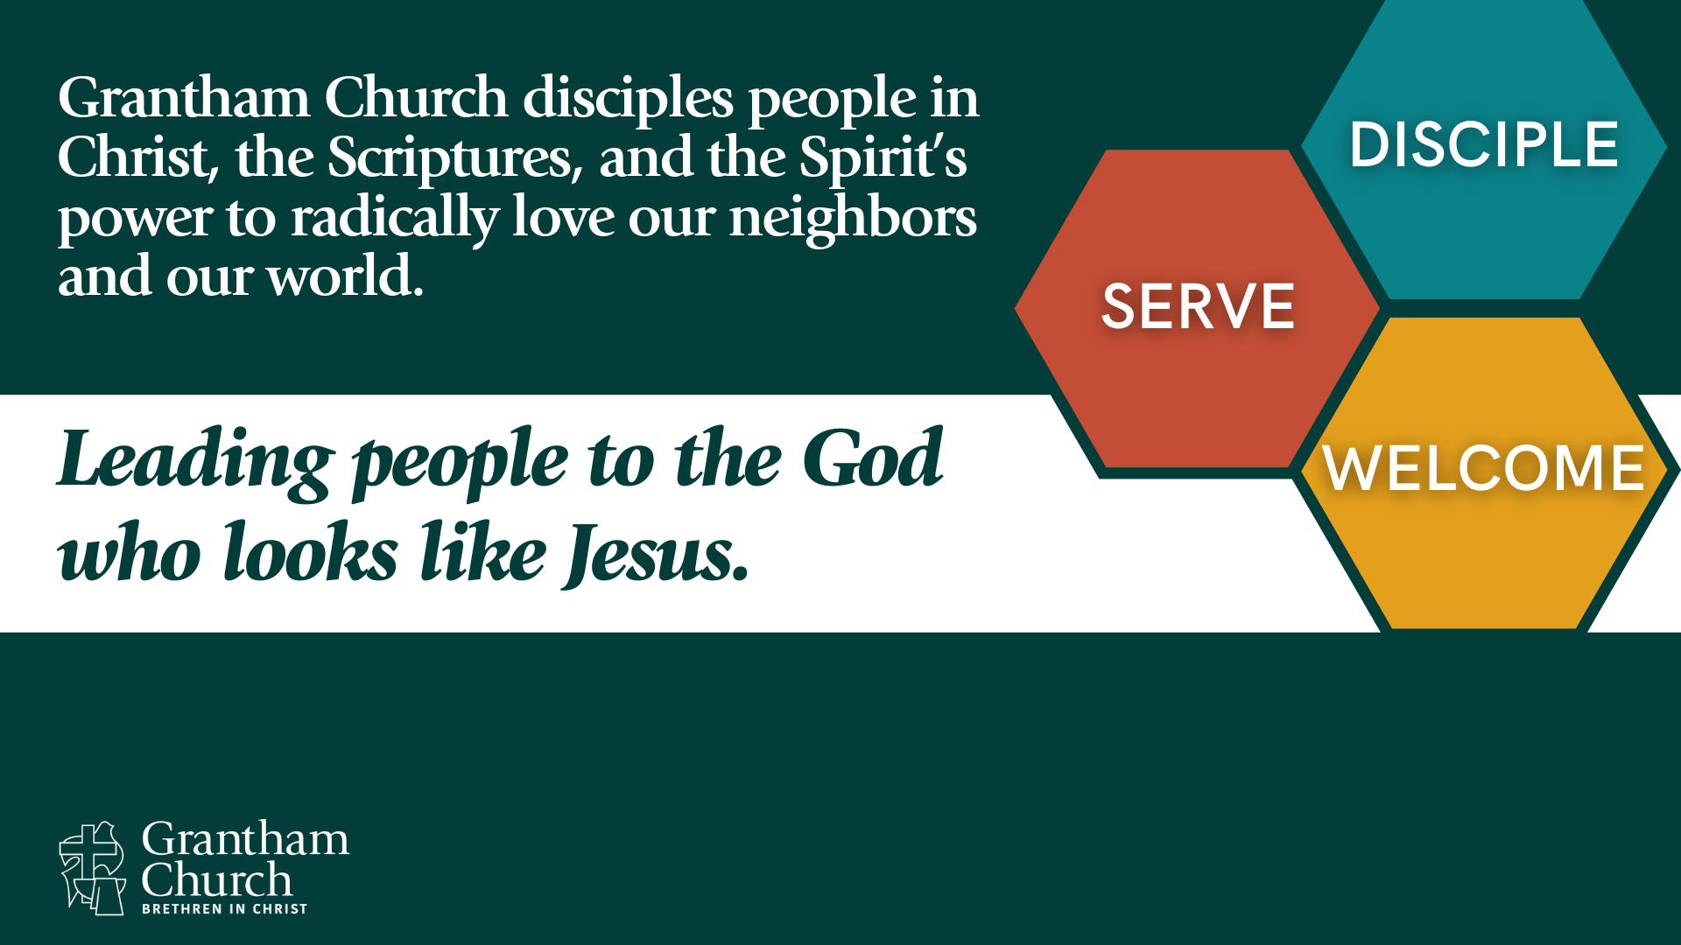
Notes:
[BRIEF COMMENT]
We warmly welcome all who enter our doors, actively participate in meeting the needs of our local community, and generously support our ministry partners in the U.S. and around the world.
And the fourth word is… [NEXT SLIDE]

Slide 18
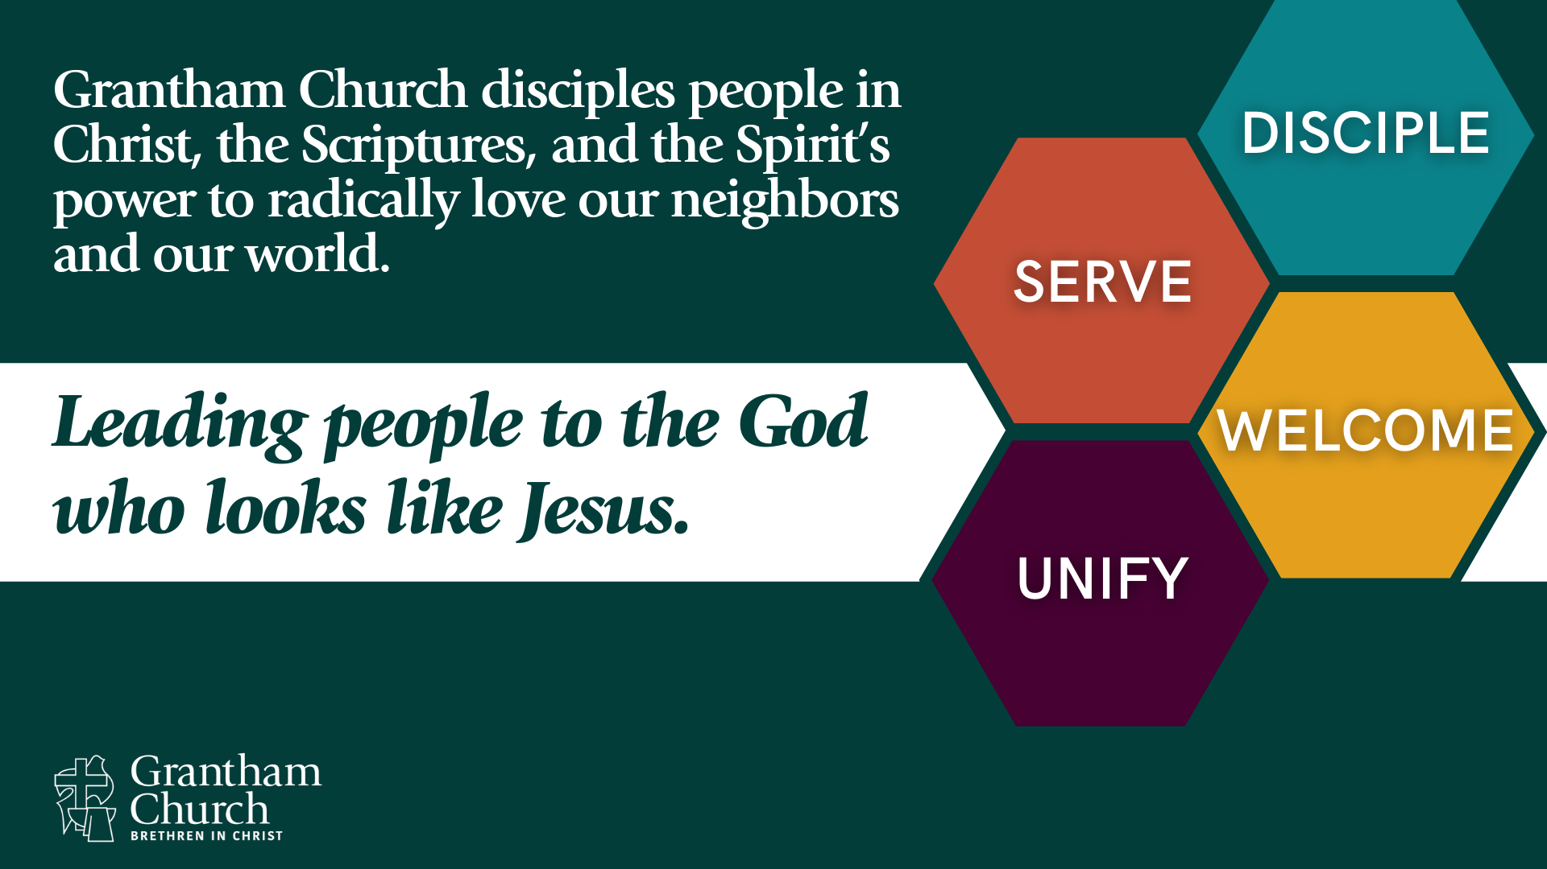
Notes:
[BRIEF COMMENT]
We promote and pursue diversity in our leadership and congregation, embrace convergent worship, and model third-way unity that bridges the divides of political and theological differences.
And lastly… the fifth word is… [NEXT SLIDE]

Slide 19
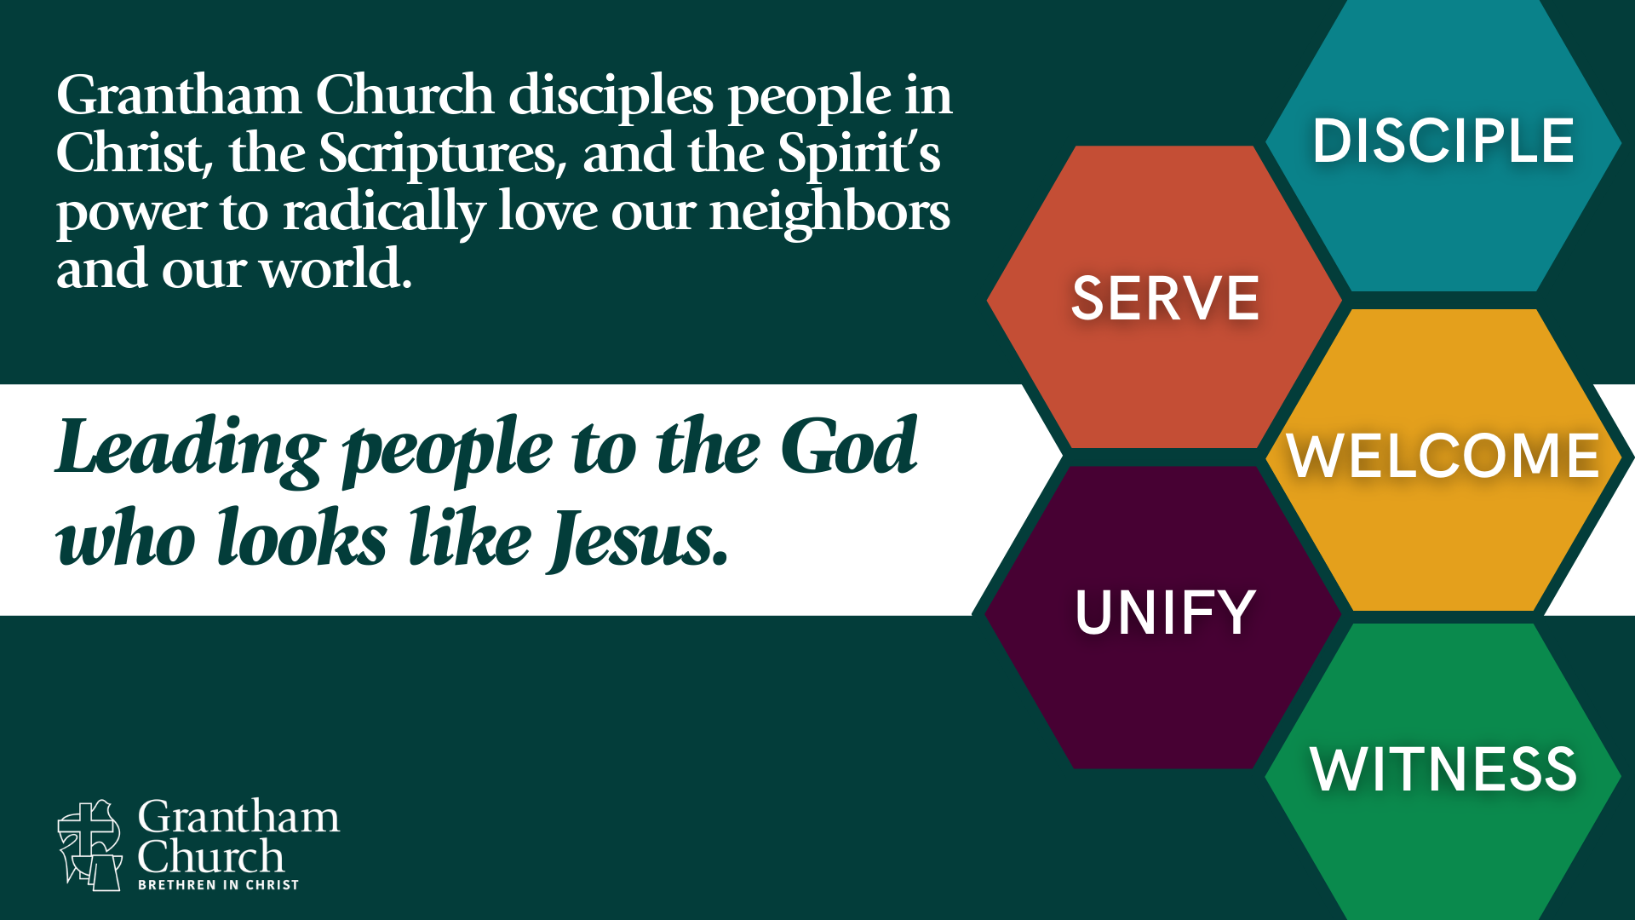
Notes:
[BRIEF COMMENT]
We equip and empower our members to share their faith with those who are spiritually curious, invite people to join us in worship, and lead people to the God who looks like Jesus.
Again, we see this as the scaffolding or the framework of our mission and vision. And now we want you to help us discern what this looks like lived out through the ministries of our church, and in blessing our community, as we join with what God is doing through other churches and ministry partners in our area. Because, while it’s true that we have a unique calling as a Brethren in Christ church—to be an intergenerational, convergent, third way congregation–we believe that we are also part of the larger Body of Christ in our region and that no single church can meet the needs of Cumberland Valley.
And so… here’s what we’re inviting you to do in the coming weeks… [NEXT SLIDE]

Slide 20

Notes:
First, pray about what your church leadership has worked on this past year that you see captured in this graphic. If you go to granthamchurch.org/vision, you can reflect on this at home and begin to imagine what each of these might look like at Grantham Church in the next few years. What would it look like if we led others to the God who looks like Jesus by doing these things well? What sort of things ought we be doing to disciple, serve, welcome, unify, and witness?
And secondly, we want you to know that we will be reaching out to our ministry commissions and other ministry leaders and volunteers in the church throughout the rest of the summer to get your input on specific steps that can help us move forward with this mission, and ultimately help us develop the vision for where we want to be in five years.
[CLOSING COMMENTS]
And finally, I’d like us to recite a passage of Scripture that we read aloud back in 2019. [NEXT SLIDE]

Slide 21

“Now all glory to God, who is able, through his mighty power at work within [Grantham Church], to accomplish infinitely more than we might ask or think. Glory to him in the church and in Christ Jesus through all generations forever and ever! Amen.”
Ephesians 3:20-21 NLT
Notes:
[RECITE TOGETHER]
[NEXT SLIDE] & [CLOSING PRAYER]

