Slide 1
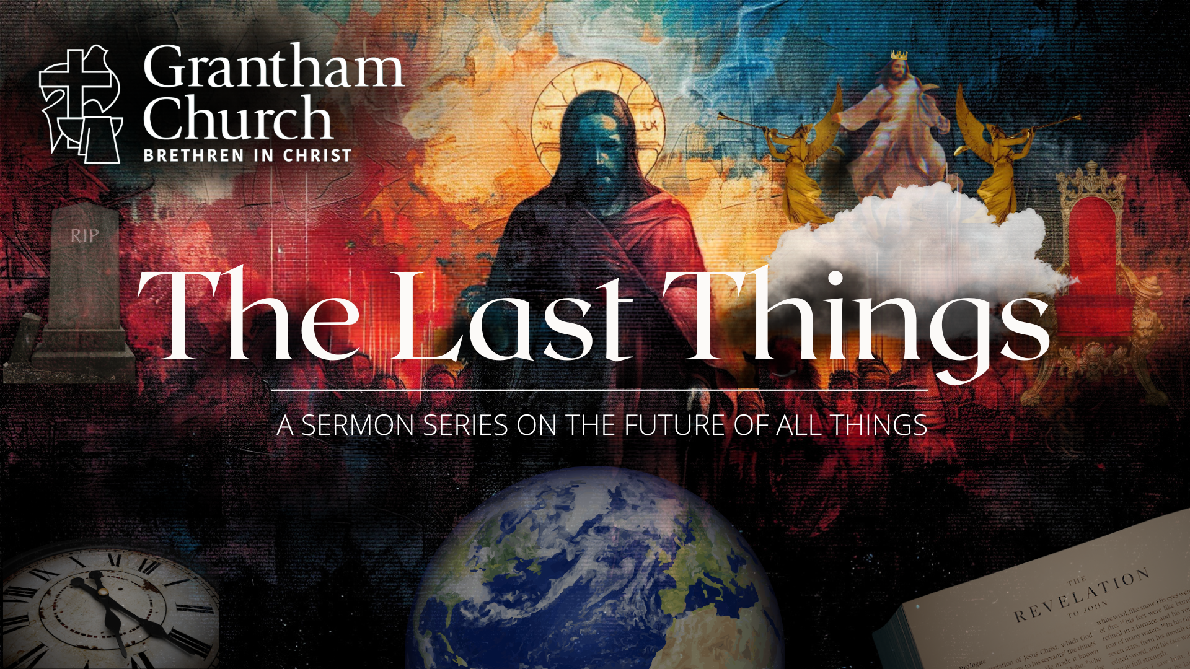
Notes:
[BRIEF WELCOME & INTRO]
We are continuing our series, The Last Things, this morning.
If you’re just joining us, the ”last things” comes from… [NEXT SLIDE]

Slide 2
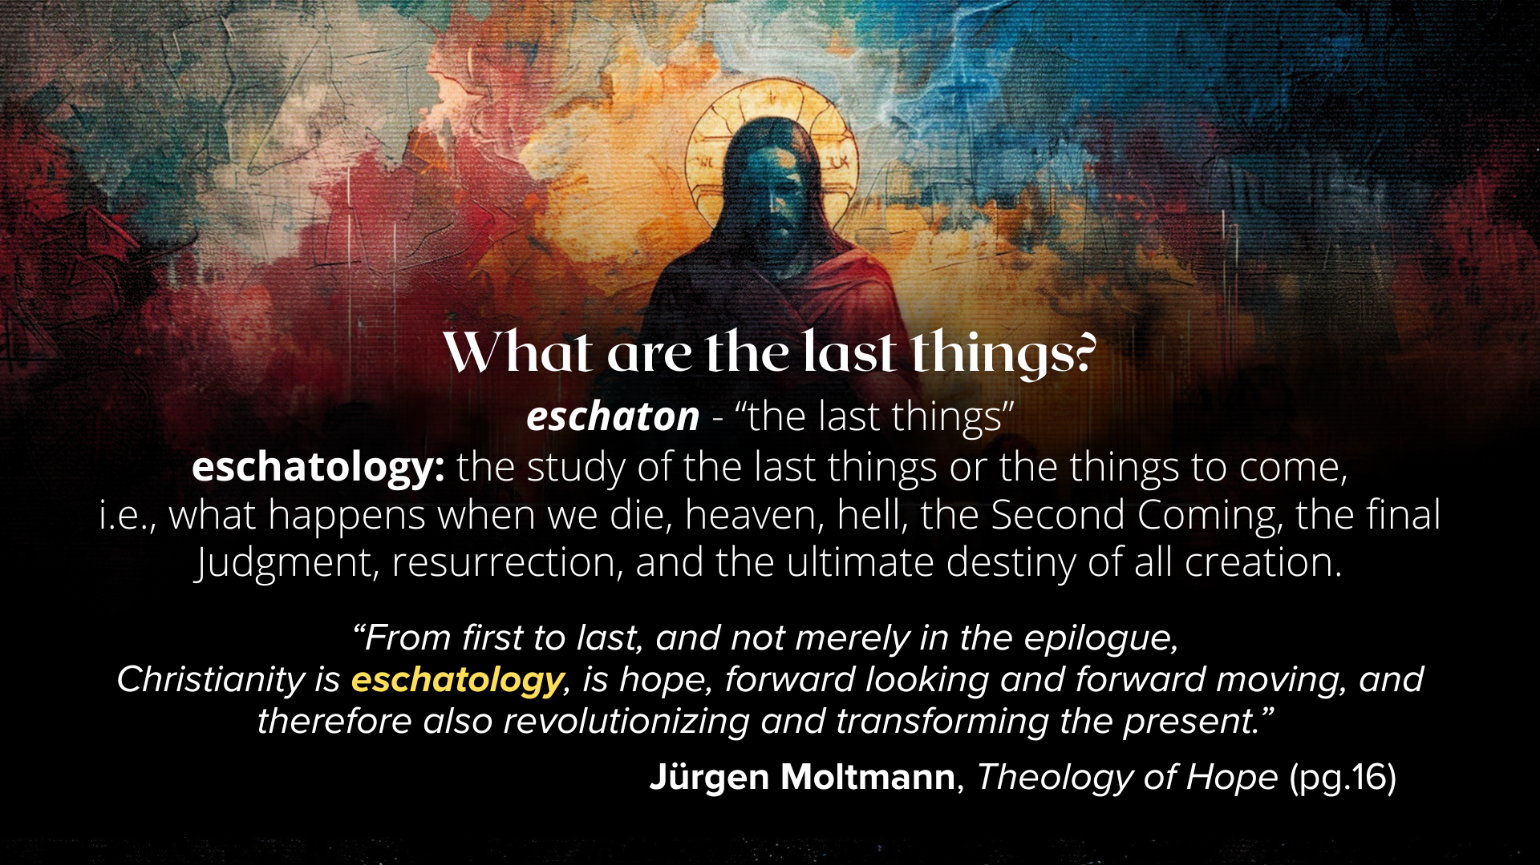
Notes:
[READ SLIDE & COMMENT]
And we’ve been addressing the last things because knowing where things are going has the potential to deepen our trust in God in times of fear and uncertainty, ground us in the Christian hope, and help us to live with peace, joy, and assurance as followers of Jesus.
And I hope you know that thinking deeply about these things is not for mere intellectual stimulation. Exploring the last things (or anything theological and biblical) should create in us a hunger to know and experience God and more of the fruit of the Spirit. So, I pray that this stuff is moving from your head, to your heart, to your hands and feet. Amen?
We’re being reminded in this series that God is guiding all of human history to its divinely intended goal so that we can keep all of life in eternal perspective… [NEXT SLIDE]

Slide 3
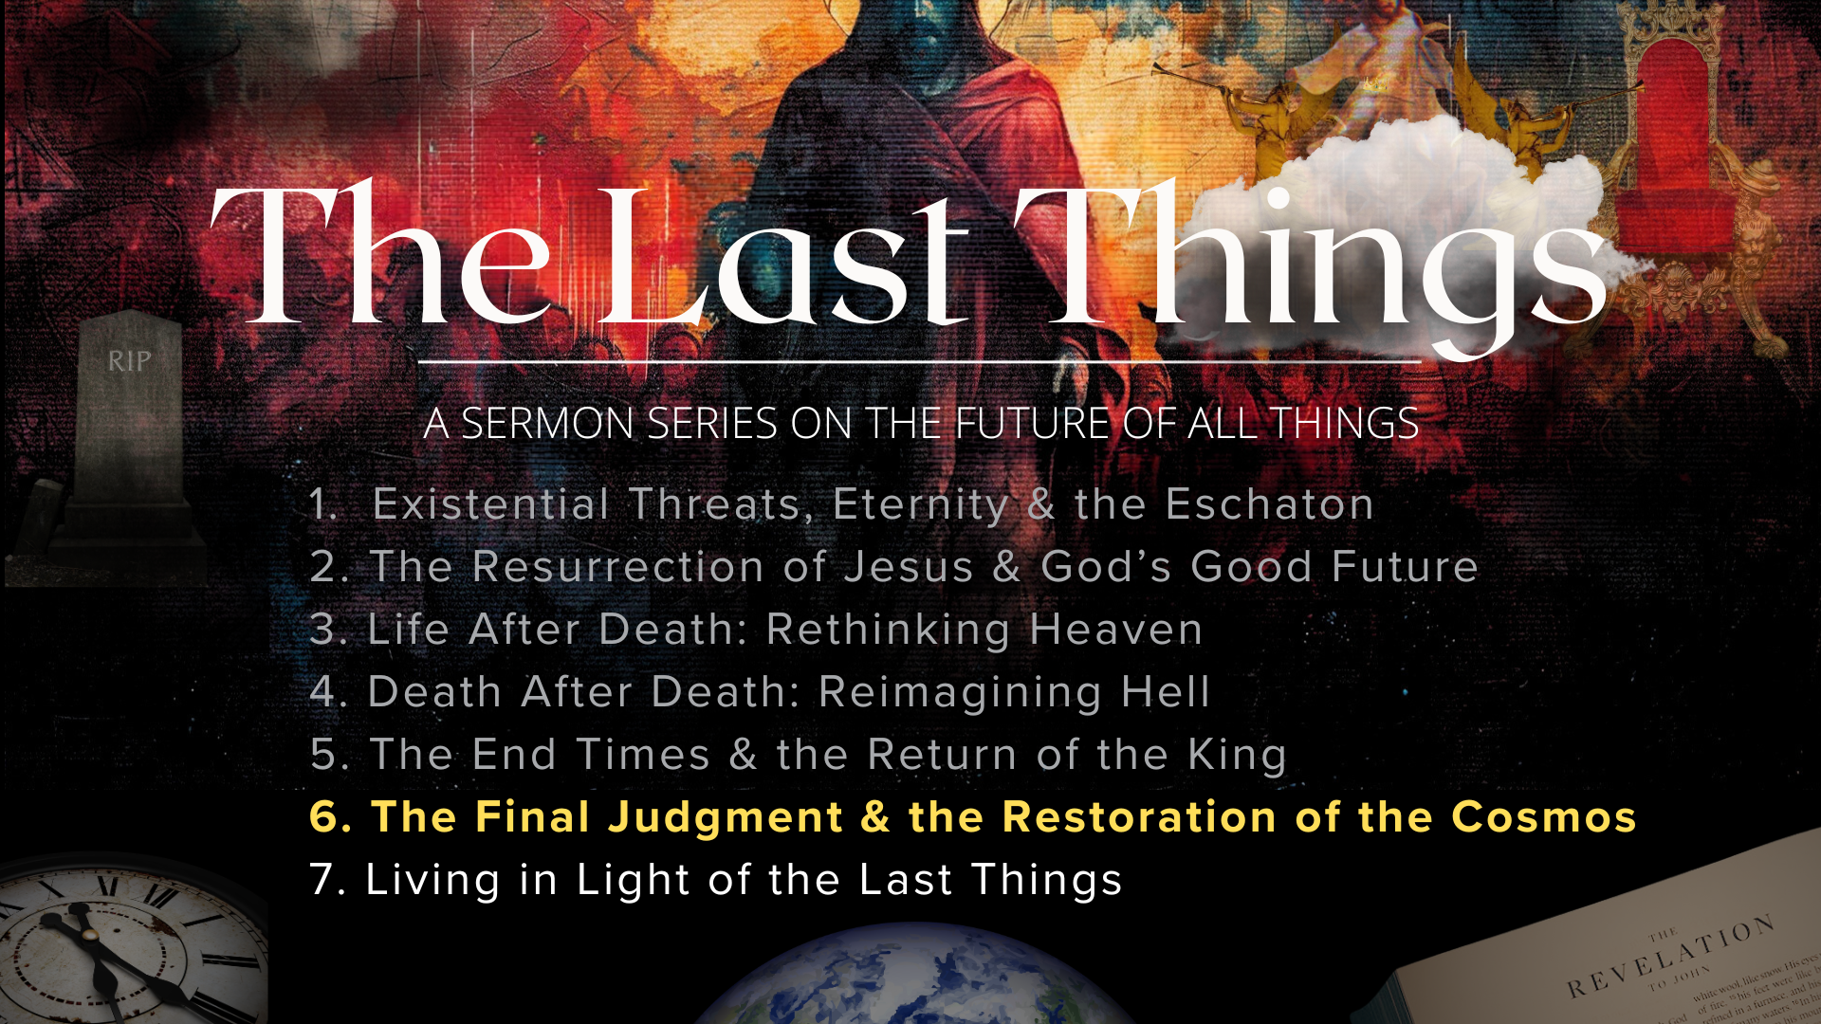
Notes:
Once again, if you’ve missed any of the messages over the first five weeks, I encourage you to go back and listen at our website, YouTube channel, or podcast.
Today is message 6 of 7 in our series. Of course, don’t forget that I will now be doing an “epilogue” message on Sun, June 22, where I will respond to the most frequently asked questions that come up when addressing the last things. So, if you have a burning question, please send that to me via email by the end of this coming week. [NEXT SLIDE]

Slide 4
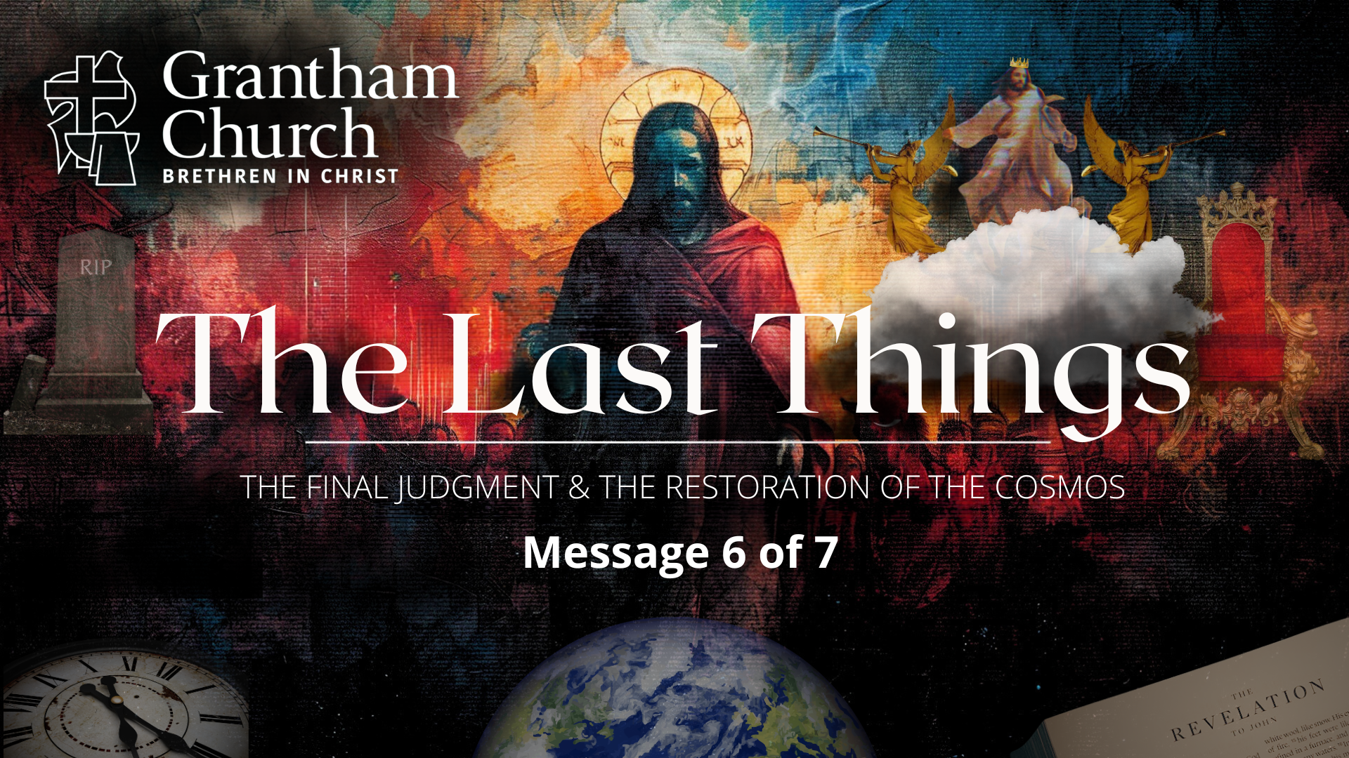
Notes:
The Final Judgment & the Restoration of the Cosmos.
[BRIEF PRAYER]
Let’s look again at this image of that captures where everything is going... [NEXT SLIDE]

Slide 5
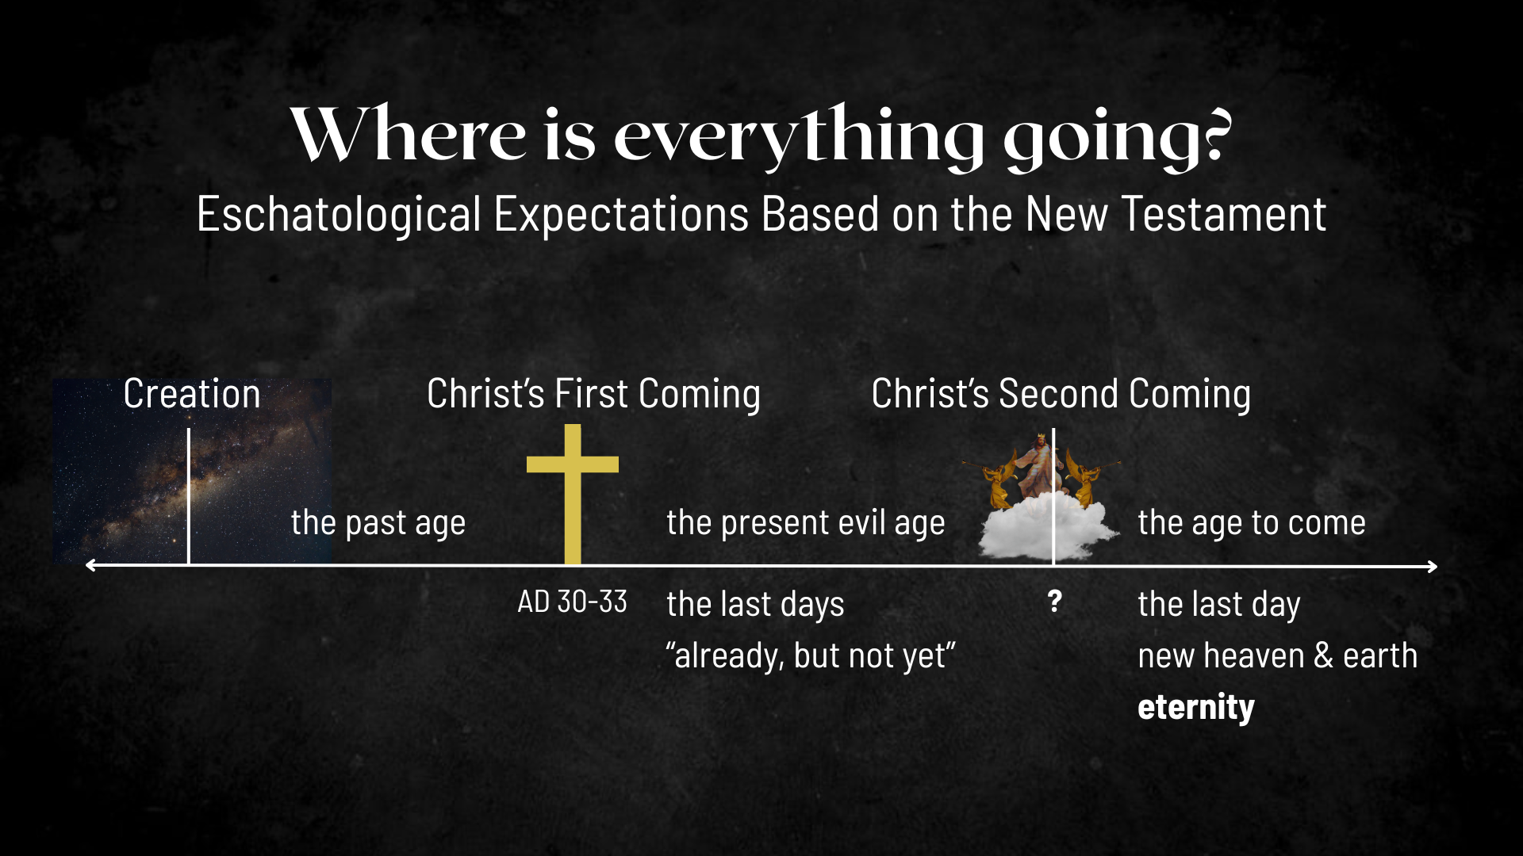
Notes:
Based on the New Testament…
Jesus’ first coming split our historical timeline (the past age & the present evil age)
So, according to the Scriptures, since the life, death, and resurrection of Christ, we’re living in the “last days”; we live in the ”already, but not yet” of the Kingdom of God; the decisive battle has been won, the victory is certain, and the future is secure.
And the Bible says that Christ will return a second time. We looked at that last week in the message, The End Times and the Return of the King. As Paul says in 1 Thessalonians 4:13-18, when Jesus returns it will be like Moses coming down the mountain (bringing God’s will and sorting out the chaos down below), and it will be like the Son of Man in Dan. 7:13-14 who is exalted in the clouds by the Ancient of Days, and it will be like a victorious king returning to his city. Therefore, we will go out and meet him and then parade him back into the city to sit on his rightful throne and rule forever in a restored and renewed cosmos.
And so, when Jesus returns in this way, this present evil age comes to an end, God raises the dead, brings heaven to earth and we enter the age to come.
But why (you may have wondered and asked at some point) has it been so long since Jesus gave his first century audience the promise that he would return? That is a question that the NT addresses and responds to in 2 Peter chapter 3. Let’s begin there… [NEXT SLIDE]

Slide 6
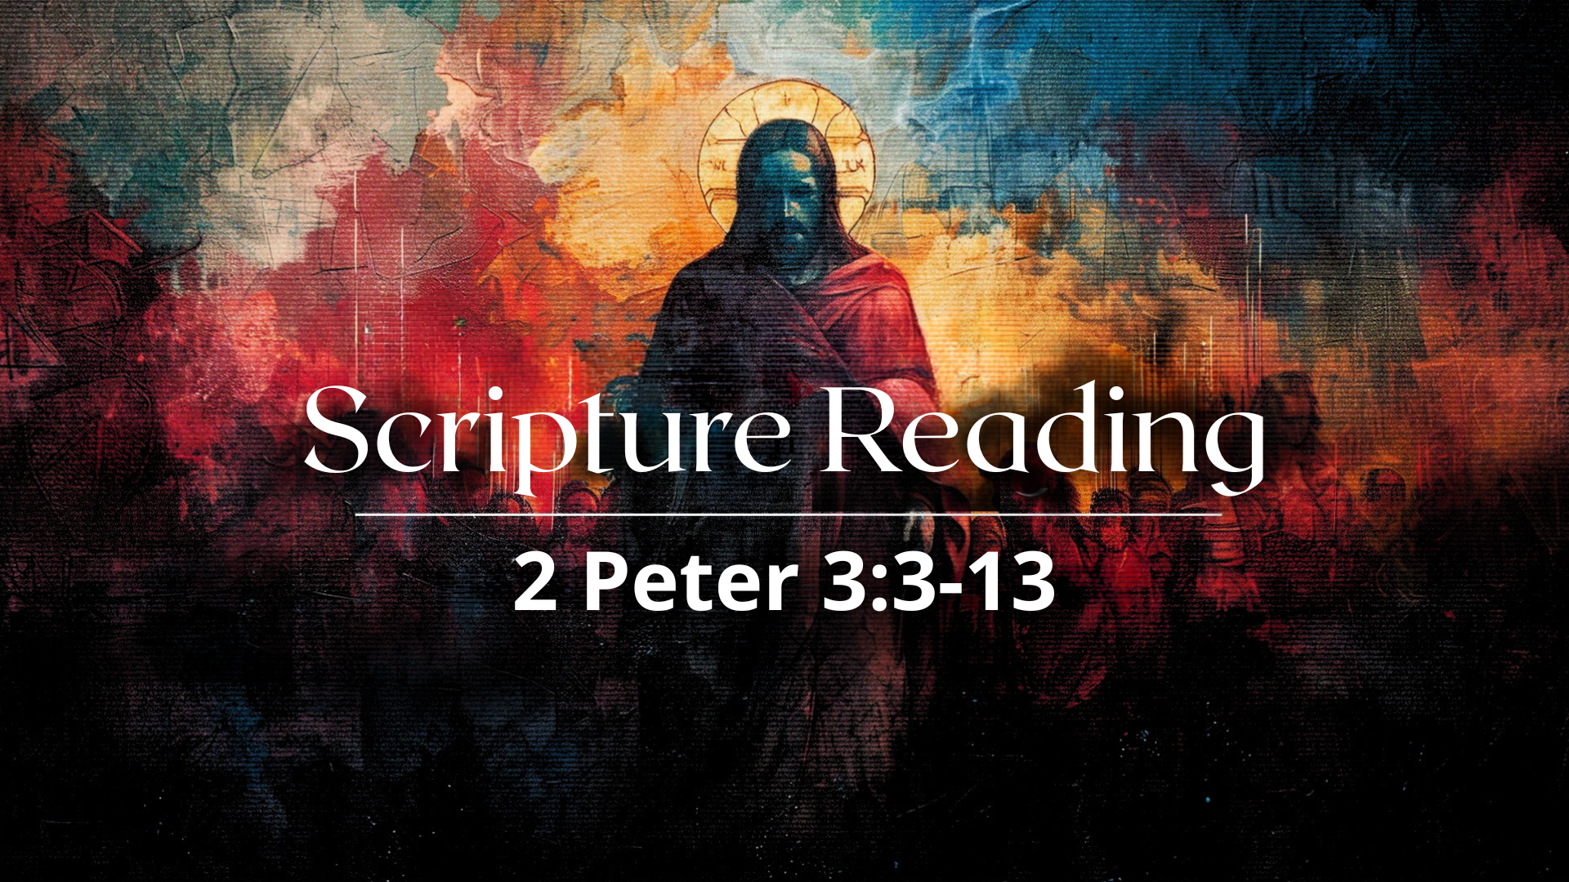
Notes:
[READ PASSAGE & COMMENT]
v. 7 – “fire” in the Bible is being used here as a metaphor of purification
v. 8 – NDEs and their experience of being outside of time and 3D space
v. 9 – God allows human history to continue in order to save more!
In verses 10-13 Peter is using apocalyptic language; not to be taken literally.
v. 12 – “look forward” to the day of God and “speed its coming”
v. 13 – this “new heaven and earth” comes from the marriage of heaven and earth
And so, this image is not a helpful one… [NEXT SLIDE]

Slide 7
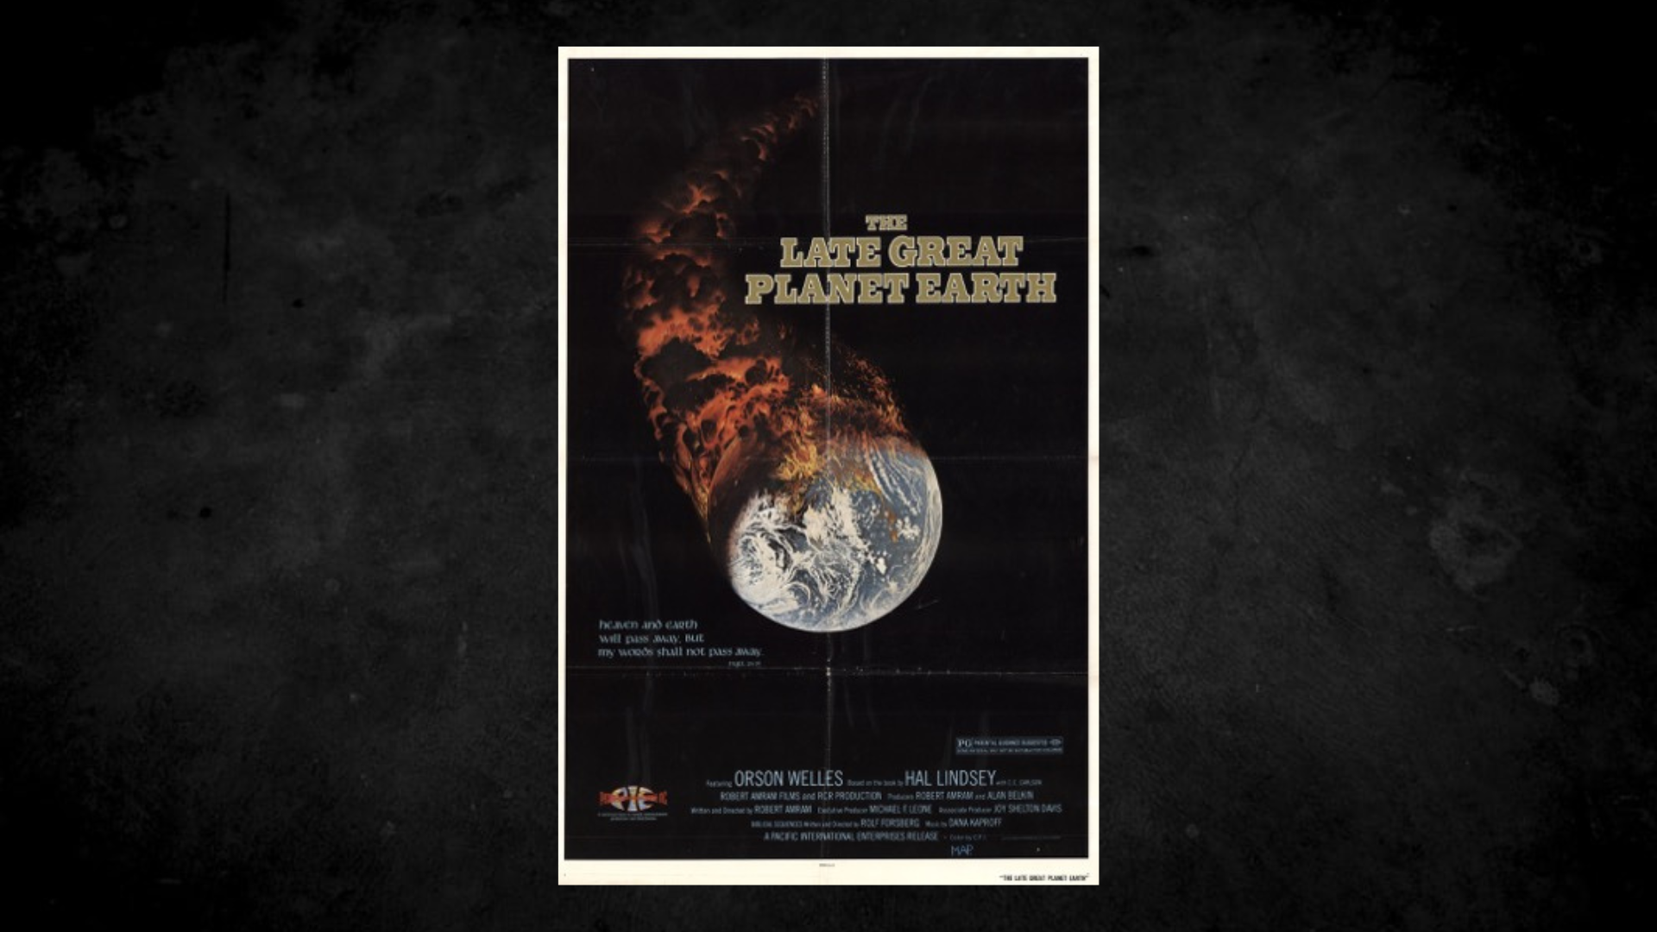
Notes:
And it’s not reflective of what Peter is actually saying. Last Sunday I mentioned the book The Late Great Planet Earth that helped to further pre-tribulation rapture theology. And in 1978, Orson Welles (creator of Citizen Cane and War of the Worlds) narrated the film, "The Late Great Planet Earth," a documentary based on Hal Lindsey’s best-selling book.
And so, we should be aware that the old evangelical mantra “It’s all gonna burn!” comes from a literal reading of 2 Peter 3:10-13 and books and media like this. Again, it’s not helpful nor is it biblically accurate. In fact, it not only envisions a false future, but it also creates an attitude and perspective in the present that says forget being caretakers of the earth; positing that concerns about the environment and creation care is a big fat waste of time. But according to the entire thrust of Scripture, heaven is coming to earth, and our actions are signposts of it.
So, let’s look now at what the Scriptures teach about the coming judgment. When Christ returns, how will God judge human beings and address the groaning of creation? What will this great reckoning and restoration of the cosmos look like? Let’s begin with what the Old Testament tells us… [NEXT SLIDE]

Slide 8
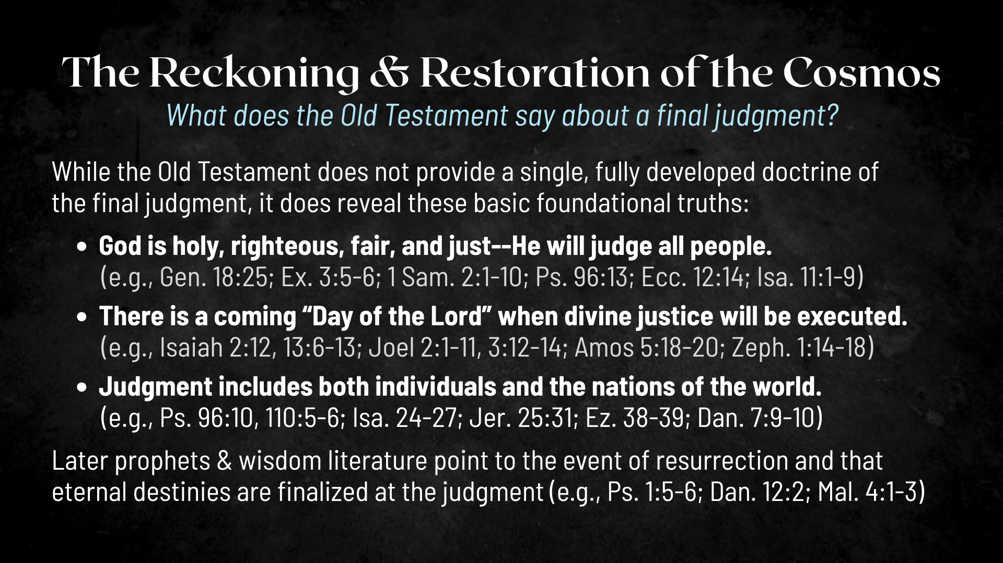
Notes:
While the OT, does not provide a single, fully developed doctrine of the final judgment, it does reveal these basic foundational truths (and I’ve given you some references):
God is holy, righteous, fair, and just—He will judge all people.
Psalm 96:13: “Let all creation rejoice before the Lord, for he comes, he comes to judge the earth. He will judge the world in righteousness and the peoples in his faithfulness.”
There is a coming “Day of the Lord” when divine justice will be executed.
The prophets proclaim this is a dark day for the wicked; they will not escape it.
Judgment includes both individuals and the nations of the world.
Again, the psalmist writes: “Say among the nations, “The Lord reigns! The world is firmly established; it cannot be moved; he will judge the peoples with equity.”
And there is another key passage in Isaiah that should be included with what the Old Testament says about these things. In Isaiah chapter 65, the prophet speaks of God’s coming judgment and then in the second half of the chapter says this… [NEXT SLIDE]

Slide 9
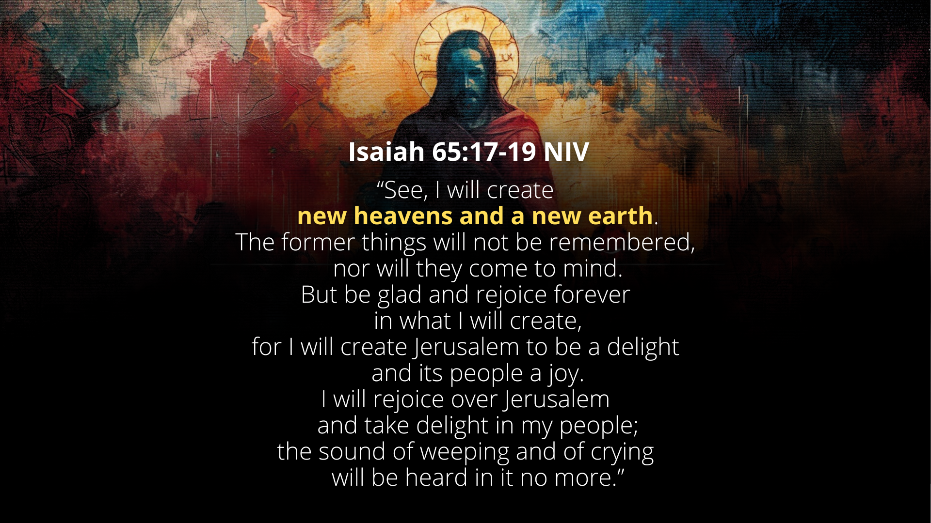
Notes:
[READ PASSAGE & COMMENT]
And so, we can see in the Old Testament, the promise and hope that God isn’t going to kick this world into the cosmic trashcan upon the judgment but rather renew and restore it.
Let’s now look at what the New Testament says, starting with the words of Jesus. Turn with me to the gospel of Matthew… [NEXT SLIDE]

Slide 10
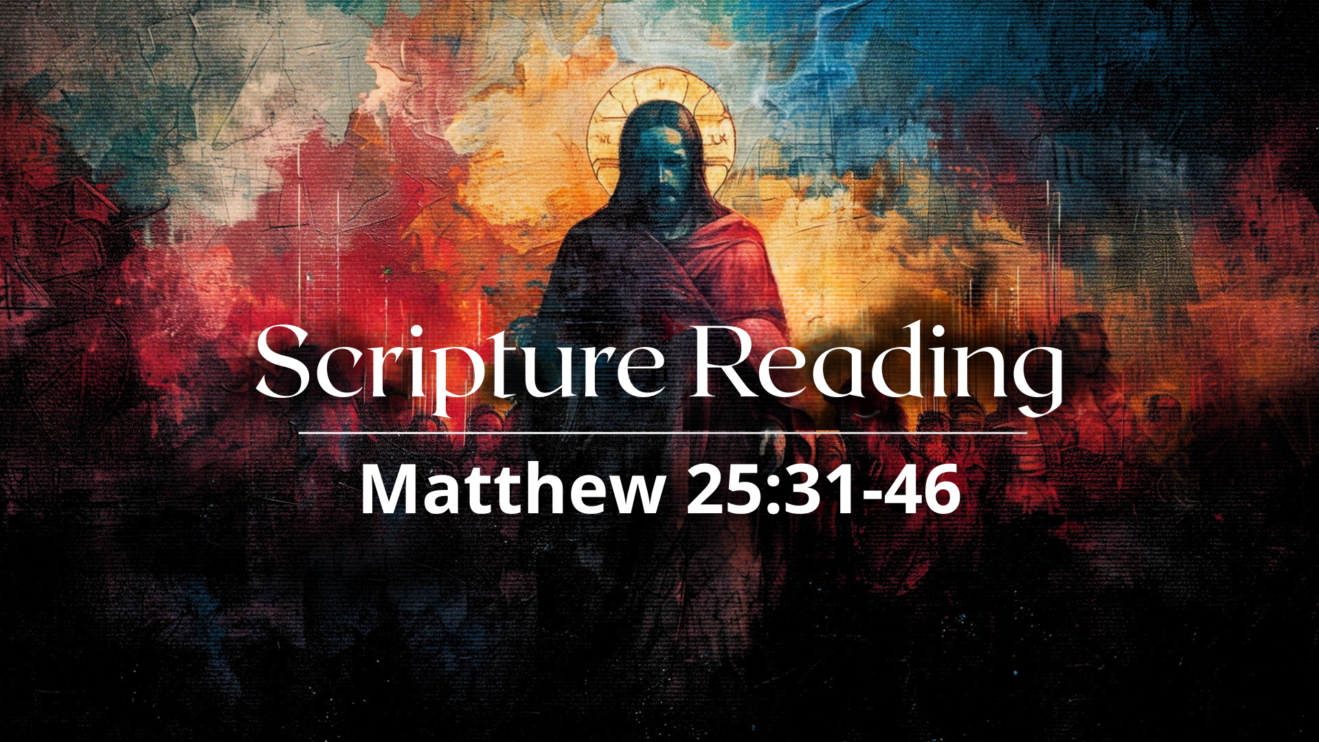
Notes:
This is the well-known passage where Jesus speaks of dividing the sheep from the goats.
[READ PASSAGE & COMMENT]
Jesus was tapping into:
A common, concrete practice His listeners saw regularly among shepherds.
A visual image of discernment and separation: what looked similar by day (sheep and goats grazing together) was divided with intentional care at night.
A moral challenge: outward appearance isn’t enough—how one lives, particularly in relation to others’ suffering, determines one's place in the kingdom. In this story, Jesus reveals that those who show mercy, compassion, and love will be revealed as truly belonging to Him, just as a shepherd discerns and separates his flocks.
In this book, Surprised by Hope, N.T. Wright says… [NEXT SLIDE]

Slide 11
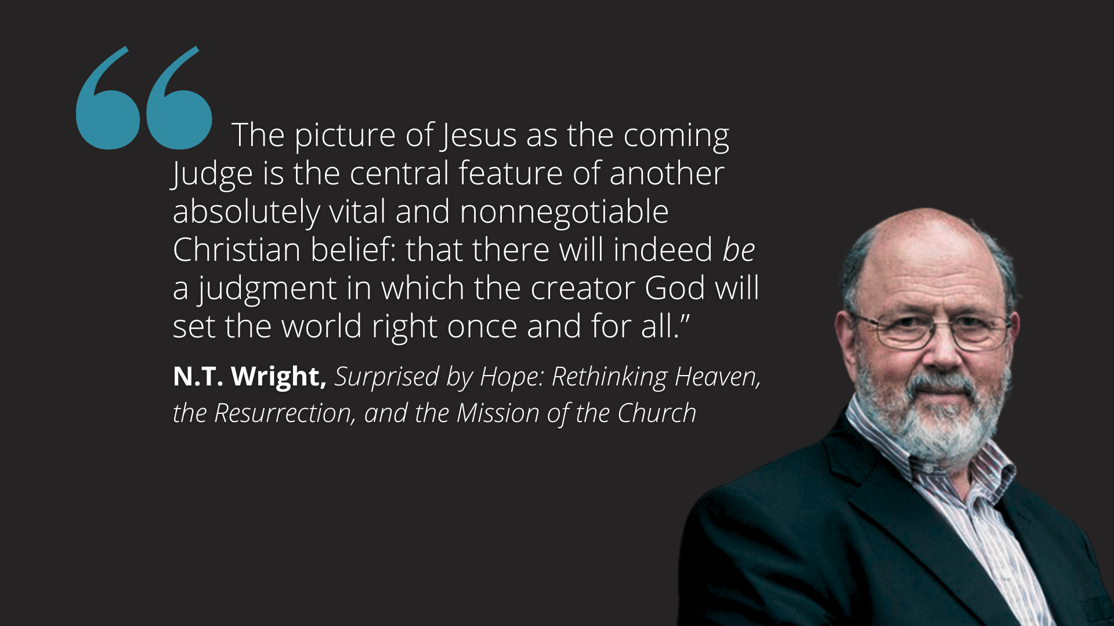
Notes:
[READ QUOTE & COMMENT]
[READ FROM HIS BOOK, PG. 137]
Let’s look now at what the rest of the NT says about the final judgment and the restoration of the cosmos… [NEXT SLIDE]

Slide 12
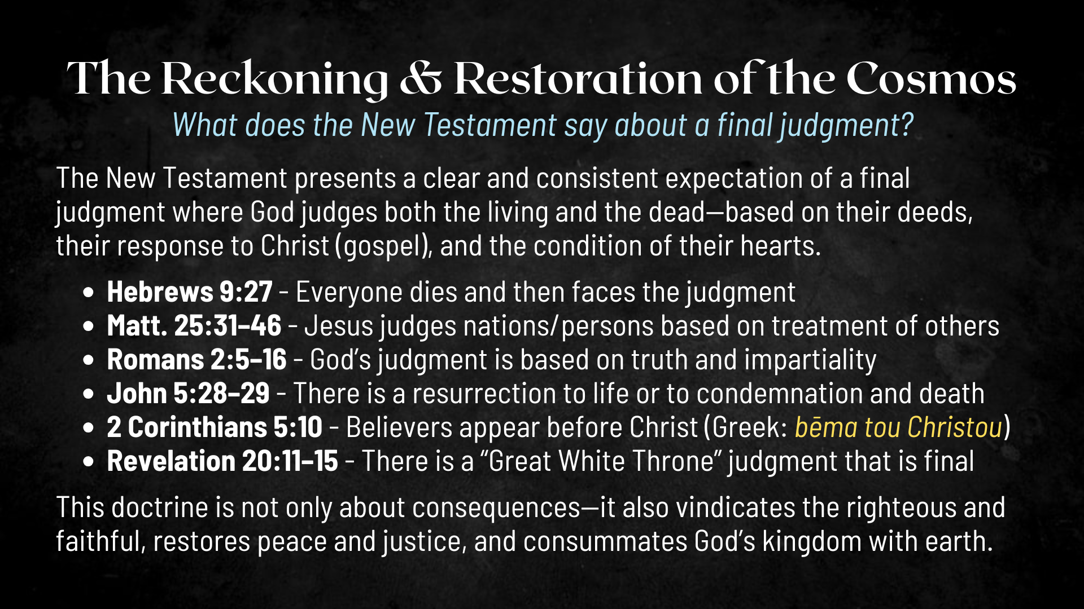
Notes:
[READ & COMMENT ON SLIDE]
Romans 2:6-11: “God “will repay each person according to what they have done.” To those who by persistence in doing good seek glory, honor and immortality, he will give eternal life. But for those who are self-seeking and who reject the truth and follow evil, there will be wrath and anger. There will be trouble and distress for every human being who does evil: first for the Jew, then for the Gentile; but glory, honor and peace for everyone who does good: first for the Jew, then for the Gentile. For God does not show favoritism.”
In John 5:29-29, Jesus said: “…for a time is coming when all who are in their graves will hear his voice and come out—those who have done what is good will rise to live, and those who have done what is evil will rise to be condemned.” Jesus is reiterating what the prophet Daniel said in Dan.12:2: “Multitudes who sleep in the dust of the earth will awake: some to everlasting life, others to shame and everlasting contempt.”
bema tou Christou - What about the rewards? And what does that mean or look like? In 1 Corinthians 3:11-15, Paul writes: “For no one can lay any foundation other than the one already laid, which is Jesus Christ. If anyone builds on this foundation using gold, silver, costly stones, wood, hay or straw, their work will be shown for what it is, because the Day will bring it to light. It will be revealed with fire, and the fire will test the quality of each person’s work. If what has been built survives, the builder will receive a reward. If it is burned up, the builder will suffer loss but yet will be saved—even though only as one escaping through the flames.” In other words, only those things built upon Christ and done from a place of genuine love and good will toward others will last.
And what do these “rewards” look like in eternity? Well, honestly, we have no idea. All we can do is speculate what the rewards of the bema tou Christou will be; Ex. N.T. Wright -- a skilled musician vs. non-musician; while everyone can certainly enjoy the music (say Handel’s Messiah), a trained and skilled musician will have a greater appreciation, understanding, and comprehension of the music being played. So it shall be in the new heaven and earth.
Finally, I told you that we would return to the book of Revelation in this message. Let’s go to Revelation chapter 20… [NEXT SLIDE]

Slide 13
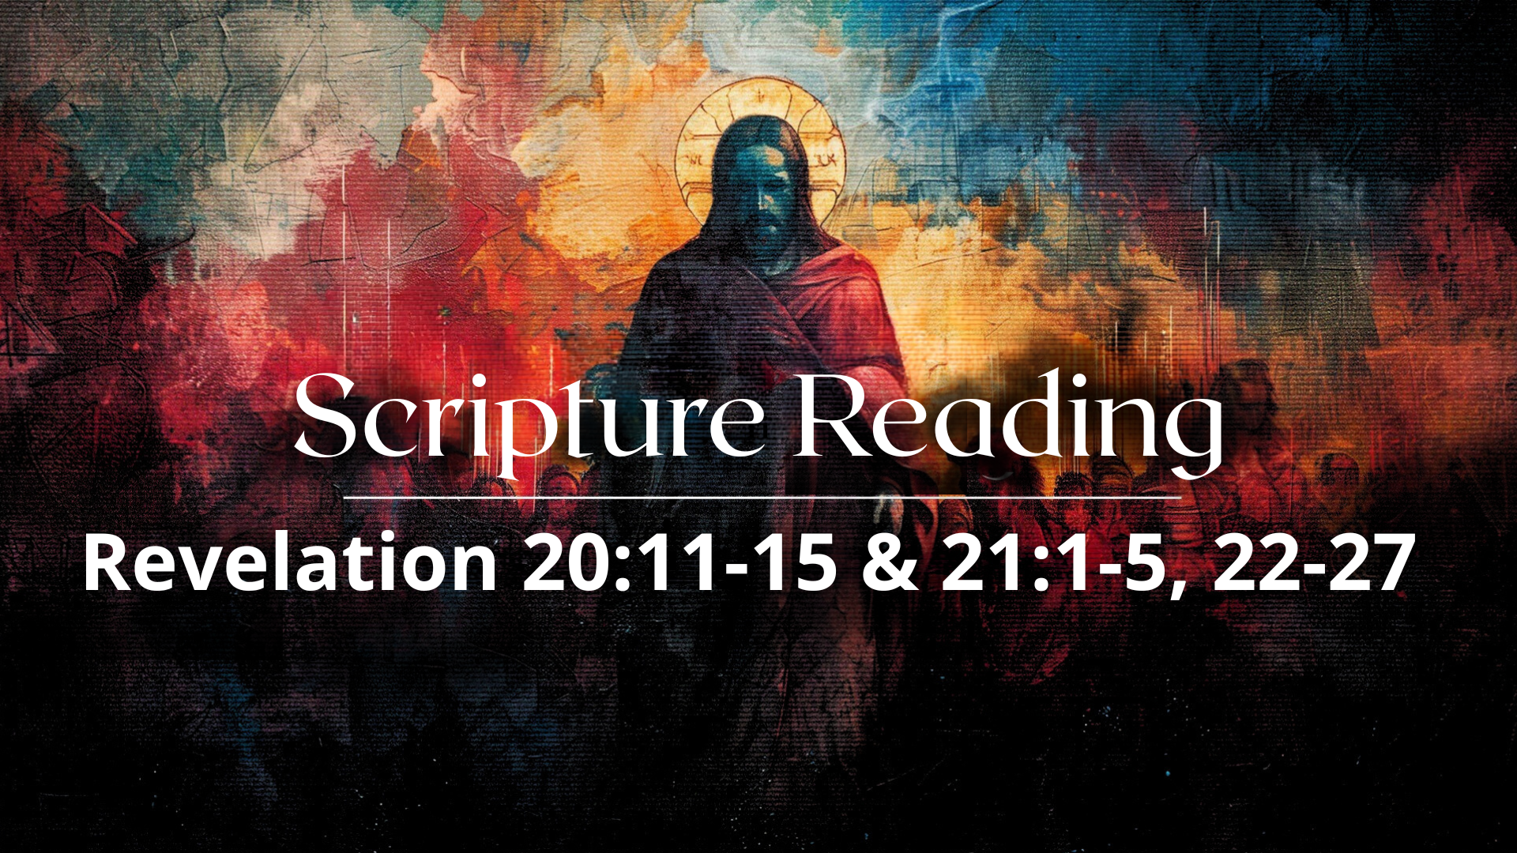
Notes:
[READ PASSAGES & COMMENT]
20:11-15
21:1-5
21:22-27
Once again, we ought to see all of these things being represented in this image… [NEXT SLIDE]

Slide 14
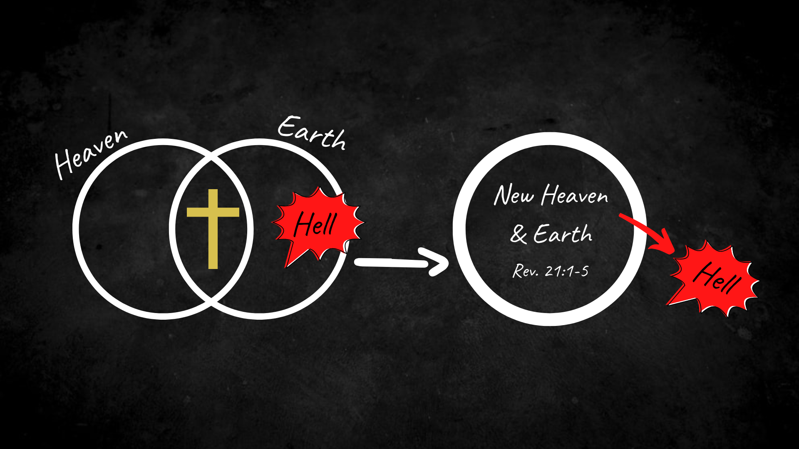
Notes:
[BRIEF COMMENTS]
This is the trajectory and divinely intended goal; this is where everything is going!
Is your name written in the Lamb’s Book of Life?
“How do I get my name written in that book?”
Let’s sum up the message with some takeaways and suggested application… [NEXT SLIDE]

Slide 15
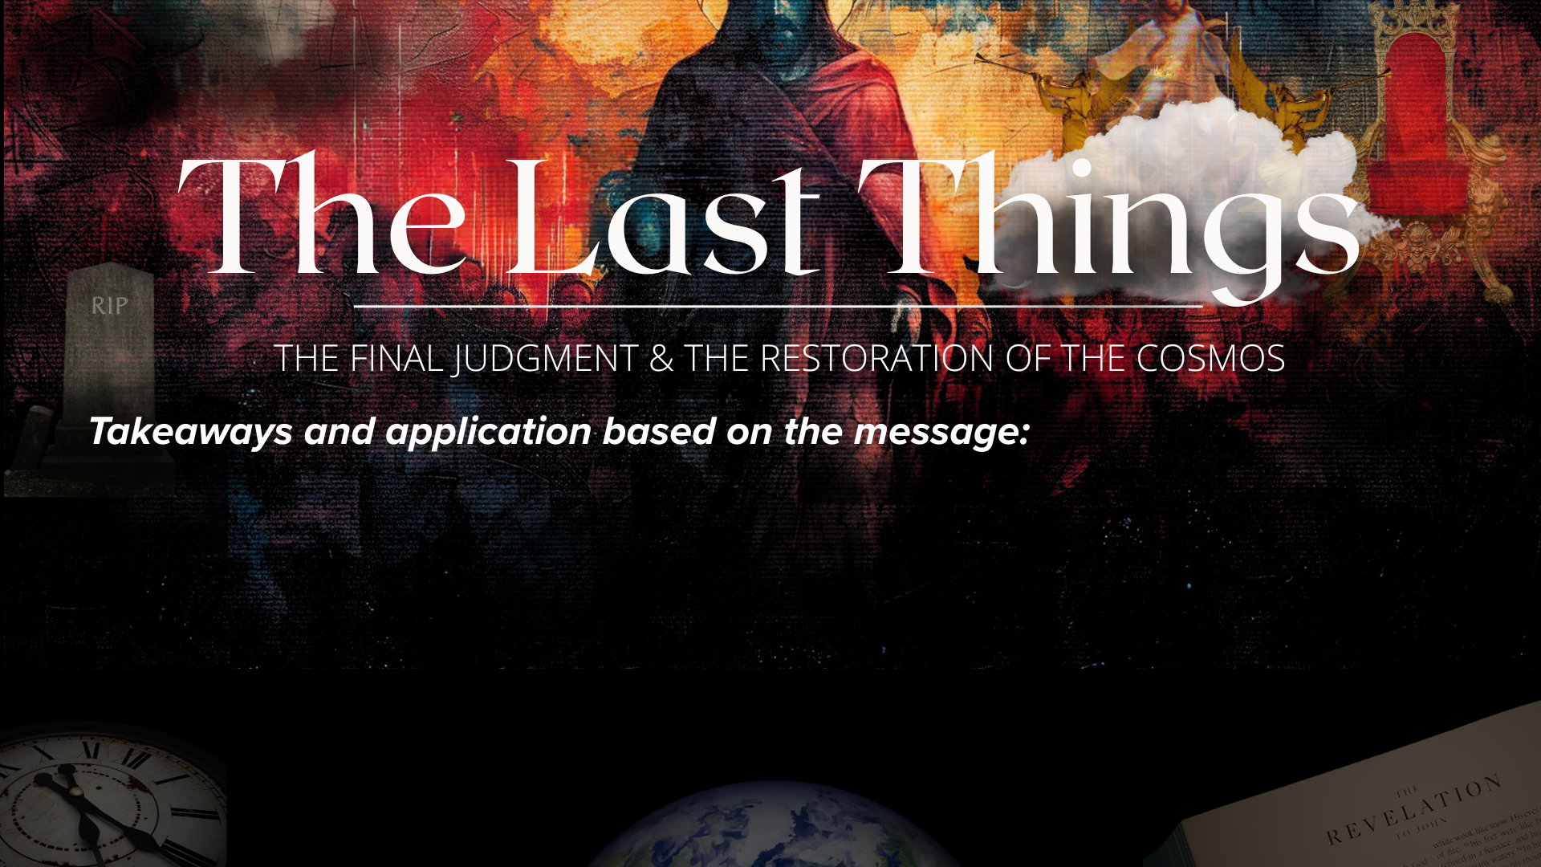

Slide 16
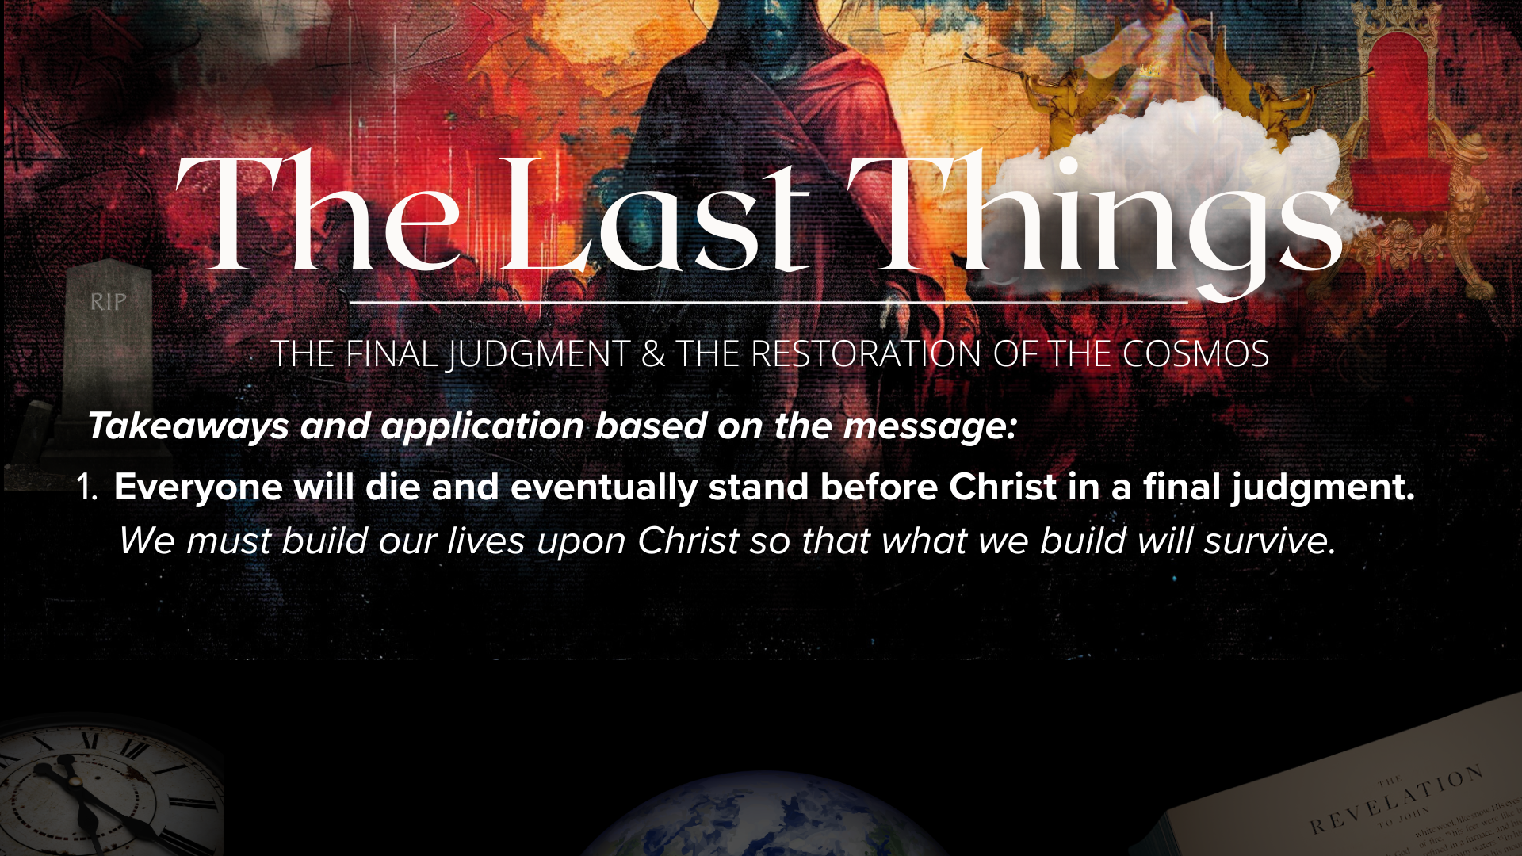

Slide 17
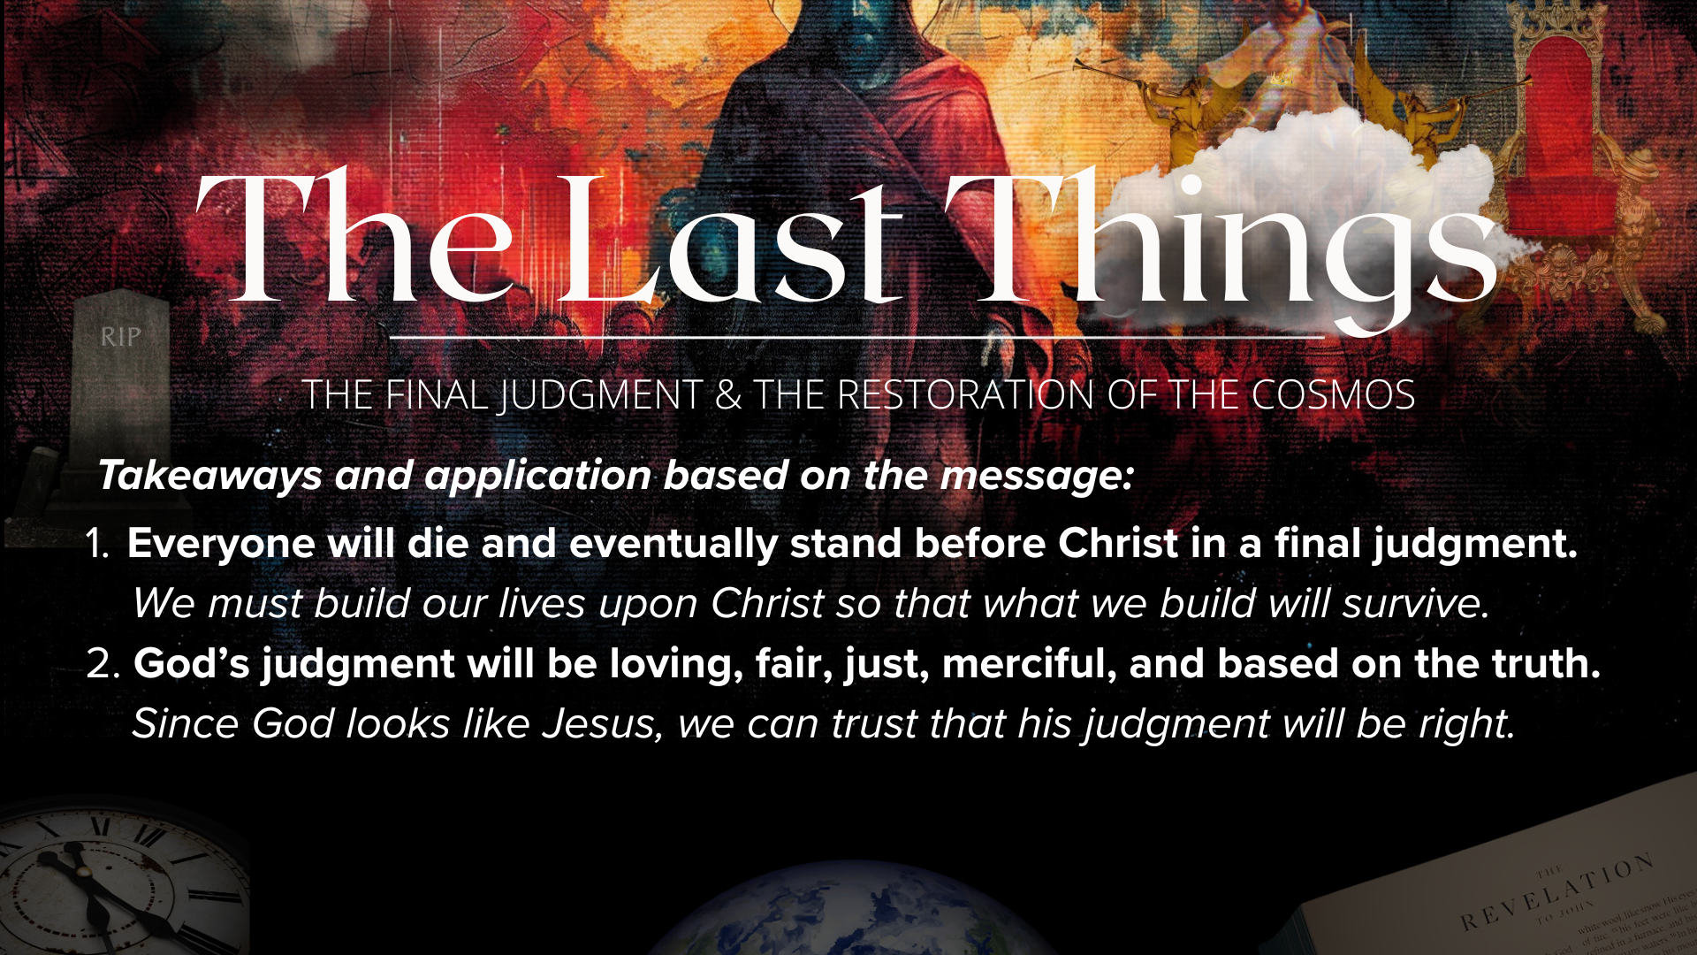

Slide 18
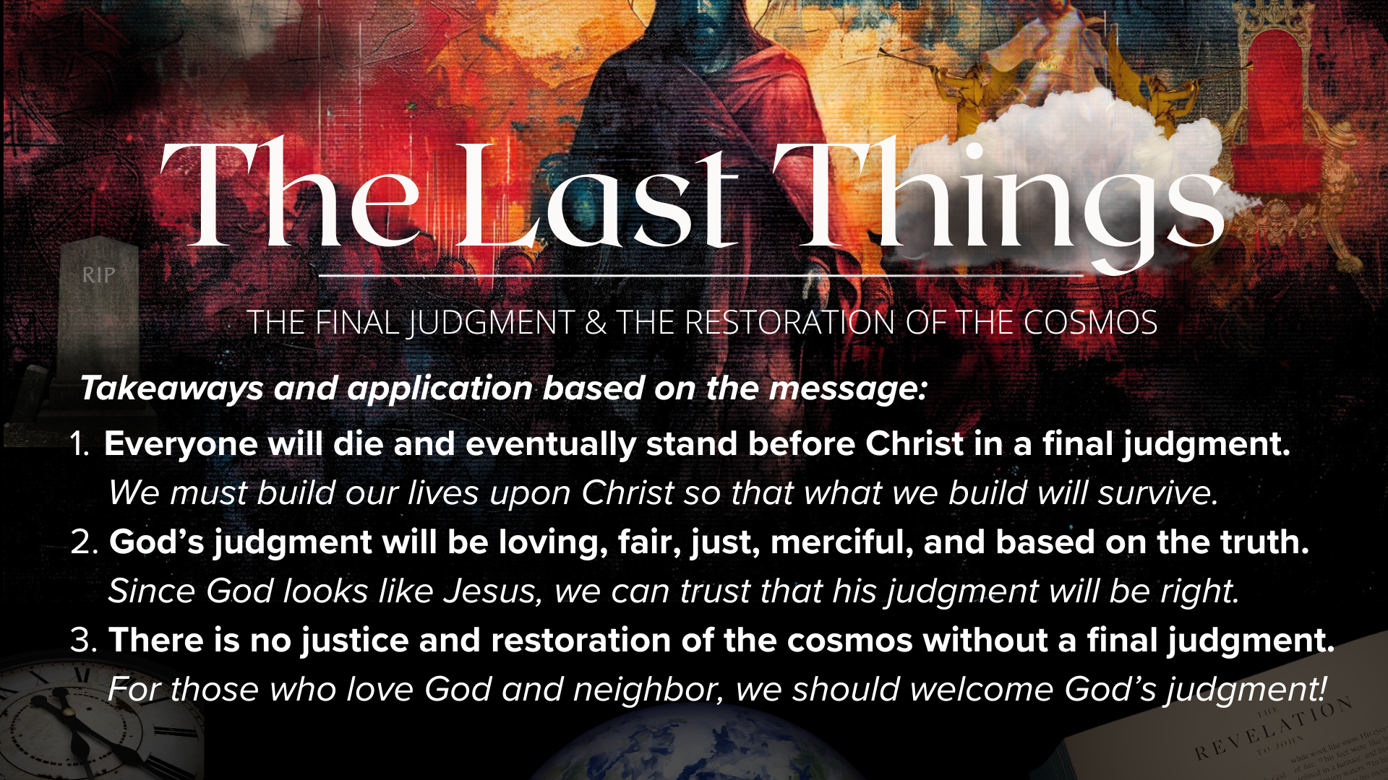
Notes:
[READ & COMMENT ON EACH TAKEAWAY]
Everyone will die and eventually stand before Christ in a final judgment.
We must build our lives upon Christ so that what we build will survive.
God’s judgment will be loving, fair, just, merciful, and based on the truth.
Since God looks like Jesus, we can trust that his judgment will be right.
There is no justice and restoration of the cosmos without a final judgment.
For those who love God and neighbor, we should welcome God’s judgment!
And here are some questions to help us reflect and respond together… [NEXT SLIDE]

Slide 19
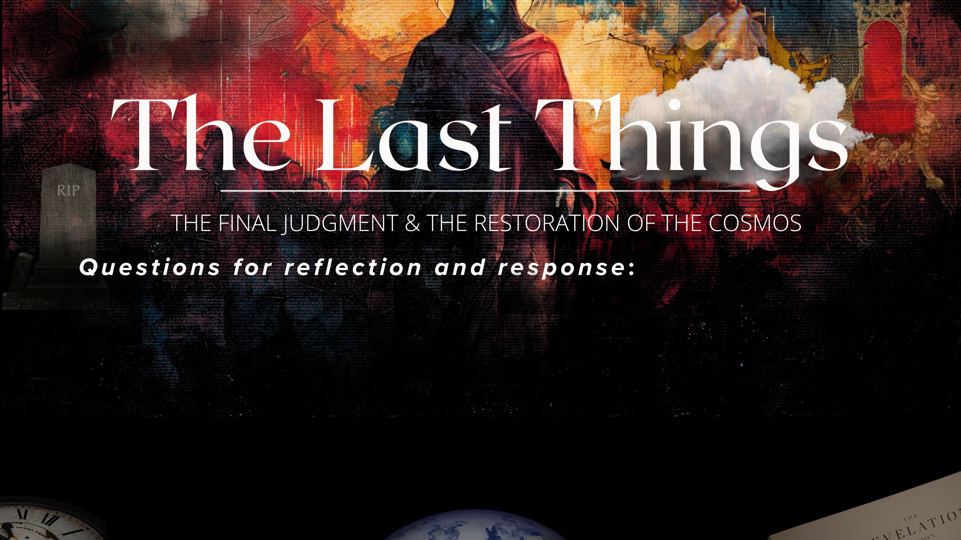

Slide 20
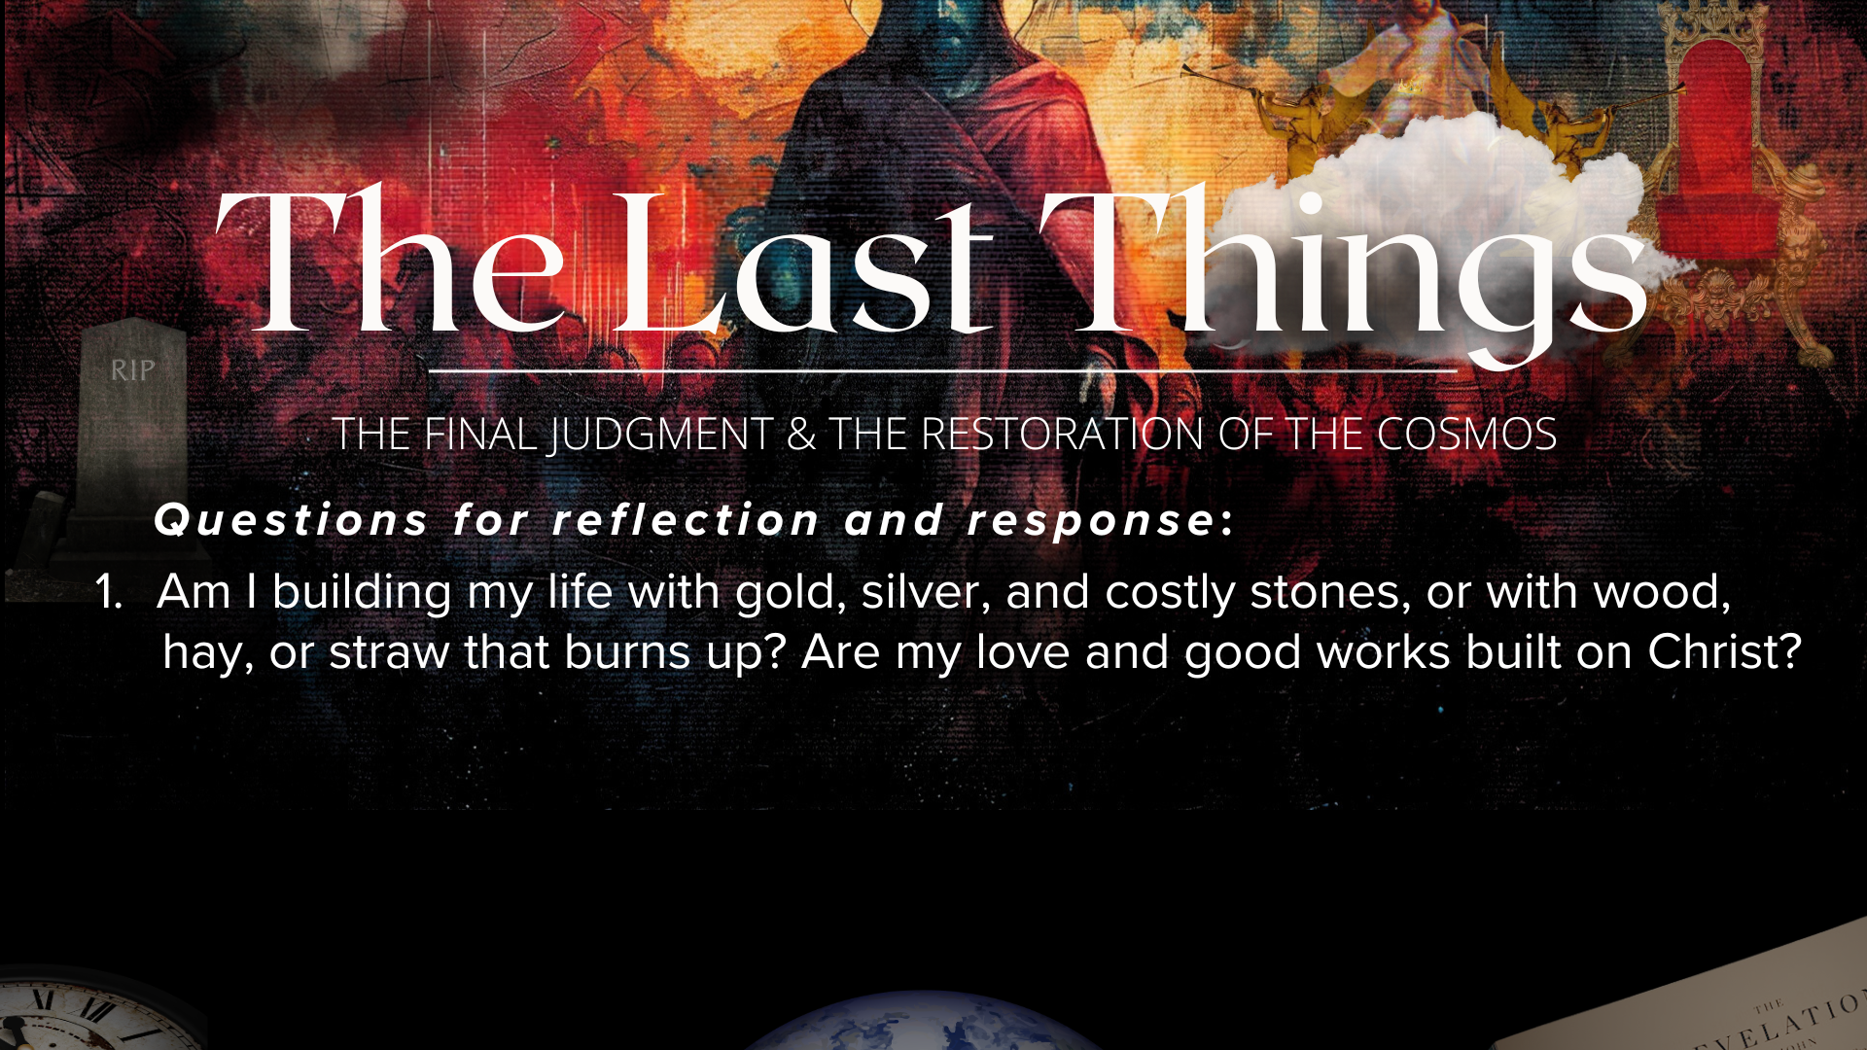

Slide 21
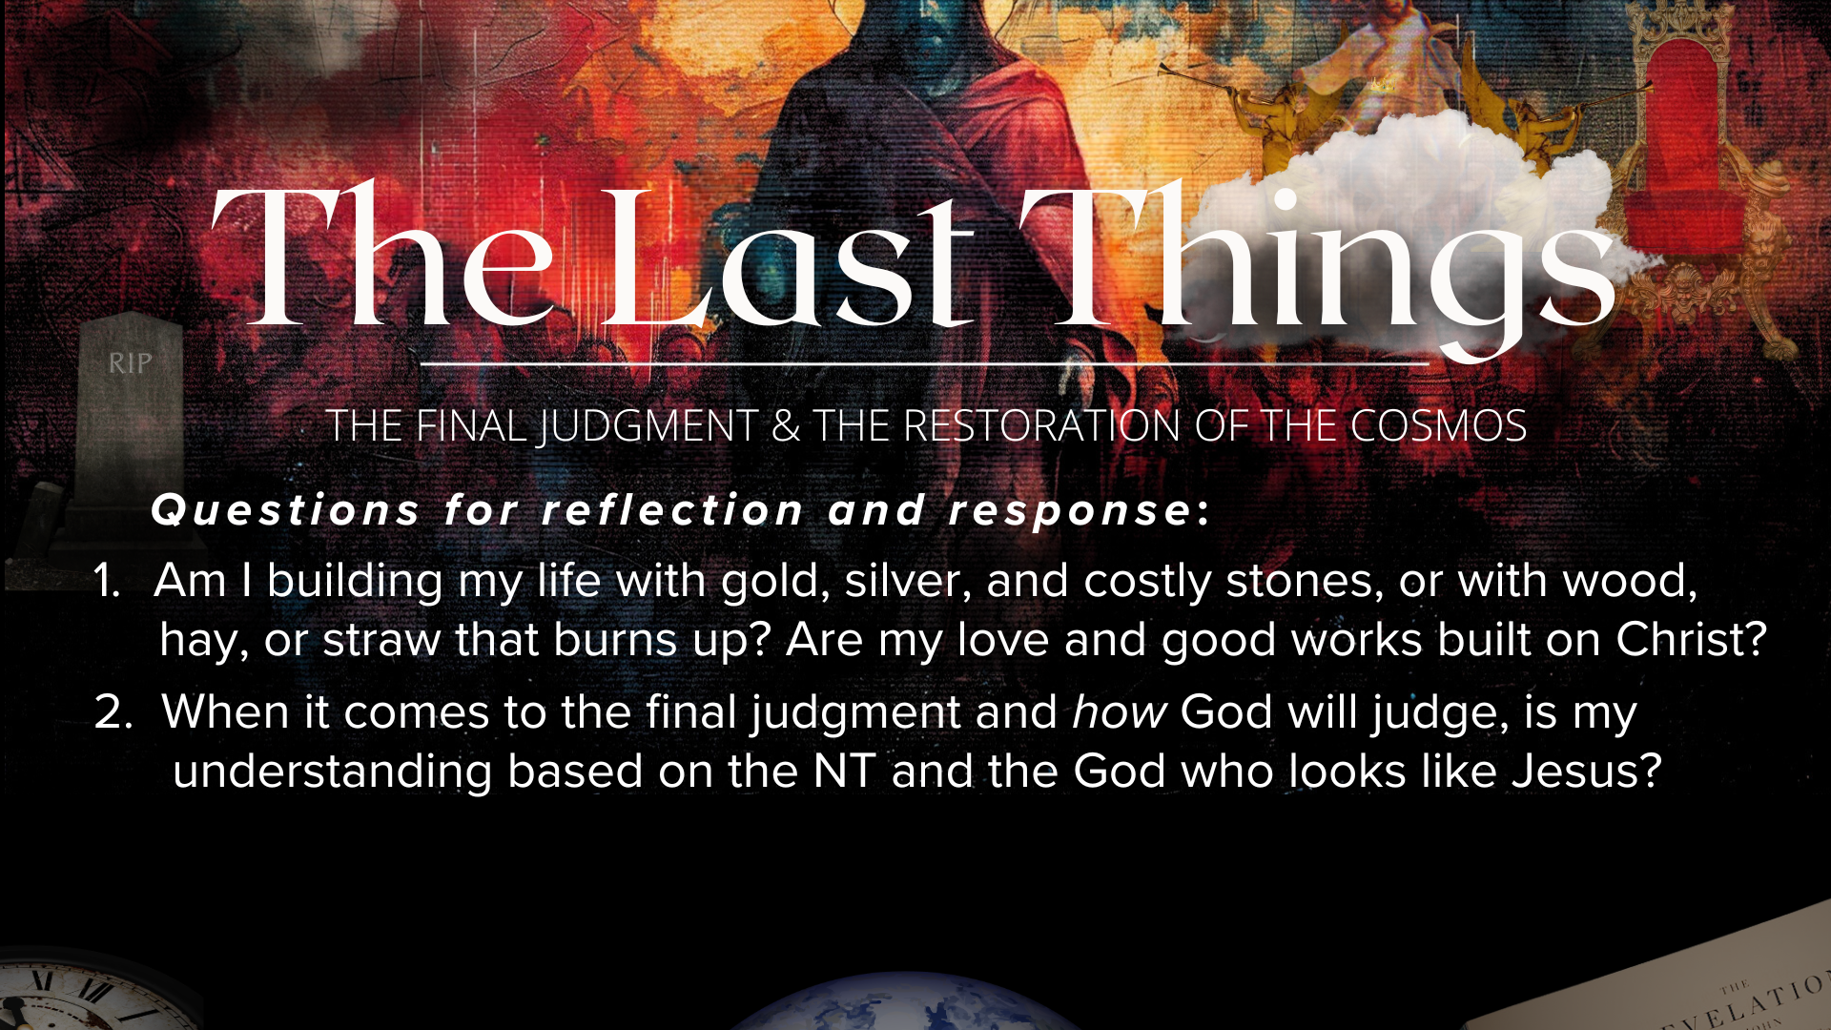

Slide 22
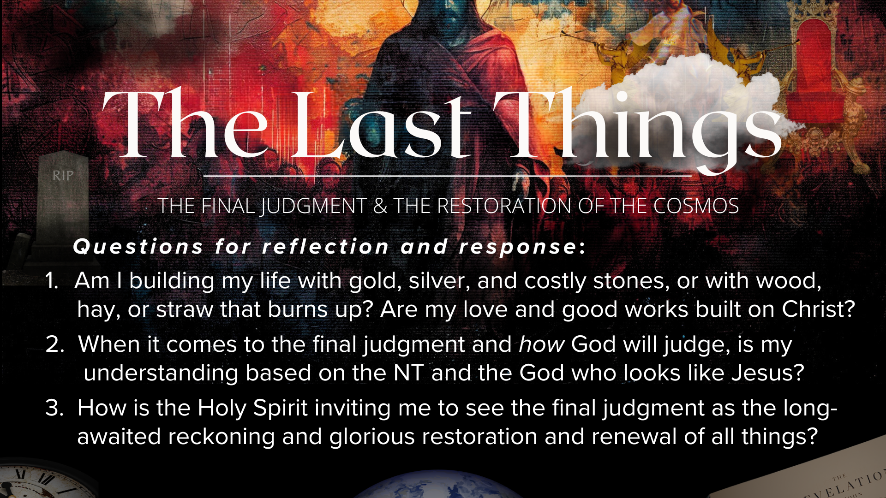
Notes:
[READ & BRIEF COMMENT ON EACH QUESTION]
Am I building my life with gold, silver, and costly stones, or with wood, hay, or straw that burns up? Are my love and good works built on Christ?
When it comes to the final judgment and how God will judge, is my understanding based on the NT and the God who looks like Jesus?
How is the Holy Spirit inviting me to see the final judgment as the long-awaited reckoning and glorious restoration and renewal of all things?
[CLOSING COMMENTS]
Let’s pray… [NEXT SLIDE FOR CLOSING PRAYER]

Slide 23
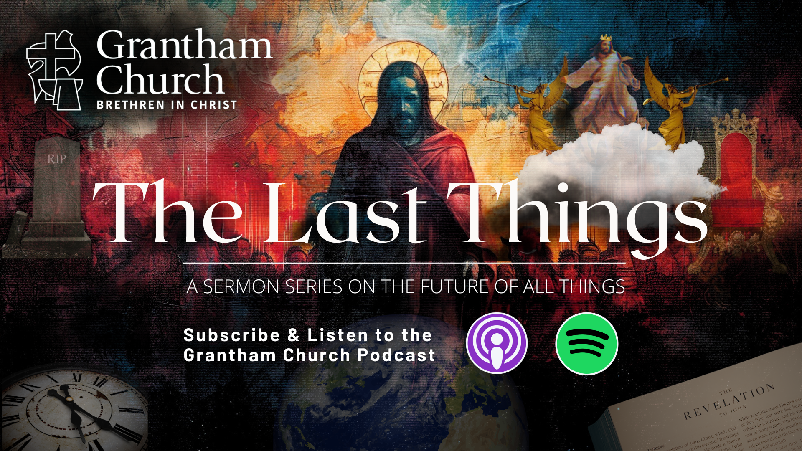
Notes:
[CLOSING PRAYER]
[CLOSING SONG]
Benediction
Church, may our sovereign God fill you with peace as you look to the future with faith, not fear. May the promise of resurrection and eternal life anchor your soul in times of uncertainty and give you hope. And may you live in light of the last things with confidence that Christ will return and bring heaven to earth. Until we gather again, go in peace to love and serve the Lord. Amen.

