Slide 1
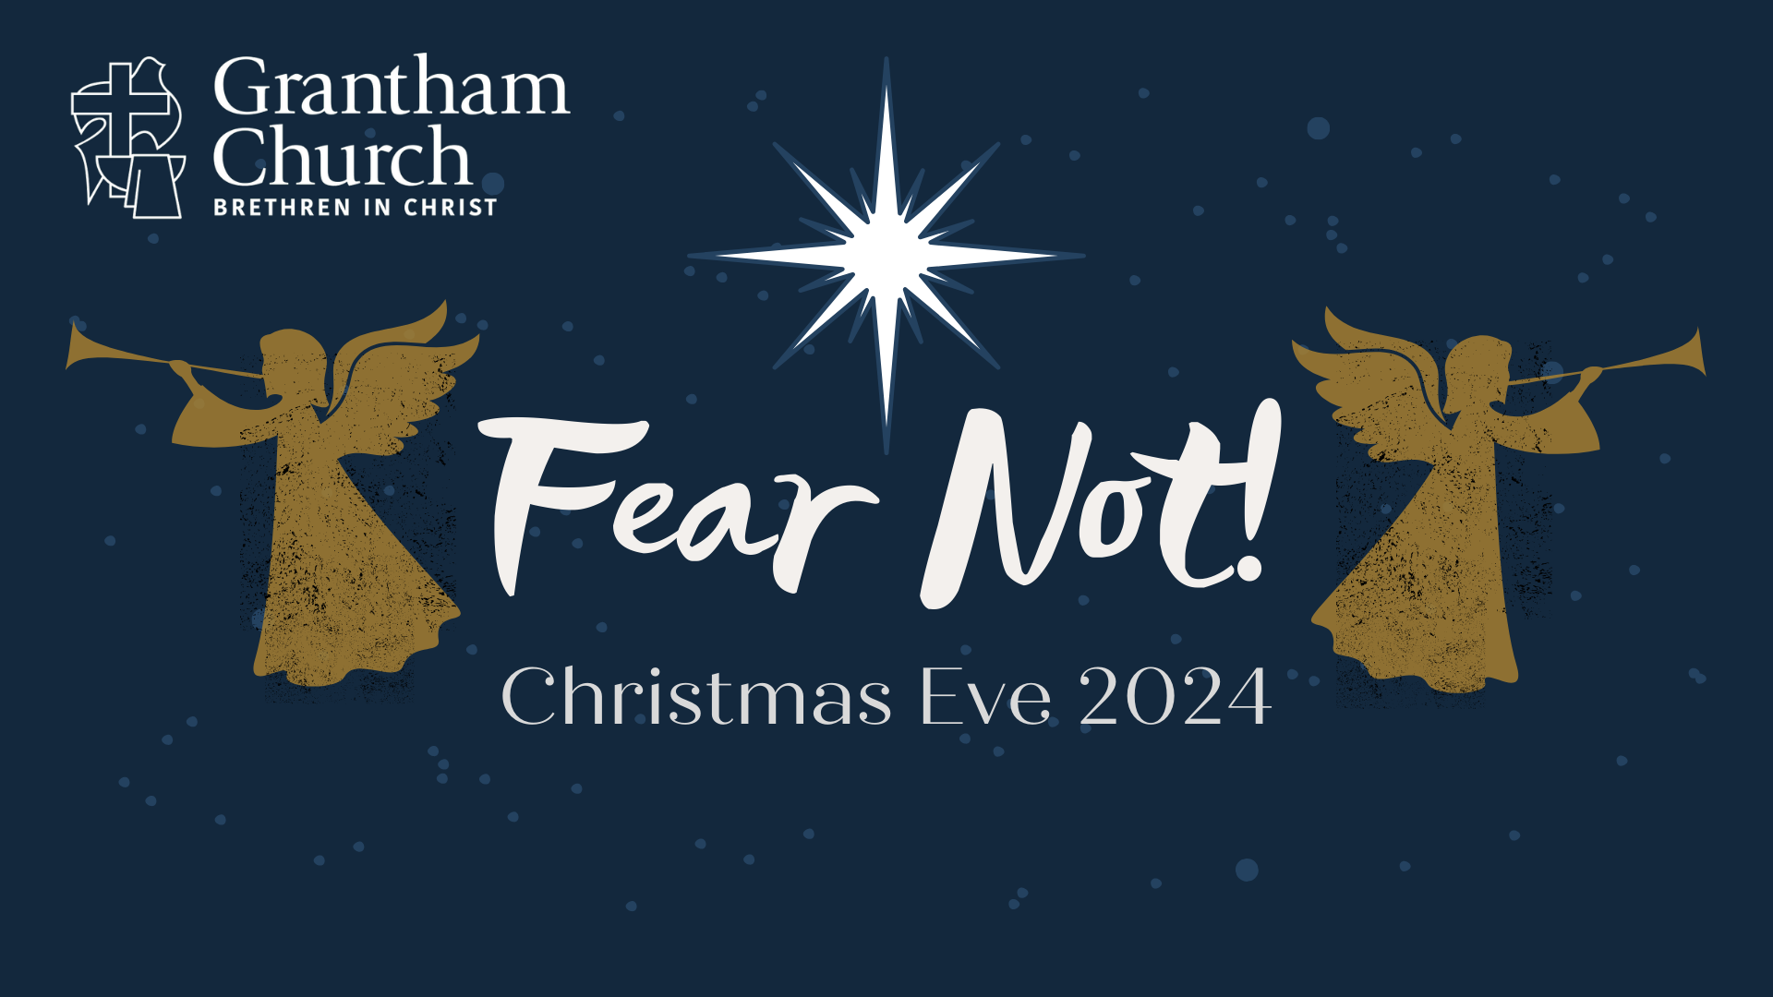
Notes:
[BRIEF INTRO]
We’re here this evening to prepare our hearts for Christmas and celebrate the coming of Jesus
For the past four weeks we’ve been in the season of Advent, where we wait and look forward to the coming of Christ: his first coming (as a baby born in a stable and lying in a manger) and his second coming, when the Lord returns at some point in the future to set the world to rights and make all things new.
In this year’s Advent series—Fear Not!—we reflected on the words “Do not be afraid!” as it is one of the most oft-repeated phrases in the entire Bible. And these are the first words from the angels to Zechariah, Mary, and the shepherds in the opening of the Gospel of Luke. I believe that we need to hear these comforting words echoing down through the ages from those heavenly messengers to where we are today.
[NEXT SLIDE]

Slide 2
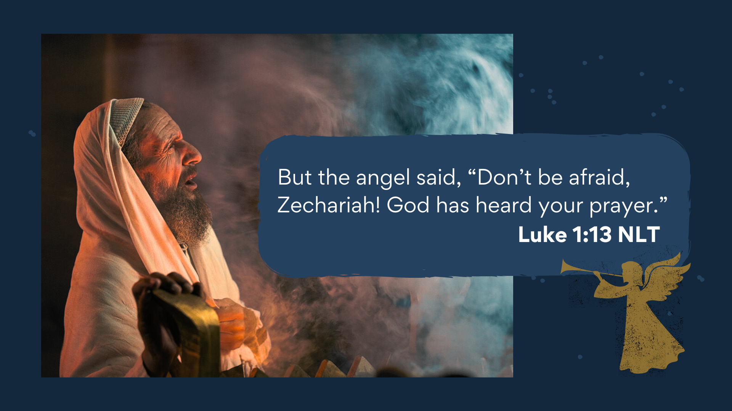
Notes:
[BRIEF COMMENTS]
[NEXT SLIDE]

Slide 3
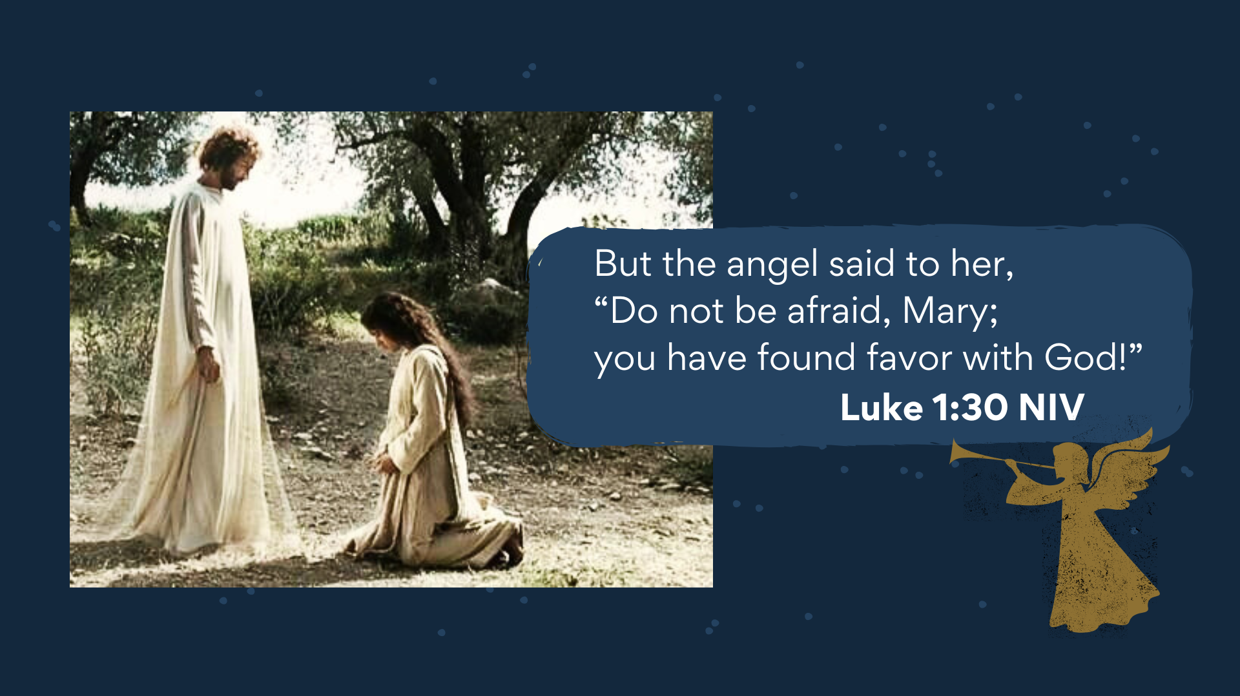
Notes:
[BRIEF COMMENTS]
[NEXT SLIDE]

Slide 4
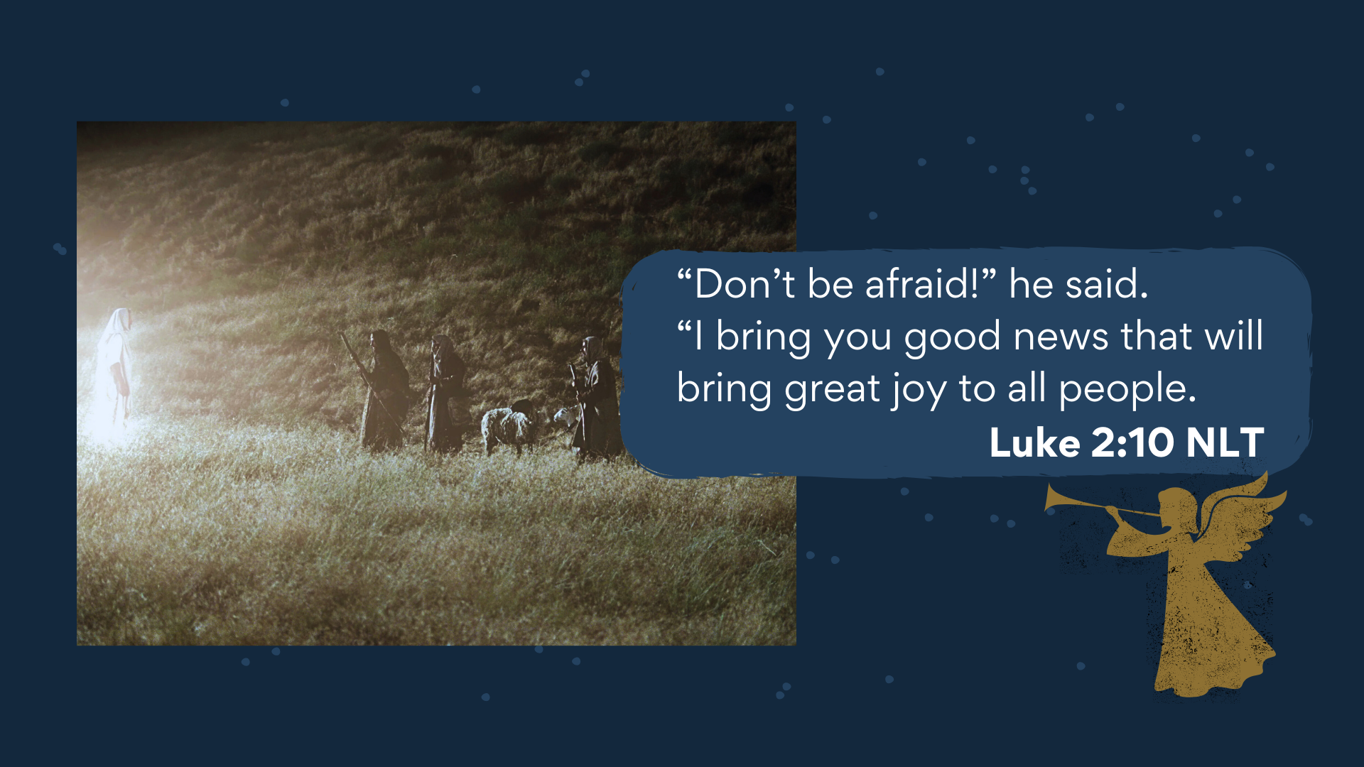
Notes:
[BRIEF COMMENTS]
[NEXT SLIDE]

Slide 5
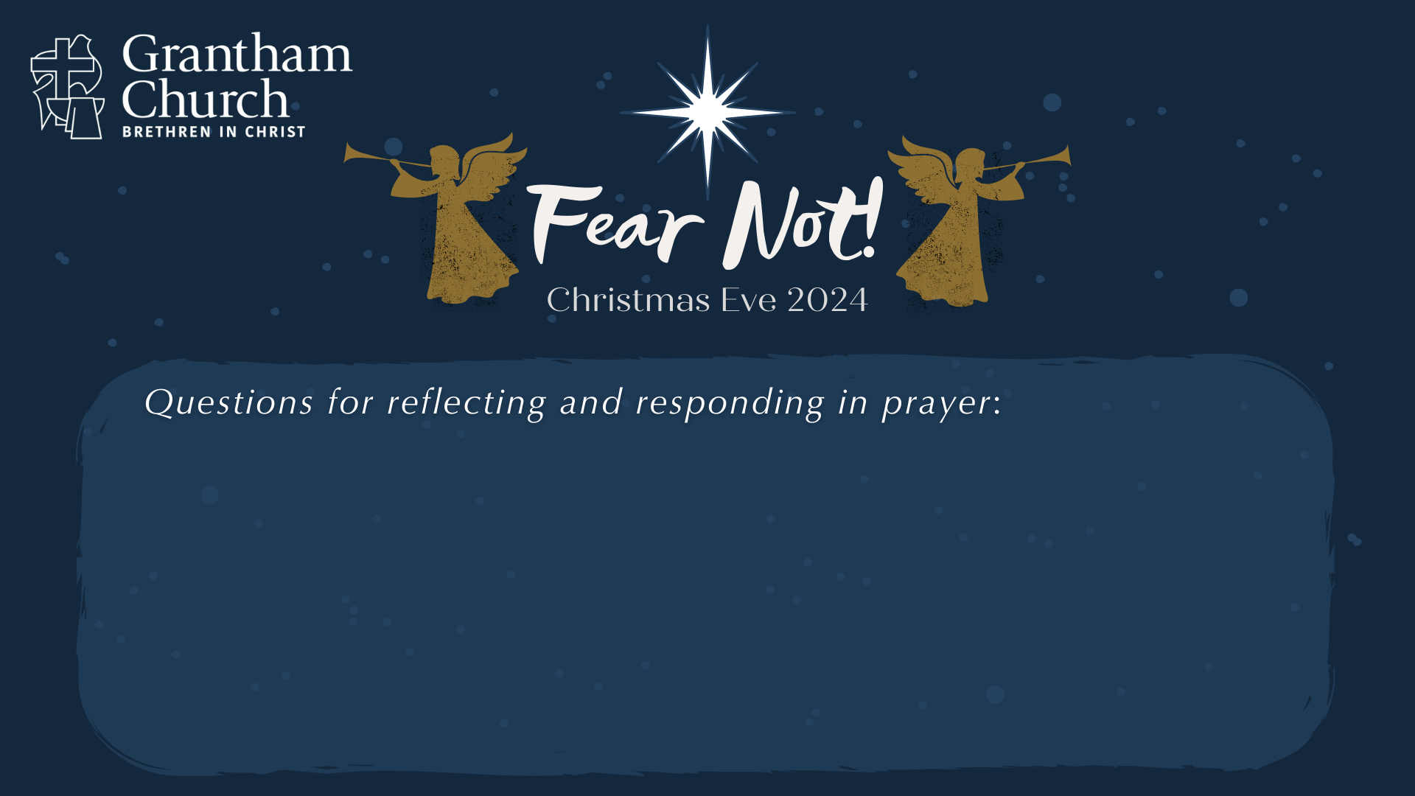

Slide 6
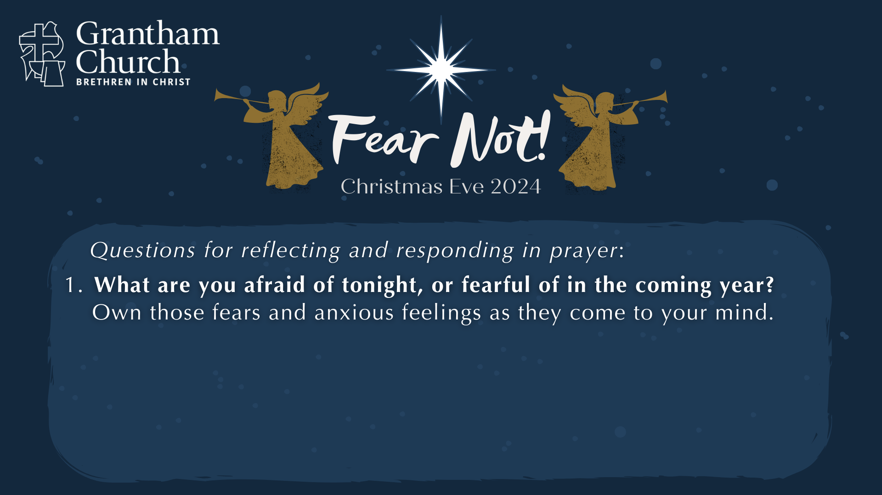

Slide 7
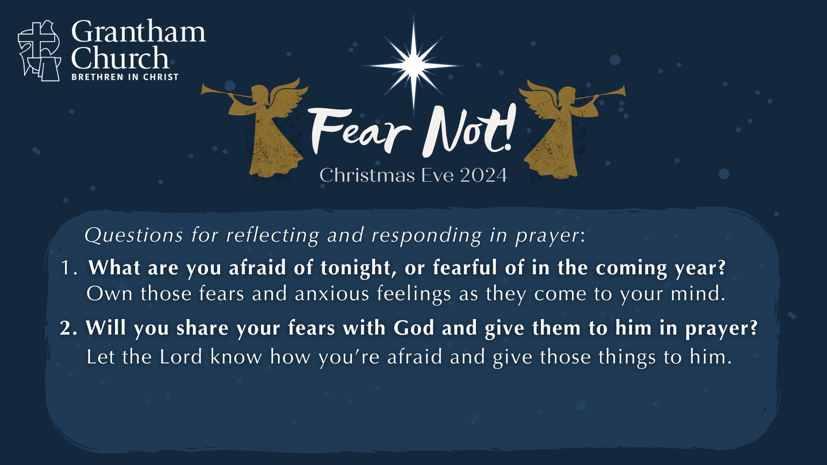

Slide 8
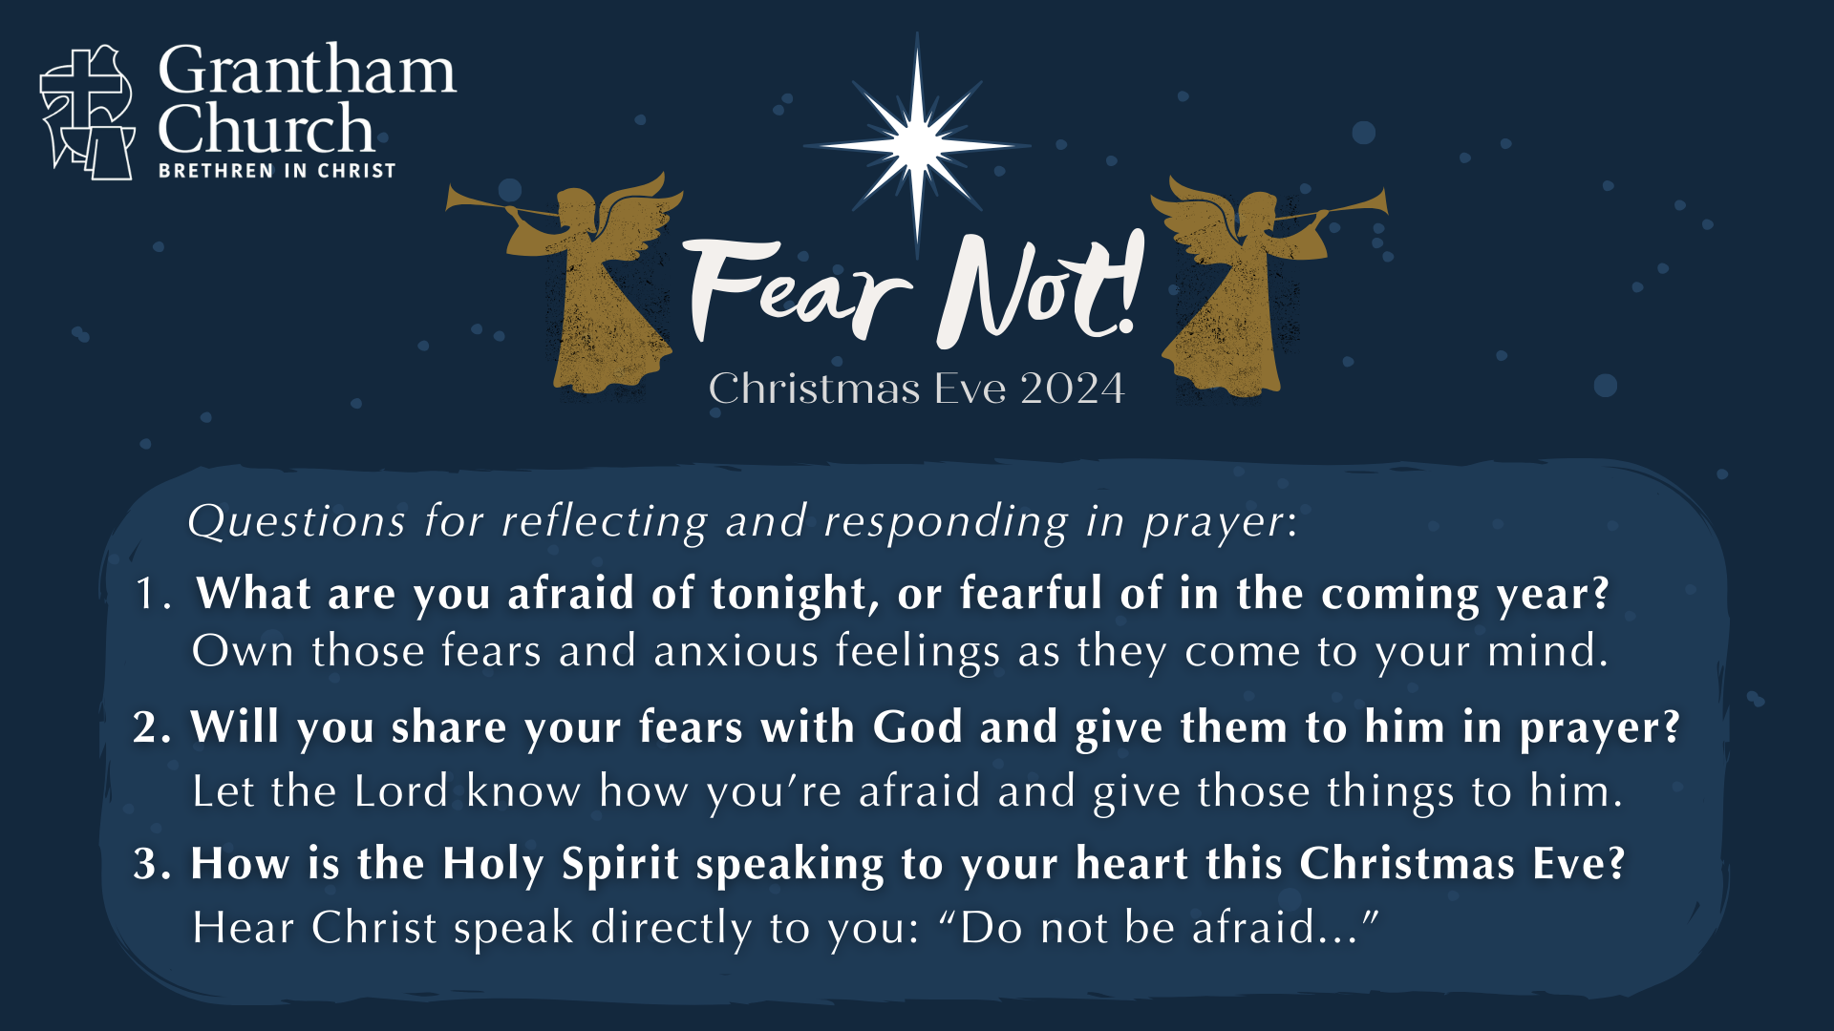
Notes:
[BRIEF COMMENT ON EACH QUESTION]
1. What are you afraid of tonight, or fearful of in the coming year?
Own those fears and anxious feelings as they come to your mind.
2. Will you share your fears with God and give them to him in prayer?
Let the Lord know how you’re afraid and give those things to him.
3. How is the Holy Spirit speaking to your heart this Christmas Eve?
Hear Christ speak directly to you: “Do not be afraid...”
[TIME OF SILENT PRAYER]
[CLOSING PRAYER]
[GO TO NEXT SLIDE DURING CLOSING PRAYER]

Slide 9
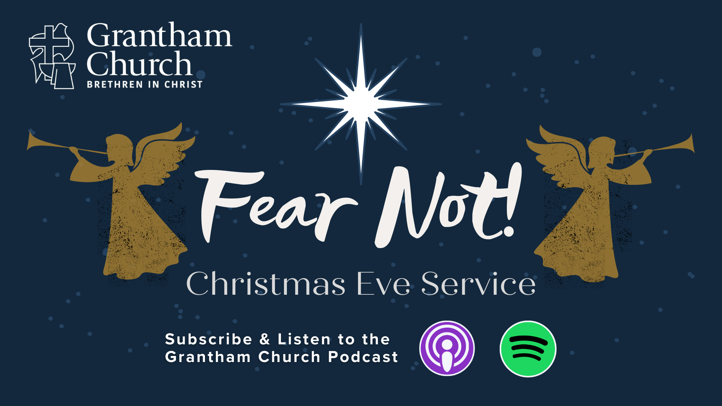
Notes:
[CANDLE LIGHTING INSTRUCTIONS]
Brothers and sisters, Fear Not! Your King is Coming.
[LIGHT CANDLES]
Benediction:
From my family to yours… we want to wish you a Merry Christmas!
May you be filled with the God’s peace, surrounded by his calming presence, and empowered by his life-giving Spirit as you celebrate the coming of Christ and the hope that Christmas brings. Go in peace, church.

