Slide 1
“The Things that Make for Peace”
Faithful Ecclesial Strategies for Social Change
Drew G. I. Hart, PhD
Author of Who Will Be A Witness?: Igniting Activism for God’s Justice Love and Deliverance

Slide 2


Luke 19:41-44: “The Things that Make for Peace”
“Now when Jesus approached and saw the city, he wept over it, saying, “If you had only known on this day, even you, the things that make for peace! But now they are hidden from your eyes. For the days will come upon you when your enemies will build an embankment against you and surround you and close in on you from every side. They will demolish you – you and your children within your walls – and they will not leave within you one stone on top of another, because you did not recognize the time of your visitation from god.” (NET)

Slide 3
Nonviolent Action & Resistance

Slide 4
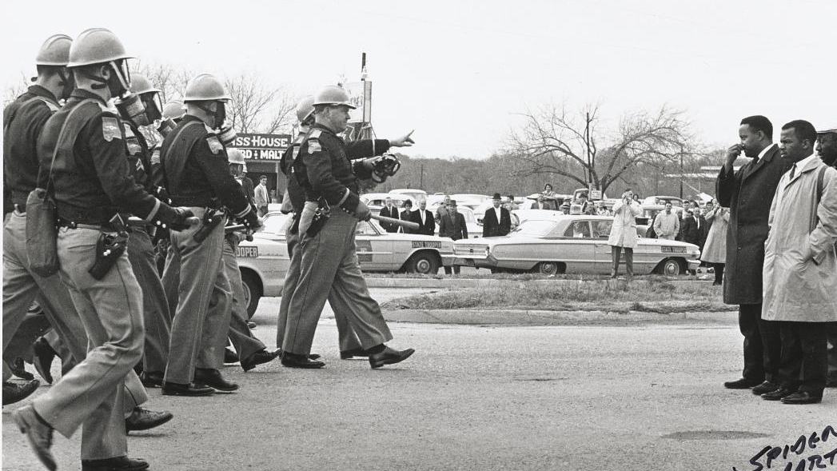
Christian Basis for Nonviolent Action & Resistance
Every person is made in the Image of God
We are called to love our enemies and be peacemakers
Our discipleship requires that we take up our cross in the way of Jesus
We are captivated by God’s dream of shalom for all creation

Slide 5
Martin Luther King’s Principles of Nonviolence
Principle 1: Nonviolence is a way of life for courageous people.
Principle 2: Nonviolence seeks to win friendship and understanding.
Principle 3: Nonviolence seeks to defeat injustice not people.
Principle 4: Nonviolence holds that suffering can educate and transform.
Principle 5: Nonviolence chooses love instead of hate.
Principle 6: Nonviolence believes that the universe is on the side of justice.

Slide 6
The Effectiveness of Strategic Nonviolence
Nonviolence should be creative, strategic, active, and sustained.
Gene Sharp’s 198 Tactics in The Politics of Nonviolent Action (1973).
Nonviolent movements are twice as successful as nonviolent ones.
Social science tells us that nonviolent campaigns that reach sustained and active involvement from 3.5 percent of a population are successful.
Nonviolent resistance is growing in effectiveness while violent resistance is decreasing in effectiveness.

Slide 7
Protest Movements

Slide 8
Protest Movements
Keyword: Mobilization
Strategy: Broad participation, creating a change in social climate, public opinion, or knocking down pillars of support. Disruption, confrontation, or mass movement.
Strength: Fosters and rides cultural momentum, participation is easy and accessible for masses of people. They create dilemma situations where people can’t remain neutral.
Weakness: With little commitment & limited structure, protest movements are often short lived.
Impact: Some usher significant change in a short time and help shift the narrative.

Slide 9
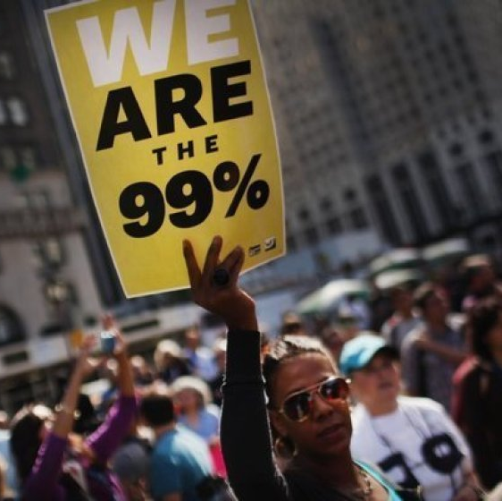
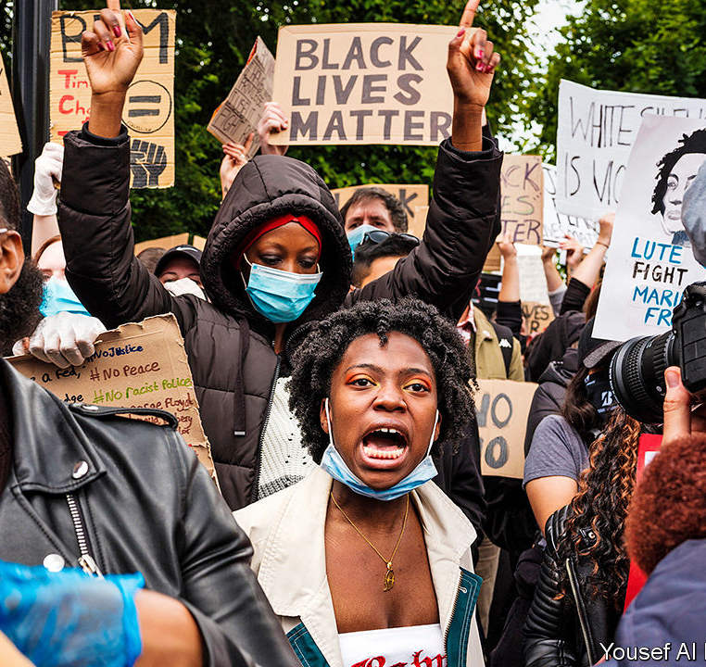
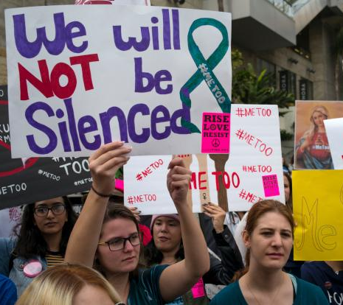
Recent National Protest Movements

Slide 10
Community Organizing

Slide 11
Community organizing
Keyword: Organization
Strategy: Building a committed base of ordinary people that leverage formal structures for incremental social change over the long haul.
Strength: Committed membership does the work regardless of what is trendy. Focused on tangible goals at the grassroots level.
Weakness: Some organizers are inflexible around methodology and berate movement activism, even when there is social momentum.
Impact: Organizing helps ordinary people realize their agency as they accomplish concrete local goals and grow in their capacity for social change over the long haul.

Slide 12
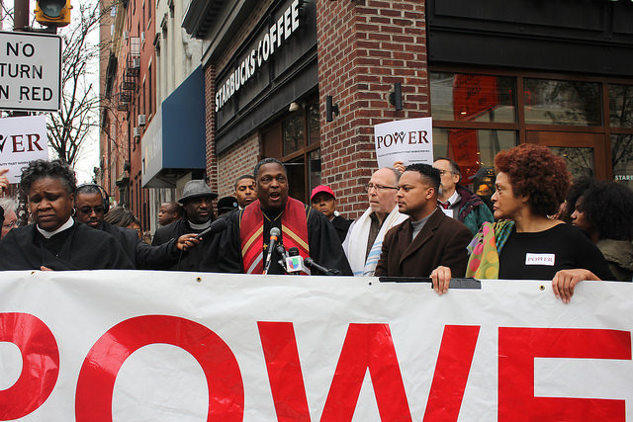
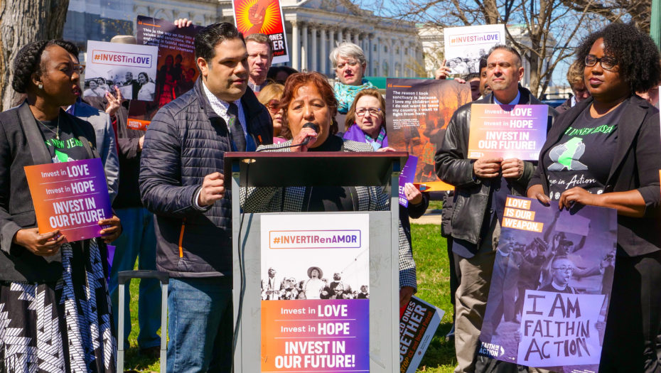
Faith-Based Organizations

Slide 13
FREE Together’s Focus Groups and Partnerships
FREE Together Focus Groups
Immigration (MILPA)
Public Education (POWER Interfaith)
Criminal Justice/Policing/Prisons (HAT)
Housing (Greater Harrisburg Area Tenants Union)

Slide 14
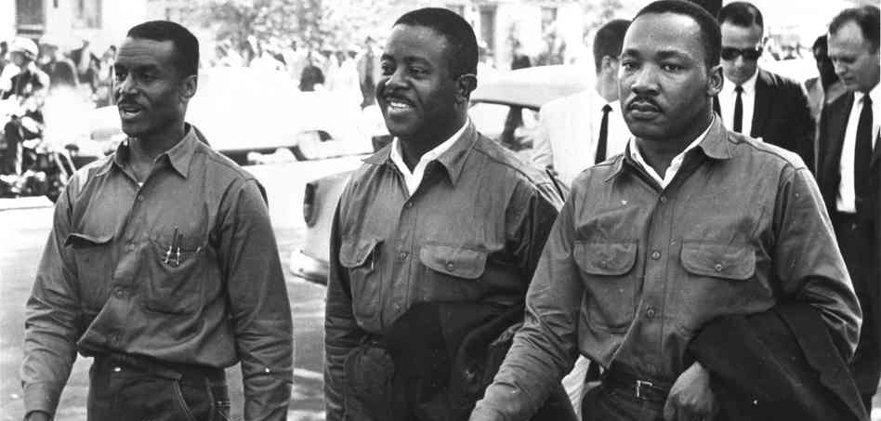

Slide 15
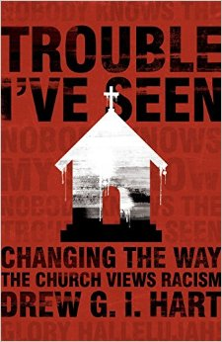
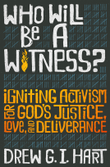
Keep Up With Me
Trouble I’ve Seen (Jan. 2016)
Who Will Be A Witness? (Sept. 2020)
Email: drew.gi.hart@gmail.com
Twitter & Instagram: @DruHart
Inverse Podcast

