Slide 1


Slide 2
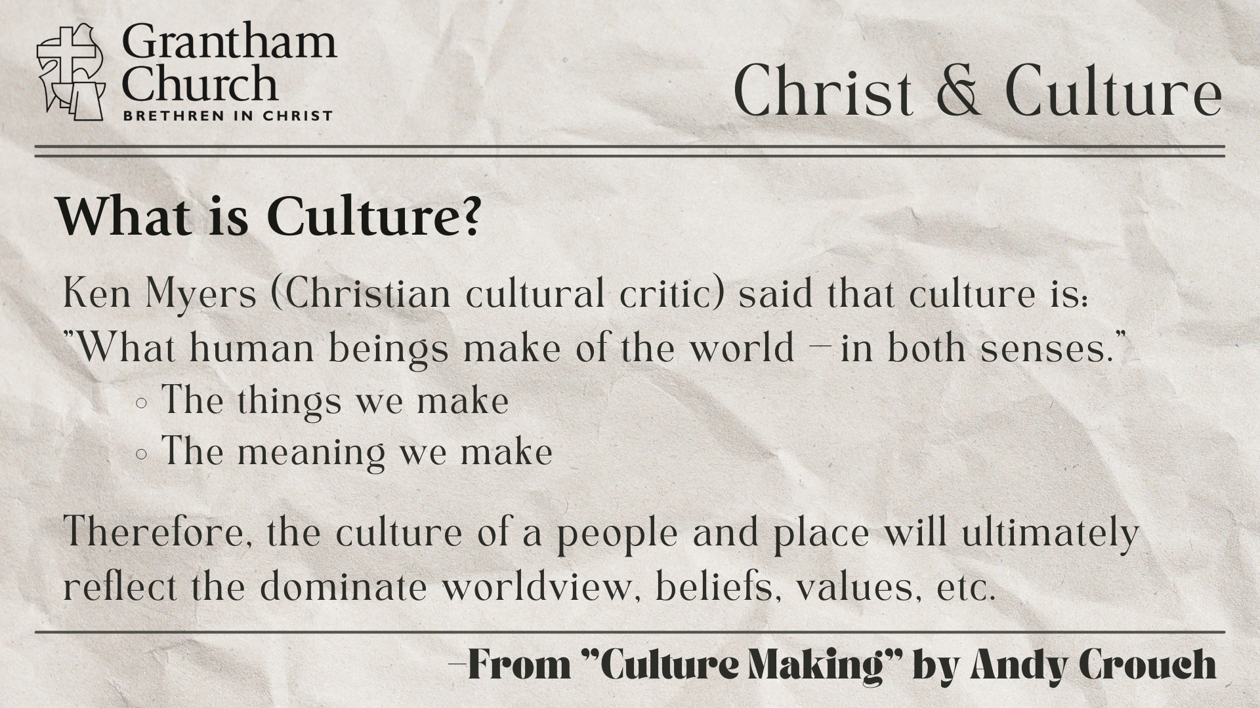

Slide 3
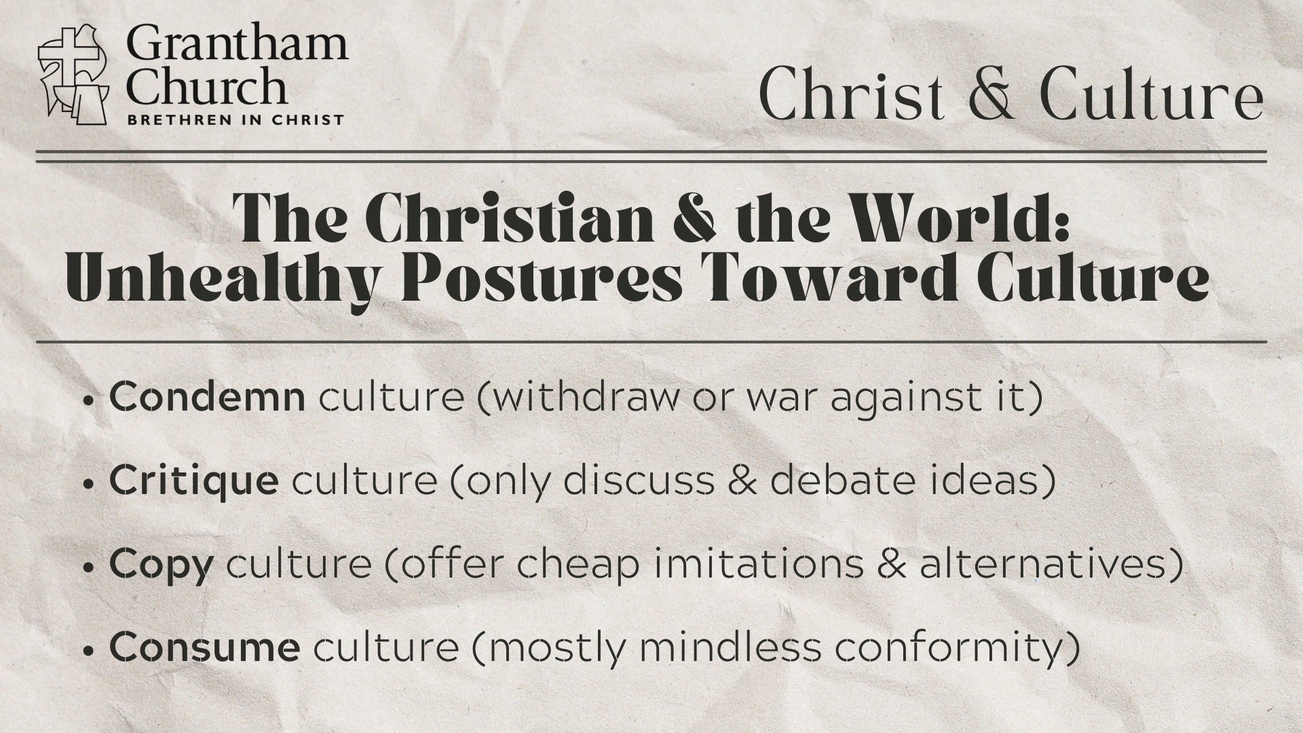

Slide 4


Slide 5


Slide 6
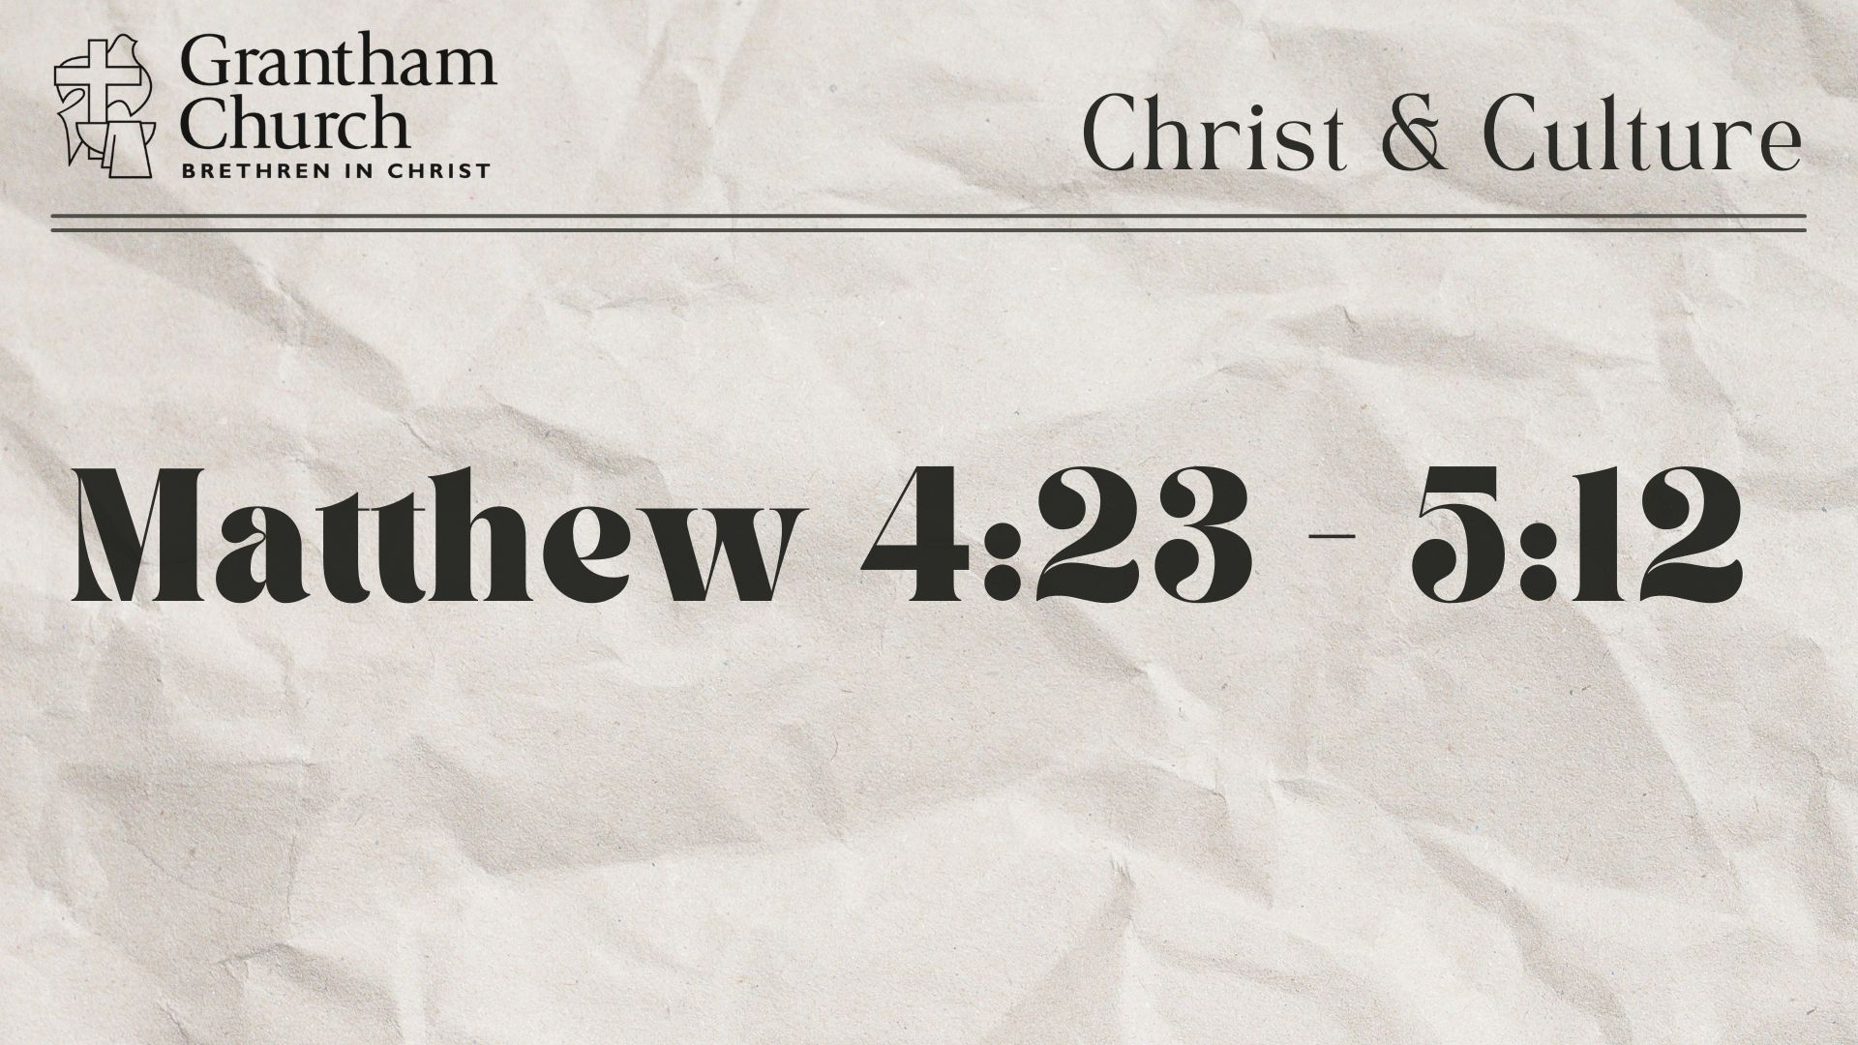

Slide 8


Slide 9

Questions for reflection and response:
Do you see yourself as blessed (as Jesus describes)?

Slide 10
Questions for reflection and response:
Do you see yourself as blessed (as Jesus describes)?
Are the poor, hurting, and broken drawn to you? If not, why?

Slide 11
Questions for reflection and response:
Do you see yourself as blessed (as Jesus describes)?
Are the poor, hurting, and broken drawn to you? If not, why?
How is your gospel imagination being recaptured each day? Where are you making space for the story of the gospel to shape your heart and life?

