Slide 1

Notes:
[BRIEF INTRO]
Spring Celebration Service; Don’t forget that immediately after this service we will hold our Spring Reporting Council over lunch in the fellowship hall. We will read and listen to stories of how God has been at work in and through our congregation over the past year. I hope you’ll join us for that, as we celebrate God’s goodness and faithfulness to us in various ways.
As you’ve seen already this morning, one thing we are celebrating is the explosion of new babies! We have had 8 babies born to Grantham families this past year. And there are 4 more on the way.
And that’s a great segue into the message today on the church as family. Listen to what the Apostle Peter wrote in… [NEXT SLIDE]

Slide 2
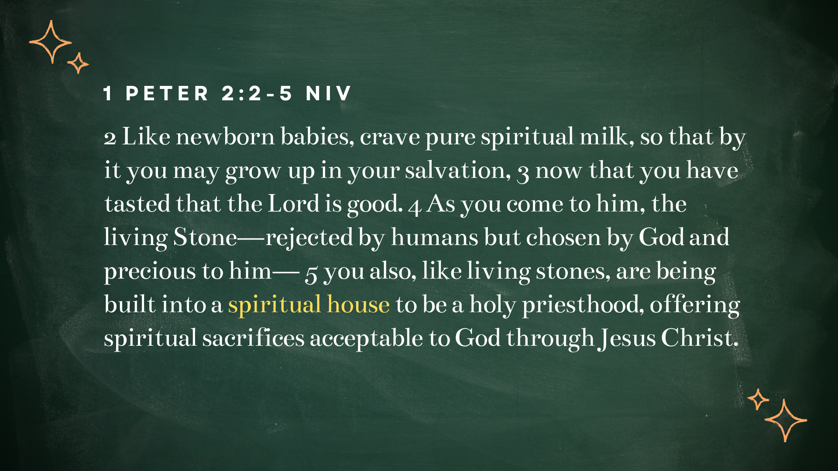
Notes:
[READ & COMMENT]
“spiritual house” – pneumatikos oikos; pneuma = Spirit; oikos = household or network of familial relationships; Peter is speaking of a new reality that Christ has created in himself—a spiritual family or household that is created and sustained by his power and presence.
According to the New Testament, Jesus birthed his Church out of his own life, death, and resurrection. And after the Holy Spirit is given to the disciples in Acts 2, communities of disciples begin to challenge society and the prevailing social structures of the Greco-Roman world. They believed that the gospel demanded the reordering of people’s lives around Jesus Christ, the true Lord, Savior, and Living Stone. It was then through the planting of churches that a radical new understanding of “family” began to change the social and familial structures of the Gentile world, and of the Jewish world as well.
And these changes first began with Jesus. Take a look at Mark chapter 3… [NEXT SLIDE]

Slide 3
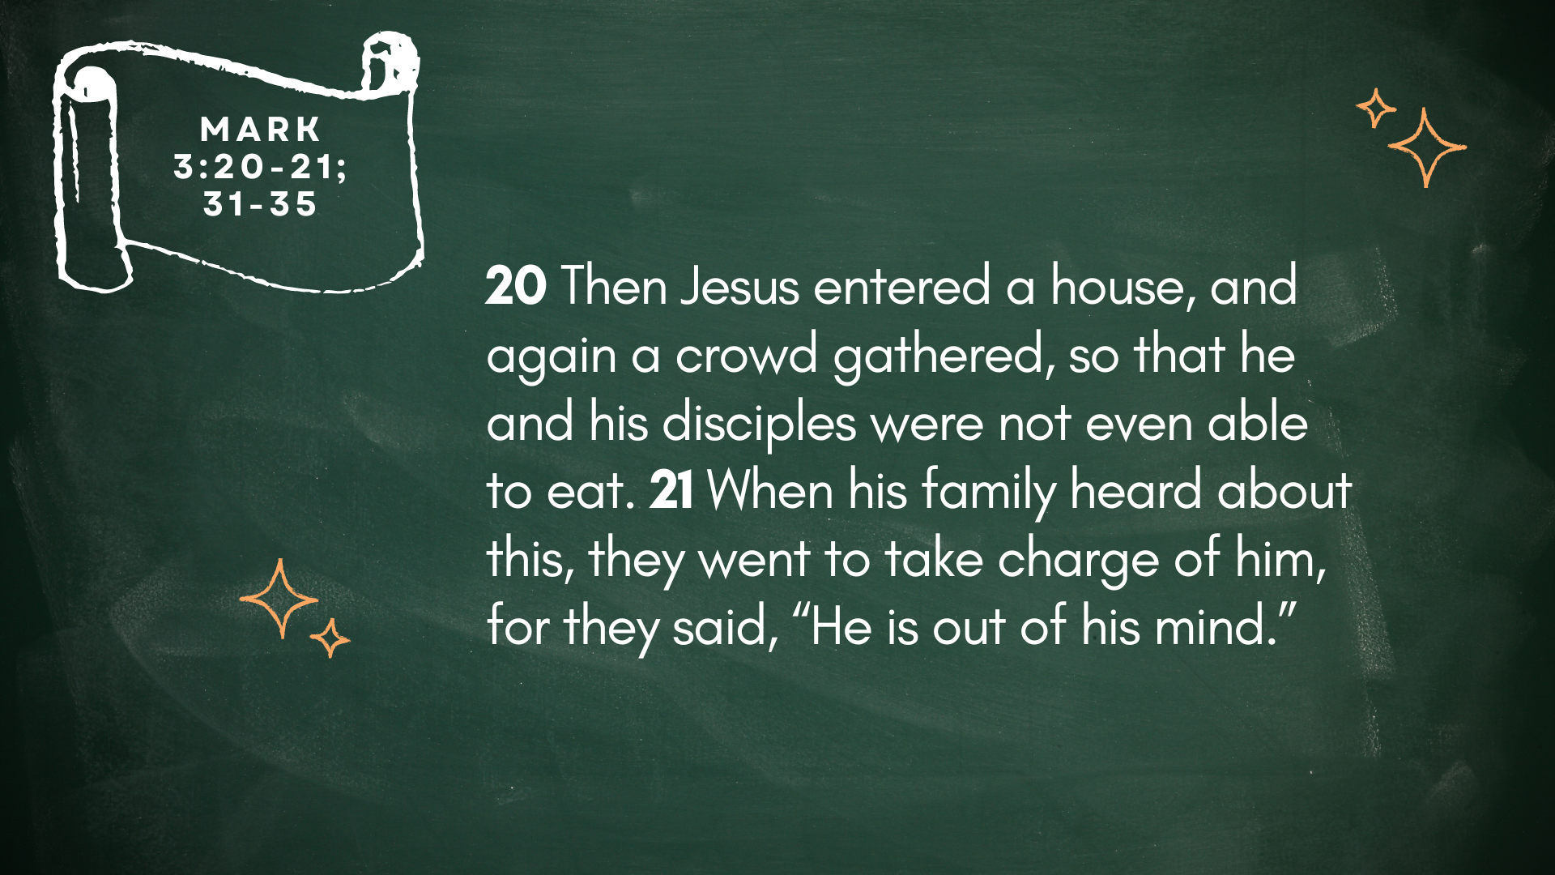
Notes:
[READ & COMMENT]
v. 21 – His family “went to take charge of him” saying ”He is out of his mind.” Folks, if you’ve got issues in your biological family, you’re not alone. Jesus understands that struggle.
Skip over to verse 31... [NEXT SLIDE]

Slide 4
Mark 3:31-35 NIV
31 Then Jesus’ mother and brothers arrived. Standing outside, they sent someone in to call him. 32 A crowd was sitting around him, and they told him, “Your mother and brothers are outside looking for you.” 33 “Who are my mother and my brothers?” he asked.
34 Then he looked at those seated in a circle around him and said, “Here are my mother and my brothers! 35 Whoever does God’s will is my brother and sister and mother.”
Notes:
[READ & COMMENT ON PASSAGE]
I can’t overstate how scandalous Jesus’ words would have been when you consider what “family” meant in his first-century context:
collectivist (group) mindset (e.g. your life and identity were determined by your family or tribe
You have heard the phrase: “blood is thicker than water” – the ANE epitomized this idea
And remember what Jesus said in Matthew 10:32-40. He tells his followers that their love for him must surpass love of biological family; he said that this love and devotion to him (and his new community/family) could and would cause division among children and their parents, as well as siblings. Why? Because the center of meaning, purpose, and real identity for a disciple, and the bond that holds all things together, is now discovered in our relationship to Jesus and his people.
It’s not that Jesus and the NT has a low view of the family with moms, dads, and children. No, quite the opposite. God designed the family to have loving moms and dads, as well as children who honor thy father and mother. And all of that certainly comes out in Paul’s epistles when he mentions what was known as “household codes” in that day. So, it’s not a low view of biological family, but an expansion of the idea through the spiritual work of Christ. Therefore, whether your earthly family is healthy or unhealthy, our identity and understanding of “family” has been affected by the person and work of Jesus. “Family” has now been redefined to include all those who know and follow Jesus.
Stanley Hauerwas says it this way… [NEXT SLIDE]

Slide 5
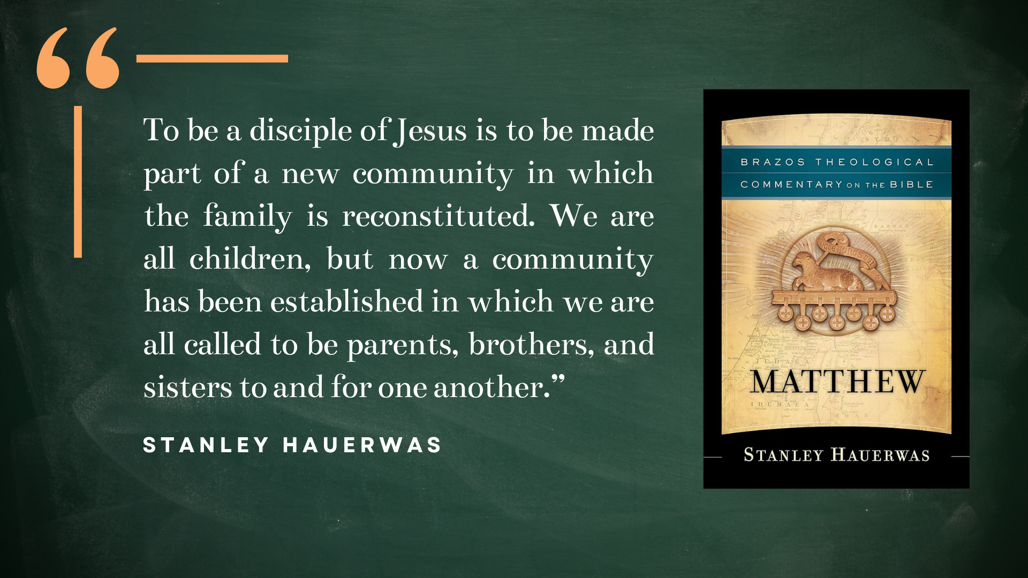
Notes:
[BRIEF COMMENTS]
This is especially good news to those who have a complicated relationship or a non-existent relationship with their parents, or with their siblings, or with their grandparents. And to those who don’t have children or couldn’t have children, listen up… you do have children. They are the children in our congregation. No matter who you are… as disciples… we have all gained a larger family where Jesus Christ is the center and is the identity-forming and relationship-forming force of our community.
After experiencing the loss that sometimes comes in following Jesus, Peter said… [NEXT SLIDE]

Slide 6
Mark 10:28-30 NIV
28 Then Peter began to speak up. “We’ve given up everything to follow you,” he said. 29 “Yes,” Jesus replied, “and I assure you that everyone who has given up house or brothers or sisters or mother or father or children or property, for my sake and for the Good News, 30 will receive now in return a hundred times as many houses, brothers, sisters, mothers, children, and property—along with persecution. And in the world to come that person will have eternal life.
Notes:
[READ & COMMENT ON PASSAGE]
Jesus is saying that whatever you might lose (or at least feel like you’re losing) by accepting his Lordship and by embracing the spiritual family he is creating through the church, the reward is far greater than anything you might be required to give up or surrender to him.
Biblical scholar N.T. Wright says… [NEXT SLIDE]

Slide 7
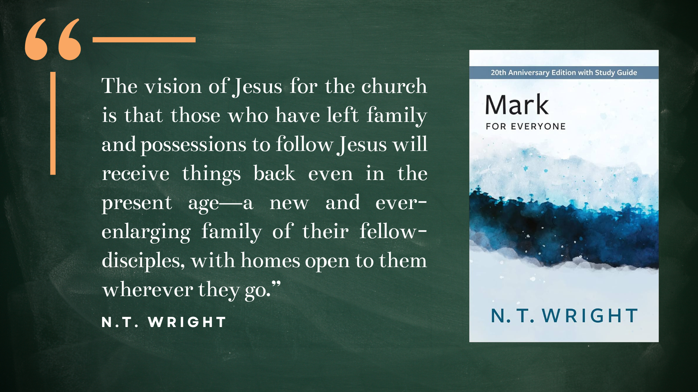
Notes:
No doubt, this larger “Kingdom” view of family will challenge us in many ways. On a personal level, it means that we must no idolize our biological families and keep them closed off to others in the church. It means that we must be intentional in sharing our financial resources, our tables, and our empty rooms with those in need of our hospitality and community. In a day where many are lonely and isolated, the church guarantees that nobody is deprived of meaningful relationships. Nobody is without parents, children, or grandparents. For we are all part of a new family—the family of God.
And on a societal and political level, it means that when we’re tempted to pass judgment on an entire ethnic group or a whole nation, we remember that we have spiritual family members in Palestine, in Iran, and in other places around the world where the US funds and supports violence. As disciples of Jesus, we remember that we have family being oppressed and persecuted around the world. And they are not strangers or foreigners. For they, like us, have been adopted and grafted into God’s family.
Listen to what the Apostle Paul wrote in Ephesians… [NEXT SLIDE]

Slide 8
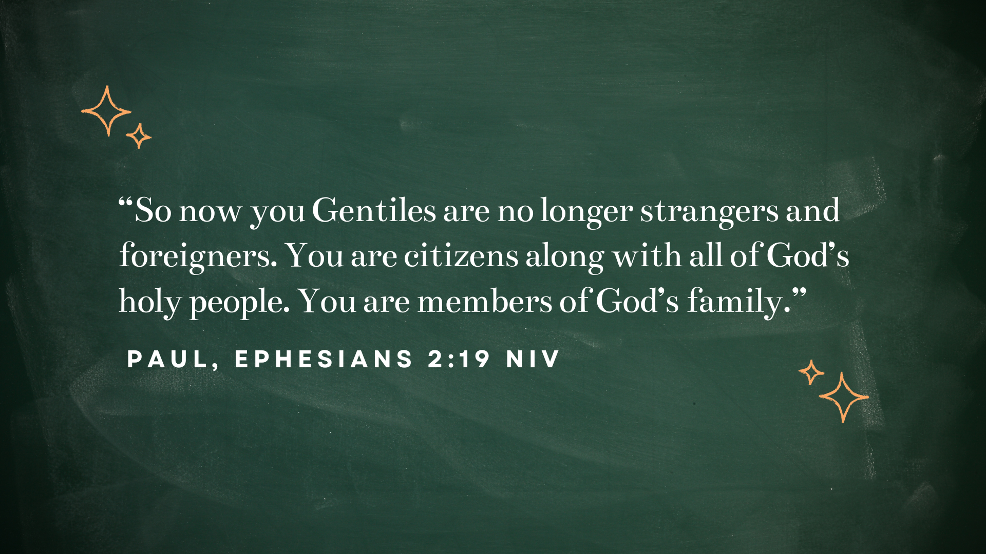
Notes:
[READ & COMMENT]
So, to be clear… the NT teaches the following:
Marriage and family is a microcosm of the church and of God's love for the world.
Our biological families are absorbed and incorporated into God's spiritual family.
Christian families exist to serve the mission and purpose of the church—God's “eternal purpose” for bringing healing and reconciling the world to God through Jesus.
Every Christian has a new extended family where all are brothers and sisters in Christ.
And again, this is made possible because Christ is the unifying force that creates and sustains this family. If Jesus were the Sun, then we are the planets orbiting around him. And for those who choose to pursue Christ with Grantham Church, you are part of this family. But being a part of the family requires intentionality on our part to share life together in our pursuit of Christ… [NEXT SLIDE]

Slide 9
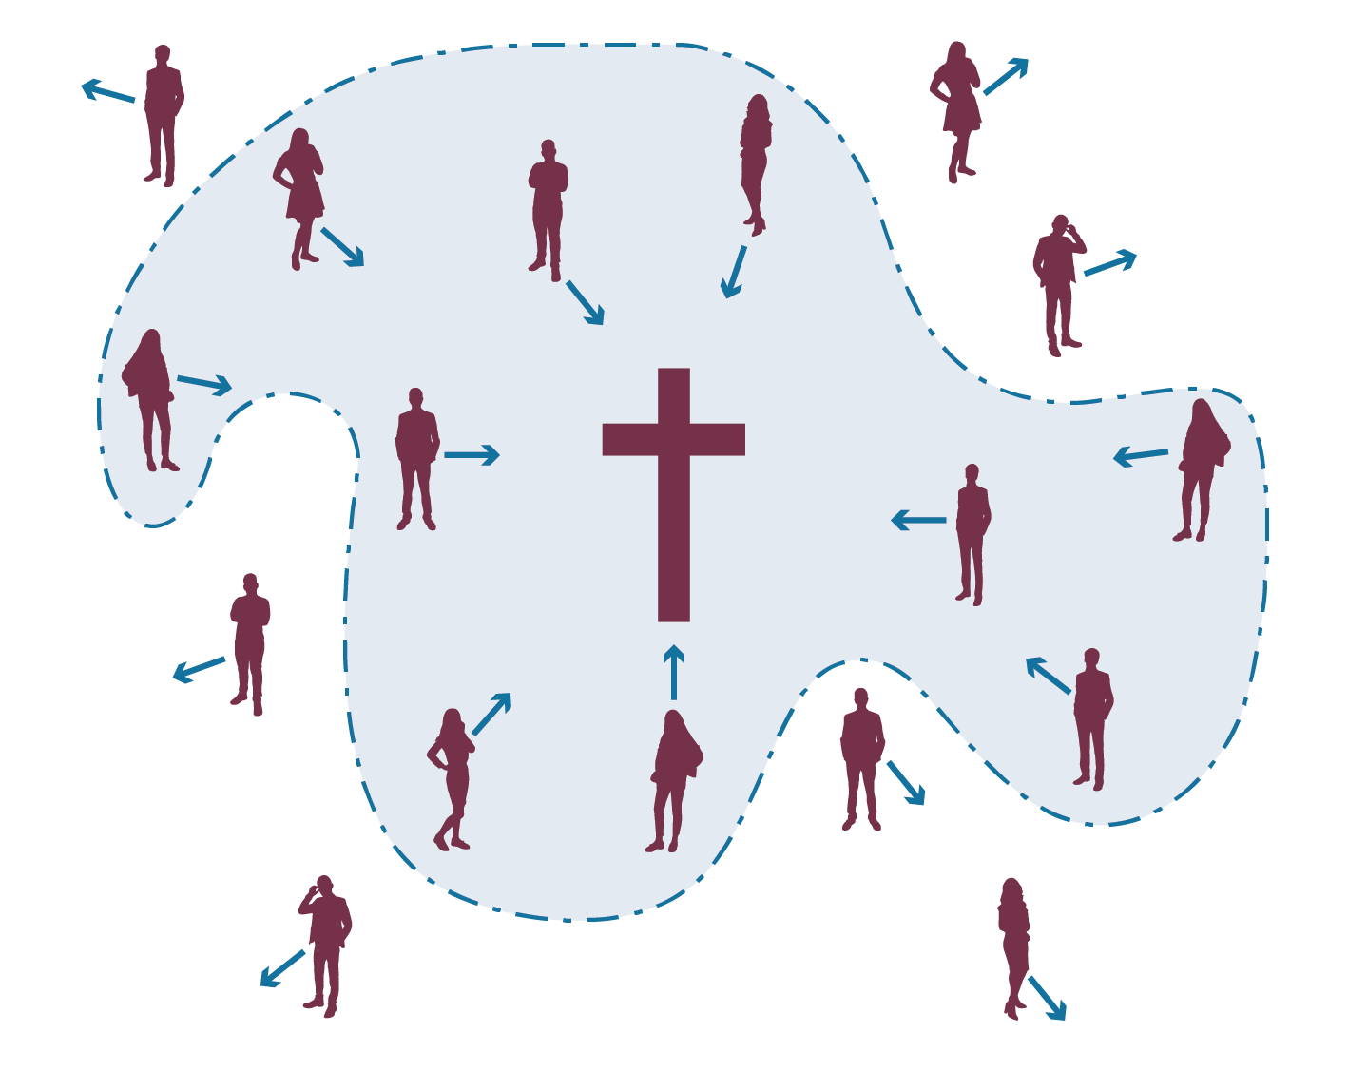
Notes:
[BRIEF COMMENTS]
Is your arrow (your heart and passions) pointed toward Christ? Does your personal life and your family life revolve around Christ and what he is doing through the Church in the world?
And ask yourself: “Am I truly seeing others at Grantham Church as part of my family?”
Brothers and sisters, for us at Grantham to continue growing into a household for Jesus, there are a few things that we must be willing to do… [NEXT SLIDE]

Slide 10
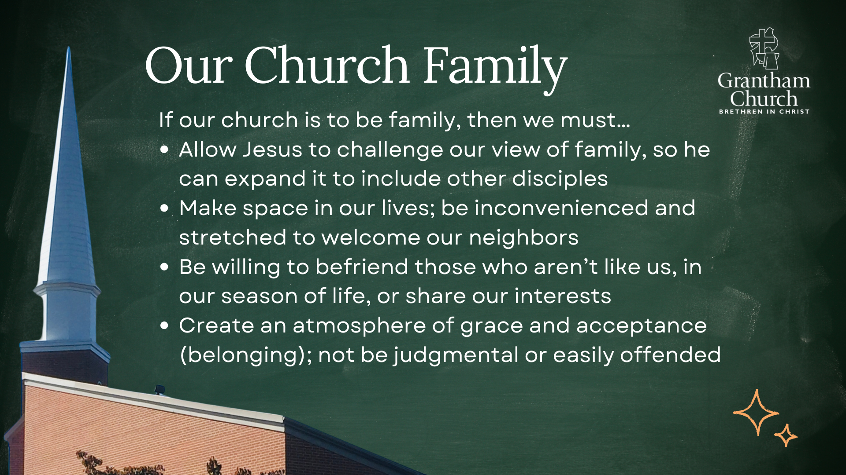
Notes:
[READ & BRIEF COMMENT ON EACH POINT]
If our church is to be family, then we must…
Allow Jesus to challenge our view of family, so he can expand it to include other disciples
Make space in our lives; be inconvenienced and stretched to welcome our neighbors
Be willing to befriend those who aren’t like us, in our season of life, or share our interests
Create an atmosphere of grace and acceptance (belonging); not be judgmental or easily offended
How is the Spirit speaking to you today about our church family? And what will you do about it?
Let’s pray… [NEXT SLIDE]

Slide 11

Notes:
[CLOSING PRAYER]
[NEW MEMBERS RECEPTION]
[SONG]
[SPRING REPORTING COUNCIL ANNOUNCEMENT]
Benediction
Grantham Church, as you worship with this congregation, and as you now go out into the world, may you choose love, mercy, and forgiveness over fear, anger, and hate. May you stay centered and guided by the God who looks like Jesus. And may you be on guard against the scattering forces of the evil one, as we make every effort to keep the unity of the Spirit. In the name of the Father, Son, and Holy Spirit, go in peace, church, to love and serve the Lord. Amen.

