Slide 1


Slide 2
Passing on the Peace
Hyacinth Stevens
Executive Director, MCC East Coast

Slide 3
Prayer of Peace
Peace before us, peace behind us, peace under our feet. Peace within us, peace over us, let all around us be peace.
Love before us, love behind us, love under our feet. Love within us, love over us, let all around us be love.
Light before us, light behind us, light under our feet. Light within us, light over us, let all around us be light.
Christ before us, Christ behind us, Christ under our feet. Christ within us, Christ over us, let all around us be Christ.
Alleluia.
Peace before us, peace behind us, peace under our feet. Peace within us, peace over us, let all around us be peace.
Songwriter: David Haas

Slide 4
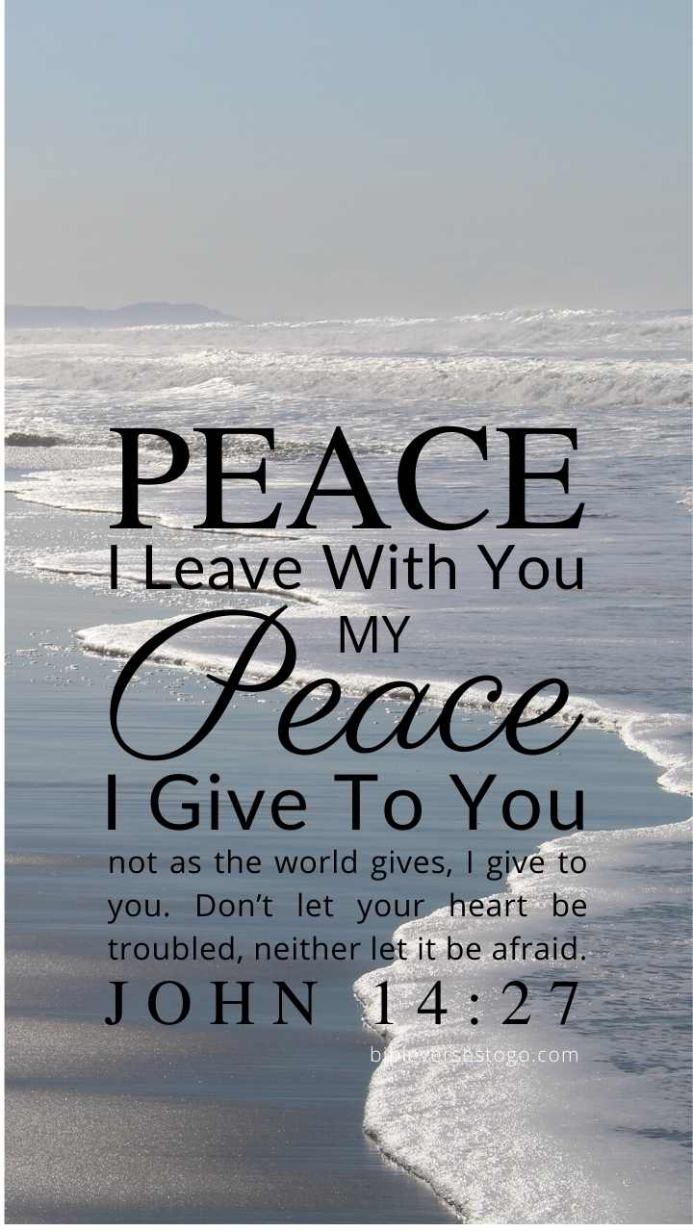

Slide 5
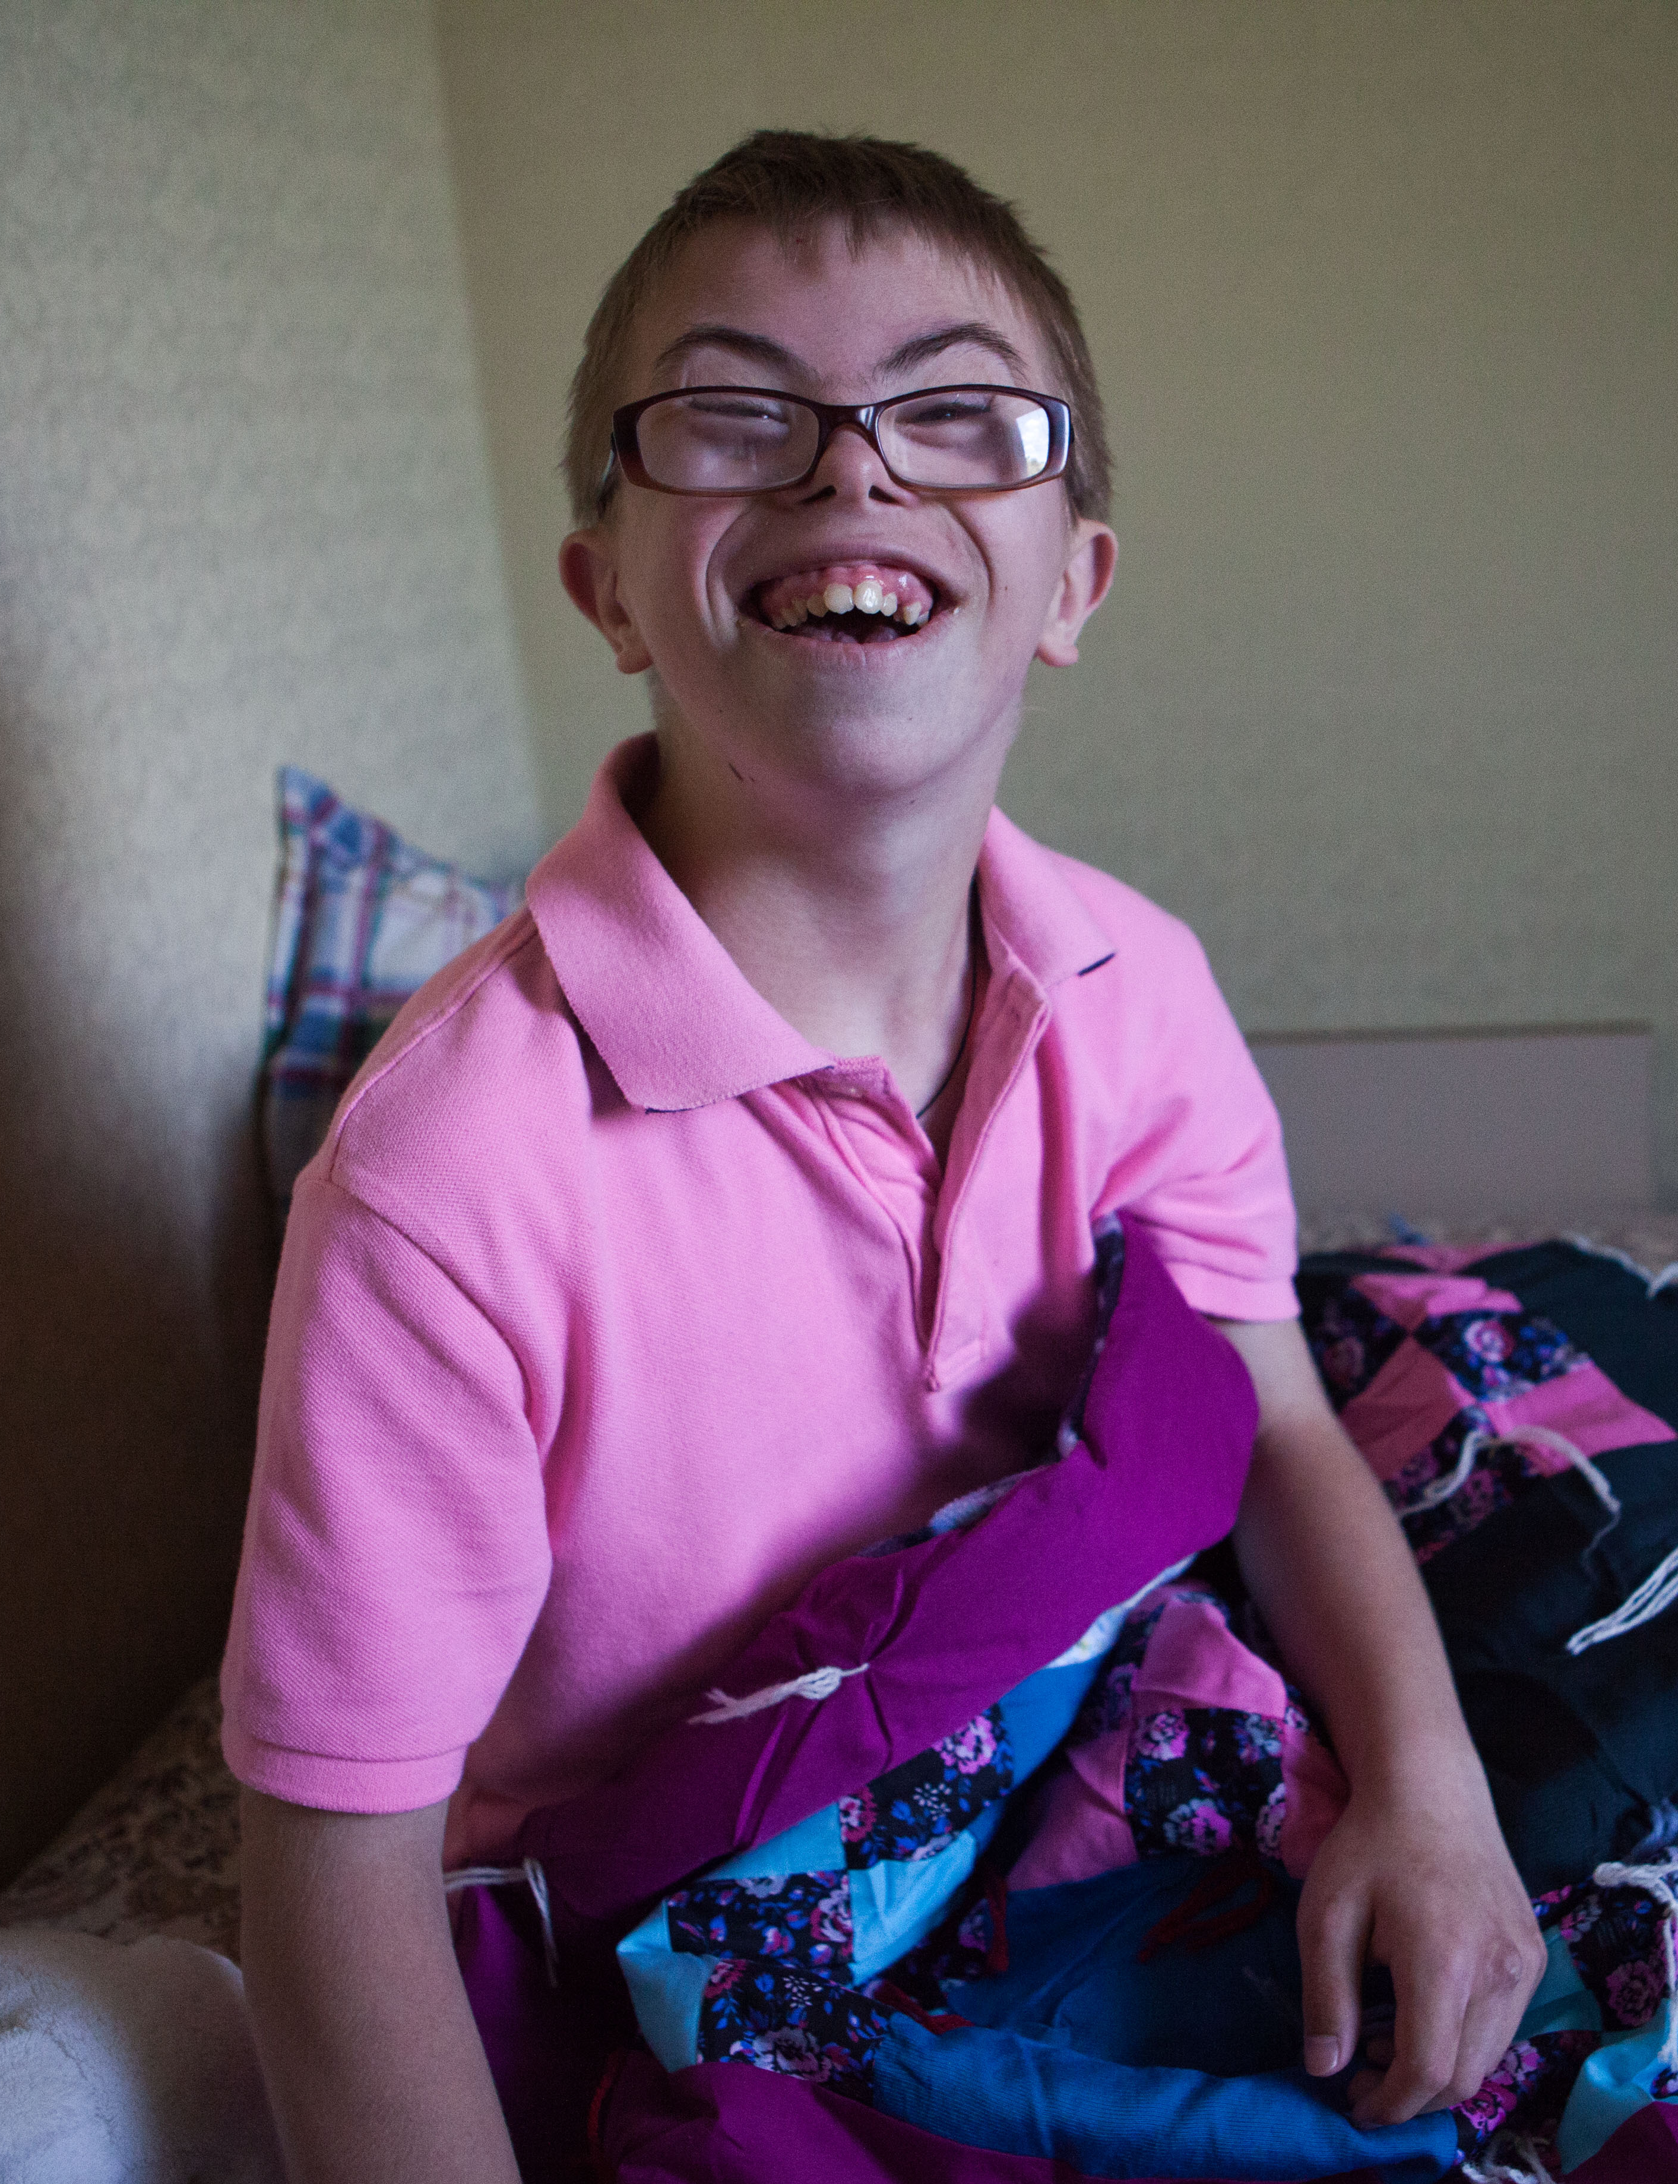
Passing on the Peace
MCC comforter recipient in Nikopol, Ukraine in 2019. MCC photo/Matthew Sawatzky

Slide 6
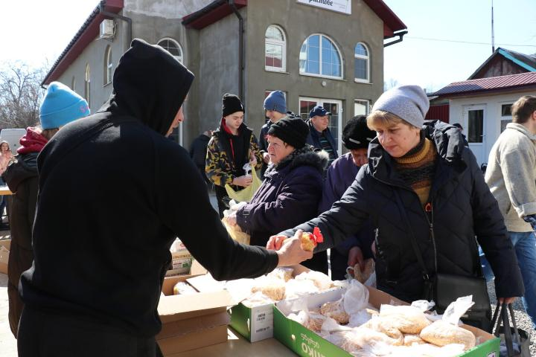
MCC humanitarian aid distribution in Uman, Ukraine in March 2022. Photo courtesy of Charitable Foundation Uman Help Center

Slide 7
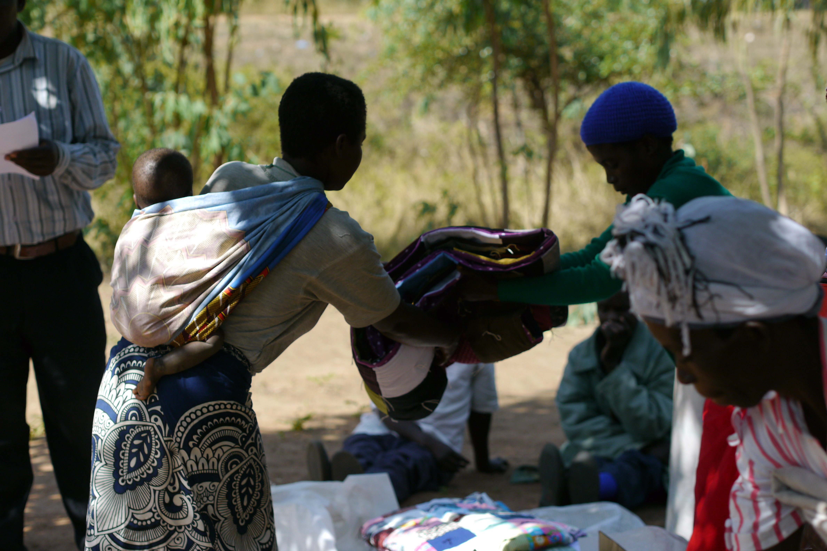
MCC comforter distribution in Ntaja, Machinga District in Malawi in 2019. MCC photo/Amanda Talstra

Slide 8
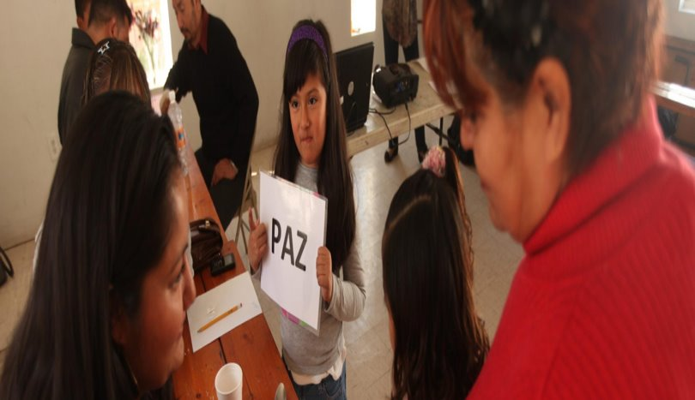

Slide 9
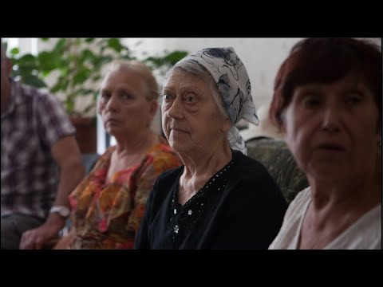
Video: A prayer for Ukraine

Slide 10


