Slide 1


Slide 2
¹¹ When Cephas came to Antioch, I opposed him to his face, because he stood condemned. ¹² For before certain men came from James, he used to eat with the Gentiles. But when they arrived, he began to draw back and separate himself from the Gentiles because he was afraid of those who belonged to the circumcision group. ¹³ The other Jews joined him in his hypocrisy, so that by their hypocrisy even Barnabas was led astray.

Slide 3
¹⁴ When I saw that they were not acting in line with the truth of the gospel, I said to Cephas in front of them all, “You are a Jew, yet you live like a Gentile and not like a Jew. How is it, then, that you force Gentiles to follow Jewish customs? ¹⁵ We who are Jews by birth and not sinful Gentiles ¹⁶ know that a person is not justified by the works of the law, but by faith in Jesus Christ. So we, too, have put our faith in Christ Jesus that we may be justified by faith in Christ and not by the works of the law, because by the works of the law no one will be justified.

Slide 4
¹⁷ “But if, in seeking to be justified in Christ, we Jews find ourselves also among the sinners, doesn’t that mean that Christ promotes sin? Absolutely not! ¹⁸ If I rebuild what I destroyed, then I really would be a lawbreaker.
¹⁹ “For through the law I died to the law so that I might live for God. ²⁰ I have been crucified with Christ and I no longer live, but Christ lives in me. The life I now live in the body, I live by faith in the Son of God, who loved me and gave himself for me. ²¹ I do not set aside the grace of God, for if righteousness could be gained through the law, Christ died for nothing!”

Slide 5
The Gospel
“a person is not justified by the works of the law,
but by faith in Jesus Christ.” (v. 16)

Slide 7
Jesus + Anything Else = “a different gospel – which is really no gospel at all” (1:6-7)

Slide 9
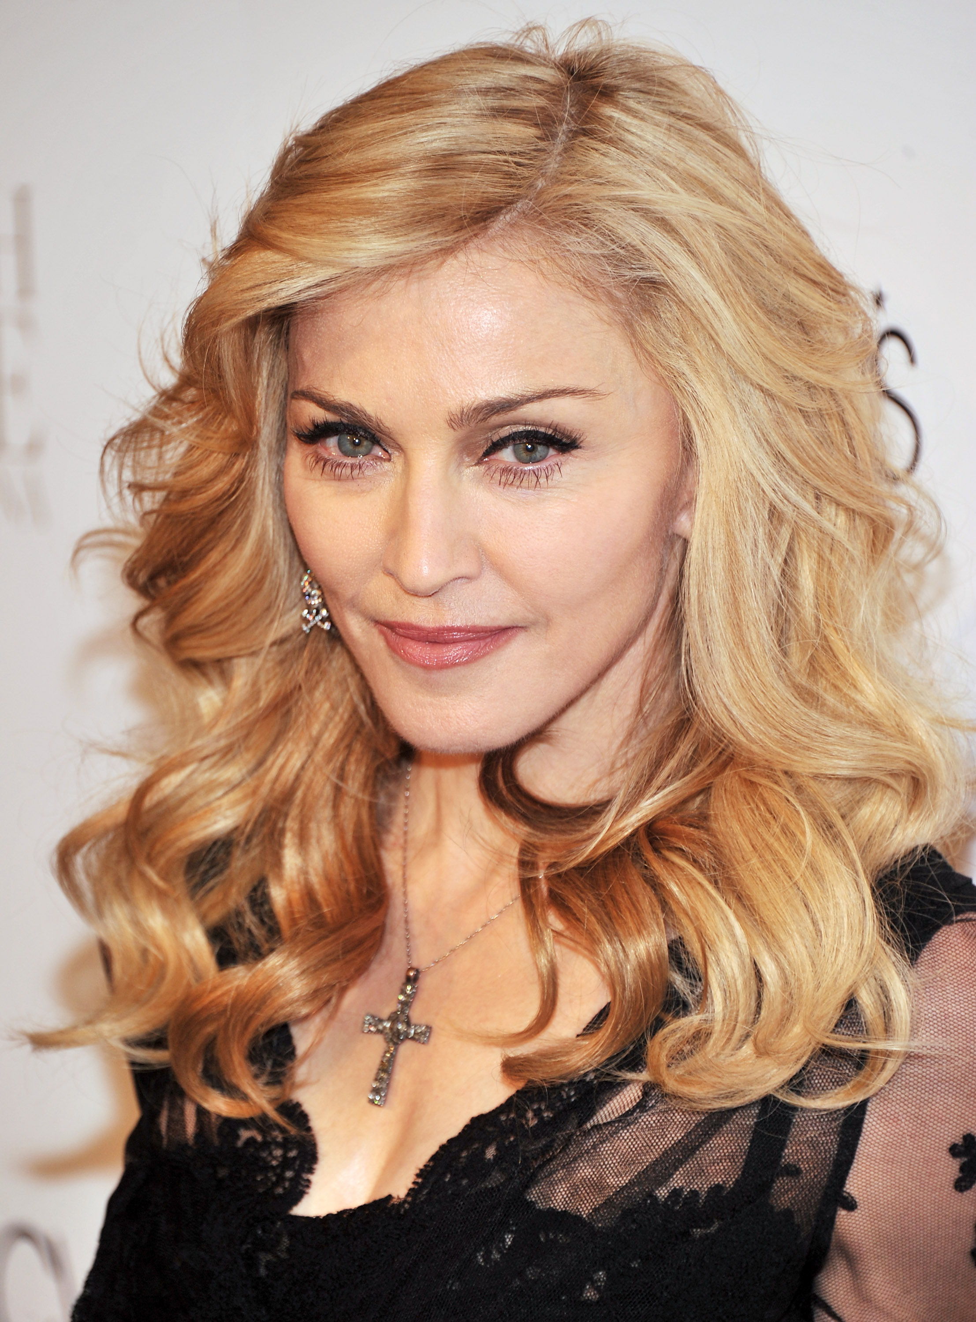
"I have an iron will. And all of my will has always been to conquer some horrible feeling of inadequacy. I'm always struggling with that fear. I push past one spell of it and discover myself as a special human being and then I get to another stage and think I'm mediocre and uninteresting. And I find a way to get myself out of that. Again and again. My drive in life is from this horrible fear of being mediocre. And that’s always pushing me, pushing me. Because even though I've become Somebody, I still have to prove that I'm Somebody. My struggle has never ended and it probably never will."

Slide 11
¹¹ When Cephas came to Antioch, I opposed him to his face, because he stood condemned. ¹² For before certain men came from James, he used to eat with the Gentiles. But when they arrived, he began to draw back and separate himself from the Gentiles because he was afraid of those who belonged to the circumcision group. ¹³ The other Jews joined him in his hypocrisy, so that by their hypocrisy even Barnabas was led astray.
¹⁴ When I saw that they were not acting in line with the truth of the gospel, I said to Cephas in front of them all, “You are a Jew, yet you live like a Gentile and not like a Jew. How is it, then, that you force Gentiles to follow Jewish customs?

Slide 13
¹¹ When Cephas came to Antioch, I opposed him to his face, because he stood condemned. ¹² For before certain men came from James, he used to eat with the Gentiles. But when they arrived, he began to draw back and separate himself from the Gentiles because he was afraid of those who belonged to the circumcision group. ¹³ The other Jews joined him in his hypocrisy, so that by their hypocrisy even Barnabas was led astray.
¹⁴ When I saw that they were not acting in line with the truth of the gospel, I said to Cephas in front of them all, “You are a Jew, yet you live like a Gentile and not like a Jew. How is it, then, that you force Gentiles to follow Jewish customs?

Slide 14
¹¹ When Cephas came to Antioch, I opposed him to his face, because he stood condemned. ¹² For before certain men came from James, he used to eat with the Gentiles. But when they arrived, he began to draw back and separate himself from the Gentiles because he was afraid of those who belonged to the circumcision group. ¹³ The other Jews joined him in his hypocrisy, so that by their hypocrisy even Barnabas was led astray.
¹⁴ When I saw that they were not acting in line with the truth of the gospel, I said to Cephas in front of them all, “You are a Jew, yet you live like a Gentile and not like a Jew. How is it, then, that you force Gentiles to follow Jewish customs?

Slide 16
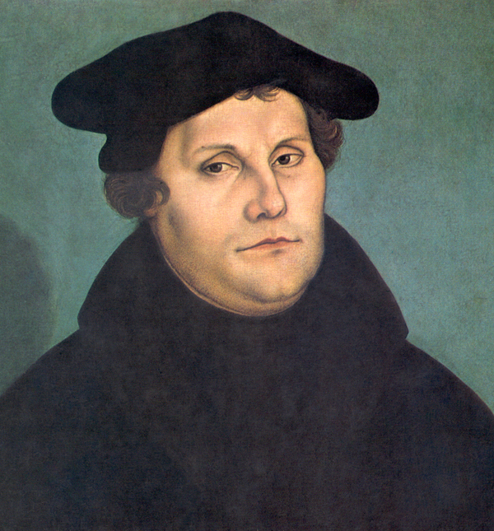
“[The truth of the gospel] is the principal article of all Christian doctrine … Most necessary is it, therefore, that we should know this article well, teach it unto others, and beat into their heads continually.”
- Martin Luther

Slide 18
¹⁹ “For through the law I died to the law so that I might live for God. ²⁰ I have been crucified with Christ and I no longer live, but Christ lives in me. The life I now live in the body, I live by faith in the Son of God, who loved me and gave himself for me.

Slide 19
²¹ I do not set aside the grace of God, for if righteousness could be gained through the law, Christ died for nothing!”

Slide 21

“If we could save ourselves, Christ’s death is pointless, and means nothing. If we realize we cannot save ourselves, Christ’s death will mean everything to us. And we will spend the life that He has given us in joyful service of Him, bringing our whole lives into line with the gospel.”
- Tim Keller

