Slide 1
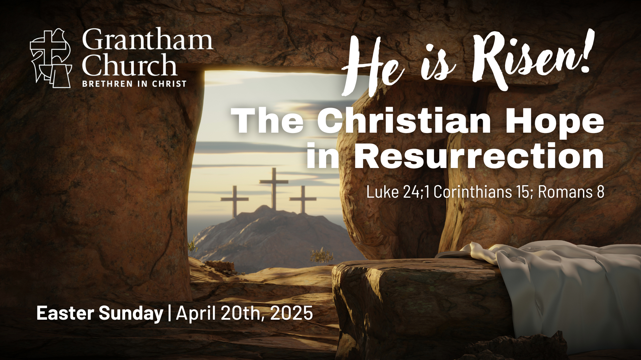
Notes:
[BRIEF INTRO]
It’s a joy to celebrate this special day with you… the day when Christians from all over the world commemorate Jesus being raised from the dead and changing the course of history.
We believe that God became a human being in Jesus of Nazareth within first century Palestine; he was the promised Messiah, he fulfilled the Law and the Prophets, he taught us and showed us how to live, and he fully revealed what God is like through his life, death, and resurrection. The Scriptures tell us that God loved the world so much that he sent his Son to us, but, in our stubborn refusal to repent of our own way, our sins nailed him to the cross where he chose to bear our iniquities and the punishment for them. And so, through the cross, God dealt with sin and death, and he forgave us.
But, of course, the cross would not have this meaning and power if it weren’t for what happened on the third day. Remember, the life and ministry of Jesus and the events of Holy Week have led up to this moment… [NEXT SLIDE]

Slide 2
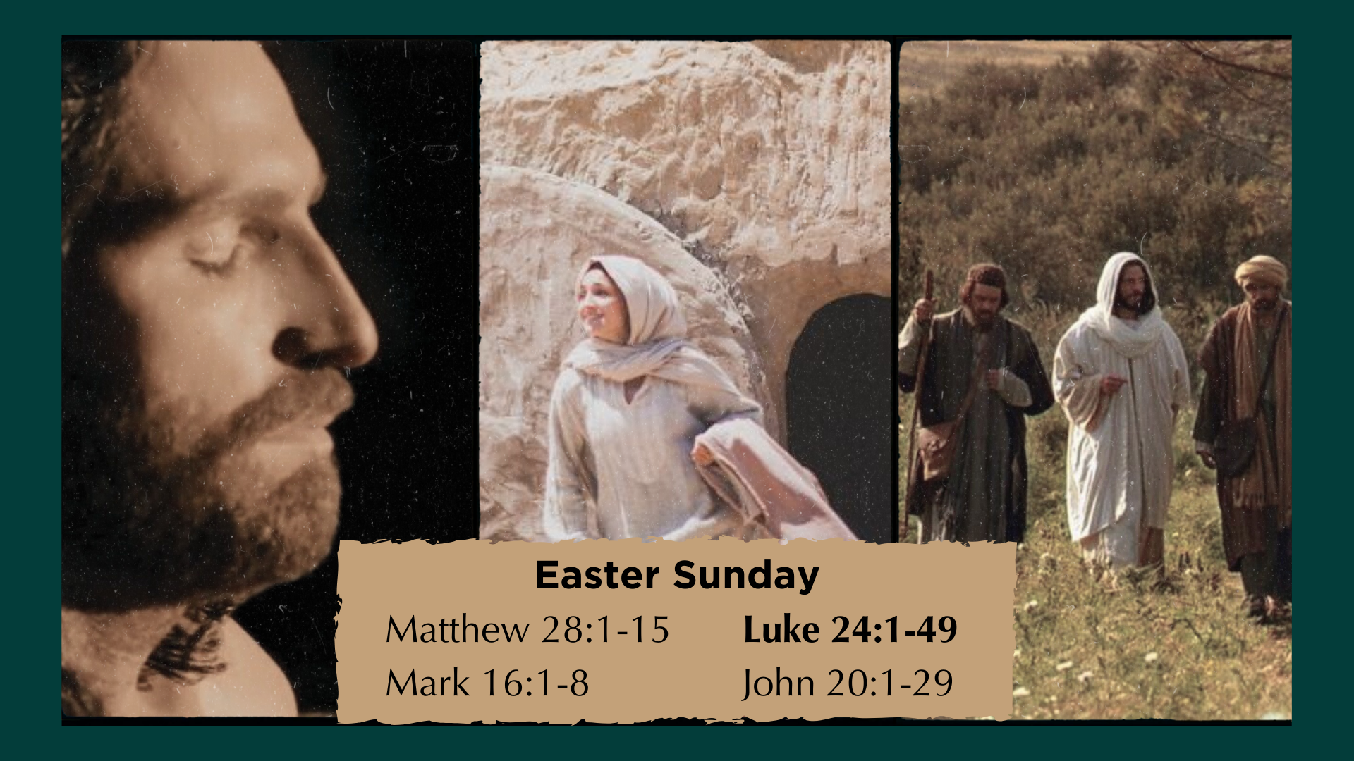
Notes:
Earlier in the service we heard the first 8 verses of Luke 24 read for us. Remember that all four Gospels record what happened on the first Easter Sunday. The spirit of Jesus returns to his body and the radiating power of the Holy Spirit heals, restores, and transforms the crucified Jesus—giving him a glorified, incorruptible, imperishable, immortal, and resurrected body. His resurrected body was in some ways like his old one (there is biological continuity), but the risen Jesus is metaphysically different. How so? Well, the risen Jesus eats and can be touched, but he can also appear in locked rooms and then disappear. John actually says that Mary Magdalene doesn’t recognize him at first. And so, when Mary goes to the tomb that morning hoping to anoint Jesus’ body with spices, she thinks the tomb has been robbed and that the risen Jesus is a gardener.
And then he says her name, “Mary”… and it’s as if her eyes are opened to see him. She is beyond excited. Naturally, she wants to grab ahold of him. But the risen Jesus tells her that he is on a mission, and that she has a job to do. She must tell the other disciples that he is alive. And she does. But it wasn’t until Sunday evening that they all became true believers. A short time after the risen Jesus had revealed himself to the two disciples on the road to Emmaus.
And at this point, skeptics are likely thinking, “Well this is just ridiculous. Do you Christians actually believe that this crucified man came back to life? This is the sort of thing that ancient people would believe, but now we know better.” And to respond to that, listen to what renowned biblical scholar and Oxford research fellow N.T. Wright says… [NEXT SLIDE]

Slide 3
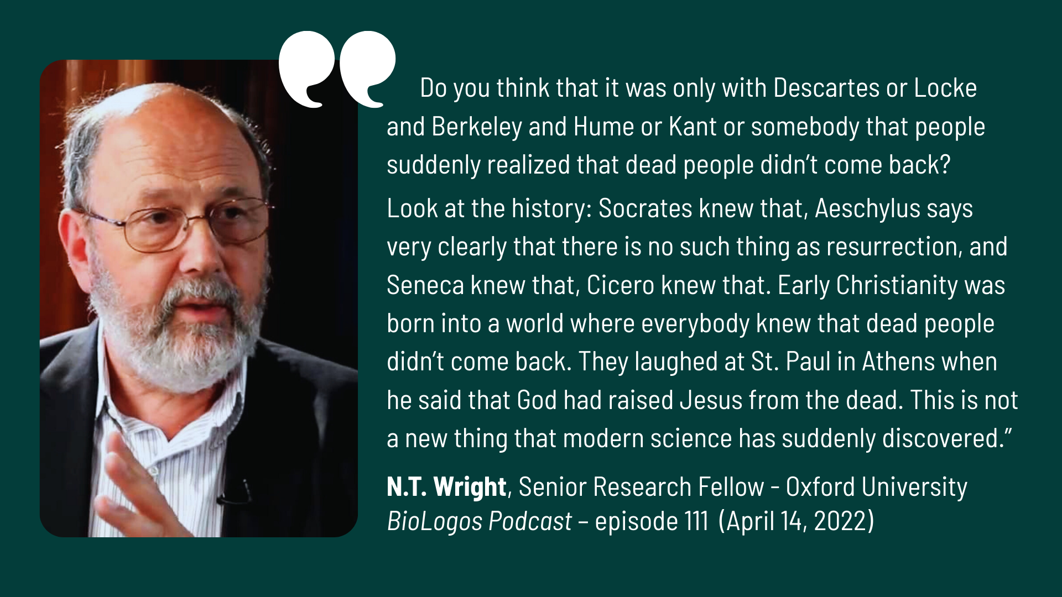
Notes:
[READ QUOTE & COMMENT]
And so, before we consider the meaning of Jesus’ resurrection and unpack the Christian hope in resurrection, I would like to take just a few short minutes to share a list of what I think are some of the strongest reasons for believing that Jesus was raised from the dead. Some of you have heard this before, so this will be a refresher for you. But keep in mind that there are others here this morning who may be hearing this for the first time and might benefit from it.
So, real quick… here are some reasons for believing in the resurrection of Jesus… [NEXT SLIDE]

Slide 4
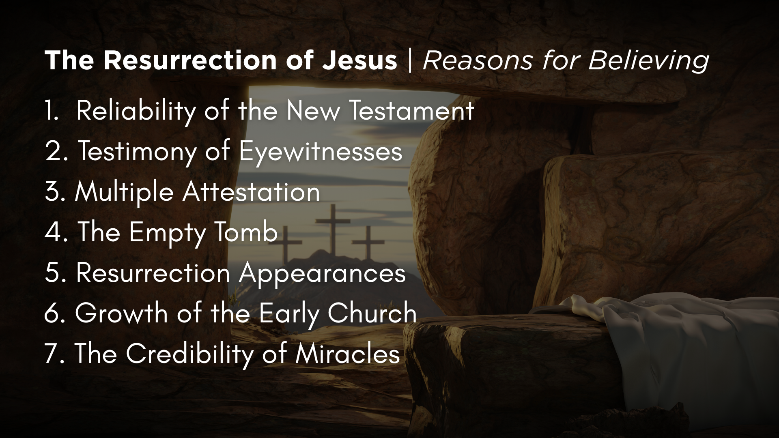
Notes:
Reliability of the New Testament – Over 5,600 early Greek manuscripts; over 20,000 manuscripts in various languages. And there are no major differences in those manuscripts and the copies of the copies. No other ancient document compares! And yes, the gospel writers want you to believe, but they are also recording historical events.
The Testimony of Many Eyewitnesses – The NT tells us that there are well over 500 witnesses to the resurrection of Jesus; in 1 Cor 15:6, the Apostle Paul indicated that most of those folks were still alive at the time he wrote his epistle.
Multiple Attestation – This means that we don’t just have one history of the life, death, and resurrection of Jesus, we have 4 ancient biographies and the rest of the 23 books of the New Testament that all attest in some way to Jesus.
The Empty Tomb – Did you know that every classical or biblical scholar of this historical period (Christian & non-Christian) agrees that the tomb of Jesus was empty? But why was it empty? Justin Martyr recorded that people in the second century were still saying that someone stole the body. And just to drive home that the empty tomb is believed to be a historical fact, in the realm of historical Jesus studies, they have all kinds of alternative theories for why the tomb was empty and people claimed to see Jesus alive (e.g. the swoon theory, group hallucination, Jesus had a twin brother, etc.). Obviously, you don’t need any of these theories if there wasn’t an empty tomb.
Resurrection Appearances – Of all the claims that people saw the risen Jesus, there are two that stick out above the rest because they were not followers of Jesus until he appeared to them: James and Paul.
Growth of the Early Church – N.T. Wright says that he knows nothing else that could explain the initial birth and rapid expansion of the early church, except that Jesus was really raised from the dead.
Wright states that there are two things “historically secure” about the first Easter: the empty tomb and the meeting with the resurrected Jesus. Nothing in Second-Temple Judaism would have produced such a radical claim that someone would be raised to life in the middle of human history. Wright says, “It is therefore historically highly probable that Jesus’ tomb was indeed empty on the third day after his execution, and that the disciples did indeed encounter him giving every appearance of being well and truly alive.”
And here is one of my favorite quotes, this one from Paula Fredriksen, a non-Christian historian of Boston University. In an ABC tv interview many years ago, she said, “I know in their own terms what they saw was the raised Jesus. That’s what they say and then all the historic evidence we have afterwards attest to their conviction that that’s what they saw. I’m not saying that they really did see the raised Jesus. I wasn’t there. I don’t know what they saw. But I do know that as a historian that they must have seen something.”
And lastly… 7. The Credibility of Miracles – As Christians, we do not believe that faith goes against reason or science, but rather that faith goes beyond it. It really is about your worldview. Does your worldview allow for the unexplained and what has been dubbed supernatural, or not? For us, we believe that the God who created the universe also revealed himself in Jesus of Nazareth and has no problem bending or transcending the laws of physics as we know them, which, after all, he created. And frankly, the more we’re learning through things like the James Webb Space Telescope and quantum physics, it demands more humility and less certainty when it comes to science and what we think we know.
If you’d like to dig deeper into this one, NT scholar Craig Keener has written a two-volume work called, Miracles: The Credibility of the New Testament Accounts. Keener presents a monumental case for miraculous phenomena from late antiquity up to contemporary times. He even includes first-hand experience of miracles.
And remember, Jesus isn’t looking for your certainty, he wants your trust—your faith. And genuine faith looks at the evidence, listens with the head and the heart, and responds in faith, where doubt is often a constant companion. It’s OK to have doubts. I have doubts. But I also doubt my doubts. And so should you. Once again, N.T. Wright says… [NEXT SLIDE]

Slide 5
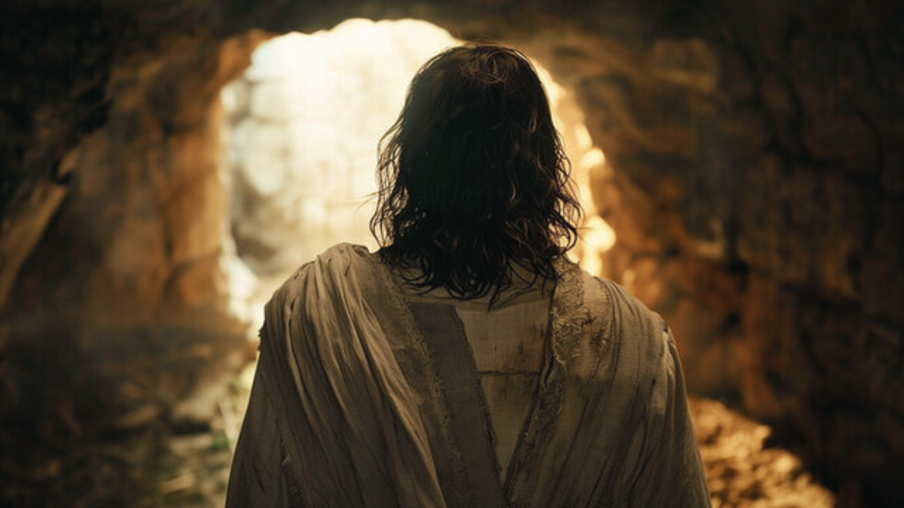
Notes:
”If a scientist says, well, I’m a scientist, so I really can’t believe in this stuff… well fine, science studies that which we can repeat, which we can test in the laboratory. Of course, that’s what science does extremely well, it has done that very successfully. But the whole claim here is that something new has launched upon the world, which in the nature of the case, you wouldn’t expect to be able to repeat in the laboratory, except in so far that the claim is about a new community, a new way of being human, a new way of living, which actually goes out into the world and has had a transformative, though still controversial, impact upon the world. That’s where the claim really comes home to roost.”
So, let’s now consider what the resurrection of Jesus means for us in the present and its implications for the future. Or put in the form of a few questions: “OK. Jesus was raised from the dead… so what? What does it mean? Why does it matter? What difference does it make?” Let’s reflect on that together… [NEXT SLIDE]

Slide 6
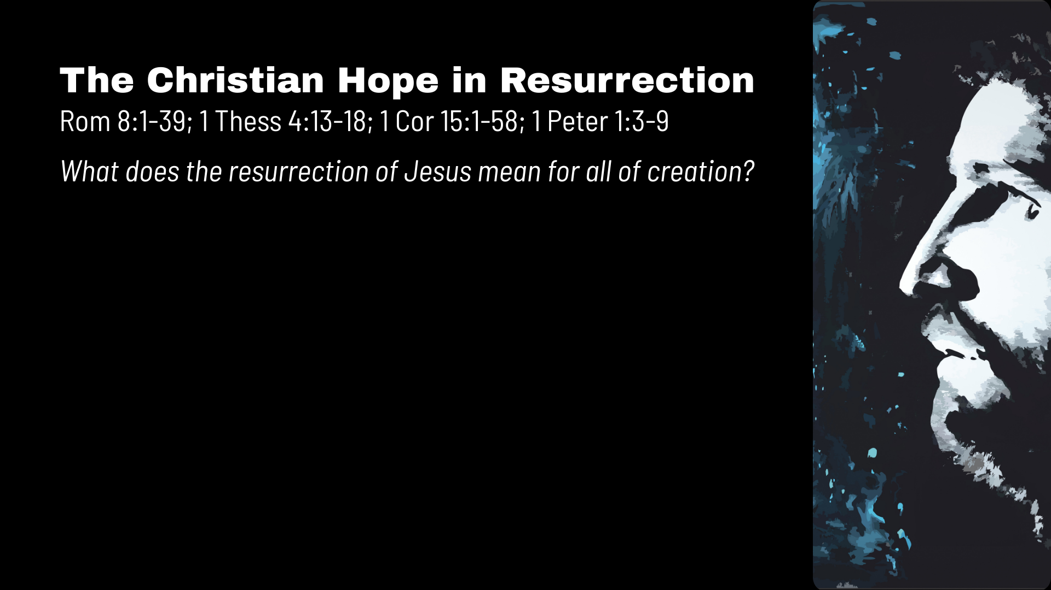

Slide 7
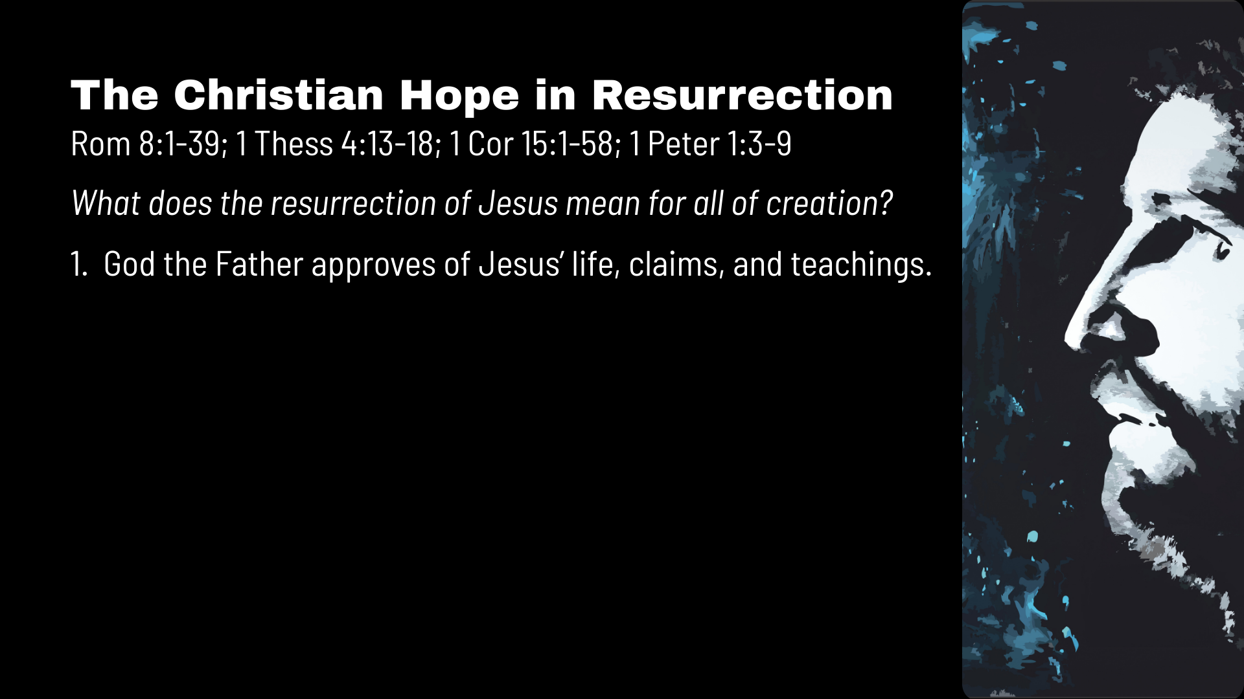
Notes:
You’ll see that I’ve listed several key NT passages at the top of the screen that expound upon the meaning of the resurrection. I want to encourage you to take some time today to read those resurrection texts. So, what does the resurrection of Jesus mean for the present and the future—for all of creation?
1. God the Father approves of Jesus’ life, claims, and teachings.
The Jesus who said, “I am the way and the truth and the life. No one comes to the Father except through me” (Jn.14:6) and a few verses later, “When you’ve seen me you’ve seen the Father” (14:9) has been vindicated by God the Father as the legitimate Son of God. The resurrection means that what he did was done in God’s power—his healings, his miracles, his exorcisms, his teachings and commands, calming the storm, and forgiving people’s sins. All of it. His hard sayings, his rebukes of the religious leaders, and his claim to be able to forgive sins, it all has God’s stamp of approval. And it means that Jesus isn’t just teacher, prophet, and the neighborhood nice guy… he is the Messiah and the Word made flesh.
The second thing… [NEXT SLIDE]

Slide 8
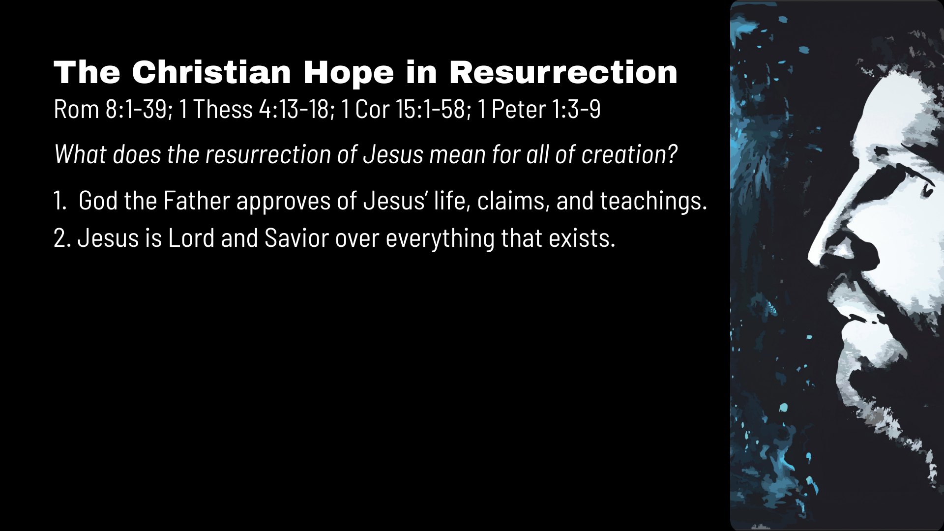
Notes:
2. Jesus is Savior and Lord over everything that exists.
It means that what the apostle Paul said in Colossians 1:15-17 about Jesus is true. Paul writes: “The Son is the image of the invisible God, the firstborn over all creation. For in him all things were created: things in heaven and on earth, visible and invisible, whether thrones or powers or rulers or authorities; all things have been created through him and for him. He is before all things, and in him all things hold together.” And that’s why he told the Corinthians: “You are not your own; you were bought at a price. Therefore, honor God with your bodies” (1 Cor,. 6:19-20). My friends, there isn’t a square inch of human existence or a dark corner in the recesses of God’s created universe that Jesus doesn’t say, “That’s mine!” And it’s the Lord Jesus who offers us salvation and promises to renew and resurrect the cosmos.
Number three… [NEXT SLIDE}

Slide 9
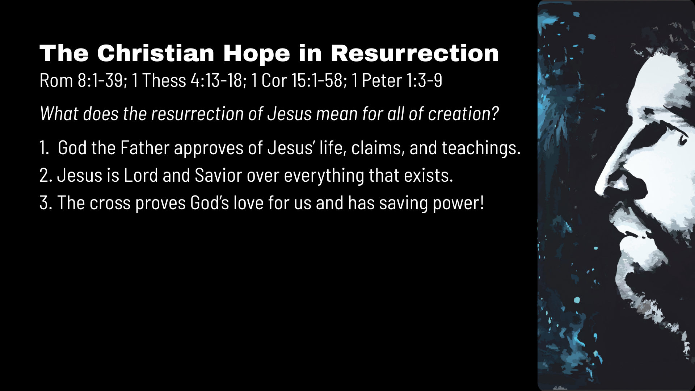
Notes:
3. The cross proves God’s love for us and has saving power!
The resurrection means that a victory had been won over Satan and the forces of darkness, over the principalities and powers. It means that the power of sin and death has died with Jesus on the cross. It means that our sins were nailed to the cross with Christ. All of it: our guilt for wrongdoing, our shame for what we’ve done, our complicity with evil, our idolatry, the times we denied or betrayed him, and every dark hidden thought we’ve ever had—crucified with Jesus of Nazareth on a hill far away. That’s because he chose to forgive and love instead of condemn and judge.
In Romans 8:1-4, Paul wrote: “Therefore, there is now no condemnation for those who are in Christ Jesus, because through Christ Jesus the law of the Spirit who gives life has set you free from the law of sin and death. For what the law was powerless to do because it was weakened by the flesh, God did by sending his own Son in the likeness of sinful flesh to be a sin offering. And so, he condemned sin in the flesh, in order that the righteous requirement of the law might be fully met in us, who do not live according to the flesh but according to the Spirit.”
Number four… [NEXT SLIDE]

Slide 10

Notes:
4. What happened to Jesus will happen to all who believe.
That’s because Jesus is the proto-type. Jesus was the first to go through death and be transformed. And in his resurrected body, heaven and earth have come together. And the Scriptures say the same will happen to us who believe in Christ. In Romans 8:17, Paul wrote: “And if the Spirit of him who raised Jesus from the dead is living in you, he who raised Christ from the dead will also give life to your mortal bodies because of his Spirit who lives in you.”
In fact, Jesus himself said that. He said, “I am the resurrection and the life. Anyone who believes in me will live, even after dying” (Jn. 11:25). But what about the brokenness in the world now? What about my aging, dying body now? Paul wrote, “outwardly we are wasting away, yet inwardly we are being renewed day by day” (2 Cor. 4:16). In other words, for those who believe in Christ, resurrection has already begun in an inward way. So, to accept Jesus is to receive his indwelling Spirit that makes us new. Jesus says, we become “born again.” And this is how the Kingdom of God has broken through into the old order of things and has already begun the work of resurrection in the here and now. It is doing a work within the hearts of those who receive him, those who make up his church, the Body of Christ on the earth. Number five… [NEXT SLIDE]

Slide 11
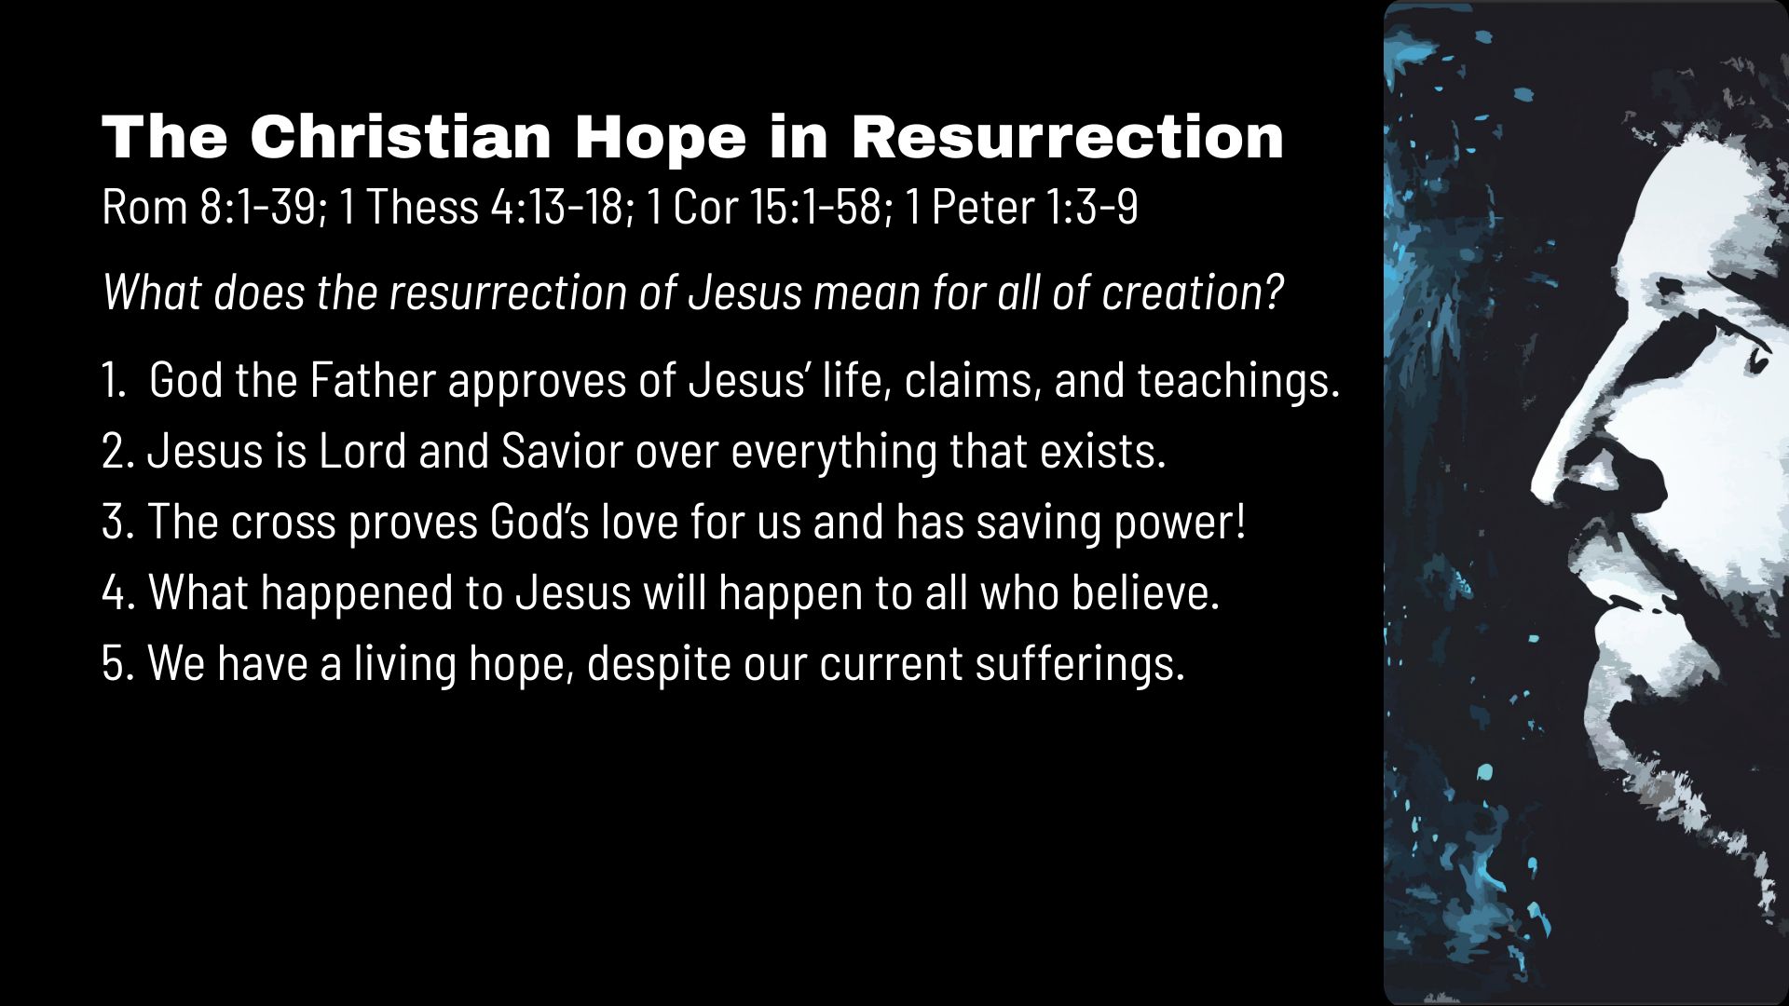
Notes:
5. We have a living hope, despite our current sufferings.
In 1 Corinthians 15, Paul makes a powerful case as he explains what the resurrection of Jesus means. And he says that if Jesus had not been raised, we would be dead in our sins; our faith would be futile and empty, like a sick joke, really. But because Jesus was raised it means that a whole new life, a new creation, something the first disciples thought would happen at the end of time, has happened in Jesus and will be completed when he returns. And so, the risen Jesus is evidence of God’s good future. And in resurrection we have hope. In 1 Peter 1:3-4, the apostle wrote, “Praise be to the God and Father of our Lord Jesus Christ! In his great mercy he has given us new birth into a living hope through the resurrection of Jesus Christ from the dead, and into an inheritance that can never perish, spoil or fade.”
But, folks, you don’t get any of that—none of it is true—unless Jesus was physically raised from the dead and was metaphysically transformed. You can’t get there by spiritualizing the resurrection to make it more acceptable or palatable in the age of scientism. And that’s because if you don’t have a physical resurrection then we can’t be assured that God is going to redeem and renew the material world, so we then just slip into a Platonic or gnostic understanding of the world where we have imagined that someday we will “fly away” and escape for an ethereal existence in a disembodied heaven, which means we can then abandon any concern for creation and how we treat the planet. And we can also disregard God’s design for our bodies, for human sexuality, for marriage, and so forth. If you think about it, nothing holds together without resurrection. It’s all just wishful thinking, total subjectivity, and fallen human constructs of morality and meaning.
Number six… since the resurrection is true… it means that… [NEXT SLIDE]

Slide 12

Notes:
6. All things are possible with God, for those who believe.
For those who believe, forgiveness, mercy, grace and redemption are possible. You or someone you care about are not too far gone that the hand of God can’t pull you or them out the pit; out of the mud and the mire, out of a cold, dark tomb. It means that love of neighbor and enemy are possible. We can love deeply, even if it kills us, because death is not the end. Because of the risen Jesus, joy is possible, even after a broken relationship, divorce, or death. There are no dead ends with Jesus. Because of the good news of resurrection, restorative justice and reconciliation are possible; signs and wonders (miracles) are possible; and repenting and starting over are possible! If you rejoice in that… say Amen?
And finally, number seven… [NEXT SLIDE]

Slide 13
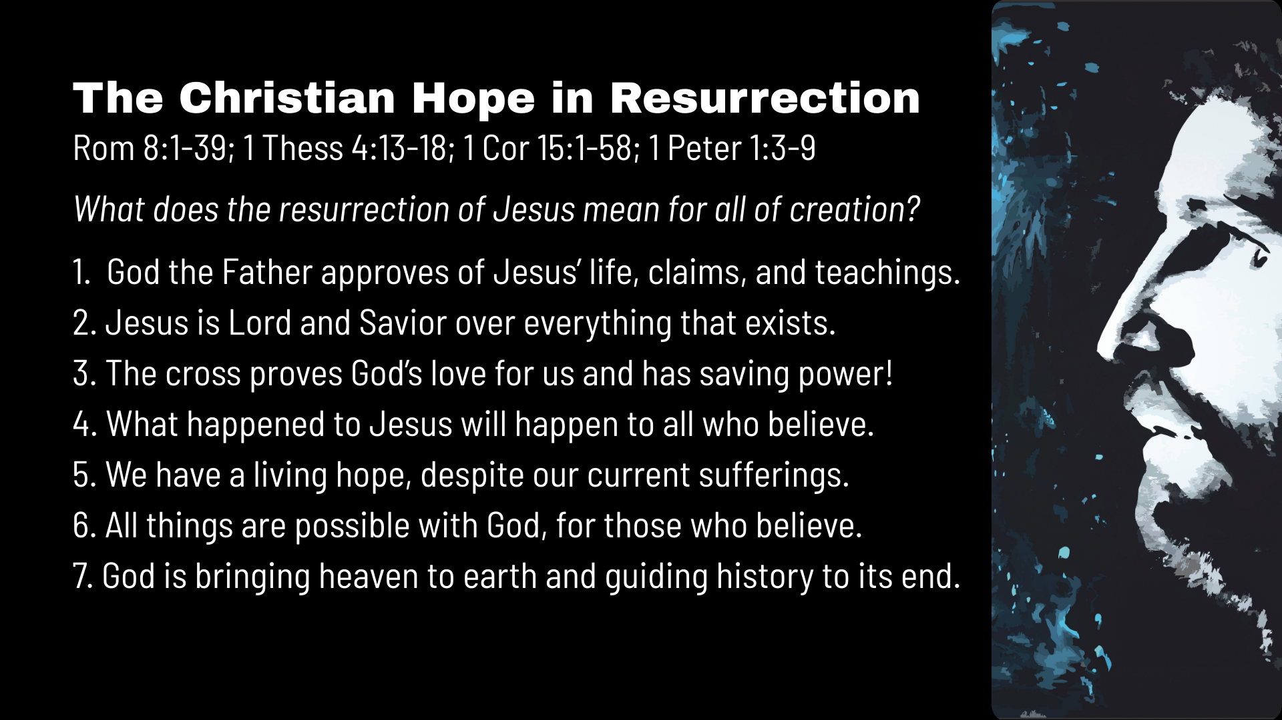
Notes:
7. God is bringing heaven to earth and guiding history to its intended end goal.
Church, Jesus prayed for heaven to come to earth. Also, the Scriptures tell us that God is coming to dwell with his people forever. Therefore, knowing the end—and embracing the Christian hope in resurrection—means that we can and should live with the end in mind. And this reminds us that no matter what darkness appears to be advancing through evil kings and tyrants, through injustice and oppression, through sickness and disease, through sin, death, and the devil… none of those things will get the last word, nor can they derail God’s plan to redeem, restore, and resurrect creation.
As promised, two weeks from now we will begin a new series called… [NEXT SLIDE]

Slide 14
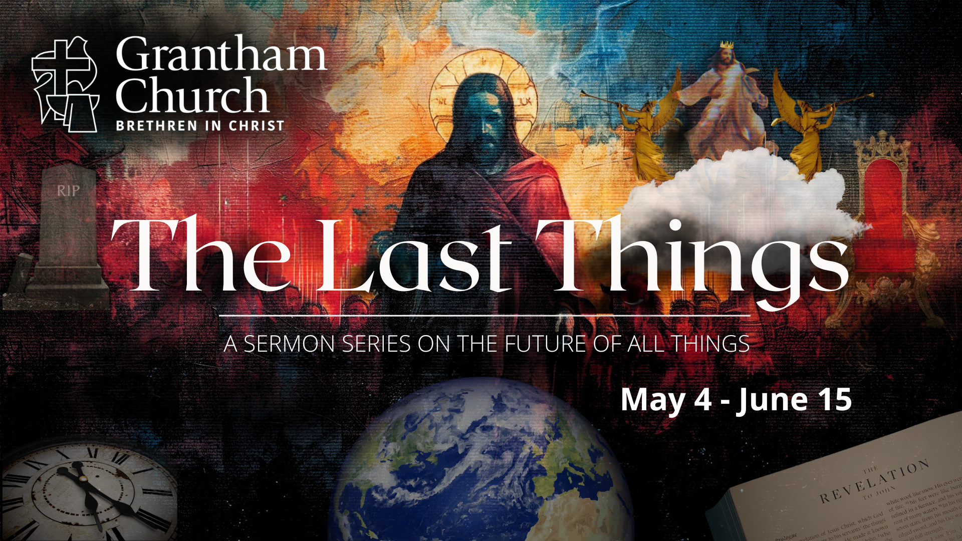
Notes:
The Last Things: A Sermon Series on the Future of All Things.
In Christian theology, eschatology is the study of the “last things”… the eschaton in Greek. And the eschaton is about the biblical view of the future, which comes into sharp focus with Jesus and the New Testament. Where is everything going? What happens when we die? And what about heaven, hell, the end times, the second coming, the final judgment, and the resurrection? I think the church in the West has often gotten a lot of this wrong (and this is really important stuff), so I hope that you’ll join us as we will explore how our knowledge of the future can deepen our trust in God in times of fear and uncertainty, ground us in the Christian hope, and help us to live in light of the last things.
And that’s what I want us to hear this Easter morning as we consider what the resurrection means for us who believe, and put this life into perspective as we are reminded of where things are going and why we can have hope for the future. So… in a single image, here is what Christ has done and this is where everything is going… [NEXT SLIDE]

Slide 15
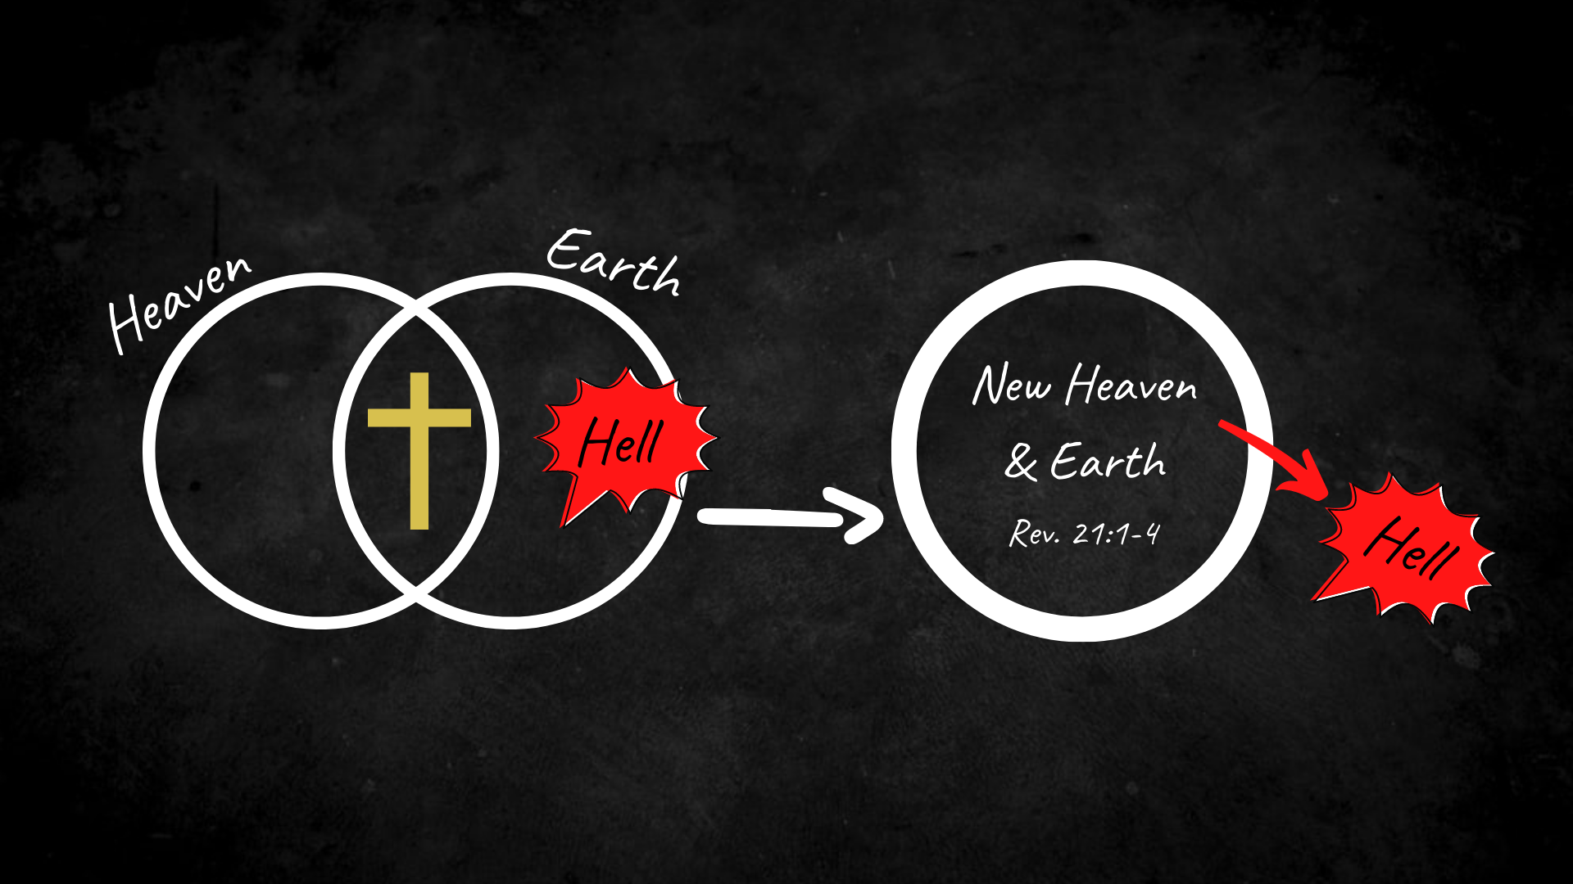
Notes:
[EXPLAIN GRAPHIC]
Heaven and earth are coming together – the risen Jesus is the proof!
Sin, death, and hell are on the way out; we wait upon the Lord
God will bring heaven to earth and rid the world of evil forever
And this promise of God’s good future is what Paul has in mind when he says this in Romans 8:18-25:
18 I consider that our present sufferings are not worth comparing with the glory that will be revealed in us. 19 For the creation waits in eager expectation for the children of God to be revealed. 20 For the creation was subjected to frustration, not by its own choice, but by the will of the one who subjected it, in hope 21 that the creation itself will be liberated from its bondage to decay and brought into the freedom and glory of the children of God.
22 We know that the whole creation has been groaning as in the pains of childbirth right up to the present time. 23 Not only so, but we ourselves, who have the first fruits of the Spirit, groan inwardly as we wait eagerly for our adoption to sonship, the redemption of our bodies. 24 For in this hope we were saved. But hope that is seen is no hope at all. Who hopes for what they already have? 25 But if we hope for what we do not yet have, we wait for it patiently.
And at the end of that classic chapter on resurrection, Paul, in 1 Corinthians 15, stresses the meaning and the importance of the resurrection and then closes his thoughts with these encouraging words… [NEXT SLIDE]

Slide 16
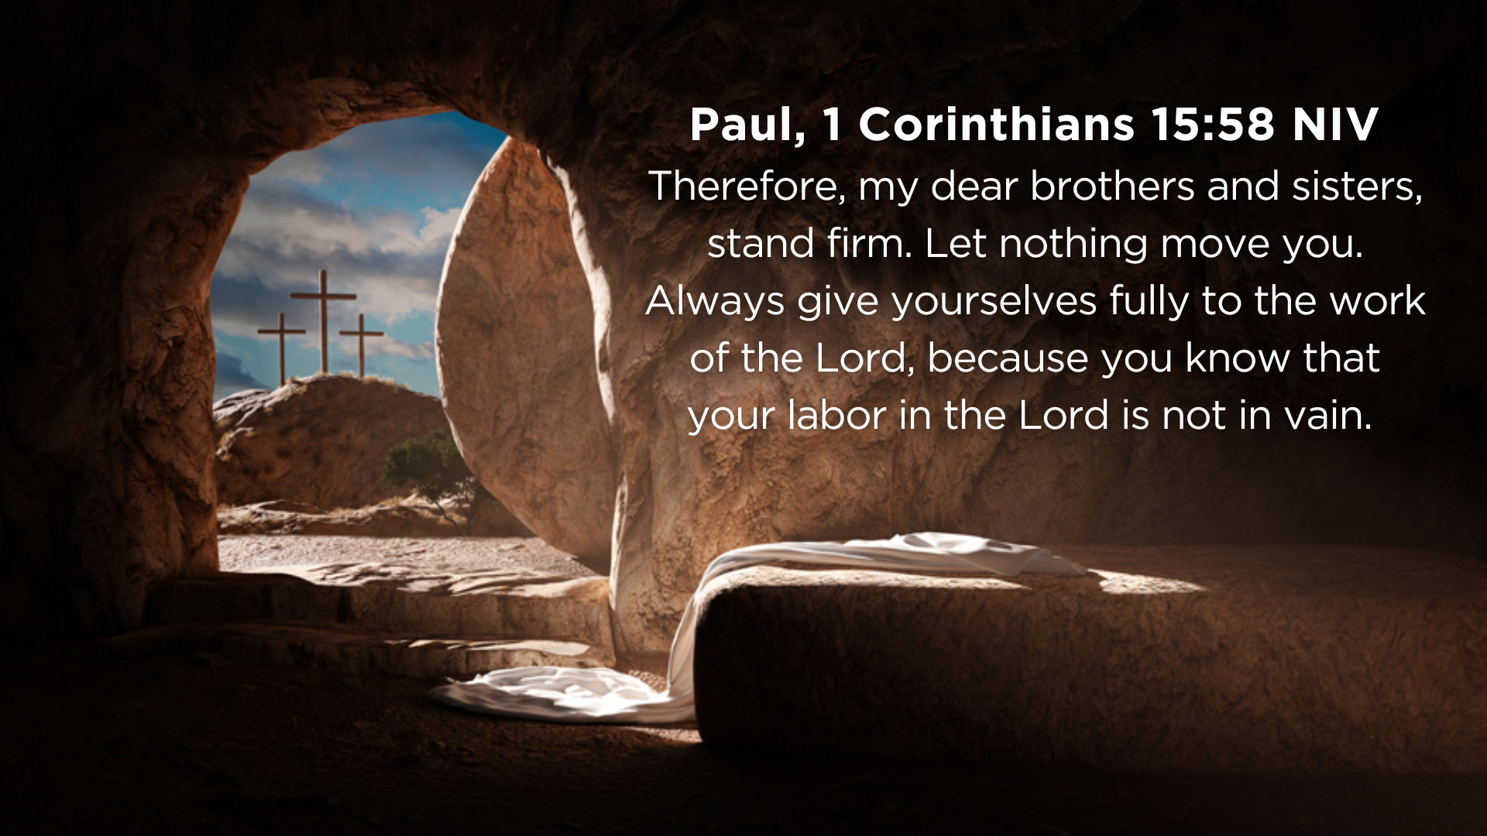
Notes:
[READ & CLOSING COMMENTS]
Finally, let’s close this message by affirming our belief in the life, death, and resurrection of Jesus. [NEXT SLIDE]

Slide 17
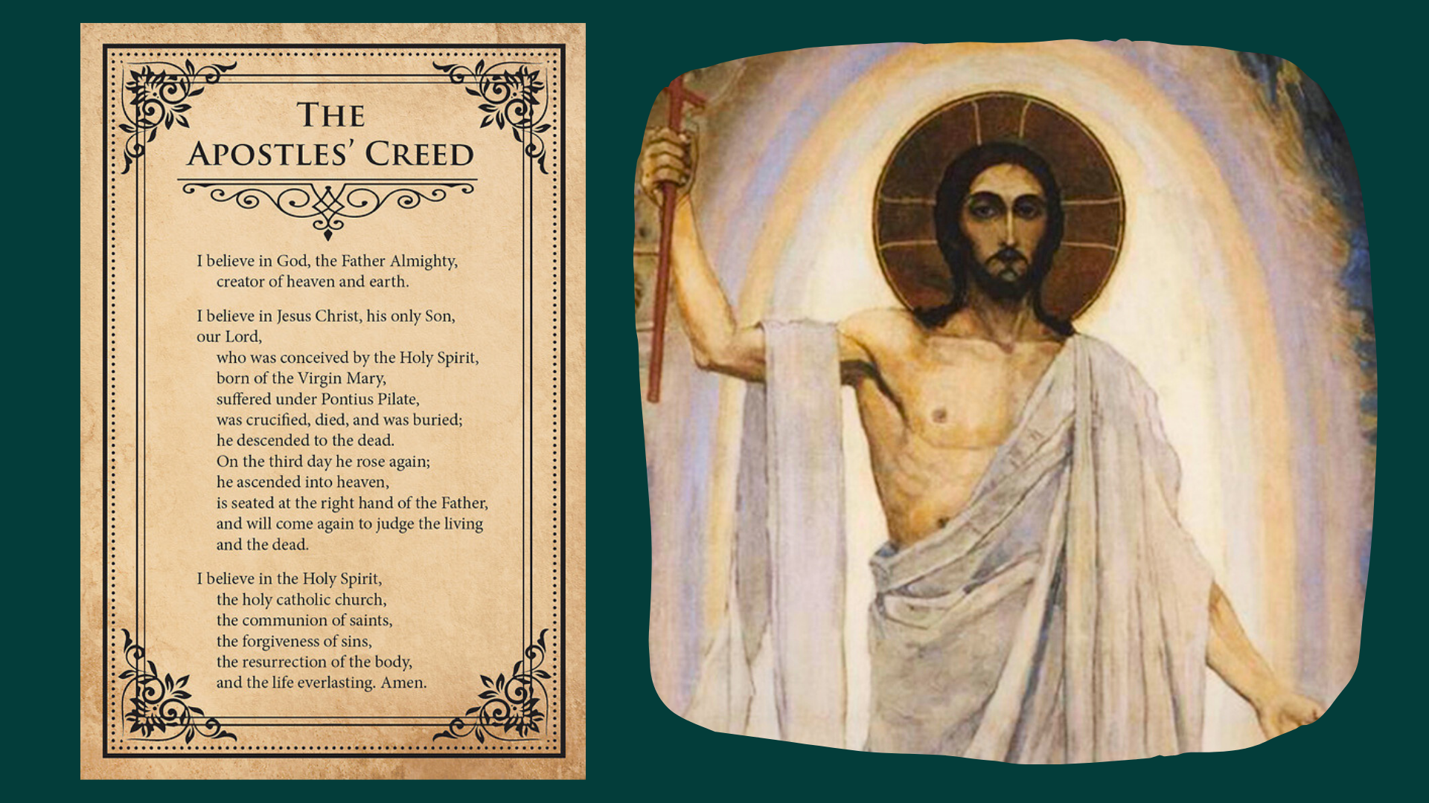
Notes:
Please join me in confessing the Apostle’s Creed…
[CONFESS CREED]
Let’s pray… [GO TO NEXT SLIDE FOR CLOSING PRAYER]

Slide 18
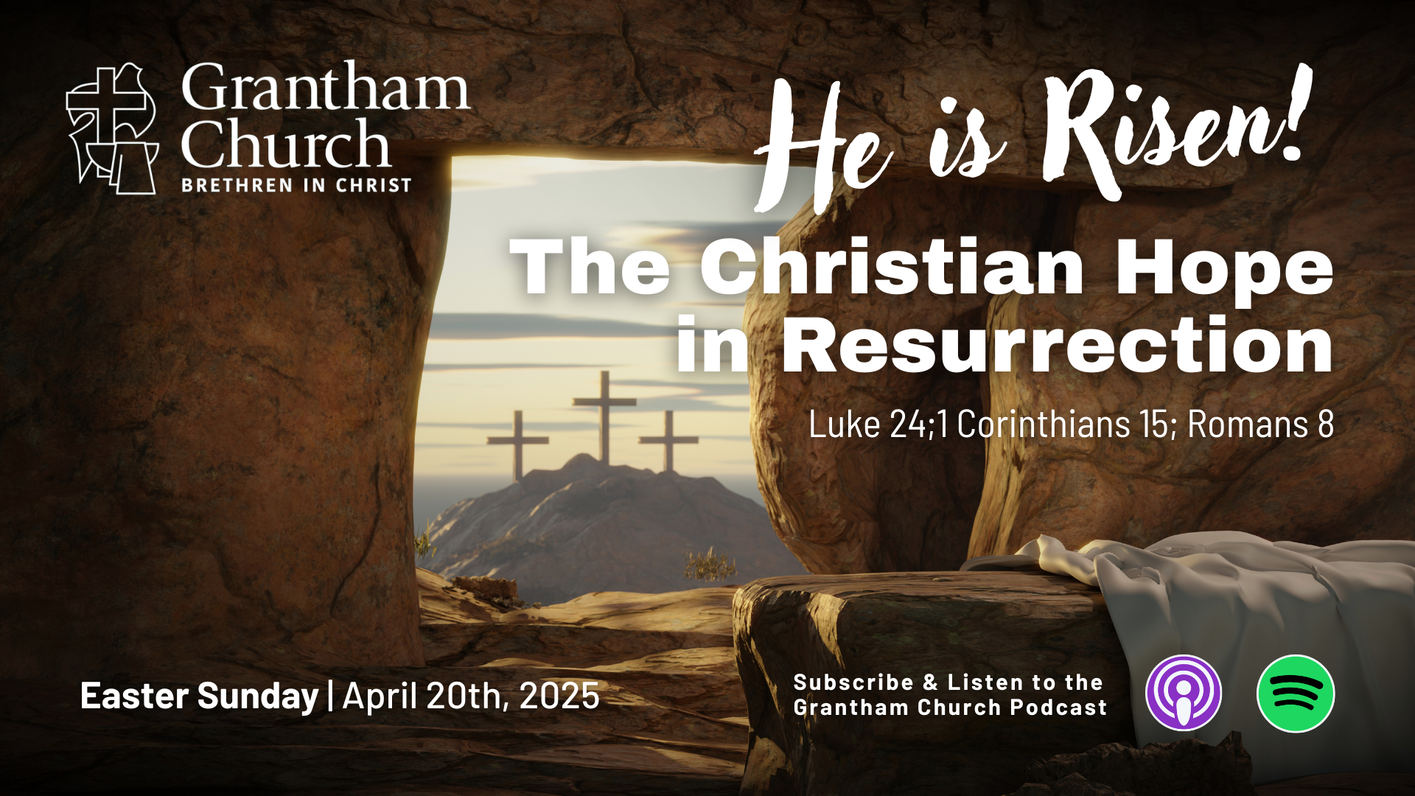
Notes:
Father God, thank You that you gave your only begotten Son, so that whoever believes in Him should not perish, but have everlasting life. He is risen! Those who believe are risen! Hallelujah! Jesus, You are the Living One; You were dead, and now look, You are alive for ever and ever! And behold, You are making all things new. He is risen! Those who believe are risen! Hallelujah! Holy Spirit, thank You that You, the same Spirit that raised Christ Jesus from the dead, live in your people today, giving life to our mortal bodies. He is risen! Those who believe are risen! Hallelujah!
And all God’s people said… Amen.

