Slide 1
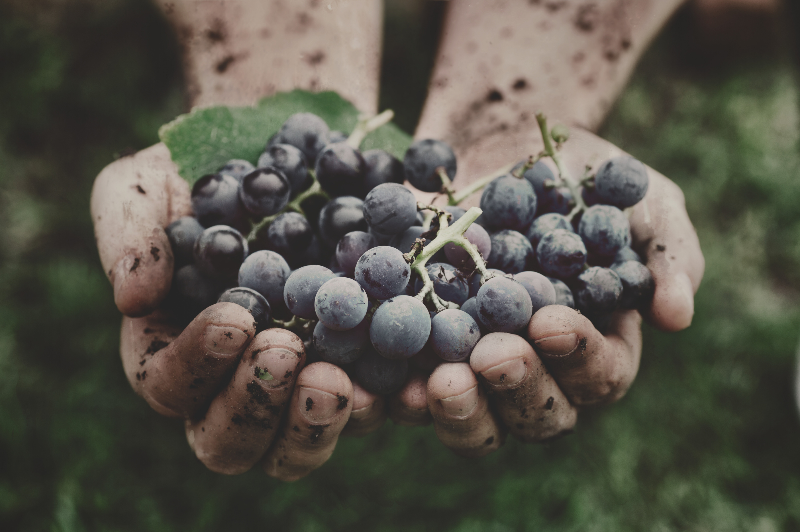


The
FRUIT SPIRIT
OF
THE
Galatians 5:22-23
SUMMER 2024 SERIES

Slide 2
The
FRUIT SPIRIT
OF
THE
BEARING FAITHFULNESS

Slide 3
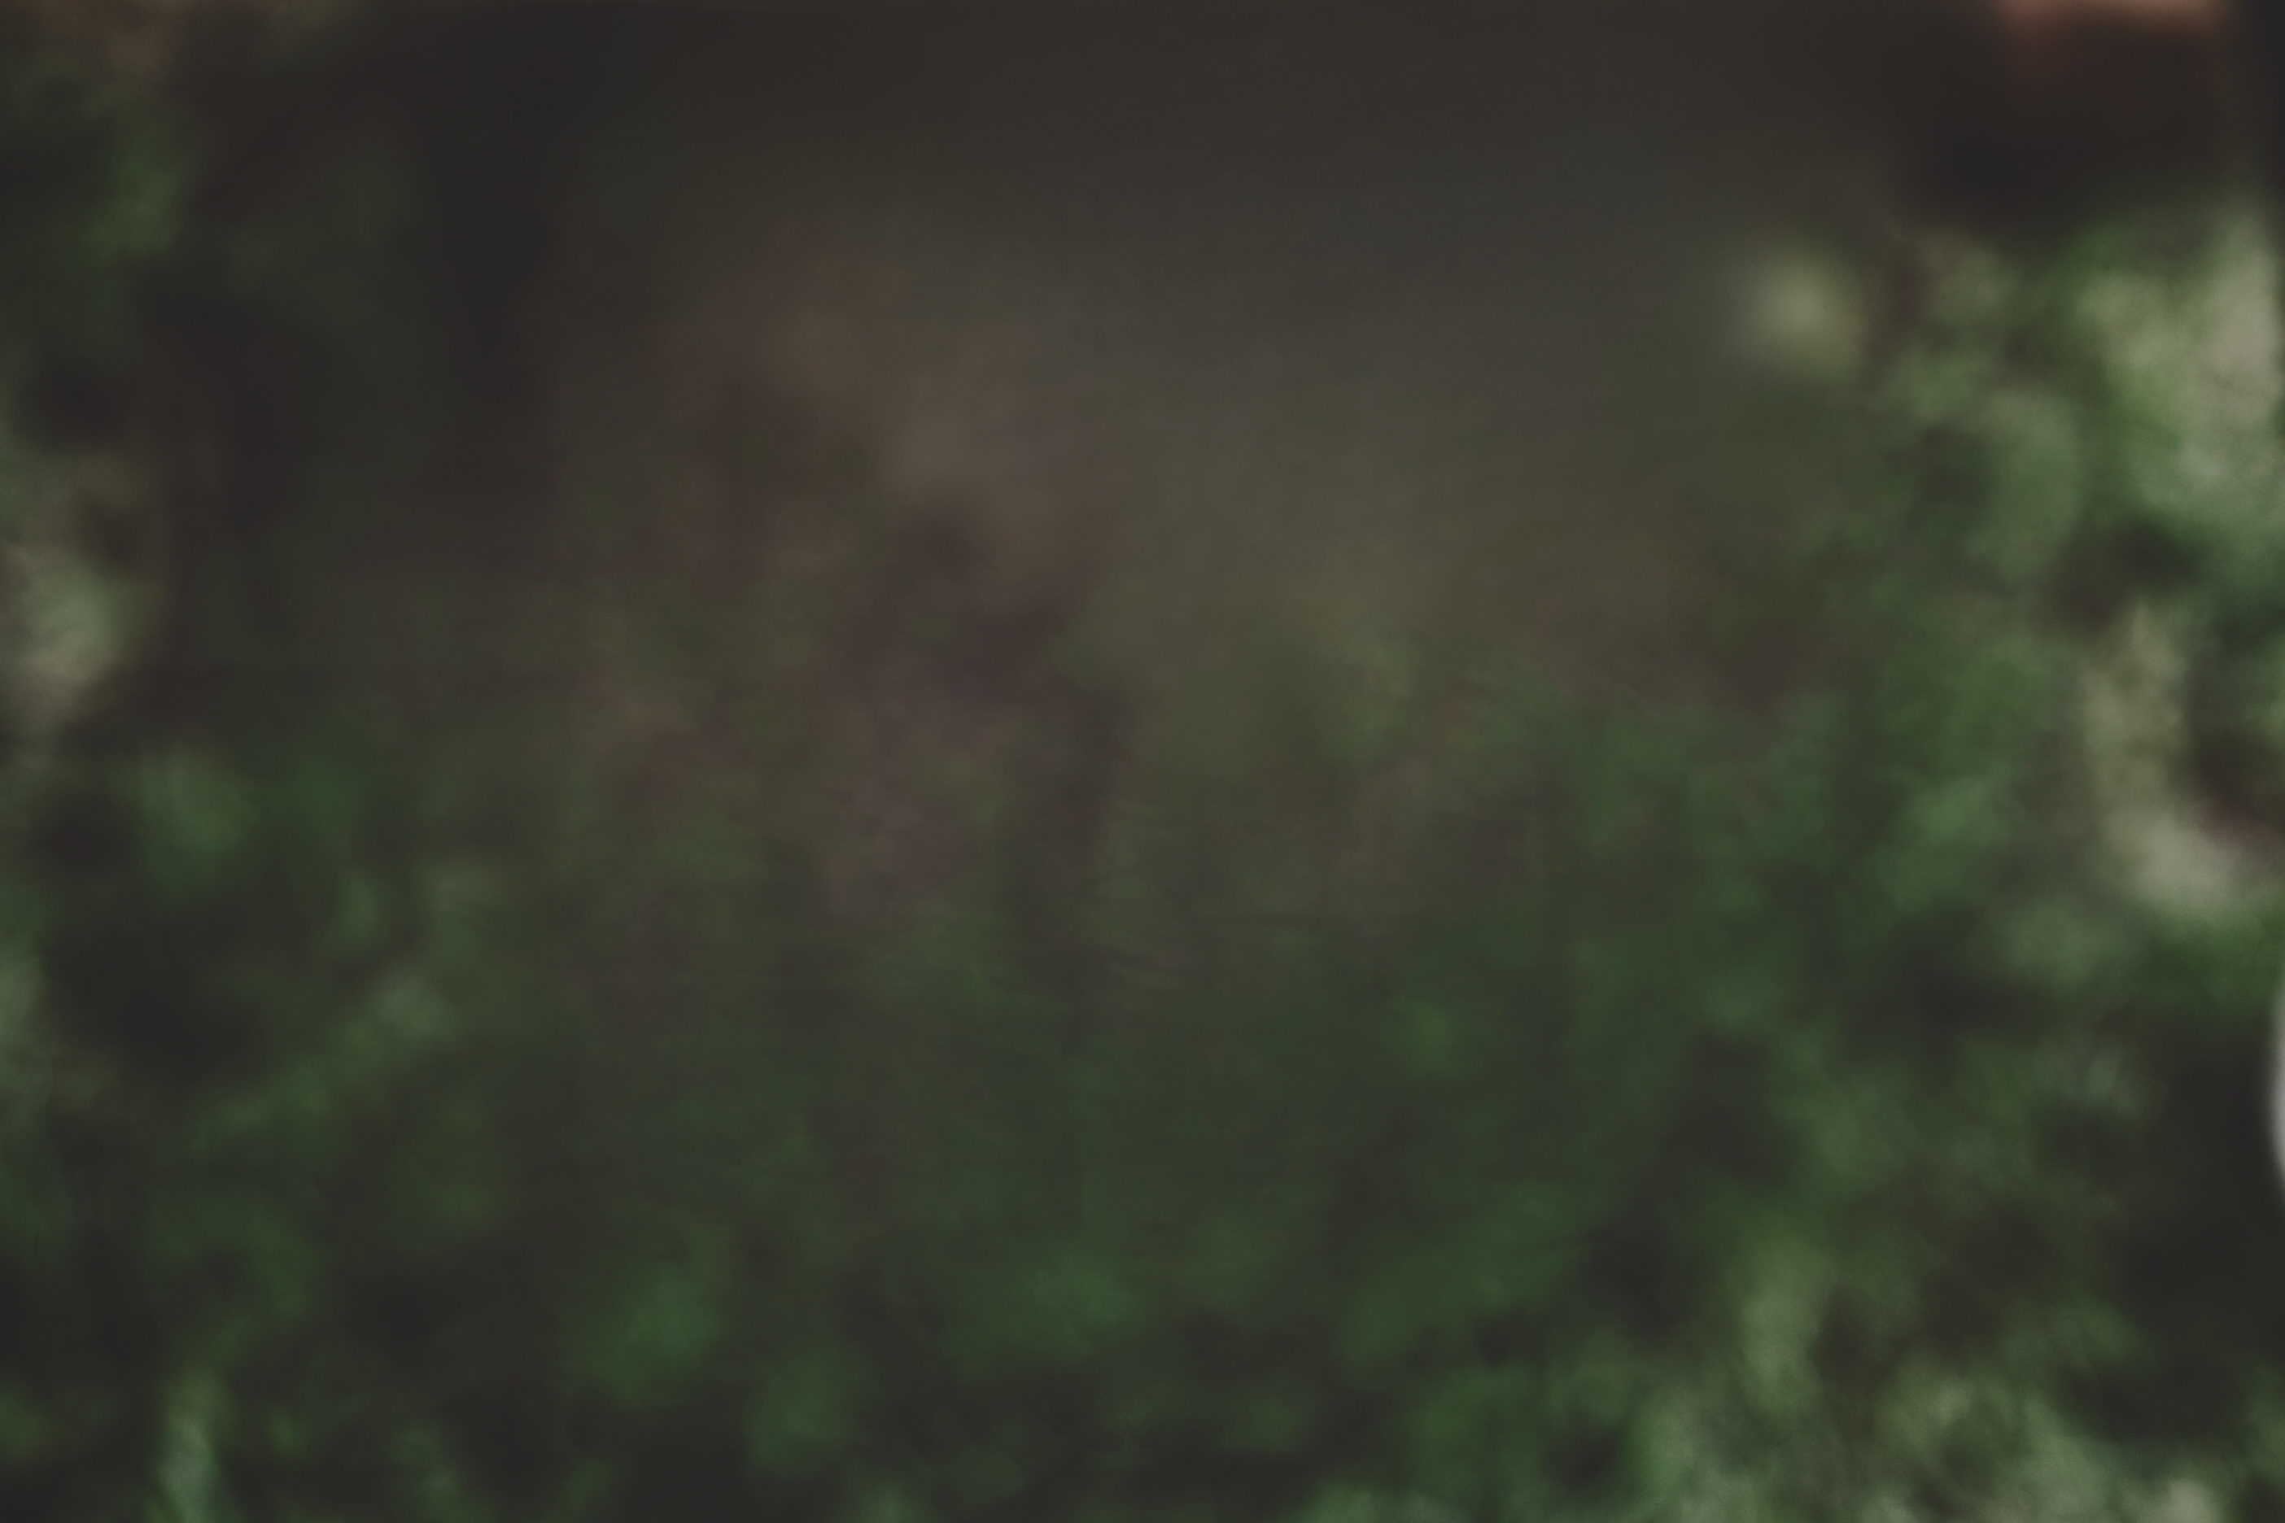
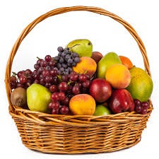
Cultivating Faithfulness in an Unfaithful World

Slide 4

Great is Thy faithfulness, O God my Father
There is no shadow of turning with Thee
Though changest not, Thy compassions they fail not
As Thou hast been, Thou forever will be
Summer and winter and springtime and harvest
Sun, moon, and stars in their courses above
Join with all nature in manifold witness
To Thy great faithfulness, mercy and love
Great is Thy faithfulness! Great is Thy faithfulness!
Morning by morning, new mercies I see
All I have needed Thy hand has provided
Great is Thy faithfulness, Lord, unto me
-Thomas O. Chisholm

Slide 5

The
FRUIT SPIRIT
OF
THE
Walking By Faith
1. It means going into the day expecting God to accomplish the impossible. A trust that God is with us and knows our every need.
2. It means taking our cue from God's Word every morning and living it throughout the day. Spending time daily in God’s word, hearing his voice through the Scriptures, memorizing and using his word in our work and our play.
3. It means hearing from God daily. Recognizing his voice. Willingly obeying Him, even when (especially when) it doesn't make sense. Praying … talking to God, not just at mealtime, or at a specific devotional time, but any time, day or night, breathing a prayer like we are talking to our best friend.

Slide 6
Acts 4:32-37
32 All the believers were one in heart and mind. No one claimed that any of their possessions was their own, but they shared everything they had. 33 With great power the apostles continued to testify to the resurrection of the Lord Jesus. And God’s grace was so powerfully at work in them all 34 that there were no needy persons among them. For from time to time those who owned land or houses sold them, brought the money from the sales 35 and put it at the apostles’ feet, and it was distributed to anyone who had need. 36 Joseph, a Levite from Cyprus, whom the apostles called Barnabas (which means “son of encouragement”), 37 sold a field he owned and brought the money and put it at the apostles’ feet.

Slide 7
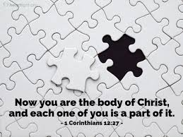

Slide 8
Zacchaeus the Tax Collector
Luke 19:1-7
1 Jesus entered Jericho and was passing through. 2 A man was there by the name of Zacchaeus; he was a chief tax collector and was wealthy. 3 He wanted to see who Jesus was, but because he was short he could not see over the crowd. 4 So he ran ahead and climbed a sycamore-fig tree to see him, since Jesus was coming that way. 5 When Jesus reached the spot, he looked up and said to him, “Zacchaeus, come down immediately. I must stay at your house today.” 6 So he came down at once and welcomed him gladly. 7 All the people saw this and began to mutter, “He has gone to be the guest of a sinner.”

Slide 9
The Samaritan Woman
John 4:4-9, 27
4 Now he had to go through Samaria. 5 So he came to a town in Samaria called Sychar, near the plot of ground Jacob had given to his son Joseph. 6 Jacob’s well was there, and Jesus, tired as he was from the journey, sat down by the well. It was about noon. 7 When a Samaritan woman came to draw water, Jesus said to her, “Will you give me a drink?” 8 (His disciples had gone into the town to buy food.) 9 The Samaritan woman said to him, “You are a Jew and I am a Samaritan woman. How can you ask me for a drink?” (For Jews do not associate with Samaritans.)
27 Just then his disciples returned and were surprised to find him talking with a woman.

Slide 10

...if we are to faithfully engage in our world, we must do it with confident hope rather than stifling anxiety, knowing that we will not always encounter an easy path.

Slide 11

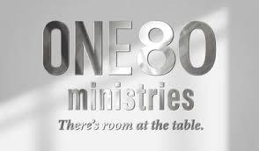



Slide 12
The
FRUIT SPIRIT
OF
THE
How will you cultivate the fruit of faithfulness...
  in your own personal relationship with God?
  in ways you can help to build up the body of Christ here at Grantham through faithfully using your gifts for one another?
  in faithfully engaging in our world to share Christ’s love to others?

Slide 13
Heavenly Father, I pray that this day I may live in your presence and please you more and more.
Lord Jesus, I pray that this day I may take up my cross and folllow you.
Holy Spirit, I pray that this day you will fill me with yourself and cause your fruit to ripen in my life: love, joy, peace, patience, kindness, goodness, faithfulness, gentleness, and self-control. Amen.

Slide 14



The
FRUIT SPIRIT
OF
THE
SUMMER 2024 SERIES
Subscribe & Listen to the
Grantham Church Podcast

