Slide 1
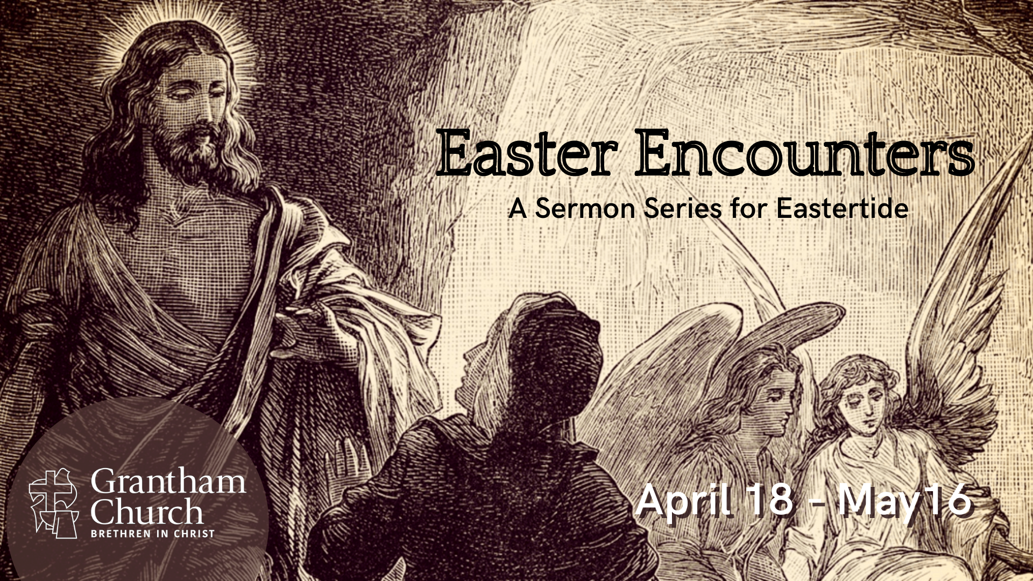
Notes:
This morning we begin a new sermon series, Easter Encounters—A sermon series for Eastertide, which is what we call the time between Easter Sunday (when Jesus rose from the dead) and Pentecost Sunday (when the Holy Spirit comes upon the disciples in the upper room, after Jesus’ ascends to heaven to rule from there). So, our 5-week series will end on what is known as Ascension Sunday on the church calendar.
I hope that you’ll join us for Easter Encounters as we will be looking at some of the experiences that the first disciples had with the risen Jesus. Specifically, we will be reflecting on the lives and encounters of Mary Magdalene at the empty tomb (which we will see today), the disciples on the road to Emmaus, Thomas and his doubts, the risen Jesus eating breakfast by the Sea of Galilee and forgiving Peter for denying him, and then the giving of the Great Commission, when Jesus commands his followers (including you and me) to make disciples who make disciples.
I expect that this series will challenge us in some ways, encourage us in others, and inspire our congregation to be Easter people-–full of hope and expecting the unexpected because Jesus is alive, and his presence and power are real. Amen?!
[BRIEF PRAYER] and then [NEXT SLIDE]

Slide 2
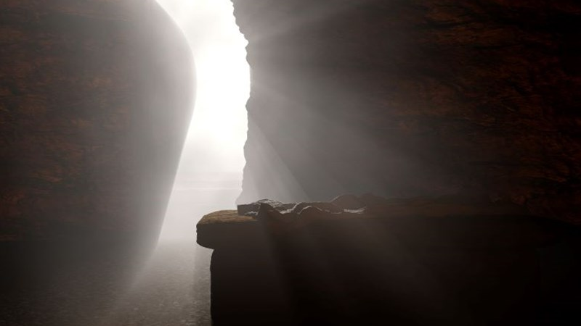
Easter Encounters
at the Empty Tomb
Matthew 28:1-10
Mark 16:1-8
Luke 24:1-12
John 20:1-18
Notes:
As many of you know, there are four gospels in the New Testament: Matthew, Mark, Luke, and John. And there are several reasons we have four gospels with both similarities and variations on the life and ministry of Jesus.
For example, they are each writing to different audiences and so they have different pastoral and theological concerns in mind. And while it may seem strange to us for them to leave certain details out or to emphasize (even add) something that another gospel doesn’t, this is an accepted way of doing biographies in the ancient world, and should also be expected when there are multiple eyewitnesses. And of course, the gospel writers are aware of each other. So, what might appear as contradictions are actually intentional literary moves by the authors to tell the Jesus story in such a way that fits with the larger themes, motifs, and message that they want to communicate to their audience.
And we certainly see this in the accounts of the empty tomb on Easter Sunday. The synoptic gospels tell us that it was a small group of women who found the empty tomb. But as you heard Pastor Tony read earlier, John, the last gospel writer (in his typical fashion), will not simply state the facts (as if he were a private investigator reporting what was seen) but rather tell the story in such a way as to present us with a “high Christology” and to highlight the experience of one woman, Mary of Magdala, also known as Mary Magdalene.
And to truly understand what’s happening in John 20:1-18, and make an attempt to enter into the experience that Mary had on the third day, we need to first know her backstory and recall her relationship to Jesus. Who is Mary Magdalene? [NEXT SLIDE]

Slide 3
Luke 8:1-3 NIV
After this, Jesus traveled about from one town and village to another, proclaiming the good news of the kingdom of God. The Twelve were with him,² and also some women who had been cured of evil spirits and diseases: Mary (called Magdalene) from whom seven demons had come out; ³ Joanna the wife of Chuza, the manager of Herod’s household; Susanna; and many others. These women were helping to support them out of their own means.
Notes:
[READ & BRIEF COMMENTS ON PASSAGE]
“After this” – the previous story is the episode of an unnamed prostitute barging into a meeting and meal Jesus was having in the home of a Pharisee. She weeps over Jesus’ feet, washes his feet with her hair, and then pours expensive perfume on the feet of God.
And I believe Mary has been misidentified as the unnamed prostitute in Luke 7.
Notice, Jesus includes women disciples with The Twelve.
Mary was from Magdala, a large port city on the Sea of Galilee known as a major center for processing and salting fish. Archaeology has revealed that Magdala was a posh place to live in the first century. Therefore, it’s most likely that Mary was a wealthy woman, as she is grouped with other women of significant means, including aristocracy—Joanna! They all helped to finance Jesus’ ministry and care for the needs of the disciples.
So here is a summary of what we know about Mary the Magdalene: [NEXT SLIDE]

Slide 4
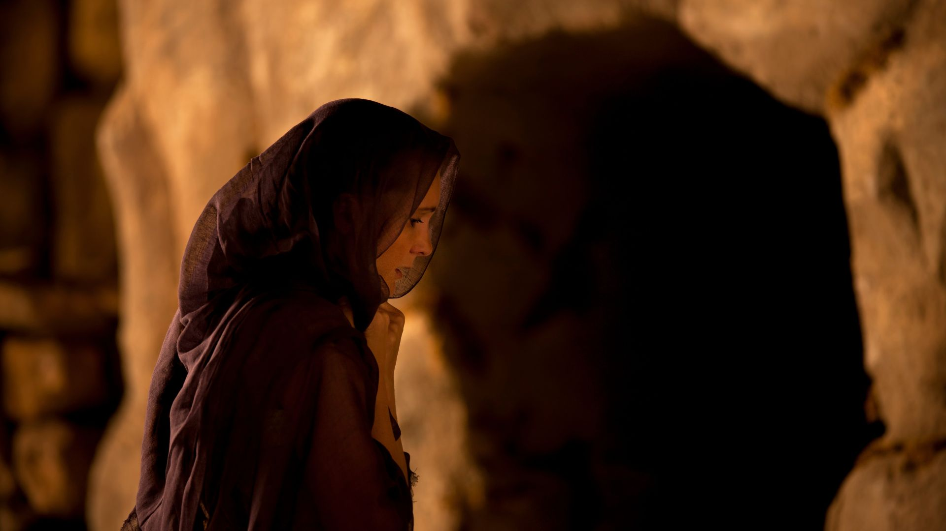
What we know about
Mary the Magdalene?

Slide 5
What we know about
Mary the Magdalene?
Wealthy & Influential

Slide 6
What we know about
Mary the Magdalene?
Wealthy & Influential
Demonized (7 demons)

Slide 7
What we know about
Mary the Magdalene?
Wealthy & Influential
Demonized (7 demons)
Jesus healed her!

Slide 8
What we know about
Mary the Magdalene?
Wealthy & Influential
Demonized (7 demons)
Jesus healed her!
She followed Jesus and supported his ministry

Slide 9
What we know about
Mary the Magdalene?
Wealthy & Influential
Demonized (7 demons)
Jesus healed her!
She followed Jesus and supported his ministry
She was at the cross and the first to encounter the risen Jesus on Easter
Notes:
Wealthy & Influential – even though women were limited in their opportunities in the first century, Mary had money, status, and the power to influence others.
Demonized – Mary had means, but she also had her demons. In fact, she had seven demons! In the Bible, seven is a sign of totality and completion. In other words, she was thoroughly inhabited by evil. Also, some believe that these seven demons represent the seven deadly sins, i.e., pride, greed, lust, envy, gluttony, anger, and sloth.
Jesus healed her! – before Jesus, Mary’s life was a hot mess! Somehow, someway, her choices, her lifestyle, and her sins opened her up to the demonic, manifesting some form of demonization; in the NT, demonization takes several forms, even mental illness.
She followed Jesus and supported his ministry – as Luke told us, she joined a group of women who had means to support and resource the itinerant ministry of Jesus (e.g. food, lodging, possibly renting the upper room, etc.).
She was at the cross and was the first to encounter the risen Jesus on Easter – when most followers fled the scene at the trial and crucifixion, she was one of several women who remained with John, the only male disciple who watched Jesus die.
And so we should be curious enough to ask the question, why Mary? Why did she have this Easter experience? And why was she the first to meet the risen Jesus? But before we answer that question, let’s return to John 20 and go verse-by-verse through Mary’s encounter. [NEXT SLIDE]

Slide 10
John 20:1-10 NIV
¹ Early on the first day of the week, while it was still dark, Mary Magdalene went to the tomb and saw that the stone had been removed from the entrance. ² So she came running to Simon Peter and the other disciple, the one Jesus loved, and said, “They have taken the Lord out of the tomb, and we don’t know where they have put him!”
Notes:
[BRIEF COMMENTS – VERSE-BY-VERSE]
Verse 3… [NEXT SLIDE]

Slide 11
³ So Peter and the other disciple started for the tomb. ⁴ Both were running, but the other disciple outran Peter and reached the tomb first. ⁵ He bent over and looked in at the strips of linen lying there but did not go in. ⁶ Then Simon Peter came along behind him and went straight into the tomb. He saw the strips of linen lying there, ⁷ as well as the cloth that had been wrapped around Jesus’ head. The cloth was still lying in its place, separate from the linen.
Notes:
[BRIEF COMMENTS – VERSE-BY-VERSE]
Verse 8… [NEXT SLIDE]

Slide 12
⁸ Finally the other disciple, who had reached the tomb first, also went inside. He saw and believed. ⁹ (They still did not understand from Scripture that Jesus had to rise from the dead.) ¹⁰ Then the disciples went back to where they were staying.
Notes:
[BRIEF COMMENTS – VERSE-BY-VERSE]
Now back to Mary. Verse 11… [NEXT SLIDE]

Slide 13
John 20:11-18 NIV – Mary’s Easter Encounter
¹¹ Now Mary stood outside the tomb crying. As she wept, she bent over to look into the tomb ¹² and saw two angels in white, seated where Jesus’ body had been, one at the head and the other at the foot.
Notes:
[BRIEF COMMENTS – VERSE-BY-VERSE]
Verse 13… [NEXT SLIDE]

Slide 14
¹³ They asked her, “Woman, why are you crying?”
“They have taken my Lord away,” she said, “and I don’t know where they have put him.” ¹⁴ At this, she turned around and saw Jesus standing there, but she did not realize that it was Jesus.
Notes:
[BRIEF COMMENTS – VERSE-BY-VERSE]
Verse 15… [NEXT SLIDE]

Slide 15
¹⁵ He asked her, “Woman, why are you crying? Who is it you are looking for?”
Thinking he was the gardener, she said, “Sir, if you have carried him away, tell me where you have put him, and I will get him.”
Notes:
[BRIEF COMMENT ON VERSE]
And look what happens next. Verse 16… [NEXT SLIDE]

Slide 16
¹⁶ Jesus said to her, “Mary.”
She turned toward him and cried out in Aramaic, “Rabboni!” (which means “Teacher”).
Notes:
[BRIEF COMMENTS]
What was it about Jesus calling her name that she recognized him?
John 10:27 – “My sheep listen to my voice; I know them, and they follow me.”
John wants us to recognize when Jesus is speaking to us—he can open our eyes too!
In this passage, she calls him “my Lord” and “the Lord” and also “Teacher.”
Mary obviously reaches for her Lord and Teacher and attempts to embrace him. And then look at Jesus’ response… [NEXT SLIDE]

Slide 17
¹⁷ Jesus said, “Do not hold on to me, for I have not yet ascended to the Father. Go instead to my brothers and tell them, ‘I am ascending to my Father and your Father, to my God and your God.’”
Notes:
Why does Jesus say this? Well, Jesus isn’t being insensitive. He loves Mary. He has just turned her grief to gladness. And she is the first he chose to reveal himself. He loves Mary. So why did he tell her not to cling to him? It’s because they both have urgent assignments to fulfill.
He is saying to this brave female disciple, “Mary, this experience is momentary. It’s good, but momentary. There is still ministry to be done. More good things (even challenging things) to do. And you must go tell the rest of my disciples that I’m about to start reigning and ruling from heaven by the authority of God the Father.”
Imagine the surprise, the elation, the blood pressure rising, the hope that was swelling inside her. Jesus was dead and now he is alive! This changes everything!
And then she leaves the empty tomb to be the first to testify and proclaim the good news of the resurrection. Verse 18… [NEXT SLIDE]

Slide 18
¹⁸ Mary Magdalene went to the disciples with the news: “I have seen the Lord!” And she told them that he had said these things to her.
Notes:
What a story! And one that you wouldn’t tell this way in the ancient world unless it were true, because it’s so embarrassing. Afterall, if you want to convince people that Jesus was raised to life and that others should believe it and follow him, you don’t have the first witness being a woman—a woman once filled with demons (a woman whose testimony wouldn’t even be considered in a court of law). Yet she is the first to encounter the risen Jesus and testify to his resurrection. Folks, you only tell it that way if it happened that way.
So again, why Mary? Why did she have this Easter experience? And why was she the first to meet the risen Jesus? Well, for a few reasons… [NEXT SLIDE]

Slide 19
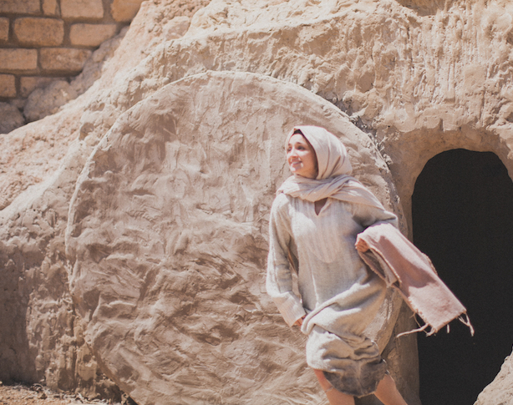
Why does Mary have this Easter encounter?
It’s because she was…

Slide 20
Why does Mary have this Easter encounter?
It’s because she was…
Grateful
Notes:
It’s because she was…
Grateful. She showed gratitude. And you would too if you were aware of what Christ has done for you. You see, Jesus had healed her and nothing else remained the same for her. Whatever lucrative business she had and whatever she spent her money on (mostly on herself) had changed when she encountered Jesus. She showed gratitude by investing in Jesus’ ministry and the work of the Kingdom. Because that’s how it works. When you’re grateful, you don’t just say, “I’m grateful.” You show that you’re grateful. You seek to be a blessing. You’ve heard the saying, “Put your money where your mouth is.” Well, that was Mary. As we heard from Luke. Mary lived that way.
Number 2… [NEXT SLIDE]

Slide 21
Why does Mary have this Easter encounter?
It’s because she was…
Grateful
Faithful
Notes:
Faithful. She showed her faithfulness in a number of ways. Wherever Jesus went. She was there. When Jesus taught. She was there. When Jesus healed someone. She was there. You see, Mary showed up, and she was content doing her work behind the scenes. It didn’t matter to her. She wasn’t in it for the glory and the fame. She was there to serve the Lord—the one who saved her and changed her, freed her from her demons and gave her a joy that her swank life in Magdala never could. Even after Jesus had died, she still desired to serve him. Why was she at the tomb? To finish preparing Jesus’ body for burial! That’s who she was. Mary always said, “How can I help? How can I bless the Lord?” and it paid off. She wasn’t just in the right place at the right time. She was faithful. And that’s why Jesus met her first.
Number 3… [NEXT SLIDE]

Slide 22
Why does Mary have this Easter encounter?
It’s because she was…
Grateful
Faithful
Resilient
Notes:
Resilient. She showed resilience. Think about this. Clearly, Mary didn’t let her past (being rich and demonized) determine her future or define her. She refused to be known by her money or her monsters. She was not the same person, and she believed it. She wasn’t stuck in the past. And she refused to be a victim. Because she knew that you can’t be a victim and a victor at the same time. And she also didn’t let being a woman (who were viewed as second-class citizens in the first century) stop her from living into her God-given potential. Not in an arrogant, mean-spirited way, but in a new identity, Christ-empowered, the Lord has set me free and made me equal with the boys sort of way!
[Jesus of Nazareth movie – “Why should he not appear to me?!”] She was resilient.
And lastly, number 4… [NEXT SLIDE]

Slide 23
Why does Mary have this Easter encounter?
It’s because she was…
Grateful
Faithful
Resilient
Courageous
Notes:
Courageous. As I said, Mary didn’t let her past or her gender hinder her from bodly following Jesus. But also consider this, she didn’t let the opinions of her rich friends back in Magdala stop her from following the one who had changed her. Think about the courage it took to leave that life behind; her comfort, her privilege, her uppity friends. Yet, she did it to follow the One who said, I’m the Way, the Truth, and the Life. And of course, the most courageous things we see from Mary come at the end of the narrative.
We see it in her willingness to be present at the foot of the cross and watch her Lord and savior be brutally executed. She showed up in her Lord’s darkest moment. Except for John and a few other women, everyone else fled. They ran and hid for fear that they too would be rounded up at crucified as accomplices of Jesus.
Oh, but not Mary. No, not Mary. She wouldn’t leave her Lord because he had never left her. And then we see her courage early that morning as she went to the tomb and found it empty. She is essentially at the scene of a crime, but she doesn’t run away. She remains. She thought the worst was over, but here she is now weeping in the dark because her one true love—her Lord—is gone.
But then it was there in the darkness of the early morning that Mary meets the risen Jesus. And I can’t help but think of Psalm 30—a psalm that can speak to Mary’s Easter encounter. [NEXT SLIDE]

Slide 24
Psalm 30:1-5 NKJV
¹ I will extol You, O Lord, for You have lifted me up,
And have not let my foes rejoice over me.
² O Lord my God, I cried out to You,
And You healed me.
³ O Lord, You brought my soul up from the grave;
You have kept me alive, that I should not go down to the pit.
Notes:
[READ & NEXT SLIDE]

Slide 25
⁴ Sing praise to the Lord, you saints of His,
And give thanks at the remembrance of His holy name.
⁵ For His anger is but for a moment,
His favor is for life;
Weeping may endure for a night,
But joy comes in the morning.
Notes:
[BRIEF COMMENTS - APPLICATION]
Finally, here are a few questions for reflection and response. [NEXT SLIDE]

Slide 26
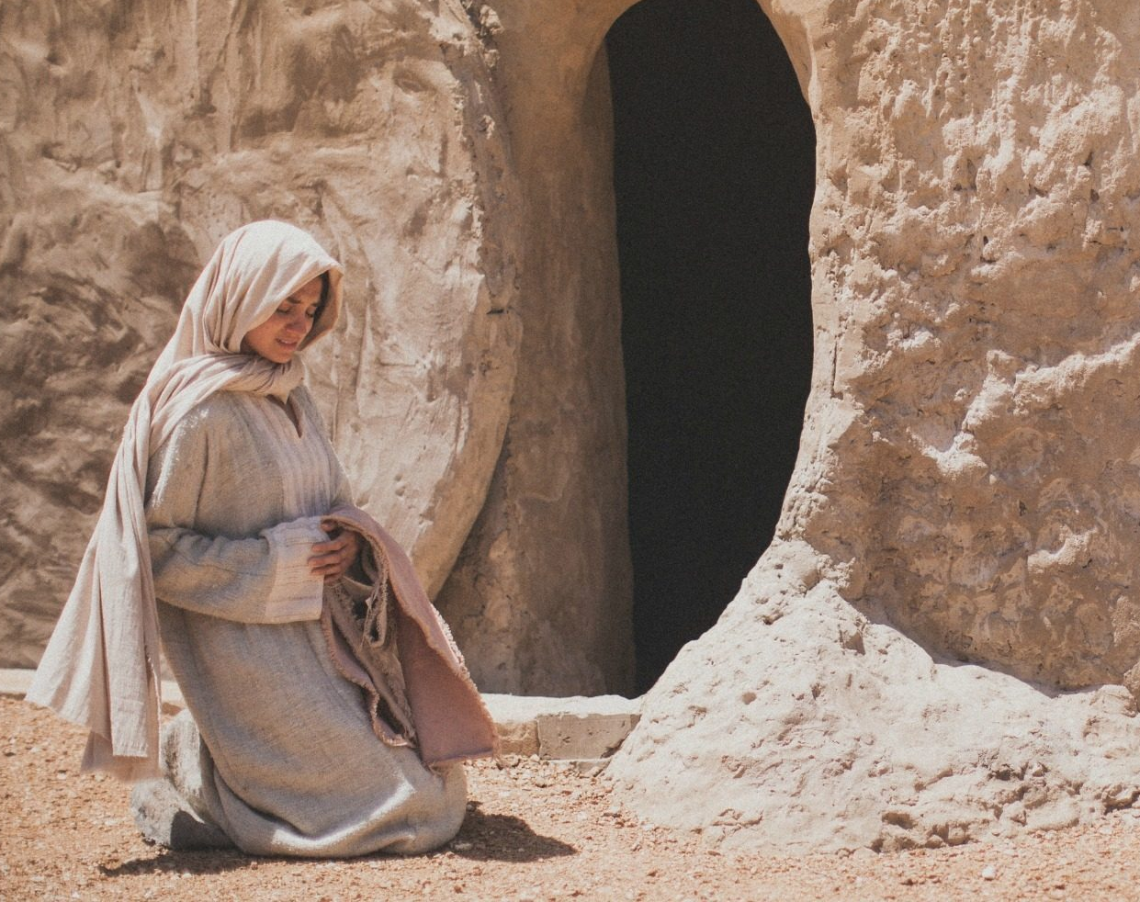
Questions for reflection & response:

Slide 27
Questions for reflection & response:
Is your faith in need of a fresh Easter encounter with Jesus?

Slide 28
Questions for reflection & response:
Is your faith in need of a fresh Easter encounter with Jesus?
How is the Spirit speaking to you through Mary’s life and witness?

Slide 29
Questions for reflection & response:
Is your faith in need of a fresh Easter encounter with Jesus?
How is the Spirit speaking to you through Mary’s life and witness?
Will you respond to God’s grace in your life just as Mary did?
Notes:
[BRIEF COMMENT ON EACH]
[CLOSING WORDS]
[GO TO NEXT SLIDE DURING CLOSING PRAYER]

Slide 30

Notes:
[CLOSING PRAYER]

