Slide 1

Notes:
[BRIEF INTRO]
A couple of months ago I had lunch with a congregant – I was asked, “What is success to you? What does success look like?”
American culture’s idea of success: money, power, being at the top, influence, social status, fame, recognition, accomplishments, accolades, etc.
And if we don’t have enough of what we think success is, we can reach a certain point in life and think, ”I must not be successful.” And wonder, “Have I failed? What’s wrong with me?”
American culture disciples us to seek success and be successful. But in the eyes of the world, many biblical characters, heroes of our faith, would not be seen as successful people:
Noah – built a gigantic boat and preached for 100 years with no converts
Jeremiah – 40-year prophetic ministry that ended in destruction and exile
Jesus – poor, lived a life of obscurity for 30 years, 3 years of ministry (only 1 where he was popular and liked), claimed to be the Messiah, but rejected by his own people and crucified
So, clearly, “success” in the eyes of the Lord is something much different than how the world defines it. And that’s what I want to address today. What does success in the eyes of the Lord look like? And how should we live in light of this knowledge? [NEXT SLIDE]

Slide 2

Notes:
[INVITE FOLKS TO STAND & READ – “This is the word of the Lord”…]
What is going on in this parable of Jesus? And what does it have to do with success in the eyes of the Lord?
First, let’s reflect on this passage of Scripture within its literary and historical context… [NEXT SLIDE]

Slide 3
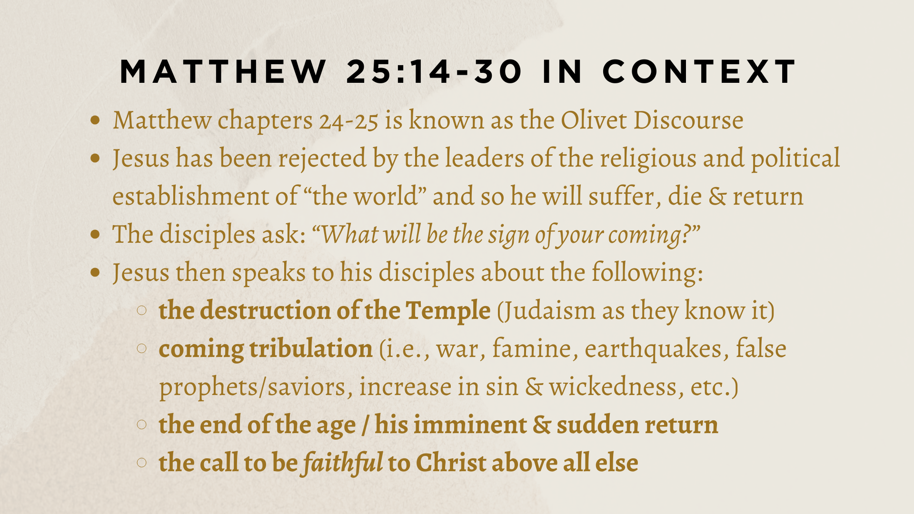
Notes:
[READ & COMMENT ON EACH POINT]
Matthew chapters 24-25 is known as the Olivet Discourse
Jesus has been rejected by the leaders of the religious and political establishment of “the world” and so he will suffer, die & return
Jesus grieves over Jerusalem’s rejection of real peace; He is walking past the Temple with his disciples, and they admire the architecture and grand stones used in its construction; Jesus then predicts its destruction!
The disciples ask: “When will all this happen?” and “What will be the sign of your coming?”
Jesus then speaks to his disciples about the following:
the destruction of the Temple (Judaism as they know it)
coming tribulation (i.e., war, famine, earthquakes, false prophets/saviors, increase in sin & wickedness, etc.)
the end of the age / his imminent & sudden return (no one knows the hour!)
the call to be faithful to Christ above all else
And at the end of Matthew 24, Jesus begins a parable to illustrate his teaching… [NEXT SLIDE]

Slide 4
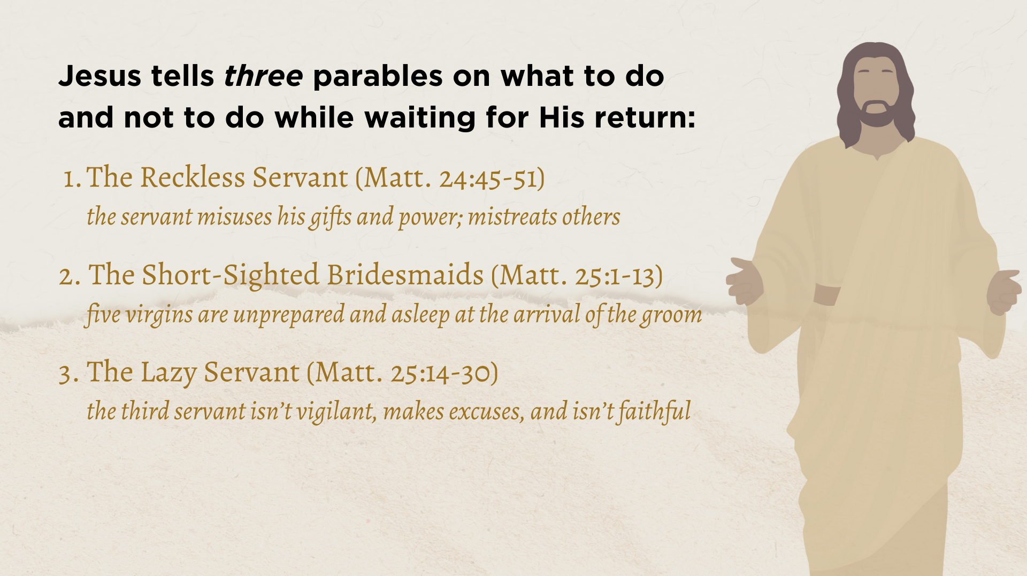
Notes:
[READ & BRIEFLY COMMENT ON EACH PARABLE]
In this parable, each servant was given different amounts based upon the ability of each. The first two servants were given more than the third. And they doubled their investment as they were wise with the Master’s resources while he was away. So, when the Master finally returned, he commended them. But the third servant took what little he had and did nothing with it. And when the Master asked him about it, this unfaithful servant insults the Master as he defends his decision not to serve and work while his Master was away.
You’ll recall from our reading, the lazy servant buries his time, talents, and treasure. Burying your valuables in a hole was a common practice and considered the safest possible course of action. But playing it safe is not the way of the Master or his Kingdom. So, in his commentary on Matthew, Robert Mounce writes: “The point of the parable is crystal clear. The servants of Christ, as they await his [Parousia] coming, have been entrusted with the responsibility of utilizing the gifts they have been given by the Master. To fail in this critical obligation is to be excluded from the kingdom when Christ returns” (pg. 235).
But again, it’s not to some worldly idea of “success” that Jesus calls us. Rather, it is to be faithful with the time, money, power, and gifts (the life) he has given us. To use everything we’ve been given to serve him. We heard these words to the first two servants who were wise and responsible with their portion and utilized their gifts for the Kingdom. The Master said… [NEXT SLIDE]

Slide 5
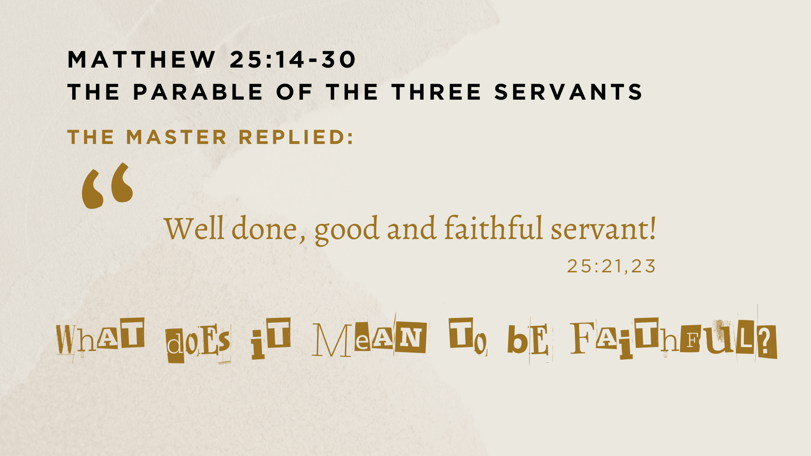
Notes:
So, what does it mean to be faithful? Well, first, in the context of Jesus’ teaching here, he tells us right after this parable in Matthew 25:31-46 that his “sheep” on his right (as opposed to the goats on his left) are faithful because they put their belief into action. Jesus says, “Then the King will say to those on his right, ‘Come, you who are blessed by my Father; take your inheritance, the kingdom prepared for you since the creation of the world. For I was hungry and you gave me something to eat, I was thirsty and you gave me something to drink, I was a stranger and you invited me in, I needed clothes and you clothed me, I was sick and you looked after me, I was in prison and you came to visit me.”
And when his disciples asked, when have we seen you in need like this? He tells them that they should see him in “the least of these” sort of folks—Jesus is in our needy neighbors, co-workers, clients, family members, friends, enemies, and so on. Therefore, the good and faithful servant lives to serve others and glorify the king, not for success in the eyes of the world. And again, this is an urgent matter because we don’t know when the Master will return. So, we must be ready, vigilant, on task, using our talents, and being faithful. And learning to be faithful begins by looking at Jesus himself. The author of Hebrews writes… [NEXT SLIDE]

Slide 6
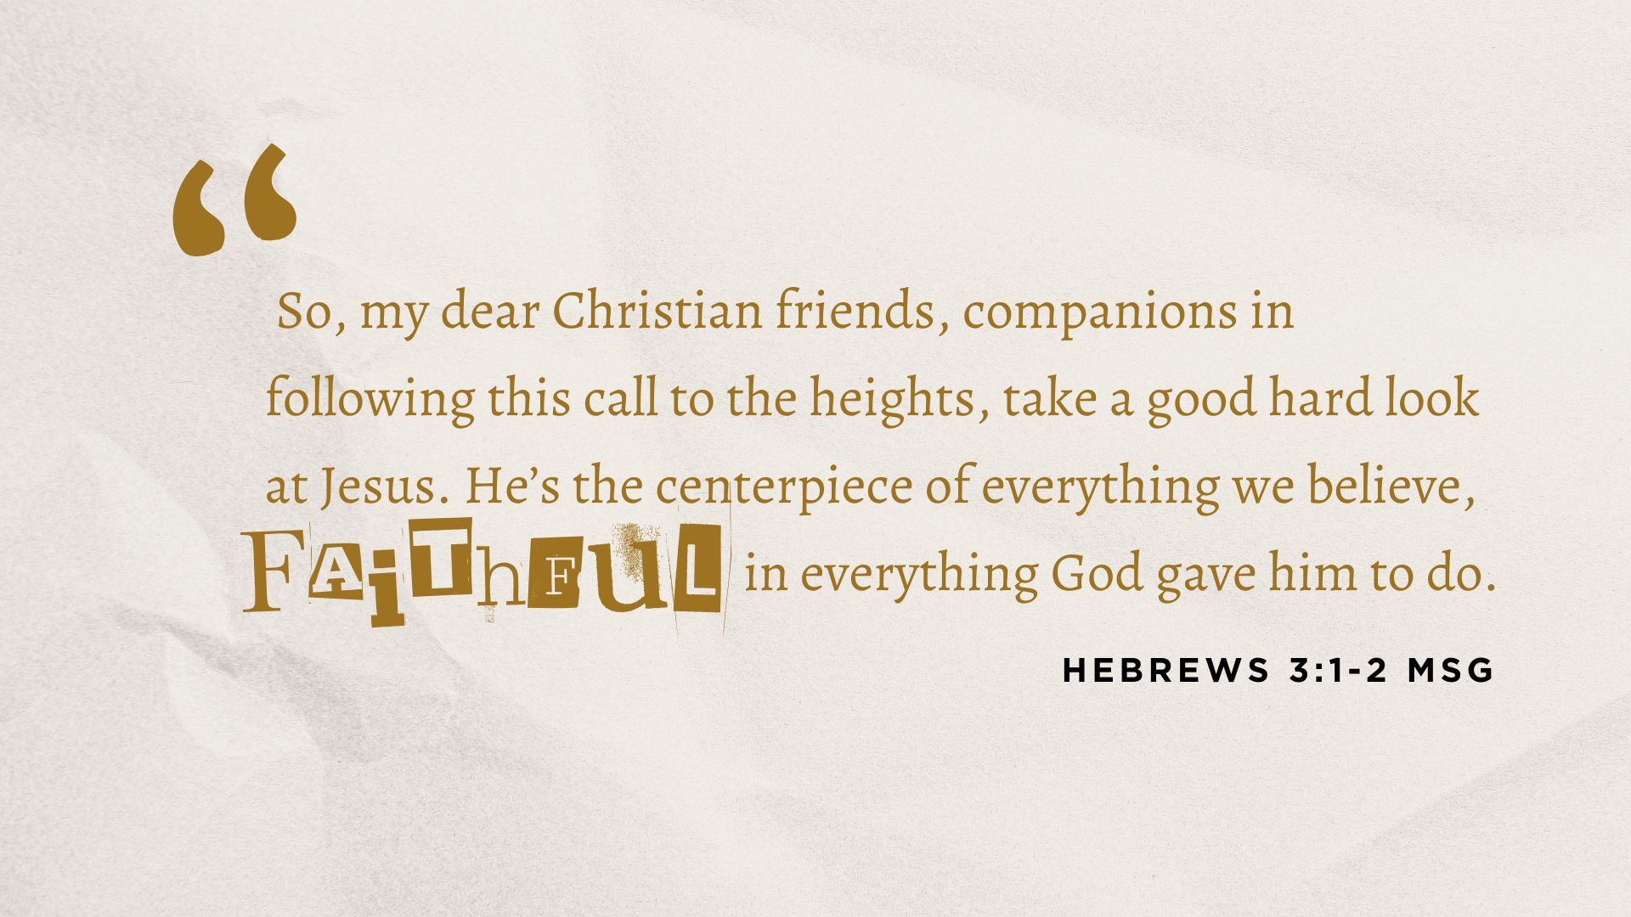
Notes:
At an early age, Jesus of Nazareth became aware of his true identity; he knew who he was and what the Father had called him to do; and nothing would deter him from following through with his calling
No doubt there were times he endured temptation, trials, hurt, and betrayal; and he even asked the Father to spare him the pain and agony of dying, as his path of being a faithful servant led him to the cross; But he said, ”Not my will, but yours be done.”
And in Philippians 2, the Apostle Paul wrote of Jesus: “he humbled himself by becoming obedient to death—even death on a cross! Therefore, God exalted him to the highest place and gave him the name that is above every name, that at the name of Jesus every knee should bow, in heaven and on earth and under the earth, and every tongue acknowledge that Jesus Christ is Lord, to the glory of God the Father.” There you have it: it’s because Jesus was a faithful servant that the Father raised, exalted, and blessed him.
Friends, Jesus used the life that the Father gave him, and he used it up for the advancement of the Kingdom, not for personal success or the benefit of his own ego or reputation. And this is what we’re called to as well. Listen to what Peter wrote… [NEXT SLIDE]

Slide 7
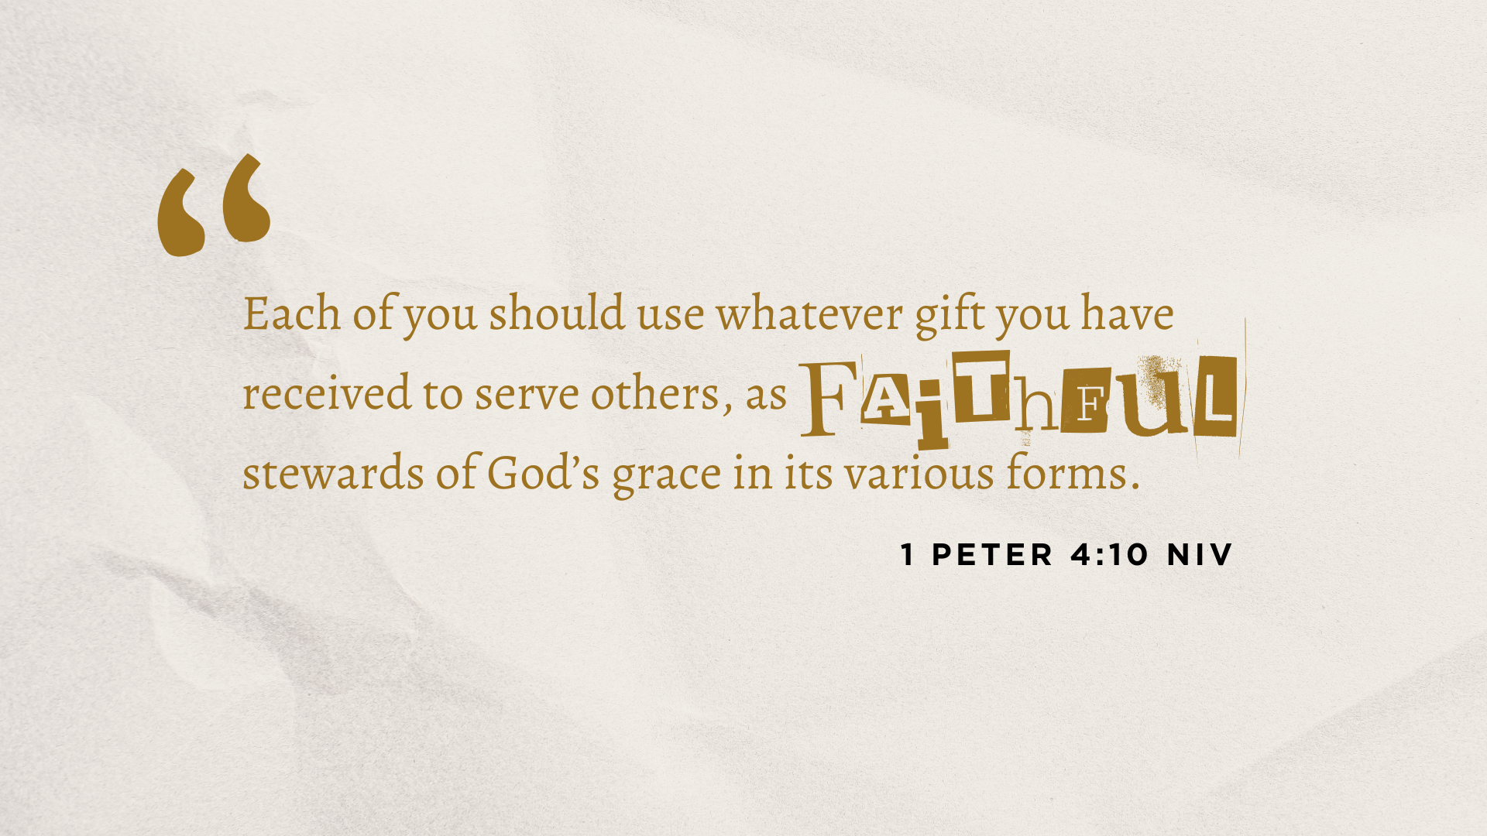
Notes:
[READ VERSE & BRIEFLY COMMENT]
We are all unique creations of God; we all have different gifts and different callings; some have a lot, some have little; But what is most important is what we do with what we’ve been given. How will we steward our gifts? It’s not about competing with others, so we shouldn’t compare ourselves to others. If there is any competition, it is only that we would be more faithful than we were yesterday. That is the race that Paul said he was running, which he wrote about at the end of his life. It’s what the author of Hebrews meant by, “let us run with perseverance the race marked out for us…” It’s about assessing what we have and using it to serve others—all for King and country.
And so, let’s sum up what we’ve heard and what the Scriptures say about being faithful… [NEXT SLIDE]

Slide 8


Slide 9


Slide 10


Slide 11
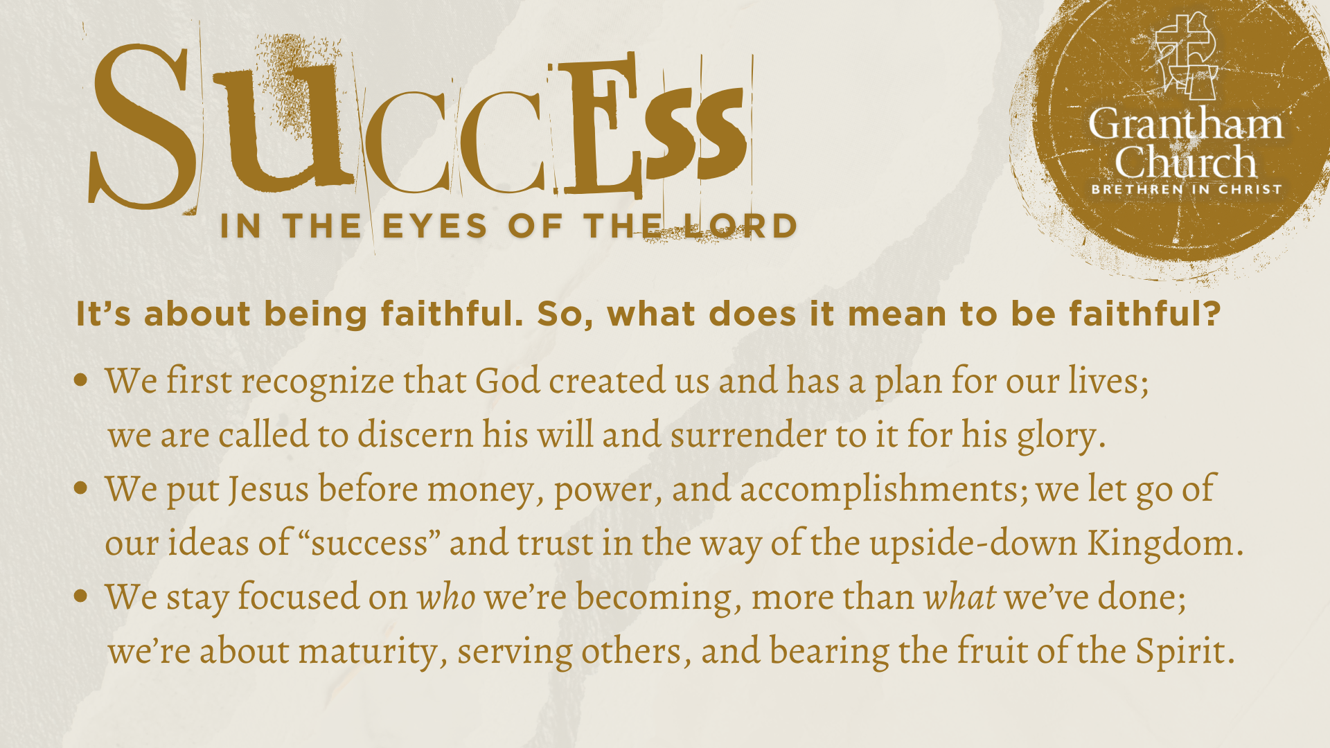
Notes:
[READ EACH POINT & COMMENT BRIEFLY]
We first recognize that God created us and has a plan for our lives; we are called to discern his will and surrender to it for his glory.
We put Jesus before money, power, and accomplishments; we let go of our ideas of “success” and trust in the way of the upside-down Kingdom (e.g., the first will be last, the last will be first; we live and win by serving and dying, not by living for self, but by denying it); no money, fame, accomplishments, or accolades in this life can compare to the treasures stored up in heaven!
We stay focused on who we’re becoming (Christ-like character), more than what we’ve done or we’re doing (and whether anyone has noticed, or we have a following); because we’re about maturity, serving others, and bearing the fruit of the Spirit.
We must be clear about that. Real faithfulness (as individuals and as a church) is evident by the fruit we bear in time and in season. Faithfulness is revealed in fruitfulness. Remember what Jesus said as he walked with his disciples in the olive grove… [NEXT SLIDE]

Slide 12
Jesus said…
“This is to my Father’s glory, that you bear much fruit, showing yourselves to be my disciples.”
John 15:8 NIV
Notes:
[READ & BRIEF COMMENTS]
And what does this fruit look like in our lives and church?
Here is the way Paul described it in Galatians chapter 5… [NEXT SLIDE]

Slide 13

Notes:
[READ VERSES & BRIEFLY COMMENT]
[CRUCIFYING THE FLESH – MY JOURNEY OF DYING TO SUCCESS]
Brothers and sisters, the Lord is far more concerned about your character and spiritual formation than he is about what you can do for him—starting a ministry, building a big business, gaining a reputation, growing a large church, and polishing your portfolio. While there is nothing inherently wrong with those things… those things ought to come (if God wills them) as we simply seek to follow Jesus as faithful servants of the coming King, leaving the results and the outcomes to the Lord. And when we do this, we give up our life to save it—we receive the very life of Jesus, and we access his peace, joy, and freedom—freedom from the pressures and anxiety that comes with trying to prove ourselves and our worth—freedom from trying to be successful and make our mark. Instead, we get to lay down the burden of ”success” so that we can freely receive God’s best for us, as we trust in his wisdom and way over our own.
Finally, here are some questions to help us reflect on what the Spirit is saying to us and help us respond… [NEXT SLIDE]

Slide 14


Slide 15


Slide 16
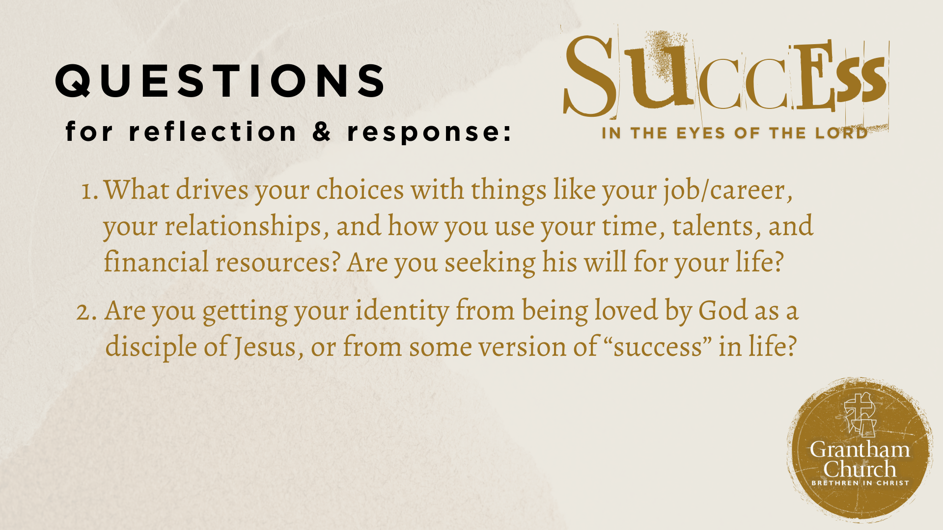

Slide 17
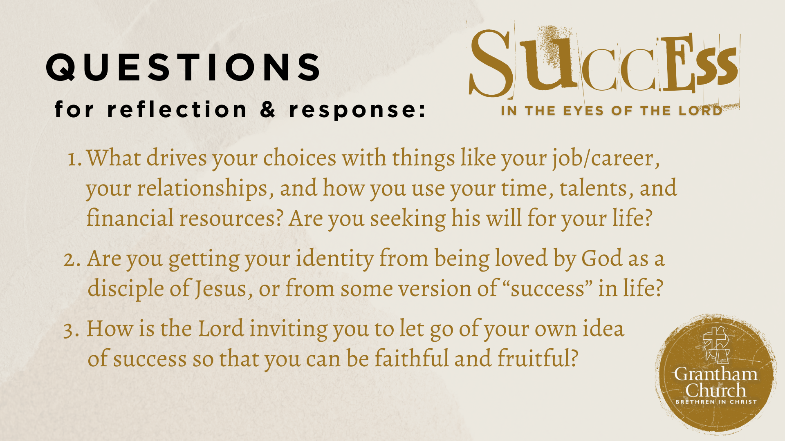
Notes:
[READ & COMMENT ON EACH QUESTION]
What drives your choices with things like your job/career, your relationships, and how you use your time, talents, and financial resources? Are you seeking his will for your life?
Are you getting your identity from being loved by God as a disciple of Jesus, or from some version of “success” in life?
How is the Lord inviting you to let go of your own idea of success so that you can be faithful and fruitful?
Let’s pray… [NEXT SLIDE FOR CLOSING PRAYER]

Slide 18
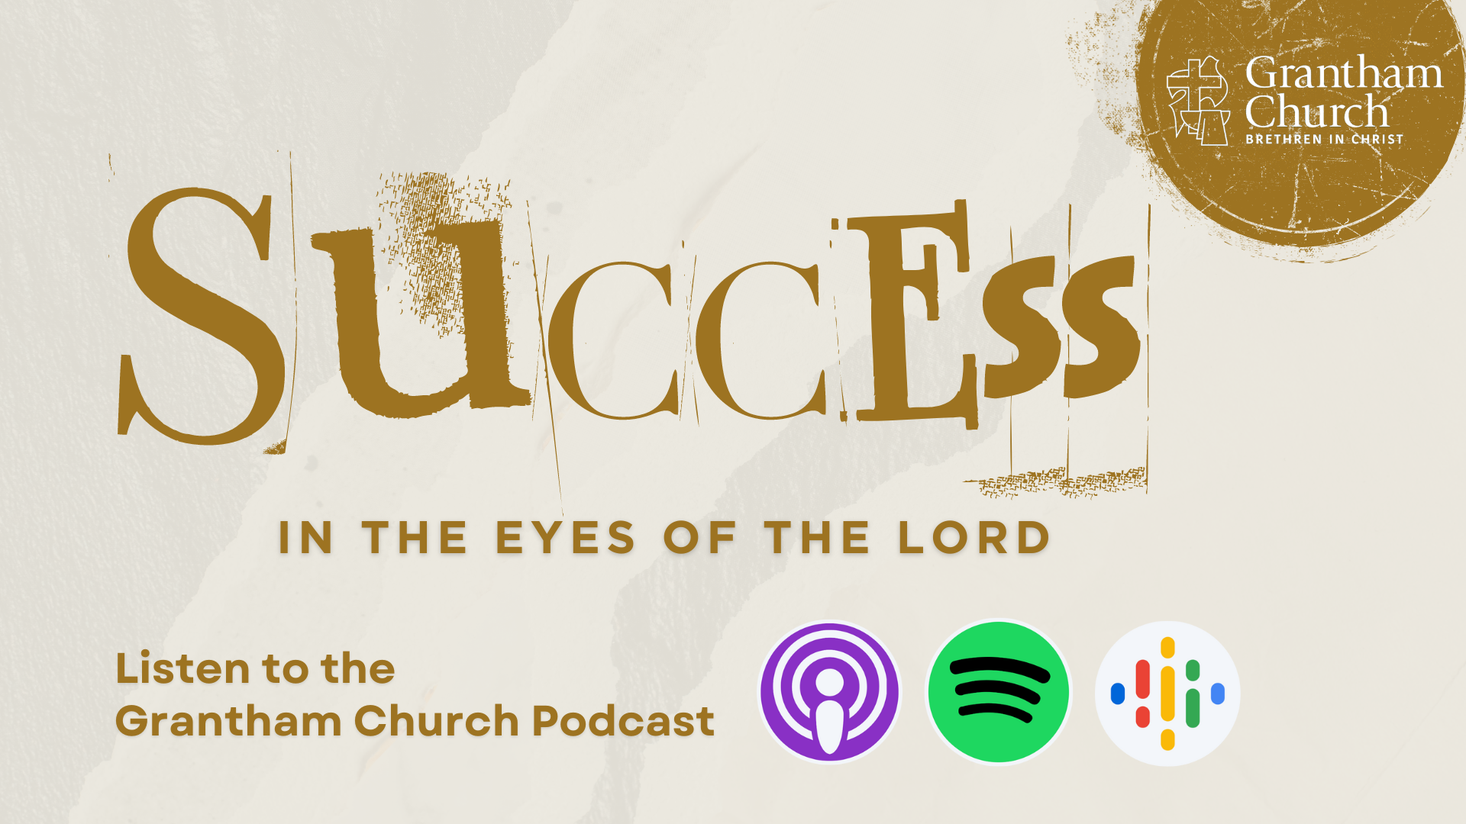
Notes:
[CLOSING PRAYER]
Benediction
May the God who has freed us from the drive to be successful in the eyes of the world, empower you to live out of your true identity and rest in the knowledge that you are enough, because He is enough. As we leave this place now and go out into the world, let us seek to be faithful servants awaiting the return of our Master, so that others will come to know the God who looks like Jesus.
Go in peace, church, to love and serve the Lord. Amen.

