Slide 1
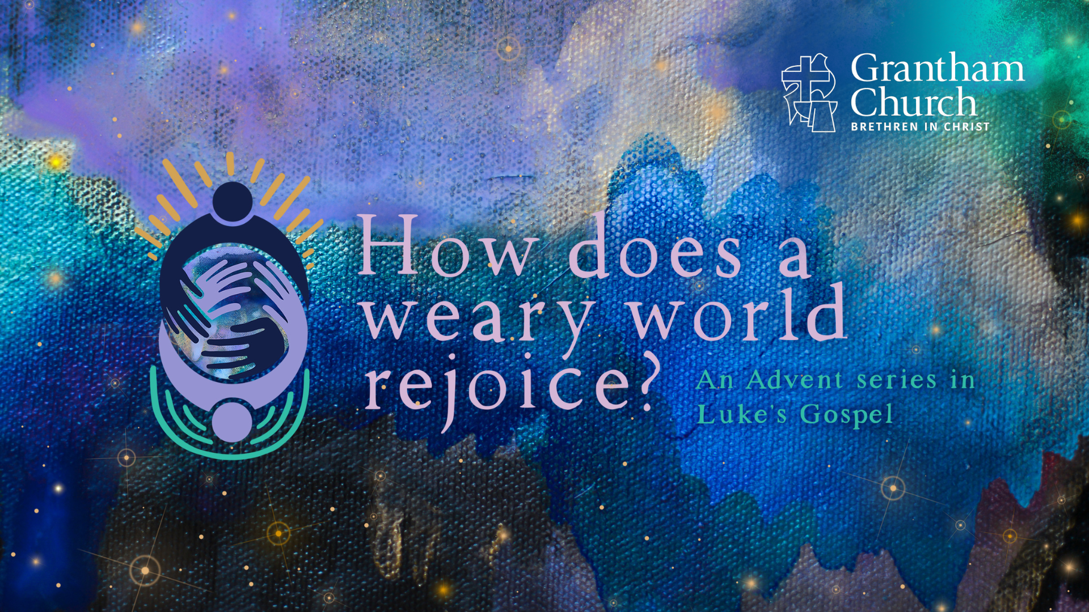
Notes:
[BRIEF INTRO]
Today we begin our Advent to Christmas series, How Does a Weary World Rejoice?
Do you recognize that phrase: ”weary world rejoice”?
It comes from the 19th century Christmas hymn… [NEXT SLIDE]

Slide 2
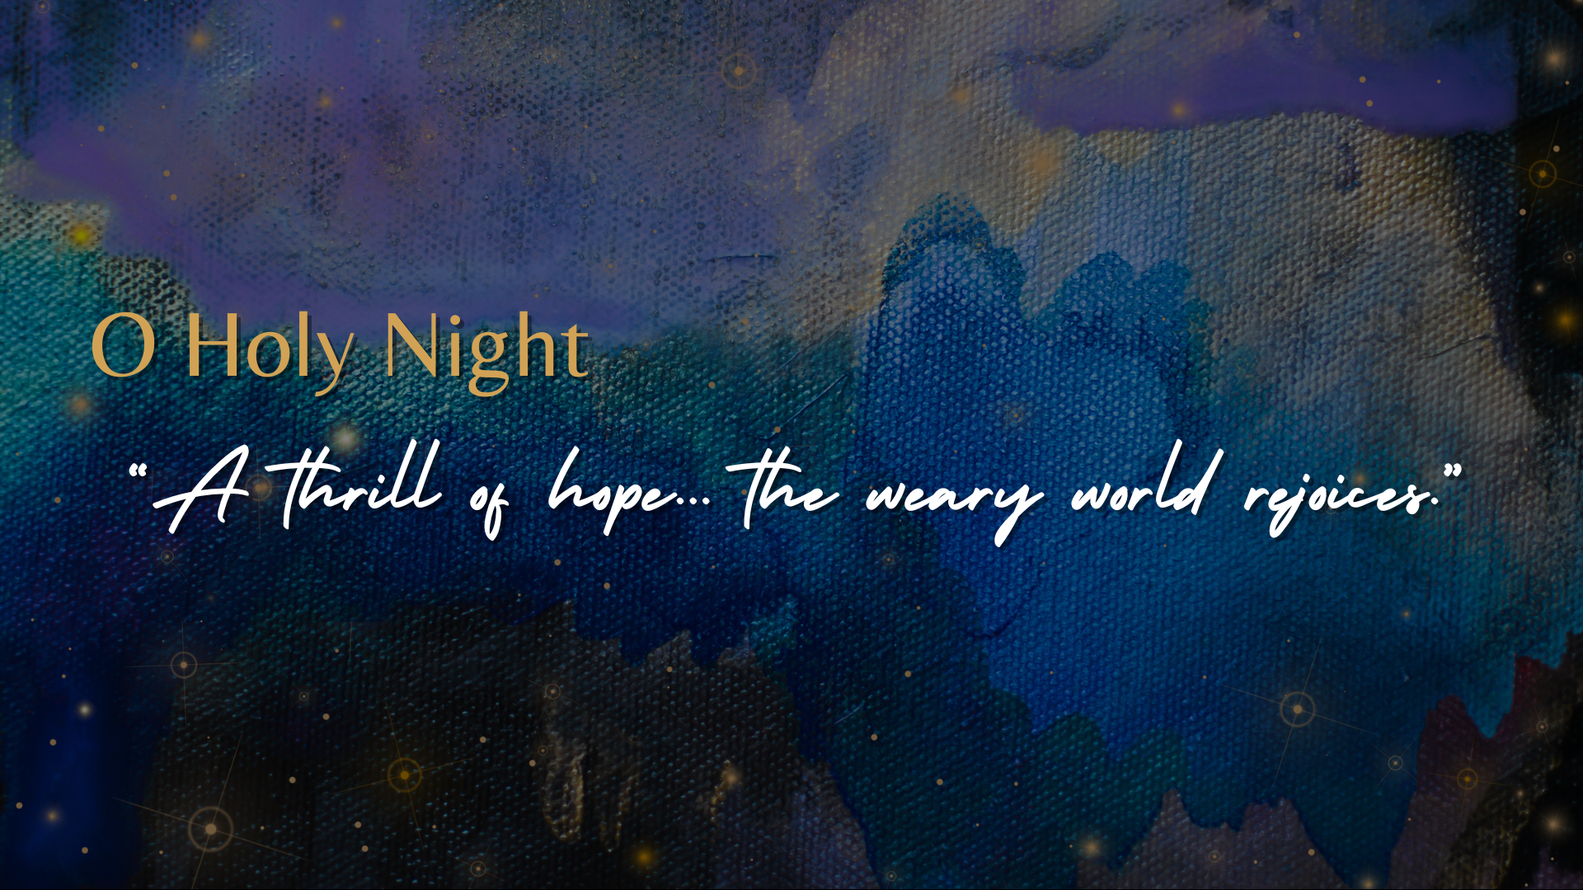
Notes:
O Holy Night, which inspired this sermon series -- “A thrill of hope… the weary world rejoices.” Weary as in tired, fatigued, or exhausted.
As you can read in bulletin this morning… Advent marks the beginning of the Christian calendar. It is in Advent that we get in touch with our need for a savior and anticipate the coming of Christ. We see the darkness. But we also see the light that is breaking through in the person of Jesus. We can get a real sense of this at Christmas because it is often an emotionally-charged time when we feel many different things deeply—sometimes all at once!
And as disciples, we want to acknowledge the weariness of our world while also knowing the “thrill of hope” and the joy of heaven. In his year’s Advent series—How Does a Weary World Rejoice?—we will create space for all of our emotions and find ways to rejoice.
But before we get into today’s message, you’re probably wondering what is happening with the art in the background? We have new artwork emerging! And to talk about that briefly, please welcome Geoff Isley… [NEXT SLIDE]

Slide 3

Notes:
[GEOFF ISLEY DESCRIBES ADVENT ART FOR 2-3 MINUTES]
Thank you, Geoff, Susan, and our entire visual arts team.
So, how does a weary world rejoice? [NEXT SLIDE]

Slide 4
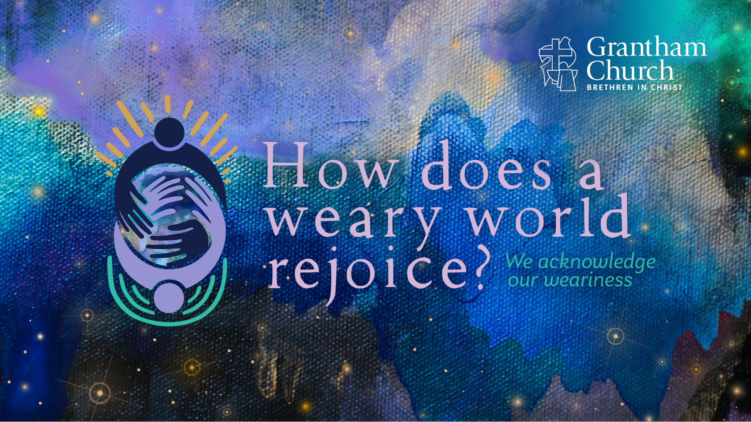
Notes:
We acknowledge our weariness. That is the first message in our series.
[BRIEF PRAYER]
If you would, please grab your Bible, open one up on your phone, or use a pew Bible and turn to our main Scripture reading this morning… [NEXT SLIDE]

Slide 5
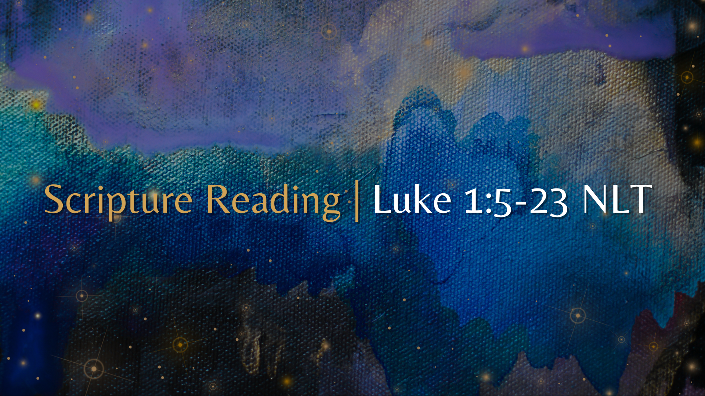
Notes:
[INVITE FOLKS TO STAND & READ – “This is the word of the Lord”…]
Have you ever been in a setting or situation that was joyous (or certainly had the potential for being joyous) but you were simultaneously mindful of something that wasn’t right in the world? What do we do with that? Or we might ask, “How does a weary soul rejoice?”
We begin our series today by recognizing the darkness in the world and to acknowledge the presence of darkness in our own lives. And that can appear as things like grief, regret, pain, fear, anger, hate, disappointment, cynicism, hopelessness, etc. But we must be careful. Because sometimes our weariness can harden us to belief in the gospel and to God’s goodness in our life, preventing us from living fully. And so, the story of Zechariah and Elizabeth, which precedes the birth story of Jesus the Messiah, can help us to acknowledge our own weariness before God and prompt us to open our eyes to the light and our hearts to joy.
As we read in our main Scripture text… [NEXT SLIDE]

Slide 6
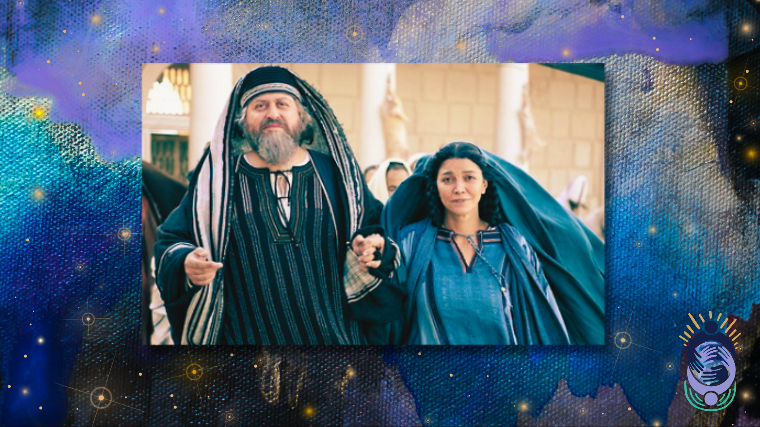
Notes:
Zechariah and Elizabeth, who would become the parents of John the Baptist, had battled infertility for many years but were still steadfast in their faith. However, you can keep to the path of righteousness and still become callous to good news and skeptical of God doing the seemingly impossible because of your life experiences. We can all relate to that in some way. As you might imagine, perhaps they feel the weight of hopes and dreams unattained.
Perhaps it’s after years of asking ”Why, Lord?” that Zechariah isn’t at his best and able to welcome joy when God sends a heavenly messenger in the Temple. [NEXT SLIDE]

Slide 7
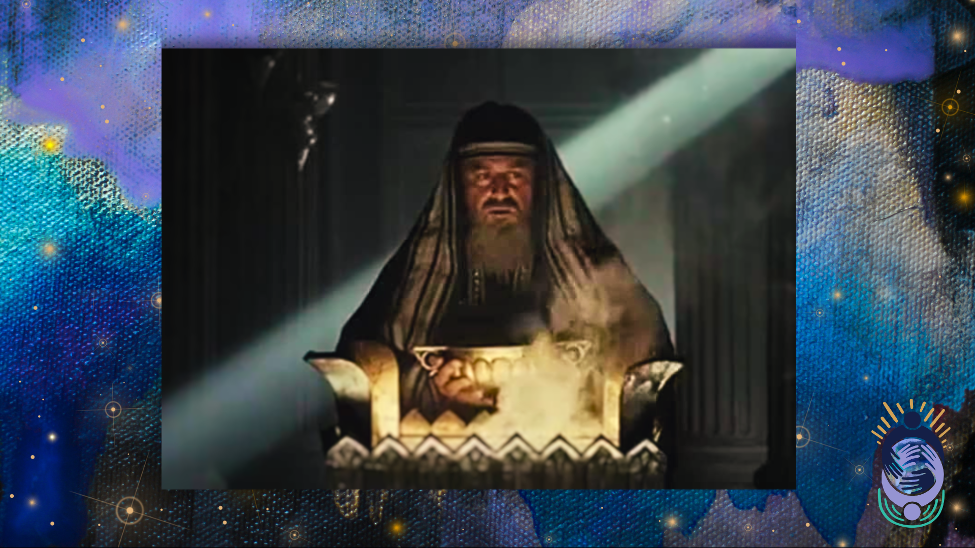
Notes:
You will recall that the angel Gabriel comes to Zechariah with a promise of good news, but Zechariah can’t fully receive it (it’s too much for him, even though he had prayed for this for years), and he is cast into silence for the duration of Elizabeth’s pregnancy. Even she will keep her gift hidden for several months. Friends, sometimes weariness can harden us and prevent us from living fully. It’s been a hard journey. Grief has left a scar on us. And we’re left waiting; trying not to be unbelieving, bitter, or cynical; just clinging to whatever faith we have left.
We can be weary in various ways. We can be weary because of our age; we’ve seen a lot in our days that have made us hard and cold inside. We can be weary because we were hurt. We can be weary because we’ve waited for years on something to change, but it hasn’t. We can be weary for lots of reasons, but do we have to remain weary? Can we exchange our weariness for hope? Is there a way to experience weariness but trust in God and experience his joy?
David the king and psalmist believed so. And he expressed a full range of emotions in many of his poems and songs. For example, take a look at Psalm 13… [NEXT SLIDE]

Slide 8
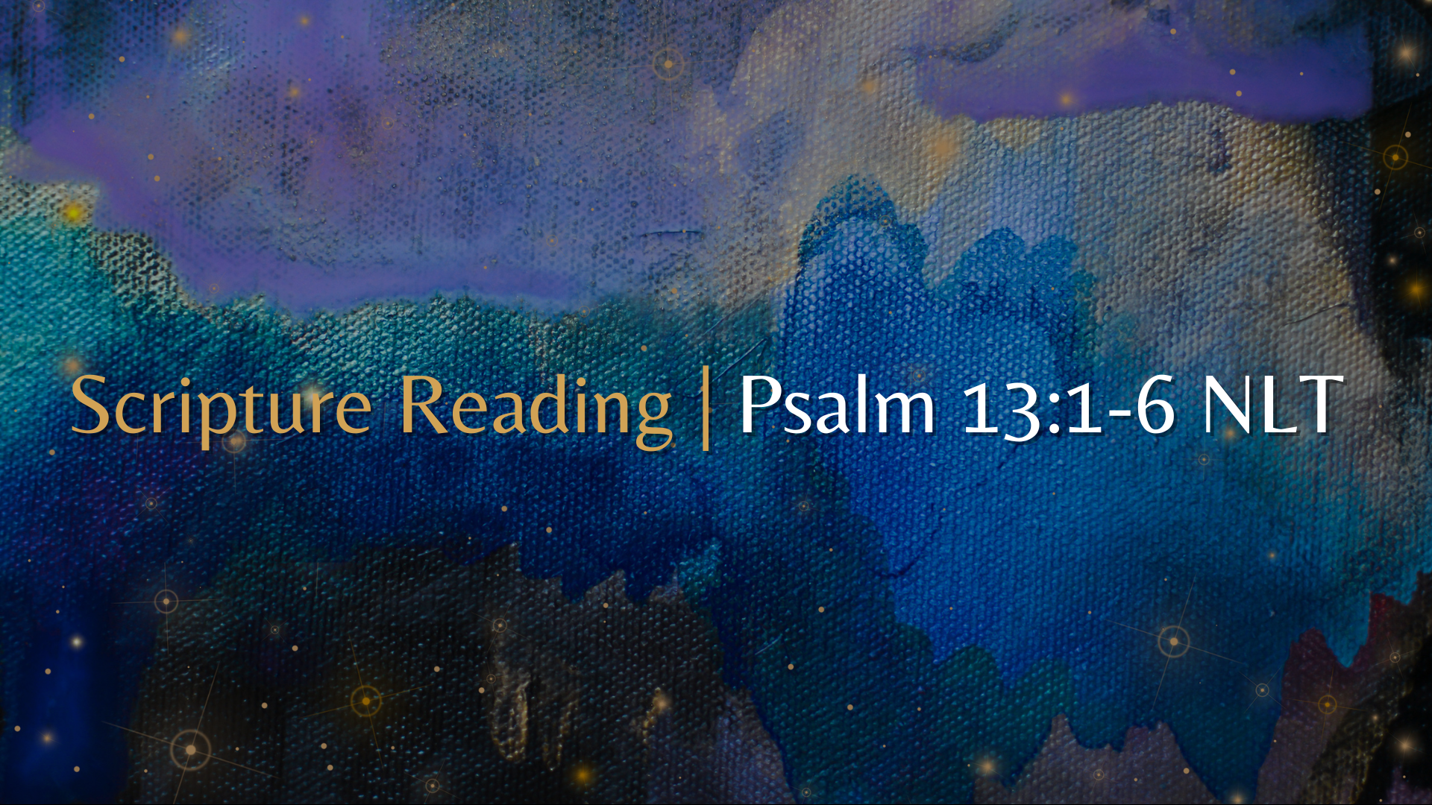
Notes:
[READ SCRIPTURE & COMMENT]
Trusting in God’s unfailing love and his ability to save us (and being able to recognize his goodness in your life and in the world) is important because, amid weariness, there must be a light at the end of the tunnel. There must be a way to combat the weariness of the present evil age. There must be a glimpse of hope—Jurgen Moltmann said that “hope is anticipated joy”—that helps to sustain us during the weary times and grants us the opportunity to rejoice and express our trust in the Lord while we wait.
Yes, we should acknowledge our weariness. But we also must recognize that we were made for joy, and thus welcome joy into our life. Remember, “joy” is listed as a “fruit of the Spirit” in Galatians 5. It’s evidence of the life of God in us. And we should also think of it this way, as Willie James Jennings said, joy is “an act of resistance against the forces of despair.”
Therefore, we mustn’t harden our hearts and let our weariness (and lack of joy) keep us from trusting in God’s unfailing love and blind us to the light of his truth, justice, and goodness in the world. For when our heavenly messenger or gift from God eventually comes, we want to be receptive and open to God’s answer to our prayers. As C.S. Lewis said, we want to be surprised by joy. That is why the Spirit inspired these words in Hebrews…. [NEXT SLIDE]

Slide 9
Hebrews 3:12-15 NLT
¹² Be careful then, dear brothers and sisters. Make sure that your own hearts are not evil and unbelieving, turning you away from the living God. ¹³ You must warn each other every day, while it is still “today,” so that none of you will be deceived by sin and hardened against God. ¹⁴ For if we are faithful to the end, trusting God just as firmly as when we first believed, we will share in all that belongs to Christ. ¹⁵ Remember what it says:
“Today when you hear his voice, don’t harden your hearts as Israel did when they rebelled.” [Ps.95:7-8]
Notes:
[READ & COMMENT ON PASSAGE]
v. 12 - Don’t become the evil that you hate
v. 13 - “deceived by sin and hardened” – by your own sin or the sin of others
v. 14 - trust and believe just as you did when you first became a Christian
And so… we may need to pray this line from David’s prayer in Psalm 51… [NEXT SLIDE]

Slide 10
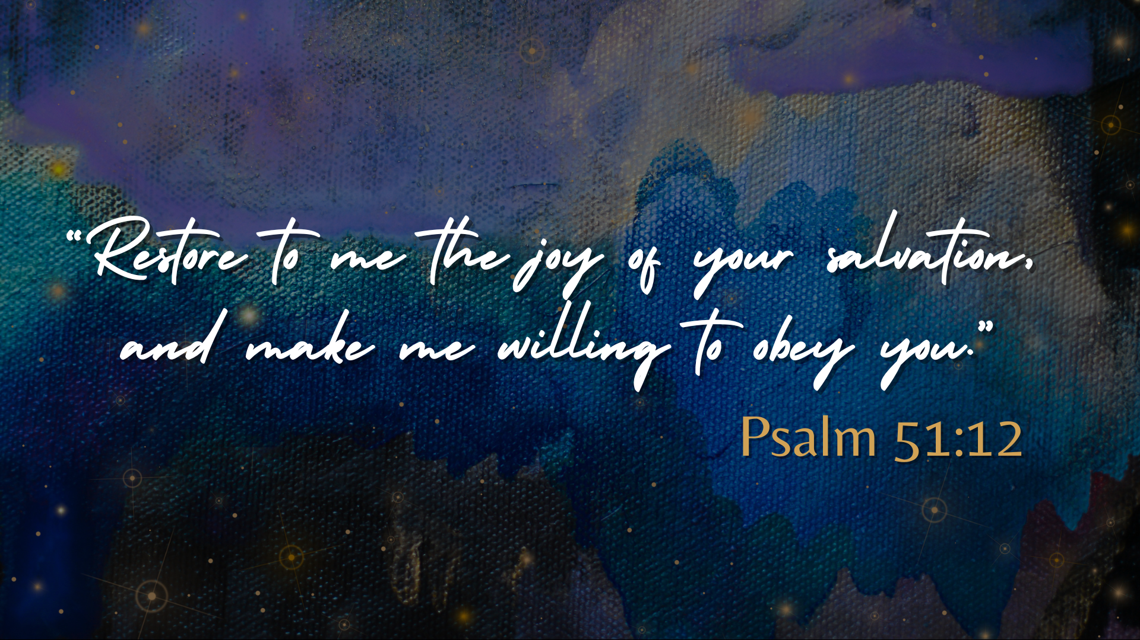
Notes:
[READ & COMMENT]
Willing to obey… willing to believe… willing to trust… willing to hope.
Finally, here are some questions to help us reflect and respond to God’s voice and the Spirit’s invitation through this first message of Advent… [NEXT SLIDE]

Slide 11
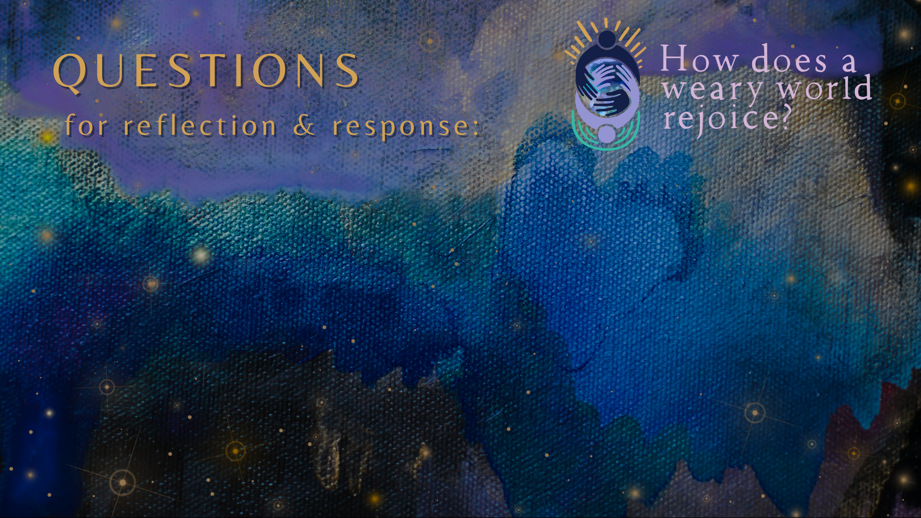

Slide 12
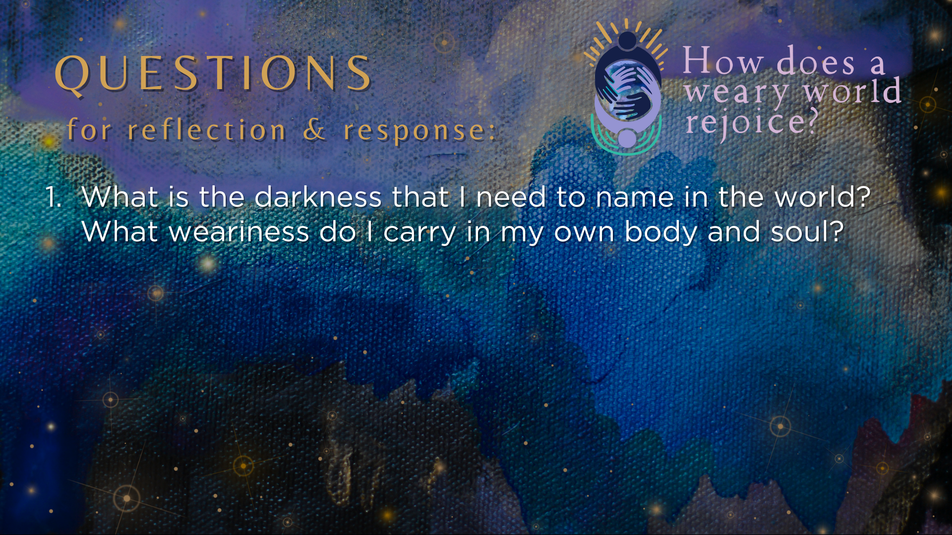

Slide 13
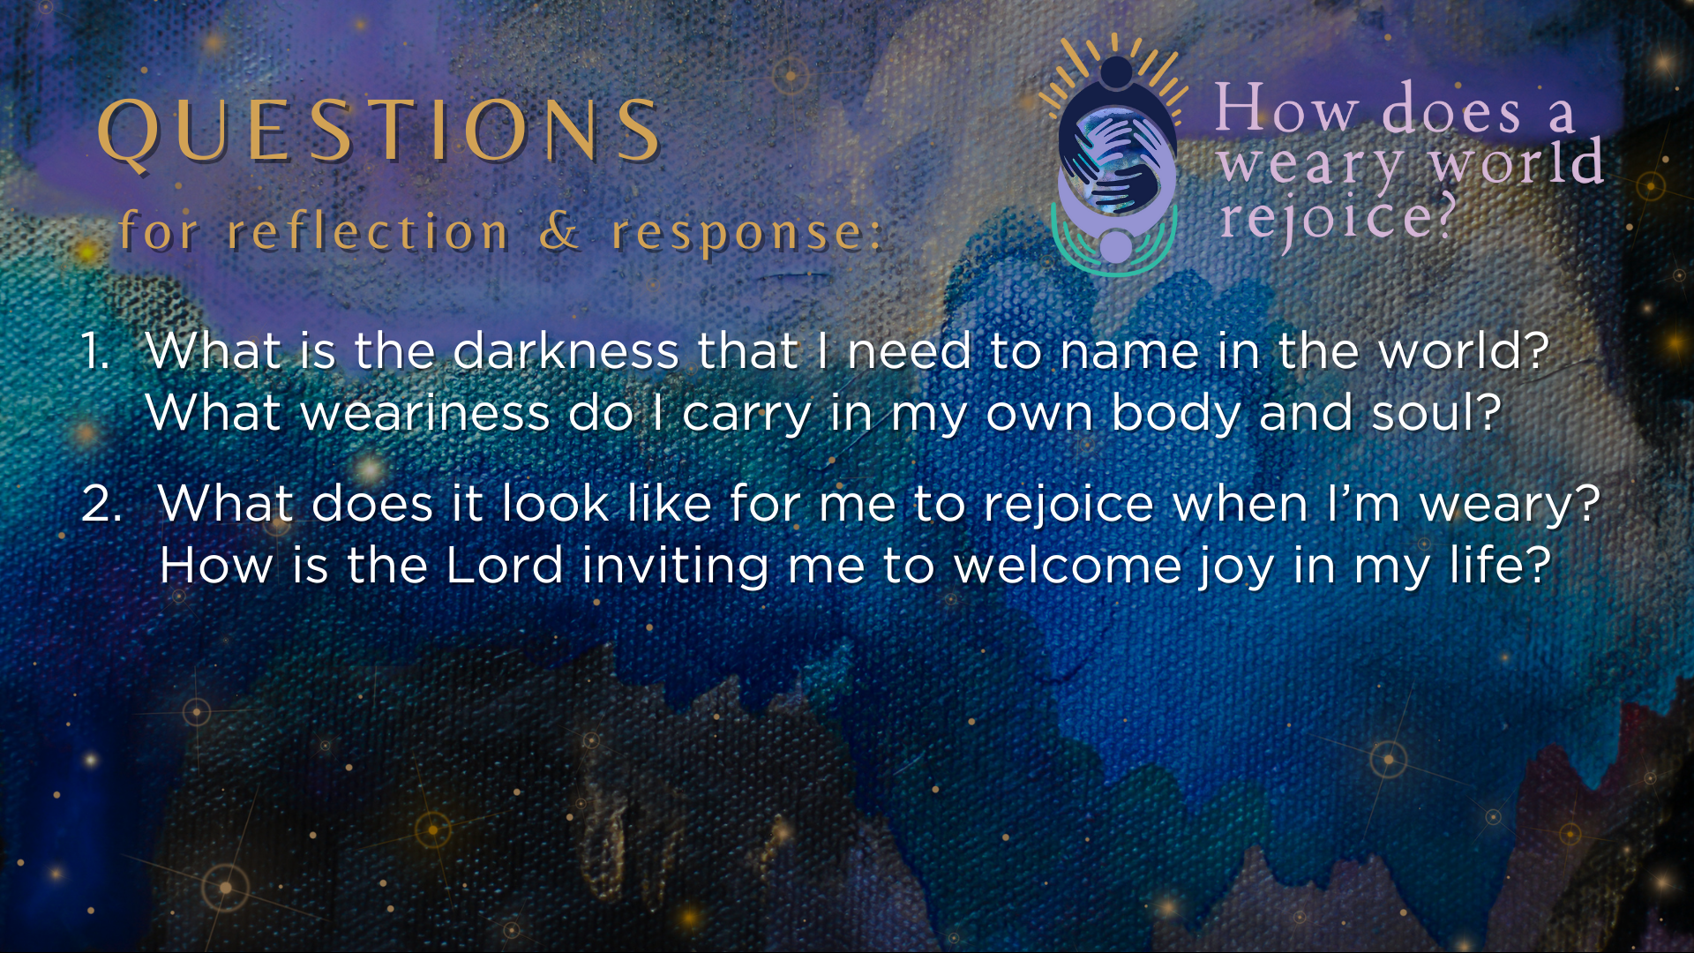

Slide 14
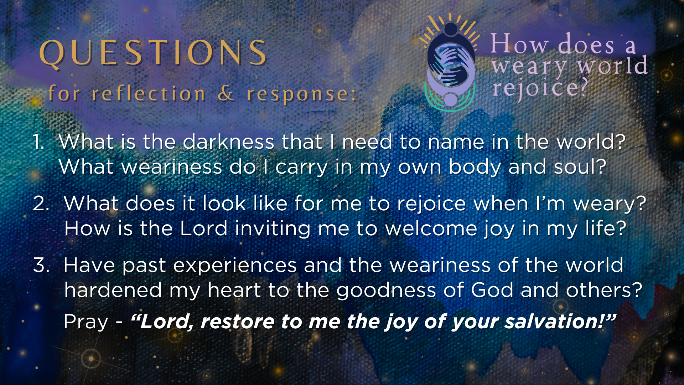
Notes:
[READ & COMMENT ON EACH QUESTION]
What is the darkness that I need to name in the world? What weariness do I carry in my own and soul?
What does it look like for me to rejoice when I’m weary? How is the Lord inviting me to welcome joy in my life?
Have past experiences and the weariness of the world hardened my heart to the goodness of God and others? Pray - “Lord, restore to me the joy of your salvation!”
[CLOSING WORDS]
Let’s pray… [NEXT SLIDE FOR CLOSING PRAYER]

Slide 15
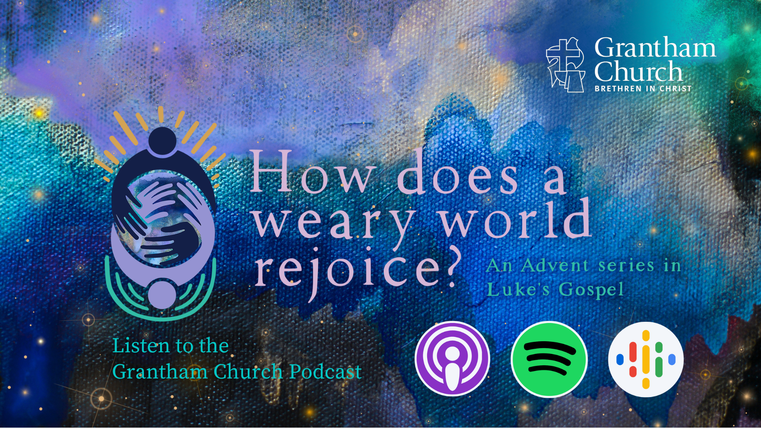
Notes:
CLOSING PRAYER
BENEDICTION
Family of faith,
as you leave this place,
you go into a weary world—
so speak tenderly.
Do the good that is yours to do.
Choose connection.
Hold onto hope.
And remember
that Christ took on flesh for you.
You are God’s beloved.
So go rejoicing.
The world needs it.
Amen.

