Slide 1

Notes:
[BRIEF INTRO]
Fourth Sunday of Lent
In our Lenten series, Seeking God’s Ways, we are exploring the “higher” ways of God. According to Isaiah 55:8-9, God says, “For my thoughts are not your thoughts, neither are your ways my ways,” declares the Lord. “As the heavens are higher than the earth, so are my ways higher than your ways and my thoughts than your thoughts.” So, we want to understand God’s ways so that we might repent of our own way, believe in the gospel, and follow the way of Christ as we welcome more of his Kingdom upon the earth.
If you’ve missed any of the messages in this series, you can access those online. So far, we have looked at how God calls us to move from security to generosity, from fear to compassion, and from earning to receiving. And now in message 4 of 6, we are being invited to move… [NEXT SLIDE]

Slide 2

Notes:
[BRIEF COMMENTS]
From Exceptionalism to Inclusion
As the summary in your bulletin says: As we seek God’s higher ways, we discover that the restoration of “sinners” and of sinful society comes through a radical embodiment of the gospel of grace and a kindness that leads to repentance, rather than withholding our love and acceptance or excluding people from the community. And so, in this message, we’re going to consider how God wants to move us away from the conditions that create exceptionalism, so that we might welcome and include everyone into the Kingdom.
Let’s pray real quick. “Father, help us now to open our hearts to you. We want to be moldable clay in your hands. We want to be holy vessels consecrated for your service. Jesus, we confess our need for you and your way. Our way gets us into trouble. Holy Spirit, as we listen, help us to hear your voice over all other voices. Convict, comfort, and give us courage to embrace the higher ways of God, so that we might live into the fullness of the life Jesus lived and promised to those who accept and then obey his word. Amen.”
Please grab your Bible and let’s go to our main Scripture reading… [NEXT SLIDE]

Slide 3

Scripture Reading
Luke 15:1-31 NLT
Notes:
[INVITATION TO STAND FOR SCRIPTURE READING]
[READ LUKE 15:1-31 NLT]
This is the word of the Lord. Thanks be to God. You may be seated.
Some of you will recall that we had Tony Campolo with us a few years ago… [NEXT SLIDE]

Slide 4
Luke 5:30-32 NIV
³⁰ But the Pharisees and the teachers of the law who belonged to their sect complained to his disciples, “Why do you eat and drink with tax collectors and sinners?” ³¹ Jesus answered them, “It is not the healthy who need a doctor, but the sick. ³² I have not come to call the righteous, but sinners to repentance.”
Notes:
[BRIEF COMMENT ON PASSAGE]
This is reflective of the attitude and the accusations that prompted Jesus to share three parables in Luke 15 – the lost sheep, the lost coin, and the lost Son.
Jesus said, ”I have not come to call the righteous, but sinners to repentance.”
So, who are the sinners in Jesus’ day? [NEXT SLIDE]

Slide 5
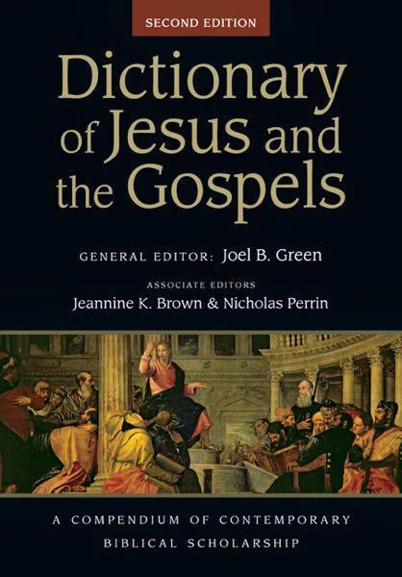
“In many cases, “sin” and “sinner” were freighted terms within Jewish sectarianism and were deployed in order to denounce or exclude persons for behavior that did not meet the perceived norms of certain Jewish factions. Jesus entered the conversation about what conduct and what persons were deemed unacceptable to God. Jesus’ statements on this topic appear to represent a controversial challenge to the dominating views of the day about “sinners.” According to Jesus, it is the restoration of sinners through repentance, rather than the exclusion of sinners from communal life, that is God’s intended purpose for sinners.”
Michael F. Bird, Ridley College – Melbourne (pg.863 on “Sin, Sinner”)
Notes:
[READ EXCERPT & COMMENT]
And so, Bird says, “Jesus was more critical of those who dismissed the sinners than of the sinners themselves because he saw in the efforts to marginalize persons a way of life that competed with his own message of the Kingdom of God” (pg.865).
In other words, Jesus’ ministry leveled the playing field. All are actually sinners, and so all need to repent and turn from their ways to the higher ways of God. All are being included, except for those who self-exclude themselves. And how do we self-exclude ourselves? Well, like the hypocritical religious leaders, it happens when we refuse to humble ourselves and respond to God’s offer of grace; when we refuse his invitation to be freed from our idols and our identities of the flesh; when we refuse to turn from our ways and the spirit of the age, and come to God for forgiveness, restoration, and new life.
The Croation theologian and author Miroslav Volf says it like this… [NEXT SLIDE]

Slide 6
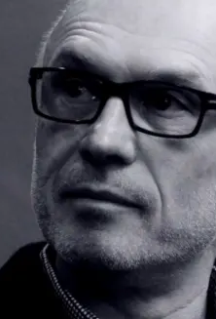
“It would be a mistake . . . to conclude from Jesus’s compassion toward those who transgressed social boundaries that his mission was merely to demask the mechanisms that created “sinners” by falsely ascribing sinfulness to those who were considered socially unacceptable. He was no prophet of “inclusion” . . . for whom the chief virtue was acceptance and the cardinal vice intolerance. Instead, he was a bringer of “grace,” who not only scandalously included “anyone” in the fellowship of “open commensality,” but made the “intolerant” demand of repentance and the “condescending” offer of forgiveness (Mark 1:15; 2:15-17).”
Miroslav Volf, Exclusion & Embrace (pg.72-73)
Notes:
Volf goes on to say, “The mission of Jesus consisted not simply of renaming the behavior that was falsely labeled “sinful” but also in remaking the people who have actually sinned and suffered distortion. The double strategy of renaming and remaking, rooted in the commitment to both the outcast and the sinner, to the victim and the perpetrator, is the proper background against which an adequate notion of sin as exclusion can emerge.”
Therefore, and we need to be clear about this, Jesus’ idea of “inclusion” isn’t about disregarding sin, rebranding sin, or being indifferent toward sin. Instead, it’s about everyone coming as you are by God’s grace through faith, so that you can be included in forgiveness, given a new identity, and become part of his Body, the church.
But before we talk more about this inclusive love of God in Christ, let’s think about where the exceptionalism and exclusion that Jesus confronted in the Pharisees was coming from… [NEXT SLIDE]

Slide 7
Codified Exclusion & Prophetic Visions
The Mosaic Law demanded that Israel exclude foreigners and separate themselves from their pagan neighbors, Jewish law-breakers, and those considered unclean. Otherwise, the Lord’s people would forsake him, worship idols, and bring judgment on the nation. E.g., Lev. 19:17-18; Deut. 23:1-8; Ezra 10:1-4
The Prophets (seers into God’s good future) challenged Israel’s tribalism, called them to repent of their exceptionalism, and embrace God’s desire for all nations to know and worship him. E.g., Jonah; Hosea 6:6; Micah 4:1-5; Isaiah 56:3-8 – “for my house will be called a house of prayer for all nations.”
Notes:
[BRIEF COMMENTS ON EACH POINT]
The Mosaic Law
The Prophets
Clearly, this vision was not realized by the time of Jesus. In fact, here is what the Temple courts looked like in the first century… [NEXT SLIDE]

Slide 8
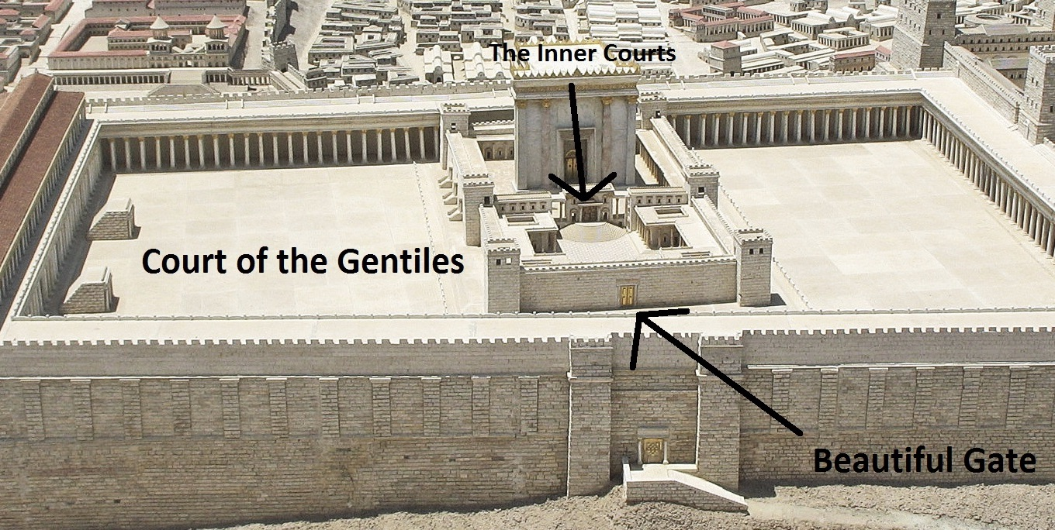
Notes:
[BRIEF COMMENTS ON TEMPLE]
Holy of Holies, Holy Place (the inner courts), and the court for Jewish women
The outer court was for Gentiles
Along the perimeter of the dividing wall was this inscription… [NEXT SLIDE]

Slide 9
Ephesians 2:14-15 MSG
¹⁴⁻¹⁵ The Messiah has made things up between us so that we’re now together on this, both non-Jewish outsiders and Jewish insiders. He tore down the wall we used to keep each other at a distance. He repealed the law code that had become so clogged with fine print and footnotes that it hindered more than it helped. Then he started over. Instead of continuing with two groups of people separated by centuries of animosity and suspicion, he created a new kind of human being, a fresh start for everybody.
Notes:
[BRIEF COMMENT ON PASSAGE]
So, this is what Jesus has done. But unfortunately, we often participate in the building up of walls that Jesus has down away with on the cross. How so? What does that look like today? And what sort of conditions create exceptionalism that leads to exclusion?
Here are a few things that come to mind… [NEXT SLIDE]

Slide 10

Conditions that Create Exceptionalism
Isolation, sectarianism & segregation
Idolizing your views, preferences & positions
Myths that glorify and/or “deify” our group
Fear & hostility toward differences
Taking the “us vs. them” approach
Minimizing or being willfully ignorant of our own sins
Having a tribalistic view of God
Notes:
[BRIEF COMMENTS ON EACH POINT]
But if we look to the God revealed in Jesus, or as we say at Grantham—”the God who looks like Jesus”—we will see a God who is much more generous, compassionate, merciful, loving, welcoming, and inclusive than what we see from many who claim his name today.
Here are just a few examples of God’s inclusive love as seen in the Gospels… [NEXT SLIDE]

Slide 11

God’s Radical Invitation & Inclusion of Sinners
Some examples of radical inclusion from the Gospels:
Matt 1:1-17 – 5 women included in Jesus’ family tree
Mk 7:24-30 – Jesus honors the faith of a Canaanite woman
Jn 4:1-26 – Jesus shares the gospel with a Samaritan woman
Mk 10:13-14 – Jesus welcomes children and affirms them
Lk 4:24-30 – Jesus praises the faith of Naaman, the Syrian (Gentile), and it infuriates the folks in Nazareth!
Lk 7 :1-10 – Jesus praises the faith of a Roman Centurion
Lk 8:1-3 – Jesus included women as close disciples
Lk 17:11-19 – Jesus touches and heals the unclean
Lk 23:40-43 – Jesus welcomes a criminal into the Kingdom
Notes:
[BRIEF COMMENTS ON EACH POINT]
And again, it’s through Christ’s work on the cross that his inclusive Kingdom has been established. Let’s return to Ephesians chapter 2. Paul wrote… [NEXT SLIDE]

Slide 12
Ephesians 2:16-22 MSG
¹⁶⁻¹⁸ Christ brought us together through his death on the cross. The Cross got us to embrace, and that was the end of the hostility. Christ came and preached peace to you outsiders and peace to us insiders. He treated us as equals, and so made us equals. Through him we both share the same Spirit and have equal access to the Father.
Notes:
[BRIEF COMMENT ON PASSAGE]
Verse 19… [NEXT SLIDE]

Slide 13
¹⁹⁻²² That’s plain enough, isn’t it? You’re no longer wandering exiles. This kingdom of faith is now your home country. You’re no longer strangers or outsiders. You belong here, with as much right to the name Christian as anyone. God is building a home. He’s using us all—irrespective of how we got here—in what he is building. He used the apostles and prophets for the foundation. Now he’s using you, fitting you in brick by brick, stone by stone, with Christ Jesus as the cornerstone that holds all the parts together. We see it taking shape day after day—a holy temple built by God, all of us built into it, a temple in which God is quite at home.
Notes:
[BRIEF COMMENT ON PASSAGE]
Before we close, I’d like to lead us in a spiritual exercise… [NEXT SLIDE]

Slide 14
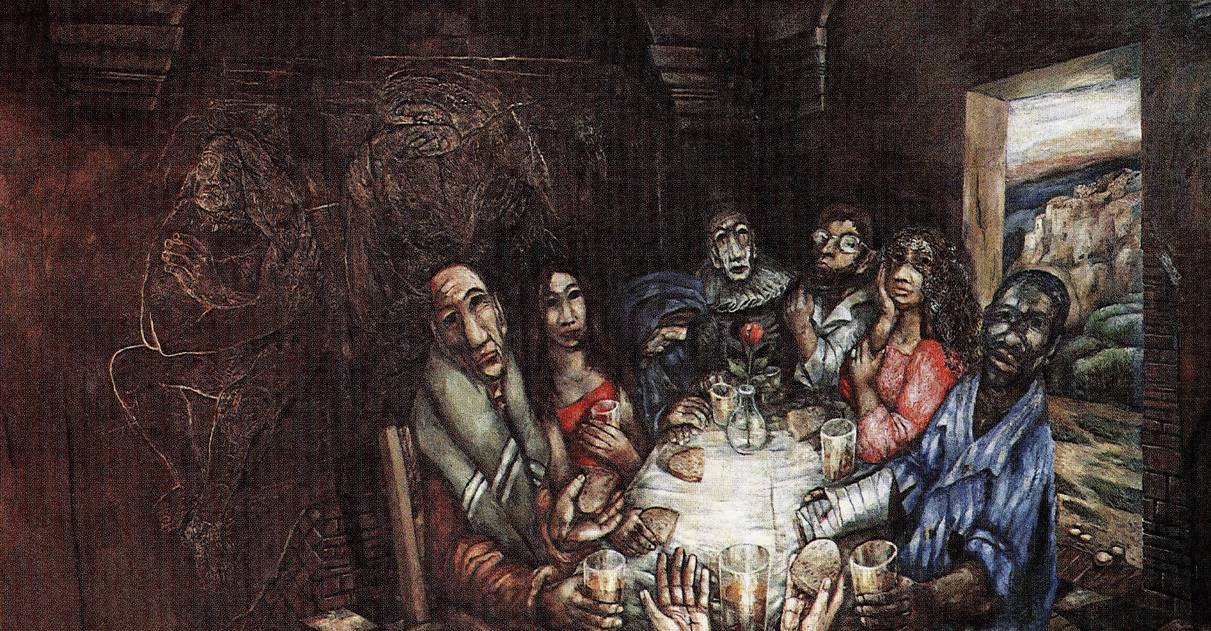
Notes:
[STEP TWO]
Now, open your eyes and gaze upon the painting on the screens
Notice the colors, the details, in the foreground and in the background
Once you have visually canvased the artwork, note where the Spirit is drawing your eyes and your attention in this painting
[STEP THREE]
Now, meditate on that part of the picture that has drawn your attention. How is God speaking to you? Why do you think the Spirit is drawing your attention to this particular part? Something that connects to your story? Do you sense an invitation? Can you see yourself at this table?
Next, embrace the feelings and emotions that come. And be mindful, what word describes your inner stirring as you embrace this feeling? Allow God’s Spirit to meet you there and speak to you.
[STEP FOUR]
And now that you’ve listened to God, what might be your response to his voice? What do you want to say to him in a short, simple prayer. Speak to him now.
[STEP FIVE]
Finally, since words are never sufficient in expressing ourselves and communing with God, let’s enter into a moment of silence and just sit in the presence of God.
[BRIEF MOMENT OF SILENCE]
[SHORT CONCLUDING PRAYER]
As we’ve been doing each week in this series, church, please join me in this responsive prayer… [NEXT SLIDE]

Slide 15
One: Your Ways, O God, are higher than our ways.
All: Your thoughts are higher than our thoughts.
One: We seek God’s ways.
All: Lord, move us from exceptionalism, favoritism, and tribal thinking to your radical inclusion.
One: As we walk with Christ on this Lenten journey, let us see your way more clearly…
All: and follow your way more faithfully. Amen.
Notes:
[PRAY THE RESPONSIVE PRAYER]
[GO TO FINAL SLIDE]

Slide 16
Notes:
ANNOUNCEMENT:
Starting next week, there will be a new learning community option on Sunday morning at 9:00 am: The Gospel of Luke: the relationship between salvation, discipleship and wealth
This is a 7-week adult learning community that builds on our Foundations Bible reading initiative and our Lenten sermon series, as we seek to understand and apply God’s ways to how we manage our financial resources. This class will study and discuss 12 key passages in Luke’s gospel that highlight stories from Jesus about wealth, poverty and generosity.
BENEDICTION:
Brothers and sisters, from this time and place into whatever awaits, may you follow God’s way of inclusion. May you recognize your assumptions of entitlement so that you can live into God’s fully inclusive love. As you go, know that our God of the wilderness remains with you on the way.
Now go in peace, to love and serve the Lord.

