Slide 1
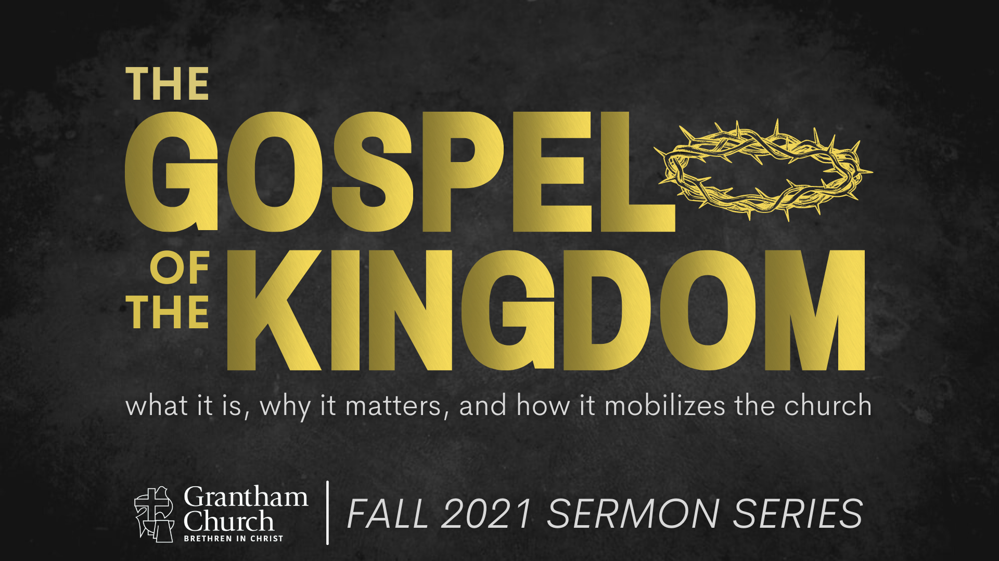
Notes:
[BRIEF INTRO]
Welcome
Week 4 in a 7-week fall sermon series – The Gospel of the Kingdom
Jesus said, “The kingdom of God has come near. Repent and believe the good news!” But what is this gospel of the kingdom? And what does it mean to believe in the gospel and partner with God in his Kingdom work?
So here is how we’re defining “good news” and “kingdom of God”: [NEXT SLIDE]

Slide 2

What is the Good News?
The gospel story of how God has been at work in the world and is now redeeming it in Jesus Christ—who will one day return to bring the fullness of the Kingdom.
What is the Kingdom of God?
The reign and rule of God on the earth, which always looks like Jesus (e.g., loving others, healing, reconciling, sacrificing self, showing mercy, doing justice, etc.).
Notes:
[READ GOOD NEWS DEFINITION]
Again, this encompasses…
The story of Israel—the OT (the larger biblical story)
The story of Jesus the Messiah (his life, teachings, death, resurrection & ascension)
The story of what Jesus continues to do through his Church (as we anticipate his return)
[READ KINGDOM OF GOD DEFINITION]
The kingdom is already, but not yet—we live in the overlap of the ages
Heaven is coming to earth; God’s space and our space will be joined in Christ’s return
If you’re just joining us in this series, so far we have looked at:
1. Gospel as Story 2. Gospel Truths 3. Gospel in You… which brings us to today’s message... [NEXT SLIDE]

Slide 3
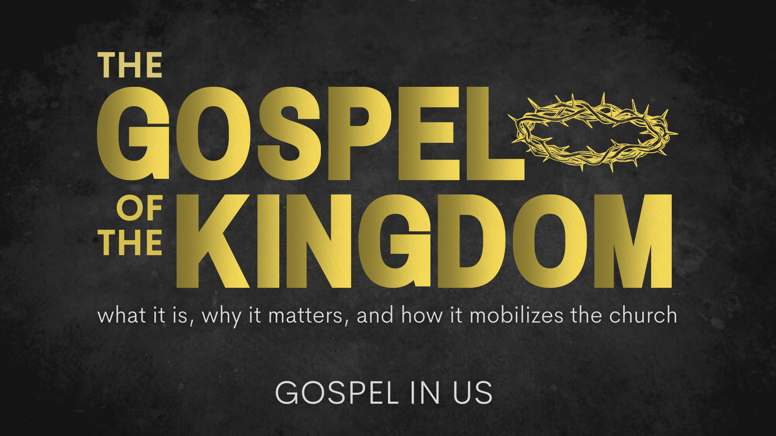
Notes:
[BRIEF COMMENTS]
In this message, we’re looking at how the Church is God’s idea. And according to the New Testament, the local church (i.e., a gathering of disciples in a given location) is called out to be a gospel community that embodies the good news and radiates the Spirit-filled life of the kingdom. Therefore, today we will see how it’s through our life together as disciples that we are transformed by the Spirit and called to display the power of the gospel through our church family. And that this is how God intends for us to bear witness to his reign and rule on the earth—to where things are going, as we await the fulness of the kingdom on the earth.
We’re going to look at a couple passages of Scripture this morning, so please have your Bible handy because not all of them will be on the screens. But before we look at our first Scripture reading, please join me in a quick prayer for the Spirit’s help. [BRIEF PRAYER] and then [NEXT SLIDE]

Slide 4
Scripture Reading
Matthew 5:1-16 NIV
Notes:
[READ & EXPOUND ON THE SCRIPTURE]
The sermon on the mount is the constitution of the kingdom
This is what it looks like when we embody the gospel
We need to read this as a community, not simply as individuals
Jesus is describing kingdom living for communities of disciples
This is how the gospel shines through us to the world
Again, we could sum the beatitudes up this way… [NEXT SLIDE]

Slide 5
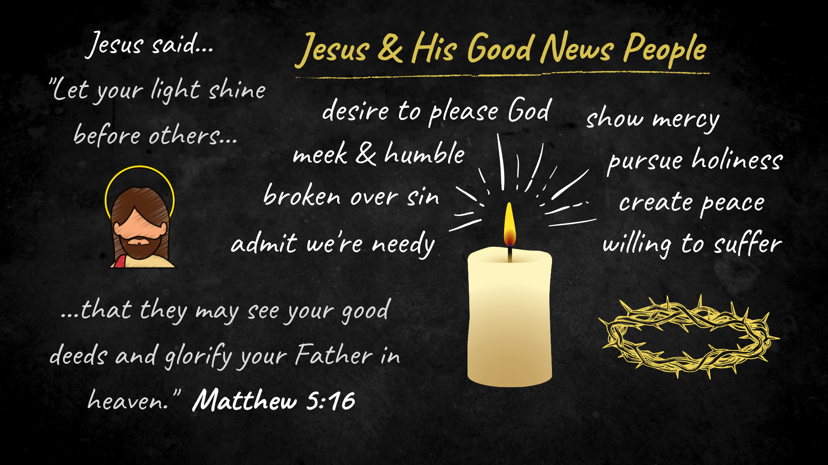
Notes:
[BRIEF COMMENTS ON IMAGE]
My friends, this is the sort of “good news people” that Jesus had in mind when he said these words later on in Matthew 16:18. [NEXT SLIDE]

Slide 6
“I will build my church; and the gates of hell shall not prevail against it.”
Matthew 16:18 KJV
Notes:
[BRIEF COMMENT]
What is the meaning of church? Why does Jesus use this word? ekklēsia – “called out” ones
it originally referred to a group of town leaders & representatives
It’s used 114 times in the New Testament to refer to the assembly or gathering of God’s people
The Scriptures tell us that this was God’s eternal purpose, his plan from the beginning. Listen to what the apostle Paul wrote in Ephesians 3:10-11 (NLT): “God’s purpose in all this was to use the church to display his wisdom in its rich variety to all the unseen rulers and authorities in the heavenly places. This was his eternal plan [purpose], which he carried out through Christ Jesus our Lord.”
Don’t miss this, folks. God calls out his people (his family) to be united in one common faith, through one baptism, and in worship of one Lord, setting aside all other loyalties and allegiances to accept the identity, the purpose, and the way of living that Jesus gives to all who chooses to follow him through the local church.
Of course, there is the universal or “holy catholic Church” all across the plant (which we are reminded of when we confess the Apostles’ Creed, which we will do before communion today). But the NT shows us that God’s eternal purpose, this grand vision for the church, is to be lived out locally.
The Church is made up of churches in every place where people gather in community to live, work, shop, and play. These churches are like Kingdom embassies or outposts spread out in every place that humans gather. And we are to be a witness on behalf of Christ and the gospel, showing a watching world how Jesus and the gospel changes everything.
As I’ve said before… the purpose of the gathering of the local church is for worship, community, and discipleship. We gather together so that we might be equipped, inspired, and empowered to the be the missional (sent) church in the world.
So, we gather, grow, give, and go. And it’s through this rhythm that we’re shaped by Christian liturgies and practices, properly orient our loves to Christ and the good news, and live into the gospel story. And again, the Lord uses this to build his church. And notice, we have a promise from Jesus that “the gates of hell” will not stop us from fulfilling God’s plans and arriving at his good future.
Remember from our image of the gospel story, hell is on the way out… [NEXT SLIDE]

Slide 7
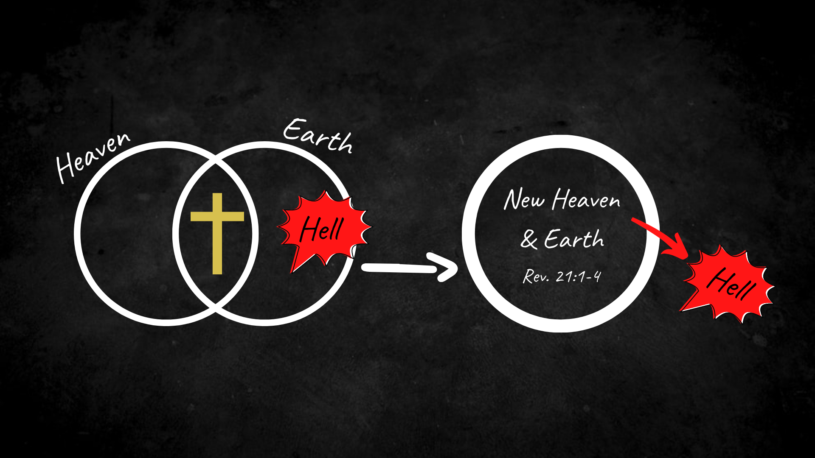
Notes:
[BRIEF COMMENTS]
Heaven and earth are coming together in Jesus
Our belief and embodiment of the gospel confronts sin, death, and hell—driving it out!
Therefore, (think of it this way) the gospel is the insurgency of heaven
So, when we confess “Jesus is Lord” and join the local church, we choose to live into this story and are then partnering with God to welcome more of the kingdom through our lives. And specifically, to embody the good news through the ekklesia of Christ. But what does that look like? [NEXT SLIDE]

Slide 8
The Church as Hermeneutic of the Gospel
What does it look like when the church is embodying the good news and living into the gospel story? The local congregation will be…

Slide 9
The Church as Hermeneutic of the Gospel
What does it look like when the church is embodying the good news and living into the gospel story? The local congregation will be…
a community of praise and worship.

Slide 10
The Church as Hermeneutic of the Gospel
What does it look like when the church is embodying the good news and living into the gospel story? The local congregation will be…
a community of praise and worship.
a community of grace and truth.

Slide 11
The Church as Hermeneutic of the Gospel
What does it look like when the church is embodying the good news and living into the gospel story? The local congregation will be…
a community of praise and worship.
a community of grace and truth.
a community that does not live for itself, but for our neighbors.

Slide 12
The Church as Hermeneutic of the Gospel
What does it look like when the church is embodying the good news and living into the gospel story? The local congregation will be…
a community of praise and worship.
a community of grace and truth.
a community that does not live for itself, but for our neighbors.
a community where all are prepared to be priests in the world.

Slide 13
The Church as Hermeneutic of the Gospel
What does it look like when the church is embodying the good news and living into the gospel story? The local congregation will be…
a community of praise and worship.
a community of grace and truth.
a community that does not live for itself, but for our neighbors.
a community where all are prepared to be priests in the world.
a community that advocates for a new social order.

Slide 14
The Church as Hermeneutic of the Gospel
What does it look like when the church is embodying the good news and living into the gospel story? The local congregation will be…
a community of praise and worship.
a community of grace and truth.
a community that does not live for itself, but for our neighbors.
a community where all are prepared to be priests in the world.
a community that advocates for a new social order.
a community of hope in a world of cynicism, nihilism, and despair.
Notes:
Lesslie Newbigin’s classic book – The Gospel in a Pluralist Society
[BRIEF COMMENT ON EACH POINT]
Brothers and sisters, this is how the first Christians lived and how they embodied the gospel in their congregations within the first few centuries of the church. And this is what we need to hold in our heads and in our hearts when we read passages like this from 1 Peter 2:9-12. [NEXT SLIDE]

Slide 15
1 Peter 2:9-12 NIV
⁹ But you are a chosen people, a royal priesthood, a holy nation, God’s special possession, that you may declare the praises of him who called you out of darkness into his wonderful light. ¹⁰ Once you were not a people, but now you are the people of God; once you had not received mercy, but now you have received mercy.
Notes:
[BRIEF COMMENT ON EACH VERSE]
Verse 11… [NEXT SLIDE]

Slide 16
¹¹ Dear friends, I urge you, as foreigners and exiles, to abstain from sinful desires, which wage war against your soul. ¹² Live such good lives among the pagans that, though they accuse you of doing wrong, they may see your good deeds and glorify God on the day he visits us.
Notes:
[BRIEF COMMENT ON EACH VERSE]
So, we’ve already heard Jesus tell us what good news people look like. And Jesus said that it’s through this radical living that we become salt and light. Now let’s hear from the apostle Paul as he uses a different metaphor for describing what it looks like when we are embodying the gospel, not just in our own individual lives, but also through the church. [NEXT SLIDE]

Slide 17
Scripture Reading
Galatians 5:13-25 NIV
Notes:
[READ & EXPOUND ON THE SCRIPTURE]
What does Paul mean? Well, let’s capture it another picture… [NEXT SLIDE]

Slide 18
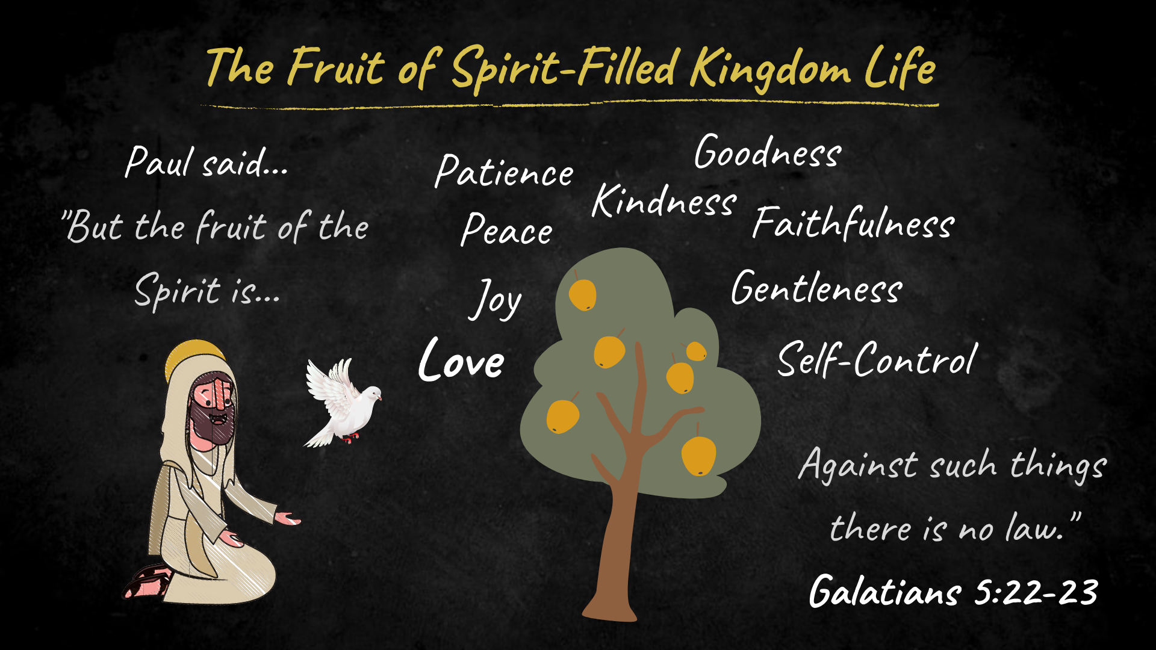
Notes:
[BRIEF COMMENT ON IMAGE]
This is the fruit that the Spirit bears in us and in our church
We bear fruit when we are intentional about discipleship and embodying the gospel
This is what our family, friends, and neighbors must see in us if we’re going to be good news people
Finally, here are a couple of questions for reflection and response. Let’s seriously consider these things before we confess our common creed together and partake of communion—a tangible reminder of the gospel in us. [NEXT SLIDE]

Slide 19

Questions for reflection and response:
Gospel in Us
Notes:
[BRIEF COMMENT ON EACH]
[CLOSING WORDS]
[CLOSING PRAYER – NEXT SLIDE]

Slide 20
Questions for reflection and response:
Are we cultivating growth that bears fruit?
Gospel in Us
Notes:
[BRIEF COMMENT ON EACH]
[CLOSING WORDS]
[CLOSING PRAYER – NEXT SLIDE]

Slide 21
Questions for reflection and response:
Are we cultivating growth that bears fruit?
Are we embodying the gospel at Grantham?
Gospel in Us
Notes:
[BRIEF COMMENT ON EACH]
[CLOSING WORDS]
[CLOSING PRAYER – NEXT SLIDE]

