Slide 1

Notes:
This is the first Sunday of Lent and this morning we are beginning a new sermon series called, Galatians: Faith Formation in Centered-Set Community. I’ve been looking forward to preaching through Galatians for a while now. And the next 6-weeks leading up to Easter seemed like a good time to do that.
In Galatians 4:19, the Apostle Paul wrote: “My children—I seem to be in labor with you all over again, until the Messiah is fully formed in you!” Labor? Wow! That’s quite the metaphor. And we’re going to to see how this passionate letter from Paul has the potential to help us experience more of the liberating work of Jesus in and through Christian community as we are formed together. Each week we’re going to better understand the problem that provoked Paul to write it and seek to gain new insights by using the concept of bounded, fuzzy, and centered-set churches as a lens for interpreting and applying Galatians to our lives.
This language of bounded, fuzzy, and centered-set will be familiar to many of you. It comes from Mark Baker’s work on the topic… [NEXT SLIDE]

Slide 2
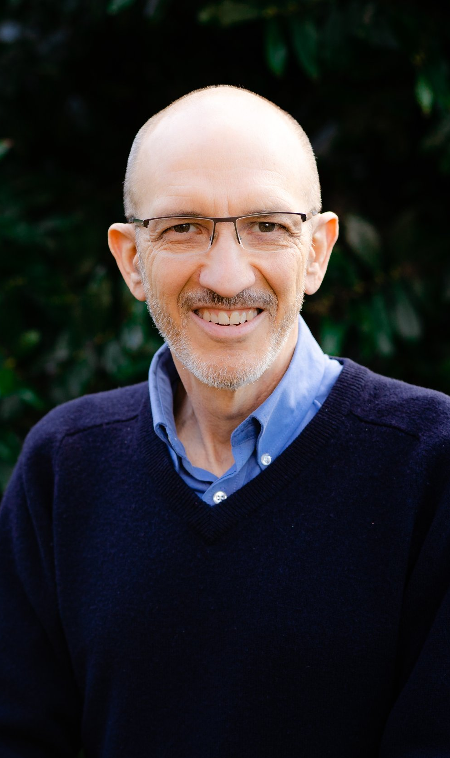


Notes:
[BRIEF COMMENTS]
Mark Baker is professor of mission and theology at Fresno Pacific Biblical Seminary in Fresno, CA. He served as a missionary in Honduras for ten years and has written several books on the church. Mark’s work is helping pastors, leaders, and their churches imagine what he himself calls a “third way” of doing Christian community.
I’m drawing from two of his books for this series on Galatians: Centered-Set Church (which I first told you about in our June 2022 series, Christ the Center) and then his follow-up: a commentary on Galatians, where Mark invites us to use the concept of bounded, fuzzy, and centered-set churches as a lens for interpreting and applying Paul’s letter to the Galatians to our lives. What do we mean?
Well, let’s begin by looking again at the differences in the bounded, fuzzy, and centered-set approach to Christian community... [NEXT SLIDE]

Slide 3

Bounded Church
A Bounded Church has a clear boundary line that is static and distinguishes Christians from non- Christians, or true Christians from mediocre Christians. The line generally consists of a list of correct beliefs and certain visible behaviors. A bounded church has tendencies toward a sense of superiority and judgmentalism. It hinders transparency and shames.
Notes:
[READ & COMMENT]
And to clue you in right away… this is the sort of thinking and way of doing community that we will see is threatening the unity of the Galatian churches.
And then there is the Fuzzy Church… [NEXT SLIDE]

Slide 4

Fuzzy Church
A Fuzzy Church is the opposite of the bounded church. It erases all lines and boundaries. The grounds for distinction (in/out) and shaming judgmentalism are gone, but the fuzziness erodes the group’s sense of identity, lacks a sense of call to a different way of living (holiness), and inhibits loving others fully. It has a tendency toward blandness, low expectations, and it creates a new set of problems in the church.
Notes:
[READ & COMMENT]
This is not what the Galatians were dealing with, but it can easily be the sort of community that we gravitate toward if we have experienced hurt within a bounded church.
I will also address this extreme practice throughout this series.
And then there is the alternative “third way” option, which I’ve been inviting us to explore and embrace together in the past several years… [NEXT SLIDE]

Slide 5
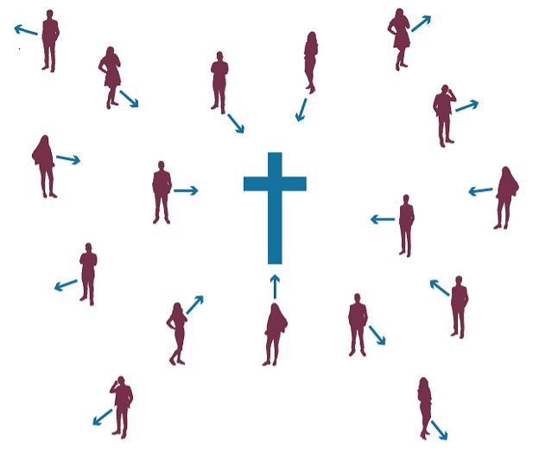
Centered Church
A Centered Church discerns who belongs to the group by observing people’s relationship with the center—Jesus Christ. The group includes all who are oriented toward the center. Their common direction brings unity. There is space to struggle and fail because they believe that everyone is in process—moving closer to the center. A centered approach remedies the problems of a bounded church that motivate a fuzzy church to blur boundaries, while also avoiding the negative fruit that grows out of a fuzzy approach.
Notes:
[READ & COMMENT]
So, where a bounded church focuses on defining and maintaining the boundary, a centered church focuses on defining the center and maintaining clarity about who we are following (the God who looks like Jesus) and what he expects of us as his disciples.
And again, we’re going to use these concepts as a lens by which we can better understand Paul’s passion and concerns in his letter to the Galatians. And then, with the help of the Holy Spirit, we can apply the message to our own lives and church community… [NEXT SLIDE]

Slide 6
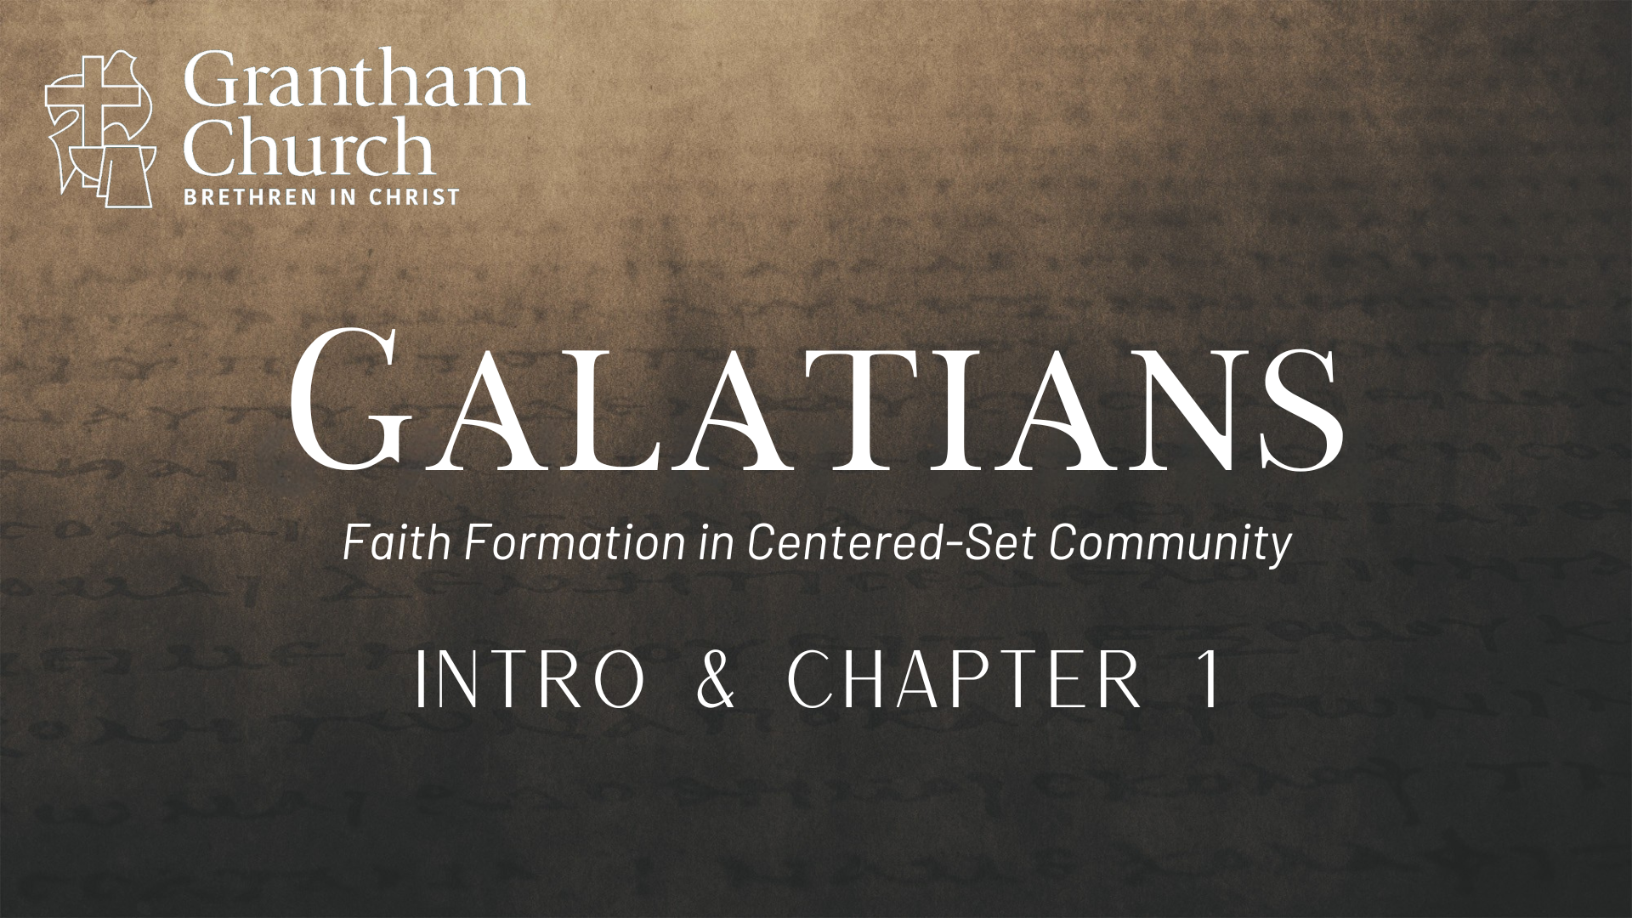
Notes:
So, in the first message of our series, I’m going to share some historical context and background to Galatians, guide us through chapter 1, and invite us to embrace God’s gospel of grace that makes a centered church possible.
[BRIEF PRAYER]
If you would, go ahead and open to Galatians and be ready begin reading in chapter 1 here in a few minutes. And while you’re doing that, I want to set the context for what we’re about to read. Galatians is the first letter written by Paul (about 49 AD) to the churches he planted in Galatia during his first missionary journey (which is recorded in Acts 13-14). Galatia is in the region of southern Turkey today… [NEXT SLIDE]

Slide 7
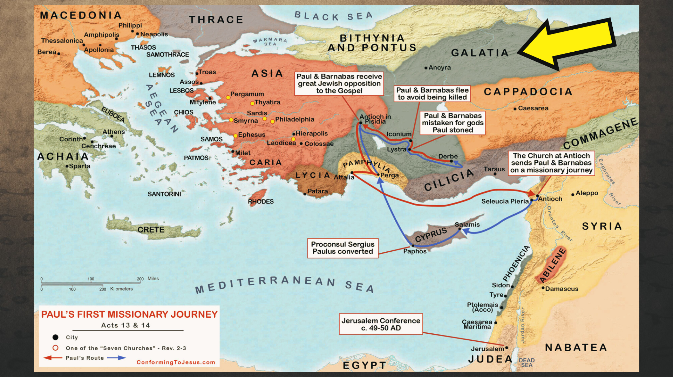
Notes:
[BRIEF COMMENTS ON MAP]
A map showing Paul’s first apostolic journey with his co-worker Barnabas
They set off from Antioch in Syria, which had become the hub for Gentile Christianity
At this point in the middle of the first century, there are just as many Gentiles as Jews in the Jesus movement, prompting a lot of debate, which culminates at the Jerusalem Council in Acts 15, where they’re asking: ”What must Gentiles do to be saved and be included in the church?” Some Jewish Christians said that they must embrace the customs and external Jewish boundary markers to be legit followers of Jesus, e.g., males must be circumcised, Gentiles must eat kosher, follow the Law, observe the Sabbath, and don’t share table fellowship with non-Jews until they comply with those boundary markers.
And of course, Paul takes issue with this because he was preaching that we are saved by grace through faith, and that all who believe can begin pursuing Christ with others in the church. As he will say to the Galatians, the death and resurrection of Jesus has launched a new age and new creation. Therefore, Paul warns them of going backwards, back to the old age, and taking on a bounded-set approach, thus adding to the gospel and creating obstacles for Gentiles who are attracted to Jesus and pursuing him as the center.
And while he initially received the approval of the Jerusalem Church (which he didn’t need or ask for), later there is some flip-flopping due to pressure from the boundary-marker activists, e.g., Peter backs away from table fellowship with Gentiles at Antioch. And Paul is going to call him out on it in this letter to the Galatians.
Furthermore, these ”agitators” (Paul calls them) are going around accusing him of bungling the gospel that he received from the 11 apostles. So, they tell the Galatian Christians that they must adhere to the Law and observe the boundaries to be true disciples. And Paul will not only defend himself as having received the gospel straight from Jesus (not the apostles) but also warn the Galatians about believing a “different” or false gospel.
And that is the reason, the purpose, and the context of this letter… [NEXT SLIDE]

Slide 8
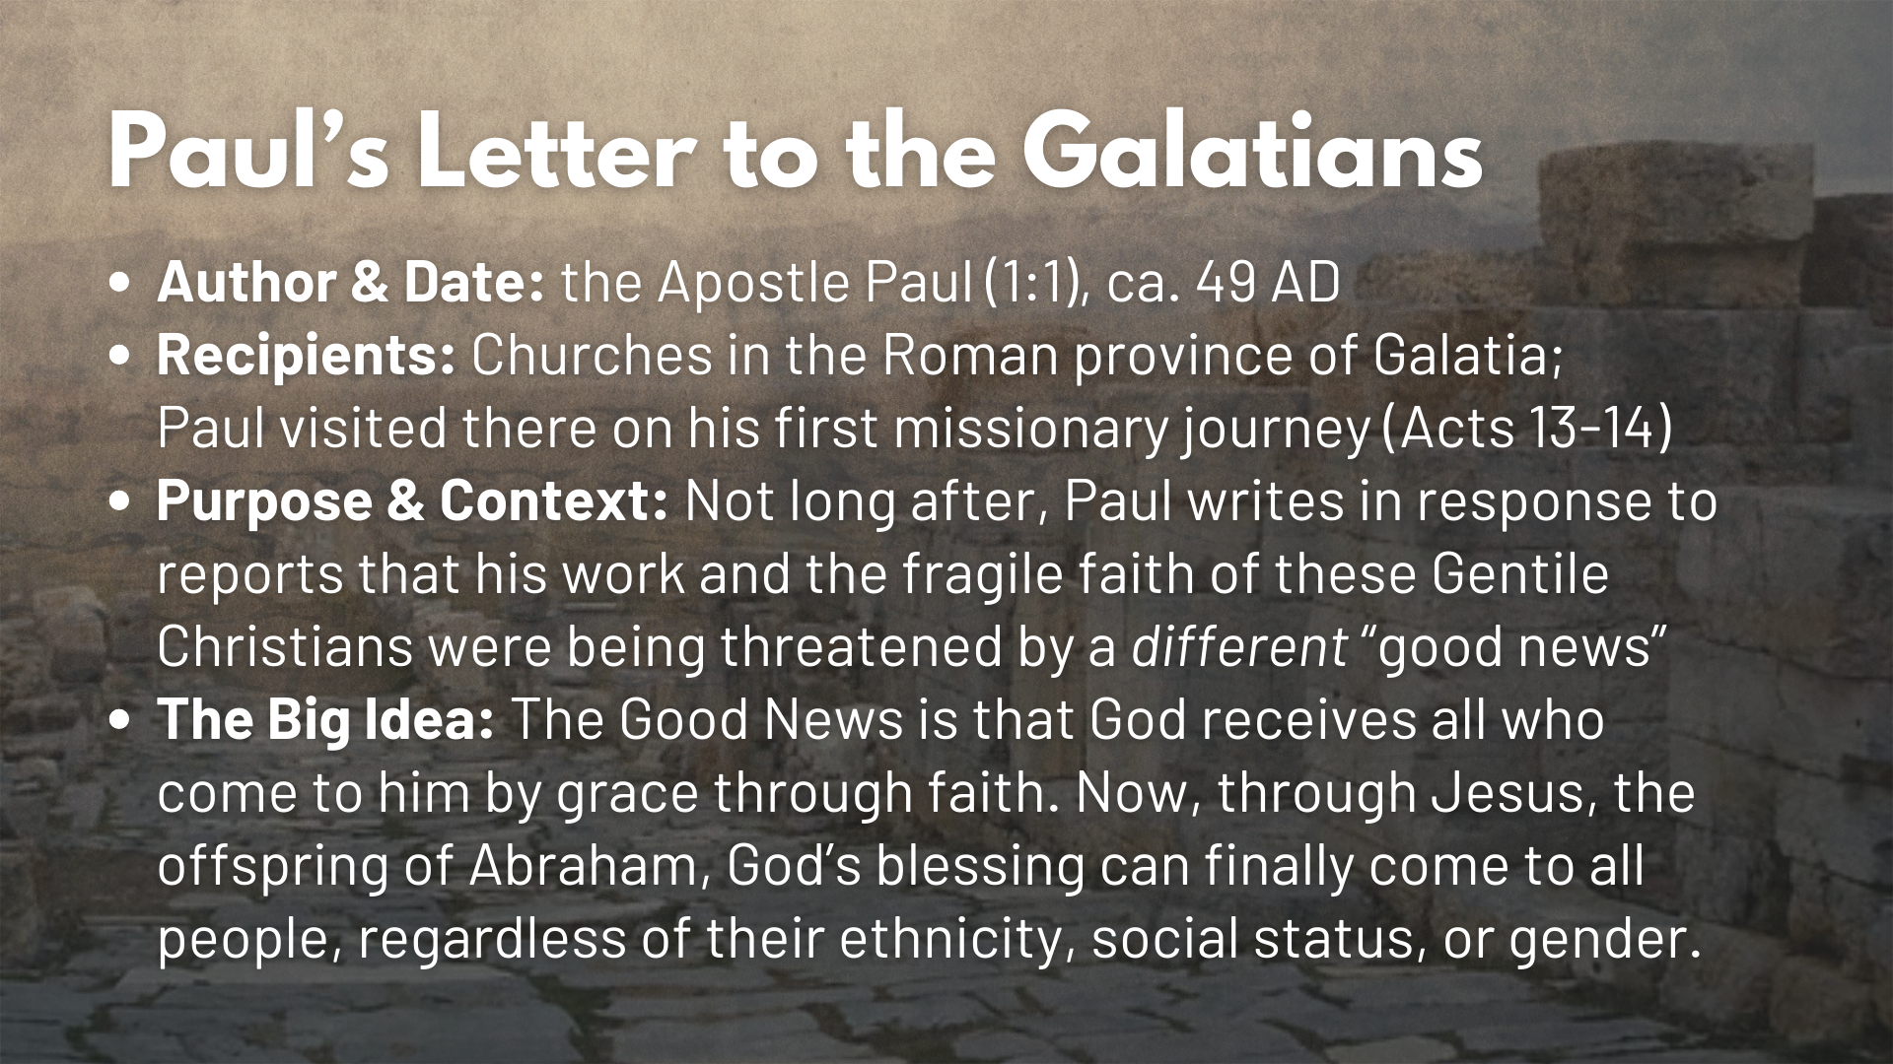
Notes:
We’re not sure how, but Paul obviously received a report about the tensions and divisions among the Galatians caused by the Jewish “agitators”… and so he writes in response to these reports that his work and the fragile faith of these Gentile Christians were being threatened by another gospel, which, according to Paul, is no good news at all.
Needless to say… Paul is upset. And when we understand all the reasons why, we can sympathize with him. For Paul wants these new Gentile believers (who he first introduced to Christ) to know that God receives all those who come to him by grace through faith. Now, through Jesus, the offspring of Abraham, God’s blessing can finally come to all people, regardless of their ethnicity, social status, or gender. You only need to put your faith in him and then begin walking with the Spirit as you are transformed into Christ’s image over time.
And with those things in mind, let’s begin reading… [NEXT SLIDE]

Slide 9
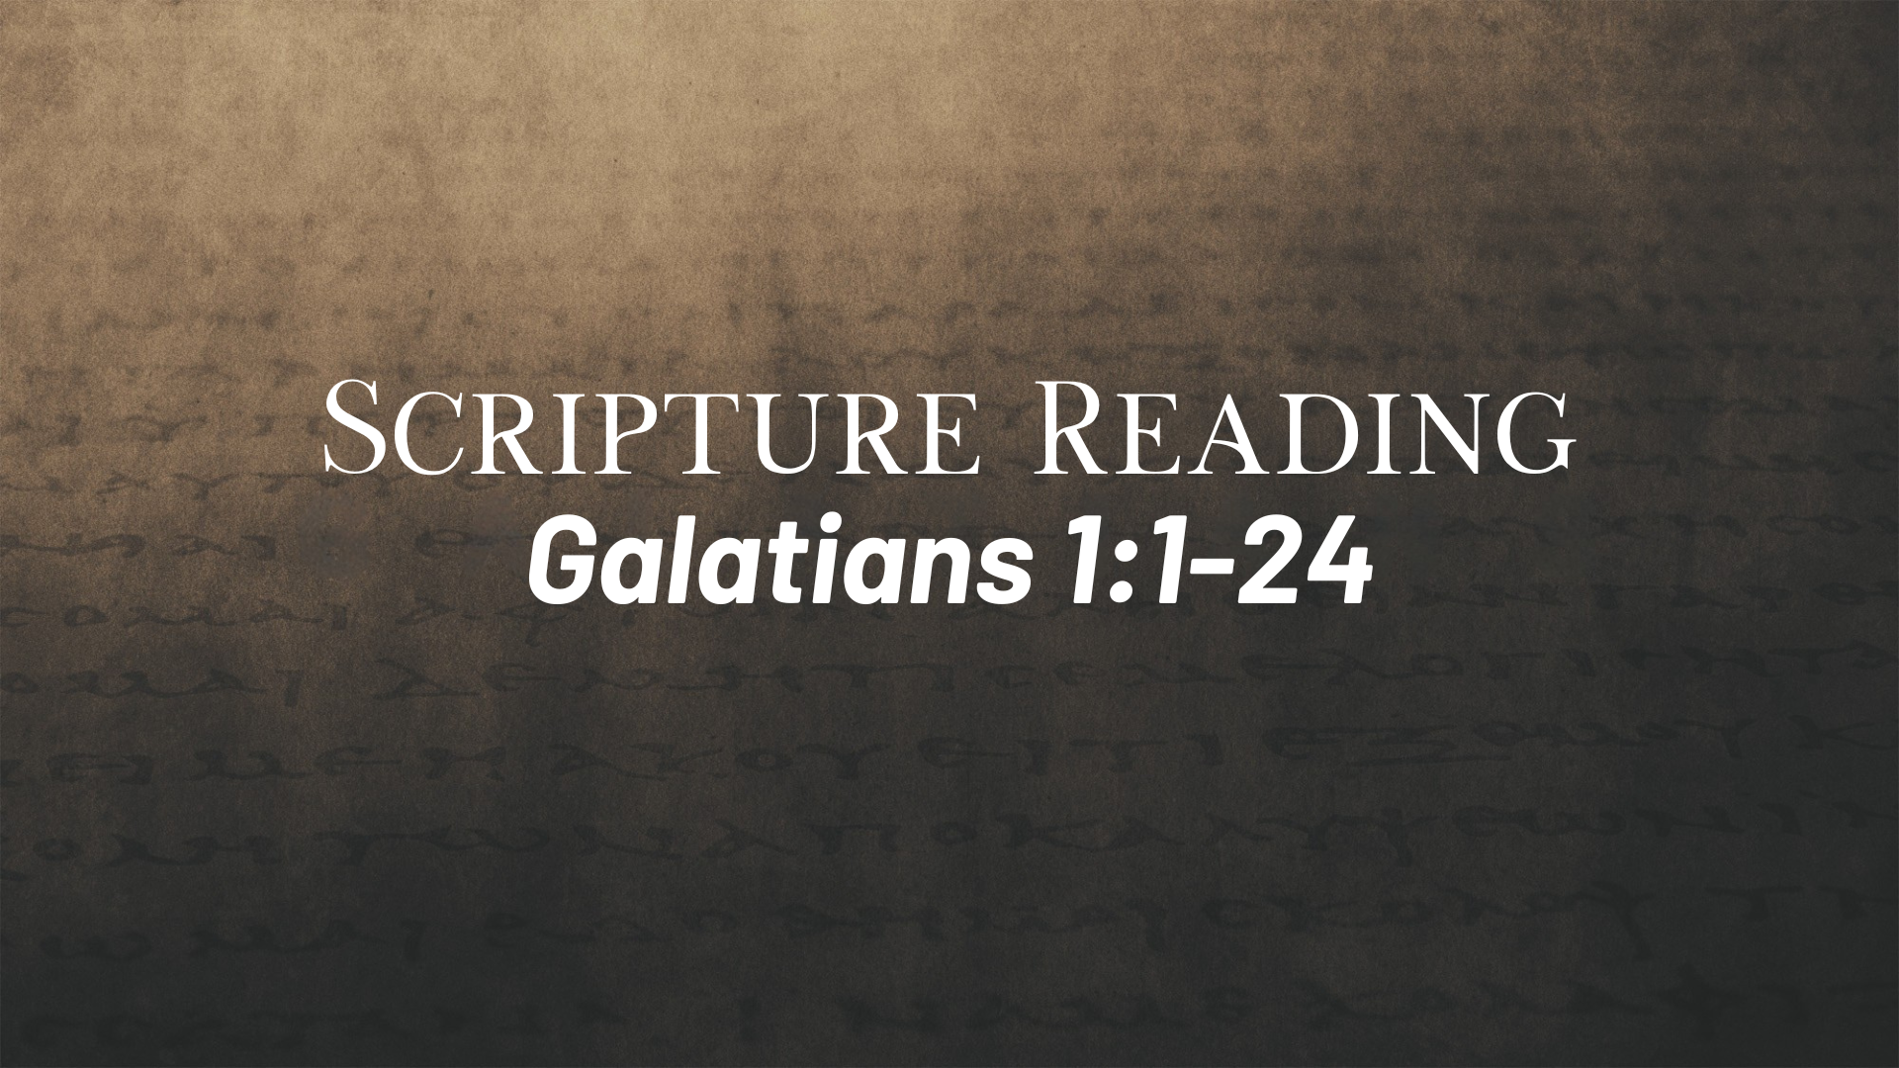
Notes:
[READ CHAPTER & COMMENT]
vs.1-5 – there is a lack of positive words or affirmation; Paul is clearly upset
v. 6 – “shocked” NIV: astonished; “turning away” NIV: quickly deserting; walking away from God; “called you to himself” NIV: called you to live in the grace of Christ; “a different way” NIV: a different gospel
v. 7 – which is really no gospel “good news” at all; NIV: some are trying to throw you into confusion and perverting the gospel of Christ
vs. 8-9 – ”curse” (anathema – a thing devoted to or headed for destruction)
v. 10 – “obviously” because Paul isn’t concerned about what people think of him; he is willing to risk his reputation, call the agitators out, and speak sternly to the Galatians
Vs. 11-24 – Paul tells his own story of God’s grace at work in his life
Paul will go on with his story, which we will pick back up with next week. But for now, let’s consider Paul’s claim to know and proclaim the true gospel against this false gospel that other Jewish Christians are spreading in Galatia. First… [NEXT SLIDE]

Slide 10
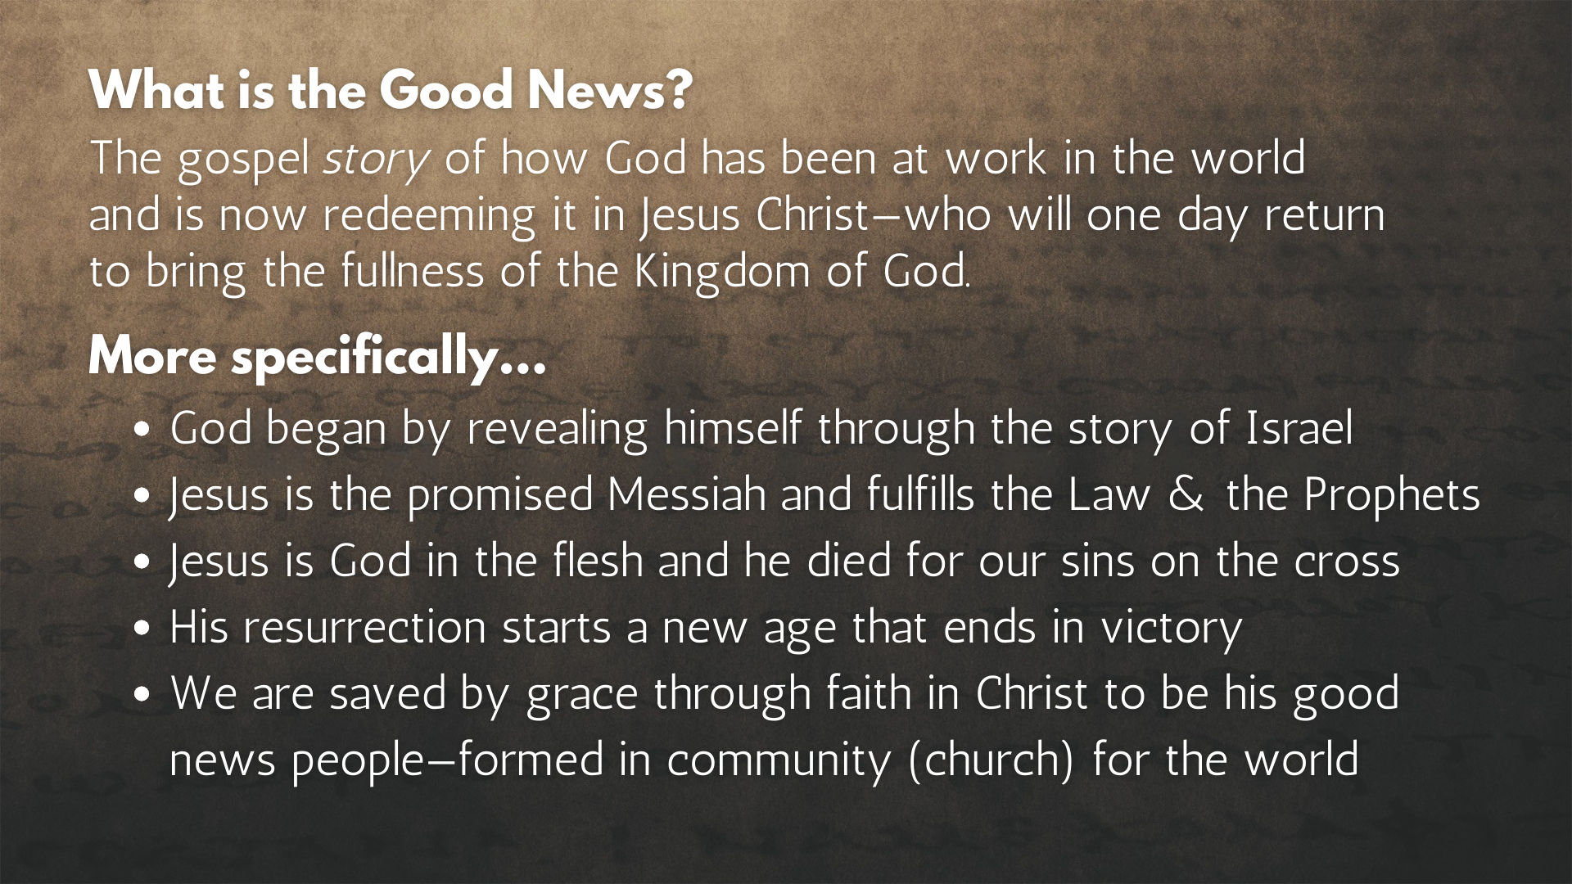
Notes:
[READ & COMMENT]
NOTES FOR BULLET POINT #2:
Matthew 5:17 – Jesus said, “Do not think that I have come to abolish the Law or the Prophets; I have not come to abolish them but to fulfill them.” (Gal. 3:24-25)
Matthew 22:37-40 – Jesus said, “’Love the Lord your God with all your heart and with all your soul and with all your mind.’ This is the first and greatest commandment. And the second is like it: ‘Love your neighbor as yourself.’ All the Law and the Prophets hang on these two commandments.” In other words, whatever is good and righteous regarding the OT, it is lived out and embodied by fully loving God and others, as we see in Christ.
To help us clarify and distinguish the gospel of Jesus (which Paul articulates in Galatians) from the “different” or false gospel, let’s now compare the two… [NEXT SLIDE]

Slide 11
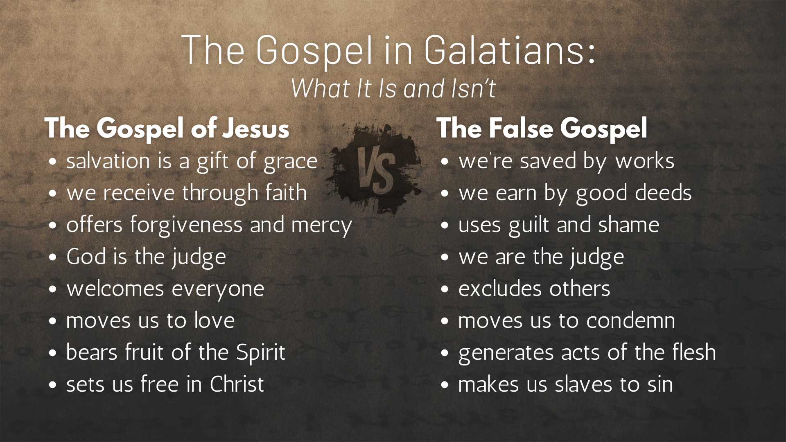
Notes:
[READ EACH POINT & COMMENT]
The Gospel of Jesus vs. the False Gospel
And that is at the heart of the issue and problem facing the Galatians. That is Paul’s concern for these believers. Listen to what Paul is writes later in this letter… [NEXT SLIDE]

Slide 12
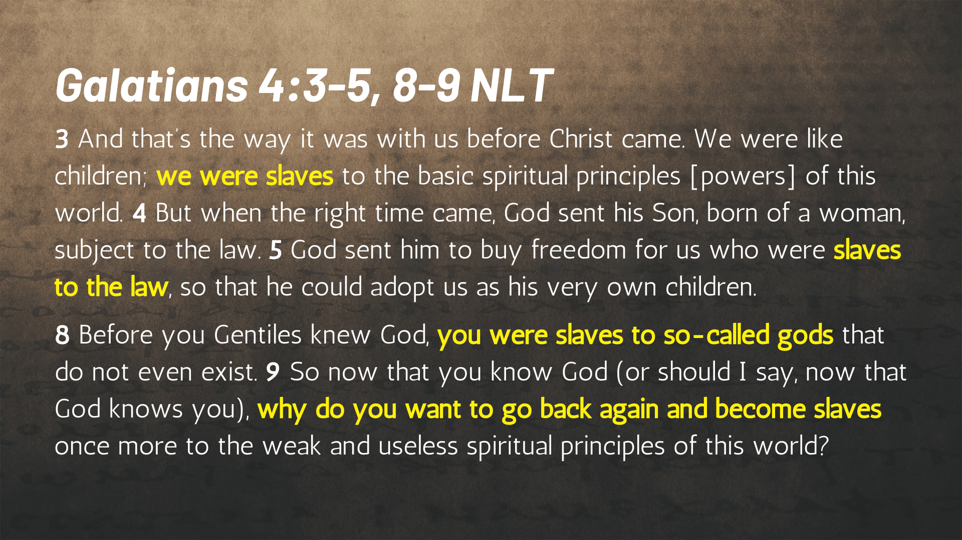
Notes:
[READ & COMMENT]
And so, you can hear Paul’s frustration and his concern for what this ”other gospel” and a focus on old covenant boundary markers (which were pre-Messianic age and tribal in nature) would do to the Galatian churches. As a former Pharisee, he knows from being on the inside of this kind of thinking. If you add anything to the gospel of grace, you become slaves and burdened down by whatever you hitch up to your wagon.
And just in case you’re thinking, “Isn’t Paul overacting a bit? It’s not like they are being invited to deny Jesus or worship pagan gods. They were just adding to Paul’s gospel.” But my friends, we need to understand the danger in believing and preaching “Jesus and… something else.” Jesus and circumcision or Jesus and the Law… is like Jesus and America, or Jesus and partisan politics or Jesus and agree with me on this issue or else!
If it’s not Christ and the gospel of God’s grace alone… you will see division, tribalism, church splits, slavery, and bondage… and nothing more than shriveled fruit from an impotent church that has little to give the world because they are so full of the world. And here are some things you can expect from this bounded church mentality… [NEXT SLIDE]

Slide 13
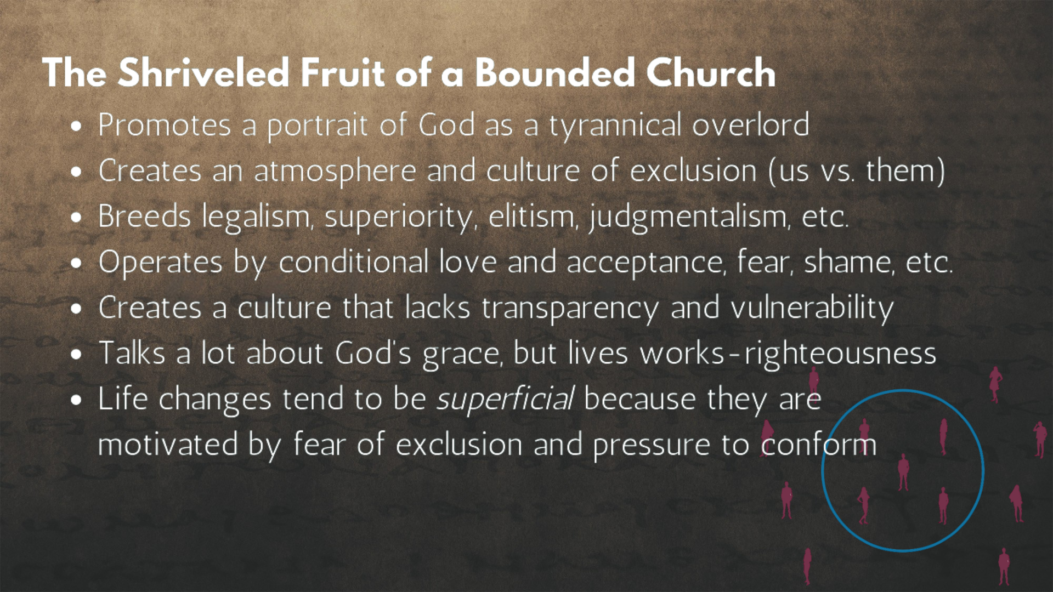
Notes:
[READ EACH POINT & COMMENT]
Folks, boundaries can be good things (there is no doubt about that), but the Bounded Church twists and misuses them in order to exclude others and relies upon laws and line-drawing to motivate right-living and modify people’s behavior.
Finally, look at each of these forms of community together and listen to these words from Baker… [NEXT SLIDE]

Slide 14
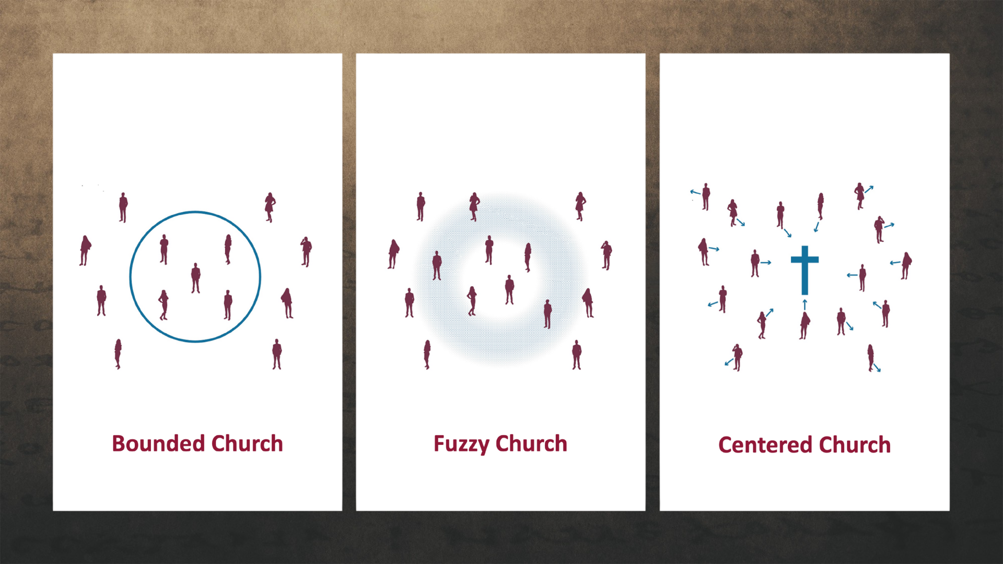
Notes:
“Bounded churches may state that Christ is at the center, but the paradigm itself acts like a magnet and pulls people to turn and focus on the boundary line that defines the group and provides security. At the other end of the spectrum, a fuzzy church might talk about the centrality of Jesus Christ, but it does not actually have a center. The focus is still on boundary lines, but in this case their identity is defined by not having any boundary lines. In a centered church our security and identity reside in our relationship to the center. Therefore, the paradigm itself, like a magnet, pulls our focus to the center—Jesus Christ.”
Brothers and sisters, despite the good that might come from a bounded approach, Jesus rejected this mindset of the Pharisees in his own ministry. And as we have heard from Paul to the Galatians, it is slavery, it is going backwards, it breeds all manner of shriveled fruit, as it reflects a tribalistic mentality born of the flesh, not the Spirit. And it fails to trust in the way that calls us to meet people where they are and journey together toward the God of the center—the God who looks like Jesus.
Therefore, let us say “No” to the false gospel of the bounded church, so that we might say “Yes” to Jesus and the gospel of grace which is best experienced and embodied in centered-set community, where grace and truth are held together in the way of Christ, for there is no other gospel. Amen?
Here are some questions to help us reflect and respond together… [NEXT SLIDE]

Slide 15
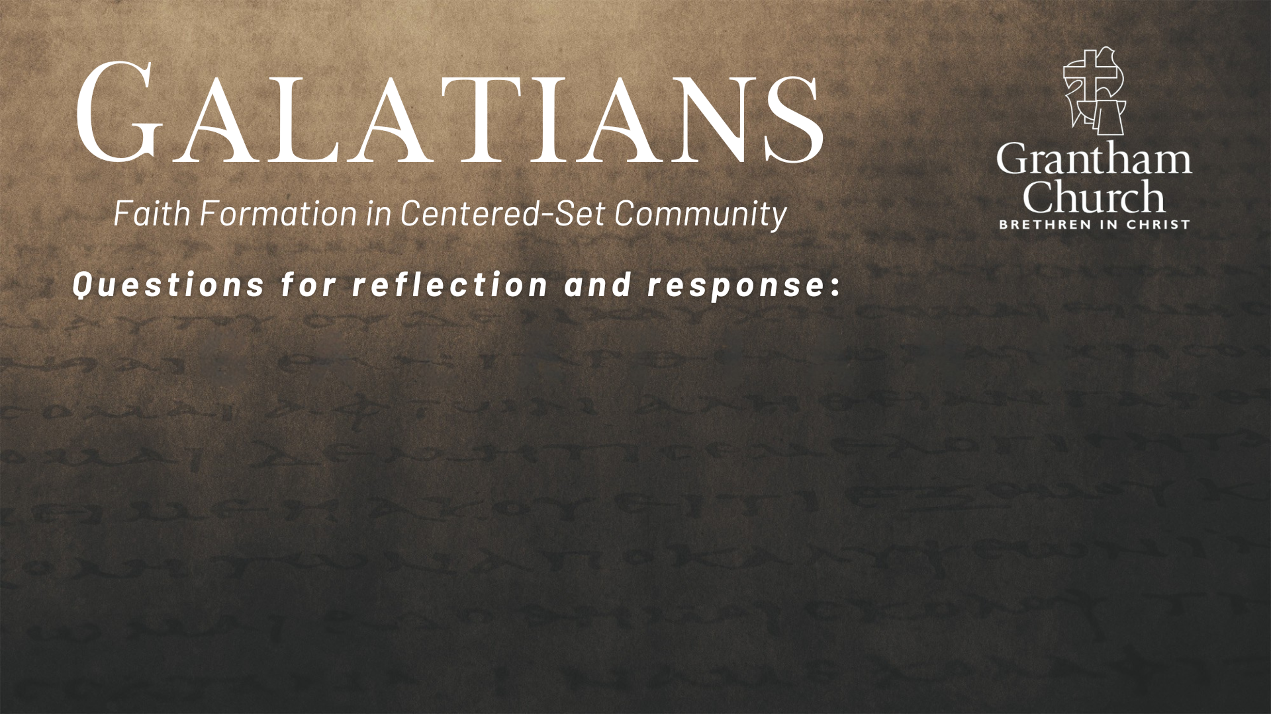
Notes:
Questions

Slide 16
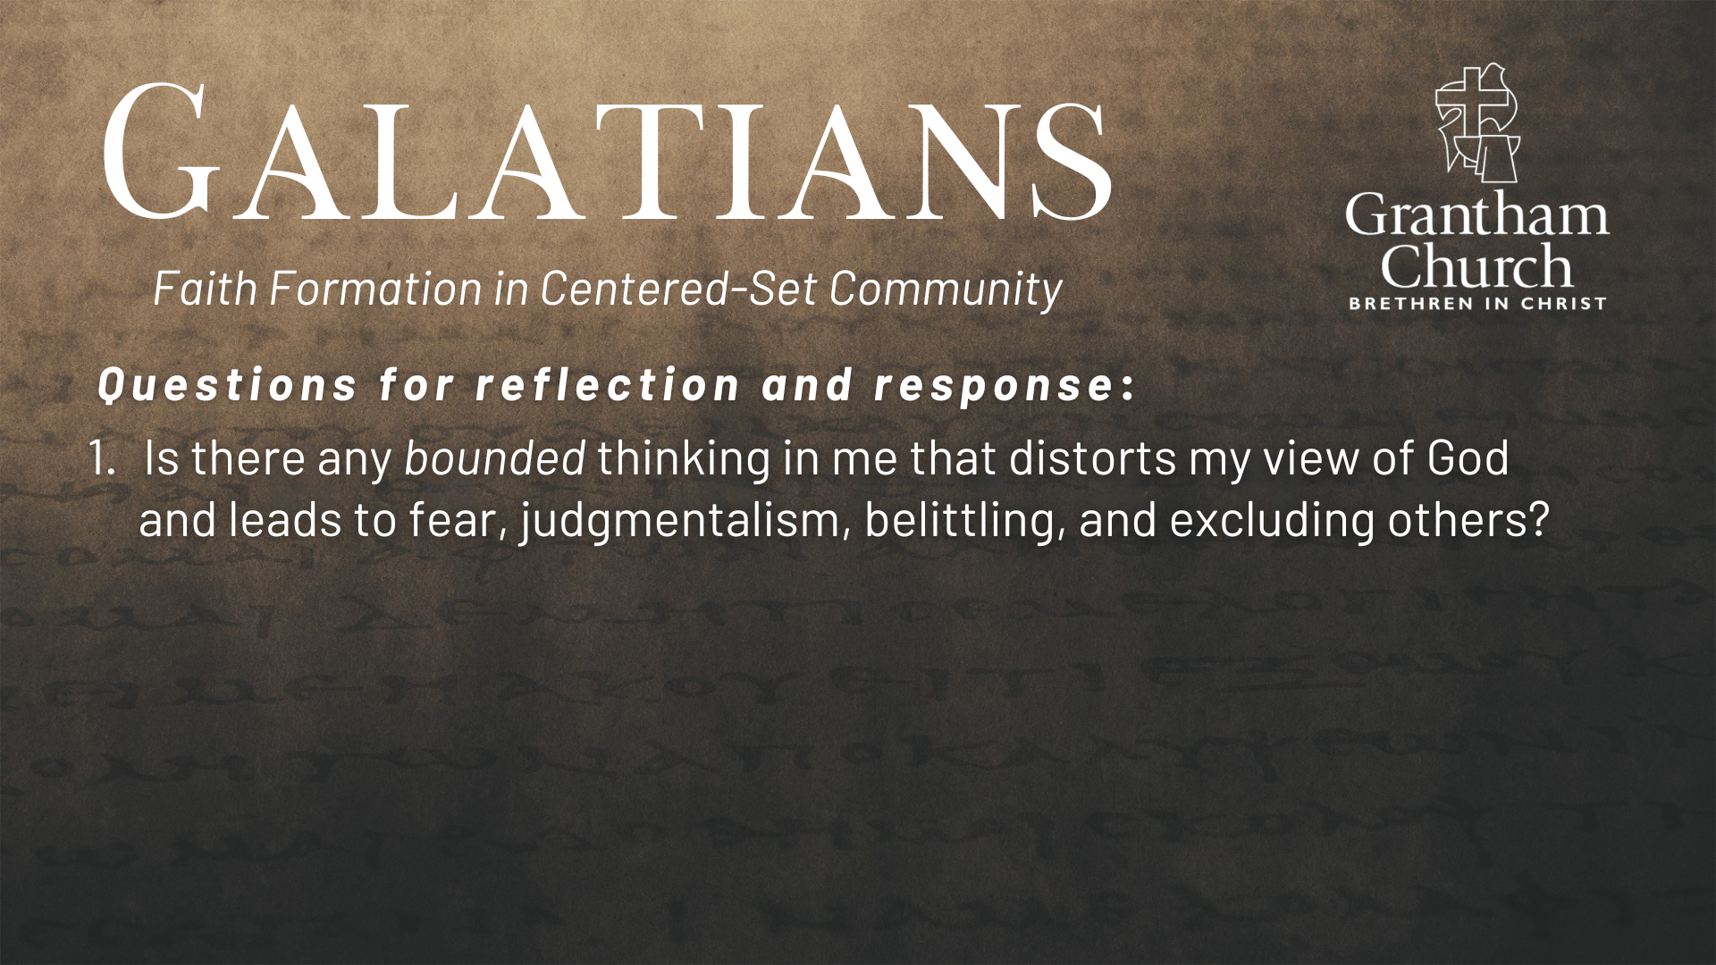

Slide 17
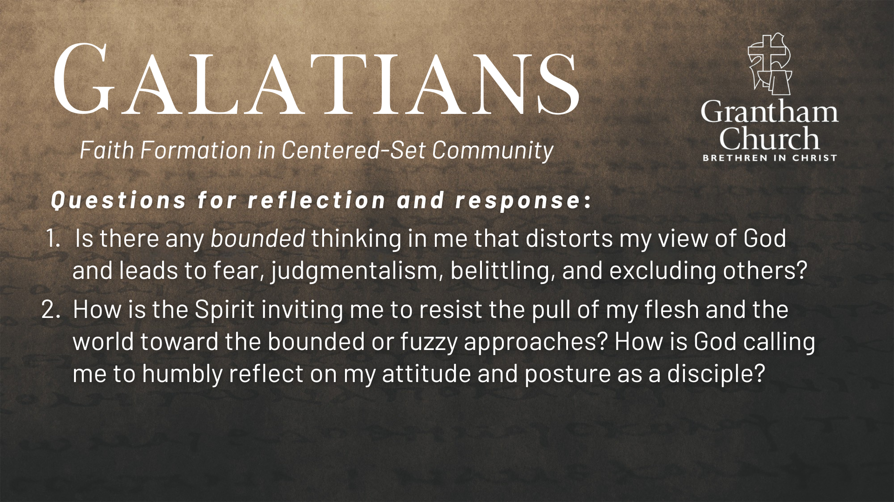

Slide 18
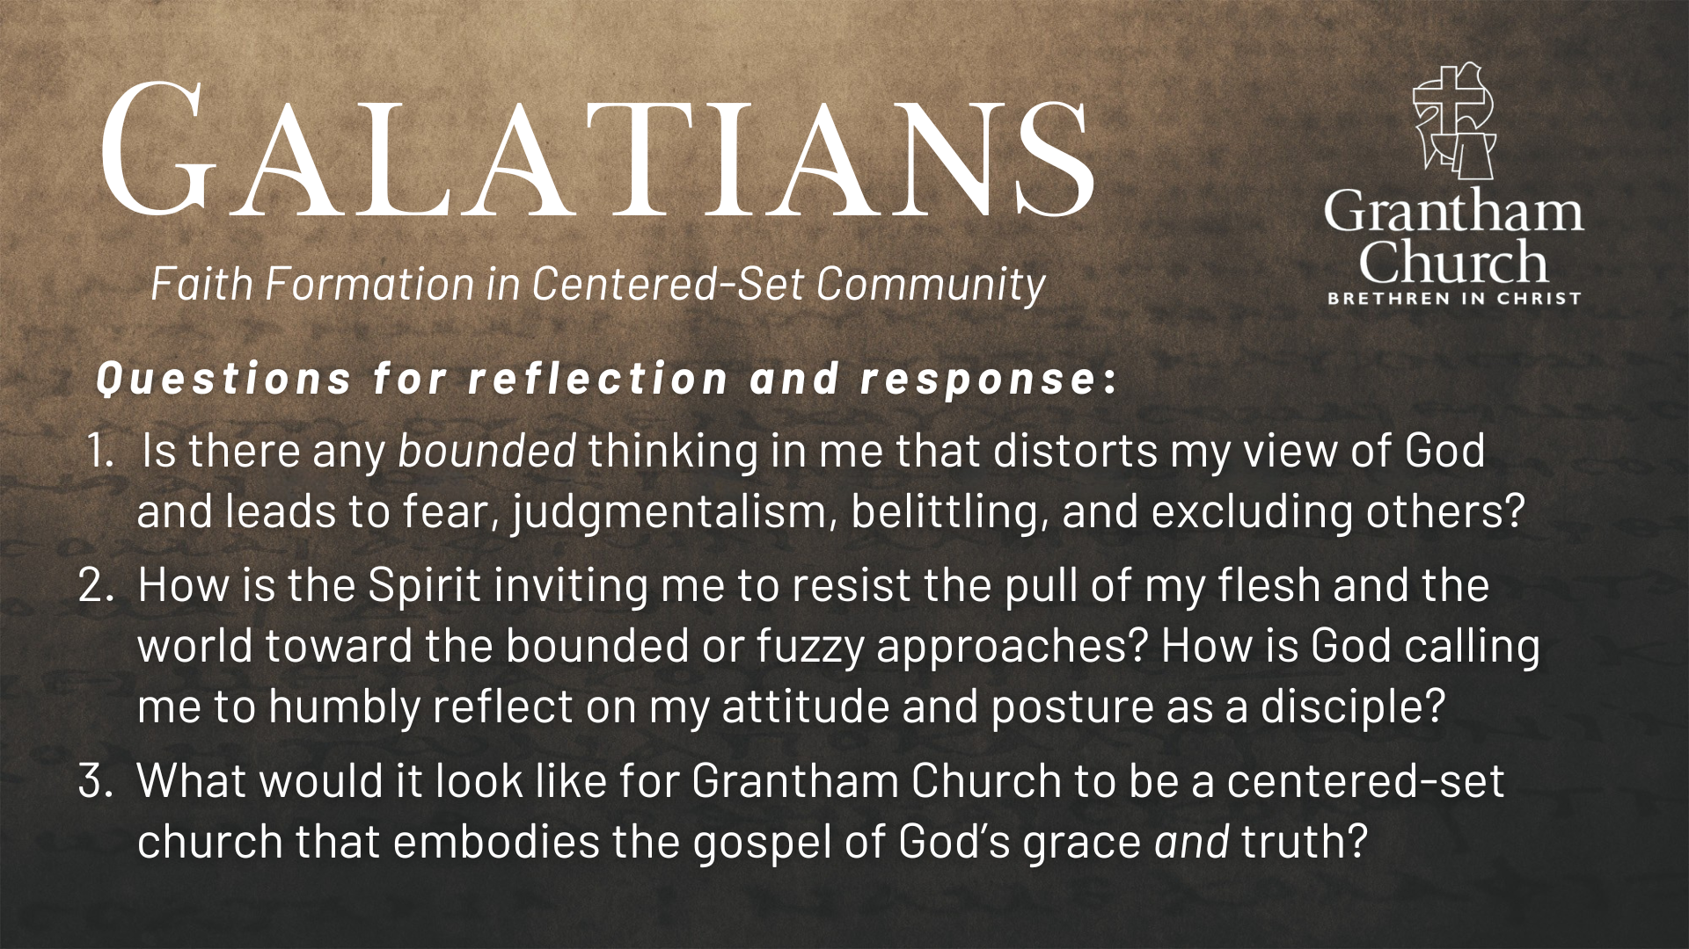
Notes:
[READ & BRIEF COMMENT ON EACH QUESTION]
Is there any bounded thinking in me that distorts my view of God and leads to fear, judgmentalism, belittling, and excluding others?
How is the Spirit inviting me to resist the pull of my flesh and the world toward the bounded or fuzzy approaches? How is God calling me to humbly reflect on my attitude and posture as a disciple?
What would it look like for Grantham Church to be a centered-set church that embodies the gospel of God’s grace and truth?
[CLOSING WORDS]
Let’s pray… [NEXT SLIDE FOR CLOSING PRAYER]

Slide 19
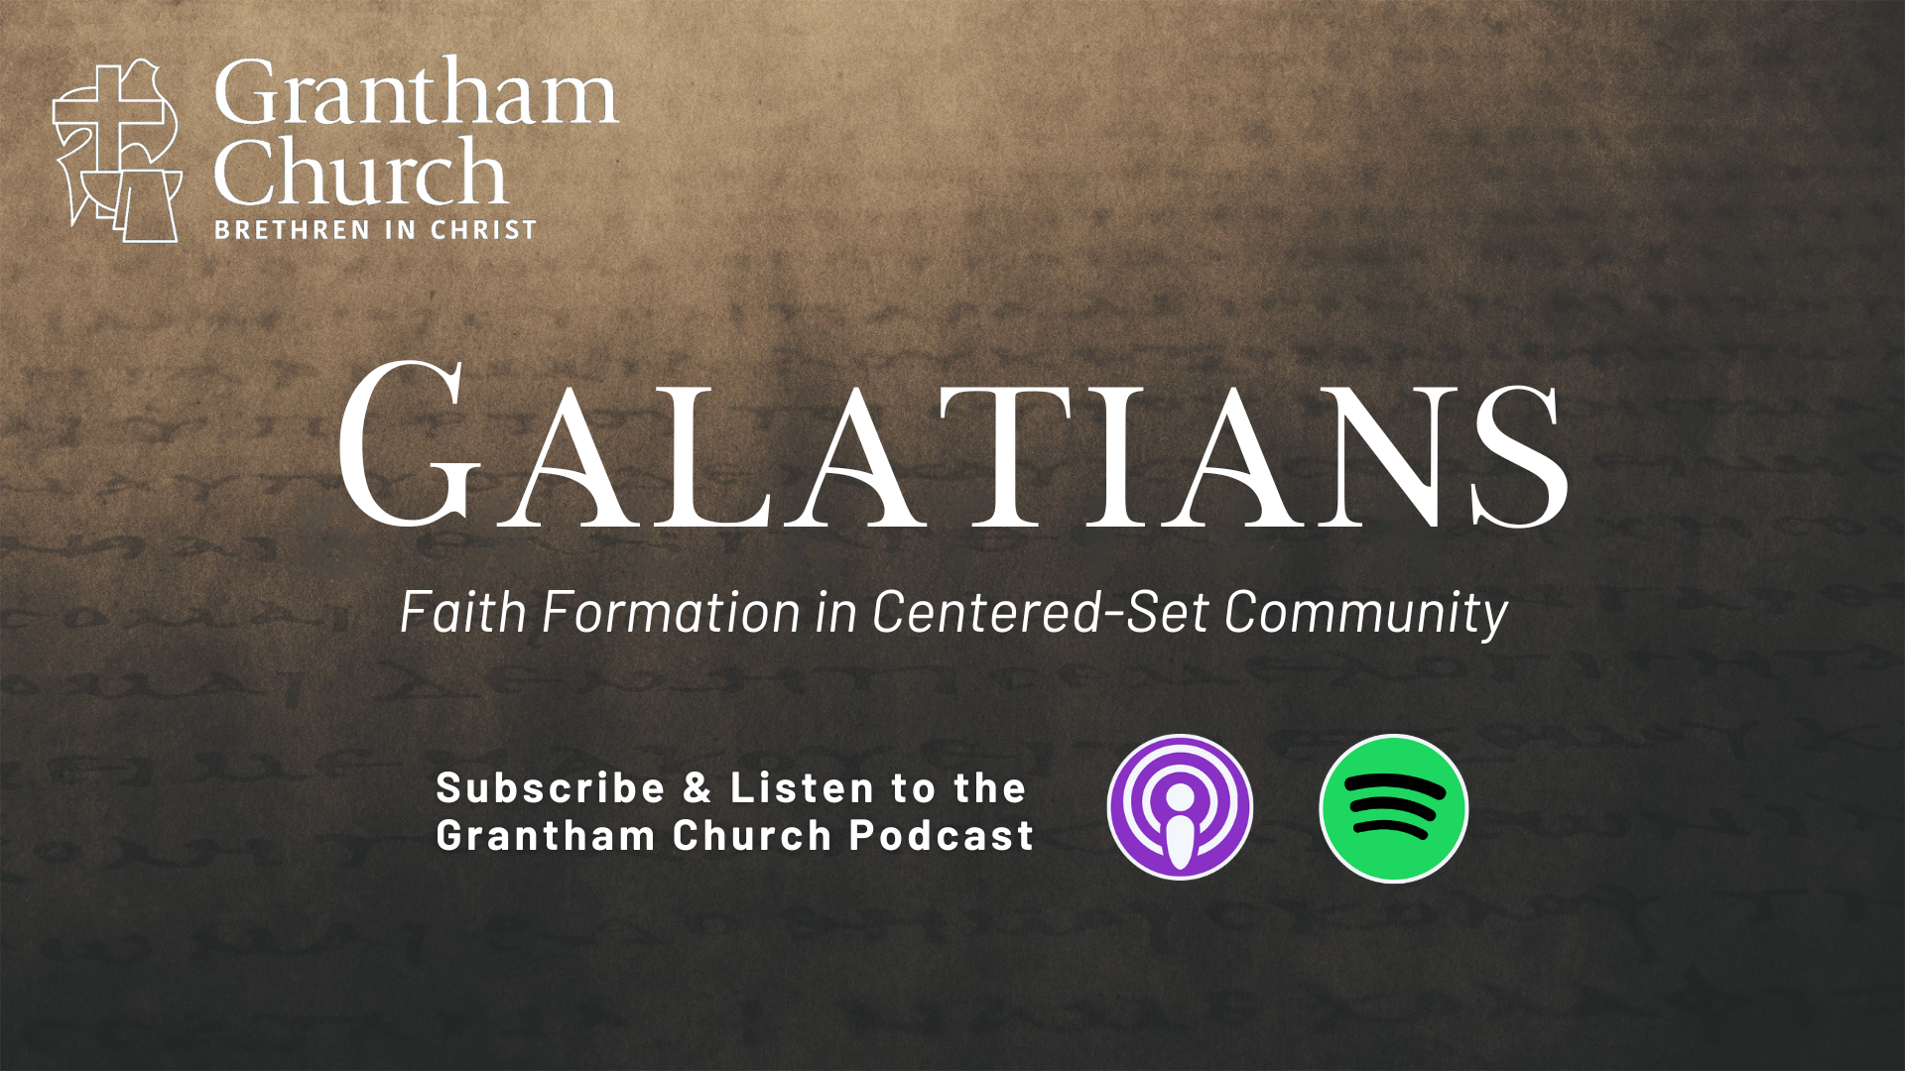
Notes:
[CLOSING PRAYER]
Benediction

