Slide 1
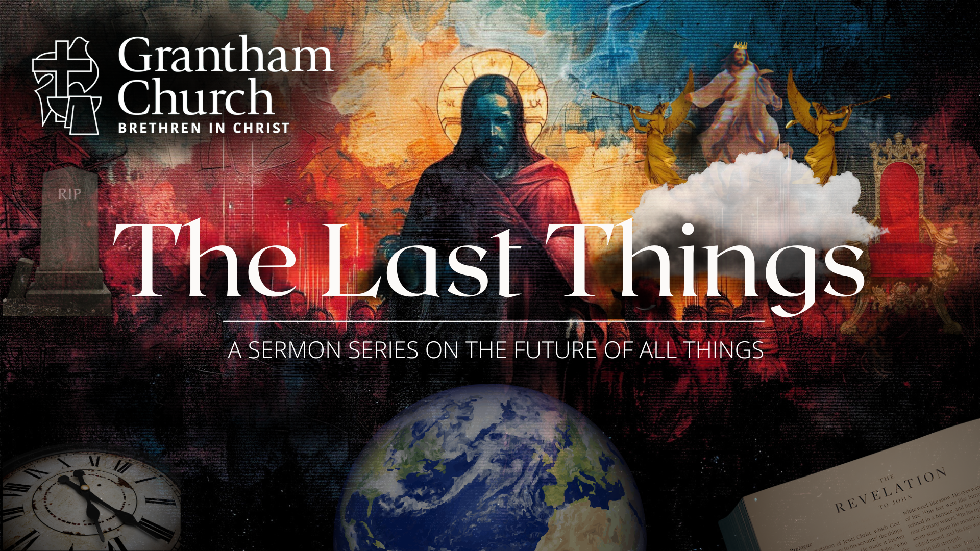
Notes:
[BRIEF WELCOME & INTRO]
We are continuing our series, The Last Things, this morning.
Remember the ”last things” comes from… [NEXT SLIDE]

Slide 2
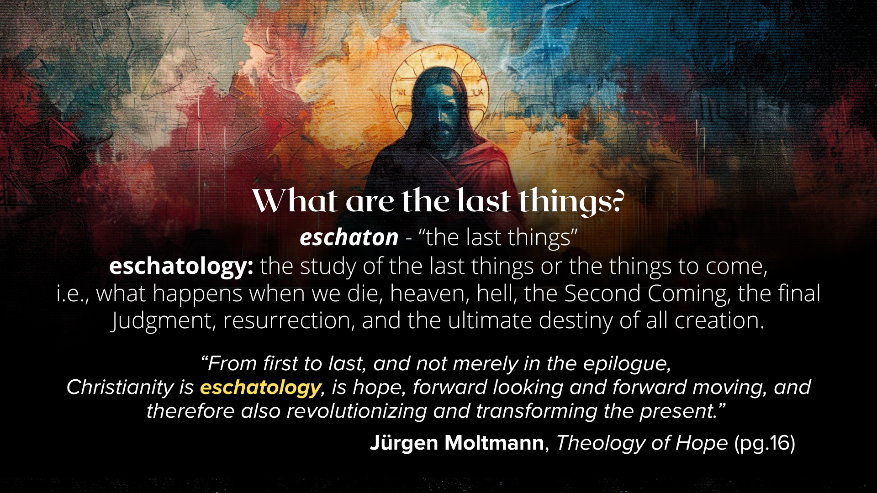
Notes:
[READ SLIDE & COMMENT]
And we’ve been addressing the last things because knowing where things are going has the potential to deepen our trust in God in times of fear and uncertainty, ground us in the Christian hope, and help us to live with peace, joy, and assurance as followers of Jesus.
Therefore, we want to be reminded that God is guiding all of human history to its divinely intended goal so that we can keep all of life in eternal perspective… [NEXT SLIDE]

Slide 3
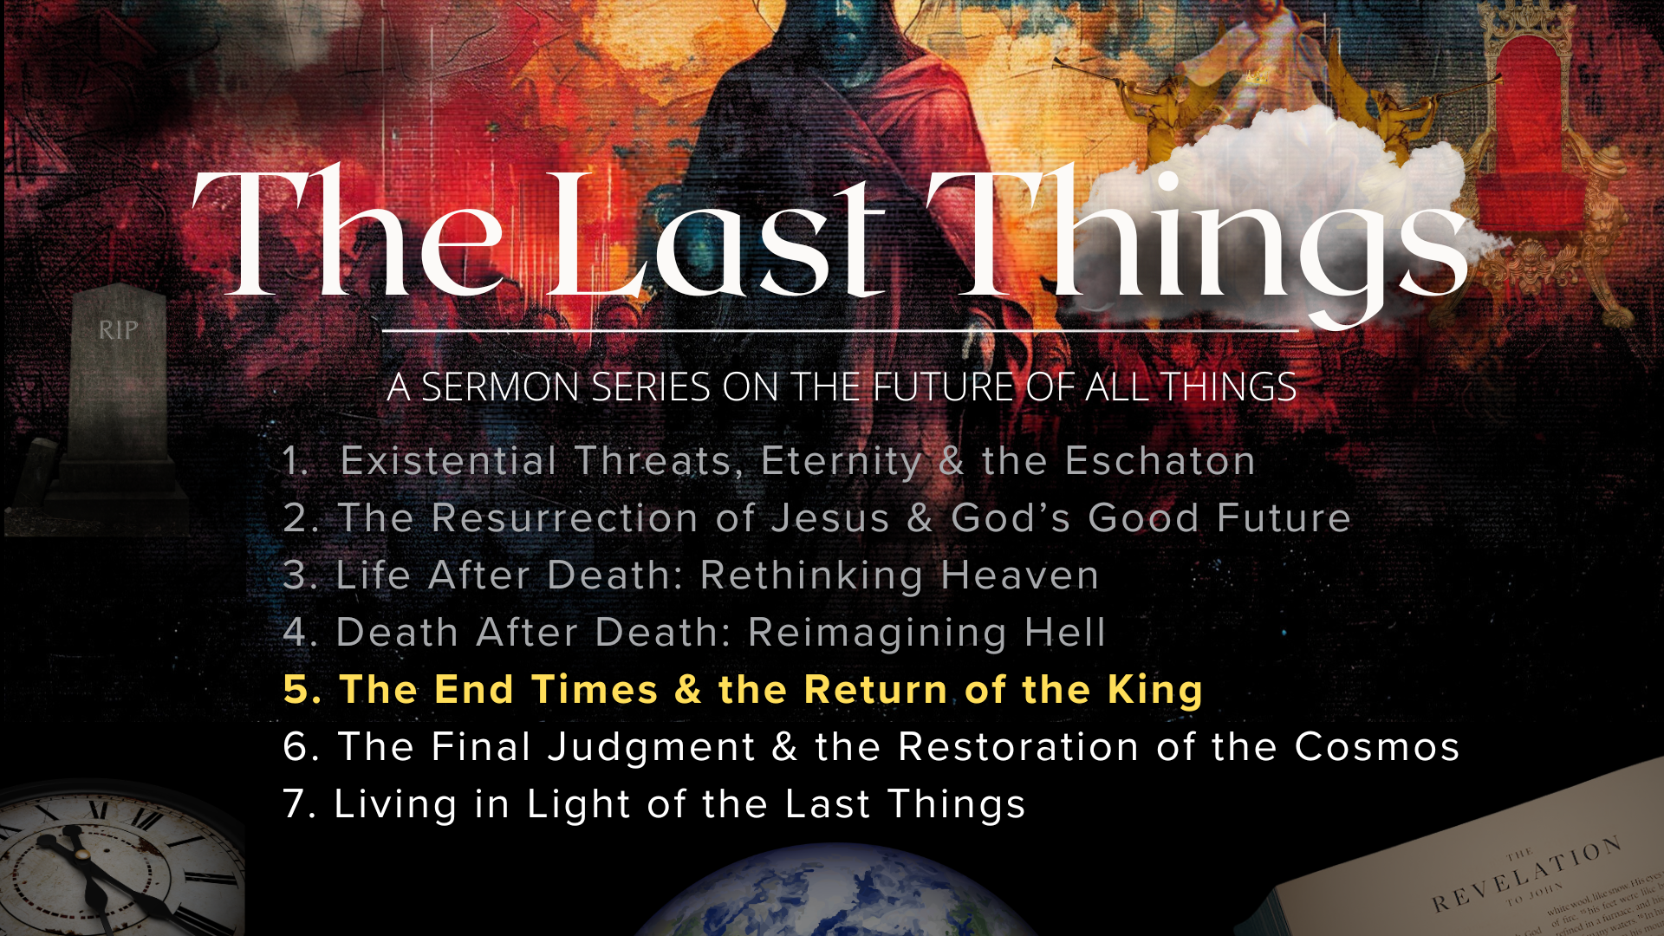
Notes:
We’ve covered a lot already in this series. If you missed any of the messages over the first four weeks, I want to encourage you to go back and listen at our website or podcast.
Today I’m going to skip the recap and just jump right into the fifth message of the series… [NEXT SLIDE]

Slide 4
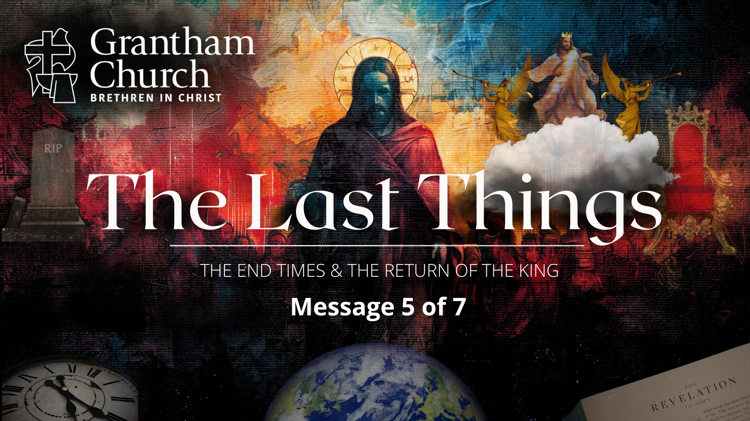
Notes:
The End Times & the Return of the King.
Once again, I’d like to remind you that we are a thinking congregation that (like the Bereans) wants to take the inspired and authoritative Scriptures seriously. We want to correctly handle the word of truth so that we can walk in it. Amen? No doubt… some of us are sure to be challenged by this message today, but that’s OK. One way or another, I believe the Spirit will speak to you and reveal more of Jesus Christ, our long-awaited King.
And with that, let’s prepare our hearts and minds in prayer. [BRIEF PRAYER]
Each week in this series I’ve shown you this image... [NEXT SLIDE]

Slide 5
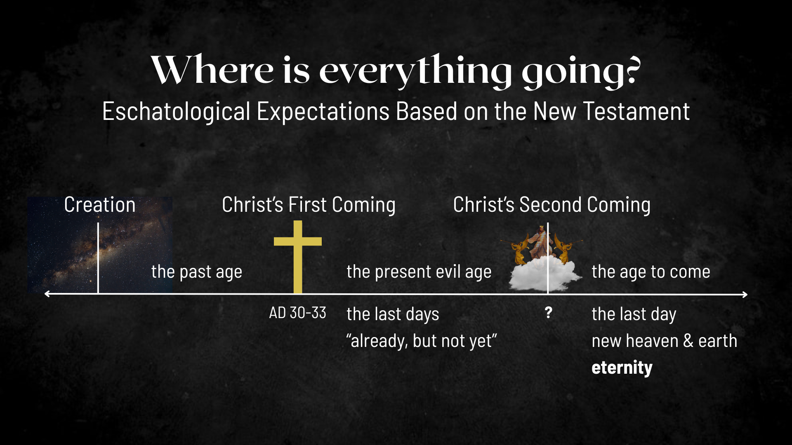
Notes:
[EXPLAIN IMAGE – CREATION TO ETERNITY]
Jesus’ first coming split our historical timeline (the past age & the present evil age)
So, according to the Scriptures, since the life, death, and resurrection of Christ, we’re living in the “last days”; we live in the ”already, but not yet” of the Kingdom of God; the decisive battle has been won, the victory is certain, and the future is secure.
And the Bible says that Christ will return a second time. Remember what the angel said to the disciples in Acts 11:1 after Jesus ascended: “Men of Galilee, why do you stand here looking into the sky? This same Jesus, who has been taken from you into heaven, will come back in the same way you have seen him go into heaven.”
And so, when Jesus returns in this way, this present evil age comes to an end, God raises the dead, brings heaven to earth and we enter the age to come.
And in seeing this illustration each week, some of you may have had the thought, “But wait a minute… based on what I was taught… something is missing… before the Second Coming.” What comes to mind? Yeah… the rapture. What about “the rapture”?
If you’ve grown up in the church, it’s possible that you’ve seen this picture or one like it… [NEXT SLIDE]

Slide 6
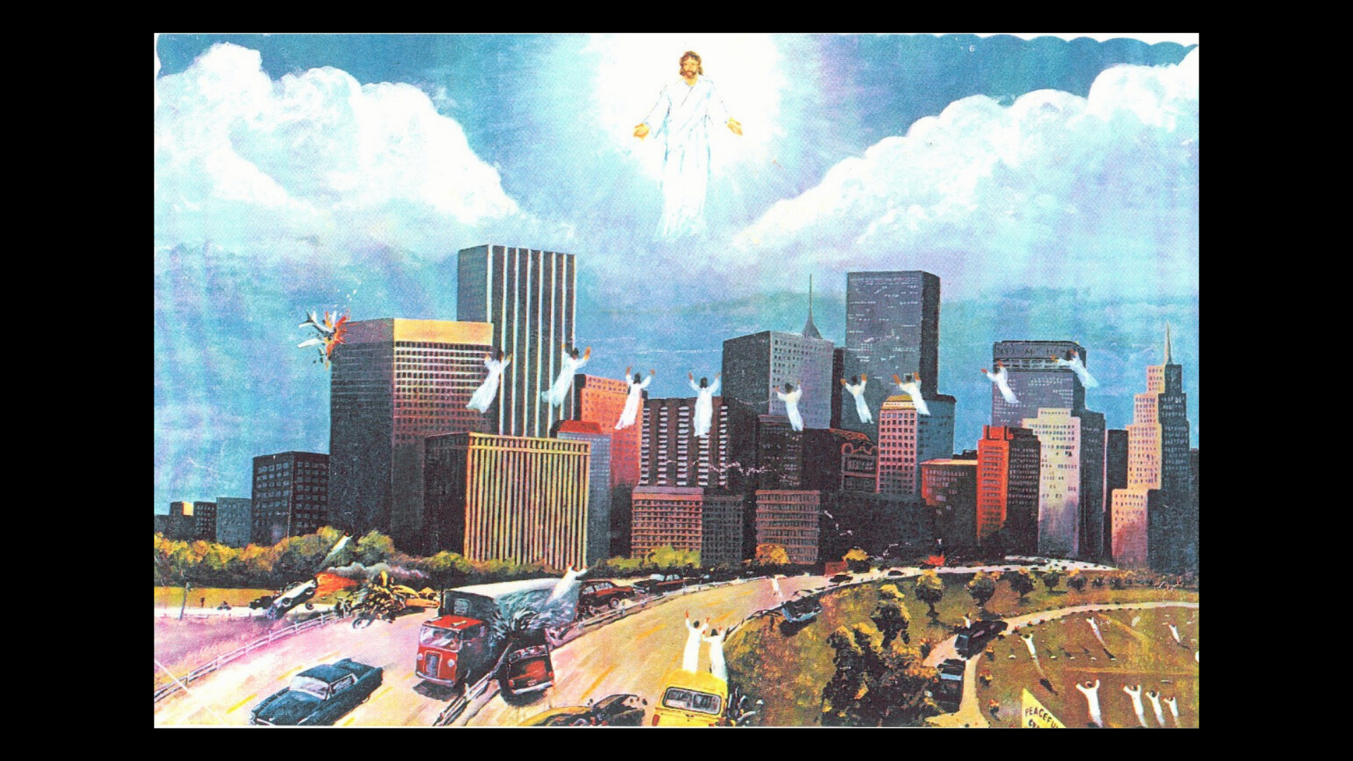
Notes:
[BRIEF COMMENT ON PICTURE]
As a kid, I can remember this poster being up in our church
It depicts what is known as ”the rapture”—an end-times scenario that is popular among American evangelicals, which says that all believers, both living and dead, will be resurrected and taken up to heaven to meet Jesus in the air. And many evangelicals believe that this event precedes a 7-year Tribulation and the Second Coming of Jesus.
But it doesn’t stop there. In fact, many of us were taught a very detailed set of expectations (depending upon your version and interpretation of certain passages of Scripture) that told us what to expect before, during, and after Christ returns. It’s all complicated, conspiratorial, and even gnostic-like, as it claims to know specific details about the future by proof-texting verses and decoding apocalyptic texts.
But is this what the Bible teaches? Is this what the early church believed? And if not, where did this view of the end times come from?
Well, let’s talk about where it originated… [NEXT SLIDE]

Slide 7
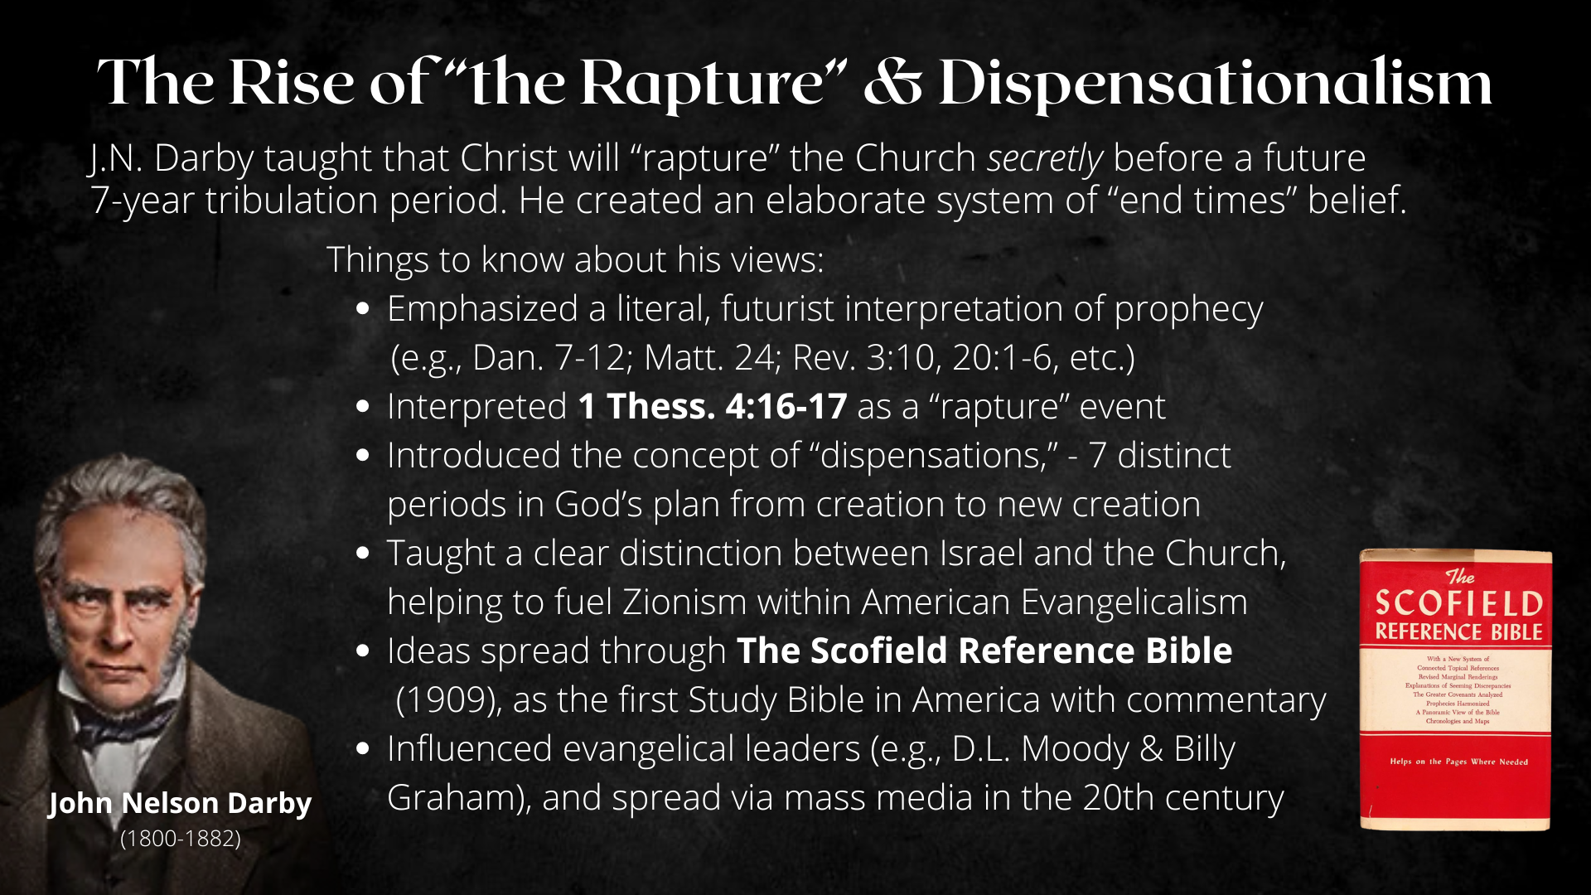
Notes:
Rapture theology began in the early 1800’s at a revival in Glasgow, Scotland with Margaret McDonald, a teenage girl who claimed to have had a vision of a pre-tribulation rapture at which time the church would be taken out of this world and swept up into heaven; she then shared it with British minister John Nelson Darby (who was there), who became convinced it was true, and then he came to the US and influenced the Plymouth Brethren, a group of nonconformist evangelical congregations that originated in Dublin, Ireland in the 1820s.
And not long after, Darby encountered Dwight L. Moody, who would soon become the worldwide disseminator of ‘pre-tribulation rapture’ theology. And to this day, Moody Bible Institute in Chicago and Dallas Theological Seminary are major propagators of this end times perspective. In fact, this was part of the whole reason for founding DTS.
Here are some things to know about about this view that was first thought up in the early nineteenth century and taught by Darby…
[READ & COMMENT ON THE BULLET POINTS]
Scofield Bible: The heading for Matthew 24 is “Jesus Predicts the Rapture”
[READ EXCERPT IN ”REVELATION FOR THE REST OF US”]
And then came the flood of mass media in the mid-to-late 20th century… [NEXT SLIDE]

Slide 8

Notes:
[COMMENT ON VARIOUS MEDIA]
And it’s important to consider the world events that helped to fuel rapture theology: WWI, WWII, the establishment of the state of Israel in 1948, the growing threat of nuclear war, fear of a one world government, the rise of the anti-Christ, natural disasters, etc., etc. And with all of these events (and others like them today), we see an ongoing effort to affirm and bolster this view of the end times, and so this escapist theology, which pervaded the Christian evangelical subculture in the 20th century still survives in the imagination of American Christians.
It reminds me of when I was in college and a beloved Bible prof on campus preached in chapel and said: “Only in America would we believe in a secret rapture where we (meaning the church) all get taken and don’t have to experience suffering and tribulation.”
So, let’s look now at the major “rapture” proof-text and see what is really going on there. Turn with me to… [NEXT SLIDE]

Slide 9
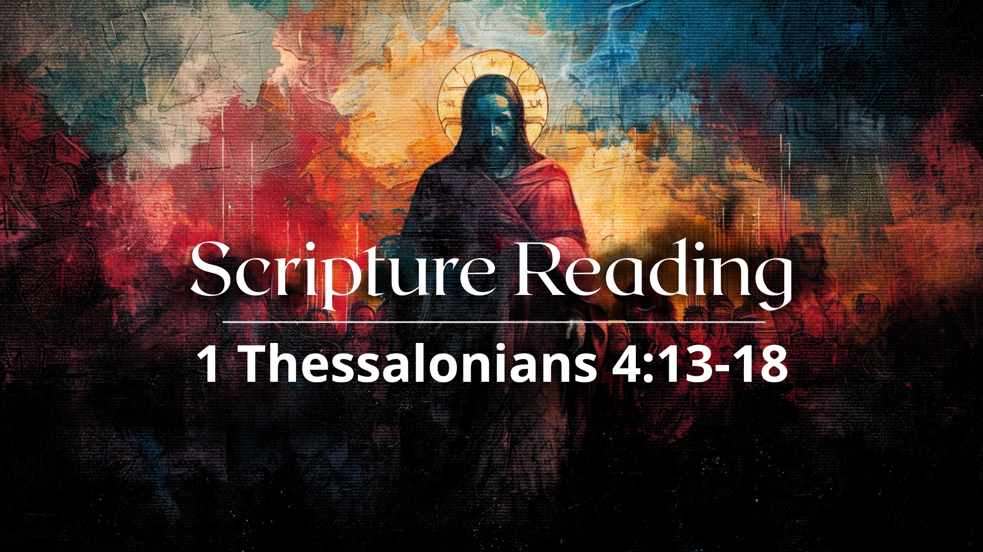
Notes:
[READ VERSES 13-15 & COMMENT]
v. 15 – “coming” is the Greek word, parousia (literally meaning “arrival” or “appearing”), which was used at that time to speak of an official visit, arrival, or coming of a ruler, emperor, or high-ranking official to a city or province. Therefore, Paul is intentionally using “kingly” imagery to imagine the return of Christ.
And now look carefully at verses 16-18… [NEXT SLIDE]

Slide 10
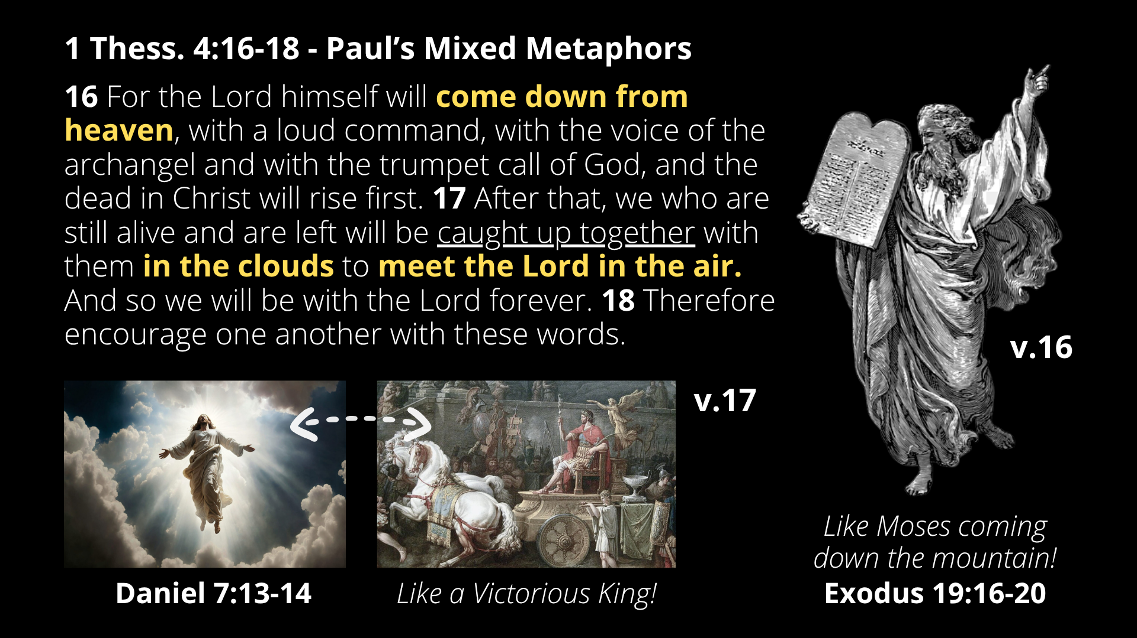
Notes:
[READ EACH VERSE & COMMENT]
Again, there are 3 primary metaphors being mixed together:
Moses (Exodus 19:16-20 – trumpet blast!)
Son of Man (Dan 7)
Royal Appearing (Parousia) – imperial metaphor with religious & political significance
Paul is trying to describe the inexplicable by saying, when Christ comes it will be like Moses coming down the mountain (bringing God’s will and sorting out the chaos down below), and it will be like the Son of Man who is exalted in the clouds by the Ancient of Days, and it will be like a victorious king returning to his city. Therefore, we will go out and meet him and then parade him back into the city to sit on his rightful throne and rule forever and ever.
In his book, Surprised by Hope, N.T. Wright says, “Jesus' resurrection is the beginning of God's new project not to snatch people away from earth to heaven but to colonize earth with the life of heaven.” And my friends, for the first 1800 years of Christian history, this was the standard view of the church.
And so, if 1 Thess. 4:16-18 isn’t teaching a secret rapture, then what about when Jesus talked about people being left behind? What do we make of that? Well, turn with me again to the Gospel of Matthew… [NEXT SLIDE]

Slide 11
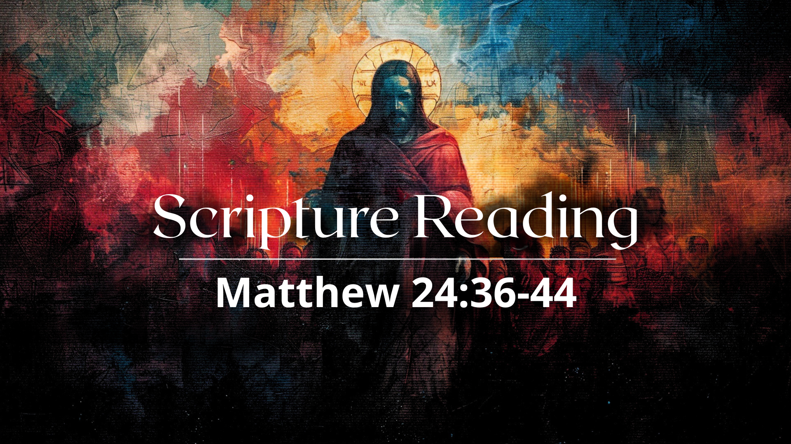
Notes:
[READ PASSAGE & COMMENT]
So, it’s the wicked who are taken, not the righteous!
Jesus is calling us to be vigilant and to live with the expectation that his appearing is imminent; he could return at any moment and bring the present evil age to an end
But we shouldn’t worry about something like this happening… NEXT SLIDE]

Slide 12

Notes:
[BRIEF COMMENT ON PICTURES]
But what about the book of Revelation? Well, in short, you don’t find this view explicitly taught there. There is nothing even closely resembling the rapture. And you have to read Revelation literally and in a mystical ball sort of way to come up with the future things imagined by proponent's of this view. What’s most unfortunate is that it totally disregards the genre of apocalyptic literature and of how the early church would have understood John’s vision. And many of us having experienced this, just want to stay away from the book.
So, I’d like to recommend two more recent books to you that does an amazing job of helping us to read Revelation through the eyes of the first century audience… [NEXT SLIDE]

Slide 13
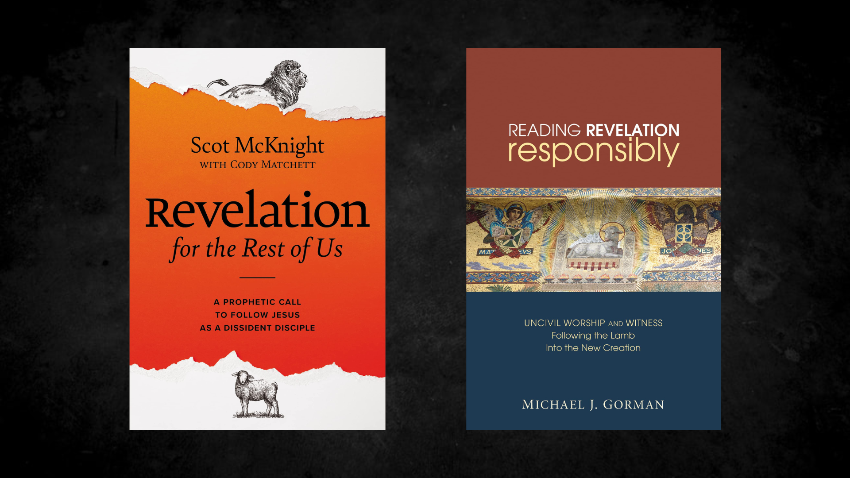
Notes:
[BRIEF COMMENTS]
In his book, Reading Revelation Responsibly, Michael Gorman critiques the Left Behind view and similar interpretations Revelation. He writes: “It treats the Bible as a puzzle to be pieced together into a script about the future, with various texts from various books taken out of context and inked to current or expected events. The method has sometimes been called biblical “hopscotch,” and the result is a patchwork quilt with scenes from Revelation as the most prominent and thematic aspect of the quilt” (pg.71).
He goes on to say, “It reduces discipleship to (a) faith in Jesus’ death in order to avoid being left behind or destroyed [fear]; (b) evangelizing others so they won’t be left behind or destroyed; (c) correlating “Bible prophecy” with current events; and (d) preparing to die or kill for the gospel” (pg.72). Gorman also points out that it is escapist, inherently violent and militaristic, inherently anti-Catholic; it is uncritically pro-American, it privileges the modern state of Israel, it is suspicious of anything to do with the United Nations, it sees wars in the Middle East as part of God’s plan, and it cultivates a survivalist and crusader mentality.
So, what does the book of Revelation say about the return of Christ? And what about those apocalyptic elements that have often been interpreted as promoting violence, militarism, and crusading for Christ. Let’s turn there and read one more passage of Scripture… [NEXT SLIDE]

Slide 14
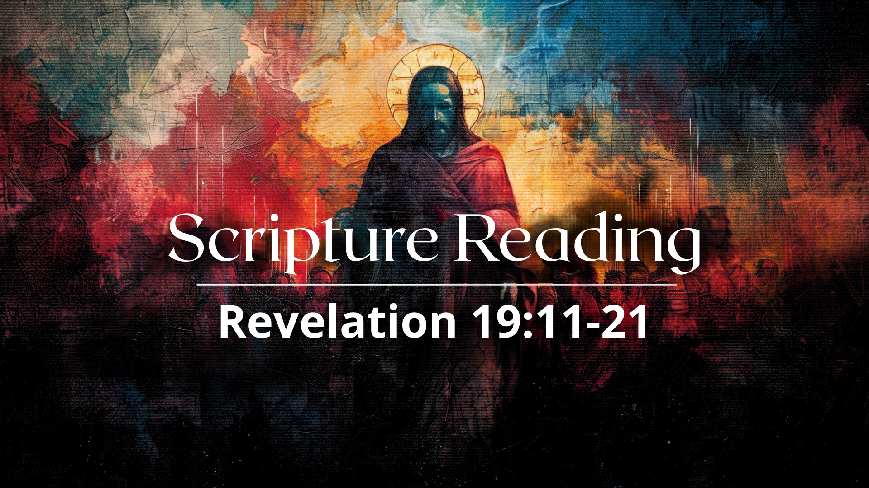
Notes:
[READ PASSAGE & COMMENT]
”beast” – the Roman empire; violent imperialism & state oppression
“false prophet” – a person(s) who promotes imperial or civic religion & propaganda
“mark of the beast” – a symbolic representation of allegiance to empire
What’s going on here? Revelation is using symbolic imagery to expose how politics, religion, and the economics of empire become demonic when they demand ultimate allegiance. The message to readers then—and now—is to resist the dragon (Satan) and false worship of the empire, remain faithful to Christ, and refuse to bow to oppressive systems. Because as we read in Revelation 19, Christ the King is coming back to judge them and overcome them all.
I imagine that there are many questions that are coming to your mind. There is a whole lot that I could say about Revelation, but we don’t have time to do that this morning. So be sure to check out the links and resources I will include in the weekly email. And of course, come back next week as we return to Revelation and continue exploring the last things.
Alright. I’ve done some deconstructing of what many have us grew up being taught. So, to be clear, what does the NT actually say about these things? What should we be expecting between now and Christ’s appearing? Let’s sum it up like this… [NEXT SLIDE]

Slide 15
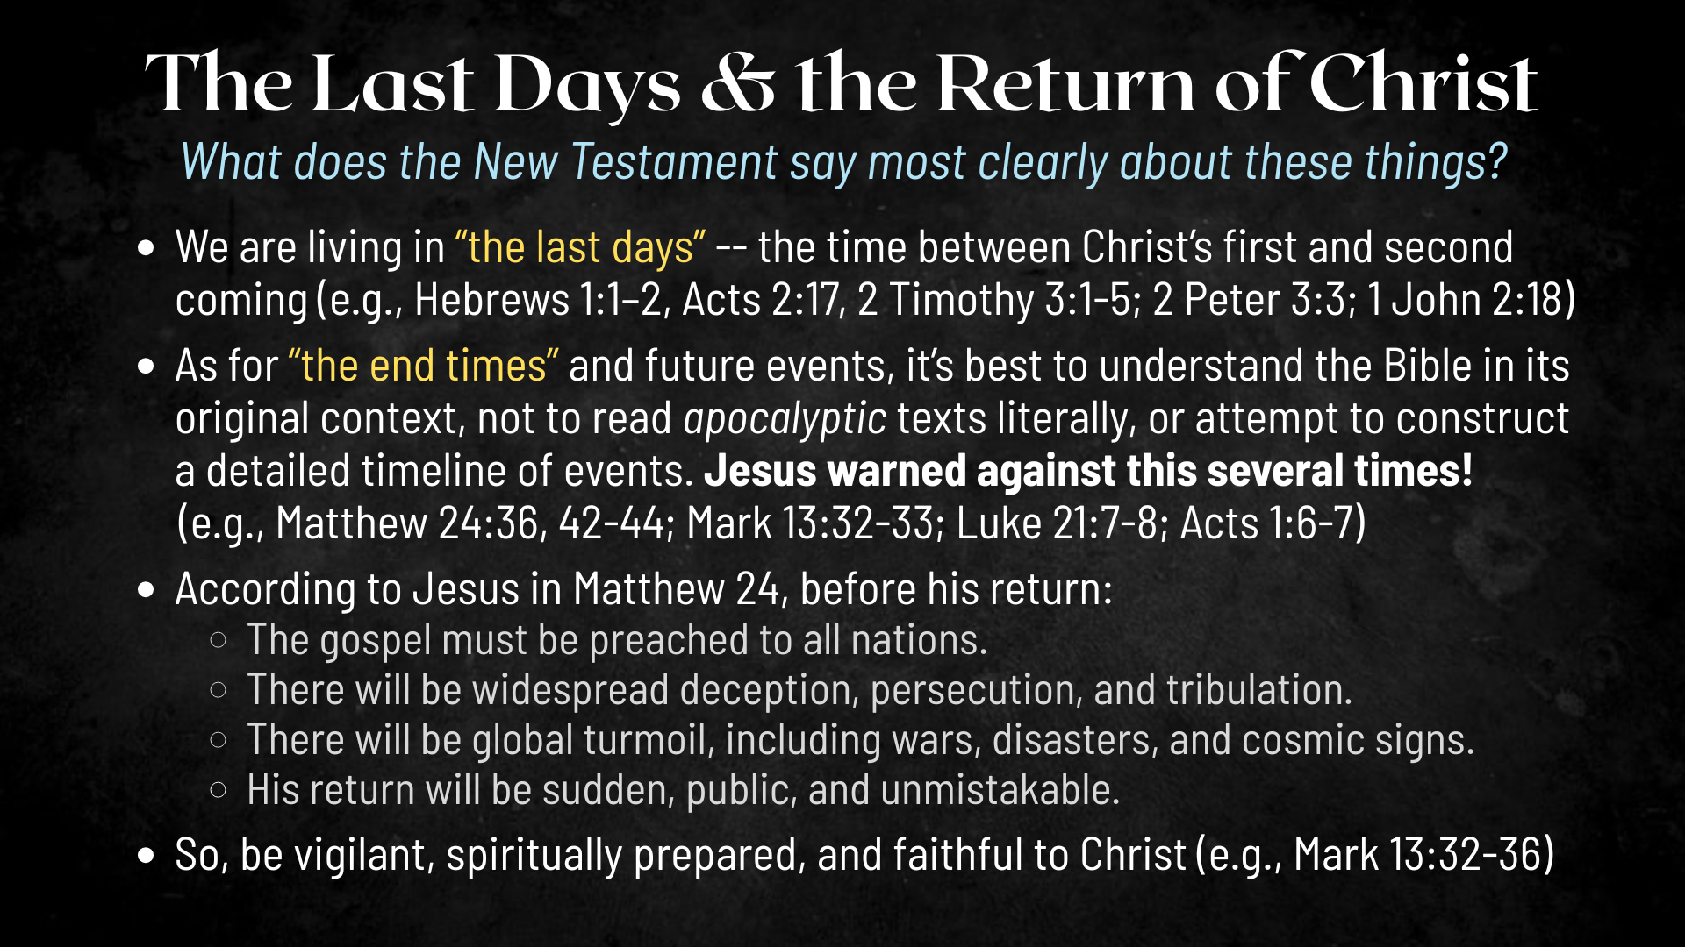
Notes:
[READ SLIDE & COMMENT]
In 2 Timothy 3:1-5, Paul said: “But mark this: There will be terrible times in the last days. People will be lovers of themselves, lovers of money, boastful, proud, abusive, disobedient to their parents, ungrateful, unholy, without love, unforgiving, slanderous, without self-control, brutal, not lovers of the good, treacherous, rash, conceited, lovers of pleasure rather than lovers of God— having a form of godliness but denying its power. Have nothing to do with such people.” Why? Because they will lure you into this behavior.
Here are some takeaways and suggested application based on the message… [NEXT SLIDE]

Slide 16
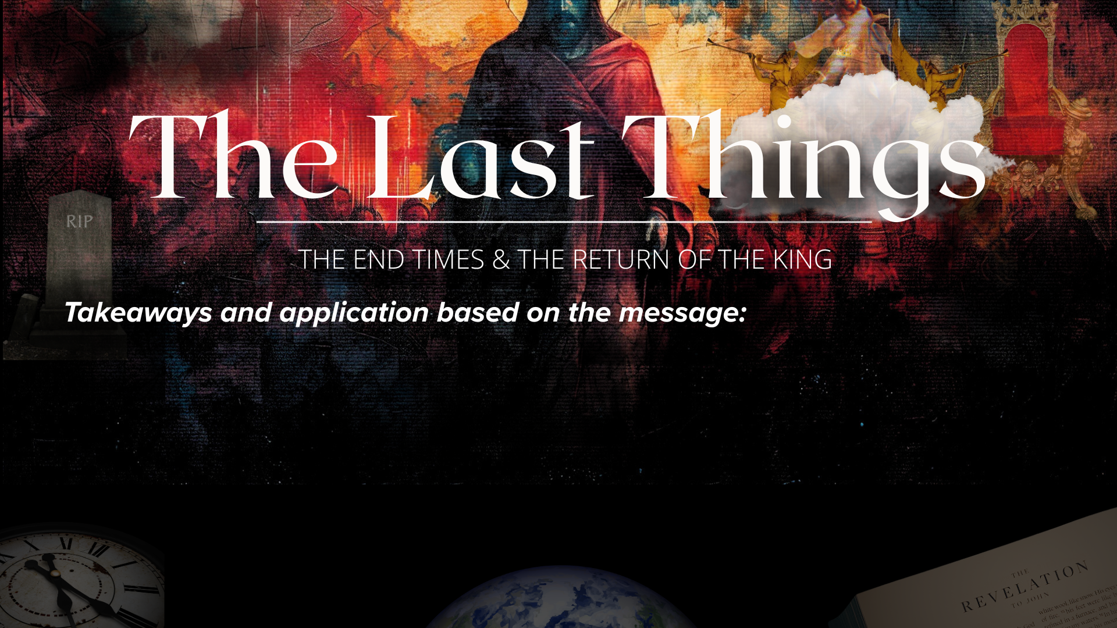

Slide 17
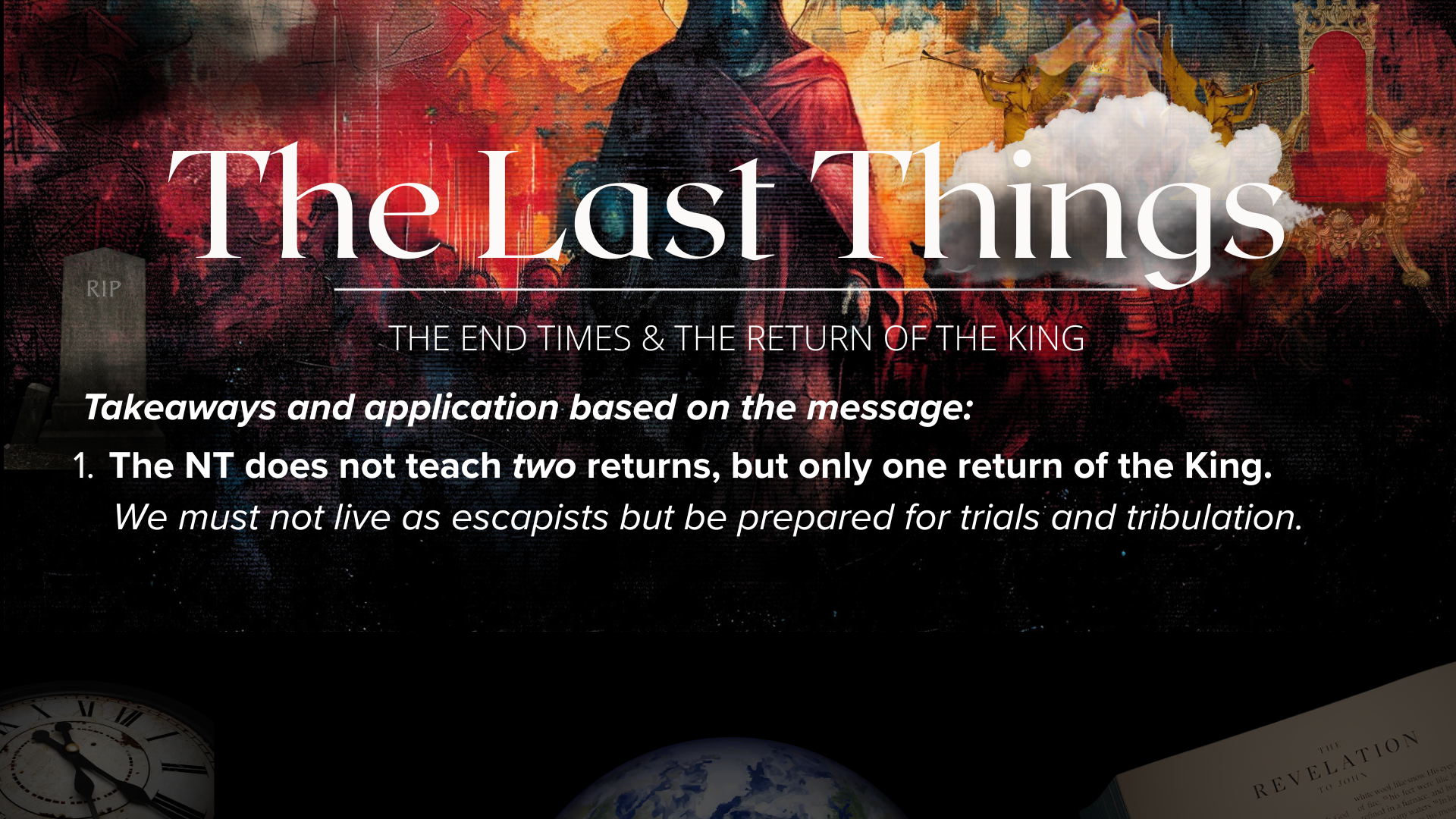

Slide 18
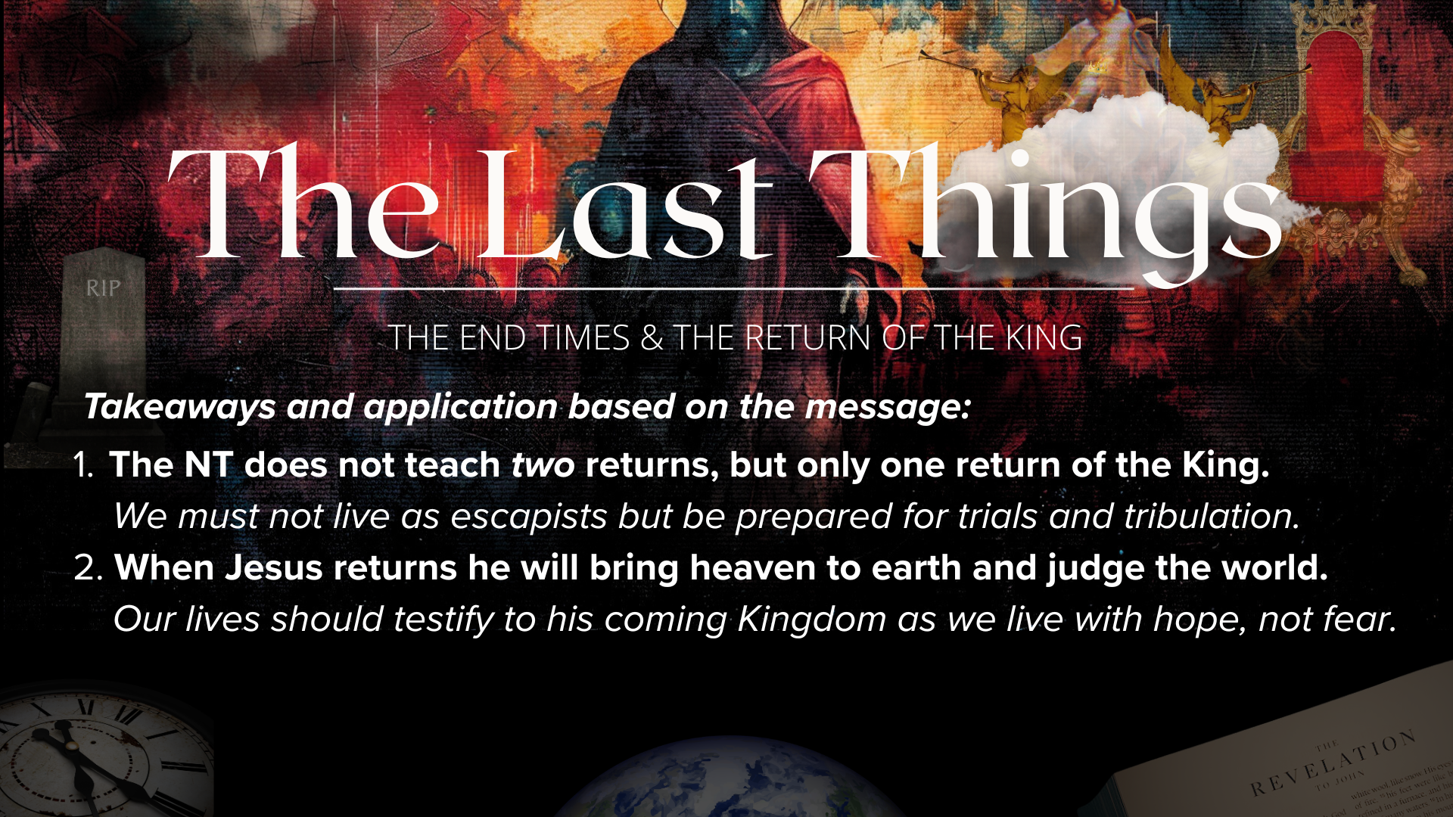

Slide 19
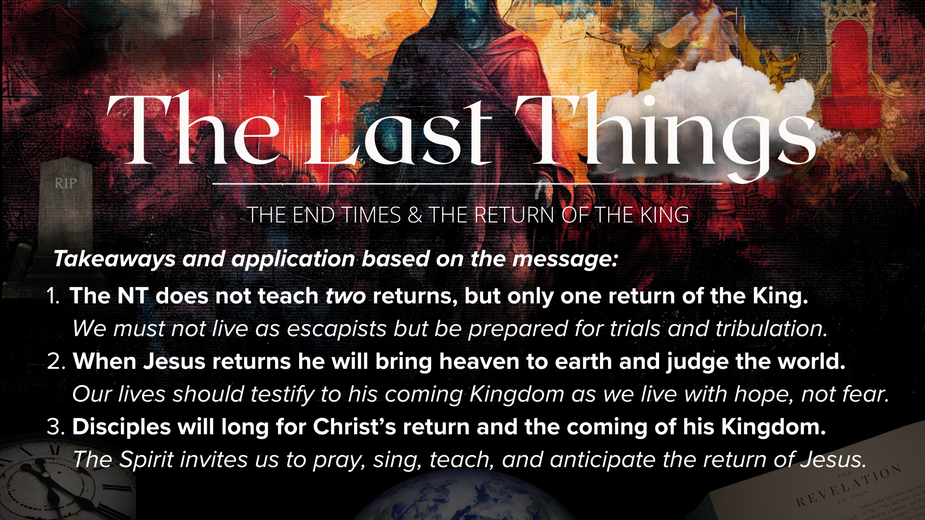
Notes:
[READ & COMMENT ON EACH TAKEAWAY]
The NT does not teach two returns, but only one return of the King.
We must not live as escapists but be prepared for trials and tribulation.
When Jesus returns, he will bring heaven to earth and judge the world.
Our lives should testify to his coming Kingdom as we live with hope, not fear.
Disciples will long for Christ’s return and the coming of his Kingdom.
The Spirit invites us to pray, sing, teach, and anticipate the return of Jesus.
Finally, here are some questions to help us reflect and respond together… [NEXT SLIDE]

Slide 20
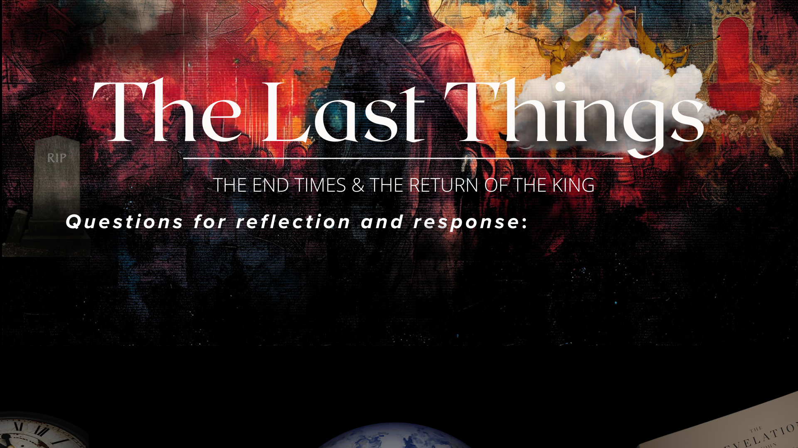

Slide 21
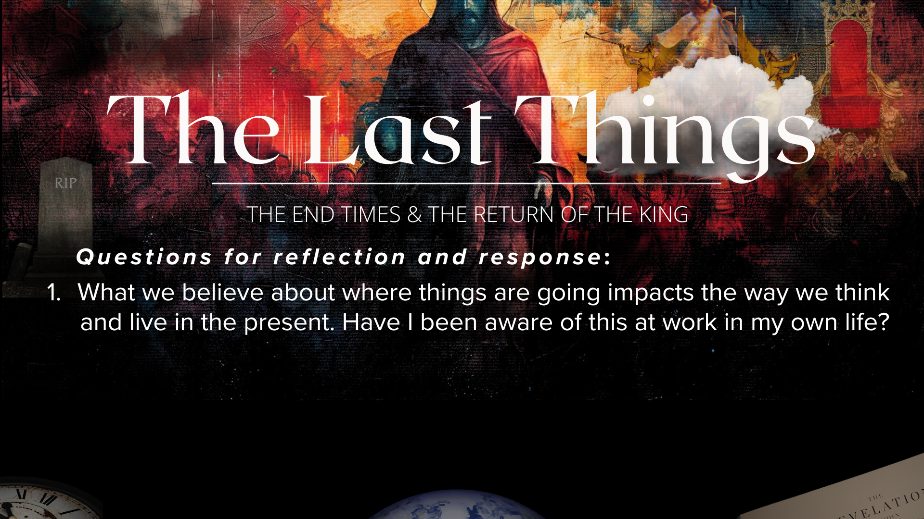

Slide 22
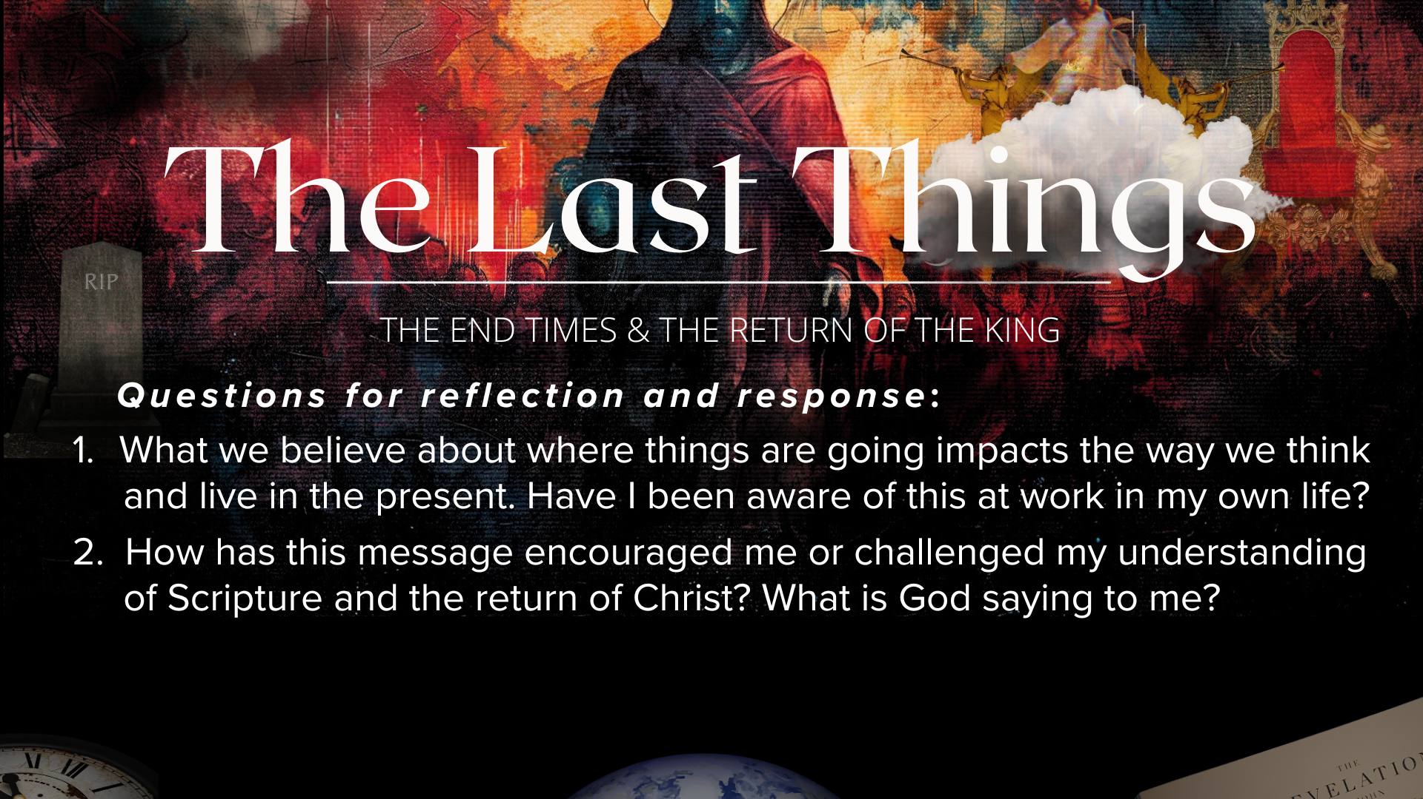

Slide 23
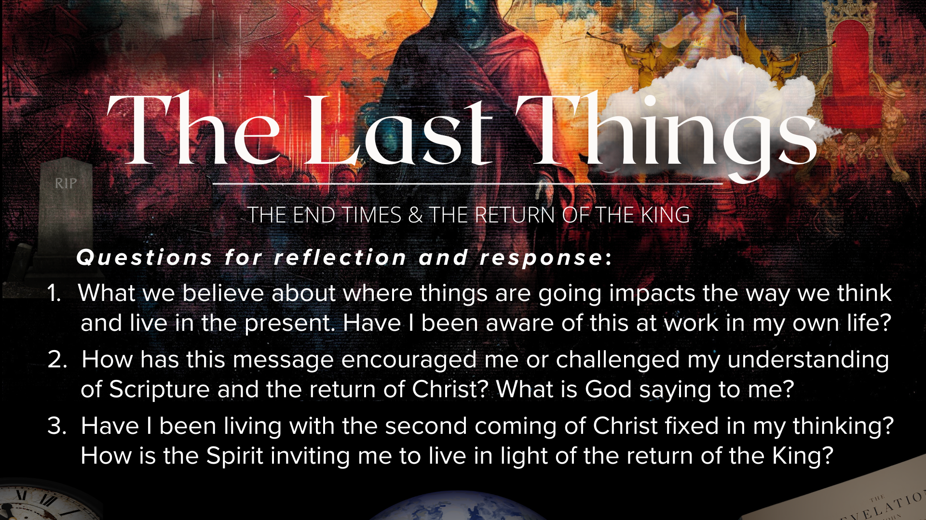
Notes:
[READ & BRIEF COMMENT ON EACH QUESTION]
What we believe about where things are going impacts the way we think and live in the present. Have I been aware of this at work in my own life?
How has this message encouraged me or challenged my understanding of Scripture and the return of Christ? What is God saying to me?
Have I been living with the second coming of Christ fixed in my thinking? How is the Spirit inviting me to live in light of the return of the King?
[CLOSING COMMENTS]
Let’s pray… [NEXT SLIDE FOR CLOSING PRAYER]

Slide 24
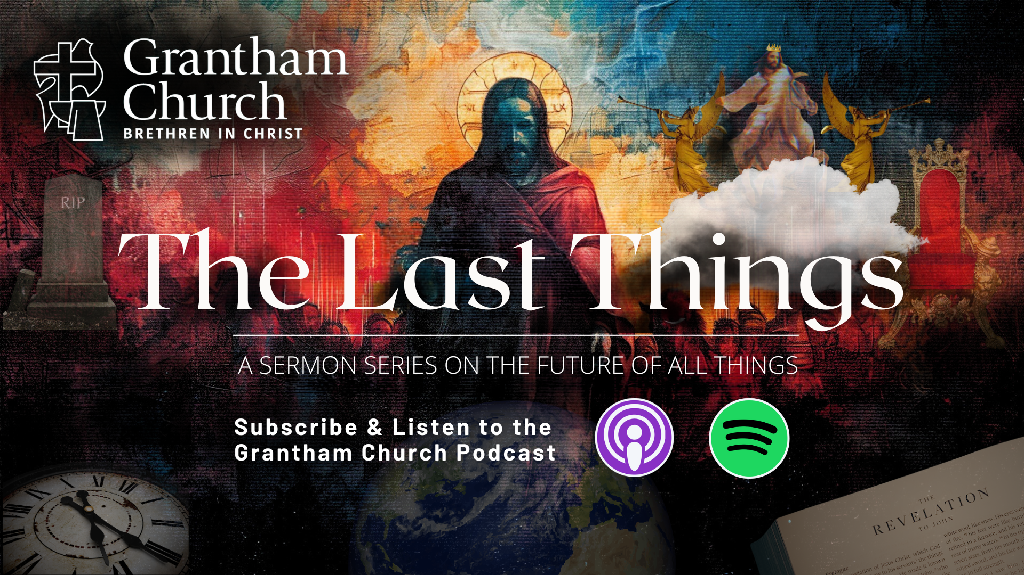
Notes:
[CLOSING PRAYER]
[APOSTLES’ CREED]
[COMMUNION]
[ANNOUNCEMENT]
Benediction
Church, may our sovereign God fill you with peace as you look to the future with faith, not fear. May the promise of resurrection and eternal life anchor your soul in times of uncertainty and give you hope. And may you live in light of the last things with confidence that Christ will return and bring heaven to earth. Until we gather again, go in peace to love and serve the Lord. Amen.

